Slide 1
LOCKING THE LINK
HOW OUR TWO RADIOS TALK TO EACH OTHER
2026-09-25: round-trip radio link established and verified on the private Group9 channel.
PROJECT
Off-Grid Vehicle Tracker
02–04 DEO what makes it possible, and how the link happens
SPONSOR
Dr. Richard Gale
05–07 VICTOR the math: frequency, signal margin, airtime
MILESTONE
Radio link ESTABLISHED
08–10 CANNON live demo on the radios + how we tested
HOURS
218 of 768 logged
11–12 JOSIAH 3D-printed armor for the display
DATE
2026-09-26
GROUP 9 | OFF-GRID VEHICLE TRACKER
WEEK 5 REVIEW
SHEET 01/12 REV F 2026-09-26
Notes:
PRESENTER PREP - Sheet 01 (~45 s, whoever opens). One headline, deliver it standing still: on September 25 the two radios completed round-trip verification on our own private channel - the tracker's radio backbone exists. Then hand out the map: Deo explains what makes two radios able to talk at all and how the link forms; Victor shows the math that decides the frequency, the signal margin, and the airtime; Cannon runs the LIVE demo on the actual radios and explains how the testing was done; Josiah closes with the 3D-printed protection for the display. Do not preview details - every claim gets its own sheet. Total run target: 15 minutes plus demo time.

Slide 2
WHAT MAKES TWO RADIOS ABLE TO TALK
OWNER: DEO
RADIO “SF”
RADIO “RG”
GPS own position, 10 s
NO WIRES. NO TOWERS. NO PAIRING.
Both radios independently tune the same frequency, speak the same modulation, and hold the same key. Agreement IS the connection.
GPS own position, 10 s
Meshtastic ESP32 + firmware
Meshtastic ESP32 + firmware
LoRa radio SX1262, +30 dBm
LoRa radio SX1262, +30 dBm
MUST MATCH | OURS | PROVEN BY
Frequency — slot 43, 912.875 MHz | channel name “Group9” | OLED frequency, both radios
Modulation — SF11 / 250 kHz | LONG_FAST preset | packets decode both ways
Encryption — AES-256 key | shared channel key | texts readable both ways
GROUP 9 | OFF-GRID VEHICLE TRACKER
WHAT MAKES IT POSSIBLE
SHEET 02/12 REV F 2026-09-26
Notes:
PRESENTER PREP - Sheet 02 (Deo, ~2 min). Core idea to land: LoRa has no connection in the WiFi/Bluetooth sense - no pairing, no session, no negotiation. Two radios can talk exactly when they independently agree on three things: where to listen (frequency), how symbols are shaped (modulation), and how bytes are scrambled (encryption key). Say it as the slide does: agreement IS the connection. Walk the three rows and their proof column - each one was verified this week on our hardware, not assumed. Vocabulary to have ready: LoRa = long-range chirp modulation; SF11 = spreading factor 11, each bit spread over 2048 chips which buys sensitivity at the cost of speed; AES-256 = the standard symmetric cipher, the same key on both radios; SX1262 = the radio chip; +30 dBm = one full watt of transmit power. If asked how the radios got the same settings: both were provisioned from the same channel URL - a QR-style string that carries the channel name and key. Segue to sheet 03: matching settings make talking POSSIBLE - here is how the link actually forms.

Slide 3
HOW THE LINK HAPPENS: LOCKING ON
OWNER: DEO
1
ANNOUNCE on boot, each radio broadcasts its name + public key (NodeInfo)
// the lock, proven on air (09-25)
$ meshtastic --traceroute ‘!49b5ead4’
Route traced towards destination:
!49b5bb5c --> !49b5ead4 (5.75dB)
Route traced back to us:
!49b5ead4 --> !49b5bb5c (6.25dB)
2
FILE the receiver records it: last-heard time + signal quality
3
TRACK every packet refreshes the record — “1 online” appears
WHY THIS COMMAND
One traceroute proves BOTH directions: the request must decode at the far radio, and its reply must decode back. Our acceptance criterion in a single line.
4
ADDRESS with keys exchanged, private direct messages unlock
No step needs a human. Power two configured radios and the lock forms by itself.
GROUP 9 | OFF-GRID VEHICLE TRACKER
HOW THE LINK HAPPENS
SHEET 03/12 REV F 2026-09-26
Notes:
PRESENTER PREP - Sheet 03 (Deo, ~2 min). The ladder is the whole acquisition story: announce, file, track, address. Emphasize there is no handshake - each radio just OVERHEARS the other's boot announcement (called NodeInfo) and starts bookkeeping: when it last heard the peer, and how strong. That bookkeeping is what the OLED's '1 online' counter reads. Step 4 nuance if asked: broadcasts (positions, channel texts) only need the shared channel key and work from the first packet; PRIVATE direct messages are encrypted per node with the public keys exchanged in step 1 - until that exchange happens a DM is refused with an error code, which we actually observed and used as a diagnostic. The code box is the milestone proof, real output: traceroute sends a request and requires the reply, so one command certifies both directions with signal-to-noise numbers per hop - 5.75 and 6.25 dB. Hand to Victor with: 'those dB numbers, the frequency, and what they buy us - that is Victor's math.'

Slide 4
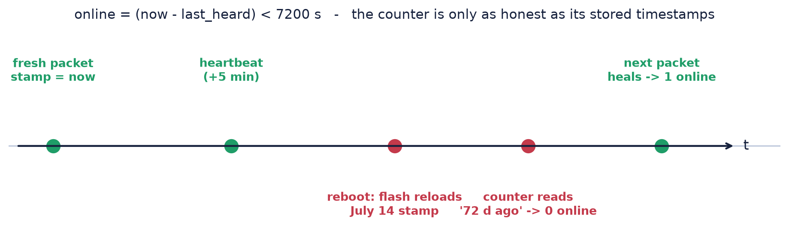
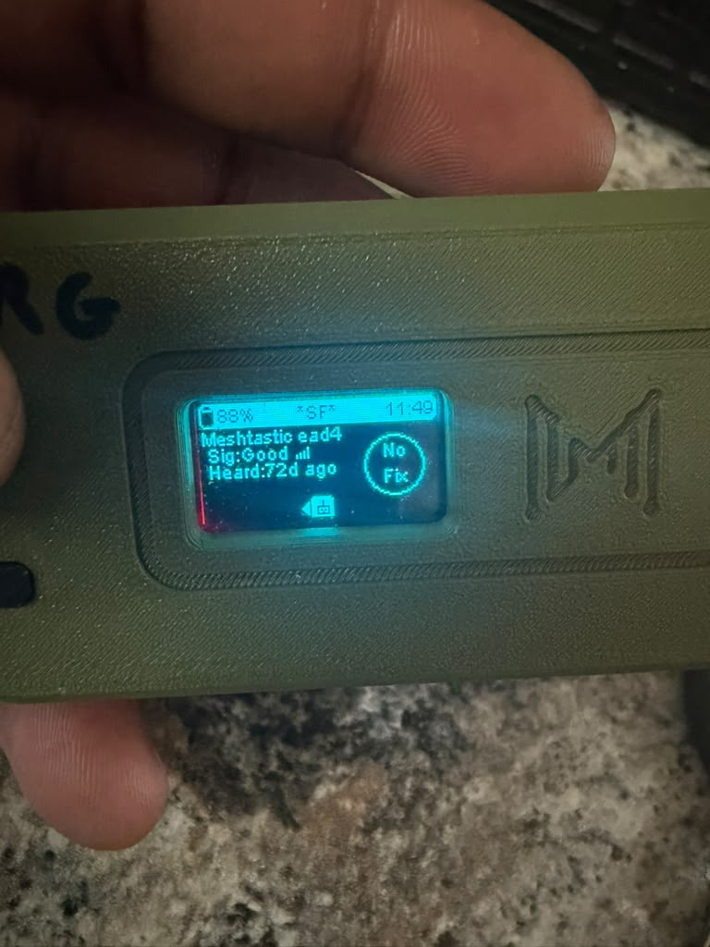
STAYING LINKED: THE HEARTBEAT
OWNER: DEO
“Online” is arithmetic: heard within 2 hours. There is no live connection to display — only timestamps.
WHEN | THE RADIO SENDS | EVERY
Driving | position (the product) | 10 s / 20 m
Parked, GPS fix | position | 60 s
Always | telemetry heartbeat | 5 min
TESTED, NOT ASSUMED
We chased every counter lie to a stale timestamp, purged them, added the heartbeat — then watched both radios hold “1 online” steadily.
The 5-minute heartbeat was added after bench testing: it keeps the counters honest even when a parked radio has nothing else to say.
the trap we found: signal GOOD,
“heard 72 d ago” — stale timestamp
GROUP 9 | OFF-GRID VEHICLE TRACKER
STAYING LINKED
SHEET 04/12 REV F 2026-09-26
Notes:
PRESENTER PREP - Sheet 04 (Deo, ~90 s). Read the equation once in words: a node counts as online exactly when now minus its last-heard time is under 7200 seconds, two hours. That's it - no link state exists. Consequence one: a switched-off radio stays 'online' on the other screen for up to two hours, by design; in a broadcast mesh nothing distinguishes off from out-of-range except silence. Consequence two, the photo: if a STORED timestamp is stale, the counter lies the other way - our bench radio showed signal GOOD and 'heard 72 days ago' in the same breath, because a July record kept resurfacing. The cadence table is the cure and the design: positions every 10 seconds or 20 meters while driving - that IS the tracker experience - a gentler 60 seconds parked, and a 5-minute telemetry heartbeat always, added specifically so bench-idle radios keep re-stamping each other. Cost of the heartbeat if asked: one half-second packet per 5 minutes, about 0.17% of the channel. Timestamp vocabulary: epoch = seconds counted since Jan 1 1970.

Slide 5
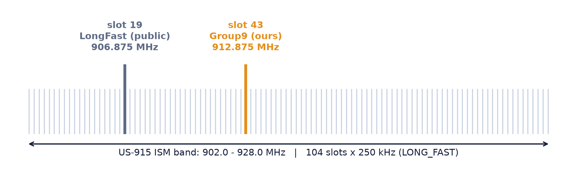
MATH I: THE NAME PICKS THE FREQUENCY
OWNER: VICTOR
// djb2 — the whole algorithm
h = 5381
for each character c:
h = h * 33 + c
slot = h mod 104
“Group9” → slot 43 → 912.875 MHz
WHY IT MATTERS two radios with identical keys but different primary channel names sit MHz apart and never hear each other — we proved this the hard way, then fixed it. The OLED LoRa screen shows the live frequency: our truth-teller.
GROUP 9 | OFF-GRID VEHICLE TRACKER
THE FREQUENCY MATH
SHEET 05/12 REV F 2026-09-26
Notes:
PRESENTER PREP - Sheet 05 (Victor, ~2 min). Read the equation left to right: start of the US band (902 MHz), plus half a channel width so the slot sits centered, plus the hash of the channel NAME times the channel width. 104 slots because the band is 26 MHz wide and each LONG_FAST channel takes 250 kHz. The hash is djb2 - the five lines in the code box are the complete algorithm. WHO IS BERNSTEIN (know this cold): Daniel J. Bernstein is a famous living cryptographer - a math professor in Chicago, known online as 'djb'. He is not part of our project or of Meshtastic; he published this tiny text-to-number recipe on Usenet in the 1990s and programmers named it djb2 after his initials. The same way engineers use Ohm's law without Ohm, software uses Bernstein's hash without Bernstein. Bonus tie-in: his OTHER famous invention, the Curve25519 encryption curve - used by WhatsApp and Signal - is what Meshtastic uses for private direct messages. Two parts of our stack, one mathematician, zero involvement. Calibration proof if challenged: the default channel name hashes to slot 19 = 906.875 MHz, the published US default - so the formula checks out against a known constant before we trust it for Group9 = 43 = 912.875. Close with the banner: this math is why a NAME mismatch is a FREQUENCY mismatch, which is exactly the failure we diagnosed and fixed this week.

Slide 6
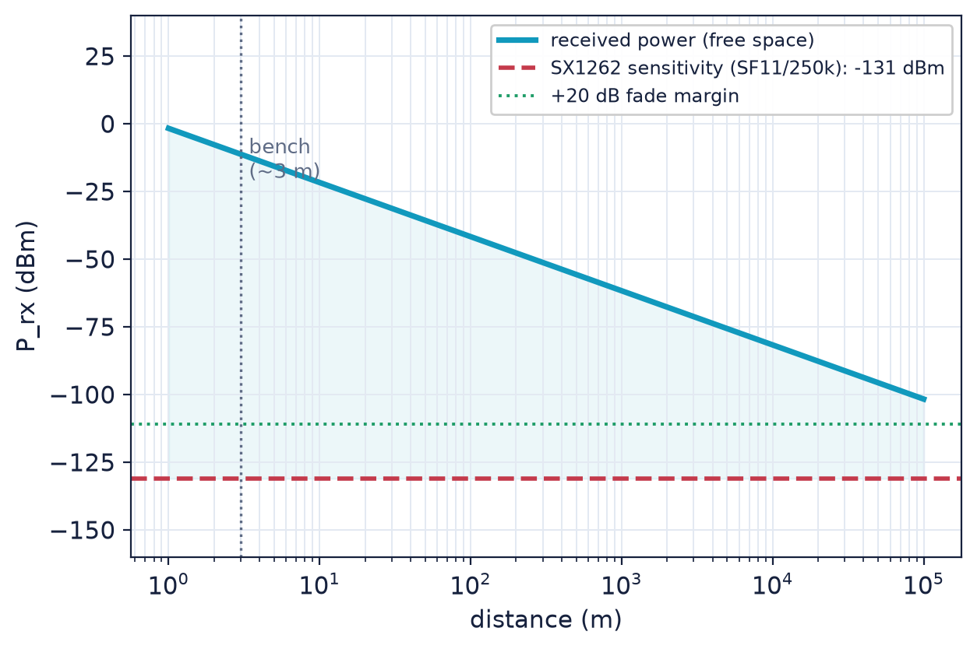
MATH II: WHAT 6 DB OF SIGNAL BUYS
OWNER: VICTOR
MEASURED SNR vs THE SF11 DECODE FLOOR
measured: ~6 dB
decode floor: −17.5 dB
23.5 dB of margin — SF11 still decodes 17.5 dB BELOW the noise floor
Rule of thumb: every 6 dB of margin ≈ double the free-space distance.
Desk numbers that look ordinary translate to kilometers outdoors — the margin is the range.
THE RANGE PREDICTION
+30 dBm out, −131 dBm decodable = 161 dB budget. With 20 dB reserved for streets and terrain: a 3–5 km design range. The drive test measures where reality lands.
dB DECODER dB = a ratio on a log scale (+3 dB ≈ ×2, +10 dB = ×10) · dBm = power vs 1 milliwatt · SNR = signal-to-noise ratio, how far the signal stands above the static.
GROUP 9 | OFF-GRID VEHICLE TRACKER
THE MARGIN MATH
SHEET 06/12 REV F 2026-09-26
Notes:
PRESENTER PREP - Sheet 06 (Victor, ~2 min). Start with the bar: the red line is where SF11 stops decoding - minus 17.5 dB, meaning the signal can be 17.5 dB WEAKER than the noise and still come through. That is the superpower of chirp spread spectrum: each bit is spread over 2048 chips, and the receiver adds them back up coherently. Our measured 6 dB positive leaves 23.5 dB of headroom. Give the audience the conversion rule slowly: 6 dB of margin doubles free-space range - so 23.5 dB is roughly 2 to 4 doublings, which is how a boring desk measurement promises kilometers outside. The dB decoder box is for the room: dB is always a ratio (log scale, +3 is double, +10 is ten times), dBm pins that ratio to one milliwatt, SNR is how far the signal stands above the static. Right graph: transmit power +30 dBm (one watt) minus the -131 dBm sensitivity gives a 161 dB total budget; free-space alone would reach absurd distances, so we reserve 20 dB for buildings, terrain, and fading, landing on the honest 3-5 km design range. The W8-W9 drive data gets plotted onto this exact chart.

Slide 7
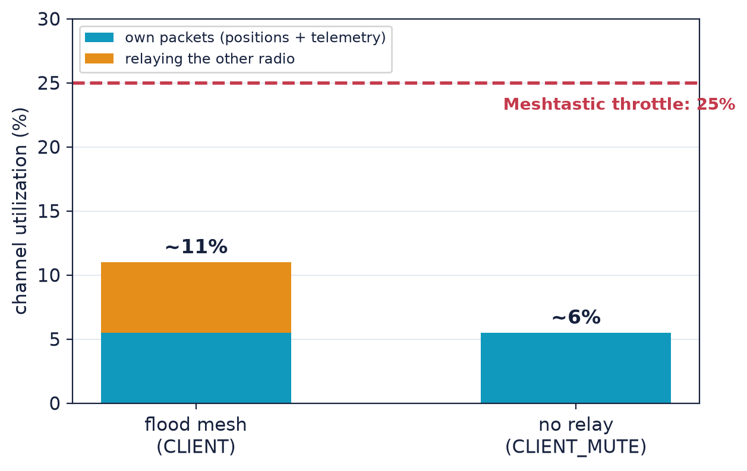
MATH III: AIRTIME IS THE BUDGET
OWNER: VICTOR
Every packet costs ~0.5 s of air. The channel throttles at 25% busy.
Two moving vehicles at 10 s cadence = 10% — but the mesh default RELAYS every packet, doubling it to ~20%. With only two radios a relay reaches no one.
Fix, verified on the bench: role CLIENT_MUTE — hear everything, repeat nothing. Utilization halved: 9–13% → ~5–6%.
WHY IT MATTERED
Above 25% busy, Meshtastic suppresses position broadcasts — our core packet — exactly when both vehicles move. CLIENT_MUTE keeps us at 2.5× headroom. Revert to CLIENT if a third radio ever joins.
SYMBOL DECODER T_sym = time per symbol: 2¹¹ chips ÷ 250,000/s = 8.19 ms · N_pre = preamble symbols the receiver locks onto · N_payload = data symbols · ChUtil = % of the last minute the channel carried radio energy.
GROUP 9 | OFF-GRID VEHICLE TRACKER
THE AIRTIME MATH
SHEET 07/12 REV F 2026-09-26
Notes:
PRESENTER PREP - Sheet 07 (Victor, ~90 s). The equation first: symbol time is 2-to-the-SF divided by bandwidth - 8.19 milliseconds at our settings - and a packet is just a count of symbols times that, roughly half a second for a position. That makes airtime the scarce resource, and Meshtastic enforces it: above about 25% channel utilization it starts suppressing position broadcasts. Now the discovery from our own bench: two IDLE radios were burning 9-13% - because a flood mesh relays by default, and with exactly two nodes every relay is pure waste, there is no third radio to reach. Project the vehicle case: 10% of legitimate traffic becomes 20% with relaying - brushing the throttle right when both vehicles move. The fix costs nothing: CLIENT_MUTE role, radios still hear and send everything but repeat nothing; measured utilization halved same day. The revert condition is documented: a third node or relay joins, both radios go back to CLIENT. Hand off to Cannon: 'that is the theory and the numbers - Cannon shows you the real thing.'

Slide 8
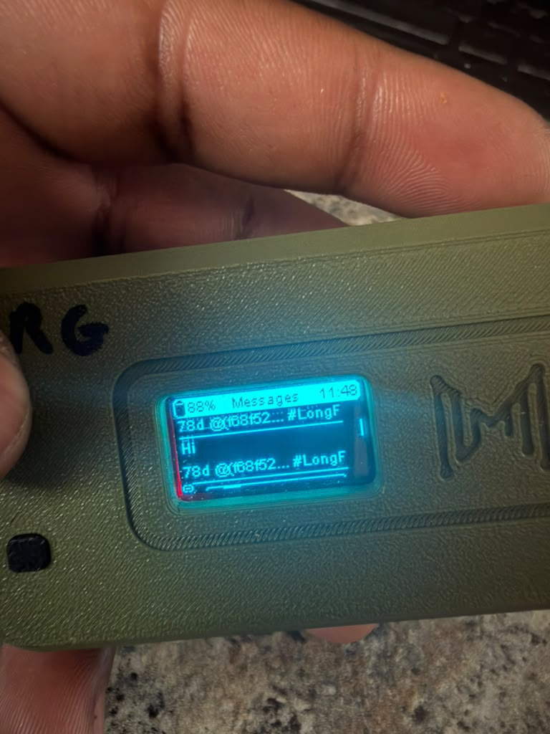
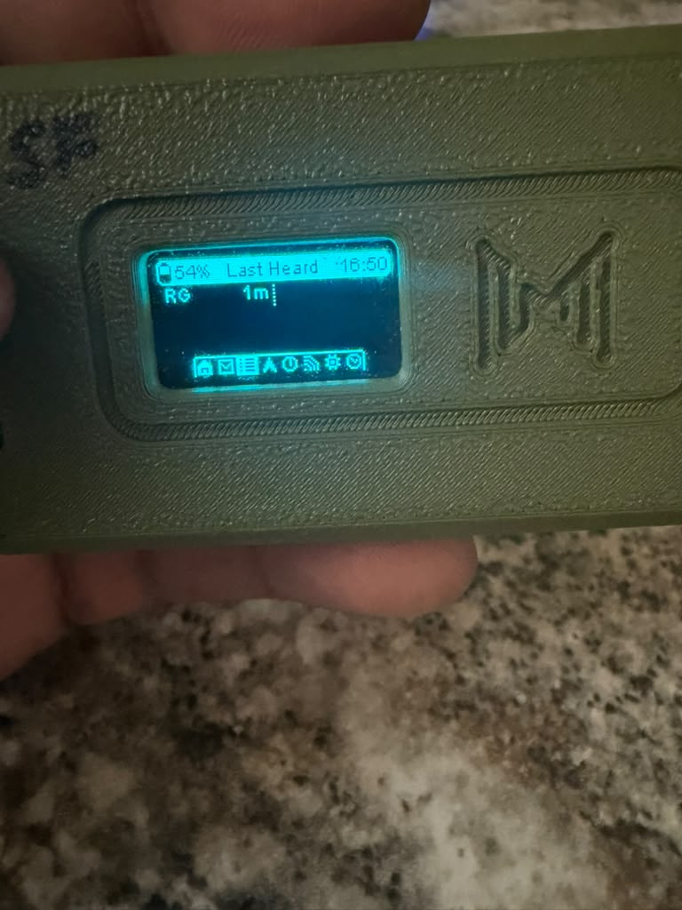
LIVE DEMO I: SEND IT, RECEIVE IT
OWNER: CANNON
LIVE ON THE RADIOS — slides show the bench captures; the demo repeats them in front of you
STEP 1 · LIVE
On radio SF: open the canned-message menu with the user button, scroll to “Hi”, send.
15 presets loaded on both radios: OK · Yes · No · Hi · How are you? · All good · Need help · Are you injured? · Send position · Position updated · On my way · Wait there · Arrived · Low battery · Heading home
STEP 2: the text lands on RG — no phone, no tower, radio to radio
STEP 3: RG’s Last-Heard list re-stamps — “SF · 1m” — the link bookkeeping updating live
GROUP 9 | OFF-GRID VEHICLE TRACKER
LIVE DEMO: MESSAGING
SHEET 08/12 REV F 2026-09-26
Notes:
PRESENTER PREP - Sheet 08 (Cannon, demo ~3 min). Bring both radios charged and already on. Choreography: hold SF up, press the user button to open the canned-message menu, scroll to 'Hi', send - then walk to RG (or have a teammate hold it) and show the message popping up, then flip RG to the Last-Heard screen and show SF's entry reading seconds ago. Narrate what is NOT there: no phone, no SIM, no tower, no internet - the text crossed on our private 912.875 MHz channel, encrypted with our key. If the room is RF-noisy or a send is missed, the slide's bench captures are the backstop - same screens, captured during the week's testing. Mention why canned messages exist: while driving nobody types; every question in the preset chain has its answer preset too (How are you? -> All good / Need help; Are you injured? -> Yes / No). Timing note: leave the radios visible for sheet 09, where we walk the rest of the screens.

Slide 9
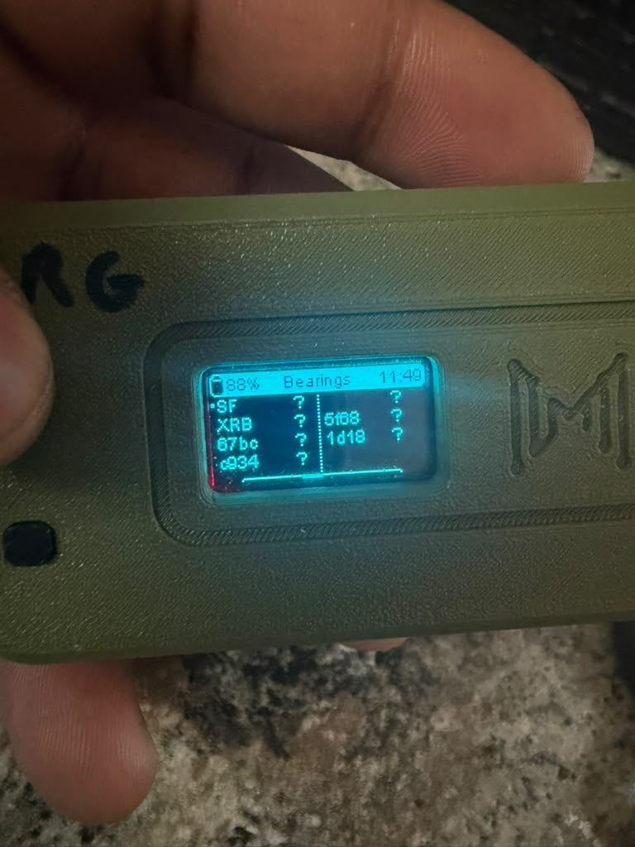
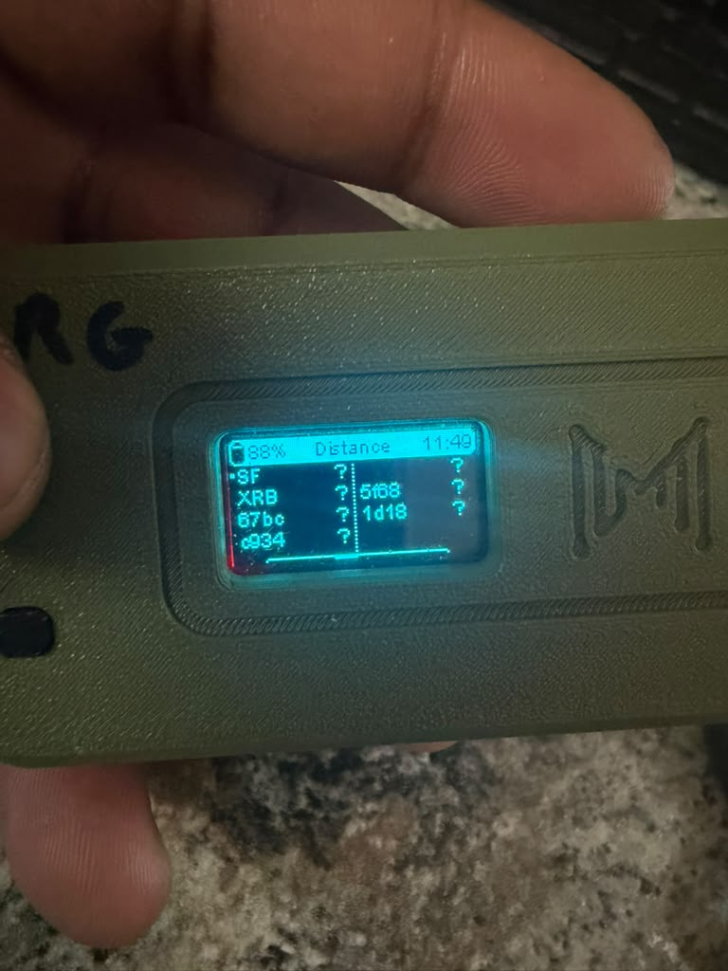
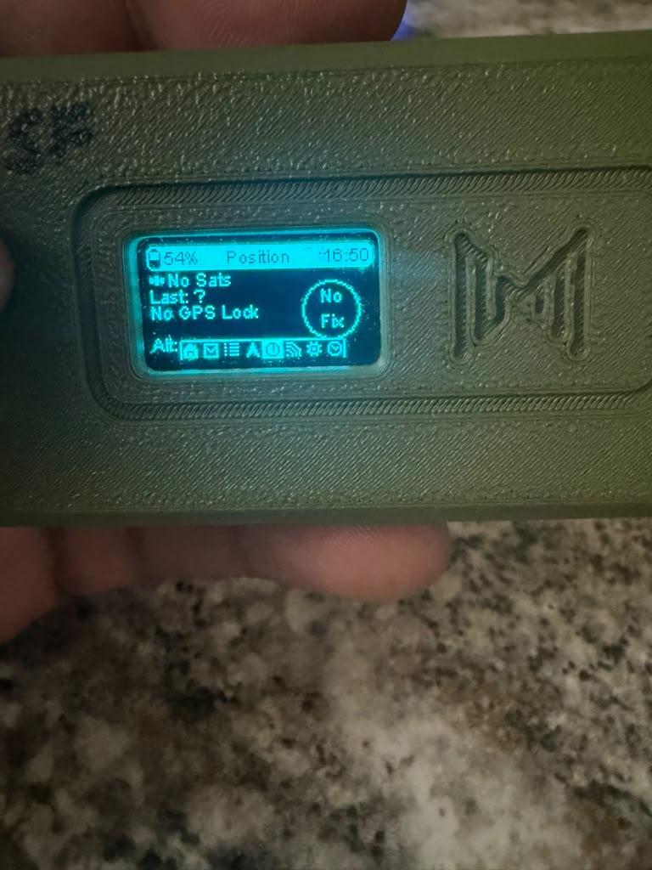
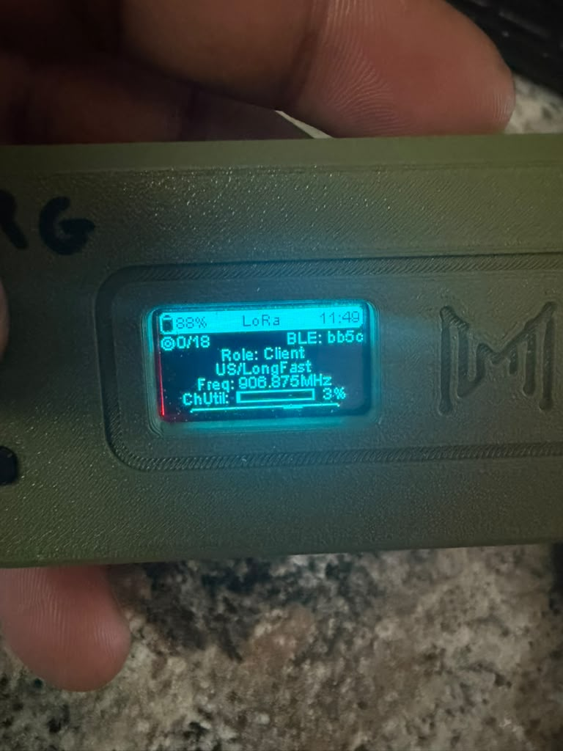
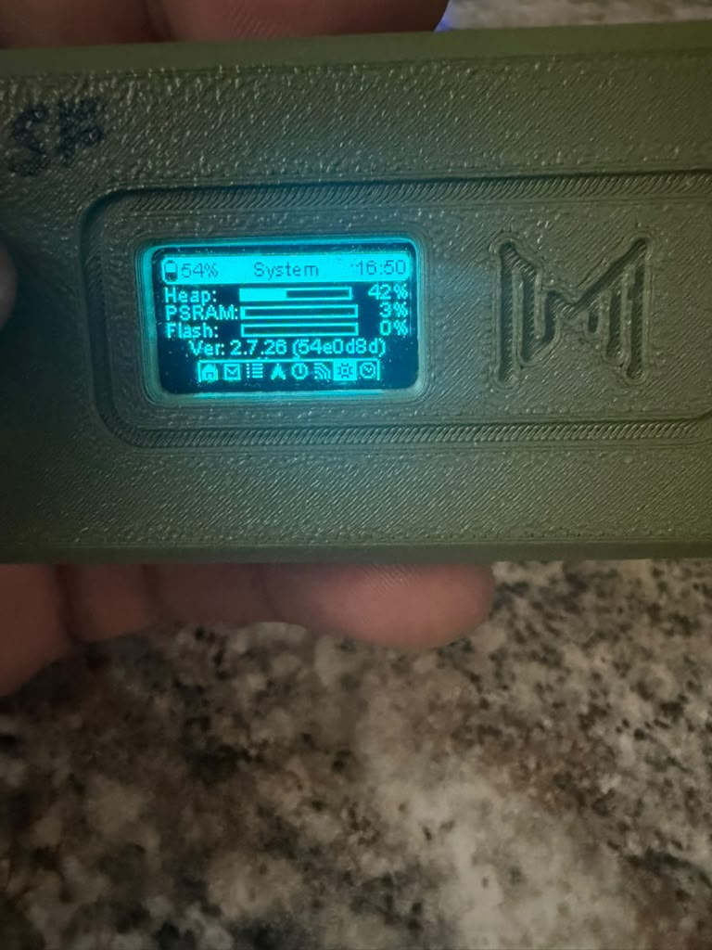
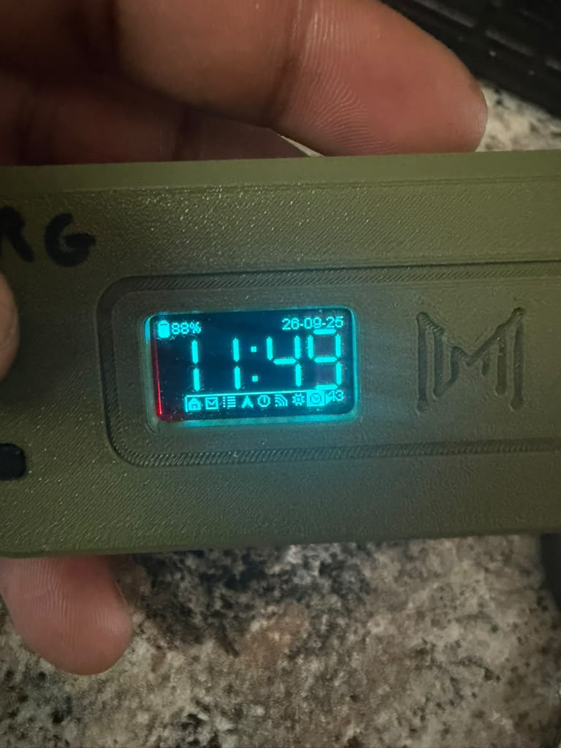
LIVE DEMO II: READING THE RADIO
OWNER: CANNON
DISTANCE — fills when both
radios hold a GPS fix
BEARING — compass direction
to the partner vehicle
POSITION — sats, fix, altitude
(indoors: No Fix, honestly)
LAST HEARD — seconds since
each node spoke
LORA — preset, live frequency,
channel utilization
SYSTEM — firmware, memory
(ver 2.7.26 on both)
TIME — GPS-disciplined clock
(needs a fix to be right)
NODE PAGE — per-peer signal
quality: SF as seen by RG
GROUP 9 | OFF-GRID VEHICLE TRACKER
LIVE DEMO: READING THE RADIO
SHEET 09/12 REV F 2026-09-26
Notes:
PRESENTER PREP - Sheet 09 (Cannon, ~2-3 min with radios in hand). Walk the OLED screens in this order on a live radio - short-press the user button cycles pages: DISTANCE and BEARING - the tracker's core outputs, straight-line meters and compass direction to the partner; they show '?' indoors because geometry needs BOTH positions - say that plainly, it is honesty, not failure. POSITION - satellites, fix state, altitude. LAST HEARD - the liveness list Deo explained, now live. LORA - the contract sheet in hardware: preset, the actual synthesizer frequency (912.875 = our private slot; this screen is the truth-teller from Victor's math), and channel utilization. SYSTEM - firmware 2.7.26, identical on both radios, deliberately. TIME - GPS-disciplined; mention it also drives the timestamps behind 'online'. NODE PAGE - per-peer signal bars: RG's view of SF. If a screen looks different live than on the slide, better: the captures are from mid-debug week; the live radios are the fixed, final configuration.

Slide 10
HOW THE TESTING WAS DONE
OWNER: CANNON
TECHNIQUE | WHAT IT MEANS | WHAT IT CAUGHT / PROVED
One variable per trial | change one setting, retest, log | isolated the frequency-slot mismatch
A/B regression | retreat to a known-good config, rebuild | default channel worked → fault was in ours
Machine probes | traceroute + node-table dumps, not eyeballs | round-trip proof, timestamps, SNR
Read-back + OLED verify | every config write checked twice | caught silently reverting writes
Log every error | NAK codes treated as data | a NAK that ARRIVES proves the RF path
NEXT: TWO-VEHICLE DRIVE TEST
convoy → split to 0.5/1/2 km → rejoin → stop-and-message. Metrics declared in advance: p95 position age ≤ 15 s moving; reacquire ≤ 60 s.
STATUS
All prerequisites met 09-25: two-way link, full drive spec on both radios, honest counters, airtime headroom. Gantt: drive test 0% → 20%; link milestone closed at 100%.
Every fix is committed to the repo with its gotcha documented — the next person hits none of these twice.
GROUP 9 | OFF-GRID VEHICLE TRACKER
HOW THE TESTING WAS DONE
SHEET 10/12 REV F 2026-09-26
Notes:
PRESENTER PREP - Sheet 10 (Cannon, ~2 min). This sheet is the credibility of everything before it: the link works because the testing was disciplined, not lucky. Walk the five techniques with their catches: changing ONE variable per trial is what finally isolated the frequency mismatch after config comparisons showed nothing; the A/B regression - dropping both radios to the known-good default channel - split the world in half in one test (hardware fine, our channel config guilty); machine-checkable probes (traceroute, node database dumps over USB) replaced squinting at screens and produced numbers we could commit; every configuration write got verified twice - read back over serial AND cross-checked on the OLED - because we caught writes silently reverting; and error codes were treated as evidence - a refusal that arrives BY RADIO proves the radio path even while the app layer says no. p95 explainer for the metrics box: the 95th percentile - all but the worst 5% of samples must beat the bar - so one bad sample cannot fake a pass, and one lucky one cannot hide a problem. Close: every gotcha is committed to the repo README, so none of them can bite twice.

Slide 11
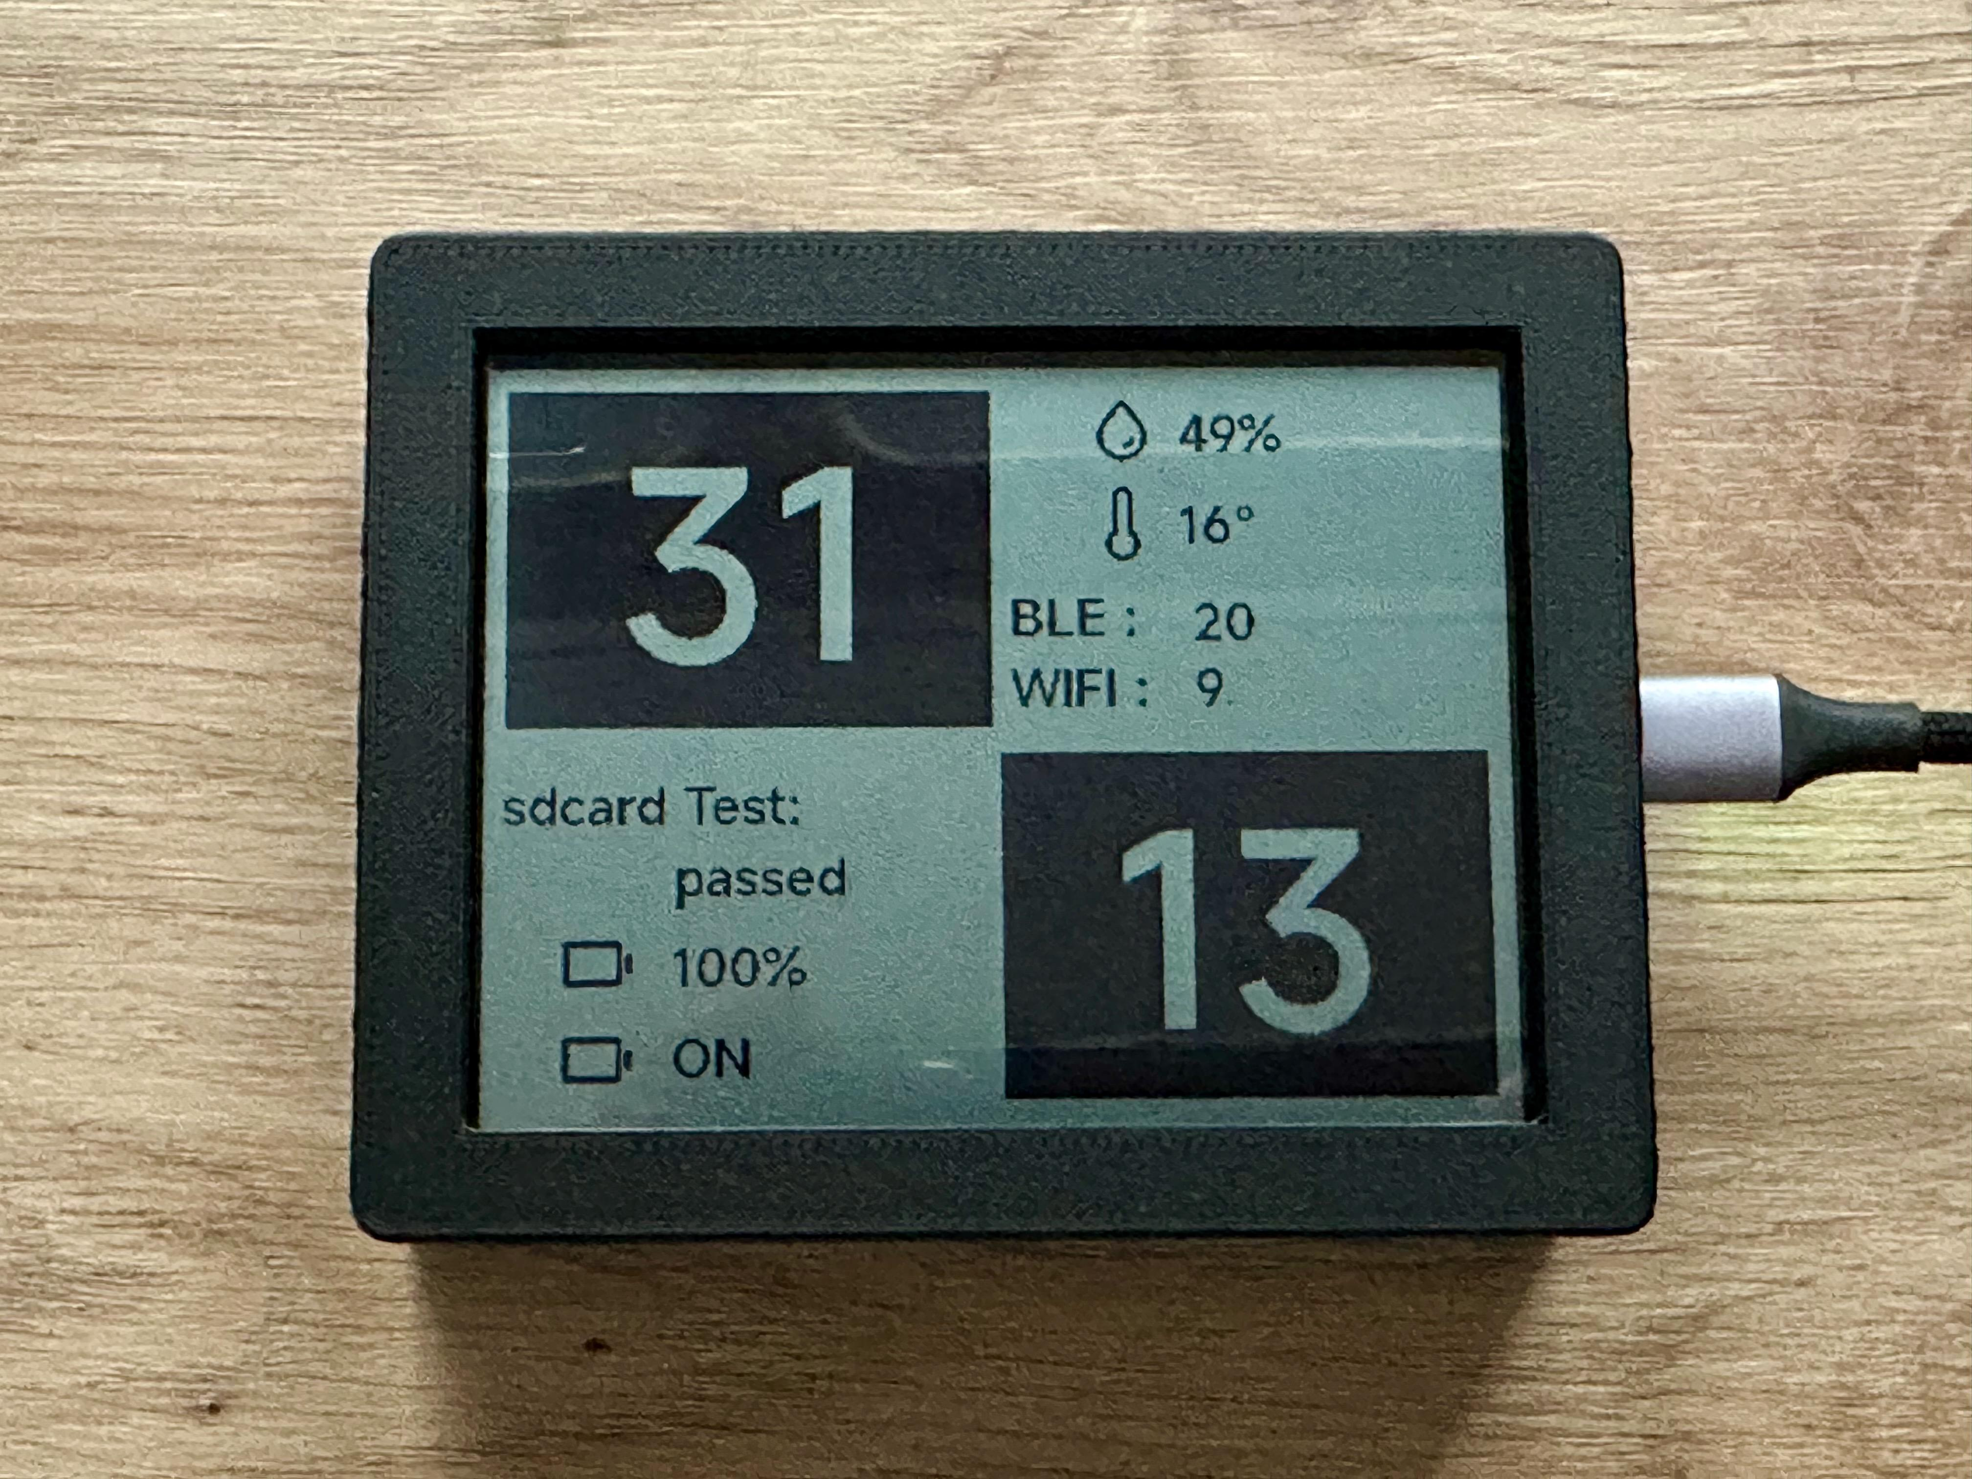
PROTECTING THE DISPLAY: THE CASE
OWNER: JOSIAH
WHY our first display arrived cracked and dead. The replacement rides in armor.
Keeps working USB-C · SD card · all 3 buttons · battery bay · speaker
Zero RF impact plastic body — invisible to the BLE radio link
Model “Symmetrical case” by AWSW · Printables 1610004 · CC BY-NC 4.0
Cost ~40 g filament (≈ $1) · one overnight print
the model assembled — glass fully framed, screen fully visible (author’s photo)
No commercial case exists for this panel — printing is the only option, and the community already solved it.
GROUP 9 | OFF-GRID VEHICLE TRACKER
DISPLAY ARMOR: THE CASE
SHEET 11/12 REV F 2026-09-26
Notes:
PRESENTER PREP - Sheet 11 (Josiah, ~90 s). Open with the incident, one sentence: the first display arrived cracked and non-functional - that is why this exists, not cosmetics. Then the four rows: everything the firmware needs stays reachable (USB-C for flashing and logs, SD for future logging, the three board buttons via printed caps, battery bay and speaker open at the rear); the body is thermoplastic so it is invisible to the 2.4 GHz BLE link between display and radio; the model is an existing open design - 'Symmetrical case for the WaveShare ESP32-S3 4.2 inch RLCD' by the maker AWSW on Printables, model 1610004, licensed Creative Commons Attribution-NonCommercial, which our class use satisfies with exactly this credit; and the whole thing costs about a dollar of filament and one overnight print. Anticipate 'why not design our own?': validating a proven fit costs zero schedule; the license allows remixing later if the vehicle mount needs changes. RLCD if asked: reflective LCD - reads by ambient light, no backlight, hence sunlight-readable on a dash.

Slide 12
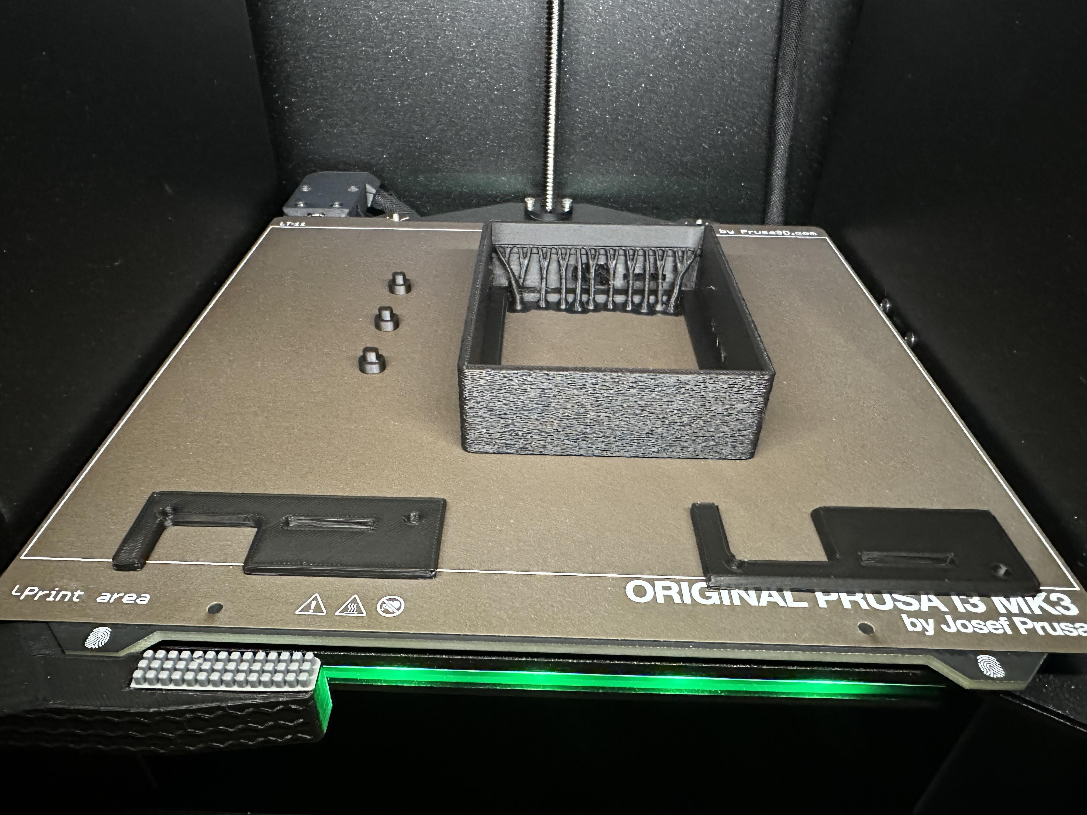
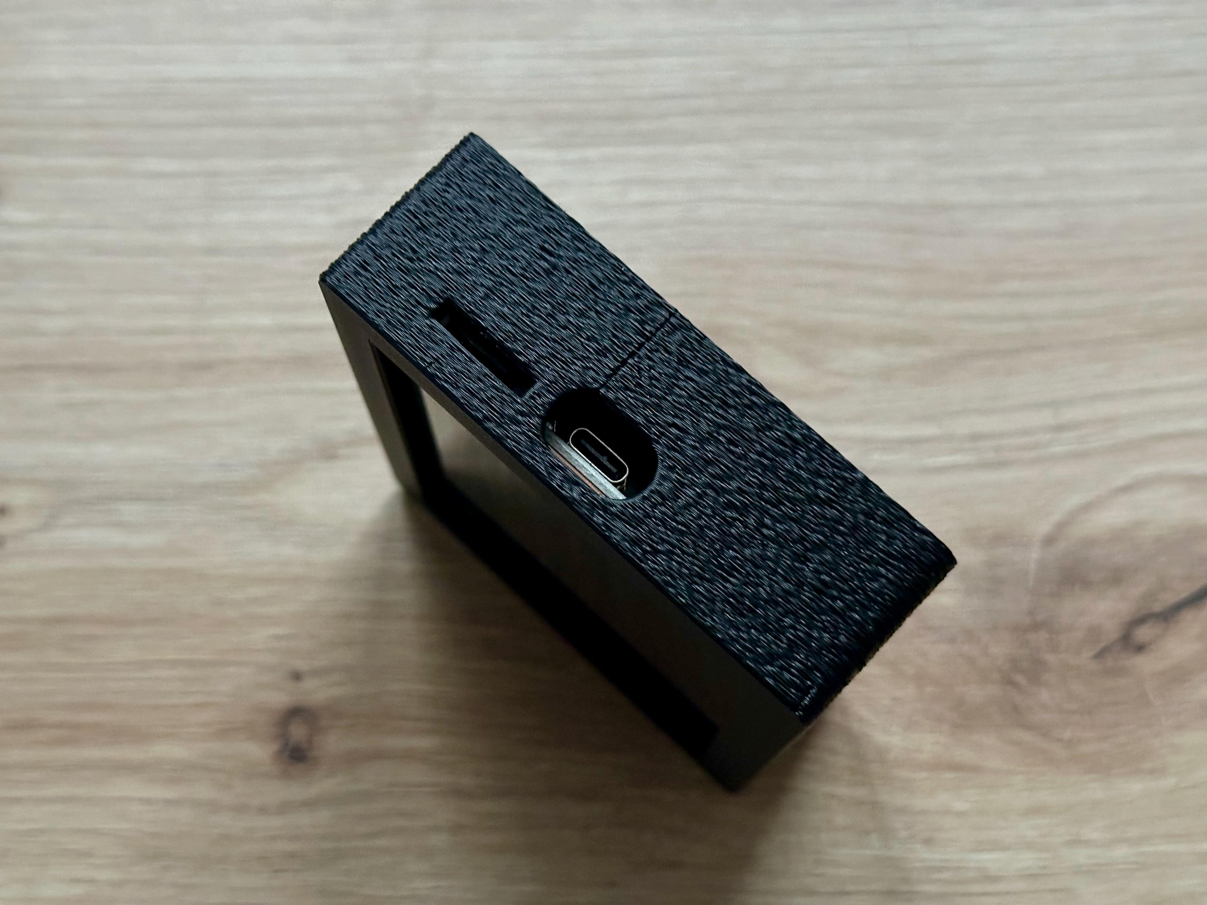
PRINT IT, SCREW IT, DONE
OWNER: JOSIAH
7 parts front frame · 2-piece back · 3 button caps (+ feet)
Settings 0.2 mm layers · organic supports · fuzzy-skin walls · no brim
Material PETG — survives dashboard heat where PLA softens
Assembly seat panel → clip backs → 4× M2.5×6 screws → press caps
⚠ One rule 6 mm screws MAX — longer screws press on the glass
author’s plate on a Prusa MK3 — organic supports, small parts sequential
PLAN print the night the replacement panel ships — armor on before first power-up.
ACCEPTANCE zero pressure on glass · every port/button usable · BLE signal within 2 dB of bare · survives a 1 m drop
USB-C + SD open
GROUP 9 | OFF-GRID VEHICLE TRACKER
PRINT + ASSEMBLY
SHEET 12/12 REV F 2026-09-26
Notes:
PRESENTER PREP - Sheet 12 (Josiah, ~90 s). Keep it brisk - five rows, one warning, one photo. Seven printed parts; the back is deliberately TWO pieces so the battery bay and speaker stay reachable without disassembly. Settings vocabulary, one breath each: 0.2 mm layers - each deposited slice a fifth of a millimeter, the strength/speed workhorse; organic supports - tree-shaped sacrificial scaffolding under overhangs, snapped off after; fuzzy skin - the nozzle deliberately jitters to texture the outer walls, hiding layer lines and adding grip; no brim - the helper skirt for bed adhesion isn't needed here. Material: PETG over PLA because a Texas dashboard exceeds PLA's roughly 60-degree softening point; PETG holds to about 80. Assembly is four moves ending in the ONE RULE row - the screw holes are in the display's own back, so 6 mm maximum length or the screws press the glass; this is the model author's own warning. Acceptance is measurable, same discipline as the radio sheets: no pressure on glass, everything usable, BLE within 2 dB of the bare panel, survives a 1-meter drop. Plan: the print runs the night the replacement panel ships.

