Slide 1
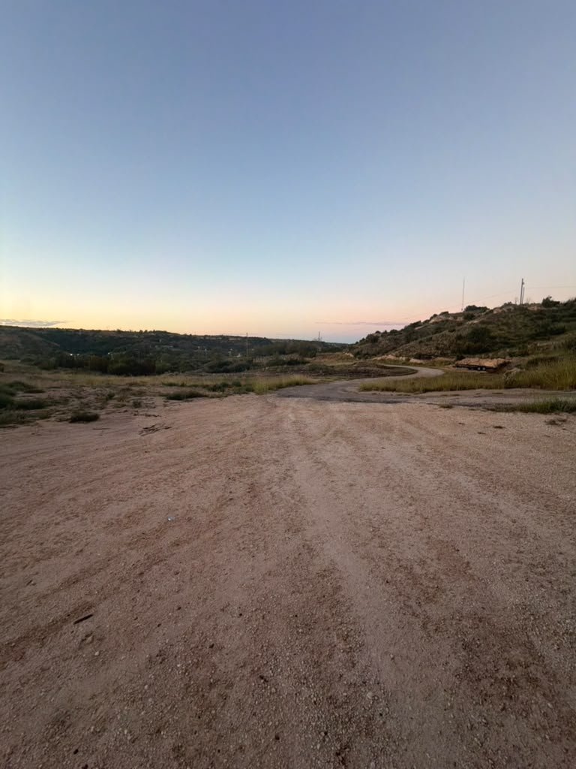
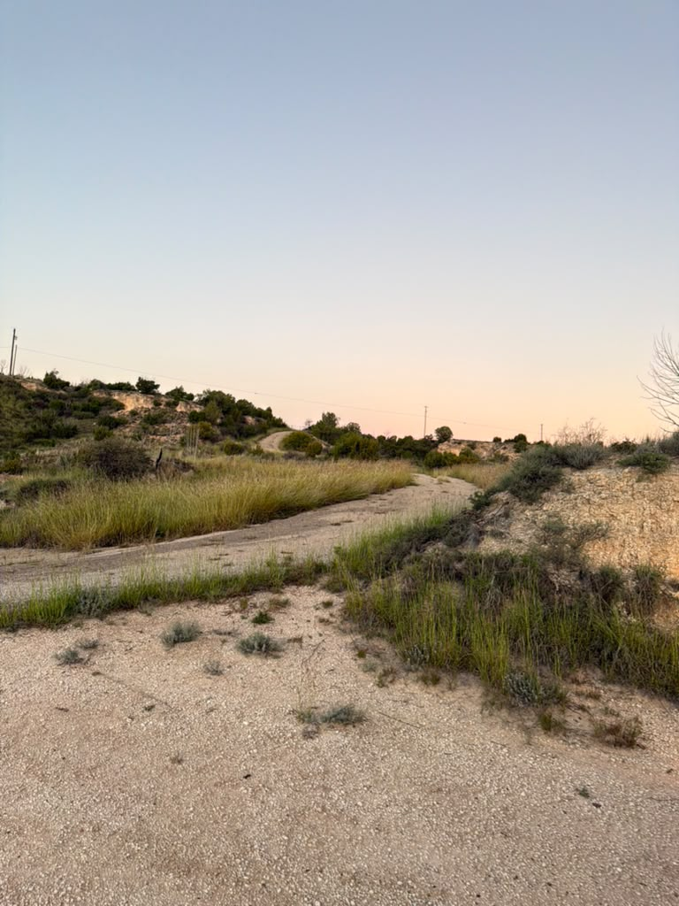
The Ceta Canyon Test
One morning, one canyon, and the hardest question we could ask our tracker
Palo Duro escarpment, Texas · October 18, 2026 · Group 9
Notes:
Both kits are powered at the podium as you begin (demo beat 1). One sentence to open: every test before this one was friendly terrain - today is about the morning we took the tracker somewhere radio is supposed to fail.

Slide 2
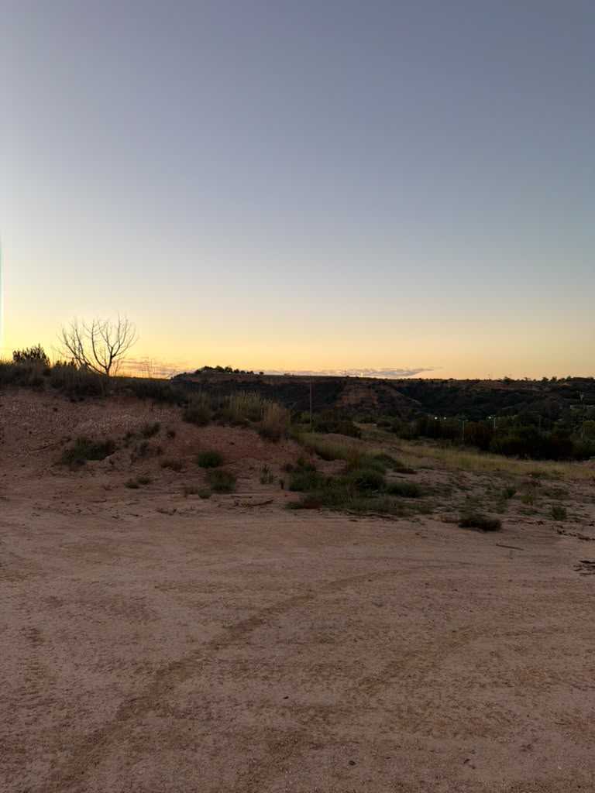
PART I · BEFORE THE TEST
Why This Test Mattered More Than Any Other
The mission is the hard case
This system exists for places with no infrastructure - mountain valleys, desert trails, canyon country. A tracker that only works where radio is easy is a toy.
Every prior result was friendly
Bench, town, and one flat road. Our range claims and our honesty design had never met terrain that fights back.
Two claims on trial at once
The physics claim: the link budget's 20 dB terrain reserve. The design claim: when the link breaks, the display never lies about it.
Notes:
Build the stakes: this is the validation test for the whole semester. If the canyon result is good, the range story is complete (town, open road, canyon). If honesty survives seven minutes of silence, the design thesis survives.

Slide 3
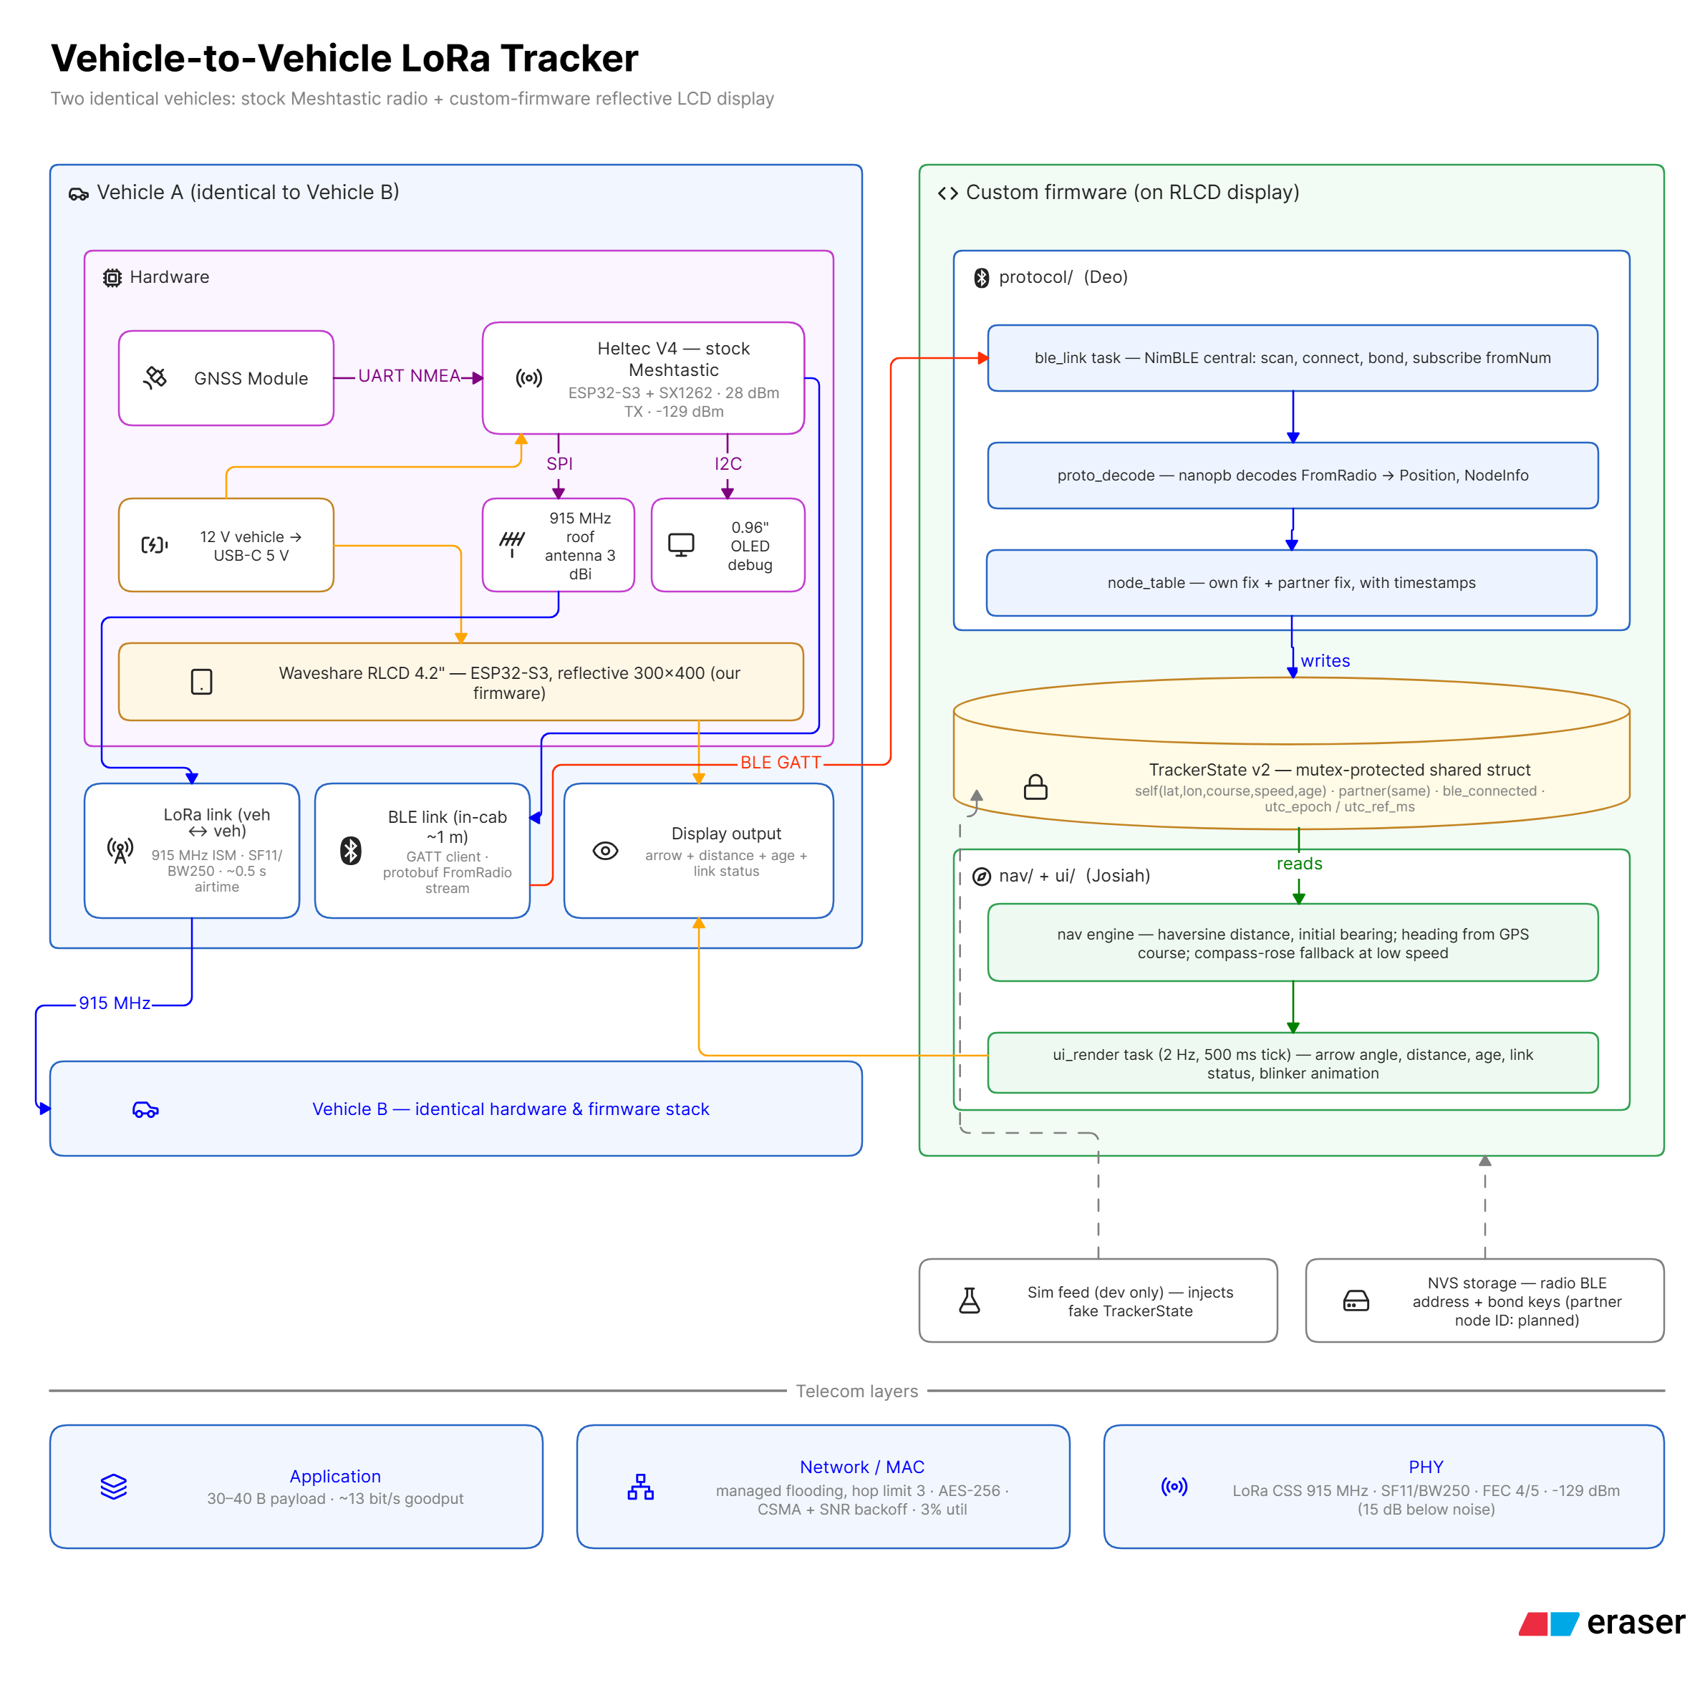
PART I · BEFORE THE TEST
The System Under Test, in Sixty Seconds
No phone. No tower. No internet.
Two vehicles exchange GPS over a private 915 MHz LoRa channel, AES-256 encrypted.
Stock radios, custom glass.
Meshtastic radios untouched; our firmware drives a sunlight-readable display over BLE.
Honesty as a feature.
Every number on screen carries its age. Estimates are drawn hollow. The display never pretends.
Notes:
One minute maximum. The right-hand card to emphasize is the third - honesty - because the canyon is about to attack exactly that.

Slide 4
PART I · BEFORE THE TEST
T-Minus Twelve Hours: Everything Was Broken
Real field tests begin before the field. The evening before, the system would not come up at all - three independent faults, found in one sitting.
Display 1: “dead”
Actually fine. The power source was the fault: power banks shut off under the display's milliwatt draw, and a reflective screen in a dim room reads as off.
Display 2: half-dead USB-C
Powers in ONE plug orientation only - damaged pins on one side of the connector. A coin-flip failure every time anyone plugged it in. Fix: mark the working orientation.
Radio EA:D4: silent config revert
A week idle and its NVS reverted THREE settings: Bluetooth mode (locked its display out), the channel (906.875 - wrong frequency), and its own name.
Why this slide is in the deck
Because it is part of the test. Field equipment fails between outings; a system is only deployable if its failures are diagnosable. Ours were - in about forty minutes - because every past failure had been written down.
Notes:
Tell it as a story: the night before the biggest test, nothing turned on. Two 'dead' displays and a radio that had quietly rewritten its own configuration while sitting in a drawer. The punchline is the bottom card - the scar catalog paid for itself.

Slide 5
PART I · BEFORE THE TEST
The Forty-Minute Diagnosis
Read the signature
The BLE loop above says the radio demands security the display, by design, cannot give.
[ble] connected
[ble] auth complete: encrypted=1 bonded=0
Write complete; status=261
[ble] want_config write failed
[ble] disconnected (reason 534)
... loop forever ...
1
Trust the OLED, not the CLI
The radio's screen read 906.875 MHz - the default channel. Ground truth beats config read-back.
2
The display's serial log: error 261 = “insufficient authentication.” One line named the fault: the radio was no longer in NO_PIN mode.
Re-run the WHOLE recipe
Reverts come in batches. Channel, Bluetooth, cadence, owner - re-provision all of it, verify each by read-back, then power-cycle and verify again.
3
By midnight: both displays alive, both radios on 912.875 MHz, full pre-flight passed. The test was on.
Notes:
The engineering lesson: the failure signature was diagnosable from one serial line because the pairing design is explicit. And the recovery rule that now lives in the manual: never fix one setting - reverts come in batches, so re-run the entire provisioning block and verify on the radio's own screen.

Slide 6
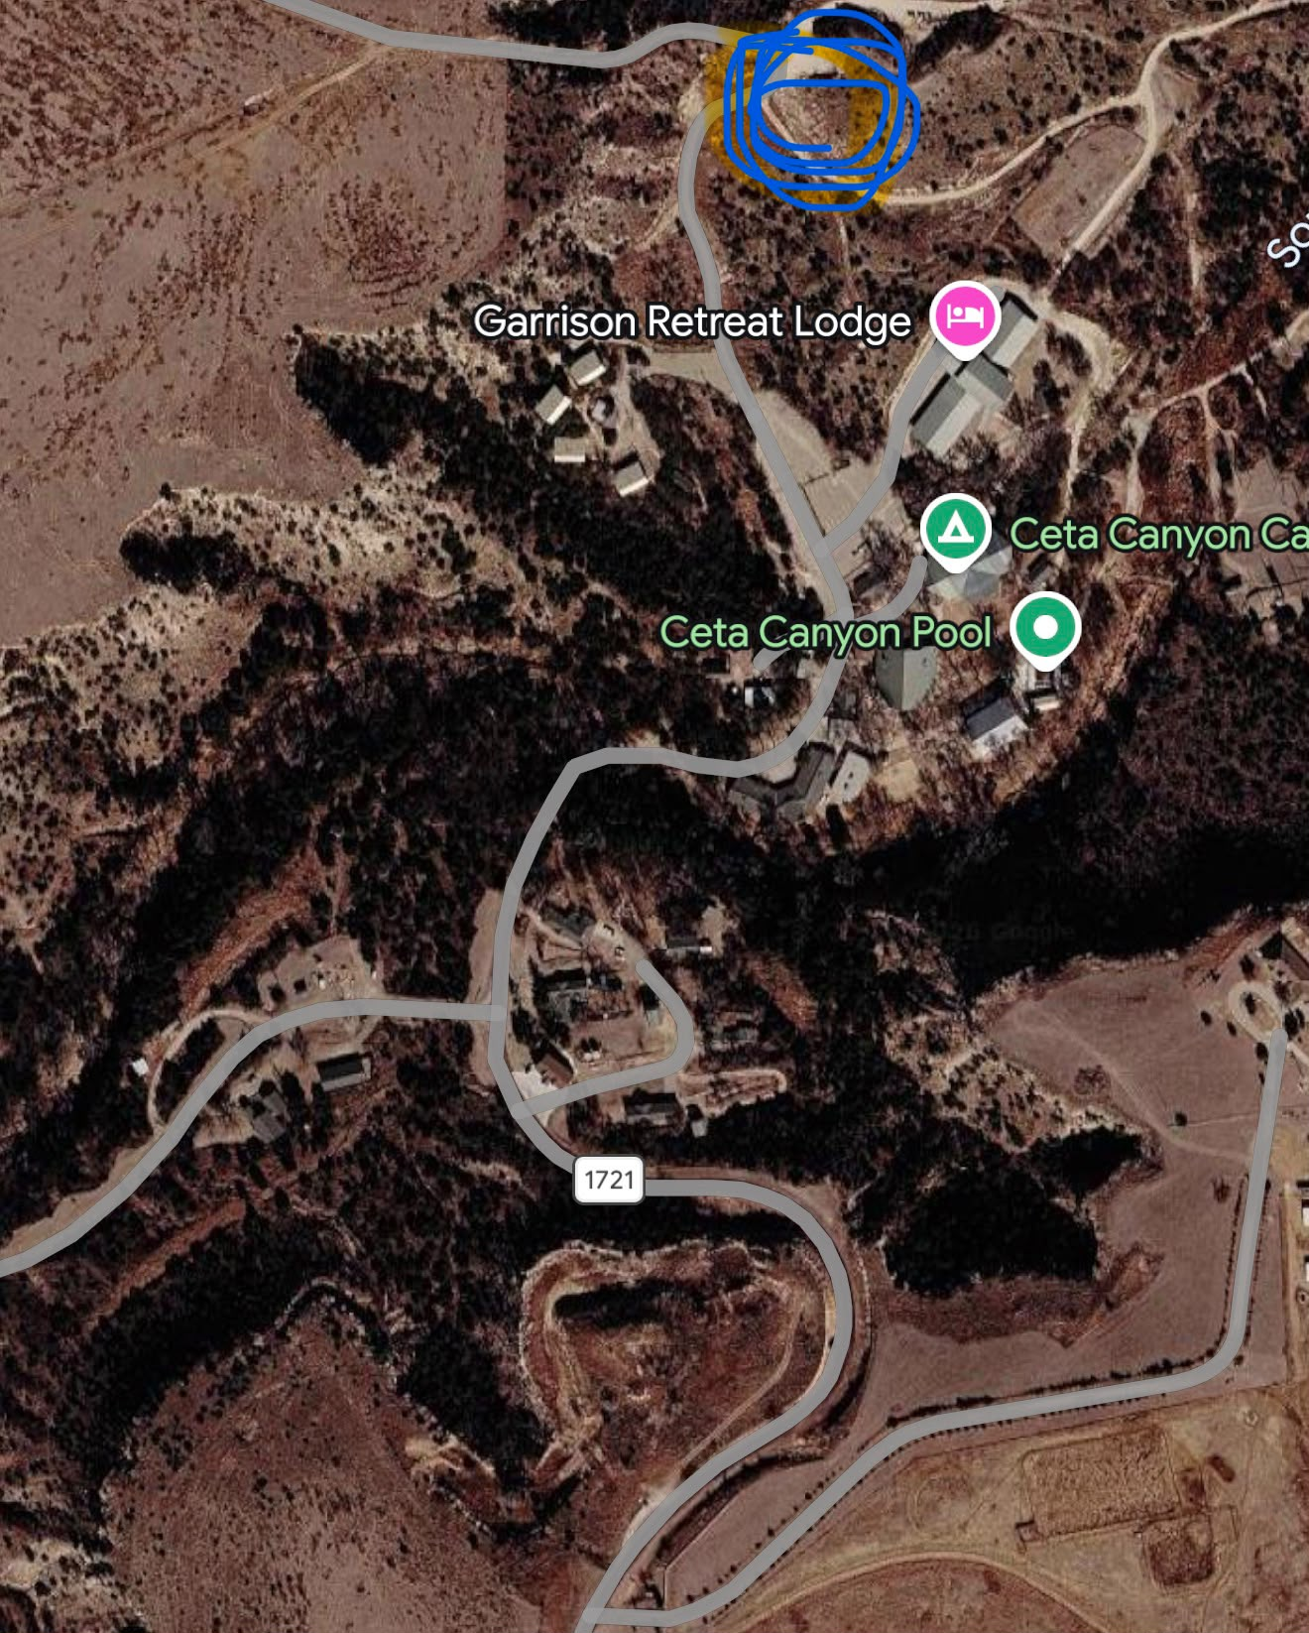
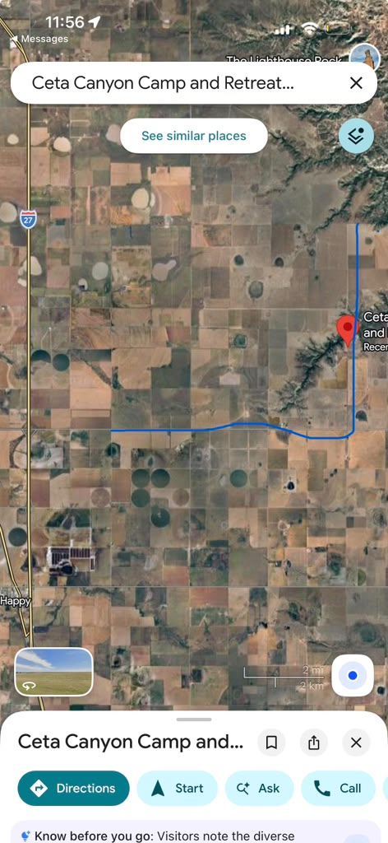
PART II · THE TEST
The Place: Ceta Canyon, Palo Duro Escarpment
RG's station: the rim point above Garrison Retreat Lodge
SF's route: down FM 1721, then west onto the caprock plains
Two opposite radio worlds in one route: shadowed canyon folds close in, flat line-of-sight plains far out — chosen deliberately.
Notes:
The actual maps. The route is the experiment: the folds attack line of sight at SHORT range, the plains restore it at LONG range. If range were about distance, the near stretch would be easy and the far stretch hard. Watch what actually happens.

Slide 7
PART II · THE TEST
Instrumentation and Protocol
Timebase
Every data point is read from video of the live screens; the display's own clock and uptime counter stamp each frame. No logs to trust - the evidence is the glass itself.
Configuration control
Full pre-flight before rollout (both OLEDs on 912.875), and a complete audit of every setting on both radios after the run - so results attribute to terrain, not configuration.
What counts as success
Not unbroken contact - that is physically impossible behind rock. Success = every outage flagged honestly, recovery without operator action, and range numbers that fit the link-budget model.
Notes:
This is what makes it an experiment rather than a drive: declared instrumentation, configuration control on both ends, and a success criterion written down before leaving. Note the third row - we did not promise the impossible, we promised honesty and recovery.

Slide 8
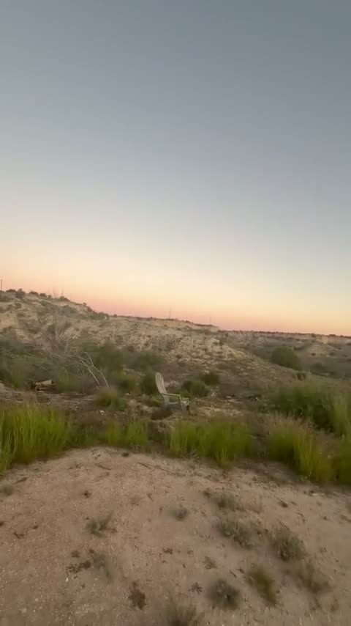
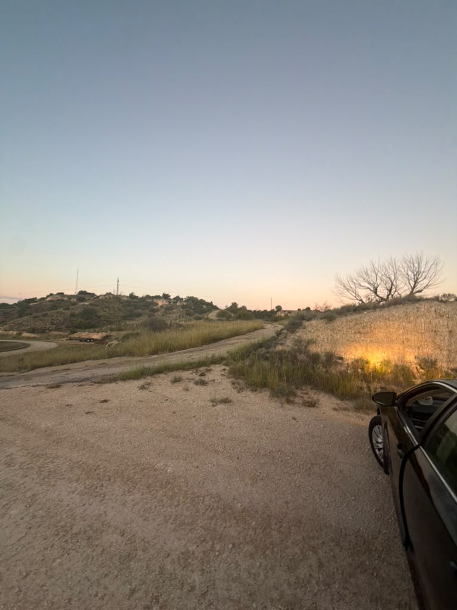
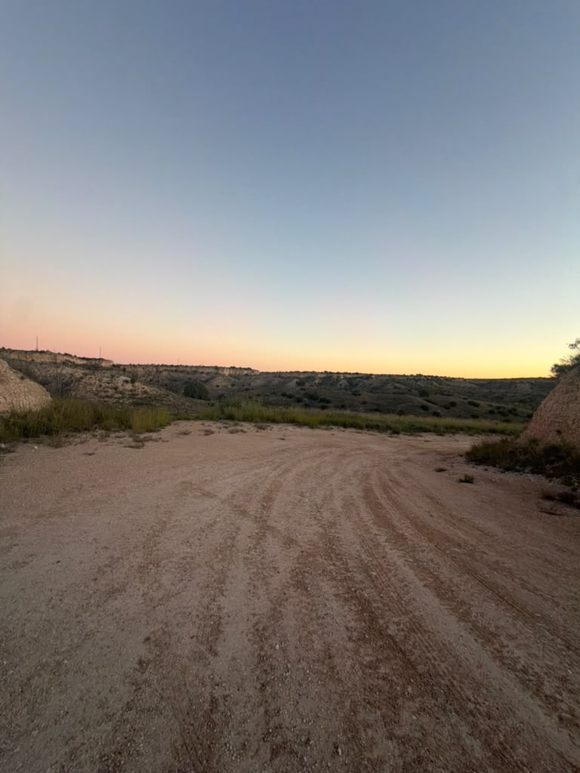
PART II · THE TEST
Dawn: Stationing the Rim Radio
RG parked at the rim, ~1,100 m — the whole canyon below its antenna
First light on the caprock: the terrain the link must cross
Notes:
The decision that shaped the whole dataset, made casually: RG parked at the rim because it was a good overlook. That accident gave one antenna elevation - and by the end of the morning it had measured the single most valuable number of the test. Let the clip pan the terrain.

Slide 9
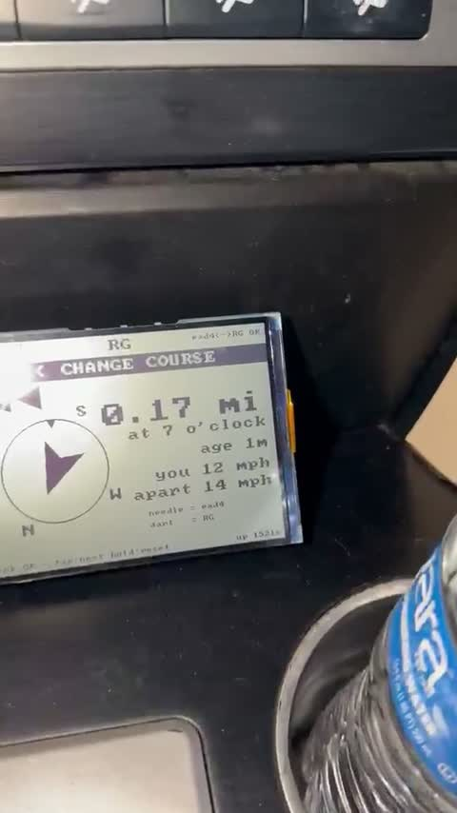

PART II · THE TEST
Rolling Out Before Sunrise
Pre-dawn start: display live on the dash from ignition
Down FM 1721 through the canyon at first light
Notes:
Ignition-on is the product flow: both units powered together, the display catches the radio's boot window and the link just holds. No pairing ceremony in the dark - it had already found its radio before the headlights hit the canyon road.

Slide 10
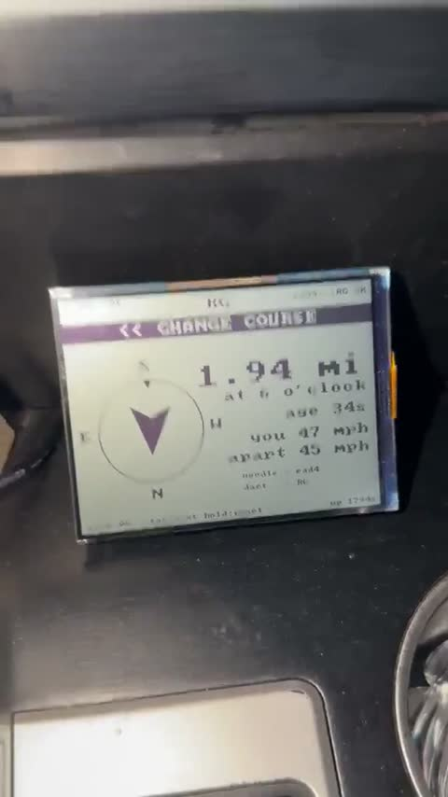
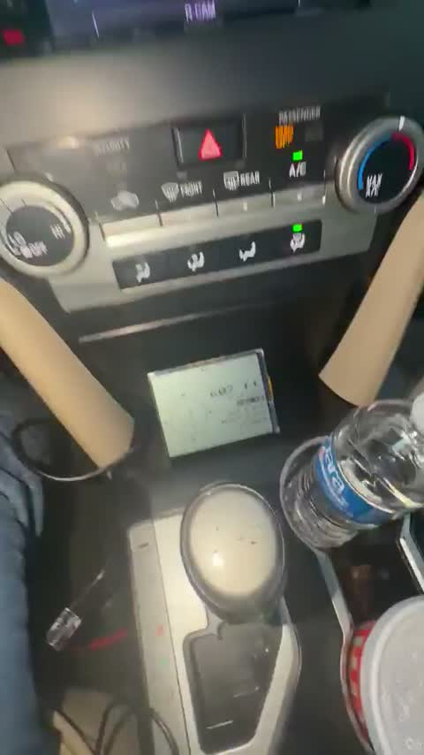
PART II · THE TEST
Outbound: the Link Working as Designed
2.09 mi, age 45 s, course guidance up — separating at 46 mph
Out onto the plains at sunrise, counting up the miles
Notes:
Before the trouble: this is nominal operation. Distance climbing, age in seconds, CHANGE COURSE chevrons tracking the geometry, closing/apart speeds correct with both cars moving. Every feature from the earlier drive tests, working at speed.

Slide 11
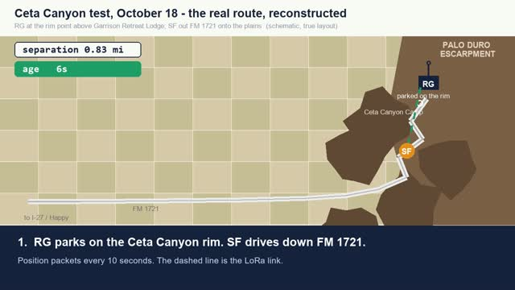
PART II · THE TEST
The Whole Run, Reconstructed
36-second reconstruction on the true route geometry — rim station, canyon folds, plains road
Notes:
Play once through; it is captioned. Matches the maps from slide 6. Seven steps: live out, stale behind rock, seven minutes of silence at the far point, one packet through a gap, self-healing return, guided arrival.

Slide 12
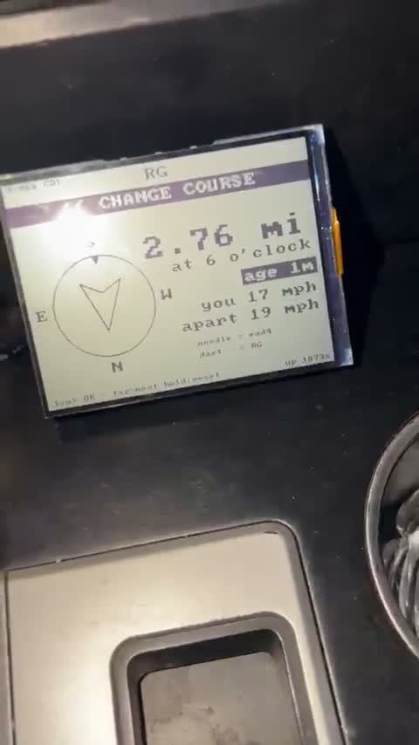
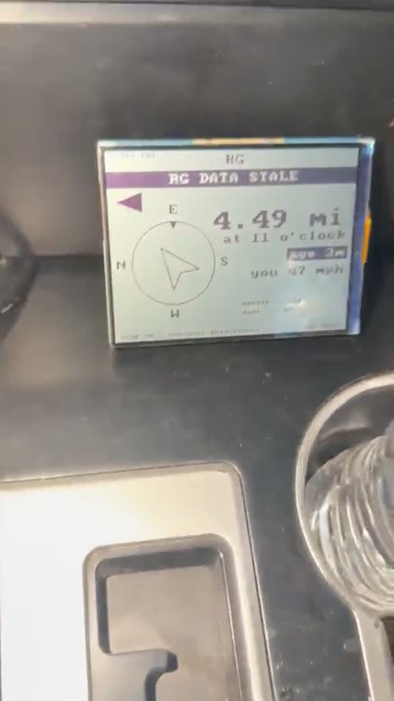
PART II · THE TEST
Watch It Go Stale
On camera: age 1m → 2m, and the banner appears at 2.7 mi
The deepest point: 4.46 mi, minutes of silence behind rock
Notes:
The transition itself, live: data aging past the two-minute threshold, banner up. The display cannot know WHY packets stopped - rock, range, or a dead partner - so it reports what is true in every case: how long the silence, and the last known position, hollow.

Slide 13
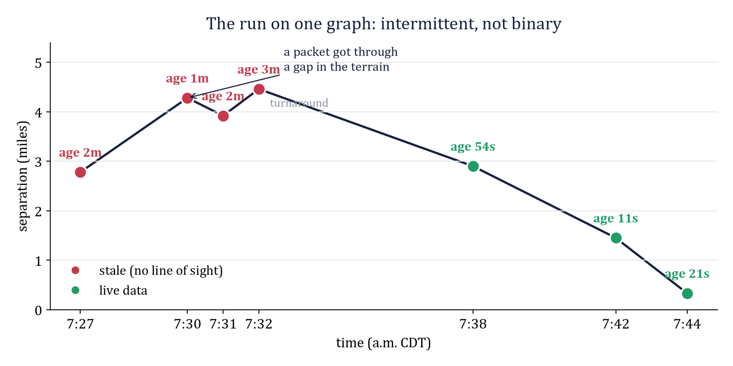
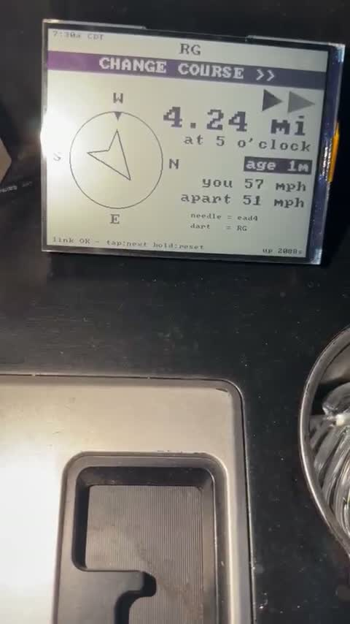
PART II · THE TEST
The Key Finding: Intermittent, Not Binary
4.23 mi: age resets to 1m — one packet through a terrain gap
Notes:
The run on one graph. The moment that matters: 7:30, nominally out of contact at 4.28 miles, and the age RESETS - a single ridge-top packet. The link in canyon country flickers with geometry; it is not a circle on a map. This finding reframes what 'range' even means.

Slide 14
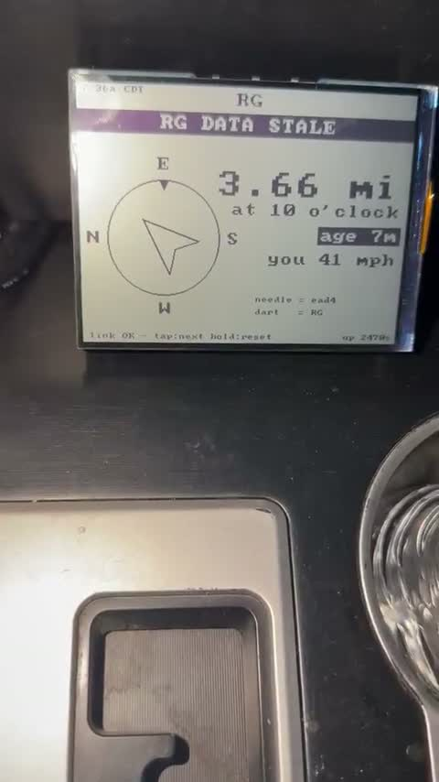
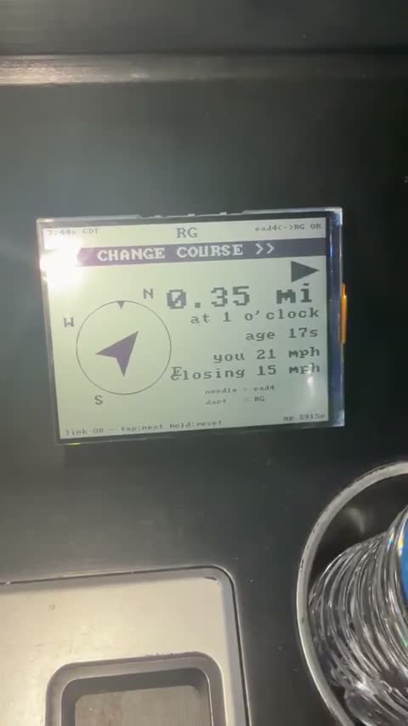
PART II · THE TEST
The Return: Seven Minutes of Silence, Healed by One Packet
Live: age 7m, then ONE packet — age 15 s. Nobody touched anything
Guided by last-known direction, back to the rim: 0.35 mi and closing
Notes:
How I got back to it: drove toward where the display said RG last was. At 3.5 miles the land opened and the age collapsed from seven minutes to fifteen seconds in a single packet. The chevrons then steered the final mile to the rim. Recovery requires no buttons - that is the designed fallback, proven on camera. DEMO BEAT 3: unplug RG's radio quietly now.

Slide 15
PART III · WHAT IT MEANS
Numbers Worth Remembering
17.5 dB
2,048
0.56 s
below the noise floor and still decoding — a whisper under a jet engine
chips per symbol: the spread-spectrum trade that buys the margin
of airtime per position — the currency every packet spends
13 bit/s
7 min
0.5–4.7 mi
of useful data. Slower than a 1950s teletype — capacity traded for range, on purpose
longest silence of the test. Healed by a single packet, no buttons
the measured envelope: terrain and antenna height set it, not the radios
Notes:
Six numbers carrying the whole engineering story: two of physics, one of airtime economics, one of deliberate under-use, and the two this test measured.

Slide 16
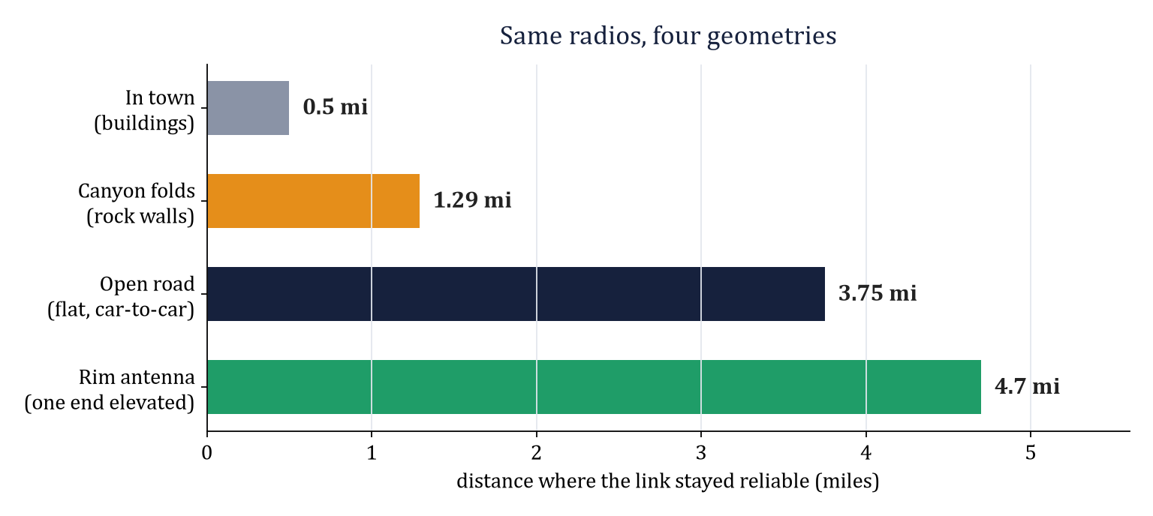
PART III · WHAT IT MEANS
Four Geometries, One Lesson
Line of sight sets the range; elevation extends it. One parking spot on the rim beat the flat-ground edge by a mile.
Notes:
Identical radios, four geometries, a factor of nine between worst and best. The green bar is the one to dwell on: RG's accidental elevation out-ranged two car-height antennas on open road. That is the quantitative case for everything on slide 19.

Slide 17
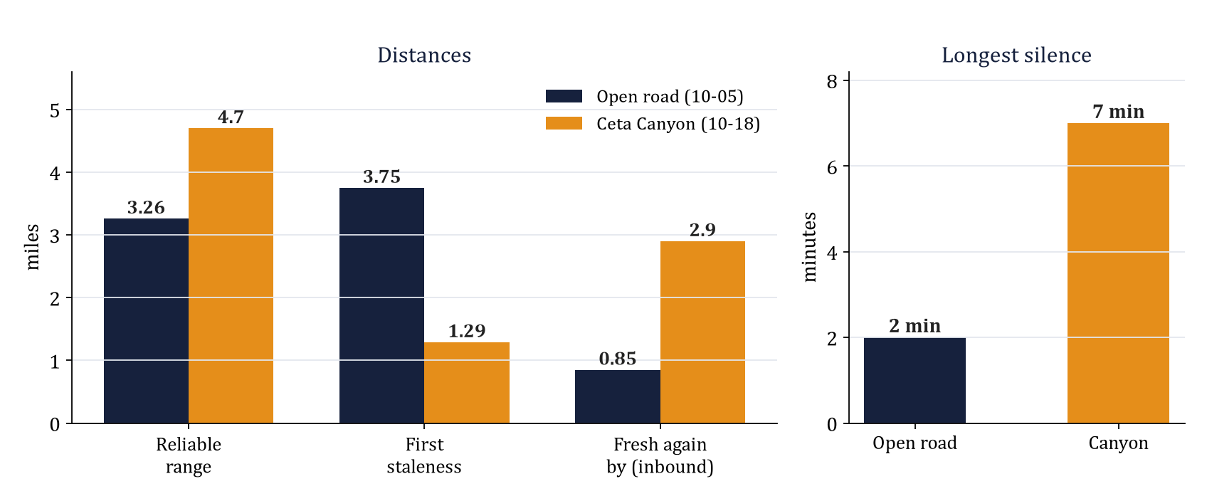
PART III · WHAT IT MEANS
Two Campaigns, Side by Side
The canyon trades early staleness and long silences for a HIGHER line-of-sight ceiling — geometry gives and takes at once.
Notes:
The comparison that completes the range story. Canyon staleness starts three times closer and the silences run three times longer - but the rim's elevation pushed the reliable ceiling PAST the open-road figure. Same radios in both campaigns; only geometry changed. Reacquire-by is farther in the canyon because healing happens where geometry opens, not at a fixed radius.

Slide 18
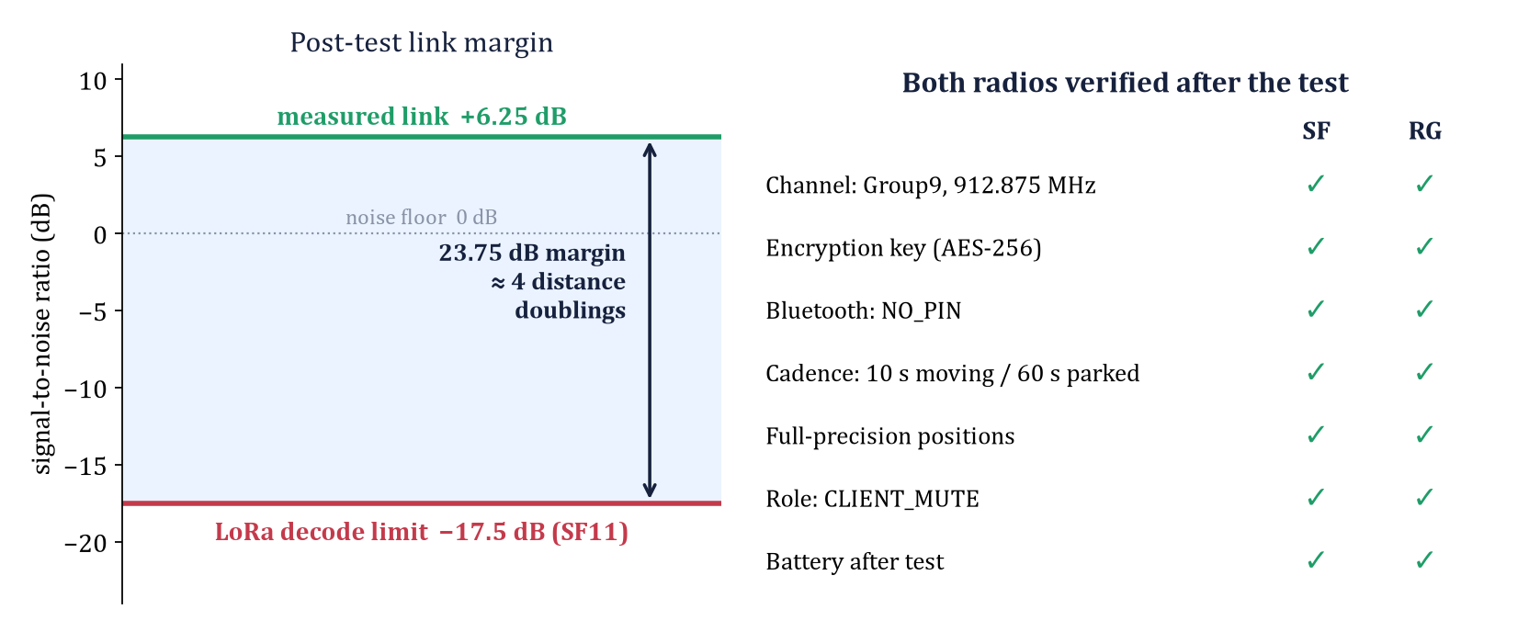
PART III · WHAT IT MEANS
The Post-Test Audit: It Was Terrain, Not Hardware
Every setting verified on both radios after the run; 23.75 dB of margin in hand. LoRa fails as a cliff, not a fade — perfect until the instant it is gone.
Notes:
Closing the loop on slide 7's protocol: the audit. Every setting green on both radios, so the stalls attribute to terrain. Left panel: why no 'signal bar' can warn you - the link is flawless at 17.4 dB below the noise and absent at 17.6. That cliff is why the fixes on the next slide are all geometric.

Slide 19
PART III · WHAT IT MEANS
What Fixes It: Change the Geometry
Repeater on high ground
One ROUTER node on the rim relays both canyon arms. Cars stay CLIENT_MUTE; recipe ready in docs/REPEATER_RECIPE.md.
Roof-mounted antennas
1 m → 3 m of height is worth ~19 dB — more than the whole TX power budget. A pure hardware swap.
Third vehicle as relay
The repeater, opportunistic: the mesh relays through any node on the channel, zero configuration.
LINK LOST alarm (shipped)
At 3 minutes of silence the display flashes who, how long, and where last seen — the recovery action, on glass.
Last-known guidance (proven)
Every blackout becomes “drive toward where they were.” Healed every outage in both campaigns.
Notes:
Green: already done. The alarm shipped this week - it is what the podium display is doing right now if you ran demo beat 3. Orange: the next deployment, justified by the green bar on slide 16. Nothing here is speculative; each item has a measured number behind it.

Slide 20
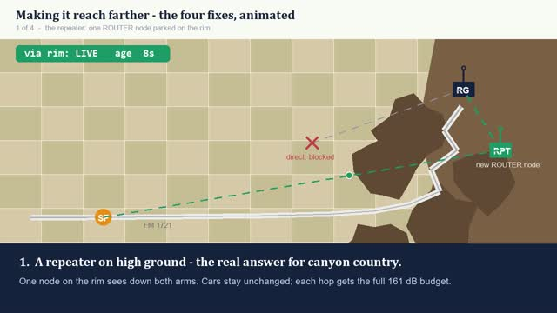
PART III · WHAT IT MEANS
The Four Fixes, Animated
42-second animation: rim repeater, antenna height, mobile relay, and the shipped honest fallback
Notes:
Each fix shown as a mechanism, in order of leverage. Chapter 1: the repeater's two green hops replacing the blocked direct path - note the cars never change configuration. Chapter 2: the side view of why height wins - watch the ray clear the terrain as the antenna rises 1 m to 3 m. Chapter 3: a third vehicle relaying opportunistically while moving. Chapter 4: the already-shipped fallback - the flashing LINK LOST alarm steering the driver to last-known until one packet heals everything.

Slide 21
PART III · WHAT IT MEANS
The Proposition: Completing the Test Program
Experiment A — New Mexico maximum
Flat highway, clear Fresnel zone, drive until the catches stop.
Prediction: beats 3.75 mi; with any elevation on one end, approaches the 4.7 mi rim figure or better.
Experiment B — Rim repeater trial
Return to Ceta Canyon with a third node on the rim, per the ready recipe.
Prediction: the 1.29 mi canyon stalls largely disappear; utilization stays under 15%.
Experiment C — Roof antenna A/B
Same route, in-cabin vs magnetic roof mount, alternating runs.
Prediction: ~2× open-road range; prices the car-body penalty the model puts at 10–20 dB.
The system never promised unbreakable radio. It promised to never lie about it — and the canyon could not make it lie.
Notes:
End on predictions, because predictions are what make it engineering: each proposed experiment has a number it must beat, derived from this test. Then the closing line - and if demo beat 3 is running, hold up the flashing display as you say it. The alarm fired exactly as designed.

