Slide 1
CLOSING THE LOOP
WEEK 4 DESIGN REVIEW: METHOD BEFORE MEASUREMENT
This week's drive test closed the cadence question: position and speed measured fresh every ten seconds on the road, with one-second motion in between. The rest of this review publishes, in advance, everything the fifth layer will be judged by: procedure, design, predicted curve, protocol, and metrics.
PROJECT
Off-Grid Vehicle Tracker
SPONSOR
Dr. Richard Gale
COURSE
OWNER | SUBSYSTEM | THIS WEEK
DEO | Backend, protocol/ | drive test: the ten-second cadence, proven
JOSIAH | Frontend, ui/ and nav/ | what changes on screen when the partner appears
VICTOR | Radio and PHY | radio two procedure, predicted link curve
CANNON | Integration and test | drive-test protocol, metrics declared in advance
Capstone Project Lab
STATUS
42% vs 25% target, ahead
HOURS
78 of 768 logged
DATE
2026-09-16
GROUP 9 | OFF-GRID VEHICLE TRACKER
DESIGN REVIEW, WEEK 4
SHEET 01/11 REV D 2026-09-16
Notes:
Opening line: last week ended on our own cliffhanger - one radio still talks to itself; radio two turns this into a tracker. This week we do the disciplined thing: publish the procedure, the design, the predicted curve, and the metrics BEFORE the measurement. Next review reports against exactly this sheet set, so nothing can be quietly redefined after the fact.

Slide 2
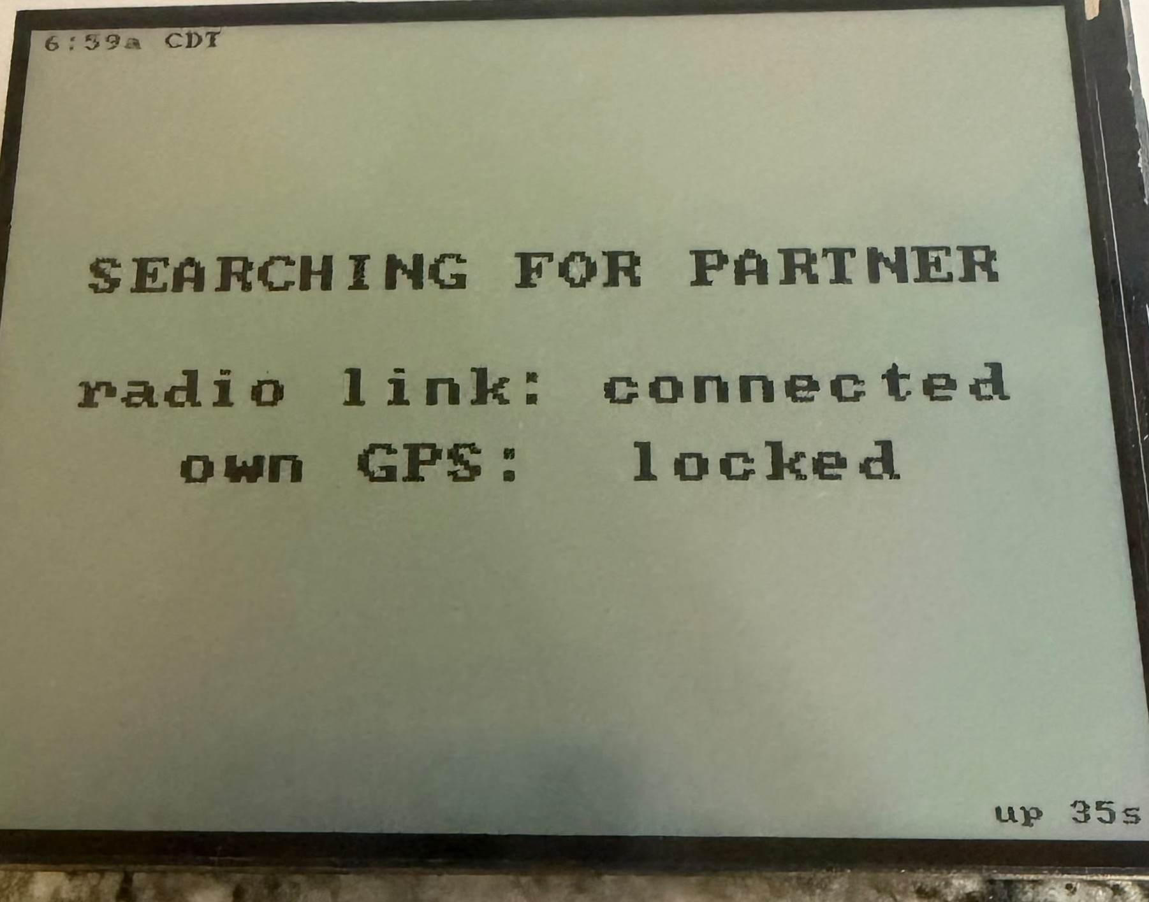
WHERE WE LEFT OFF: ONE LAYER OPEN
OWNER: DEO
GPS to radio
PROVEN
THE CLIFFHANGER
“One radio still talks to itself. Radio number two turns this into a tracker.” That sentence is this week's work order.
Radio to display
PROVEN
Decode to TrackerState
PROVEN
The display says it plainly
Everything below the dashed layer runs today: decoding, navigation, dead reckoning, honest ages.
The partner path is the same decode code with a different node number. Nothing new is written; something existing gets its second speaker.
Navigation and UI
PROVEN
Partner over LoRa
THIS WEEK
This review publishes the plan the fifth layer will be judged by: procedure, design, predicted curve, protocol, metrics.
GROUP 9 | OFF-GRID VEHICLE TRACKER
THE OPEN LAYER
SHEET 02/11 REV D 2026-09-16
Notes:
Thirty seconds of recap, no re-teaching: four layers proven with one device, the dashed fifth is this week. Key claim to land: the partner path is the identical decode path with a different node number - the code that will handle the partner has been running for weeks on our own packets.

Slide 3
RESULT: EVERY TEN SECONDS, ON THE ROAD
OWNER: DEO
GPS fix
every 10 s
gps_update_interval 10
Smart broadcast
10 s / 20 m moving
min interval + distance
BLE delivery
milliseconds
notify, then drain
Screen motion
every second
dead reckoning
VERIFIED IN MOTION, 2026-09-16 DRIVE TEST
Observed while driving: coordinates and speed refreshed roughly every ten seconds, matching the configured cadence for the first time on the road.
This closes the chain of cadence fixes from weeks three and four: the coarse-grid freeze, the stale GPS refresh, and the re-broadcast ghost each hid this behavior until removed.
The cadence question is now settled for one vehicle. Radio two inherits this configuration through the channel recipe, so the partner arrives at the same ten seconds.
WHY THIS MATTERS FOR THE EXAM
Two of the five declared metrics depend on this cadence: packet delivery ratio counts against the ten-second schedule, and the age target of 25 seconds assumes fixes arrive on it. This drive test pinned down the denominator before the two-radio test supplies the numerator.
GROUP 9 | OFF-GRID VEHICLE TRACKER
DRIVE TEST RESULT
SHEET 03/11 REV D 2026-09-16
Notes:
The week's one hard result: on the road, position and speed updated every ten seconds as configured - the first drive where observed cadence matched designed cadence. Tell the archaeology briefly: three earlier defects (position precision grid, 30-second GPS refresh, ghost re-broadcasts) each masked this until fixed, so this drive is the validation that the whole chain is clean. The navy card ties it forward: PDR and the age metric on sheet 09 are only measurable because the schedule is now known-good.

Slide 4
PARTNER SELECTION: FROM RULE TO CONFIGURATION
OWNER: DEO
node_table.cpp today: the bring-up rule
design: partner as configuration
// first non-self node heard becomes the partner
if (s_partner_num == 0) {
s_partner_num = from_num;
Serial.printf("[node] partner: 0x%08lx", from_num);
}
// NVS-persisted choice, selectable from the UI
prefs.putUInt("partner", chosen_node);
// node_table accepts only the chosen node;
// KEY-hold cycles candidates when several heard
The bring-up rule was correct for one radio: with a single voice on the channel, first-heard is unambiguous.
With a mesh it becomes a race. The fix is the same pattern as the radio's own address: the choice lives in NVS flash, survives power cycles, and is set from the display, not the code.
Same firmware in every vehicle. Pairing is configuration, not code.
WHY THIS ORDER OF WORK
Selection ships before the two-radio bench test on purpose: the first time two real nodes speak, the display must already know how to choose between them. Designing the chooser after the ambiguity exists would mean debugging both at once.
GROUP 9 | OFF-GRID VEHICLE TRACKER
PARTNER SELECTION
SHEET 04/11 REV D 2026-09-16
Notes:
Left box is the code running today, verbatim from the repository, including its own TODO comment. Right box is the design being implemented this week. The argument: the pattern is proven - the radio's BLE address already lives in NVS the same way. And the sequencing point matters to a reviewer: build the chooser before the ambiguity arrives, not after.

Slide 5
RADIO TWO: A FIFTEEN-MINUTE PROCEDURE
OWNER: VICTOR
hardware/README.md the recipe, one command per line
TWO DOCUMENTED TRAPS
Reboot-triggering writes can silently revert (the port close resets the chip mid-save): read back every setting. And identical boards demand a named upload port: we have paid for that lesson once.
meshtastic --port COMx --seturl "https://meshtastic.org/e/#Ci4S..."
# channel URL: carries the AES key AND the frequency agreement
meshtastic --port COMx --set position.position_broadcast_secs 60
meshtastic --port COMx --set position.broadcast_smart_minimum_interval_secs 10
meshtastic --port COMx --set position.broadcast_smart_minimum_distance 20
meshtastic --port COMx --set position.gps_update_interval 10
meshtastic --port COMx --get lora.region # VERIFY every write
ACCEPTANCE CRITERIA, WRITTEN BEFORE THE ATTEMPT
1
Radio two's OLED shows the Group9 channel and US region
2
Both OLEDs read “1 online”: each radio hears the other
3
The display's PTR row fills with radio two's live position
4
ChUtil stays in single digits with both radios broadcasting
GROUP 9 | OFF-GRID VEHICLE TRACKER
RADIO TWO PROCEDURE
SHEET 05/11 REV D 2026-09-16
Notes:
The recipe exists because radio one's configuration was learned the hard way and written down each time. The channel URL is the crown jewels: it carries the encryption key, and because the channel name hashes to the frequency slot, it is also the frequency agreement. Read the four acceptance criteria aloud - declaring them before the attempt is the difference between a procedure and a hope. Criterion 2, both OLEDs reading one online, will be the first photograph.

Slide 6
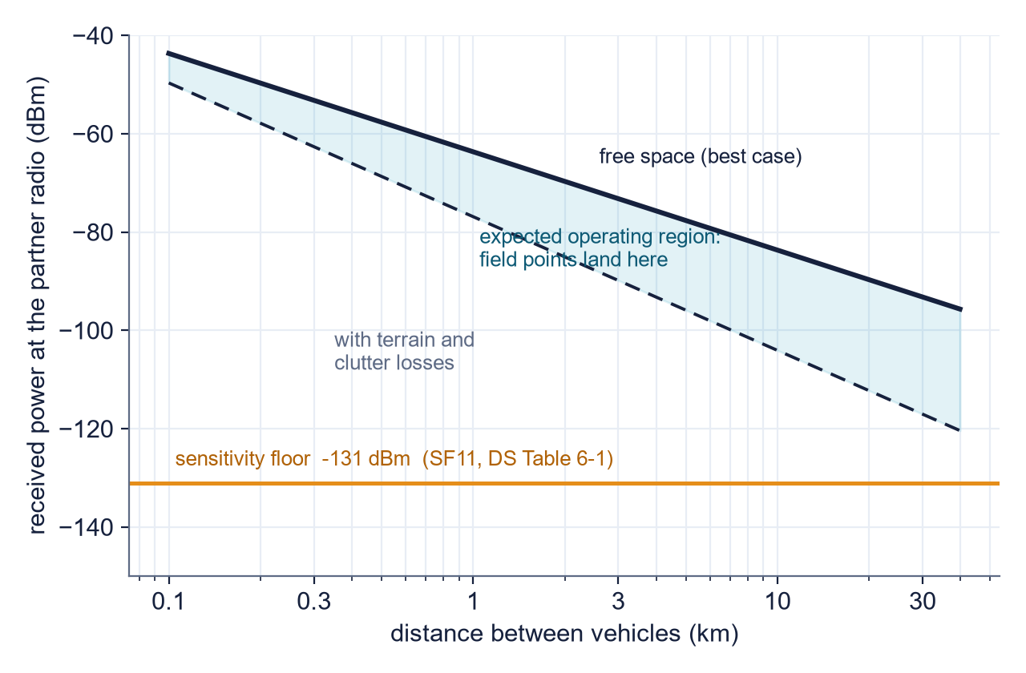
THE PREDICTION THE RANGE TEST WILL JUDGE
OWNER: VICTOR
Transmit +22 dBm, 3 dBi at each end, free-space loss at 915 MHz: the solid curve. Terrain and clutter cost more: the dashed band.
The orange line is the wall: -131 dBm, the SF11 sensitivity from the datasheet. Where the band crosses the wall is the range prediction.
Free space says tens of kilometers; terrain will decide the real number. The range campaign plots measured RSSI points onto this exact chart.
WHY PUBLISH THE CURVE FIRST
A measurement without a prior prediction is a demo. A measurement against a published curve is an experiment. Next review overlays the field points on this figure, wherever they land.
MODEL: FSPL = 32.45 + 20log(f) + 20log(d) · RSSI = 22 + 3 + 3 - FSPL - terrain [DS Table 6-1 · AN1200.22 · TELECOM_ANALYSIS.md]
GROUP 9 | OFF-GRID VEHICLE TRACKER
PREDICTED LINK CURVE
SHEET 06/11 REV D 2026-09-16
Notes:
Walk the chart: received power falls with distance (log scale); the orange wall is the minus 131 dBm sensitivity floor from datasheet Table 6-1; the shaded band between free space and the terrain-degraded curve is where reality lives. The claim to make carefully: free space predicts absurd range, tens of kilometers - real range is set by terrain, Fresnel clearance, and the vehicle install, which is precisely what the range campaign measures. The methodological point is the navy card: publishing the prediction before measuring converts a demo into an experiment.

Slide 7
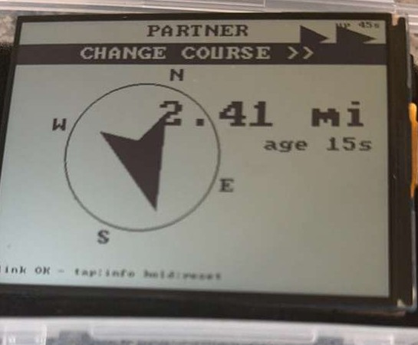
THE SCREEN IS ALREADY PARTNER-SHAPED
OWNER: JOSIAH
Every partner element exists and runs today, exercised for weeks by the simulator and by our own radio's packets: the arrow, the distance, the ages, the banners.
When radio two speaks, node_table stores a second fix and the same rendering draws it. The planned frontend change for that day is zero lines.
Queued this week instead: partner-selection screen (choose among heard nodes) and night readability with the edge light.
Today: honest about the gap
Sim preview: what fills in
Definition of ready: the UI needs nothing from radio two's arrival except the data itself. That was the point of building on simulated partners from week one.
The compass photo above is the simulator driving the real display: the partner pipeline, rehearsed nightly for three weeks.
GROUP 9 | OFF-GRID VEHICLE TRACKER
FRONTEND, PARTNER-READY
SHEET 07/11 REV D 2026-09-16
Notes:
The left photo is the live system being honest about the missing partner; the right photo is the same hardware running the simulator, which has fed fake partners through the real rendering since week one. So the frontend claim is unusual and strong: the plan for radio two's arrival is zero frontend changes. The queued work is the partner-selection screen (pairs with Deo's NVS design) and night readability.

Slide 8
DRIVE-TEST PROTOCOL, VERSION ONE
OWNER: CANNON
P0 BENCH
LOGGED PER PACKET
timestamp
node id
RSSI [dBm]
SNR [dB]
distance at receipt
age when displayed
Harness: serial capture on the display side; one dated log per test in testing/.
both radios on one desk: acceptance criteria 1 to 4 from sheet 04, thirty minutes of soak, zero drops expected
P1 STATIC RANGE
one radio fixed, one carried: log RSSI and SNR at marked distances until packets stop; plot onto sheet 05
P2 TWO-VEHICLE DRIVE
city loop then open road: PTR row live, ages under 15 s while moving, arrow tracks the real partner
P3 EDGE CASES
canyon streets, garage exit, one vehicle parked with no sky: ghosts must age honestly, links must self-heal
Every phase inherits its checks from the constraints ledger: the sky-view rule, the ignition-on rule, the one-client rule, the adapter rule. The ledger was the test plan all along.
GROUP 9 | OFF-GRID VEHICLE TRACKER
DRIVE-TEST PROTOCOL
SHEET 08/11 REV D 2026-09-16
Notes:
Four phases, strictly ordered so each isolates one variable: bench removes distance, static range removes motion, the drive adds motion, edge cases add the failure modes we already catalogued. The right panel is the per-packet log schema - six fields, chosen so sheet 05's curve and sheet 08's metrics can both be computed from the same file. Close on the ledger line: the constraints sheet from last week literally becomes the checklist.

Slide 9
THE NUMBERS THAT WILL JUDGE THE SYSTEM
OWNER: CANNON
PDR
received / expected broadcasts per interval
> 90% inside working range
packet delivery ratio
AGE p95
95th percentile of displayed partner age
< 25 s while both move
freshness
RECONNECT
BLE self-heals after drop, no user action
100% of drops, < 30 s
link resilience
DR ERROR
gap between projected and next real fix
< 30 m at highway speed
projection honesty
CHUTIL
utilization with both radios broadcasting
< 10% steady state
channel citizenship
TARGETS SET BEFORE THE FIRST TWO-RADIO PACKET. NEXT REVIEW REPORTS EACH ROW, PASS OR FAIL.
GROUP 9 | OFF-GRID VEHICLE TRACKER
METRICS DECLARED
SHEET 09/11 REV D 2026-09-16
Notes:
Five metrics, each with its definition and a pre-declared pass threshold. Why declare now: after the data exists, any threshold looks chosen to flatter it. PDR is computable because broadcasts are scheduled, so expected count is known. Age p95 is the driver-facing truth. Reconnect covers the known BLE drop cases. DR error audits the dead reckoning against each next real fix. ChUtil keeps us honest citizens of the shared band. Every one computes from the six-field log on sheet 07.

Slide 10
STATUS AND WHAT COMES NEXT
42%
10 s
4 + 1
5
of tasks complete against a 25% week-four target
cadence verified on the road this week
layers proven + the layer this sheet set closes
metrics pre-declared, thresholds locked
DONE THIS WEEK, AND NEXT IN ORDER
NEXT REVIEW REPORTS
Done: drive test verified the ten-second cadence end to end, in motion.
Next: partner selection lands in firmware (Deo), before the ambiguity arrives.
Next: radio two provisioned by the recipe; acceptance criteria checked (Victor).
Next: bench soak, static range walk with the logging harness (Cannon); partner-selection screen and night readability (Josiah).
The before/after of the PTR row: “no partner heard yet” to live coordinates.
Field RSSI points overlaid on sheet 05's predicted curve.
The five metrics from sheet 08, each marked pass or fail.
Then the first two-vehicle drive test.
Last week we showed a working machine. This week we published the exam it must pass. Next week it takes the exam.
GROUP 9 | OFF-GRID VEHICLE TRACKER
STATUS AND NEXT STEPS
SHEET 10/11 REV D 2026-09-16
Notes:
The closing line is the deck's thesis: machine, then exam, then results. If asked why radio two is not already done, the honest answer is scheduling - the gantt has it in weeks 4 to 5, we are at 42 percent against a 25 percent target, and the disciplined move was to publish the acceptance criteria and metrics before touching the hardware.

Slide 11
REFERENCES
[1]
Semtech Corp., SX1276/77/78/79 Datasheet. SNR limit per spreading factor.
[6]
FCC Rules, 47 CFR 15.247. The 902 to 928 MHz ISM band.
semtech.com/products/wireless-rf/lora-connect/sx1276
law.cornell.edu/cfr/text/47/15.247
[2]
Semtech Corp., AN1200.22, LoRa Modulation Basics. Airtime and processing gain.
[7]
ITU-R M.1371, Automatic Identification System. Beacon-interval precedent.
info.semtech.com/find-documentation (search AN1200.22)
itu.int/rec/R-REC-M.1371/en
[3]
Semtech Corp., SX1261/2 Datasheet. Sensitivity and transmit specifications.
[8]
Friis/FSPL path-loss model background and haversine reference.
semtech.com/products/wireless-rf/lora-connect/sx1262
movable-type.co.uk/scripts/latlong.html
[4]
Meshtastic Documentation, LoRa and Position Configuration.
[9]
Bluetooth SIG, Core Specification (GATT).
meshtastic.org/docs/configuration/radio/lora
bluetooth.com/specifications/specs/core-specification
[5]
Meshtastic Protobufs Repository. The published message schema.
[10]
Group 9 repository: RADIO_PHY_DEEP_DIVE, TELECOM_ANALYSIS, hardware/README, testing/.
github.com/meshtastic/protobufs
github.com/deosgracius/offgrid-vehicle-tracker
All firmware, documentation, logs, and this deck's generator are version controlled at github.com/deosgracius/offgrid-vehicle-tracker
GROUP 9 | OFF-GRID VEHICLE TRACKER
REFERENCES
SHEET 11/11 REV D 2026-09-16
Notes:
Same verified links as last week. If the link-budget model on sheet 05 is challenged: FSPL is the standard Friis free-space form, the sensitivity floor is datasheet Table 6-1, and the full derivation is in TELECOM_ANALYSIS.md in the repository.

