Slide 1
OFF-GRID VEHICLE TRACKER
WEEK 3 DESIGN REVIEW: A WORKING TRACKER, END TO END
The display now shows a live vehicle: real packets, real navigation math, a screen that moves every second. Each section: architecture first, then the working hardware and its code.
PROJECT
Off-Grid Vehicle Tracker
SPONSOR
Dr. Richard Gale
OWNER | SUBSYSTEM | SCOPE THIS WEEK
DEO | Backend, protocol/ | system diagram, BLE link, decode, TrackerState
JOSIAH | Frontend, ui/ and nav/ | arrow math, two-page UI, dead reckoning
VICTOR | Radio and PHY | link physics: real time versus 10 seconds
CANNON | Integration and test | the constraints ledger, test sequence
COURSE
Capstone Project Lab
STATUS
42% vs 19% target, ahead
HOURS
78 of 768 logged
DATE
2026-09-07
GROUP 9 | OFF-GRID VEHICLE TRACKER
DESIGN REVIEW, WEEK 3
SHEET 01/14 REV C 2026-09-07

Slide 2
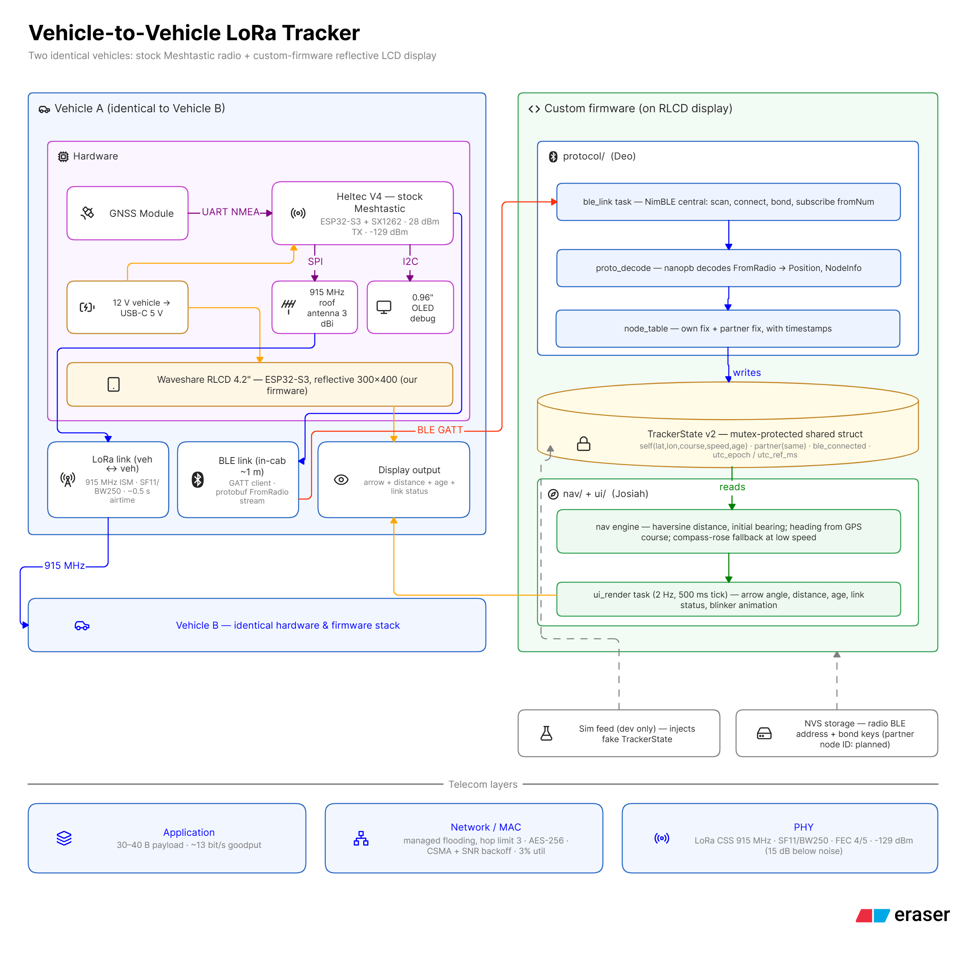
THE COMPLETE SYSTEM ON ONE SHEET
OWNER: DEO
READING ORDER
Left: one vehicle's hardware. GNSS feeds the radio; the radio drives the roof antenna.
Right: the display firmware. Protocol writes TrackerState; navigation reads it. One writer, one reader.
Bottom: the telecom view. A 40 byte payload on a PHY that decodes 15 dB below the noise.
Vehicle B is an identical copy. No server, no master, no single point of failure.
WHY THIS SHAPE
Everything hard about long-range radio ships pre-tested in Meshtastic. The chains on the right are the only custom code, and they meet at one struct.
GROUP 9 | OFF-GRID VEHICLE TRACKER
COMPLETE SYSTEM DIAGRAM
SHEET 02/14 REV C 2026-09-07
Notes:
Open with the whole system so every later sheet has a home. Walk left region (hardware per vehicle), right region (firmware split with TrackerState as the single interface), bottom strip (telecom layers). Close on symmetry: vehicle B is identical, nothing is a server.

Slide 3
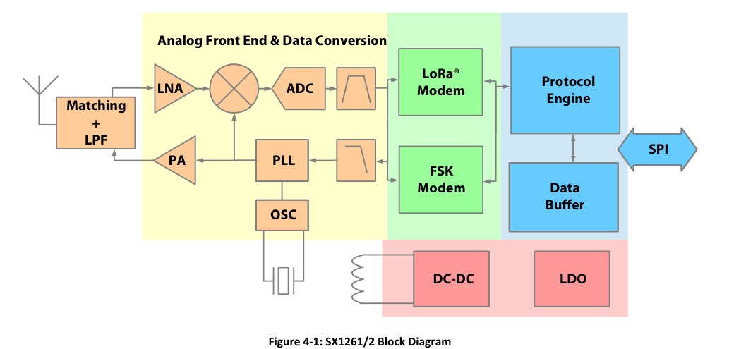
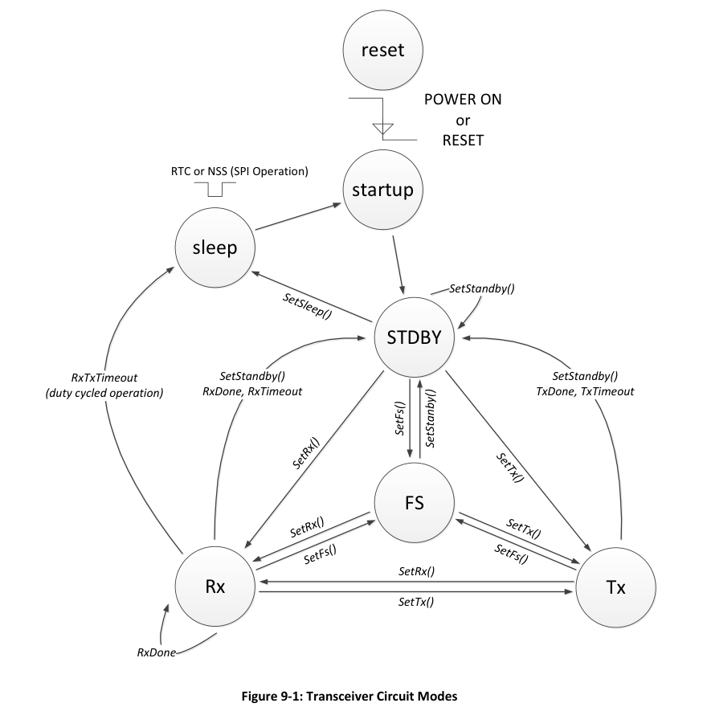
INSIDE THE TRANSCEIVER (DATASHEET REV 2.2)
OWNER: DEO
SX1262 BLOCK DIAGRAM, DS FIG 4-1 p.23. TWO MODEMS SHARE ONE FRONT END; WE USE ONLY THE LoRa ONE.
OPERATING MODES, DS FIG 9-1 p.64
RX
always listening
CAD
channel clear? 6.1.5 p.41
FS
PLL locks channel
TX
chirps, ~0.5 s
TxDone
IRQ on DIO1
RX
back to listening
ONE POSITION BROADCAST TRACED ON THE STATE MACHINE. CAD IS THE PHYSICAL LISTEN-BEFORE-TALK: BELOW THE NOISE FLOOR RSSI IS USELESS, SO THE CHIP CORRELATES FOR LoRa SYMBOLS INSTEAD.
meshtastic RadioInterface.cpp how region US becomes a frequency
Both radios hash the same channel name, so they meet on the same frequency with no coordination message. Full walkthrough: docs/RADIO_PHY_DEEP_DIVE.pdf
RDEF(US, 902.0f, 928.0f, ...); freq = start + bw/2000 + hash(name)*(bw/1000);
GROUP 9 | OFF-GRID VEHICLE TRACKER
INSIDE THE SX1262
SHEET 03/14 REV C 2026-09-07
Notes:
Presented by Deo as the descent from the system map into the machine my protocol rides on. This sheet is the silicon-level story, all from the Semtech datasheet in our repo of references. Left: the block diagram - antenna, matching, LNA, mixer, ADC, then everything is digital: the LoRa modem correlates chirps (that is the processing gain), the protocol engine handles preamble, header, FEC and CRC, and a 256-byte buffer meets the ESP32 over SPI. Note the FSK modem sitting beside the LoRa modem: present, powered, and unused - FSK needs positive SNR, LoRa decodes at minus 17.5 dB. Right: the operating-mode state machine, and below it one of our broadcasts traced across it: park in RX, CAD to check the channel (the physical CSMA - below the noise floor RSSI is meaningless so the chip listens for LoRa symbols), FS while the PLL locks, half a second of TX, TxDone interrupt, back to RX. Bottom code: the region line that sets 902 to 928 MHz and the hash that picks the channel - both radios compute the same hash from the channel name, so the shared URL is simultaneously the encryption domain and the frequency agreement. Close by handing the physics forward: Victor will quantify what this silicon buys and what it costs.

Slide 4
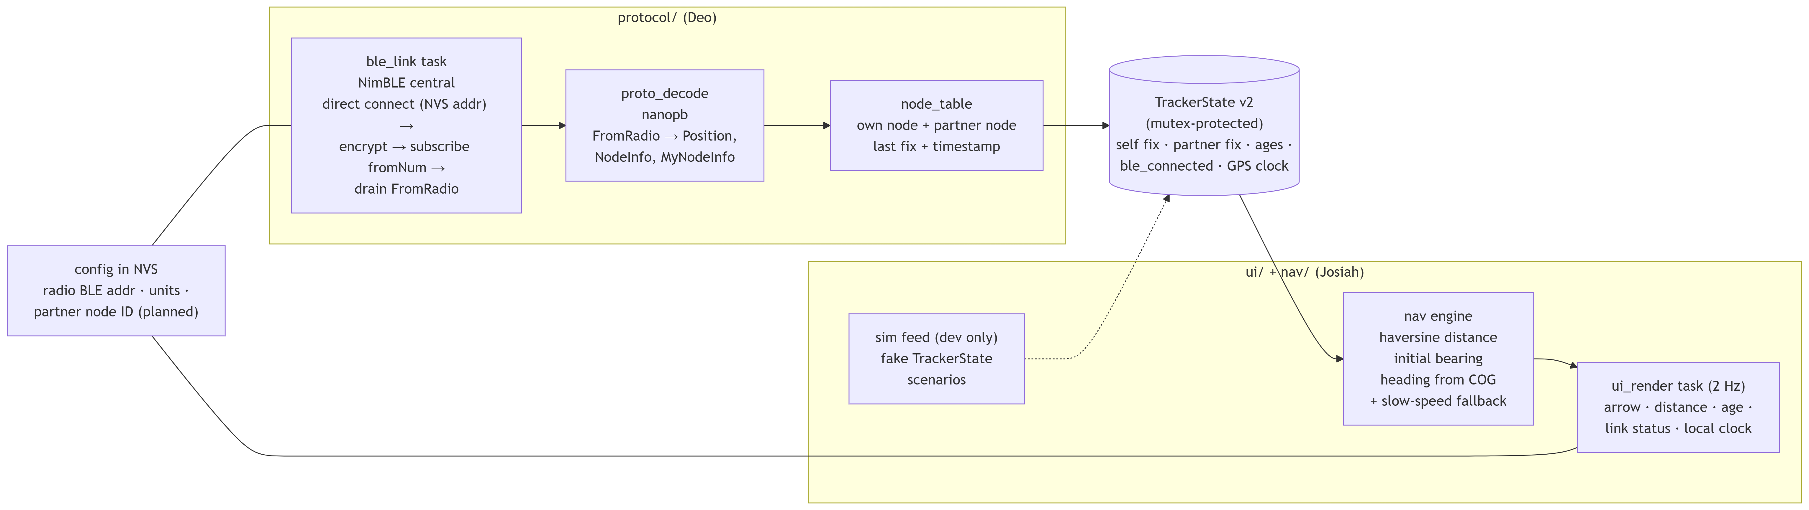
BACKEND: THE DATA SPINE
OWNER: DEO
ble_link connects by remembered address, encrypts, subscribes, drains. proto_decode names the bytes. node_table keeps honest fixes and publishes TrackerState v2.
Road-tested: the link reconnects itself, and stale re-broadcasts can no longer pose as fresh data.
GROUP 9 | OFF-GRID VEHICLE TRACKER
BACKEND ARCHITECTURE
SHEET 04/14 REV C 2026-09-07
Notes:
Zoom from sheet 02 into the firmware. Emphasize the single mutex-protected interface and that the whole left chain is proven on the road, not the bench: automatic reconnection, duplicate re-broadcast detection for honest ages, and the GPS clock guard.

Slide 5
HOW THE PIECES CONNECT IN CODE
OWNER: DEO
ble_link.cpp drain the radio's GATT queue
proto_decode.cpp bytes to named fields
for (;;) {
NimBLEAttValue v = s_fromRadio->readValue();
if (v.size() == 0) break; // queue empty
proto_decode_from_radio(v.data(), v.size());
}
if (pb_decode(&is, meshtastic_Position_fields, &pos))
node_table_position(pkt->from,
pos->latitude_i, pos->longitude_i,
pos->ground_speed, pos->time);
node_table.cpp publish the contract, 1 Hz
ui_render.cpp frontend picks it up, 2 Hz
TrackerState st;
st.self = s_self.fix; st.partner = s_partner.fix;
st.ble_connected = connected;
st.utc_epoch = s_utc_epoch; // GPS wall clock
tracker_store_set(&st); // the ONE writer
tracker_store_get(&st); // the ONE reader
dr_apply(&st); // dead-reckon fixes forward
NavOutput nav = nav_compute(&st);
// arrow angle, distance, ages, clock
MUTEX BOUNDARY
Four files, one direction of flow, one struct. The halves meet only at the store functions; the mutex cannot be bypassed.
Road hardening: km/h converted at the door, jitter deadband, duplicate detection, a clock that cannot run backwards.
GROUP 9 | OFF-GRID VEHICLE TRACKER
BACKEND CODE PATH
SHEET 05/14 REV C 2026-09-07
Notes:
Read the arrows aloud: the GATT loop reads until the radio reports empty; nanopb decodes with code generated from Meshtastic's own schema; node_table publishes once per second; the UI copies its own snapshot at 2 Hz, projects it forward, and computes the arrow. Every hardening item in the bottom card came out of an actual drive test.

Slide 6
FRONTEND: FROM STRUCT TO ARROW
OWNER: JOSIAH
TrackerState v2
snapshot copy under mutex
dr_apply()
project both fixes forward
nav_compute()
distance, bearing, arrow
render at 2 Hz
compass page and status page, KEY toggles, hold resets
nav.c the arrow in three lines
dead_reckon.c 1 Hz motion between fixes
d = haversine(self, partner); // meters
bearing = initial_bearing(self, partner); // deg
arrow = wrap180(bearing - self.course); // 0 = ahead
d = speed * min(age, 120); // meters traveled
lat += d*cos(course)/111320;
lon += d*sin(course)/(111320*cos(lat));
Heading from GPS course over ground: no magnetometer in a steel cab. Below 5 mph, north-up rose.
Every element is a state machine on the struct: CHANGE COURSE, chevrons, STALE past 120 s, position-derived clock.
Pure C, no hardware dependencies: 12 of 12 native tests pass on a laptop.
Measurements every 10 s. The display projects both vehicles every second, and each real fix snaps it back to truth.
GROUP 9 | OFF-GRID VEHICLE TRACKER
FRONTEND ARCHITECTURE
SHEET 06/14 REV C 2026-09-07
Notes:
Sector flow left to right, then the two fragments that do all the work. Testability is the design win: nav.c and dead_reckon.c run on the laptop with zero hardware, which is how the whole UI was built before the radio link existed.

Slide 7
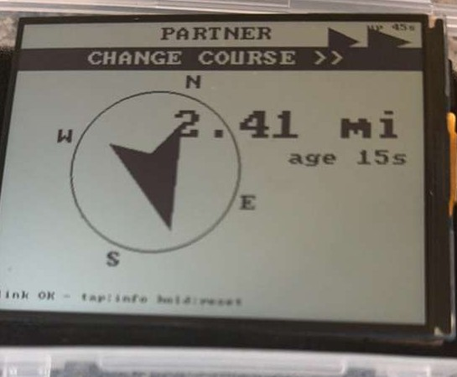
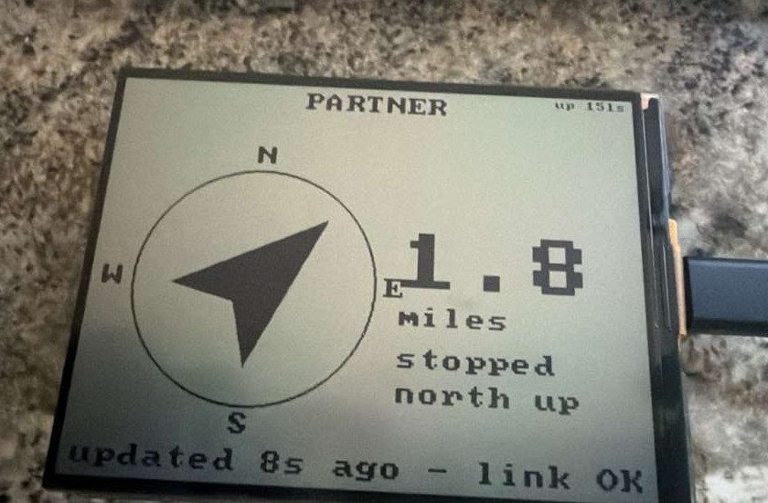
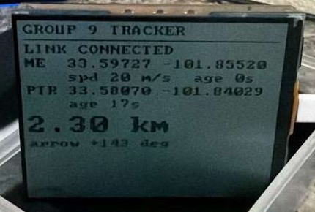
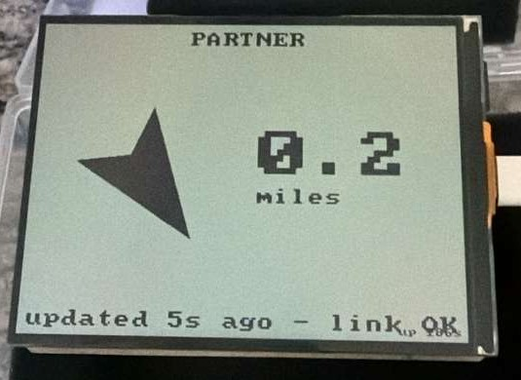
THE UI, RUNNING ON REAL PACKETS
OWNER: JOSIAH
WHY THESE SHOTS MATTER
No simulator: every value arrived by radio.
Reflective panel: sharper in sunlight, built for a dash.
The age readout is the honesty metric.
Banner, chevron, rose: state machines on live data.
Stopped: automatic north-up rose fallback
Driving view. Partner 2.41 mi, CHANGE COURSE with turn chevron, age 15 s
Close range, 0.2 mi
Status page: live ME and PTR coordinates
GROUP 9 | OFF-GRID VEHICLE TRACKER
THE UI ON REAL PACKETS
SHEET 07/14 REV C 2026-09-07
Notes:
All four photos show the real display on decoded radio packets. Point at the state machine working: banner and chevron in the driving view, rose fallback when stopped, and the diagnostic page with raw coordinates that we use for debugging.

Slide 8
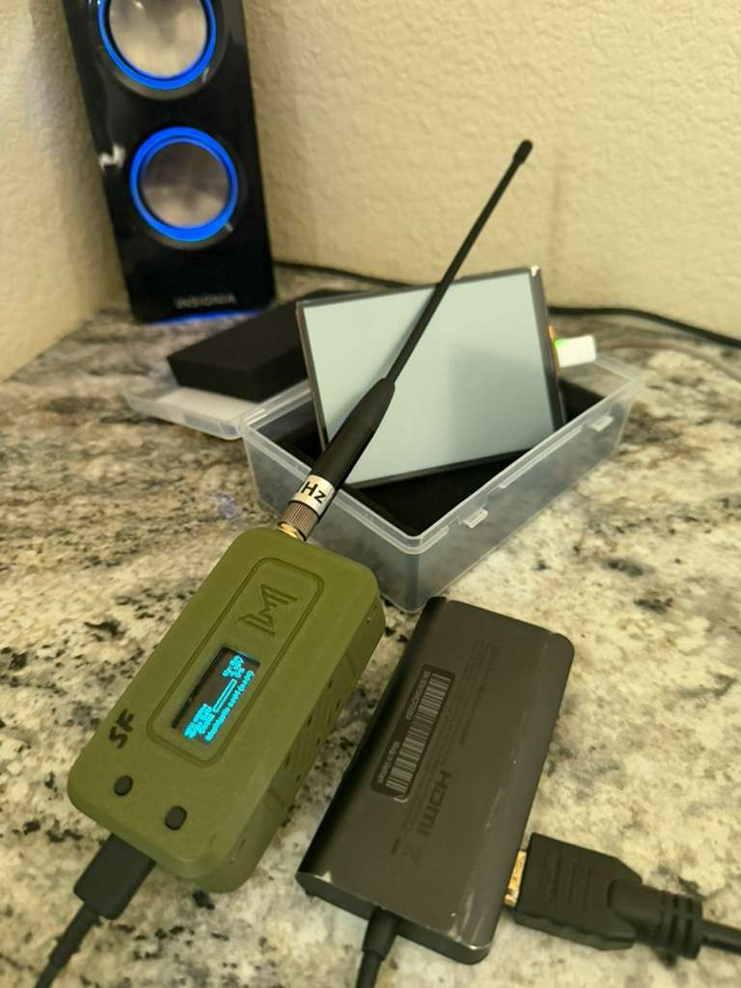
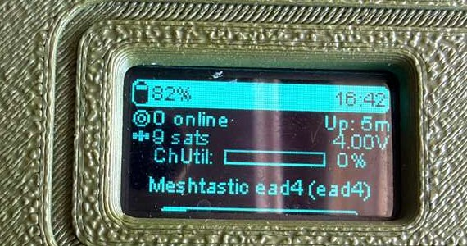
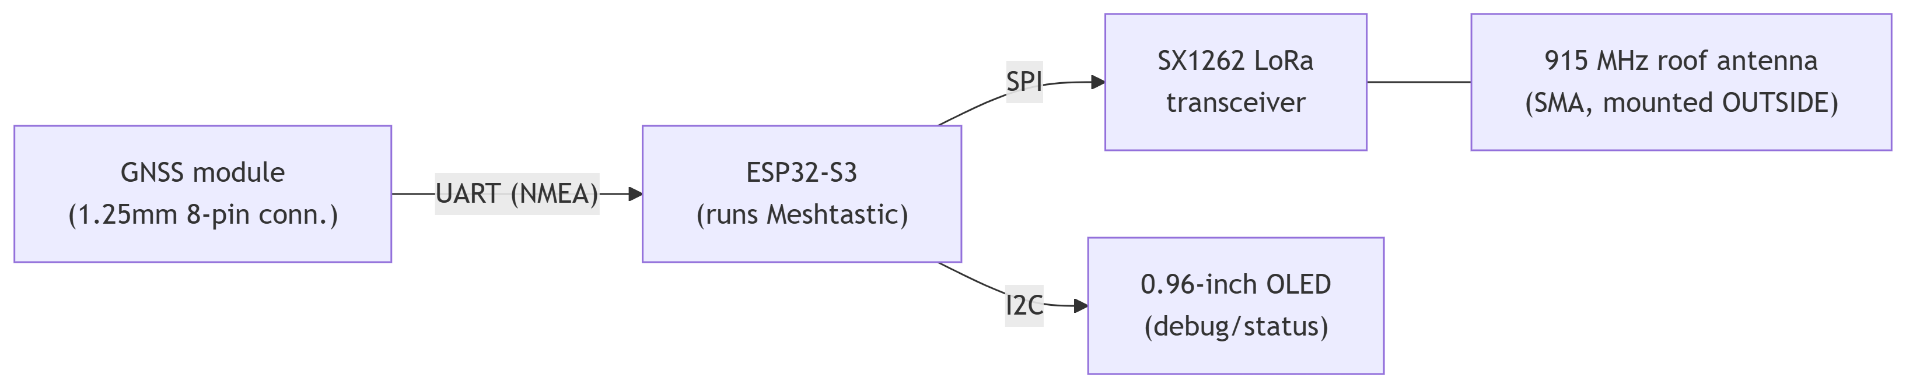
RADIO AND PHY: THE LONG-RANGE LINK
OWNER: VICTOR
RADIO NODE, HELTEC V4 RUNNING STOCK MESHTASTIC
OLED: 9 satellites, ChUtil 0%
LONG_FAST: SF11 over 250 kHz, FEC 4/5, 915 MHz ISM, private AES-256 channel, full precision.
Smart broadcast 10 s / 20 m moving, 60 s parked. GPS refresh 10 s: every broadcast carries a new fix.
The OLED is the free field debugger: satellites, nodes, utilization, last RSSI.
The rig with 915 MHz antenna
PROVISIONING DISCIPLINE (hardware/README.md)
Radio 2 joins with the exact channel URL (it carries the AES key). Verify every CLI write; always name the upload port.
GROUP 9 | OFF-GRID VEHICLE TRACKER
RADIO AND PHY
SHEET 08/14 REV C 2026-09-07
Notes:
Hardware diagram first, then the configuration that three road tests produced: 10 second smart broadcast matched by 10 second GPS refresh on a full-precision private channel. The amber card is the recipe that makes radio two a fifteen-minute job instead of a rediscovery project.

Slide 9
REAL TIME VERSUS 10 SECONDS: THE PHYSICS
OWNER: VICTOR
EQ 1 AIRTIME
DS 6.1.1 p.39 + AN1200.22
EQ 2 UTILIZATION
Meshtastic docs, ~25% cap
EQ 3 SENSITIVITY
DS Table 6-1 p.39, 3.5.3 p.20
EQ 4 LATENCY
DS 6.1.4 p.41 (airtime term)
EQ 5 DEAD RECKONING
dead_reckon.c, 12/12 tests
THE VERDICT
Delivery is real time: about one second. Sampling is 10 s, because airtime is the currency and we bought range with it. Dead reckoning fills the gap at 1 Hz.
GROUP 9 | OFF-GRID VEHICLE TRACKER
LINK PHYSICS
SHEET 09/14 REV C 2026-09-07
Notes:
This sheet answers the question everyone asks: why not every second. Equation 1: at spreading factor 11 each symbol is 2048 chips, so one position costs about half a second of air. Equation 2: two vehicles at one hertz would occupy 100 percent of the channel; at ten seconds they occupy ten percent. Equation 3: the same slowness buys sensitivity of minus 131 dBm, fifteen decibels below thermal noise, which is the entire range budget. Equation 4: actual information latency is about one second. Equation 5: the display projects both vehicles forward every second between fixes. Marine AIS beacons every 2 to 30 seconds and every chartplotter animates between reports; we are in good company.

Slide 10
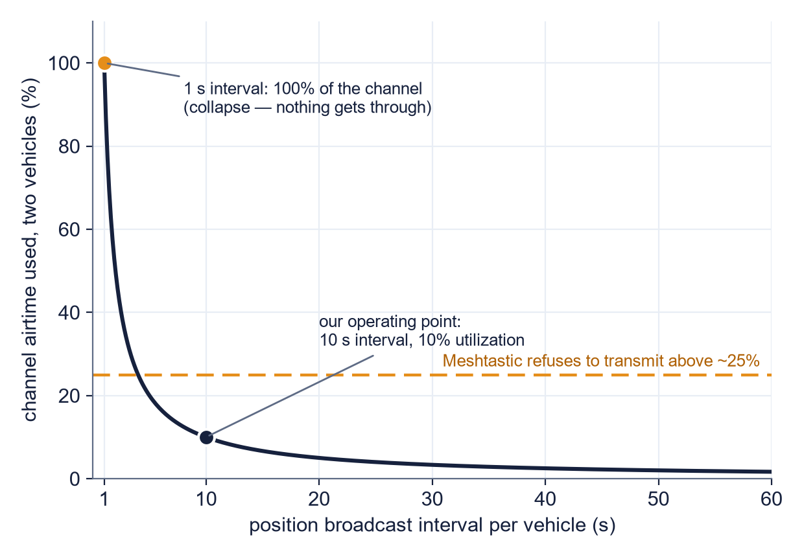
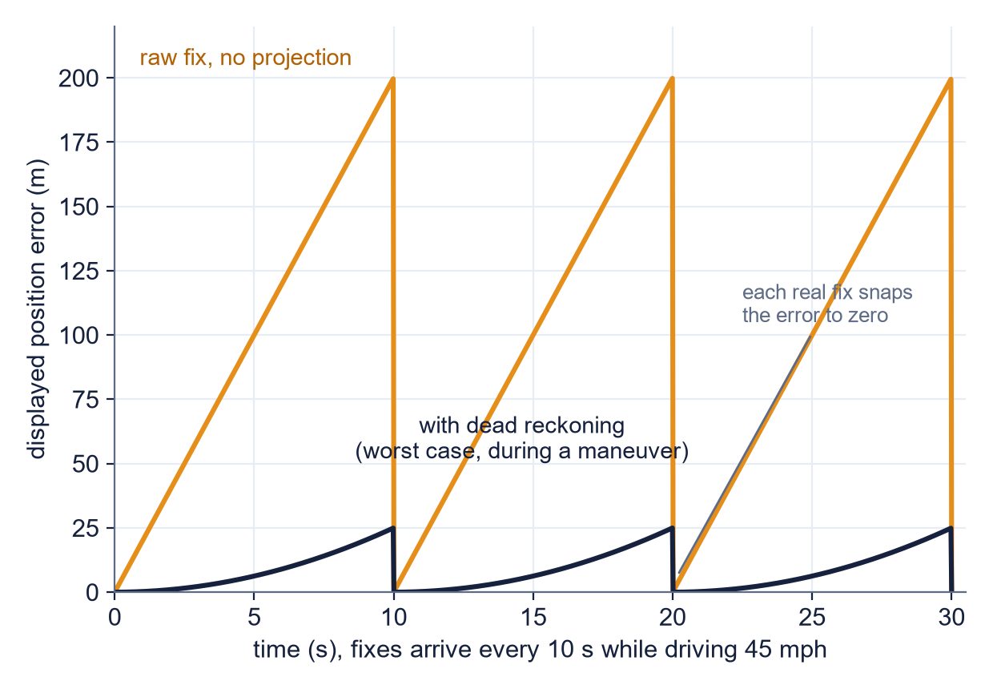
THE SAME PHYSICS, GRAPHED
OWNER: VICTOR
The update-rate wall: 1 s would take 100% of the channel. Our point: 10 s, 10%, under the enforced 25% ceiling.
Raw fix: up to 200 m behind at 45 mph. Dead reckoning: bounded near 25 m, snapped to zero by each real fix.
SOURCES [1] Semtech SX1276 datasheet, SNR limit per spreading factor [2] Semtech AN1200.22, LoRa modulation and airtime [3] Meshtastic docs, LoRa config and duty limit [4] ITU-R M.1371, AIS reporting intervals (full citations in the notes)
GROUP 9 | OFF-GRID VEHICLE TRACKER
LINK BEHAVIOR, GRAPHED
SHEET 10/14 REV C 2026-09-07
Notes:
Two pictures replace ten minutes of argument. Left graph: utilization is inversely proportional to the interval; the 1 s point is literally impossible and the dashed line is Meshtastic's own 25 percent duty limit; we sit at 10 percent. Right graph: the sawtooth is the display error over time at 45 mph; orange is what holding the raw fix would show, up to 200 meters stale; navy is dead reckoning with a worst-case maneuver assumption of 0.5 m/s^2, bounded near 25 meters and typically a few meters in steady driving. Sources are on this sheet's reference list in the notes: the SNR-per-spreading-factor table and airtime equations are from Semtech's datasheet and AN1200.22, the duty limit and configuration from the Meshtastic documentation, and the AIS precedent from ITU-R M.1371.

Slide 11
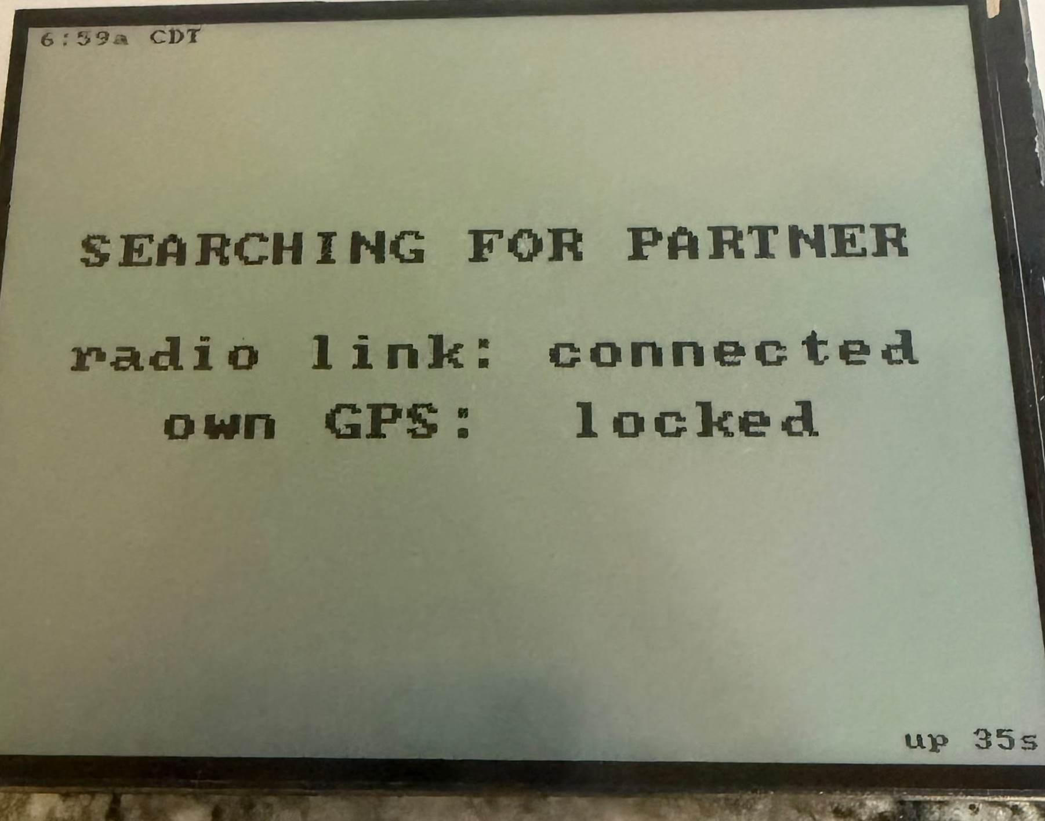
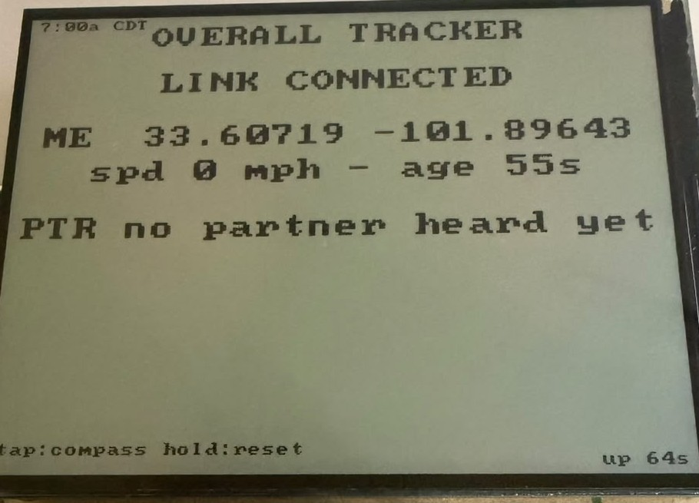
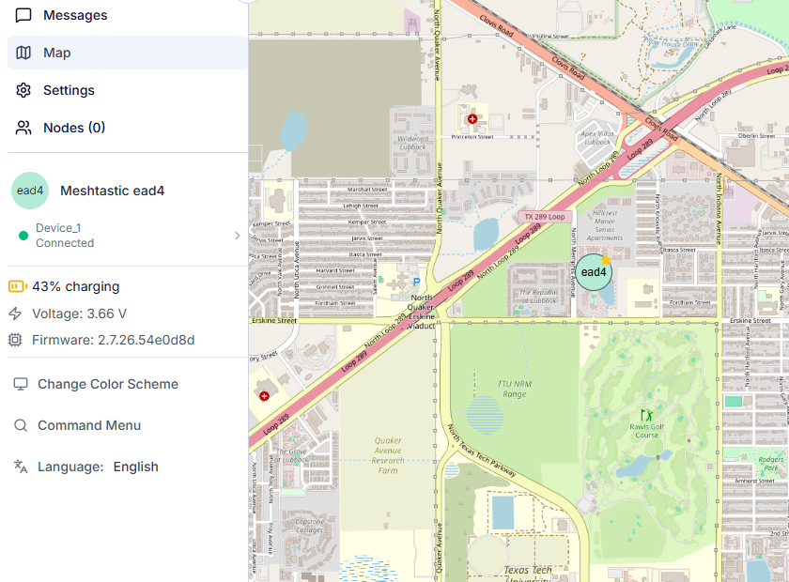
INTEGRATION: THE HALVES ARE JOINED
OWNER: CANNON
GPS to radio
satellites acquired, fixes flowing over UART
PROVEN
POSITION CROSS-CHECK
"own GPS: locked"
Same fix, same radio, two programs sharing no code. Agreement is the accuracy check.
Radio to display
BLE GATT link, automatic reconnect
PROVEN
"radio link: connected"
Boot: link + GPS proven
ME 33.60719 -101.89643
Decode to TrackerState
protobuf frames become live coordinates
PROVEN
INDEPENDENT CLIENT: MESHTASTIC WEB APP, SAME RADIO, NODE ead4 CONNECTED
One device proves four of five layers. The dashed one waits only for radio two.
"ME 33.60719 -101.89643"
Navigation and UI
state-driven pages, honest ages, local clock
PROVEN
"6:59a CDT, age 55 s"
Partner over LoRa
second radio joins the encrypted channel
NEXT
"PTR no partner heard yet"
GROUP 9 | OFF-GRID VEHICLE TRACKER
INTEGRATION, ONE DEVICE
SHEET 11/14 REV C 2026-09-07
Notes:
This sheet is the integration story: the two halves of the firmware are joined and running on real hardware. Walk the stack top to bottom, and point at the photo text that proves each layer: own GPS locked proves layer one, radio link connected proves layer two, the live coordinates prove decoding, and the clock reading Central time proves the navigation layer is deriving timezone from position. The dashed layer is the honest gap, and the display itself says it: no partner heard yet. The strategy: one device tracking itself exercises everything except the LoRa hop, so integration bugs get found cheaply before the two-vehicle test. Radio two closes the loop without changing a line of display code.

Slide 12
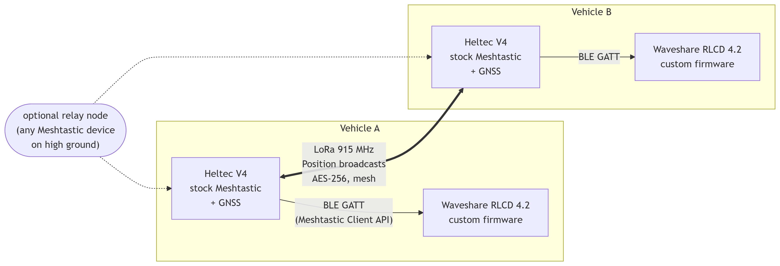
INTEGRATION CONSTRAINTS: THE LEDGER
OWNER: CANNON
Every constraint below was discovered on the bench or on the road, and each one shaped the design. None are theoretical.
TEST SEQUENCE: provision radio 2, bench two-radio decode, two-vehicle drive test, range characterization.
RADIO / PHY
GPS
BLE LINK
0.5 s airtime caps cadence at 10 s. Utilization under ~25%. No region, no transmit. Roof antenna is the biggest range factor.
Needs sky view; cold start takes minutes. Indoor multipath fakes phantom speed (deadbanded). Fix rate must match broadcast rate.
The radio advertises only at boot: power both units together. One client at a time; a phone or USB session steals the link.
DISPLAY
POWER
PROVISIONING
One-bit reflective panel: no grayscale, needs ambient light at night (edge light planned). 2 Hz redraw budget.
Cheap 12 V USB adapters cut off on low draw: validate every adapter.
Channel URL (the AES key) must match on every radio. Node IDs survive reflashes. Read back every write.
GROUP 9 | OFF-GRID VEHICLE TRACKER
INTEGRATION CONSTRAINTS
SHEET 12/14 REV C 2026-09-07
Notes:
Each card becomes a line item in the test protocol. The strength of this slide is provenance: phantom speed, the advertise-once trap, the charger cutoff, and the configuration revert were all found by us, on our hardware, and every one is documented in the repository with its fix.

Slide 13
WEEK 3 STATUS AND WHAT COMES NEXT
42%
78 h
12/12
10 s / 1 s
of tasks complete against a 19% week-three target
logged through week three
native unit tests passing
measurement cadence / on-screen motion
PROVEN END TO END THIS WEEK
NEXT, WEEKS 4 AND 5
GPS fix to arrow, end to end, at 10 s cadence with 1 Hz projected motion.
Position-derived clock, honest ages, ghost re-broadcasts detected.
The link reconnected itself after every drop, four drive tests running.
Full radio recovery drill: flash, provision, verify, in minutes.
Victor: provision radio two from the recipe; first two-radio bench decode.
Cannon: constraints ledger becomes the drive-test protocol and logging harness.
Deo and Josiah: partner selection in NVS; night readability.
Then the milestone: the first two-vehicle drive test.
One radio still talks to itself. But every layer between a GPS fix and the driver's arrow is now real, tested code. Radio number two turns this into a tracker.
GROUP 9 | OFF-GRID VEHICLE TRACKER
STATUS AND NEXT STEPS
SHEET 13/14 REV C 2026-09-07

Slide 14
REFERENCES
[1]
Semtech Corp., SX1276/77/78/79 LoRa Transceiver Datasheet. Demodulator SNR limit per spreading factor (SF11 = -17.5 dB), used on sheet 09.
[6]
FCC Rules, 47 CFR 15.247. Operation in the 902 to 928 MHz ISM band.
semtech.com/products/wireless-rf/lora-connect/sx1276
law.cornell.edu/cfr/text/47/15.247
[2]
Semtech Corp., AN1200.22, LoRa Modulation Basics. Symbol duration T_sym = 2^SF / BW, packet airtime, and processing gain.
[7]
ITU-R Recommendation M.1371, Automatic Identification System (AIS). Reporting intervals of 2 s to 3 min; the beacon-then-animate precedent.
info.semtech.com/find-documentation (search AN1200.22)
itu.int/rec/R-REC-M.1371/en
[3]
Semtech Corp., SX1261/2 Transceiver Datasheet. The radio IC on the Heltec V4; sensitivity and transmit specifications.
[8]
R. W. Sinnott, Virtues of the Haversine, Sky & Telescope, vol. 68, no. 2, p. 159, 1984. The distance formula used in nav.c.
semtech.com/products/wireless-rf/lora-connect/sx1262
movable-type.co.uk/scripts/latlong.html (implementation ref)
[4]
Meshtastic Project Documentation, LoRa and Position Configuration. Presets, smart broadcast, position precision, the ~25% utilization limit.
[9]
Bluetooth SIG, Bluetooth Core Specification (GATT). The service and characteristic model behind the Meshtastic Client API.
meshtastic.org/docs/configuration/radio/lora
bluetooth.com/specifications/specs/core-specification
[5]
Meshtastic Protobufs Repository. The published message schema our decoder is generated from, including Position field units.
[10]
Group 9 repository: TELECOM_ANALYSIS, ARCHITECTURE, BLE_LINK_WALKTHROUGH, RADIO_PHY_DEEP_DIVE, hardware/README. Our link budget, architecture, silicon walkthrough, and recipes.
github.com/meshtastic/protobufs
github.com/deosgracius/offgrid-vehicle-tracker
All firmware, documentation, logs, and this deck's generator are version controlled at github.com/deosgracius/offgrid-vehicle-tracker
GROUP 9 | OFF-GRID VEHICLE TRACKER
REFERENCES
SHEET 14/14 REV C 2026-09-07
Notes:
Leave this up during questions. If a number is challenged, the sources are: equations from Semtech [1][2], configuration behavior from Meshtastic docs [4], wire units from the protobuf schema itself [5], and the AIS precedent [7].

