Slide 1
WHAT BROKE, AND WHAT IT TAUGHT US
THE TEST AND FAILURE RECORD, AUGUST TO OCTOBER 2026
Ten root-caused failures, four field campaigns, and the rules each one left behind. Every entry here happened on this hardware and was reproduced or root-caused before it was written down. The New Mexico drive test will be added when it is complete.
Deo Grace Mwala
Josiah Horn
Victor Okwonna
Cannon Thomas
Sponsor: Dr. Richard Gale
October 2026
GROUP 9 | OFF-GRID VEHICLE TRACKER
TESTS AND FAILURES
SHEET 01/18 REV A 2026-10-24
Notes:
Open with the thesis: a system is only as deployable as its failures are diagnosable. This deck is the evidence that ours are.

Slide 2
WHY THE FAILURES ARE THE DELIVERABLE
A FAILURE IS ONLY USEFUL ONCE IT HAS A SIGNATURE
Every entry in our catalog records the symptom, the root cause, and the recovery, so the next person recognizes it in minutes, not days. A failure that was merely survived is a failure that will happen again; one with a written signature is a test case.
EACH FAILURE PRODUCED A RULE OR A FEATURE
Pre-flight checks, cadence-aware alarms, the course-up compass, the config snapshot, the LINK LOST alarm: none were in the original plan. All came from something breaking on a bench, on a road, or on a canyon rim, and all are now in the manuals.
FIELD EQUIPMENT FAILS BETWEEN OUTINGS
The question is never whether; it is whether the team can diagnose it on a canyon rim with a phone. Three of ten failures struck the night before a test, and every one was cleared in time because the signature had already been written down.
GROUP 9 | OFF-GRID VEHICLE TRACKER
PART I - THE FAILURES
SHEET 02/18 REV A 2026-10-24
Notes:
Set expectations: this is not a list of embarrassments, it is the verification record of a system that is honest about itself. Ten failures, ten rules.

Slide 3
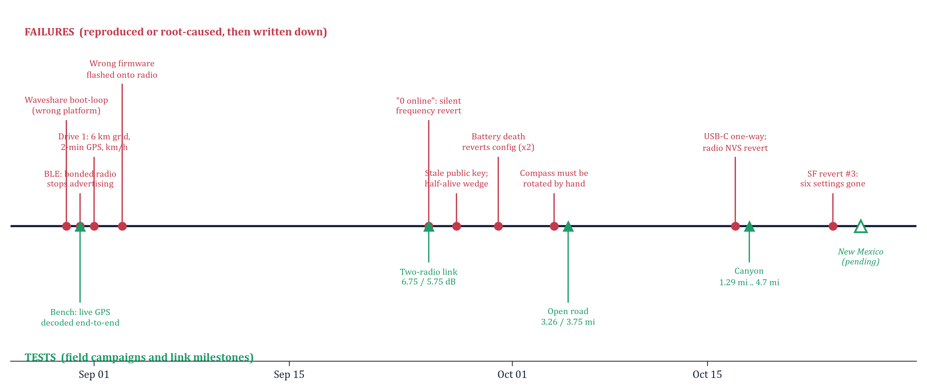
THE SEMESTER ON ONE LINE
RED: FAILURES, ROOT-CAUSED. GREEN: TESTS. THE HOLLOW TRIANGLE IS NEW MEXICO, PENDING.
GROUP 9 | OFF-GRID VEHICLE TRACKER
PART I - THE FAILURES
SHEET 03/18 REV A 2026-10-24
Notes:
Walk it left to right. Note how failures cluster right before tests - and how the same villain, battery death, returns three times.

Slide 4
FAILURES 1-3: BRING-UP, AUGUST 30-31
OWNER: DEO
1. THE DISPLAY BOOT-LOOPED SILENTLY
The official espressif32 platform (Arduino core 2.x) boot-loops this panel's chip revision. Fix: the pioarduino platform, dio_opi memory, dio flash mode. One full day to find.
2. A BONDED RADIO GOES INVISIBLE
Store a BLE bond and the Meshtastic radio stops advertising to everyone, including its own peer. Fix: pair Just-Works on every connect, never store a bond, never deleteAllBonds() at boot.
3. PIN PAIRING REJECTED US
Default RANDOM_PIN mode fails our keypad-less display (SM confirm mismatch, rc=1284). Fix: radios run NO_PIN. This same setting is what reverts in failures 8 and 10.
WHAT THEY BOUGHT
The BLE link state machine with exactly one recovery path (any failure tears down to SCANNING), the ignition-on product flow, and the first entries of the scar catalog. The display has never wedged since.
GROUP 9 | OFF-GRID VEHICLE TRACKER
PART I - THE FAILURES
SHEET 04/18 REV A 2026-10-24
Notes:
Day one. None of these were in any datasheet. The boot-loop alone cost a day and taught us to trust the vendor's ESP-IDF config over its Arduino screenshot.

Slide 5
FAILURE 4: THE FIRST DRIVE TEST, SEPTEMBER 1
OWNER: JOSIAH
Symptom on the road | Root cause | Fix
Partner position frozen on a 6 km grid | Channel default position_precision = 13 truncates every broadcast | Precision 32 (full) on the channel
~4 minutes of apparent latency | gps_update_interval default 120 s: fresh fixes only every two minutes | GPS interval 10 s, broadcast 10 s moving
Speeds wildly wrong | Position.ground_speed is km/h on the wire, not m/s | Decoder converts; display shows mph
Parked car shows 1-3 mph | GPS jitter reported as speed | 4.5 km/h deadband in the node table
Clock an hour off | West Texas is Central time; the CT/MT line is not at -97.5 | Timezone bands carried to the TX/NM border
The lesson that outlived the fixes: windowsill tests cannot find any of these. Smart broadcast, GPS refresh, precision quantization and speed units only show while actually driving. Every later feature was validated on the road.
GROUP 9 | OFF-GRID VEHICLE TRACKER
PART I - THE FAILURES
SHEET 05/18 REV A 2026-10-24
Notes:
Five faults, one drive. Every one invisible on the bench. This is why we drove six more times.

Slide 6
FAILURES 5-6: WRONG FLASH, LYING CLI (SEP 3)
OWNER: DEO
5. DISPLAY FIRMWARE FLASHED ONTO A RADIO
Both boards share USB ID 303A:1001; an auto-picked COM port put our firmware on the Heltec and erased Meshtastic. Seeing display logs proved nothing about WHICH board was flashed. Recovery: esptool erase, factory image, full re-provision. The node number survives (MAC-derived), so the display reconnected unchanged.
6. A CONFIG WRITE THAT SILENTLY REVERTED
The CLI's port-close toggles DTR/RTS, hard-resetting the ESP32 mid-save. The write 'succeeds'; the next read shows the old value. Reboot-triggering settings (region, Bluetooth mode) are the usual victims, and nothing on the radio's screen changes.
RULES THAT CAME OUT OF IT
Identify every board by its MAC (SER=) before touching it - never let a tool pick the port. Verify every config write by read-back AND on the radio's own screen. For stubborn values, use the Python API holding the port open. Both rules are now steps in the manual's flashing procedure.
GROUP 9 | OFF-GRID VEHICLE TRACKER
PART I - THE FAILURES
SHEET 06/18 REV A 2026-10-24
Notes:
The identity rule and the verification rule. Both sound obvious; both were learned by losing a radio for an afternoon.

Slide 7
FAILURE 7: "0 ONLINE", SAME CONFIGS (SEP 25)
OWNER: VICTOR
THE SYMPTOM
Two radios, same key, every config read-back identical, zero channel utilization, traceroute MAX_RETRANSMIT - total mutual silence. Every instrument said RF failure, and both radios' screens looked perfectly healthy.
THE ROOT CAUSE
Meshtastic derives the frequency from a hash of the channel name: slot = djb2(name) mod 104. One channel write had silently reverted, so one radio sat on the public slot (906.875 MHz) and the other on Group9's slot 43 (912.875). Same key, different frequencies: nothing couples.
THE TWO-SECOND PRE-FLIGHT THAT CAME OUT OF IT
Both OLED LoRa screens must read 912.875 MHz before any test or drive.
The screen is ground truth. The CLI can read back the intended config while the radio still radiates on the old slot.
GROUP 9 | OFF-GRID VEHICLE TRACKER
PART I - THE FAILURES
SHEET 07/18 REV A 2026-10-24
Notes:
Idea 2 of the project - the name IS the frequency - was learned here. The debug ladder: config diff, matched-power tests, traceroute, regression on the default channel, then the hash math exposed the slot mismatch.

Slide 8
FAILURES 8-10: BATTERY DEATH REVERTS CONFIG
OWNER: DEO
Date | Radio | What reverted | How it was found
Sep 30 | Both | RG: channels. SF: everything (channel, role, Bluetooth, telemetry, owner) | Healthy screens, total silence; peer missing from node tables
Oct 17 | SF (EA:D4) | Bluetooth mode, channel (906.875), owner name | Display looping: encrypted=1 bonded=0, write rc=261, disconnect 534
Oct 24 | SF (EA:D4) | Channel + key, precision, Bluetooth, cadence, owner, canned messages, node DB | Routine diagnostic before the New Mexico test; role survived
MECHANISM - MITIGATED, NOT FIXED
A brownout mid-write corrupts the config records in flash; at the next boot the firmware substitutes compiled-in defaults and saves them. This happens inside stock Meshtastic, which we do not fork, so we cannot prevent it. What we did is make it cheap: detectable in seconds and recoverable in a minute, without a laptop reflash.
THE MITIGATION STACK
Detect in 2 s: the OLED pre-flight. Recover in 90 s: a full config snapshot per radio (--export-config / --configure) replaces the four-command recipe; the phone app's channel QR is the no-laptop path. Rule: re-run the WHOLE block, reverts come in batches. Never store a radio flat.
GROUP 9 | OFF-GRID VEHICLE TRACKER
PART I - THE FAILURES
SHEET 08/18 REV A 2026-10-24
Notes:
Be precise on stage: this is mitigated, not fixed. The corruption lives in the vendor firmware. Our contribution is that it went from a lost test morning to a non-event.

Slide 9
FAILURE 9: THE HAND-ROTATED COMPASS (OCT 4)
OWNER: JOSIAH
THE SYMPTOM
North-up ring at night: to read the arrow against the road the driver physically turned the unit - at which point nothing on it could be read. And the staleness cue alarmed at 59 s of perfectly normal silence from a parked partner.
THE FIX, SHIPPED THE NEXT DAY
Course-up compass: the top of the ring is always straight ahead, cardinals rotate with the car, a nose mark at 12 o'clock, directions in clock positions. Cadence-aware staleness: 30 s for a moving partner, 90 s for a parked one.
WHY IT BELONGS IN A FAILURE DECK
Neither change was a bug fix; both were design errors that only a real drive at night could expose. They were validated on the road the next day (dart at 12 o'clock at 37 mph) and have carried every test since. The honest-display philosophy was tested here first: a cue that cries wolf is as dishonest as one that stays silent.
GROUP 9 | OFF-GRID VEHICLE TRACKER
PART I - THE FAILURES
SHEET 09/18 REV A 2026-10-24
Notes:
The user-experience failures. Thirty seconds of night footage redesigned the main screen.

Slide 10
FAILURE 10: THE NIGHT BEFORE THE CANYON (OCT 17)
OWNER: DEO
DISPLAY 1 "DEAD"
Actually fine. Power banks shut off under the display's milliwatt draw, and a reflective screen in a dim room reads as off. Flashlight test first.
DISPLAY 2 HALF-DEAD USB-C
Powers in ONE plug orientation - damaged pins on one side. A coin-flip failure on every plug-in. Marked the working orientation; a repair item.
RADIO EA:D4 REVERTED
A week idle, battery flat: Bluetooth mode, channel and name gone. The display's serial log named it in one line: write status 261, insufficient authentication.
DISPLAY SERIAL LOG - THE SIGNATURE
[ble] auth complete: encrypted=1 bonded=0
Write complete; status=261 <- insufficient authentication: radio not in NO_PIN
[ble] want_config write failed
[ble] disconnected (reason 534) <- our side hung up, by design, to retry
GROUP 9 | OFF-GRID VEHICLE TRACKER
PART I - THE FAILURES
SHEET 10/18 REV A 2026-10-24
Notes:
Three independent faults in one evening, diagnosed in forty minutes because every one had a written signature. The test ran the next morning.

Slide 11
EVERY FAILURE BECAME A RULE
Failure | Rule or feature it produced | Where it lives now
Boot-loop | pioarduino + dio_opi; vendor IDF config is ground truth | platformio.ini, manual 14
Bonded radio invisible | Just-Works pairing, no stored bond, one teardown path | ble_link.cpp, manual 8
First-drive faults | Precision 32, 10 s GPS, km/h decode, deadband; validate on the road | Provisioning recipe, node_table.cpp
Wrong flash | Identify by MAC before any upload; never auto-pick a port | Manual 14.2 fleet table
Lying CLI | Read back every write; the OLED outranks the CLI | Manual 16, entry 6
Silent frequency revert | Pre-flight: both OLEDs read 912.875 | User guide 3, manual 7
Battery death reverts | Config snapshots; re-run the whole block; never store flat | hardware/*-config.yaml
Hand-rotated compass | Course-up compass; cadence-aware staleness | ui_render.cpp, manual 9
Night before the canyon | Flashlight test, plug orientation, the 261 signature | Manual 16, entries 9-10
GROUP 9 | OFF-GRID VEHICLE TRACKER
PART I - THE FAILURES
SHEET 11/18 REV A 2026-10-24
Notes:
The point of the deck in one table: ten failures, ten rules, every rule with an address in the codebase or the manual.

Slide 12
THE TEST CAMPAIGNS SO FAR
OWNER: CANNON
Date | Campaign | Environment | Key result
Aug 31 | Bench, end-to-end | Desk | Live GPS decoded radio-to-display; link held across the room
Sep 1 | First drive | Town | Pipeline works at speed; five faults found (sheet 5)
Sep 25 | Two-radio link | Desk | Round-trip traceroute 6.75 / 5.75 dB after the slot fix
Oct 4 | Night convoy drive | Town | Stale onset ~0.5 mi; course-up and cadence-aware cue born
Oct 5 | Open-road range | Flat farm road | Full tracking to 3.26 mi; stale edge 3.75 mi; auto-reacquisition
Oct 18 | Canyon range | Ceta Canyon | Stale from 1.29 mi; packet at 4.28; 7-min outage healed; rim antenna 4.7 mi
pending | New Mexico maximum | Open highway | Prediction: beats 3.75 mi - to be added
GROUP 9 | OFF-GRID VEHICLE TRACKER
PART II - THE TESTS
SHEET 12/18 REV A 2026-10-24
Notes:
Seven campaigns. Each one found something the previous one could not. The last row is reserved.

Slide 13
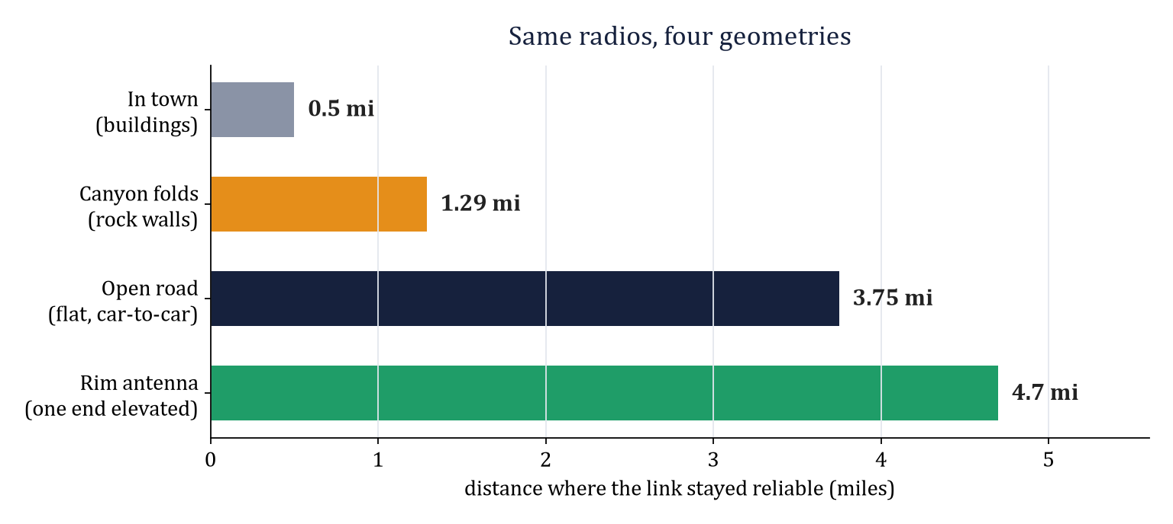
WHAT THE RANGE TESTS MEASURED
SAME RADIOS, FOUR GEOMETRIES: 0.5 MI TO 4.7 MI. TERRAIN AND ANTENNA HEIGHT SET THE RANGE, NOT THE HARDWARE.
GROUP 9 | OFF-GRID VEHICLE TRACKER
PART II - THE TESTS
SHEET 13/18 REV A 2026-10-24
Notes:
The measured envelope. Every bar is a different day, same two radios, same settings - verified by post-test audit.

Slide 14
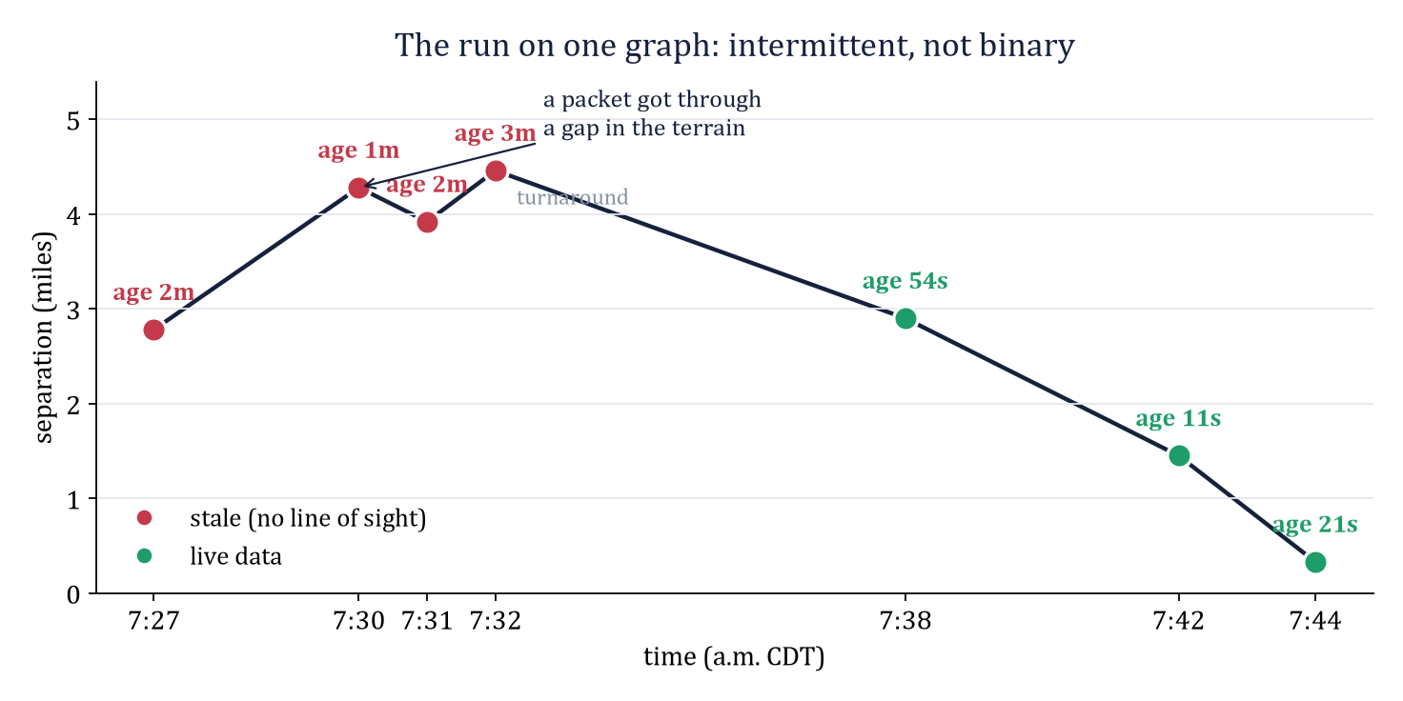
THE HARDEST TEST: CETA CANYON, OCTOBER 18
WHAT IT PROVED
Behind rock the link is intermittent at any distance: stale from 1.29 mi, yet a packet landed at 4.28 mi through a gap. The longest silence ran seven minutes and was healed by one packet with no operator action. Both radios audited clean afterward: terrain, not hardware. The rim antenna held 4.7 mi - the quantitative case for the repeater.
GROUP 9 | OFF-GRID VEHICLE TRACKER
PART II - THE TESTS
SHEET 14/18 REV A 2026-10-24
Notes:
Red stale, green live. The 7:30 age reset is the finding: intermittent, not binary.

Slide 15
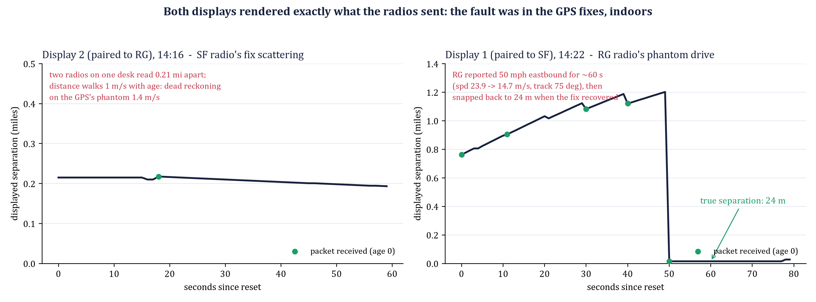
PRE-DRIVE DIAGNOSTIC, OCT 24: THE DISPLAYS
OWNER: DEO
WHAT THE SERIAL LOGS PROVED
Both displays booted clean, paired in under 8 s (encrypted=1 bonded=0, every config write status 0), completed the config dump, built the correct node table (SF/RG), and held the link at heartbeat state 3 with zero rescans. Display 1 again needed a USB-C plug flip before it enumerated.
THE OBSERVATION: 0.21 MI BETWEEN TWO RADIOS ON ONE DESK
The displays were right and the GPS fixes were wrong. Indoors, SF's fix scattered 100 to 400 m between packets with 1.4 m/s of phantom speed; RG later reported a coherent 50 mph eastbound drive for a minute before snapping home. A marginal fix produces fake velocity, not just jitter, and dead reckoning faithfully projects it. Fixes shipped the same hour: the closing/apart line reads "holding" when both cars are parked; the distance stays honest. Rule: judge a bench distance only with sky view.
GROUP 9 | OFF-GRID VEHICLE TRACKER
PART II - THE TESTS
SHEET 15/18 REV A 2026-10-24
Notes:
This is the display track's own verification record: the links and the firmware were fine; the data they rendered was bad because the radios' GPS receivers were indoors. The graph is parsed straight from the archived serial logs.

Slide 16
PRE-DRIVE DIAGNOSTIC, OCT 24: THE RADIOS
OWNER: DEO
Check | SF (EA:D4) | RG (BB:5C)
Channel 0 | Group9, 32-byte key, precision 32 | Group9, 32-byte key, precision 32
Role / Bluetooth | CLIENT_MUTE / No PIN | CLIENT_MUTE / No PIN
Position cadence | 60 s, smart 10 s / 20 m, GPS 10 s | 60 s, smart 10 s / 20 m, GPS 10 s
Telemetry heartbeat | was OFF (leftover of the morning revert): set to 300 s | 300 s
Owner | SF / SF | was "Meshtastic bb5c": set to RG / RG
Battery | 96 % (4.15 V) | 69 % (3.88 V): charge before the drive
Own GPS, indoors | fix at 14:27, alt 1398 m | no fix: the radio that showed the phantom drive
Heard the partner | RG 1.1 min ago, 6.25 dB | SF 0.6 min ago, 6.5 dB
OLED LoRa screen | 912.875 MHz | 912.875 MHz
RESULT
Both radios fully provisioned and in agreement; link at the September figure (~6.5 dB); config snapshots re-exported. Both displays showed the link on the first power-cycle after unplugging.
GROUP 9 | OFF-GRID VEHICLE TRACKER
PART II - THE TESTS
SHEET 16/18 REV A 2026-10-24
Notes:
Same diagnostic as the morning's, run on both radios at 14:27 before the New Mexico drive. Two leftovers corrected and read back.

Slide 17
NEW MEXICO MAXIMUM-RANGE TEST - RESULTS PENDING
OWNER: VICTOR
EXPERIMENT A - TO BE COMPLETED
Flat highway, clear Fresnel zone, drive until the catches stop. Prediction written before the test: beats the 3.75 mi flat-ground edge; with any elevation on one end, approaches the 4.7 mi rim figure or better.
Measurement | Open road (10-05) | Canyon (10-18) | New Mexico
Full-health range | 3.26 mi | 4.7 mi (rim LOS) | ____
First staleness | 3.75 mi | 1.29 mi | ____
Longest silence | ~2 min | 7 min | ____
Reacquired by (inbound) | 0.85 mi | 2.90 mi | ____
Pre-test audit | clean | clean | SF re-provisioned 10-24 after revert
GROUP 9 | OFF-GRID VEHICLE TRACKER
PART II - THE TESTS
SHEET 17/18 REV A 2026-10-24
Notes:
Reserved sheet. Fill the right-hand column from the screen footage when the drive is done; the pre-test audit row is already true.

Slide 18
WHAT THE FAILURES BOUGHT
10
10
0
root-caused failures, each with a written signature and recovery
rules or features that exist only because something broke
reflashes needed for any configuration failure - all are re-provisioning
90 s
2 s
4.7 mi
to recover a fully reverted radio today, versus a lost morning in September
pre-flight check that would have caught every field-day failure so far
measured reach, with the honest envelope 0.5-4.7 mi by terrain
EVERY FAILURE BECAME A RULE; EVERY RULE BECAME A TEST.
GROUP 9 | OFF-GRID VEHICLE TRACKER
PART II - THE TESTS
SHEET 18/18 REV A 2026-10-24
Notes:
Close on the numbers. The system is not one that never fails; it is one whose failures name themselves.

