Slide 1

VA API Governance
Discovery Readout
Leanna Miller
Project Manager
Lauryl Zenobi
UX Researcher
July 12, 2018

Slide 2
Problem statement
How might we build an authorization framework that is
Easy for outside developers to integrate with
Easy for Veterans to control access to their data
Easy for us to maintain over time
Allows for flexibility as standards and technology change?
Insulates API owners from the implementation details of end-user authorization
Based on where we felt we could be most effective, we focused on product-centered questions:
How could you make authorization the best experience possible for end users? And how can you ensure that the apps using our APIs do the same?
Notes:
TO VALIDATE
Sit in as much as possible, Collaborate as much as possible
Deliverables
Discovery Readout
Strategy Document
Template for repeating
Output list - API use/need matrix
As the Lighthouse Product Owner, I must have a repeatable process to communicate with internal and external stakeholders the availability of existing, new, and future APIs so that the information can be consumed for the benefit of the Veteran. This outreach/evangelism effort may be different depending on the API type.

Slide 3
Methodology
Five user research interviews
API consumers
API providers
Public sector APIs
Industry research for best practices
Public and private sector APIs
Very high number of conversations given the short time frame of this project = excellent data set
Notes:
Short projects like this might only get a few exploratory conversations, we had five. That, in combination with our industry research for best practices = we got a very rich data set to draw from

Slide 4
Best authorization practices
for end users

Slide 5
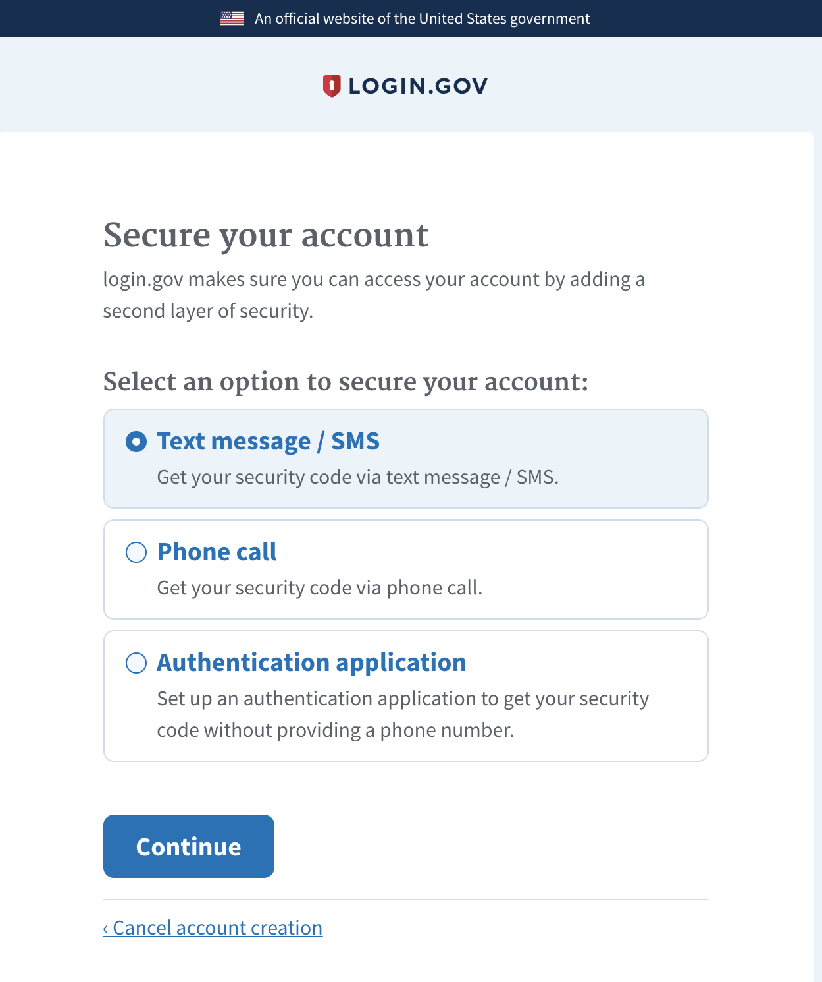
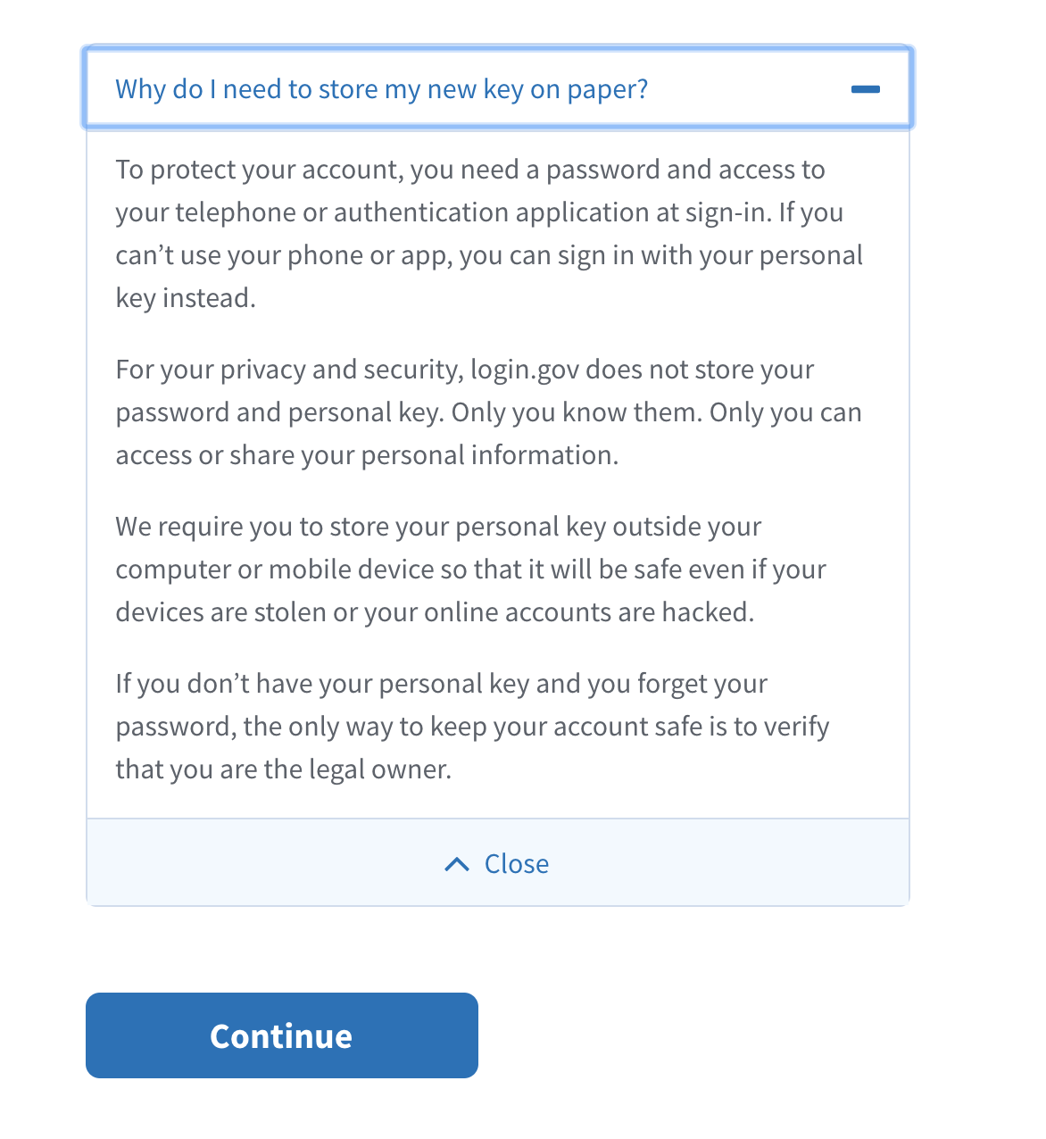
Provide multiple 2FA options and explain when necessary why these security features are in place
Be intentional about when you require 2FA/MFA

Slide 6
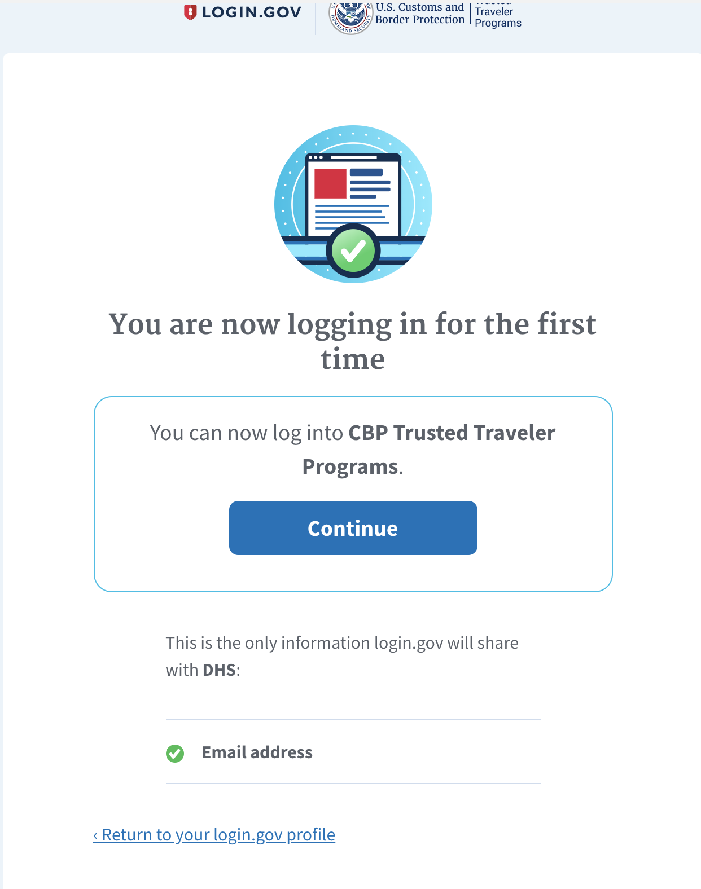
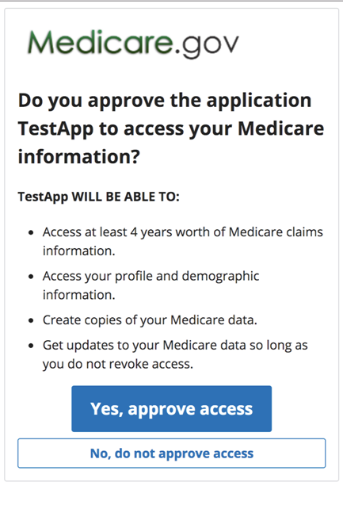
Make it obvious what data is being shared when authorizing third party applications

Slide 7
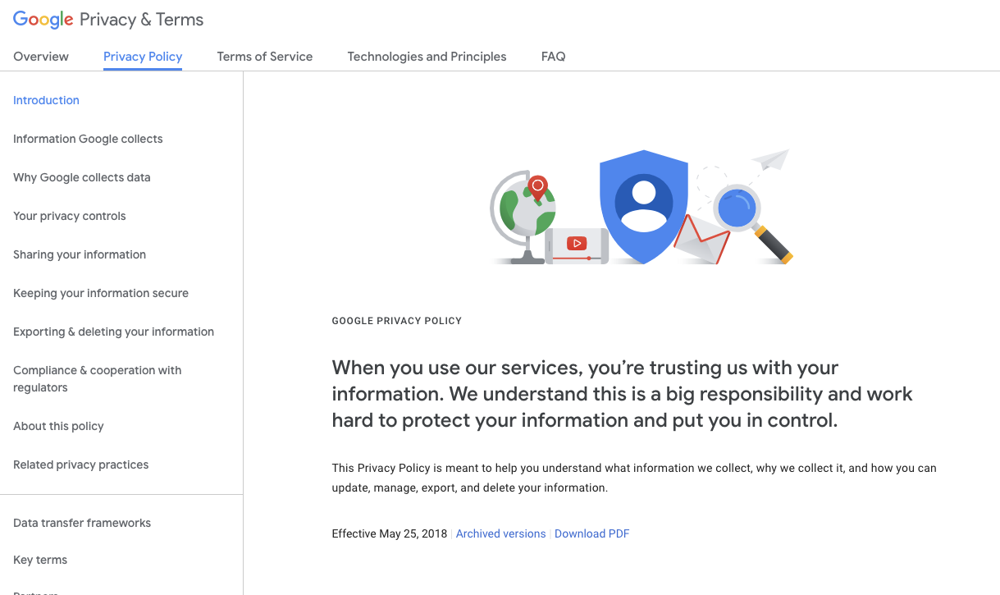
Use plain language in privacy policies and terms of service
Call out important pieces in a summary and add detail below

Slide 8
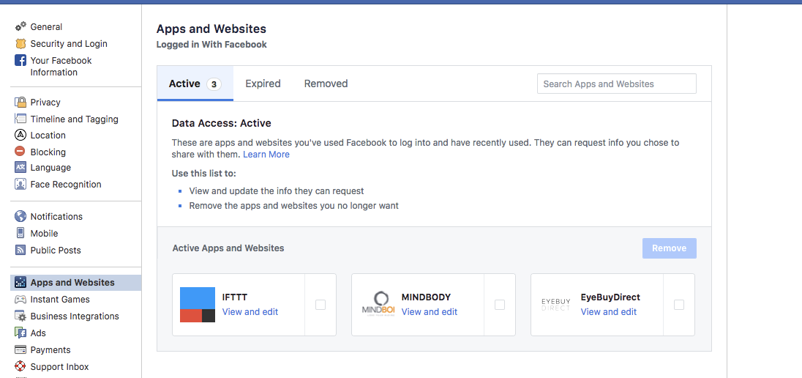
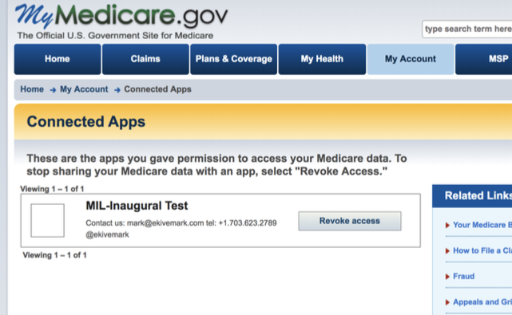
Allow a user to easily see who has access to their information

Slide 9
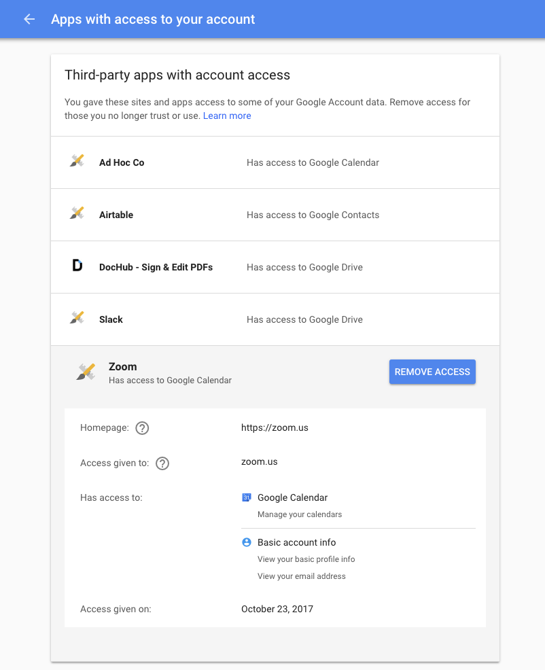
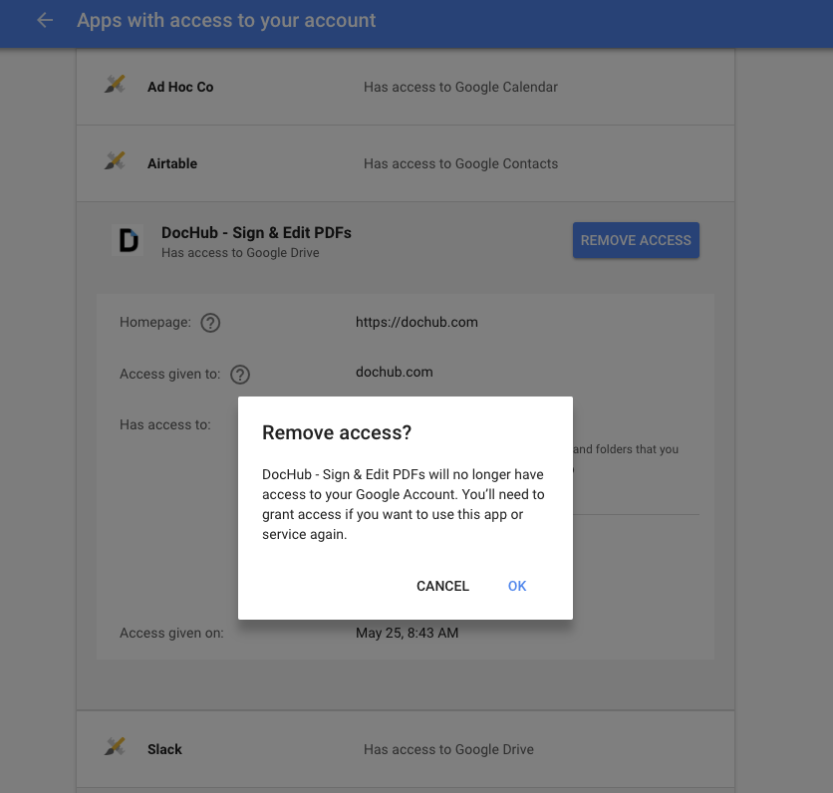
Allow a user to easily revoke a third party’s access to their information

Slide 10
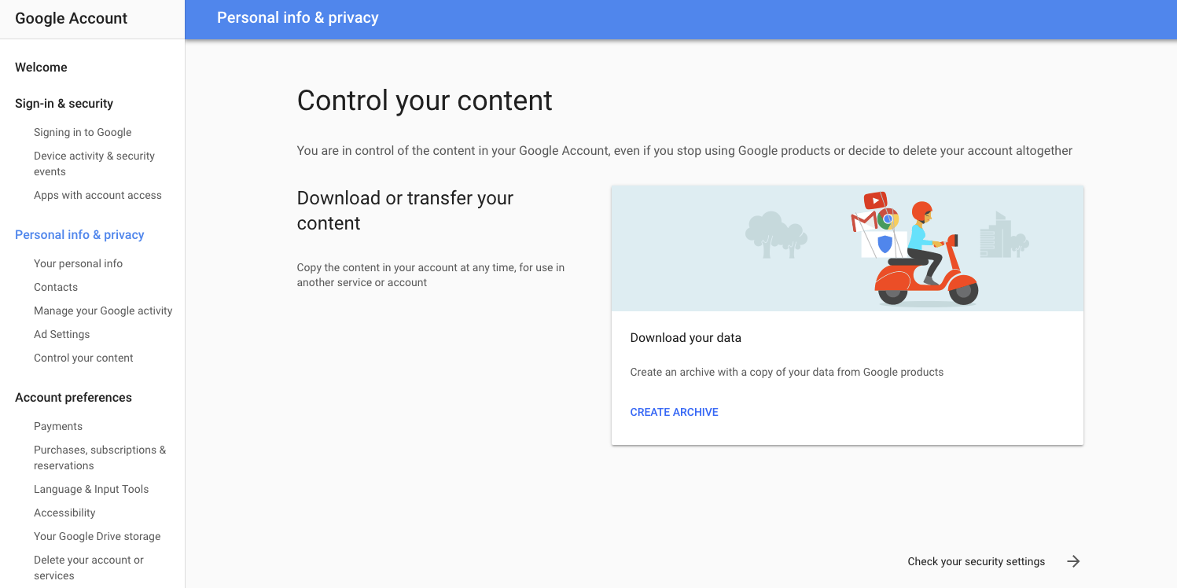
Allow a user to access all their data associated with an account

Slide 11
Authorization API best practices

Slide 12
When building APIs with authorization...
Use established and tested technical standards
Provide high quality documentation, and put it in the API docs instead of in a privacy policy at the bottom that no one reads
Refine the approach over time
Provide self service options as much as possible but be prepared for white glove support, especially in the beginning
Require and reinforce best security and privacy practices for API consumers dealing with PII; apply the standards where they’re needed
Notes:
TO VALIDATE
Sit in as much as possible, Collaborate as much as possible
Deliverables
Discovery Readout
Strategy Document
Template for repeating
Output list - API use/need matrix
As the Lighthouse Product Owner, I must have a repeatable process to communicate with internal and external stakeholders the availability of existing, new, and future APIs so that the information can be consumed for the benefit of the Veteran. This outreach/evangelism effort may be different depending on the API type.

Slide 13
Provide comprehensive documentation about authorization
“I think bad documentation would be documentation that excludes steps….Bad documentation would be, I make the first call, it gives me a peace to authentication, but they don't list what I need to do next to get the next piece of authentication...As long as all the steps are there and defined and I know exactly what I need to call, what information I need to pass, I think the documentation is good.”

Slide 14
Protect end user privacy and maintain high security standards
“Each agency can request what attributes they want to receive. But, if an agency wants to use SSN, but they only have a LOA1, we won’t allow that. LOA3 attributes are first name, last name, address, SSN, driver's license. We maintain that information in our database encrypted...If you request an account deletion, we won’t do it right away, we send an email, wait 24 hr, etc, in the instance it’s a malicious users.”
“We have a demo meeting with the customer, they walk us through the application, and then we ask them questions about privacy policy/terms of service, how they handle security and data breaches. “

Slide 15
Reinforce best practices amongst consumers
“So if an agency wants to integrate with us they need to have best practices, good documentation, and plan with us in advance, documenting questions people could be asking.”

Slide 16
Recommended next steps
Evaluate other APIs that share PII to develop processes to manage compliance over time
Design and test lightweight prototypes for users to grant, revoke, or review permissions they’ve granted for their data
Continue to perform user research with API consumers so we can refine the tools we provide for integration
Technical discovery to ensure our authorization framework with future flexibility in mind
Simplify and streamline API Playbook
Notes:
TO VALIDATE
Sit in as much as possible, Collaborate as much as possible
Deliverables
Discovery Readout
Strategy Document
Template for repeating
Output list - API use/need matrix
As the Lighthouse Product Owner, I must have a repeatable process to communicate with internal and external stakeholders the availability of existing, new, and future APIs so that the information can be consumed for the benefit of the Veteran. This outreach/evangelism effort may be different depending on the API type.

Slide 17
General best practices

Slide 18
Provide self-service options to developers as much as possible
“They have since done a whole new dashboard where you can kind of go in and see what configurations you have out there and you can actually add the configurations yourself instead of going through them. So that helped out a lot.”

Slide 19
Use past experiences of end user results to inform decisions when implementing with a new consumer
“I would say they were able to provide us guidance based on previous projects. They had just gone through [integration with] Global Entry and working with them so they were able to tell us, you know, kind of use that as a use case and say, well, in that case we would advise because of our experience, they're not to do this and maybe try this other thing.”

Slide 20
Provide open lines of communication about releases to API customers
“If we had known a delete account feature was coming up a relatively soon, you know, maybe a couple months out, then we could have had a lot of discussions on that and see what changes we want to make on our side to meet that new feature that being implemented…”
“I think because of that change [releasing a new feature] we asked for more advanced notice of what changes they're making because we were sort of getting them like the morning of.”

Slide 21
Provide versioning of APIs.
Versioning standards allow for easier integration and future development
“..typically an API would follow a versioning best practice where there would be a version endpoint that was stable so that all the groups using that API could develop against it and you know, sort of have their flexibility to do what they needed to do. But then also giving the team who's developing that API, the ability to develop the next version independently of all of the groups using the API.”

Slide 22
Embed provider team members if possible during API integration
“They [login.gov team] did provide .. a designer to work with who had worked for awhile on their interface. They could answer questions about the design decisions they made there, as well as help vet our designs for possible problems. He was just a really great reference for my team and myself… to bounce ideas off of and to ask questions… He was a guest in our slack and vice versa….So we were able to get fairly immediate answers when we are in the design phase.”

Slide 23
Give consumers data on use cases that help sell reluctant state holders on the value of integrating with your API
“We've mostly tried to answer from our perspective: this is the benefits and this is what it's costing us today and what have you. But they [login.gov team] actually did help quite a bit with convincing folks this [integrating with their API] is the right way to go.”

