Slide 1
IBM Federal Mobile Blue Button+
MetLife TechJam for VA

Slide 2
Team Members
Ben Fletcher Watson Research Lab
James Jong RTP Lab / Cordova
Parker Behseta IBM Federal WebSphere Engineer
Bhargav Parepa IBM Federal WebSphere Architect
Ritesh Saxena IBM Federal Architect for VA & DHA
Tom Carey IBM Architect for MetLife
Mark Smith IBM Federal Manager

Slide 3
Solution Overview
Mobility
  Write once run on many, Open Standards
  Responsive design
Security
  FIPS 140-2, NIST certified AES 256 Cryptography
  End-to-end Data Encryption
Consumability
  Vitals info available for First Responders
  Medication data and drug interaction lookup
Futures
  Platform is designed for Blue Button+
  Care Plans, Updates, Rules, Watson, etc.

Slide 4

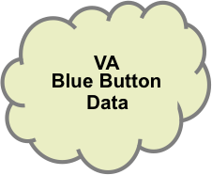
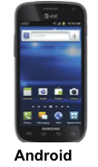

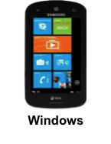

Solution Architecture
To streamlined, transparent access
Worklight transforms enterprise data into
mobile-friendly, JSON format
Worklight Server manages caching, data
synchronization and end-to-end encryption
Apple
JSON
WORKLIGHT
SERVER
BlueButton DIRECT
BlueButton
JSON SYNC
SMTP PUSH
PULL
Worklight Adaptors
HTTPS/FIPS
data
CAST IRON
JSON
JSON
JSON
Encrypted
JSON
BB data
parsed
XML=>JSON
JSON

Slide 5
Demo

