Slide 1
The Algorithm
Automatic Case Distribution
Caseflow
Updated - February 24, 2021

Slide 2
Table of Contents
Overview
Definitions
Algorithm (simplified) Steps
Calculations
Example
Distribution data for FY 2021 to date
Levers

Slide 3
Overview
Before AMA, there was a single docket, and cases could be distributed by hand
AMA added 3 additional dockets: direct review, evidence submission and hearing
Problem: How do we distribute cases to judges under AMA?
Goals
Clear the legacy inventory
Meet the Direct Review docket timeliness goal
Proportionally distribute cases from other dockets
To handle the new complexity, the Caseflow team created the automatic case distribution algorithm
Algorithm: A set of step-by-step instructions to solve a problem

Slide 4
Definitions
Priority case: A case is considered a priority if it is:
AOD
post-CAVC
Tied to a judge: A case is considered “tied to a judge” if there is a specific judge who must receive it.
A legacy case with a hearing must be decided by the same judge who held the hearing
AOD post-remands are associated with the judge who previously issued a remand
General population (genpop): A case that is not tied to a judge (can be distributed to anyone)
Ready to be distributed: A case where all tasks that must be completed before a decision is written have been completed
Notes:
Examples of blocking tasks: CongressionalInterest, ExtensionRequest, FOIA, if Hearing is open that will block, privacy complaint, transcription, translation, POAmailtask
Follow legal requirements, don’t want to disrupt workflows that have already began

Slide 5
Overview
There are two ways VLJs receive cases:
Priority Push Distribution
Automatic Case Distribution

Slide 6
Priority Push Distribution
Launched in September 2020
Distributes priority appeals to available VLJs automatically every Monday at 8am ET
Step | Description
1 | Distribute priority cases that are tied to a VLJ without limit
2 | Distribute priority cases that are general population Distributes appeals evenly across VLJs over the course of a month
Notes:
Code: https://github.com/department-of-veterans-affairs/caseflow/blob/master/app/jobs/push_priority_appeals_to_judges_job.rb
Priority push distributions was added to Caseflow in September 2020. With the goal of clearing priority case inventory on a timely basis, the priority case distribution:
Distributes appeals to available VLJs automatically every Monday at 8am EST
Distributes the appeals evenly across VLJs over the course of a month
Distributes cases without limit to VLJs

Slide 7
Automatic Case Distribution
When a judge requests cases… what happens underneath the hood?

Slide 8
Calculations
Batch size: The number of cases the judge receives when they order cases
# Attorneys X 3 cases per attorney
Total Batch Size: If every judge tried to distribute cases at the same time, this is the maximum # of cases we need to distribute
Total # Attorneys X 3 cases per attorney
Priority Target: Target percentage of priority cases in this distribution
# Priority Cases / Total Batch Size
Ensures priority cases are distributed evenly amongst judges

Slide 9
Algorithm (high-level)
Step | Description
0 | Priority push distribution runs every Monday
1 | If there are priority cases available, distribute priority cases that are tied to the judge Priority Legacy cases tied to the judge Priority AMA Hearing cases with affinity for the judge
2 | Distribute non-priority cases tied to the judge Legacy hearing cases AMA hearing cases with affinity for the judge
3 | If there are priority cases available, distribute priority cases that are general population Distribute priority cases from any docket (first-in, first-out) to meet the priority target (if not yet met)
4 | Distribute non-priority cases that are general population based on docket proportions
Notes:
Note that this does not include the priority case distributions via push feature that was added to Caseflow in September 2020. With the goal of clearing priority case inventory on a timely basis, the priority case distribution:
Distributes appeals to available VLJs automatically every Monday at 8am EST
Distributes the appeals evenly across VLJs over the course of a month
Distributes cases without limit to VLJs

Slide 10
Algorithm (high-level)
Example
Batch Size = 20
Priority Target = 25% = 5 cases
Step | Description
1 | Distribute priority cases that are tied to the judge Priority Legacy cases tied to the judge Priority AMA Hearing cases with affinity for the judge
2 | Distribute non-priority cases tied to the judge Legacy hearing cases AMA hearing cases with affinity for the judge
3 | Distribute priority cases that are general population Distribute priority cases from any docket (first-in, first-out) to meet the priority target (if not yet met)
4 | Distribute non-priority cases that are general population based on docket proportions (using stochastic rounding)
Remaining
Priority + Tied to Judge
3 cases
17 cases
Non-Priority + Tied to Judge
5 cases
12 cases
Priority + Genpop
2 cases
10 cases
Legacy: 8 cases
2 cases
Direct Review: 2 cases
0 cases
Evidence Submission: 0
Stop
Hearing: 0

Slide 11
FY 2021 Data: Oct 1, 2020 - Feb 23, 2021
Total number of cases distributed: 34,454
Docket | Number of Cases | Percentage
Legacy | 24,265* | 70.4%
Direct Review | 7,674 | 22.3%
Evidence Submission | 1,389 | 4.0%
Hearing | 1,126 | 3.3%
* Of the legacy cases, 66% were tied to a VLJ
Notes:
Reference dashboard - https://query.prod.appeals.va.gov/dashboard/7
Legacy breakdown
- Tied to judge: 66% - 16, 028. General population: 34% - 8,378
- Priority: 51%, Non priority: 49%
Overall breakdown
Priority (AOD, post-CAVC remands): 44% (15,173)
Tied to a judge: 48.1% (16,586)
AOD:
Veteran is 75+
Terminal illness
Severe financial or emotional distress
No differentiation within priority cases, they’re all prioritized to the same degree
Non General population - Tied to a Judge
Legacy hearings must be decided by judge who held hearing
AOD post CAVC-remands must go to the same judge who issued the remand
AMA hearing is preferred to go to judge who held it
If Judge no longer works at the Board, Veteran must file a motion to waive right

Slide 12
Levers
Lever | Current Setting
Batch size per attorney | 3
Direct review timeliness goal | 365 days from receipt date
Direct review distribution due date | Timeliness Goal - 65 days
Minimum legacy docket proportion | 10%
Maximum direct review proportion | 80%
Interpolated direct review proportion adjustment* | 67%
*no longer relevant due to time since AMA launch
Notes:
With those numbers in mind, here are the different levers available to easily make a change to the case distribution algorithm to meet your needs.
Batch size per attorney: how many cases expected to be assigned to each attorney in a distribution. Used to calculate the total number of cases the VLJ receives when they request cases.
Direct review timeliness goal and Direct Review Distribution Due Date: These two work together. Caseflow aims to distribute direct review cases on average by timeliness goal minus distribution due date. As you saw in the charts, we’ve seen these goals being met, but they are slowly creeping up as more AMA Direct Review appeals are being intaken.
Minimum legacy docket proportion: After priority appeals are distributed, this is the minimum percentage of legacy appeals in the distribution. This lever was set up to ensure that we continue to work legacy appeals, even as they become a smaller proportion of all appeals overall.
Maximum direct review proportion: After priority appeals are distributed, the maximum percentage of direct review appeals in the distribution. Even if there are many direct review appeals, we still want to work appeals from other dockets.
Interpolated direct review proportion adjustment: This one is a bit complicated and we’ve attached a full slide deck to the email that goes further in depth about this. To calculate the proportion of direct review appeals included in distributions, we use the rate of incoming direct review appeals in the past year, multiplied by this adjustment factor, so that the amount of direct review appeals that are being worked is not 0, but proportional to the incoming rate. Generally, increasing this lever means more direct review appeals will be worked, decreasing it means fewer direct review appeals will be worked. However, if the proportion of due direct review appeals is greater than this rate, that proportion will be used instead.
Code here - https://github.com/department-of-veterans-affairs/caseflow/blob/master/app/models/docket_coordinator.rb#L33-L37
The following slides will dig into the Direct Review proportion calculation further

Slide 13
NEW Settings for Levers
Lever | Current Setting
Cases distributed to VLJ per attorney | 3
Direct review timeliness goal | 365 days from receipt date
Direct review distribution due date | Timeliness Goal - 65 days
Minimum legacy docket proportion | 90%
Maximum direct review proportion | 7%
Interpolated direct review proportion adjustment* | 67% (often unused) Remove
*no longer relevant due to time since AMA launch
Notes:
With those numbers in mind, here are the different levers available to easily make a change to the case distribution algorithm to meet your needs.
Batch size per attorney: how many cases expected to be assigned to each attorney in a distribution. Used to calculate the total number of cases the VLJ receives when they request cases.
Direct review timeliness goal and Direct Review Distribution Due Date: These two work together. Caseflow aims to distribute direct review cases on average by timeliness goal minus distribution due date. As you saw in the charts, we’ve seen these goals being met, but they are slowly creeping up as more AMA Direct Review appeals are being intaken.
Minimum legacy docket proportion: After priority appeals are distributed, this is the minimum percentage of legacy appeals in the distribution. This lever was set up to ensure that we continue to work legacy appeals, even as they become a smaller proportion of all appeals overall.
Maximum direct review proportion: After priority appeals are distributed, the maximum percentage of direct review appeals in the distribution. Even if there are many direct review appeals, we still want to work appeals from other dockets.
Interpolated direct review proportion adjustment: This one is a bit complicated and we’ve attached a full slide deck to the email that goes further in depth about this. To calculate the proportion of direct review appeals included in distributions, we use the rate of incoming direct review appeals in the past year, multiplied by this adjustment factor, so that the amount of direct review appeals that are being worked is not 0, but proportional to the incoming rate. Generally, increasing this lever means more direct review appeals will be worked, decreasing it means fewer direct review appeals will be worked. However, if the proportion of due direct review appeals is greater than this rate, that proportion will be used instead.
Code here - https://github.com/department-of-veterans-affairs/caseflow/blob/master/app/models/docket_coordinator.rb#L33-L37
The following slides will dig into the Direct Review proportion calculation further

Slide 14
Direct Review Docket calculations
Target distribution date: 365 - 65 = 300 days after docket date is the goal for distributing case
Due direct review: A case on this docket is considered “due” if the target distribution date is equal to the current date or in the past
Pacesetting proportion: Incoming rate at which direct reviews are intaken by the Board (calculated by year)
Steady state proportion: # Due direct reviews / (total batch size - # priority target)
Direct review proportion
Maximum direct review proportion
Min (
Max (
Pacesetting proportion
Steady state proportion
)
)
,
,
Lever
Notes:
Due to the timeliness goal, the proportion of cases to distribute from the Direct Review docket is calculated differently. We distribute appeals from the docket sufficient to meet the goal, instead of proportionally.
The direct review proportion is bounded by both a minimum and a maximum. The minimum is the pacesetting proportion and the maximum is the Maximum direct review proportion. As we saw on the previous slide, both of those are levers we can adjust.
If the steady state proportion, the actual proportion of due direct reviews right now is within those limits, the direct review proportion will be set to the steady state proportion.
If the steady state proportion is lower than the pacesetting proportion, the direct review proportion will be set to the pacesetting proportion.
If the either the steady state or the pacesetting proportions are above the maximum direct review proportion - we have not hit this limit yet - the direct review proportion will be set to that maximum.
Code: https://github.com/department-of-veterans-affairs/caseflow/blob/master/app/models/docket_coordinator.rb#L33-L37
direct_review_proportion = (direct_review_due_count.to_f / docket_margin_net_of_priority)
.clamp(interpolated_minimum_direct_review_proportion, MAXIMUM_DIRECT_REVIEW_PROPORTION)

Slide 15
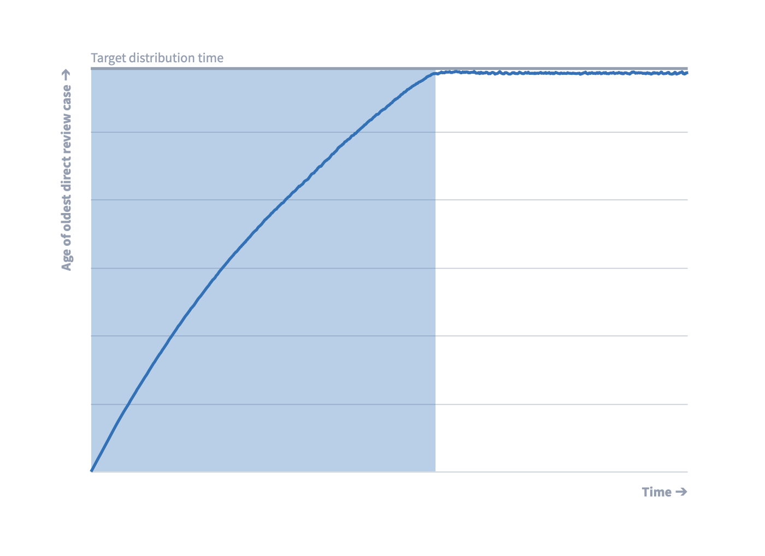
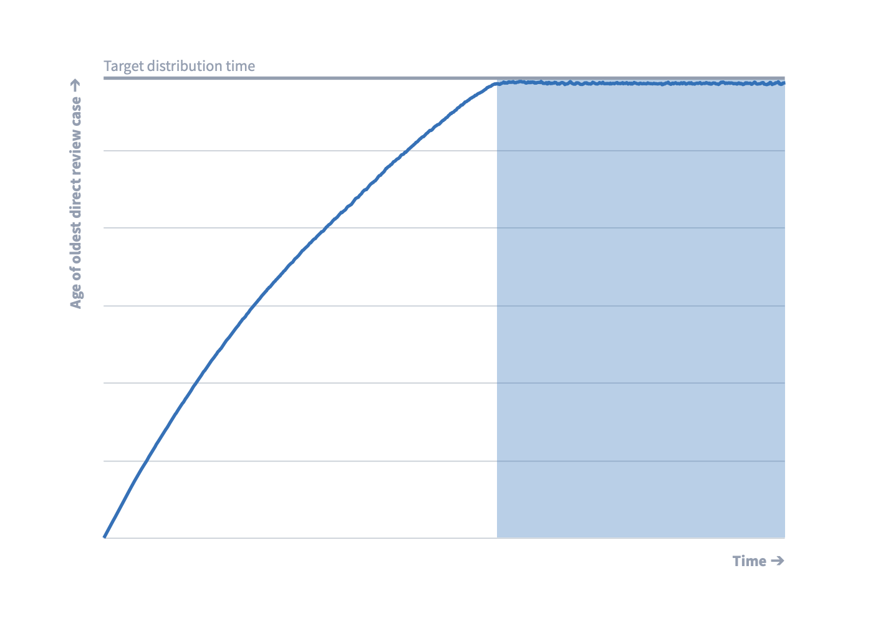
Direct Review Docket
Pacesetting proportion
Steady state proportion
# Direct Reviews incoming / year
# due cases in the Direct Review docket
# non-priority decisions completed / year
Total non-priority batch size

Slide 16
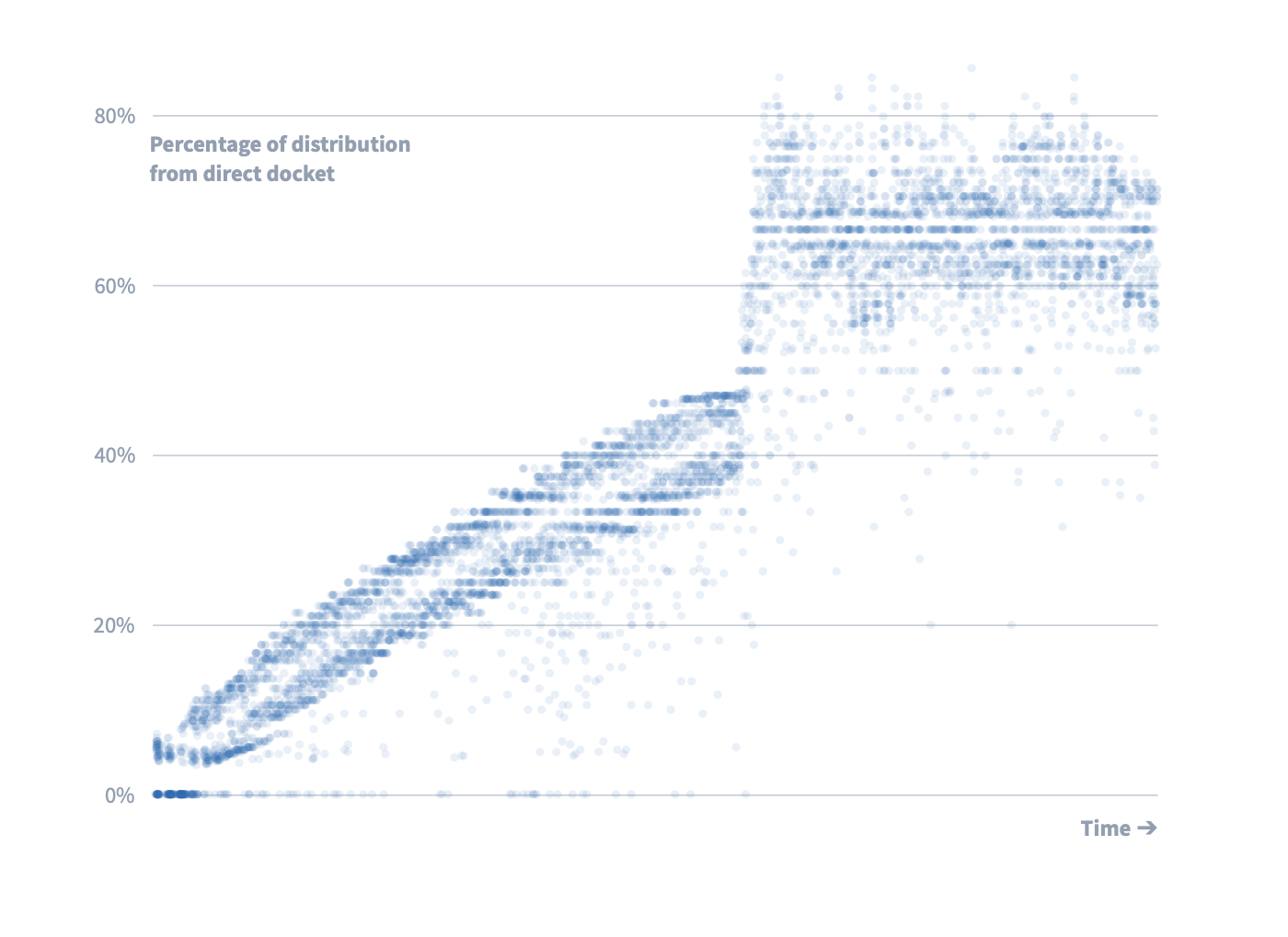
Direct Review Docket
To gradually build up to the steady state, we interpolate between 0 and the pacesetting proportion based on the age of the oldest Direct Review in the system.
To accelerate this curve out, we also multiply this interpolated figure by the interpolated direct review proportion adjustment.
Pacesetting proportion
Interpolator
Interpolated adjustment

Slide 17
References
Code
High-level distribution algorithm
Calculations
Legacy case selection
Dockets logic
Priority Push Distribution
Automatic Case Distribution Wiki
Algorithm simulations
Previous presentation by Chris Given
Video Recording
Appeals Case Distribution dashboard (internal-only)

