Slide 1
VSP PM Workshop
Setting Team Missions + OKRs

Slide 2
Intro + OKR overview
1:00 - 1:30 PM ET

Slide 3
Meeting Objectives
PMs have draft team missions and OKRs they can use as starting points to kick off discussions with their full teams, to riff and finalize these artifacts.
PMs gain experience talking through mission + OKRs in a “safe space,” so they’re empowered to continue exploring these concepts and to effectively run subsequent meetings with their own teams.
Get to know what other teams goals / missions / work are!

Slide 4
General OKR hygiene – group collaboration
OKRs are the goals we set to guide the solutions we create, to align those solutions to the outcomes we want them to achieve. To be revisited on a quarterly basis.
Important “do”s
Be ambitious!
Think about VSP north star and how our team relates to that
Check in over time and adjust what isn’t working
Communicate them often, they’re meant to be public
OKRs should encompass the global team, such that each person on the team has something it’s clear they can contribute to
Important “don’t”s
Write more than 5 Objectives, or write more than 4 KRs per O
Write KPIs (which are barometers that measure overall success of your solutions in your problem space), but KPIs (if you have them) can guide the OKRs you set. Know that OKRs might disrupt that barometer (it’s ok for there to be negative correlation.)

Slide 5
General OKR hygiene
3 - 5 Objectives
3ish Key Results for each Objective
Framework for brainstorming OKRs
How can your team contribute to the overall VSP OKRs?
What outcomes do you hope to achieve for your users?
What outcomes do you hope to achieve for your team?
What are some ways you’ll know if you’re successful?
What things do you need to do to achieve this?

Slide 6
General OKR hygiene
Framework for validating OKRs
Do your priorities make it more likely that VSP will successfully achieve its overall OKRs?
Are there things missing that others think you should be working on?
Do your OKRs represent all that is fully needed to result in success for your team?
Are your Os about status quo, instead of conveying desired endpoints?
keep hiring, maintain market position, continue doing X vs climb the mountain, eat 5 pies, ship feature Y
Do your KRs describe activities, instead of outcomes?
assess customer service satisfaction vs publish customer service satisfaction levels by March 7th.
Are measurements for your KRs available, credible, and easily discoverable?

Slide 7
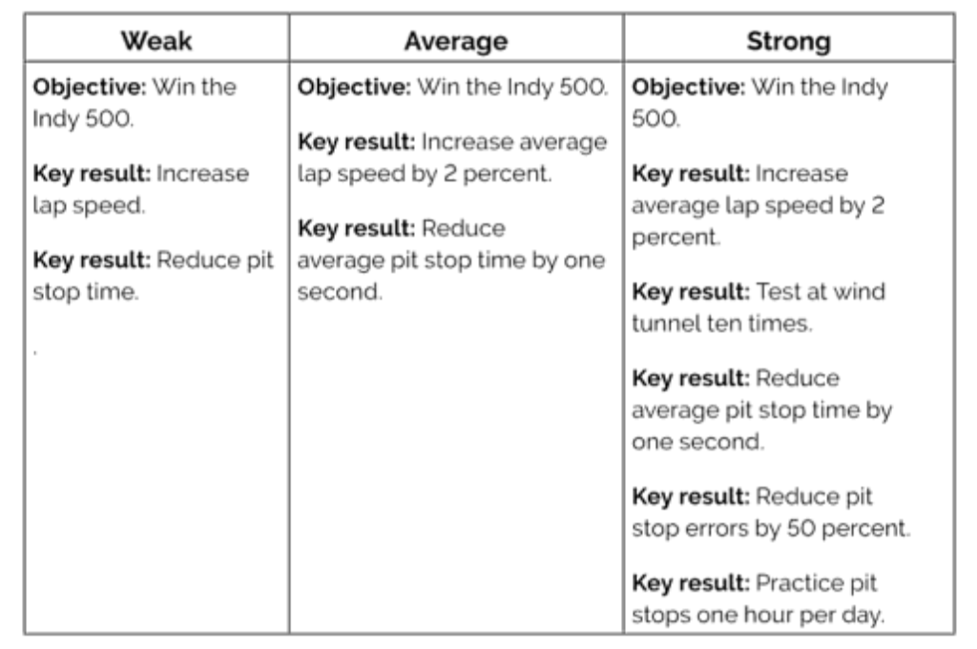
OKR example
Source: Measure What Matters, by Joen Doerr

Slide 8
Review VSP mission, vision, and OKRs
1:30 - 1:45 PM ET

Slide 9
VSP Mission, Vision, Roadmap, OKRs
https://docs.google.com/presentation/d/1-8LlD8jljlv-C9IIQO1fHDC4ok0NzpJF3nLfwnx5610/edit#slide=id.g5bcedc037d_2_48

Slide 10
Team mission workshop
1:45 - 2:15 PM ET

Slide 11
What is a mission statement?
Brief description of why your team exists. It explains what your team does, who you serve, and what impact you hope to have. It’s used to provide focus, direction, and inspiration to team members, and tell others what to expect from you.
TED: Spread ideas.
Google: Organize the world’s information and make it universally accessible and useful.
Walmart: Save people money so they can live better.
Patagonia: Build the best product, cause no unnecessary harm, use business to inspire and implement solutions to the environmental crisis.
SpaceX: design, manufacture, and launch advanced rockets and spacecraft. Revolutionize space technology, with the ultimate goal of enabling people to live on other planets.
(starter team mission descriptions: https://docs.google.com/presentation/d/1tIn0Bsqgc7yNtqUhhNXpt4wS9m6Xam4OEgh5HWwJcZE/edit#slide=id.g5b56be569c_0_0)
Sources:
https://www.shopify.com/encyclopedia/mission-statement
https://www.smestrategy.net/blog/example-mission-statements-why-they-are-great

Slide 12
VSP Mission

Slide 13
Tools Mission

Slide 14
Operations Mission

Slide 15
Triage Mission

Slide 16
Product Support Mission

Slide 17
Insights & Analytics Mission

Slide 18
Content & IA Mission

Slide 19
Break
2:15 - 2:30 PM ET

Slide 20
Heads-down: stream of conscious OKRs
2:30 - 3:00 PM ET

Slide 21
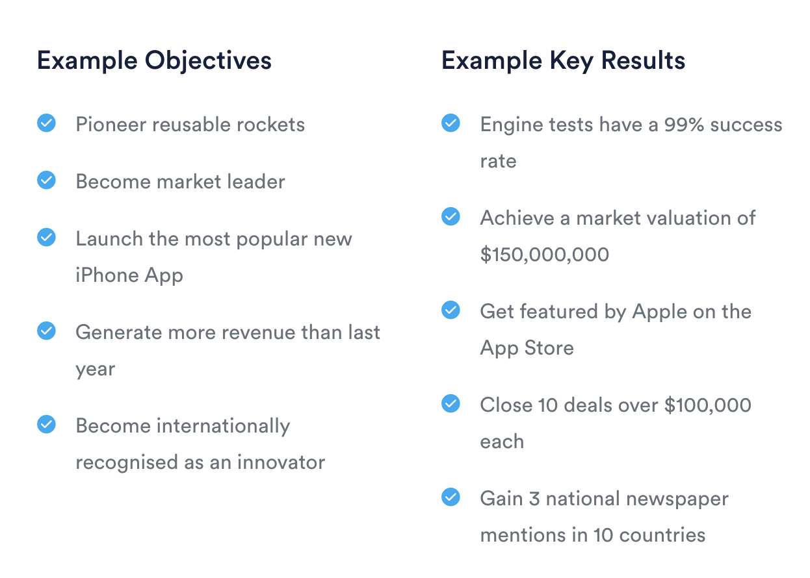
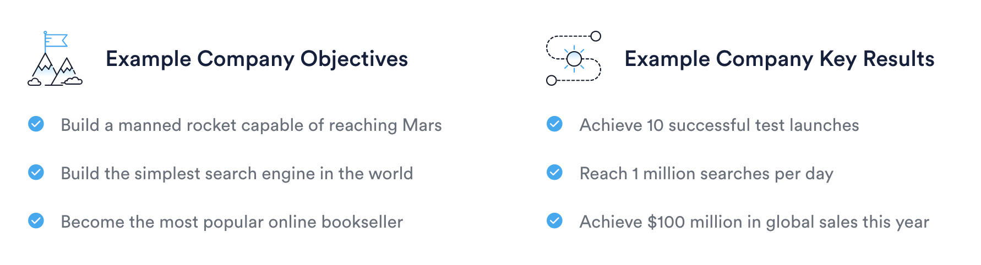
Inputs for brainstorming
Overall VSP OKRs
Your team’s mission
OKR brainstorming framework
How can your team contribute to the overall VSP OKRs?
What are the big risks to users + VSP if your team “fails”?
What outcomes do you hope to achieve for your users?
What outcomes do you hope to achieve for your team?
What are some ways you’ll know if you’re successful?
What things do you need to do to achieve this?

Slide 22
Tools OKRs

Slide 23
Tools OKRs
Biggest risks / blockers / challenges today in VA delivering performant, human-centered products
Big ideas
Where is there overlap with other teams?

Slide 24
Operations OKRs

Slide 25
Operations OKRs
Biggest risks / blockers / challenges today in VA delivering performant, human-centered products
Big ideas
Where is there overlap with other teams?

Slide 26
Triage OKRs

Slide 27
Triage OKRs
Biggest risks / blockers / challenges today in VA delivering performant, human-centered products
Big ideas
Where is there overlap with other teams?

Slide 28
Product Support OKRs

Slide 29
Product Support OKRs
Biggest risks / blockers / challenges today in VA delivering performant, human-centered products
Big ideas
Where is there overlap with other teams?

Slide 30
Insights & Analytics OKRs

Slide 31
Insights & Analytics Notes
Biggest risks / blockers / challenges today in VA delivering performant, human-centered products
Big ideas
Where is there overlap with other teams?

Slide 32
Content & IA OKRs

Slide 33
Content & IA OKRs
Biggest risks / blockers / challenges today in VA delivering performant, human-centered products
Big ideas
Where is there overlap with other teams?

Slide 34
Group sharing and discussion
3:00 - 4:00 PM ET

Slide 35
Heads down: OKR refinement
4:00 - 4:30 PM ET

Slide 36
Additional Reading
Setting individual OKRs: https://okrexamples.co/product_management-okr-examples

Slide 37
Next Steps
Put these things into upcoming sprint (except Ops)
Share materials about OKRs with your team so they can start reading into what OKRs are, and see some initial ideas
Run an OKR-setting meeting w/the team, capture ideas - they don’t have to be perfect!!
Run through the ideas, compare to best practice examples of good OKRs, iterate and get feedback from team
Share w/VSP Leadership + DSVA for discussion

