Slide 1
Covid-19 screening tool Update & success factors
CIO Innovation Council
August 13, 2020
FOR INTERNAL USE ONLY

Slide 2
A Tale of Two Screeners
Screener 1: Clinical VA Medical Center
Clinical settings
Additional screening available on site
VA Digital Experience Product Office (DEPO)
Hosted on VA.gov
Screener 2: Non-clinical VA employee
Non-clinical settings
No additional screening available on site
Presidential Innovation Fellows (PIFs)
Hosted by GSA

Slide 3
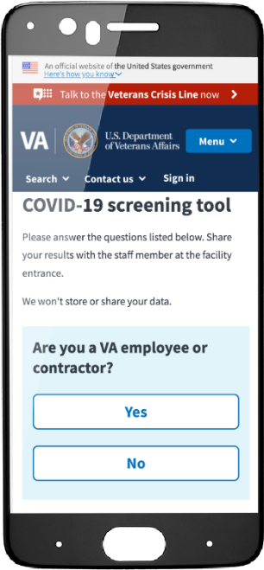
Screener 1: Clinical VA Medical Center
User goals for employee/patient/visitor
Avoid waiting in line to complete COVID-19 risk assessment
Get to duty station/appointment/loved one faster
Remain physically distanced
Solution: VA.gov COVID-19 screening tool
Facility visitors complete COVID-19 risk assessments digitally
Displays results to attendants at a safe distance
Notes:
Built by an all government team based on a prototype from the Durham VAMC in less than 12 days.
Collaborated with VEO on communications; VHA on promotion and product design.

Slide 4
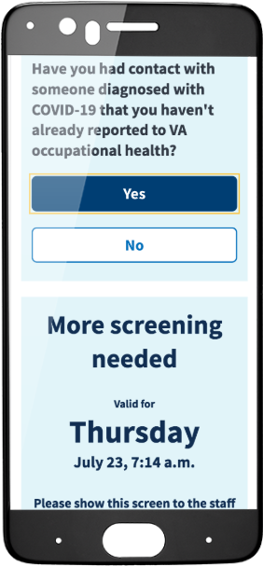
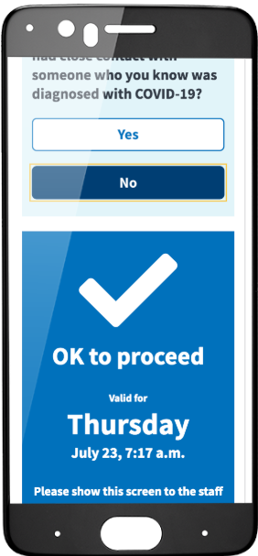
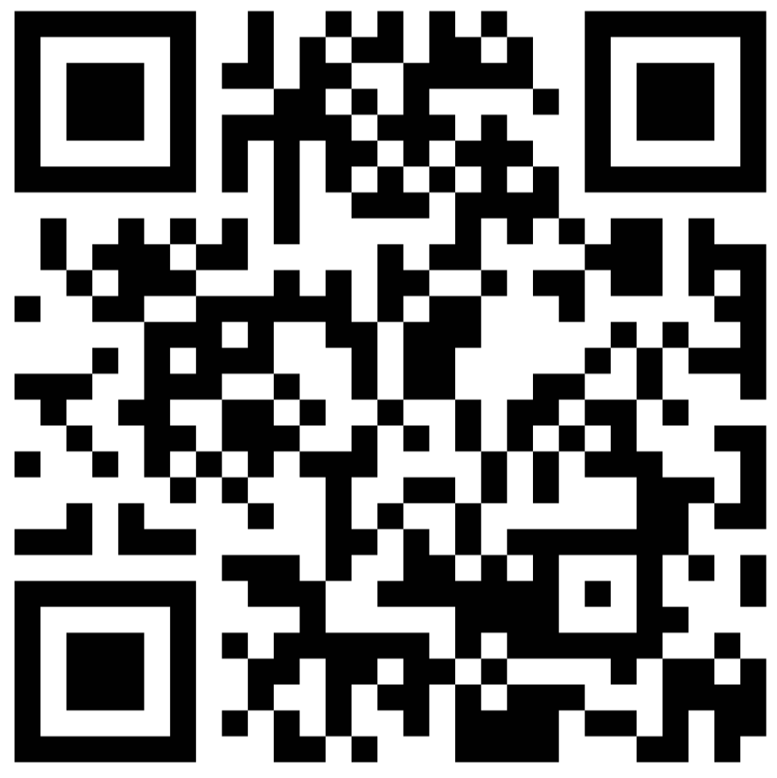
Try it now!
Text SCREEN to 530-79
Or go to www.va.gov/ covid19screen

Slide 5
Screener 1 stats: 1.2M+ screens Jun01-Aug11
Notes:
Over 1.2 million screens have been completed since launch on 6/1.
Roughly 5% of all VA.gov traffic is now from the screener.
Drove nearly 300K first-time visitors to VA.gov.
In use at dozens of major VAMCs across the country.

Slide 6
Screener 1 success factors: VHA partnership
CTO learned about the Durham prototype via the “COVID ideas” inbox
Quickly connected with VHA partners in the field
No weighty intake or demand management process
Quickly evaluated positive impact and technical feasibility
Prioritized relationships with VHA members (facility executives, managers, line employees)

Slide 7
Screener 1 success factors: VA.gov Platform
Shipped code into production almost immediately
Integration and deployment pipelines already established
More than just code: VA.gov Platform answered common questions
Balanced autonomy and self-direction vs. governance and Platform quality control

Slide 8
Screener 1 success factors: Gov expertise
All-gov CTO team (designers, content strategists, engineers, product managers) started delivering immediately
Entrepreneurial mindset
No contract management
No waiting for a task order
No onboarding a new team
No negotiating scope
No waiting for access to systems

Slide 9
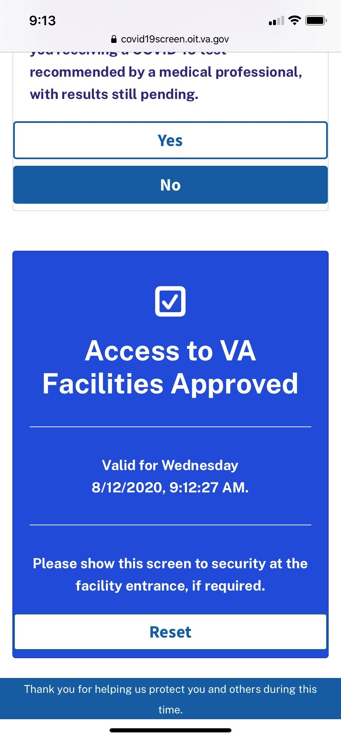
Screener 2: Non-clinical VA employee
User goals for employees
Avoid waiting in line to complete COVID-19 risk assessment
Get to duty station faster
Remain physically distanced
Solution: Non-clinical VA employee screener
Adapted Screener 1 to meet non-clinical user needs
Employees complete COVID-19 risk assessments digitally before traveling to work
Notes:
Built by an all government team based on a prototype from the Durham VAMC in less than 12 days.
Collaborated with VEO on communications; VHA on promotion and product design.

Slide 10
Screener 2: Next steps
Pilot test of a tool offered by GSA for its tenant agencies
PIFs leveraged their roles to foster inter-agency collaboration
Reach out to Elizabeth.Delnegro@gsa.gov

