Slide 1

Update Modernized Find a VA Form 1.0
April 2021

Slide 2
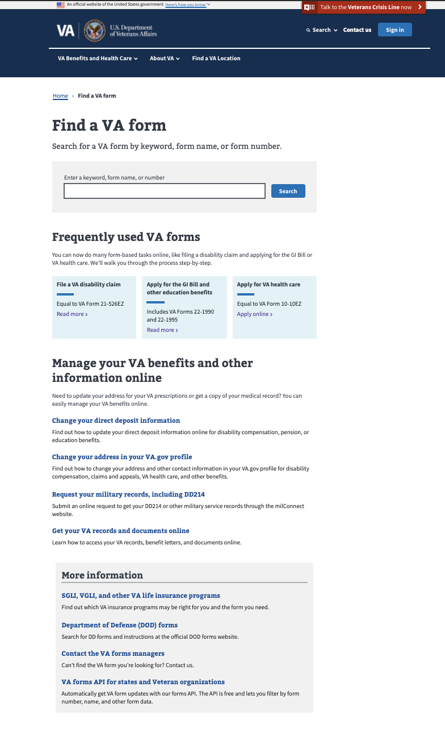
Latest Releases: Search Improvements
Modernized Find a VA Form
Example changes:
VA + space => ignored
FORM => ignored
ESPANOL => Changed to “Spanish”
Starts w/ 20 | 20123 => 20-123
Starts w/ 21 | 21123 => 21-123
Starts w/ 22 | 22123 => 22-123
Starts w/ 25 | 26123 => 26-123
Starts w/ 29 | 29123 => 29-123
Starts w/ 40 | 40123 => 40-123
21P => 21P-
1010 => 10-10
1010EZ => 10-10EZ
1010 EZ => 10-10EZ
10-10 EZ => 10-10EZ
Results for affected searches (ex: “VA Form 10-10ez”) were reduced from 14 pages to 1-3 highly-relevant results

Slide 3
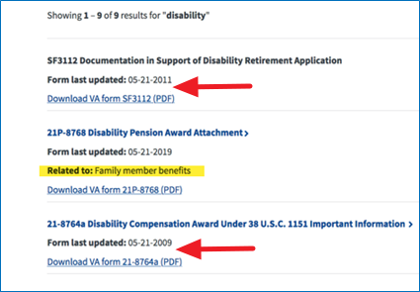
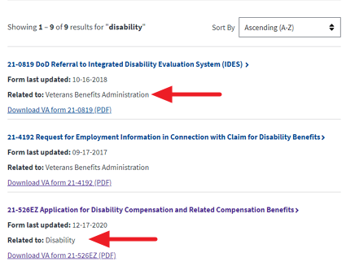
Latest Releases: Administration Field
Modernized Find a VA Form

Slide 4
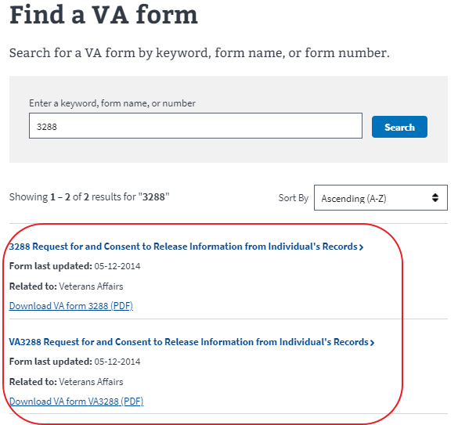
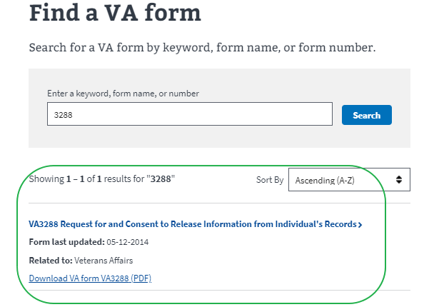
Latest Releases: Deleted Duplicate Forms, Added Unique ID Number
Modernized Find a VA Form

Slide 5

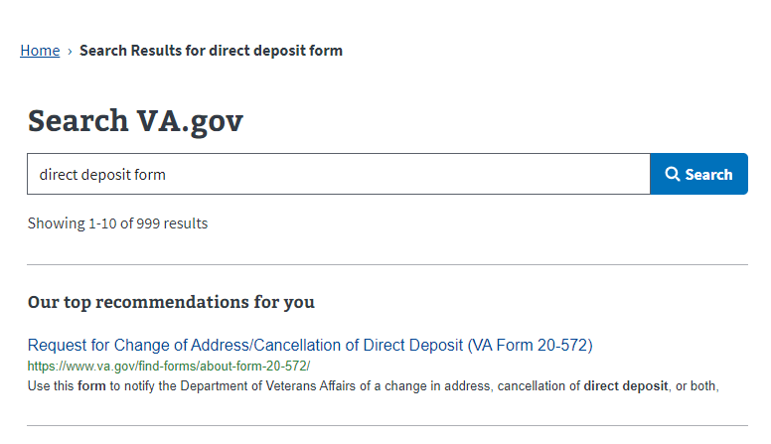
Latest Releases: Best Bets on Search.gov
Modernized Find a VA Form

Slide 6
Metrics - Landing Page March 2021
Modernized Find a VA Form
Unique Page Views: Bounce rate: 10.1% (down 13% from Feb)
Unique Searches: 14% increase from February
Monthly average unique form searches: 109,003
Search refinement rate: 30%
Top Forms Searches in March:
Frequently used VA forms clicks: 11,464 in February
10-2850c
21-526ez
10-2850a
21-4138
20-0995
21-22
21-2680
10-8678
10-2850
21-686c

Slide 7
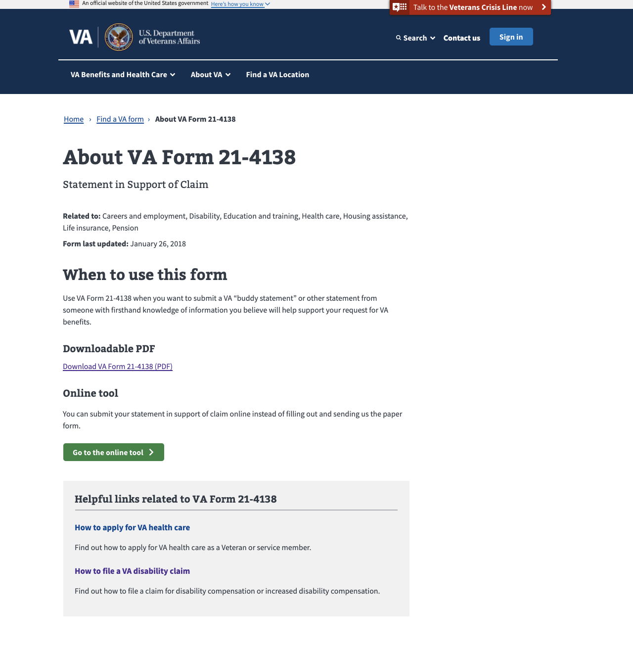
Metrics – Detail Pages March 2021
MODERNIZED Find a vA Form
Total Unique Page Views: Rose 21% to 209,000 from February to March.
Top 5 PDF Downloads from Detail Pages:
21-4138 (11,358)
20-0995 (7,486)
10-5345 (7,348)
10-10172 (5,746)
21-526EZ (5,712)

Slide 8
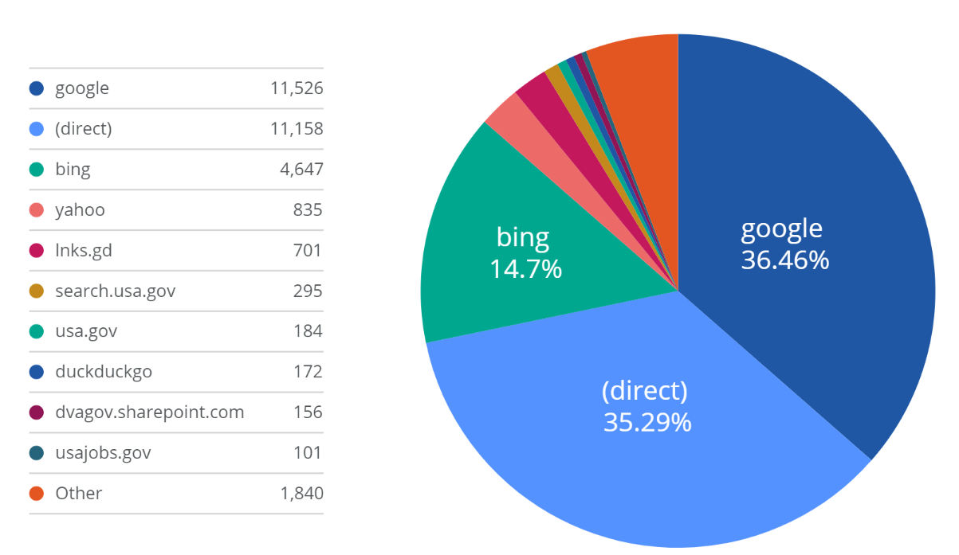
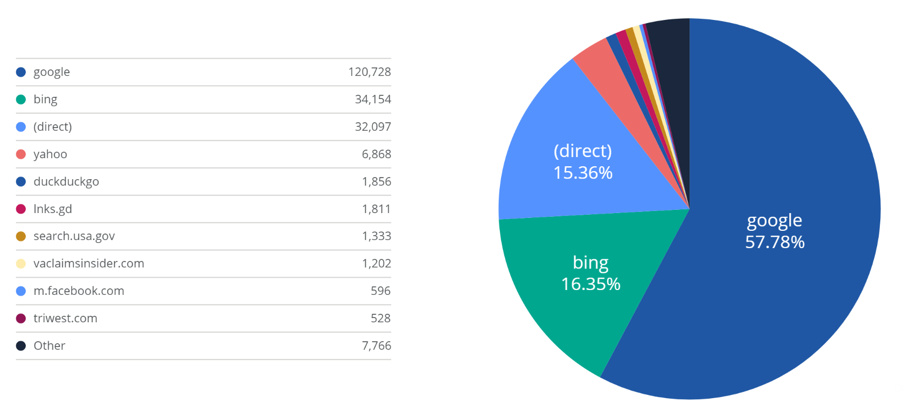
Metrics: Key Actions & Drivers March 2021
Modernized Find a VA Form
Total VA Form PDF Downloads: 220,061 (16% increase from Feb)
Landing Page: 70,582 (14% increase)
Details Pages: 149,479 (16% increase)
Total Online Tool Clicks: 21,097 (34% increase from Feb)
Landing Page: 4,535 (13% increase)
Details Pages: 16,562 (41.67% increase)
Top Sources of Traffic
Landing Page
Details Pages

Slide 9
Product Team Focus
MODERNIZED Find a vA Form
Q2 2021
Improving Search experience
Discovery for VA forms management Proof of Concept (POC)
Ongoing
Link to new digital applications as they come online to encourage veterans to self-serve and speed time to outcomes

