Slide 1

Readjustment Counseling Services
ORLANDO VET CENTER
www.vetcenter.va.gov
Elizabeth Jackson, LCSW
Veteran Outreach Program Specialist

Slide 2
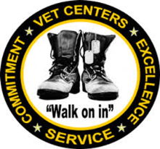
Our Mission
“ To welcome home and honor those who served, those still serving, and their families by reaching out to them, engaging their communities, and providing them with quality readjustment counseling and timely referral.

Slide 3

VET CENTER HISTORY
The Vet Center Program was established by Congress in 1979 out of the recognition that a significant number of Vietnam era vets were still experiencing readjustment problems. Vet Centers have always been community based and a part of the U.S. Department of Veterans Affairs.

Slide 4
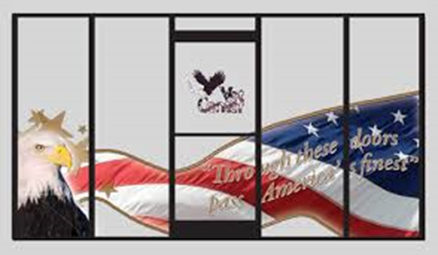
Confidentiality
The Vet Center staff respects the privacy of all veterans and their families. We hold in the strictest confidence all information disclosed in the counseling process.
No information will be released to any person or agency, including VA/DOD agencies without written consent from the client, except in circumstances averting a crisis.

Slide 5
War Zone Veterans all eras, including...
Eligibility
WORLD WAR II
AMERICAN MERCHANT MARINES
KOREAN WAR - 27 June 1950 to - 27 July 1954
VIETNAM WAR - 28 Feb. 1961 to 7 May 1975
LEBANON - 25 Aug. 1982 to 26 Feb. 1984
KOSOVO - 24 Mar. 1999 to
OPERATION ENDURING FREEDOM-7 Oct. 2001 to Present
OPERATION IRAQI FREEDOM - 19 Mar. 2003 to 17 Feb. 2010
OPERATION NEW DAWN - 17 Feb. 2010 to Present
GRENADA - 23 Oct. 1983 to 21 Nov. 1983
PANAMA - 20 Dec. 1989 to 31 Jan. 1990
PERSIAN GULF - 2 Aug. 1990 to
SOMALIA - 17 Sept. 1992 to
BOSNIA - 21 Nov. 1995 to 01 Nov. 2007

Slide 6
Eligibility Continued…
Operation Joint Endeavor, Operation Joint Guard, & Operation Joint Forge - Veterans who participated in one or more of the three successive operations in the former Yugoslavia (Bosnia-Herzegovina and Croatia, aboard U.S. Naval vessels operating in the Adriatic Sea, or air spaces above those areas).
Active Duty Service Members and their Families-All Vet Center services are available.
All Discharges types are eligible- including Veterans who have received an Other than Honorable, and any war zone Veteran with a Dishonorable discharge who is working towards a discharge upgrade.
Sexual Trauma and Harassment Counseling - veterans of both sexes, group readjustment counseling, liaison with community agencies, marital and family counseling sexual trauma counseling, and community education.

Slide 7

Bereavement Counseling - Bereavement counseling is offered to parents, siblings, spouses and children of Armed Forces personnel who die in the service to our country. Also eligible are family members of Reservists and National Guardsmen who die while on federally activated duty.
Mortuary Affairs Personnel
Any Veteran or active duty personnel who has escorted fallen servicemembers, handled the deceased, and/or delivered death notifications.
Drone Operators
Any Veteran or active duty personnel who has operated Drones in a war/combat zone but may not have physically been in the area themselves.
Military Medical Personnel
Any Veteran or active duty personnel who has worked with Trauma Patients and/or in Traumatic Situations.

Slide 8

Services
The goal of the Vet Center program is to provide a broad range of counseling, outreach, and referral services to eligible veterans in order to help them make a satisfying post-war readjustment to civilian life.
Individual Counseling
Support Groups/Counseling Groups
Screening for Posttraumatic Stress Disorder (PTSD)
Referrals for Sexual Trauma Counseling
Marital/Family Counseling
Bereavement Counseling
Liaison with the VA
Information and Referral to community resources
Community Education and Outreach
Referrals for Benefits Assistance
Outreach and education including PDHRA, community events, etc.

Slide 9
PTSD and TRAUMA
PTSD is a natural reaction that can occur after someone goes through a traumatic event like war, assault, an accident or disaster
Adjusting to Life at Home
It can be difficult to change to a “civilian” mindset once a veteran is back at home with family, friends, co-workers, and U.S. civilians. However, many people have successfully made this transition.
Veterans who have deployed more than once, you might expect that with each deployment, the emotional cycle will become easier. But things may actually become more difficult. This is especially the case if you have unresolved problems from previous separations and reunions. Each deployment is also different from the last.
National Center for PTSD 2014

Slide 10
Bereavement Counseling
What Is Bereavement Counseling?
Bereavement counseling is assistance and support to people with emotional and psychological stress after the death of a loved one. Bereavement counseling includes a broad range of transition services, including outreach, counseling, and referral services to family members.
Where Is Counseling Offered?
VA's bereavement counseling is provided at community-based Vet Centers located near the families. There is no cost for VA bereavement counseling.
How Can You Obtain These Services?
Services are obtained by contacting any Vet Center or via electronic mail at vetcenter.bereavement@va.gov, RCS staff will assist families in contacting the nearest Vet Center.

Slide 11
Military Sexual Trauma Counseling
What Is Military Sexual Trauma Counseling?
Military sexual trauma counseling may include individual or group counseling, marital and family counseling, referral for benefits assistance, liaison with community agencies to help you cope with the emotions of military sexual trauma and regain confidence in your everyday life.
Who Is Eligible For Military Sexual Trauma Counseling?
Any veteran who was sexually traumatized or harassed while serving in the military is eligible to receive counseling regardless of gender or era of service.
Where Are Services Available?
Medical services are available at your local VA Medical Center and can be accessed by contacting the Military Sexual Trauma Coordinator or Women Veterans Program Manager). Assessment and referral for Sexual Trauma Counseling are available at all Vet Centers. On site counseling is available at all Vet Centers across the country.

Slide 12
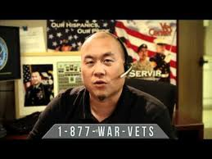
Vet Center Call Center
1-877-WAR-VETS is an around the clock confidential call center where combat Veterans and their families can call to talk about their military experience or any other issue they are facing in their readjustment to civilian life. The staff is comprised of combat Veterans from several eras as well as families members of combat Veterans. The Call Center will also relay messages to local Vet Centers during after hours.

Slide 13
Resources
https://health.mil/, Military Health System and the Defense Health Agency
https://www.dol.gov/vets/ahaw/, Americas Heroes at Work
https://www.veteranscrisisline.net/, 1-800-273-8255, Veterans Crisis Line
https://www.va.gov/SURVIVORS/OUTREACH.asp,Office of Survivor assistance
http://www.hfuw.org/mission-united/ , Mission United
https://www.vetcenter.va.gov/VetCenterServices.asp ,Vet Center Services

Slide 14
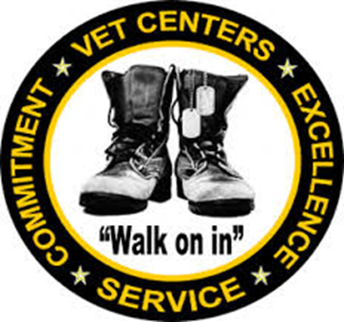
Orlando Vet Center
407-857-2800
Clermont Vet Center
352-536-6701
Questions?

