Slide 1

Update Modernized Find a VA Form 1.0
May 2021

Slide 2
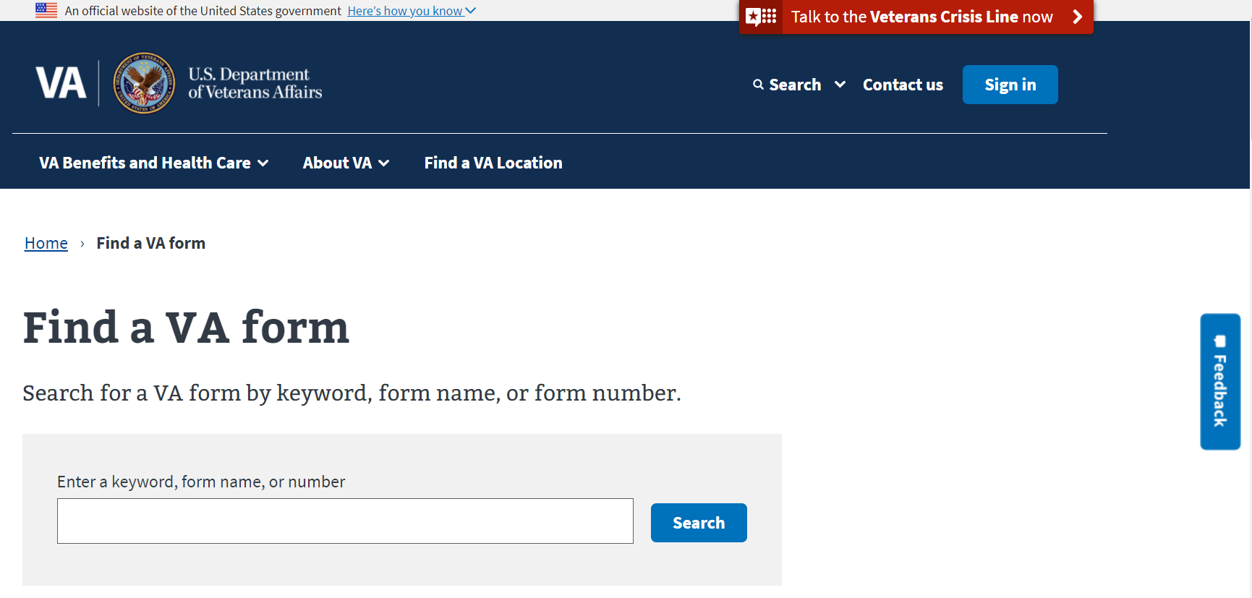
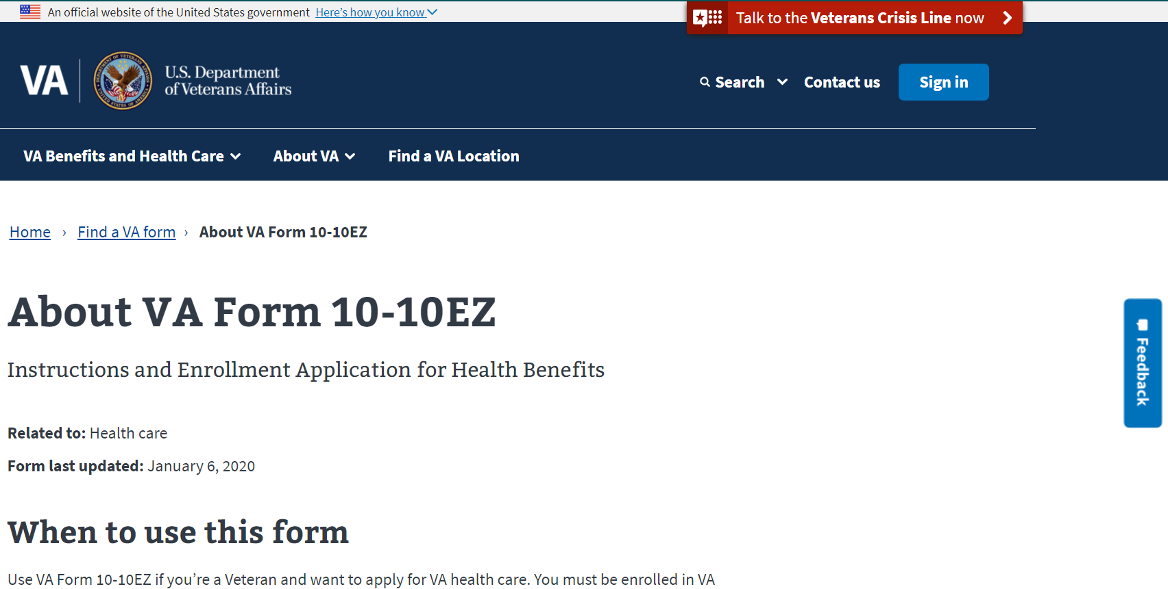
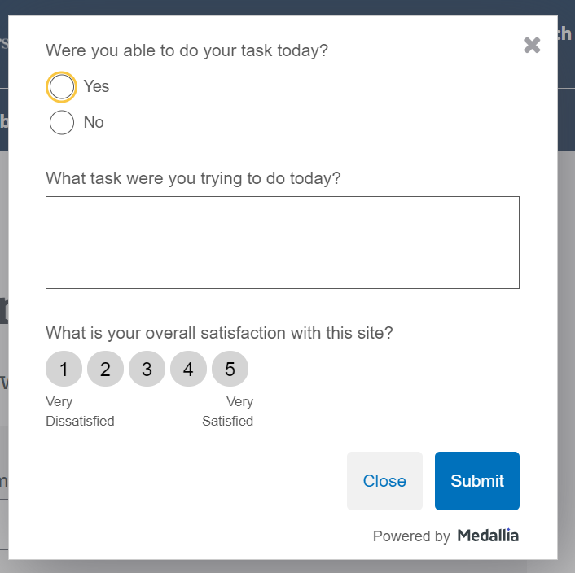
Recent Activity: Medallia Surveys
Modernized Find a VA Form
Medallia Survey now on landing page and form detail pages
Very simple, lightweight survey
Will provide greater insight into user experience, ability to complete desired tasks
Initial data will be requested four weeks after go-live (May 17)

Slide 3
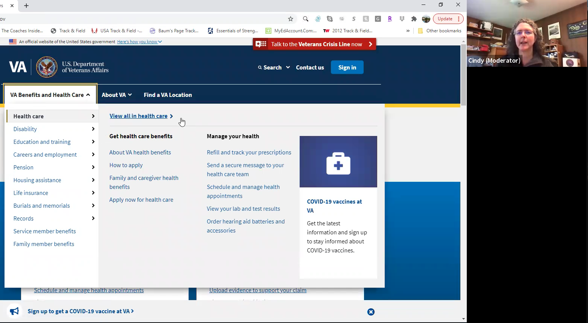
Recent Activity: Wayfinding Research Study
Modernized Find a VA Form
Team researcher conducted study April 26 – May 5
Included 13 participants:
12 Veterans, including one who was also a caregiver for another Veteran
1 family member of a Veteran
Participants were on a variety of devices:
8 on a desktop/laptop computer
4 on a smartphone
1 on a tablet
Participants were asked to complete several tasks, including some related to locating VA forms
Participants were also asked where they would expect to find a link to Find a VA Form
Topline summary has been completed; detailed analysis in progress

Slide 4
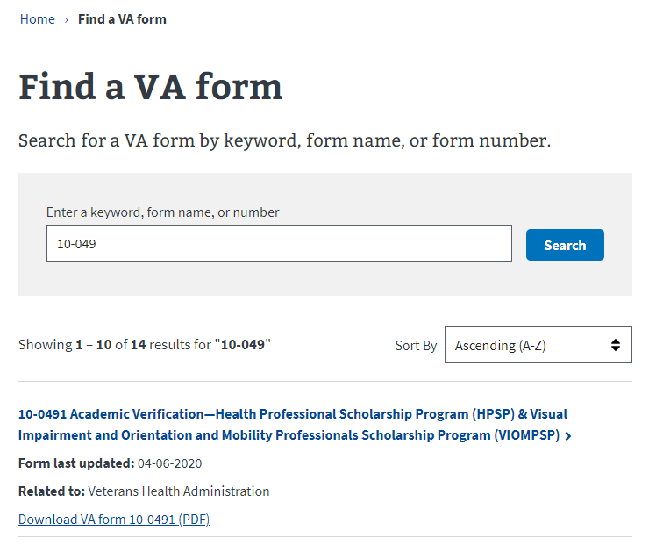
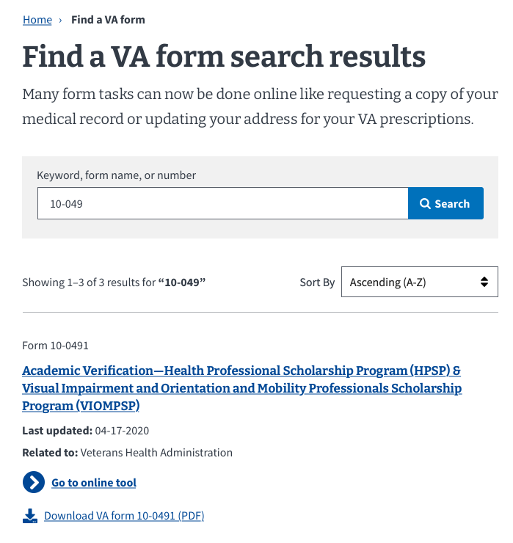
Recent Activity: Search UI Consistency
Modernized Find a VA Form
Before
After
We collaborated with UI/UX, Accessibility, Information Architecture and Content teams to create consistent designs for several VA.gov search tools
UI elements were modified so that calls to action are more visible, and each tool incorporates the same colors, styles, icons, etc.
Updated design elements are approved and will be formally documented as a new pattern in the VA.gov Design System
Find a VA Form will be the first search tool to implement the new pattern

Slide 5
Recent Activity: Search UI Consistency
Modernized Find a VA Form
Before
After
We collaborated with UI/UX, Accessibility, Information Architecture and Content teams to create consistent designs for several VA.gov search tools
UI elements were modified so that calls to action are more visible, and each tool incorporates the same colors, styles, icons, etc.
Updated design elements are approved and will be formally documented as a new pattern in the VA.gov Design System
Find a VA Form will be the first search tool to implement the new pattern

Slide 6
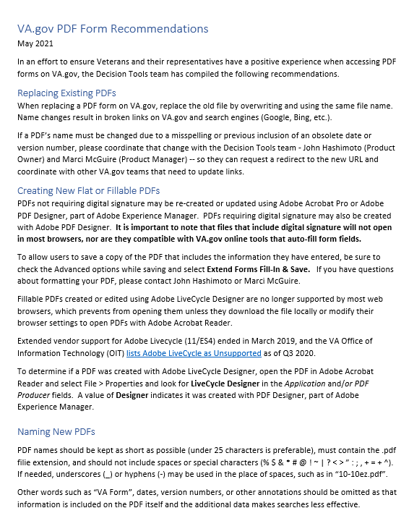
Recent Activity: PDF Recommendations
Modernized Find a VA Form
A VA Form PDF file (10-10CG) was unexpectedly renamed on May 5, resulting in broken links on VA.gov and search engines
We responded with high-level PDF guidelines, but an in-depth inventory may be warranted. Observed issues include:
Web browsers cannot open PDFs created with now-unsupported software and/or containing digital signature fields (including XFA forms, as first surfaced by Jen Lee and Boris Ning in Sept 2020)
Some PDF forms do not allow users to save PDFs after completing
Forms with certain signature fields require the user to print and manually complete form -- cannot be done on computer
Users have also encountered challenges related to PDF file names
VA users encounter the same problems on the internal VA web site
Analyzing problem and identifying solutions:
Add instructions on how best to use VA Forms
Uniform formatting approach for VA Forms

Slide 7
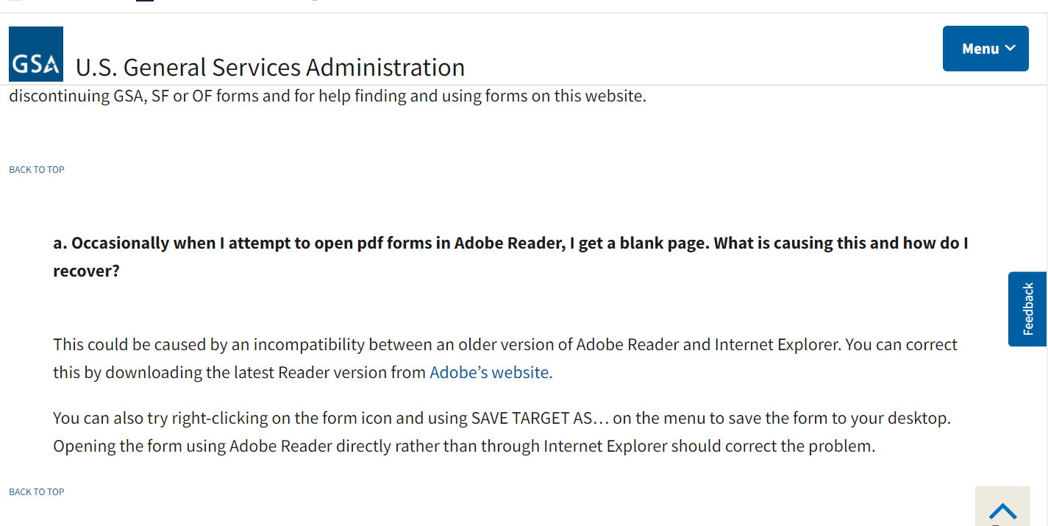
PDF Compatibility Issues
MODERNIZED Find a vA Form
Recommendations
Workflow: Because of the varying degree of support for XFA forms in modern web browsers, makers of PDFs should stay with the Acroforms, and keep the forms as simple, and as static as possible.
Convert existing and make all new forms in the Acroforms format, instead of XFA based forms. Ensure that all forms are accessible through modern devices.
User Experience: Encourage users who download the PDF to use Adobe Reader, which supports both Acroform and XFA or save the PDF to their desktop,
Related Reading: Acroforms vs. XFA Forms https://www.foxitsoftware.com/blog/acroforms-vs-xfa-forms/ https://www.datalogics.com/blog/pdfjt/form-with-function-part-three-working-with-acroforms-xfa-form-documents/

Slide 8
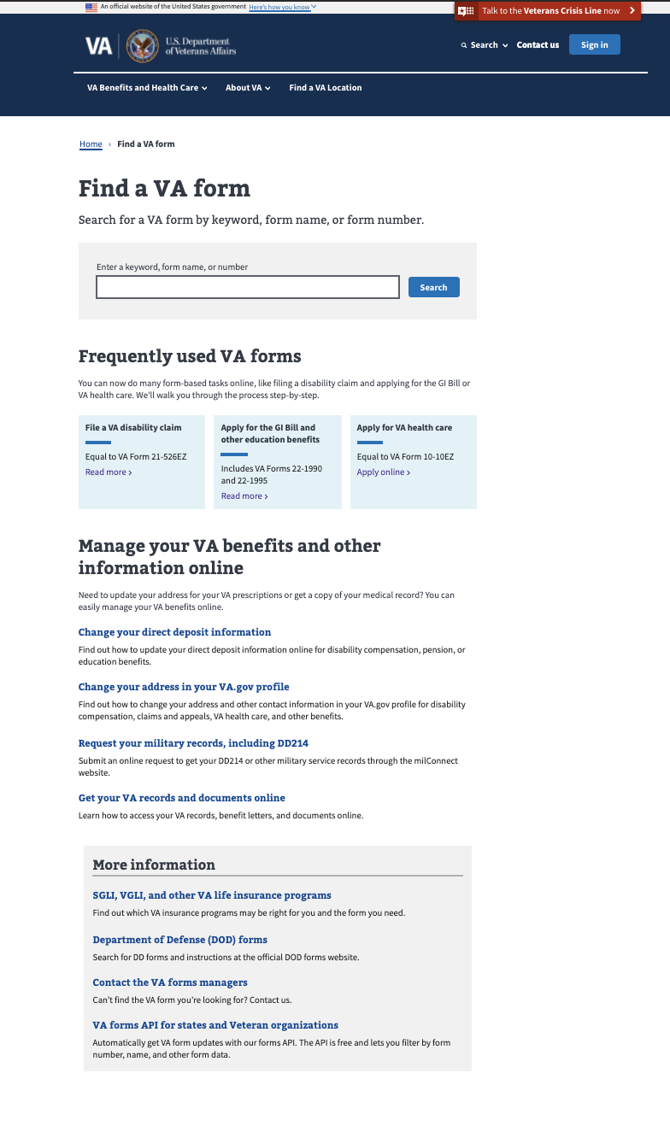
Metrics - Landing Page
Modernized Find a VA Form
Unique Page Views: 147,377 (13% decrease from March)
Unique Searches: 167,391 (14% increase)
Bounce rate: 16.71% (0.54% increase)
Search refinement rate: 41.62% (3% decrease)
Top Forms Searches in April:
Frequently used VA forms clicks: 9,748
Manage Your VA Benefits clicks: 6,050
10-2850c
10-2850a
21-526ez
21-4138
21-22
20-0995
21-2680
10-2850
10-2850c
20-0996

Slide 9
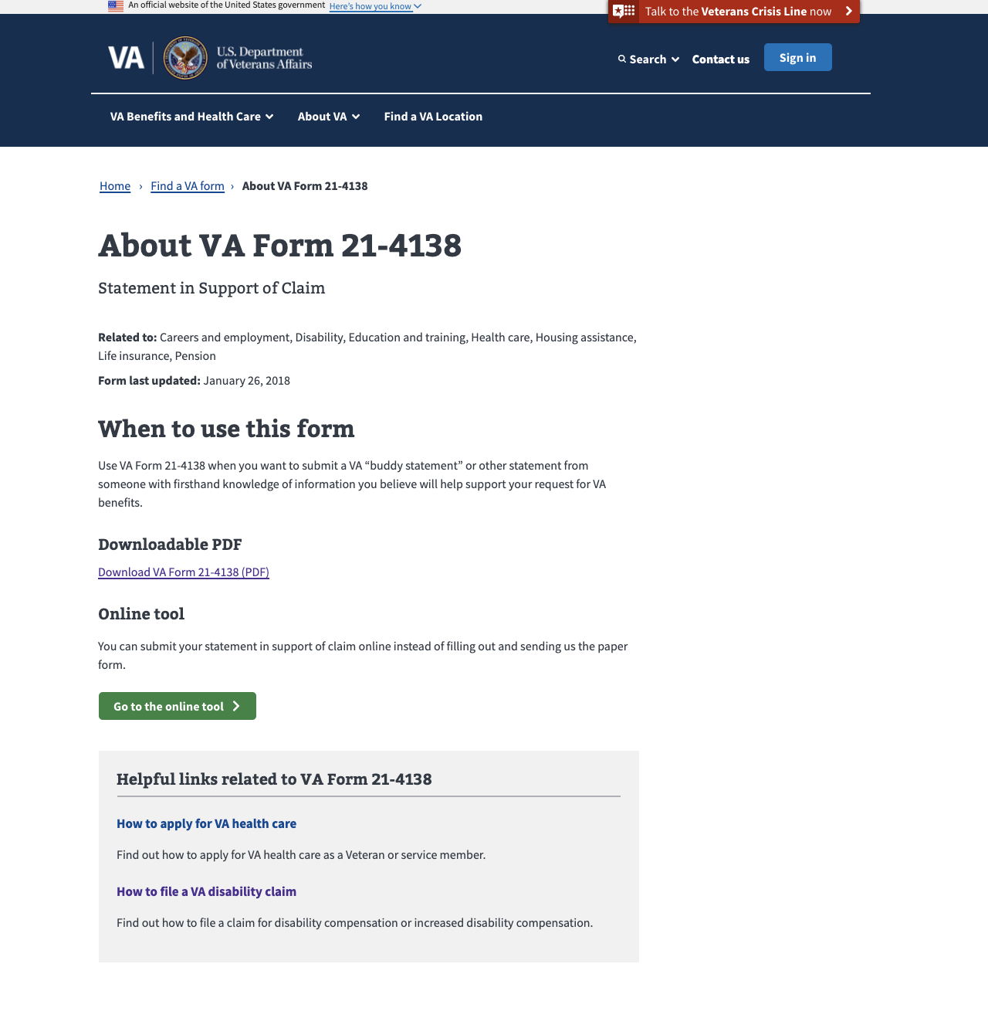
Metrics – Detail Pages
MODERNIZED Find a vA Form
Total Unique Page Views: 175,304 (down 16%)
Top 5 PDF Downloads from Detail Pages:
21-4138 (8,826)
20-0995 (5,859)
10-5345 (5,806)
10-10172 (5,212)
21-526EZ (4,394)

Slide 10
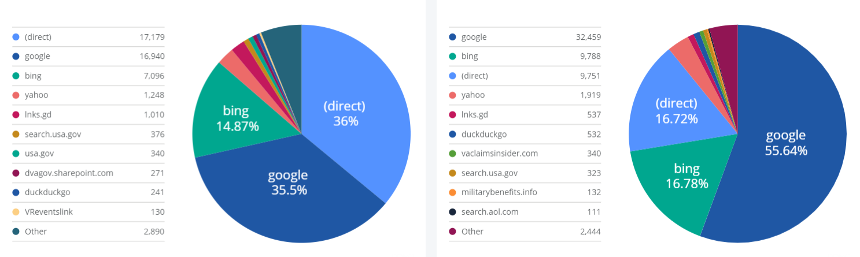
Metrics: Key Actions & Drivers
Modernized Find a VA Form
Conversion Rate (PDF downloads & online tool clicks): 62.31%
Total VA Form PDF Downloads: 183,750 (17% decrease)
Landing Page: 58,031 (18% decrease)
Detail Pages: 125,719 (16% decrease)
Total Online Tool Clicks: 17,316 (18% decrease from Mar )
Landing Page: 3,845 (15% decrease)
Detail Pages: 13,471 (19% decrease)
Top Sources of Traffic:
Landing Page
Detail Pages

Slide 11
Product Team Focus
MODERNIZED Find a vA Form
Q2 2021
Improving Search experience for whole word queries e.g., “direct deposit” -- next update this month
Implementing new search design pattern
PDF Forms Issues: More analysis/solutioning
Ongoing
Link to new digital applications as they come online to encourage veterans to self-serve and speed time to outcomes

