Slide 1

Update Modernized Find a VA Form 1.0
June 2021

Slide 2
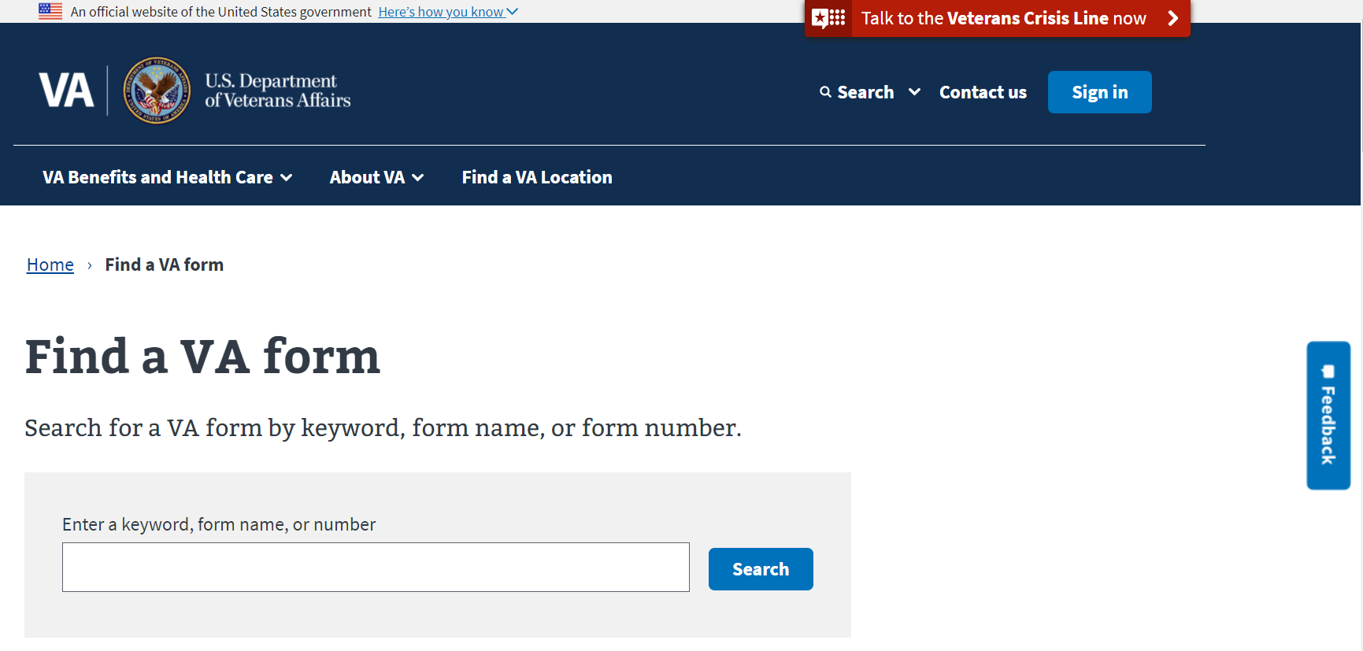
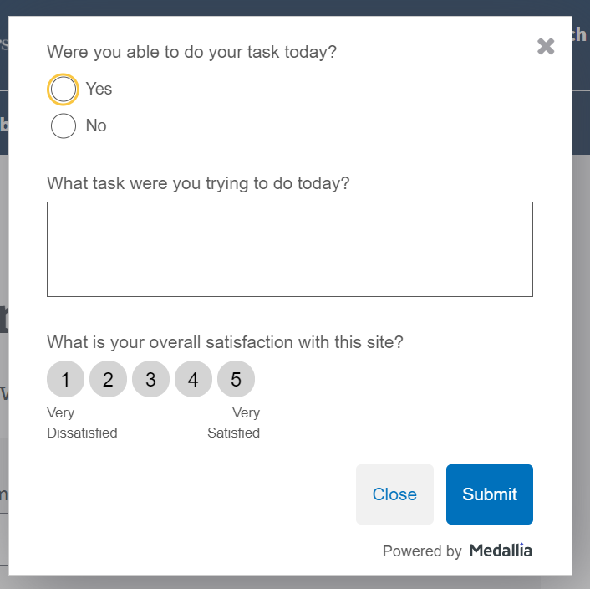
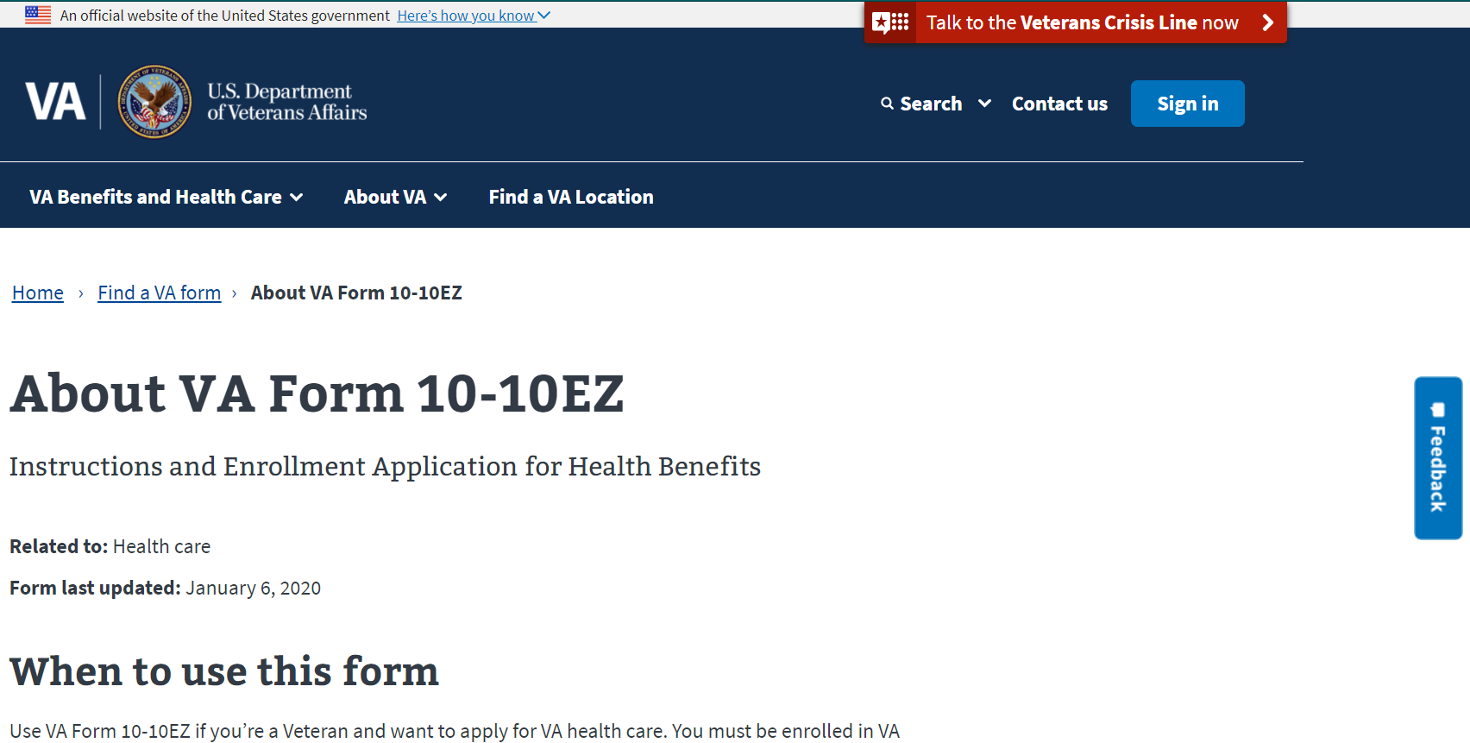
Product Highlights: Medallia Survey Results
Modernized Find a VA Form
Initial results from Medallia surveys are in
~40% of respondents who took survey found what they needed on Find a VA Form
Respondents tend to skew toward those with negative experience
Possible reasons users may not find what they need:
Too many results to search*
Search term not in form number or name*
Typos*
Seeking non-VA form
Seeking retired form
*Upcoming changes should improve

Slide 3
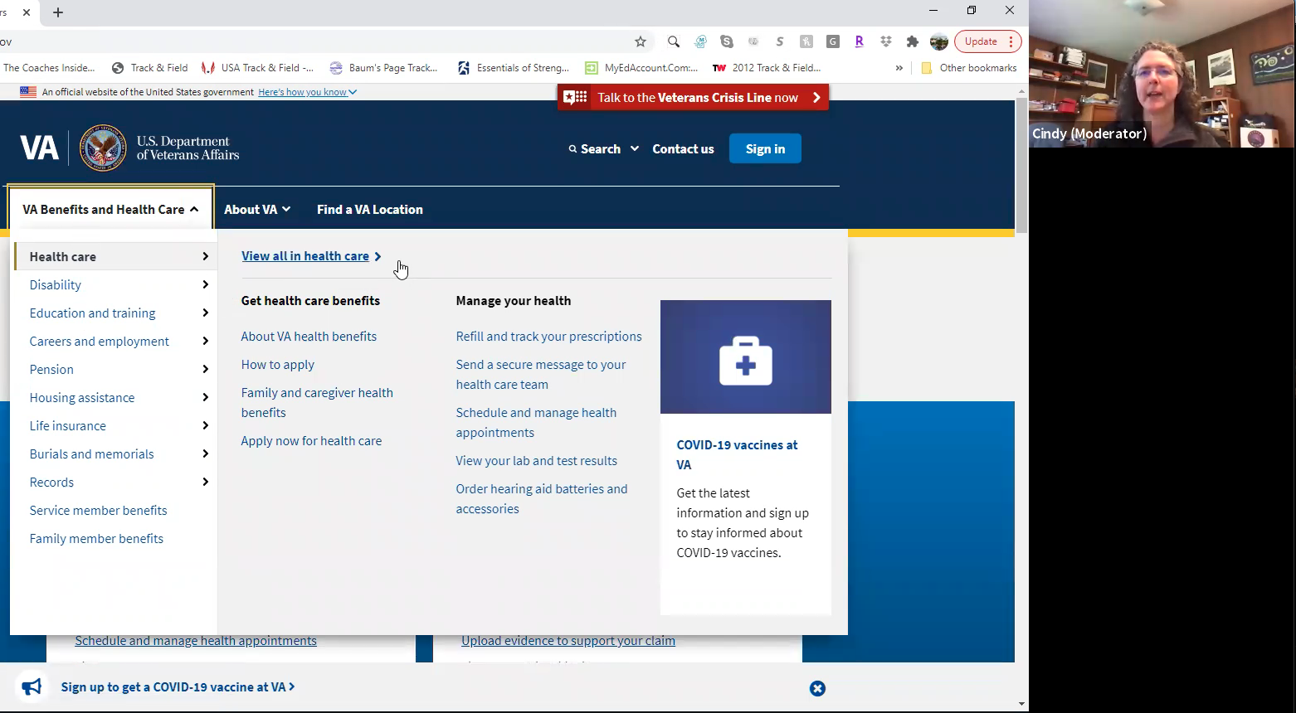
Product Highlights: Wayfinding User Research
Modernized Find a VA Form
Team researcher conducted study April 26 – May 5
Recommendations based on study analysis was shared with the team
Most recommendations are addressed in our next release for early July
Disregard articles “a”, “an”, “the”
Disregard prepositions – “of”, “for”
Disregard helper words such as “how do I”
Handle minor misspellings

Slide 4
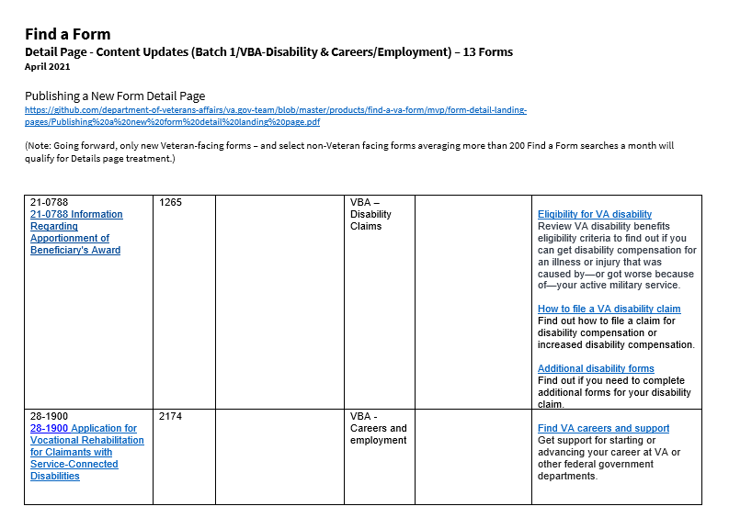
Product Highlights: Content Enhancements
Modernized Find a VA Form
We identified the 100 most searched forms
60 of the top 100 lacked detail pages
Split into three content requests organized by VBA and VHA (and their program offices)
Content team writing "When to Use“ text and where possible adding "Related Forms" and/or "Helpful Links“ info
Content team has completed first batch and is ready for VA subject matter expert to review
Once reviewed and approved, info will be entered into the Content Management System
Moving forward, any form with 200+ searches per month will receive a detail page (except OF and SF)

Slide 5
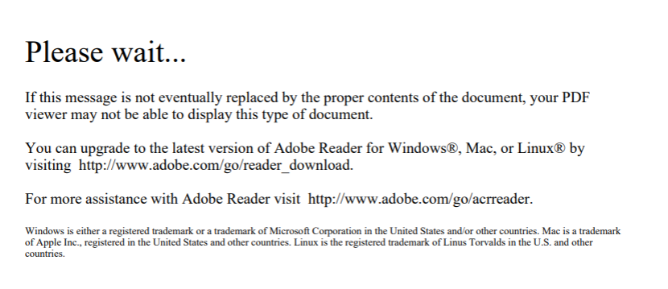
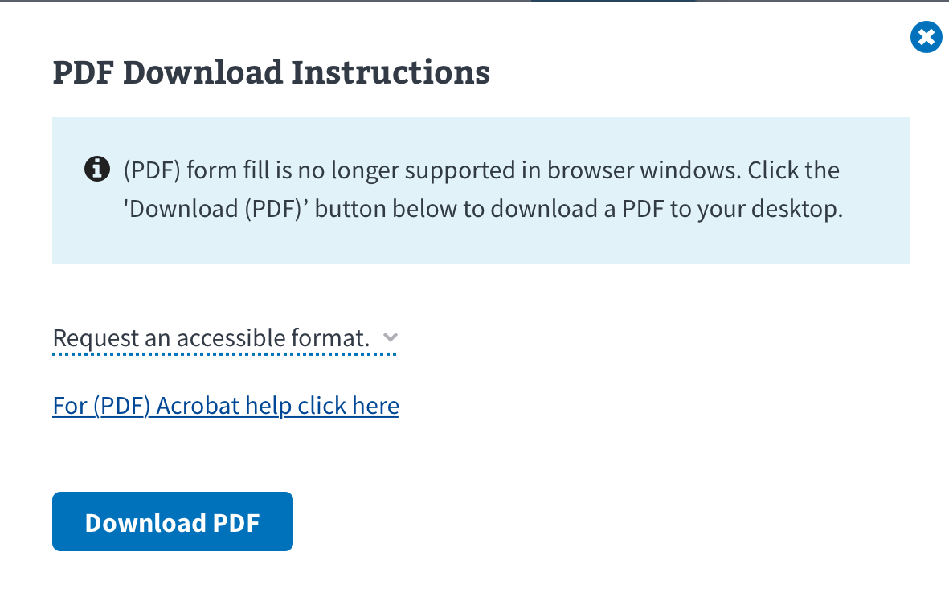
Product Highlights: PDF Download Instructions
Modernized Find a VA Form
Some PDF forms are browser-incompatible (ex: 10-0003k)
Adobe acknowledges issue, recommends downloading to device/computer, opening with Adobe Acrobat Reader DC
Find a Form already uses an HTML attribute to force PDF download when hosted on VA.gov; not supported by all web browsers
Find a VA Form will soon display assistive text beside PDF links to improve user experience
DRAFT OPTION A

Slide 6
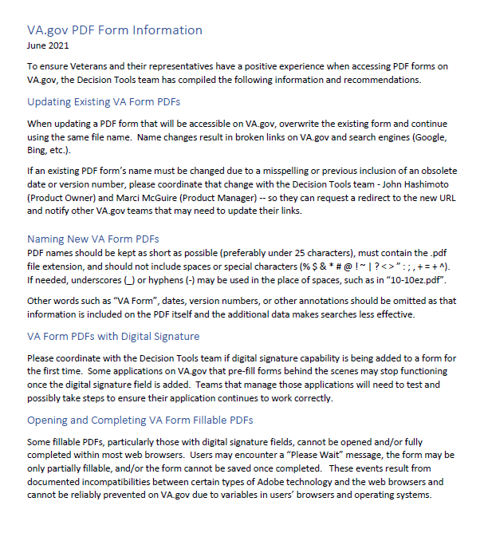
Product Highlights: Updated PDF Recommendations
Modernized Find a VA Form
After meeting with a VA Adobe representative, we revised the PDF form recommendations distributed last month
It’s our understanding that VHA and VBA now use Adobe Designer, which is supported by OIT
Numerous older PDF forms were created with Adobe software no longer supported by Adobe or OIT, but are not currently causing issues for users
Find a VA Form will soon provide PDF download instruction to assist users with some forms containing digital signature
Renaming PDF forms is something we need to closely monitor; can cause broken links, harm search engine ranking

Slide 7
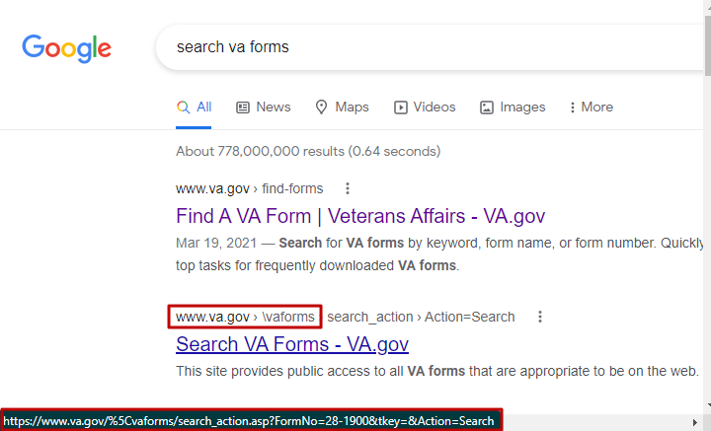
Product Highlights: Modified Legacy URLs
Modernized Find a VA Form
We recently learned that some URLs on the legacy VA Forms page have changed in a way that prevents them from being redirected to the modernized application
All affected URLs now contain a back slash (\), which is converted to its ASCII equivalent %5C when parsed in a browser. Ex: https://www.va.gov/%5Cvaforms/
Bulk redirects in late 2020 were not configured to include this previously unencountered type of URL
Some changed legacy URLs have been indexed by search engines and now appear alongside or above modernized Find a VA Form links
We’ve made Kevin Reid aware of this issue – and also renewed our request/recommendation that the legacy Search for VA Forms tool be “retired.”
Meantime, we will open a new redirect request this week to point these updated legacy URLs to the new experience

Slide 8
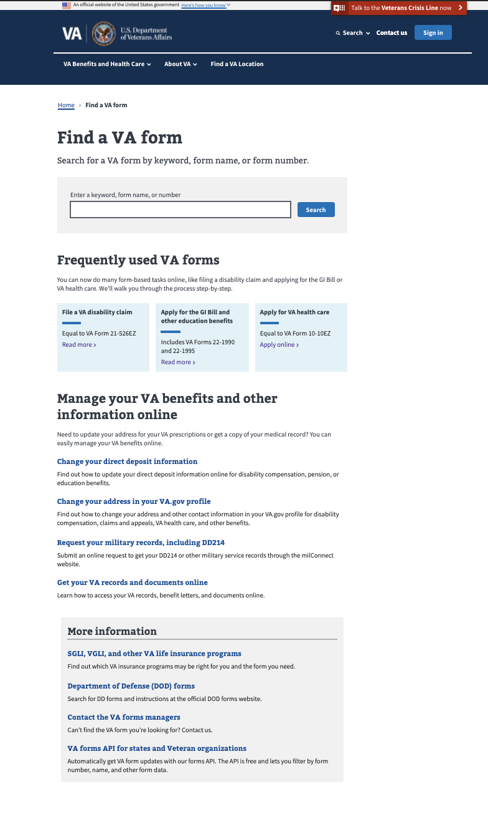
Metrics - Landing Page
Modernized Find a VA Form
Unique Page Views: 124,234 (16% decrease from April)
Unique Searches: 144,830 (14% decrease)
Bounce rate: 16.15% (0.54% increase)
Search refinement rate: 41.62% (3% decrease)
Top Forms Searches in May:
Frequently used VA forms clicks: 9,748
Manage Your VA Benefits clicks: 6,050
Overall VA.gov pageviews were down 8.23% in May Avg VA.gov bounce rate: 38.55%
10-2850c
21-526e
21-4138
20-0995
21-22
10-2850a
21-686c
21-2680
20-0996
dd214

Slide 9
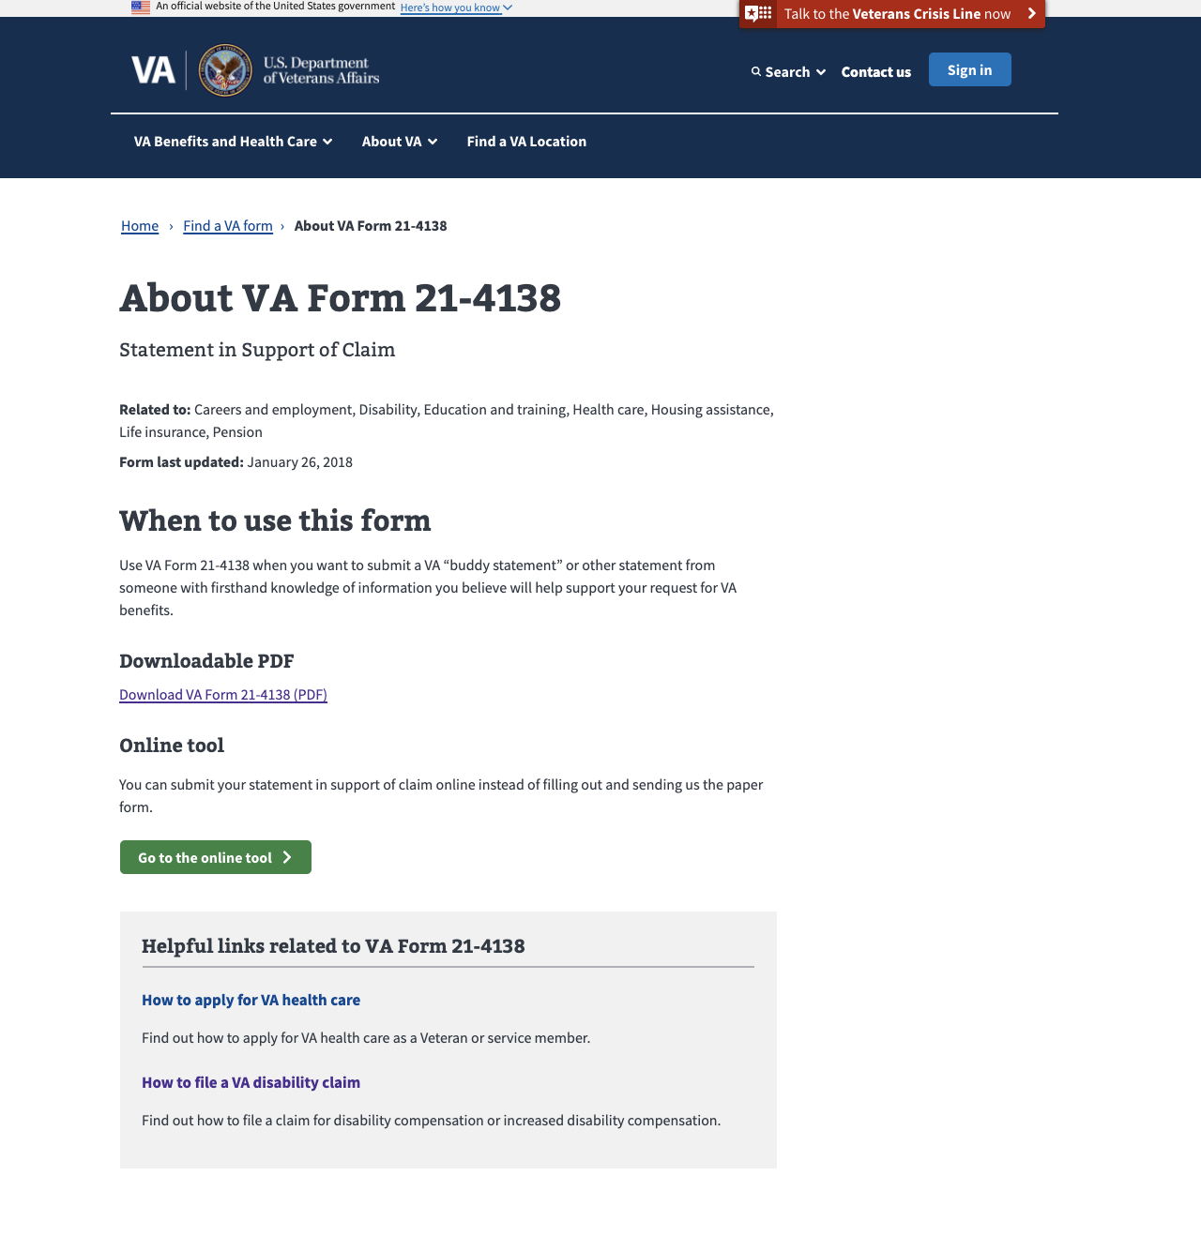
Metrics – Detail Pages
MODERNIZED Find a vA Form
Total Unique Page Views: 169,979 (down 8%)
Top 5 PDF Downloads from Detail Pages:
21-4138 (8,832)
20-0995 (4,613)
10-10172 (4,232)
10-5345 (4,187)
10-2850C (4,161)

Slide 10
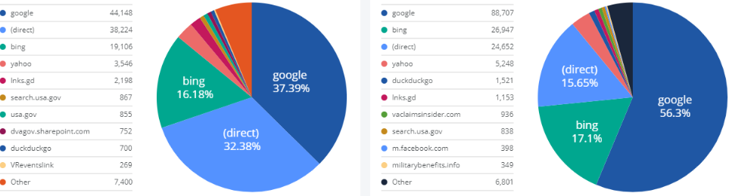
Metrics: Key Actions & Drivers
Modernized Find a VA Form
Conversion Rate: 64.38% (3% increase over April)
Total VA Form PDF Downloads: 168,275 (8% decrease)
Landing Page: 52,225 (10% decrease)
Detail Pages: 116,050 (8% decrease)
Total Online Tool Clicks: 15,998 (8% decrease from April)
Landing Page: 3,771 (2% decrease)
Detail Pages: 12,227 (9% decrease)
Top Sources of Traffic:
Landing Page
Detail Pages

Slide 11
Ahead: Product Team Focus
MODERNIZED Find a vA Form
Q2 2021
Improved Search experience for whole word queries e.g., “direct deposit” and ranked based on popularity - early July release
Updated UI to improve user experience and create consistency across search tools
PDF download instructions
Ongoing
Link to new digital applications as they come online to encourage veterans to self-serve and speed time to outcomes

