Slide 1

Update Modernized Find a VA Form 1.0
February 2021

Slide 2
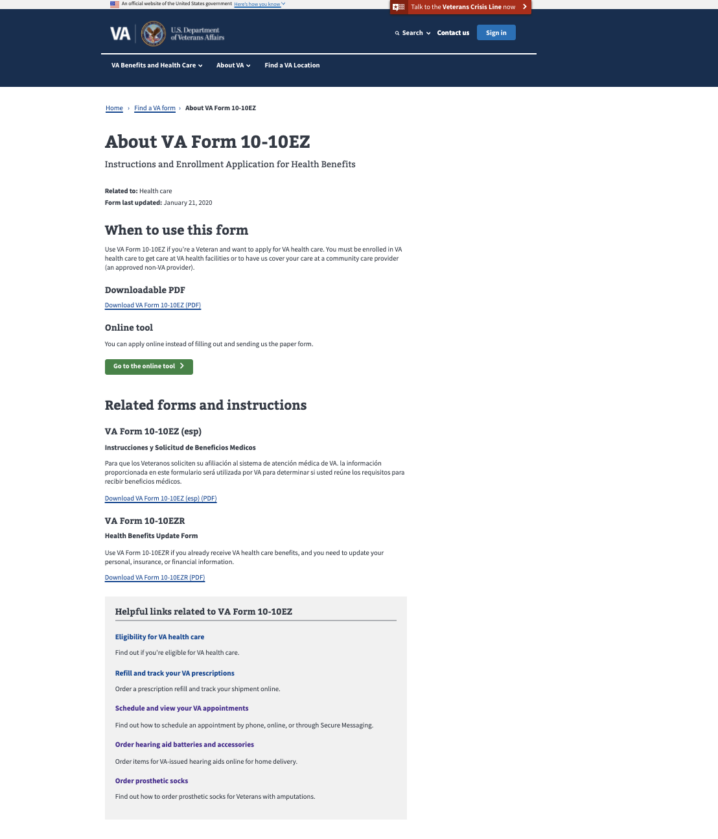
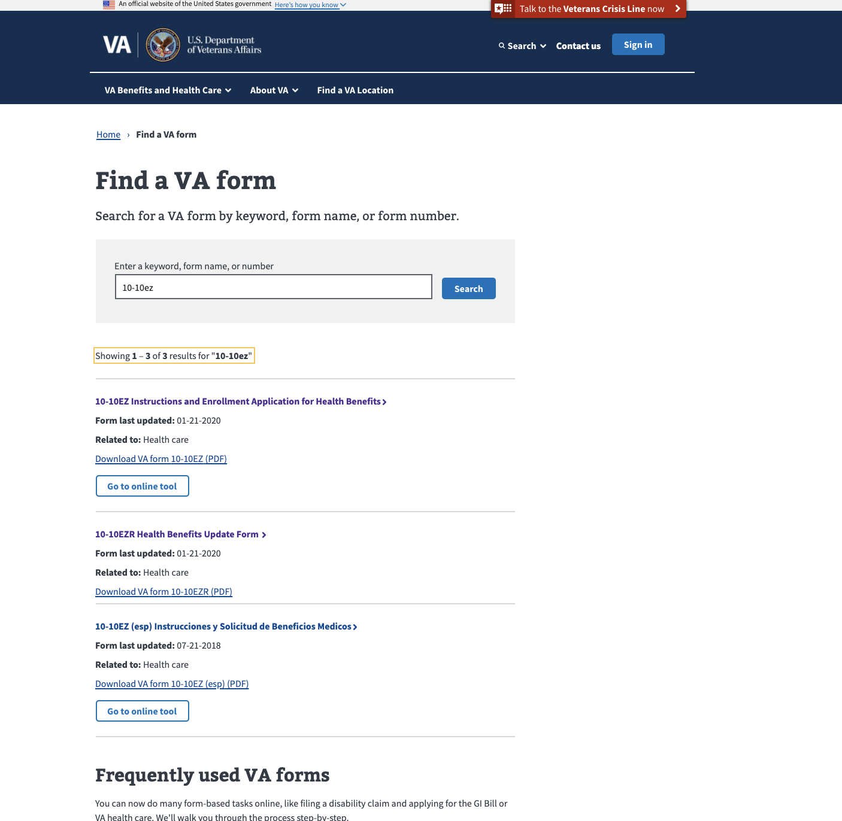
Latest Releases: Connecting Search to Details Page
Modernized Find a VA Form
Notes:
Live week of January 18th.

Slide 3
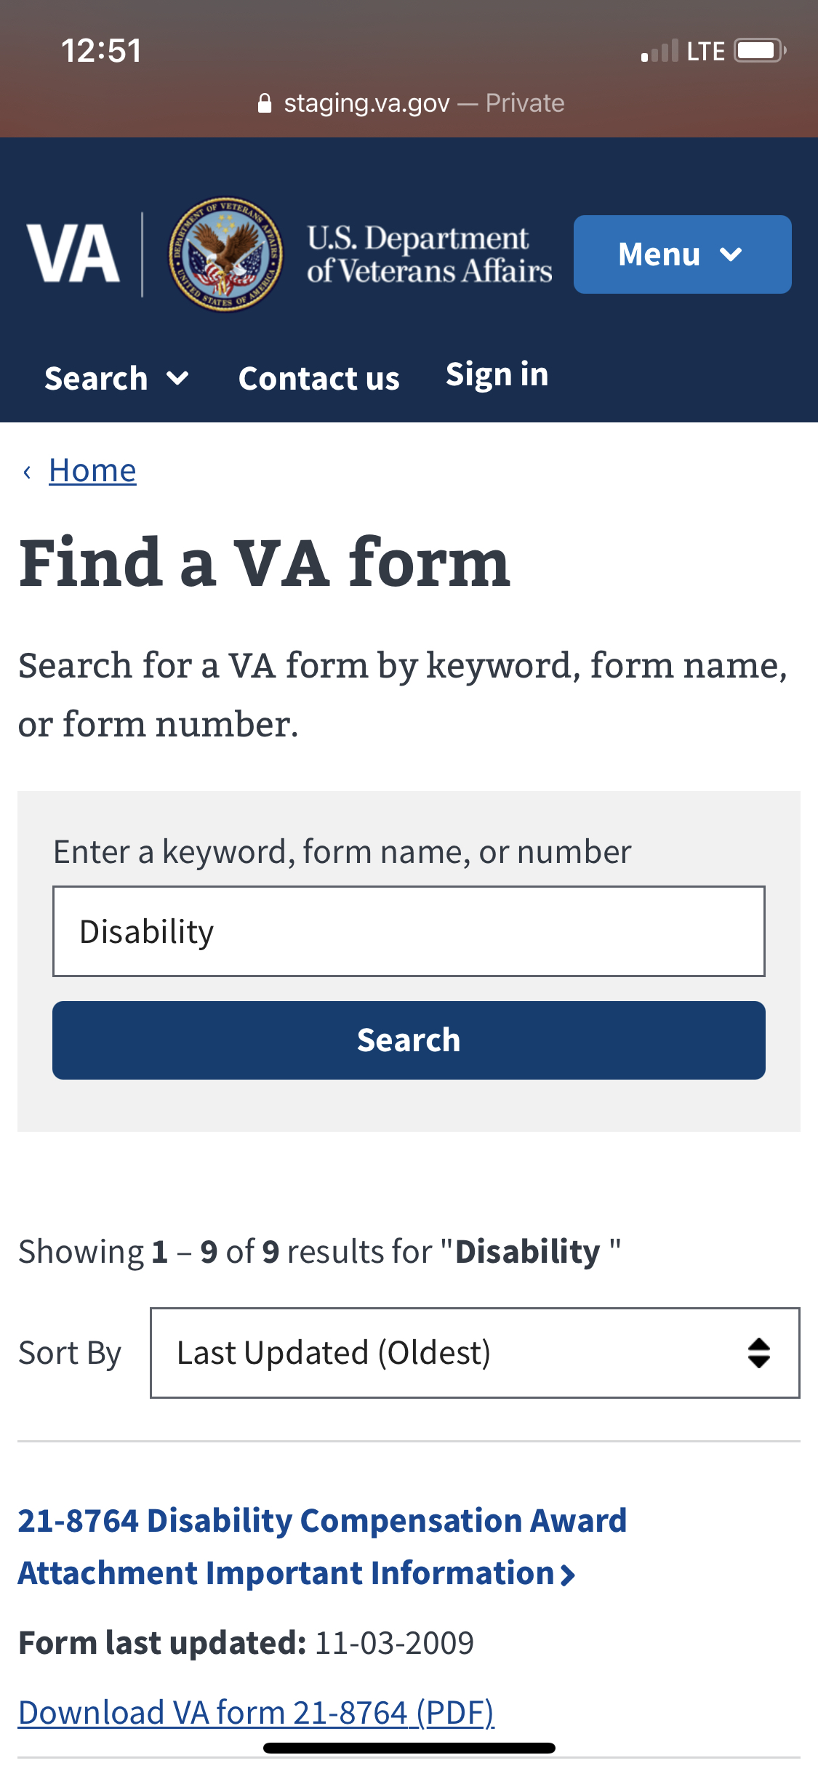
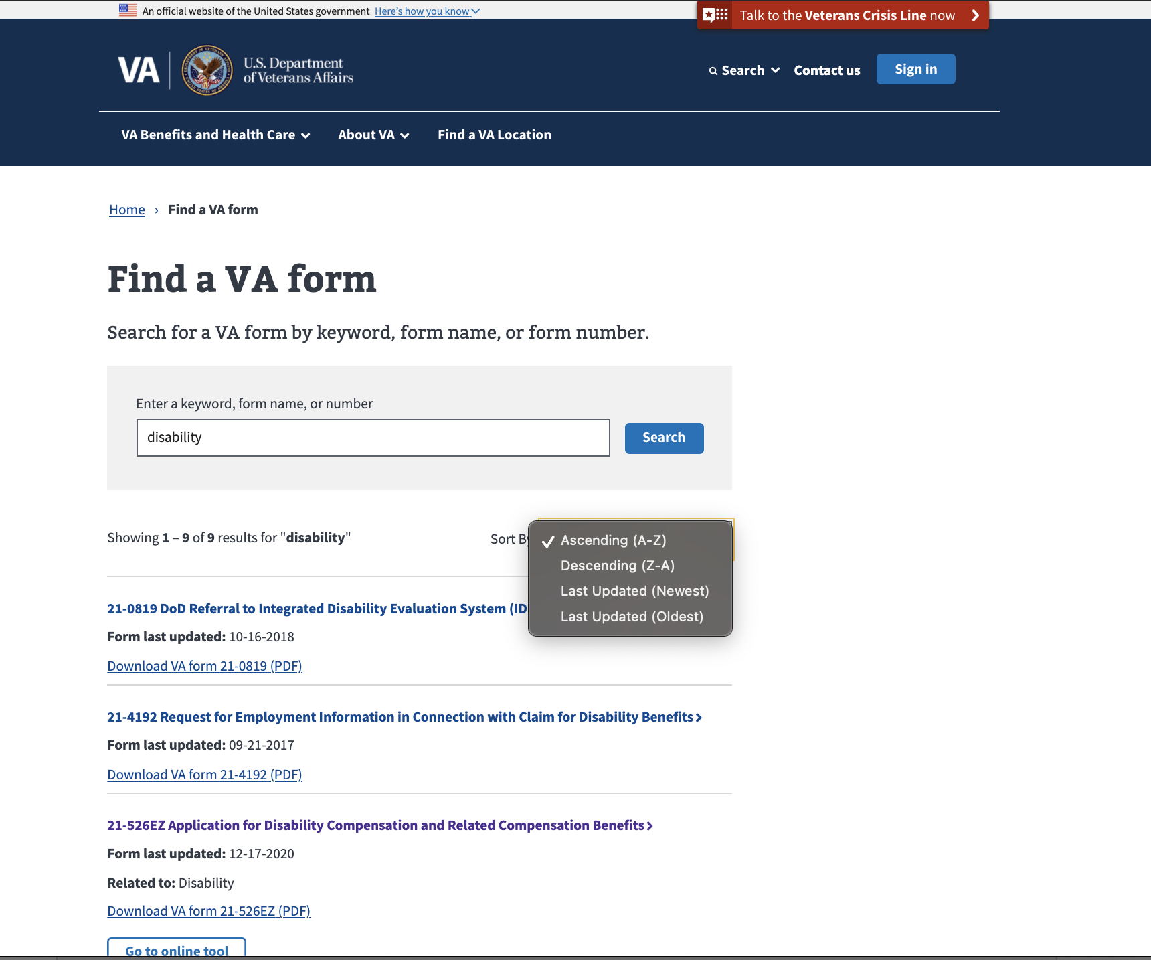
Latest Releases: Search Sorting Feature
Modernized Find a VA Form

Slide 4
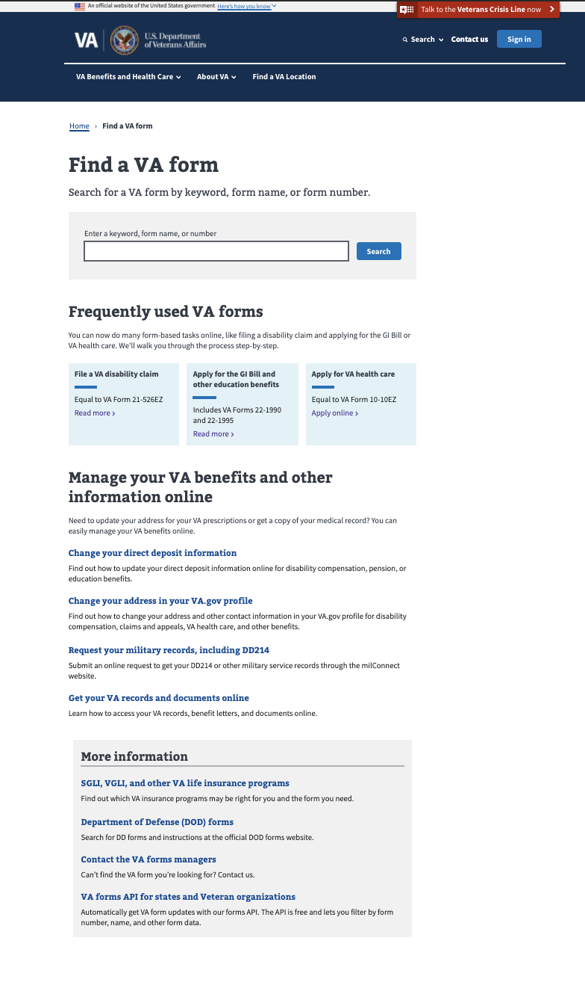
Metrics - Landing Page
Modernized Find a VA Form
Unique Page Views: 41% increase since launch -- 425,887 in July to 600,317 in January. Monthly average page views: 476,542, with average growth rate of 6.6%.
Bounce rate: 18%
Searches: 14% increase from January to December (holiday lull).
Monthly average form searches: 175,000
Search refinement rate: 51%
Top Forms Searched:
10-2550c
10-2850a
21-526ez
21-4138
20-0995
Frequently used VA forms clicks: 12,158 in January
21-22
10-2850
20-0996
21-2680
21-686c

Slide 5
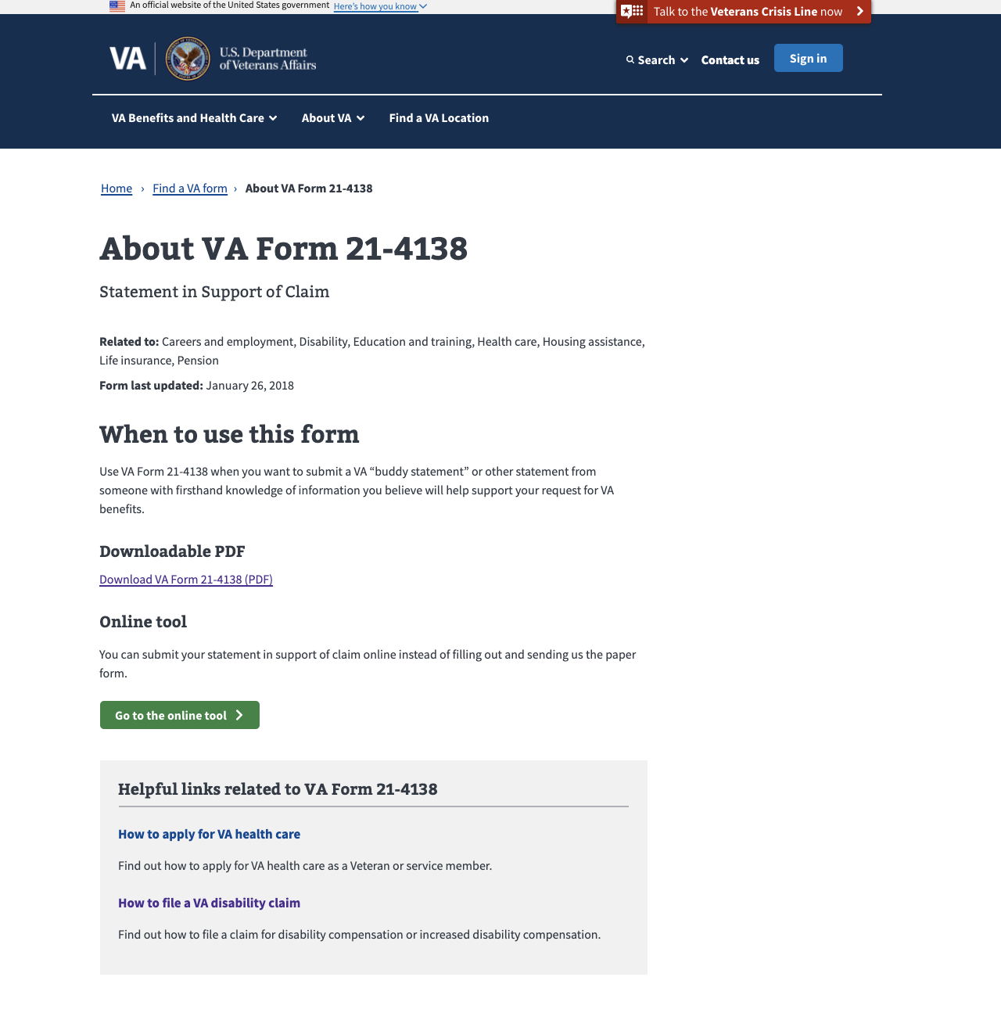
Metrics – Detail Pages January 2021
MODERNIZED Find a vA Form
Total Unique Page Views: Rose 24% to 173,000 in January after a holiday slowdown in December.
Top 5 Downloaded PDFs per Page:
21-4138 (16,680)
10-5345 (16,473)
20-0995 (12,917)
21-526ez (10,055)
10-7959c (8,636)

Slide 6
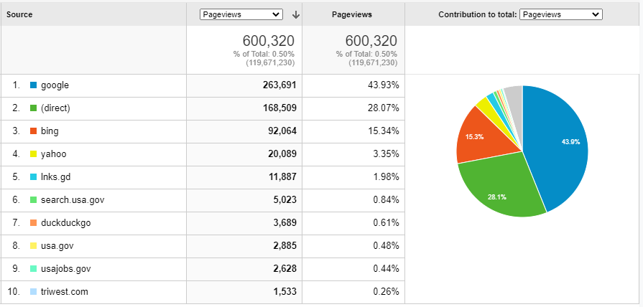
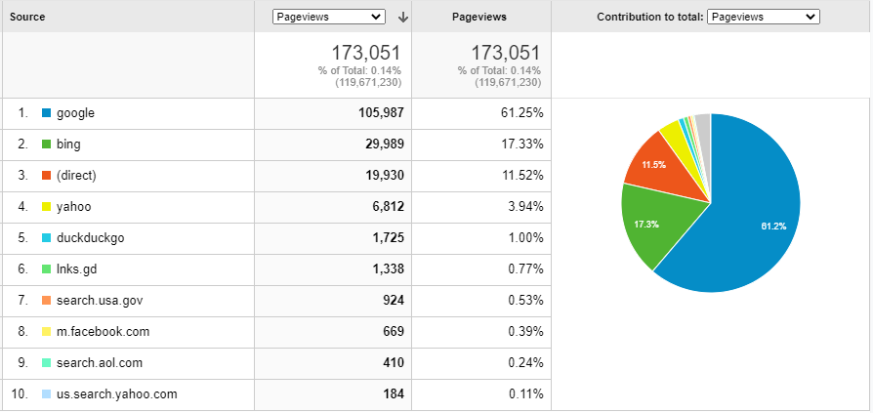
Metrics: Key Actions & Drivers January 2021
Modernized Find a VA Form
Total VA Form PDF Downloads: 193,683
Landing Page: 85,737
Details Pages: 107,946
Total Online Tool Clicks: 9,720
Landing Page: 1,224
Details Pages: 8,496
Top Sources of Traffic
Landing Page
Details Pages

Slide 7
Product Team Focus
MODERNIZED Find a vA Form
Q1/Q2 2021
Improving Search experience
Discovery for VA forms management Proof of Concept (POC)
Ongoing
Link to new digital applications as they come online to encourage veterans to self-serve and speed time to outcomes

