Slide 1

Update Modernized Find a VA Form 1.5
July 2021

Slide 2
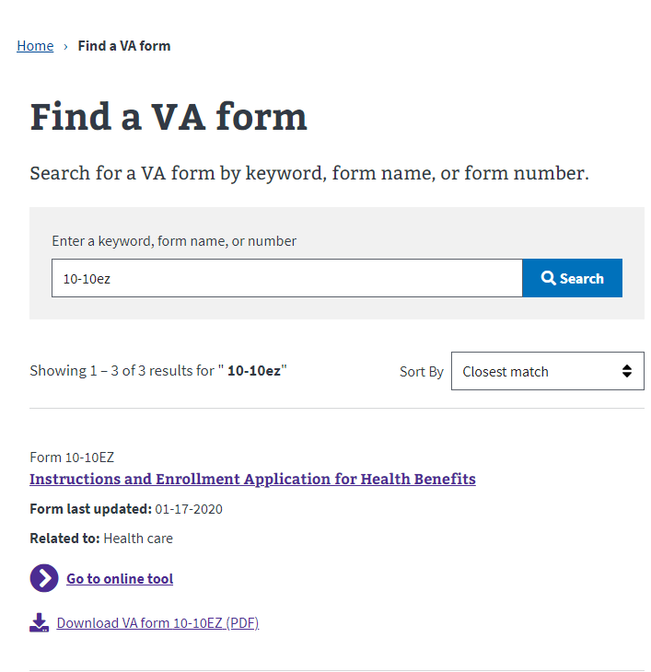
Product Highlights: Find a VA Form 1.5
Modernized Find a VA Form
Forms API search logic now ignores common words (a, an, the, of, for), matches on root words, handles minor typos
Form popularity is used to determine order in which search results are displayed
Results can be sorted by closest match (relevance)
UI updates make Find a Form more consistent with other VA.gov search tools

Slide 3
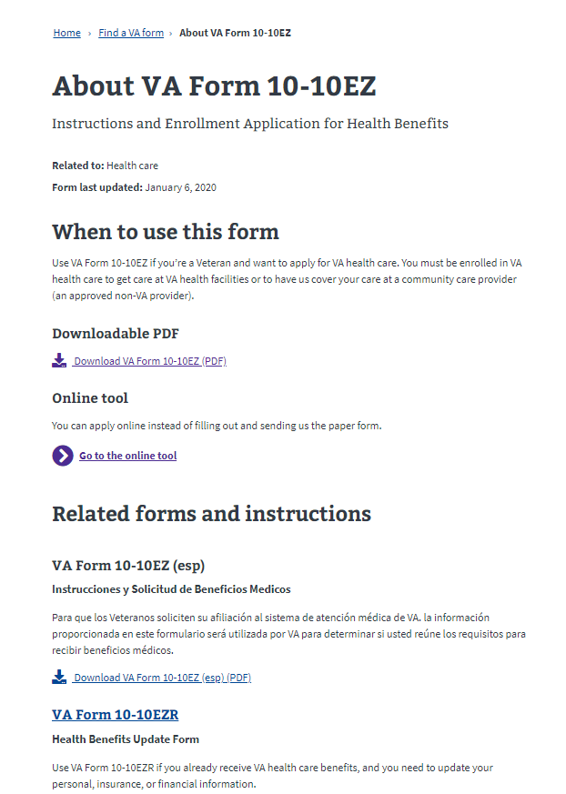
Product Highlights: Find a VA Form 1.5
Modernized Find a VA Form
PDF and online tool links are more visible within the page content
Related forms listed on detail pages now link to applicable form page(s)

Slide 4
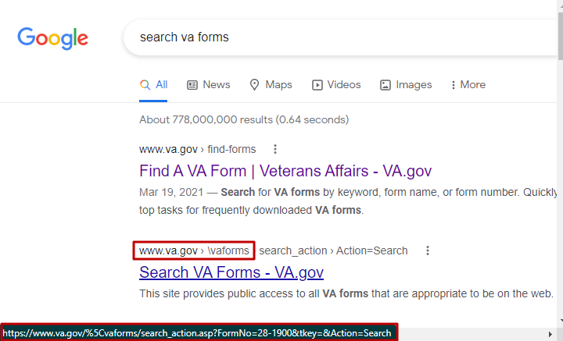
Product Highlights: Legacy URL Redirects
Modernized Find a VA Form
In June we learned that some URLs on the legacy VA Forms page had changed in a way that prevents them from being redirected to the modernized application
All affected URLs contain a back slash (\), which is converted to its ASCII equivalent %5C when parsed in a browser. Ex: https://www.va.gov/%5Cvaforms/
Bulk redirects in late 2020 were not configured to include this previously unencountered URL format
Some changed legacy URLs have been indexed by search engines and now appear alongside or above modernized Find a VA Form links
We’ve made Kevin Reid aware of this issue – and also renewed our request/recommendation that the legacy Search for VA Forms tool be “retired.”
These redirects will go into effect on July 15, 2021.

Slide 5
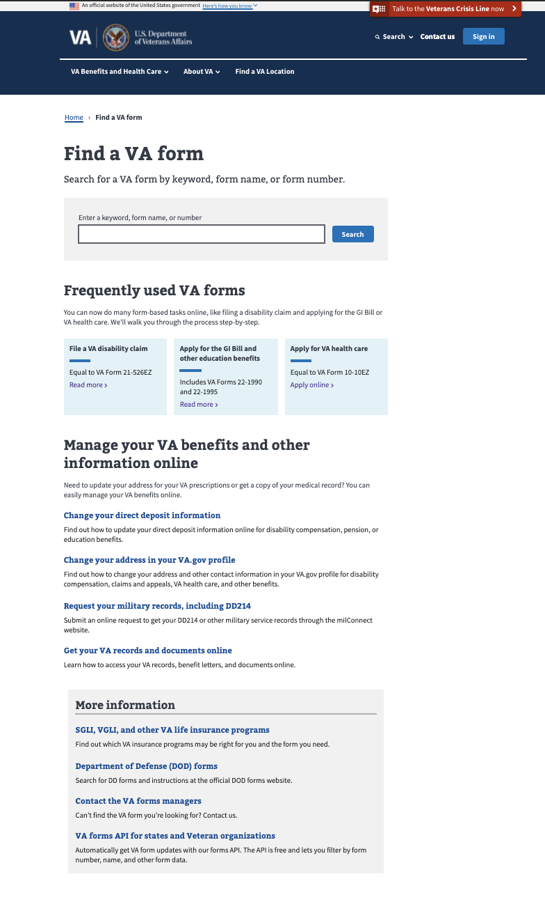
Metrics - Landing Page
Modernized Find a VA Form
Unique Page Views: 123,323 (flat)
Unique Searches: 145,425 (flat)
Bounce rate: 15.20% (6% decrease)
Search refinement rate: 41.62% (3% decrease)
Top Forms Searches in June:
Frequently used VA forms clicks: 8,774 (8% increase)
Manage Your VA Benefits clicks: 5,590 (6% increase)
21-526ez
21-4138
21-22
20-0995
10-2850c
21-2680
21-686c
20-0996
21-4142
21-0966

Slide 6
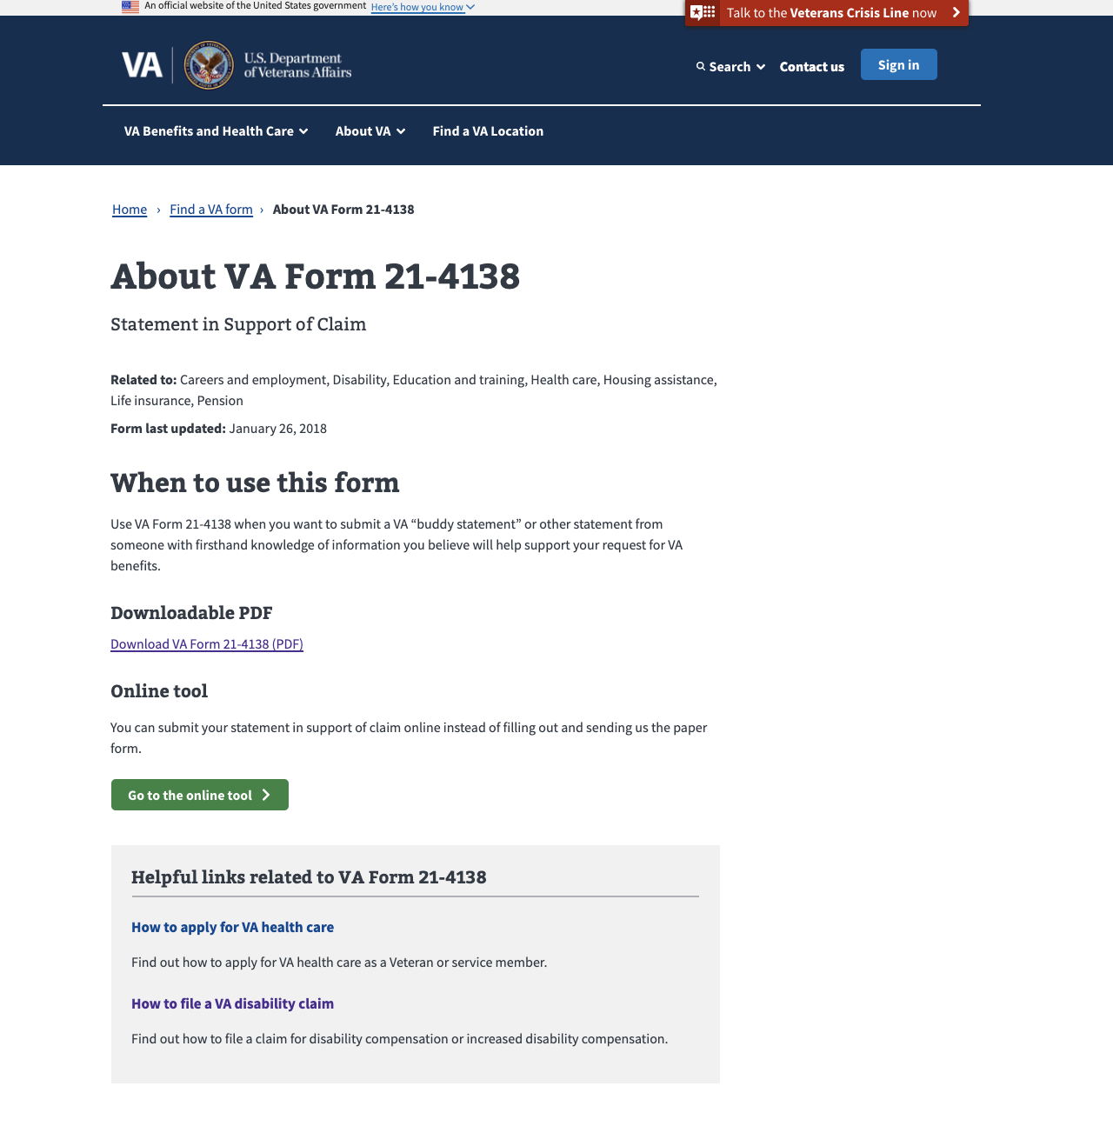
Metrics – Detail Pages
MODERNIZED Find a vA Form
Total Unique Page Views: 170,546 (up 5%)
Top 5 PDF Downloads from Detail Pages:
21-4138 (9,445)
10-10172 (5,734)
20-0995 (4,875)
10-5345 (4,366)
21-526EZ (4,260)

Slide 7
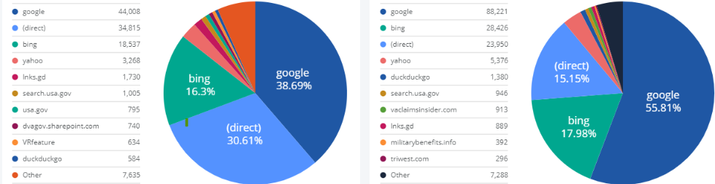
Metrics: Key Actions & Drivers
Modernized Find a VA Form
Conversion Rate: 65.56% (2% increase over May)
Total VA Form PDF Downloads: 174,695 (4% increase)
Landing Page: 52,237 (flat)
Detail Pages: 122,458 (6% increase)
Total Online Tool Clicks: 17,677 (11% increase from May)
Landing Page: 4,035 (7% increase)
Detail Pages: 13,642 (12% increase)
Top Sources of Traffic:
Landing Page
Detail Pages

Slide 8
Ahead: Product Team Focus
MODERNIZED Find a vA Form
Q3/Q4
PDF download research study
Add PDF download instructions to Find a VA Form
Keywords for common abbreviations
Possible proof of concept for digital signature PDF alternative
Ongoing
Link to new digital applications as they come online to encourage veterans to self-serve and speed time to outcomes
Add search keywords as requested by VA stakeholders

