Slide 1

Find a VA Form Product Roadmap
March 2021

Slide 2
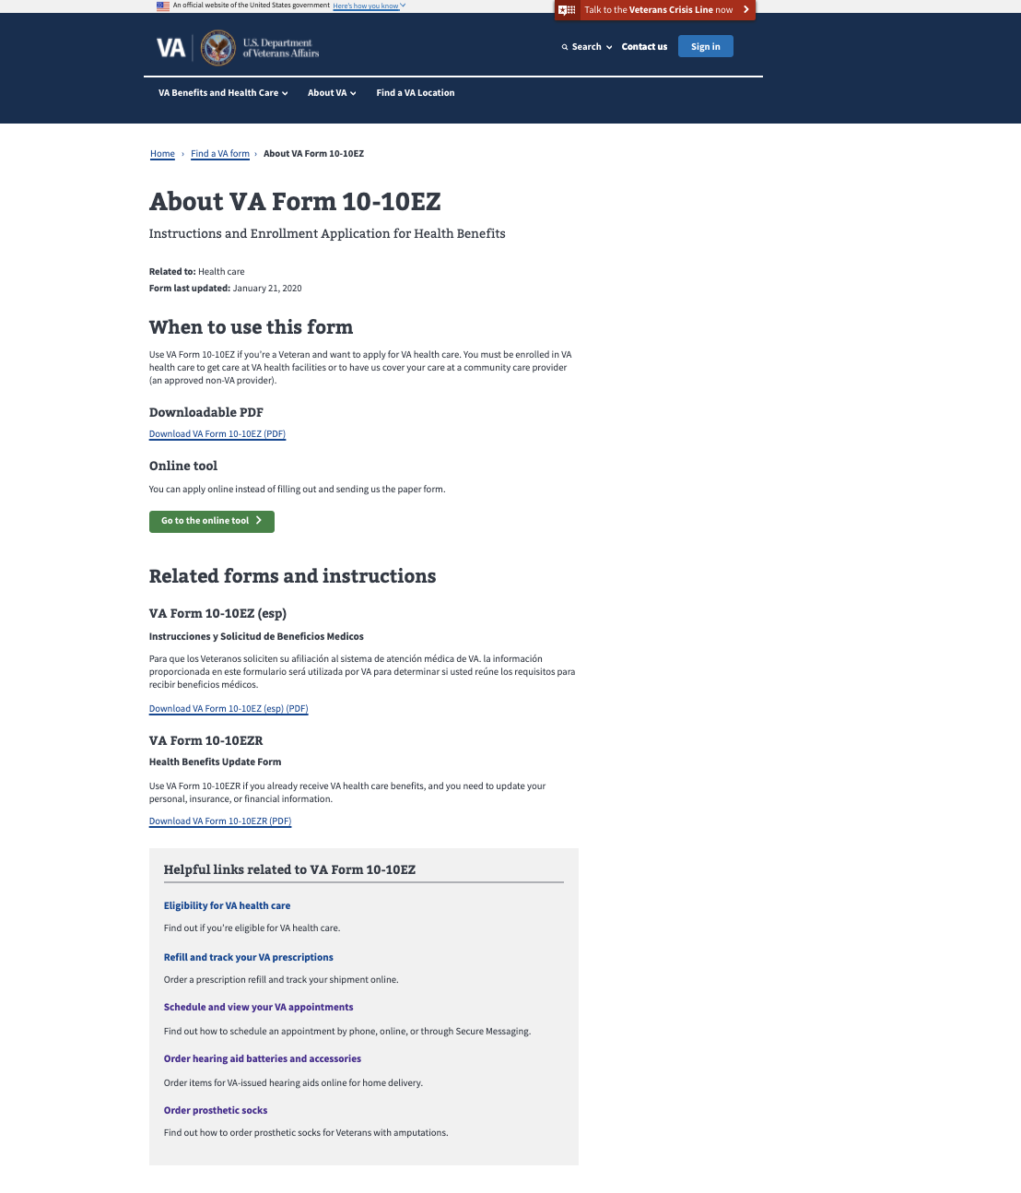
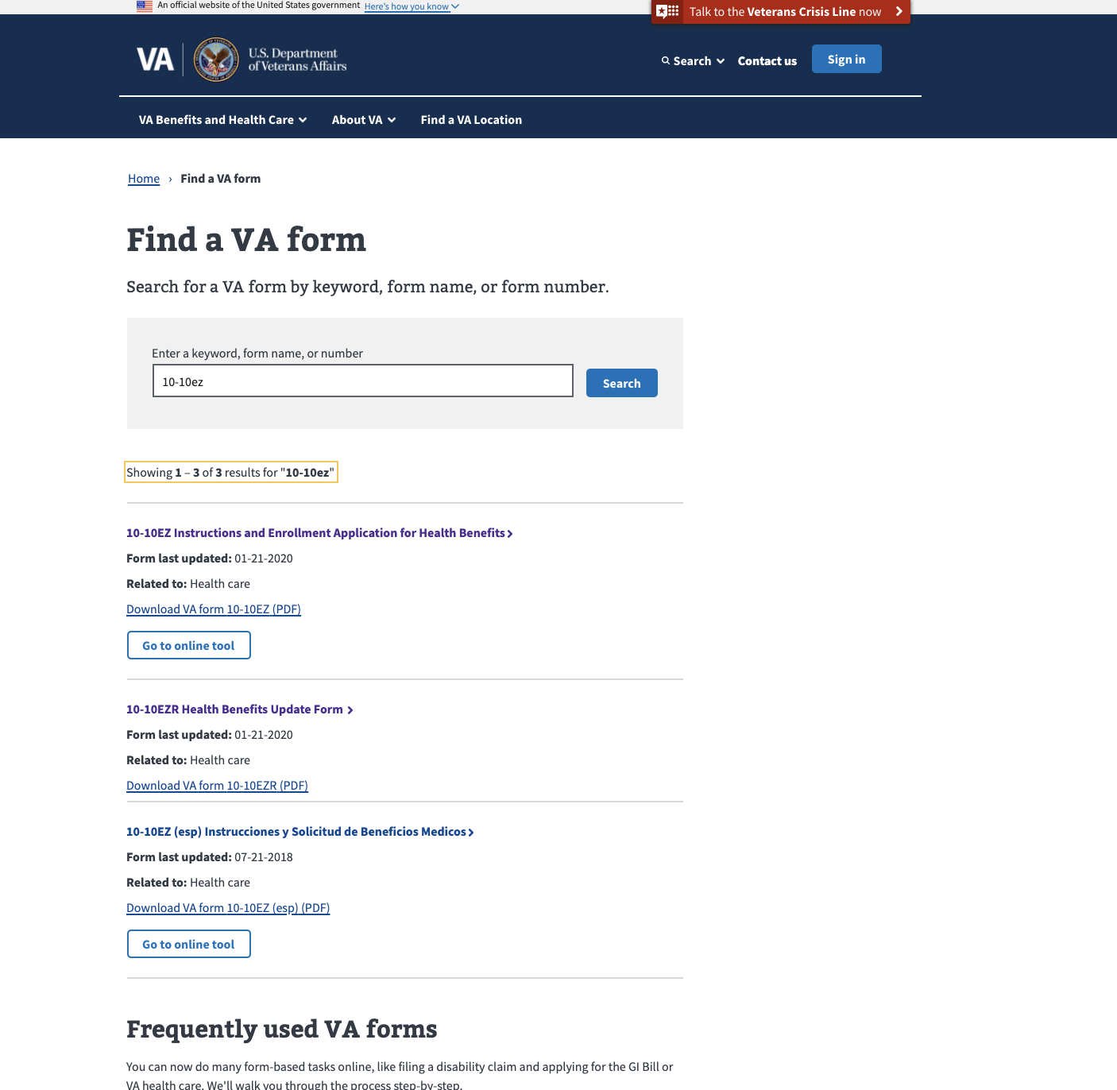
Latest Releases: Connecting Search to Details Page
Modernized Find a VA Form
Notes:
Live week of January 18th.

Slide 3
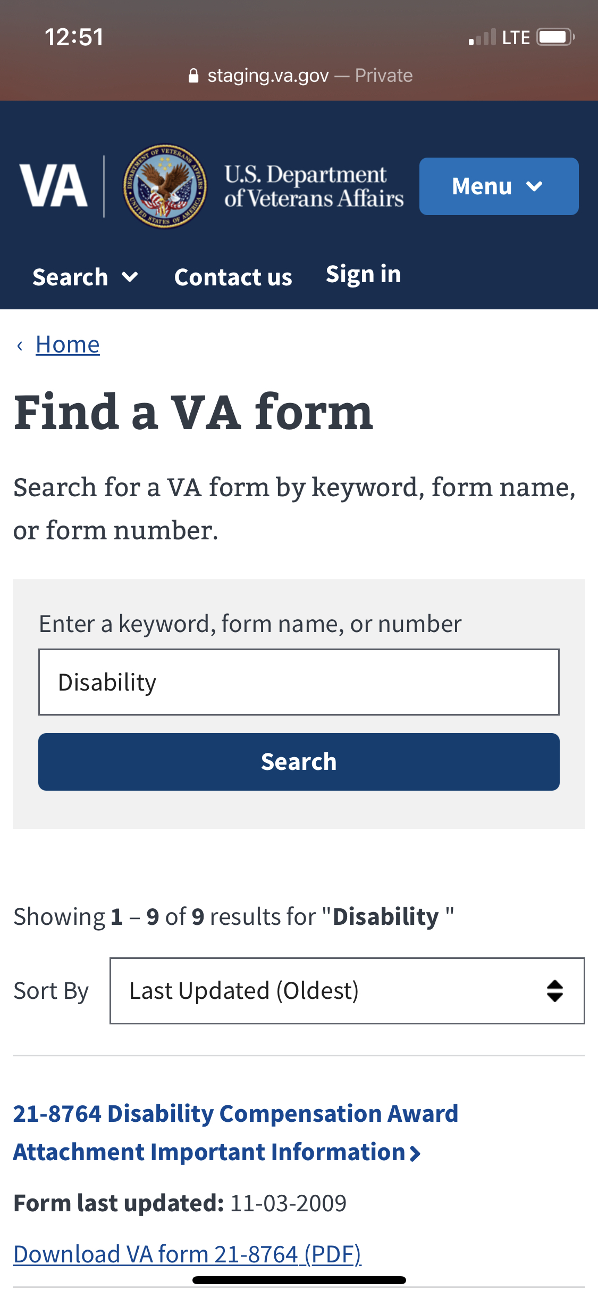
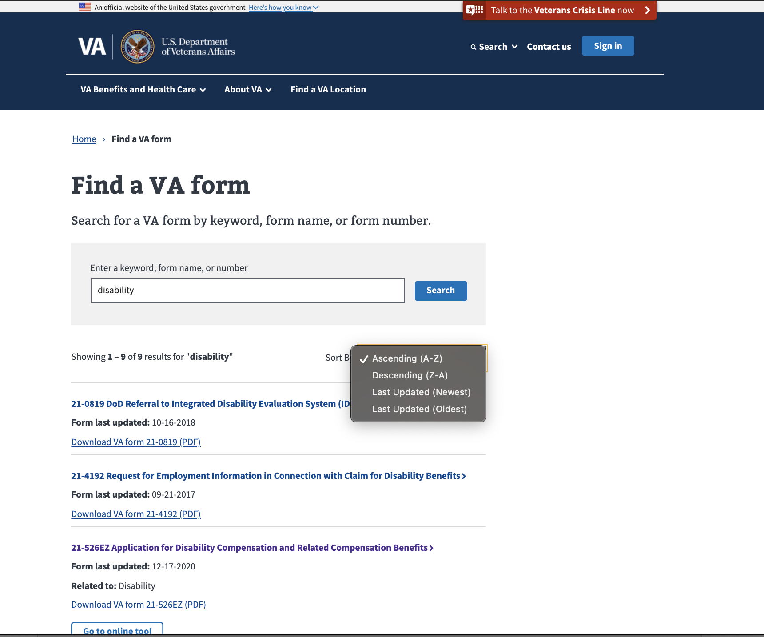
Latest Releases: Search Sorting Feature
Modernized Find a VA Form

Slide 4
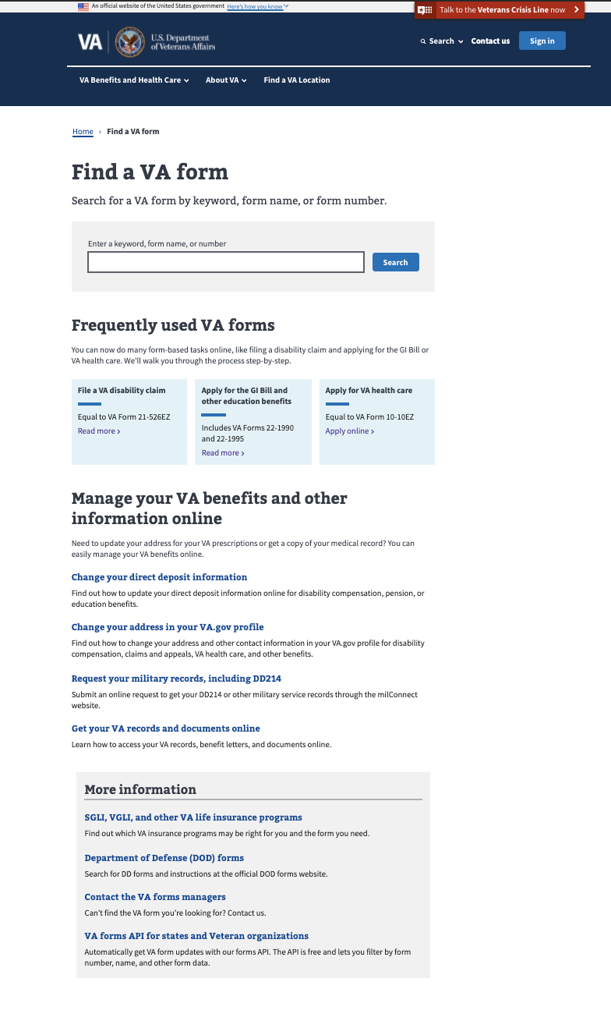
Metrics - Landing Page
Modernized Find a VA Form
Unique Page Views: Monthly average page views: 155,023 with average growth rate of 1%.
Average Monthly Bounce rate: 18%
Unique Searches: 8% decrease from January to February.
Monthly average form searches: 174,561
Search refinement rate: 48% (1.4% decrease)
Top Forms Searched:
10-2850c
10-2850a
21-526ez
21-4138
20-0995
Frequently used VA forms clicks: 10,895 in February
21-22
10-10ez
10-2850
dd214
20-0996

Slide 5
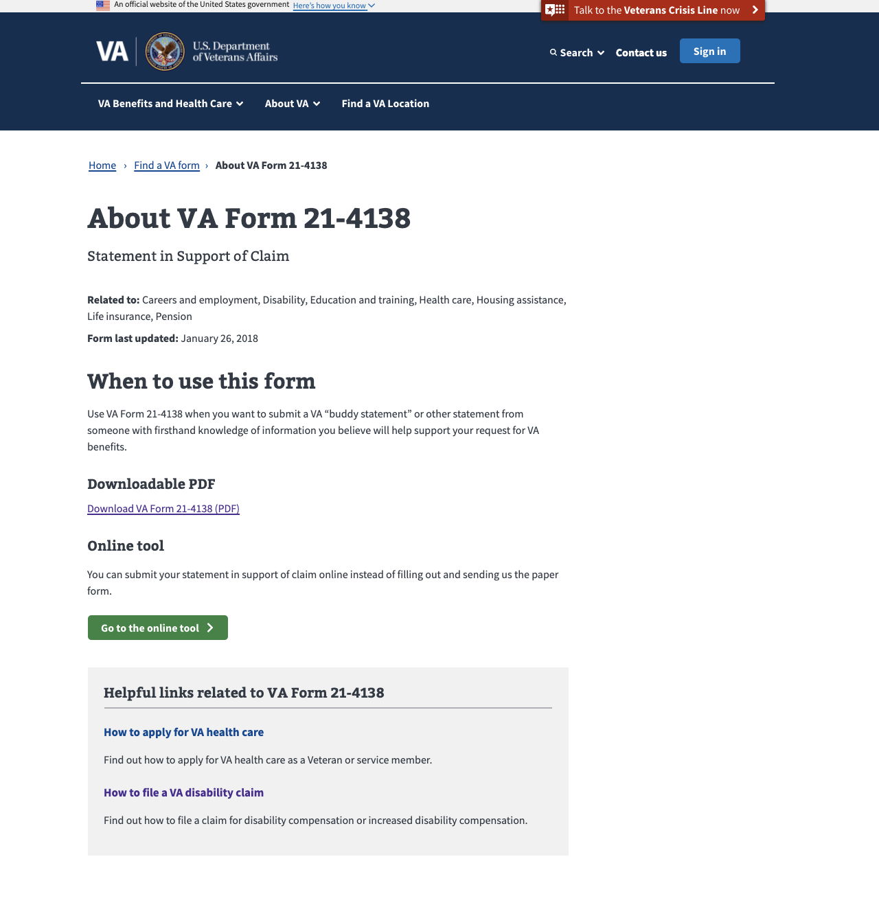
Metrics – Detail Pages February 2021
MODERNIZED Find a vA Form
Total Unique Page Views: Rose 14% to 172,378 in February.
Top 5 Downloaded PDFs per Page:
21-4138 (9,702)
10-5345 (6,548)
20-0995 (6,383)
10-10172 (5,026)
21-526EZ (4,808)

Slide 6
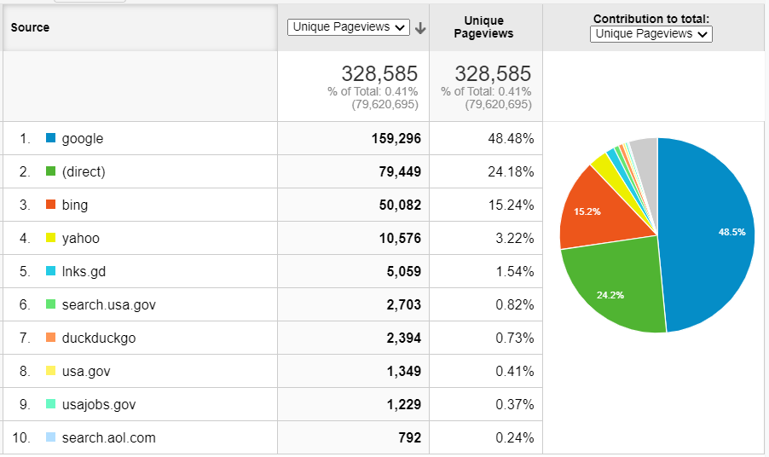
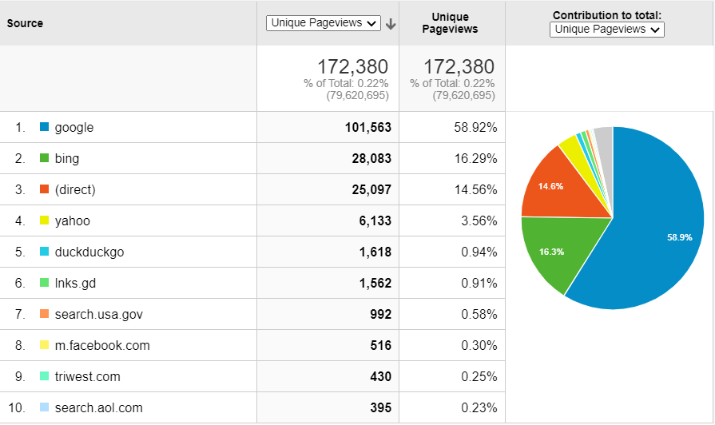
Metrics: Key Actions & Drivers February 2021
Modernized Find a VA Form
Total VA Form PDF Downloads: 190,389
Landing Page: 62,065
Details Pages: 128,324
Total Online Tool Clicks: 15,607
Landing Page: 3,457
Details Pages: 12,150
Top Sources of Traffic
Landing Page
Details Pages

Slide 7
Form Data Inconsistencies
MODERNIZED Find a vA Form
Below assessment based on 2/26/2021 data pull via Lighthouse API
21 form names inconsistent with linked PDF name
11 forms with duplicate records
92 forms with invalid PDF links
59 forms with problematic PDF links (characters, formatting)
13 forms with PDF links that don’t resolve to PDF forms
600+ questionable/missing dates
Form names do not appear to be standardized
PDF link formats do not appear to be standardized
Full assessment can be viewed here

Slide 8
VA Collaboration Areas Needed
MODERNIZED Find a vA Form
Form data inconsistencies
CMS form management proof of concept (POC)
Unique identifier to prevent duplicate records of the same form, orphaned links when a form is retired

