Slide 1

Update Modernized Find a VA Form 1.0
January 2021

Slide 2
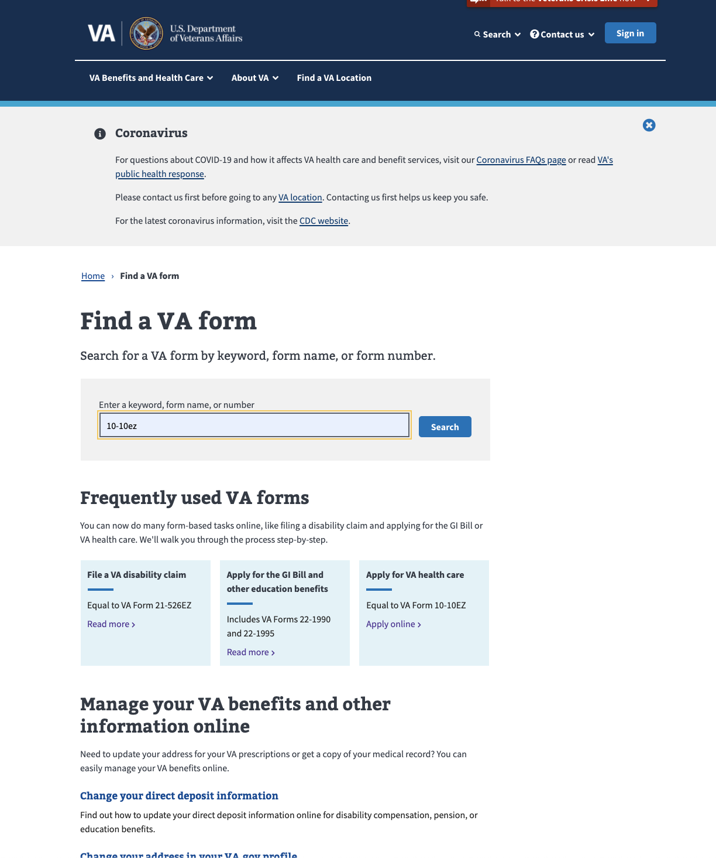
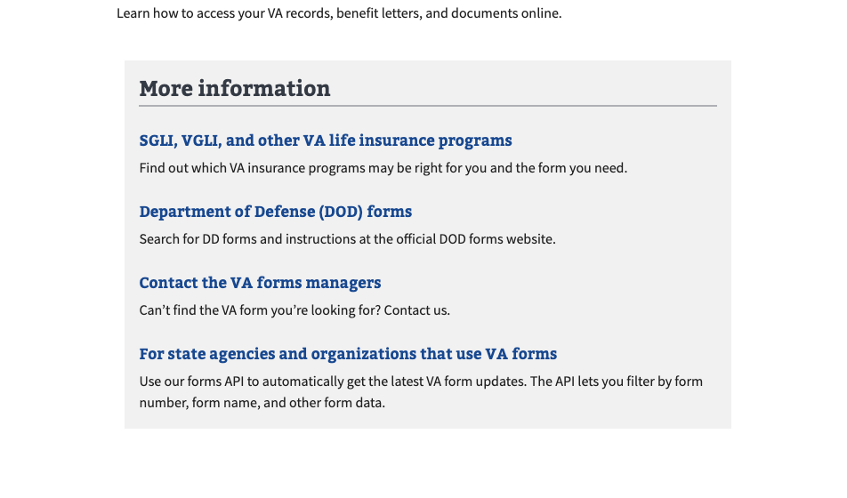
Metrics: Find a VA Form (Dec 1 – Jan 1)
Modernized Find a VA Form
Unique pageviews compared to previous month remained nearly the same (0.10% increase)
Bounce rate from search page decreased by 2%
Clicks on 6 of the Top Tasks links on the search page saw double digit increases ranging from 11% to 44%
Clicks on 9 of the top 10 More Information links saw increases ranging from 4% to 92%

Slide 3
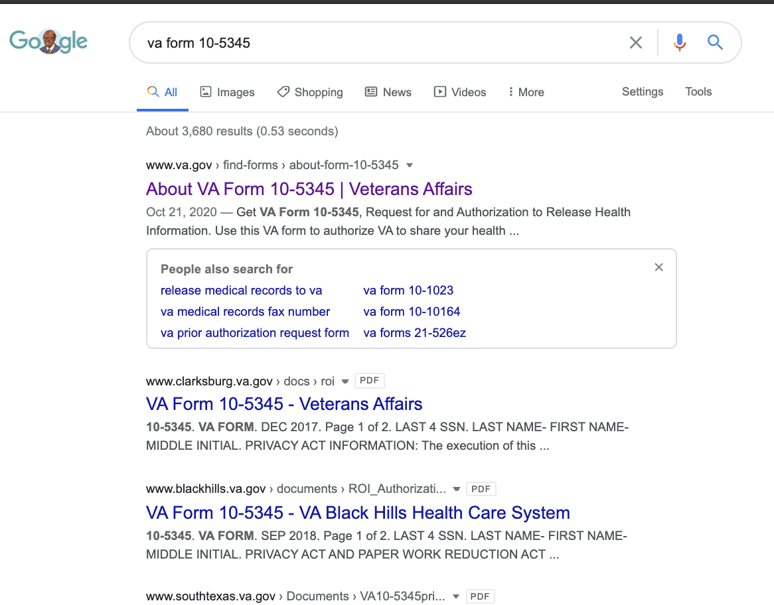
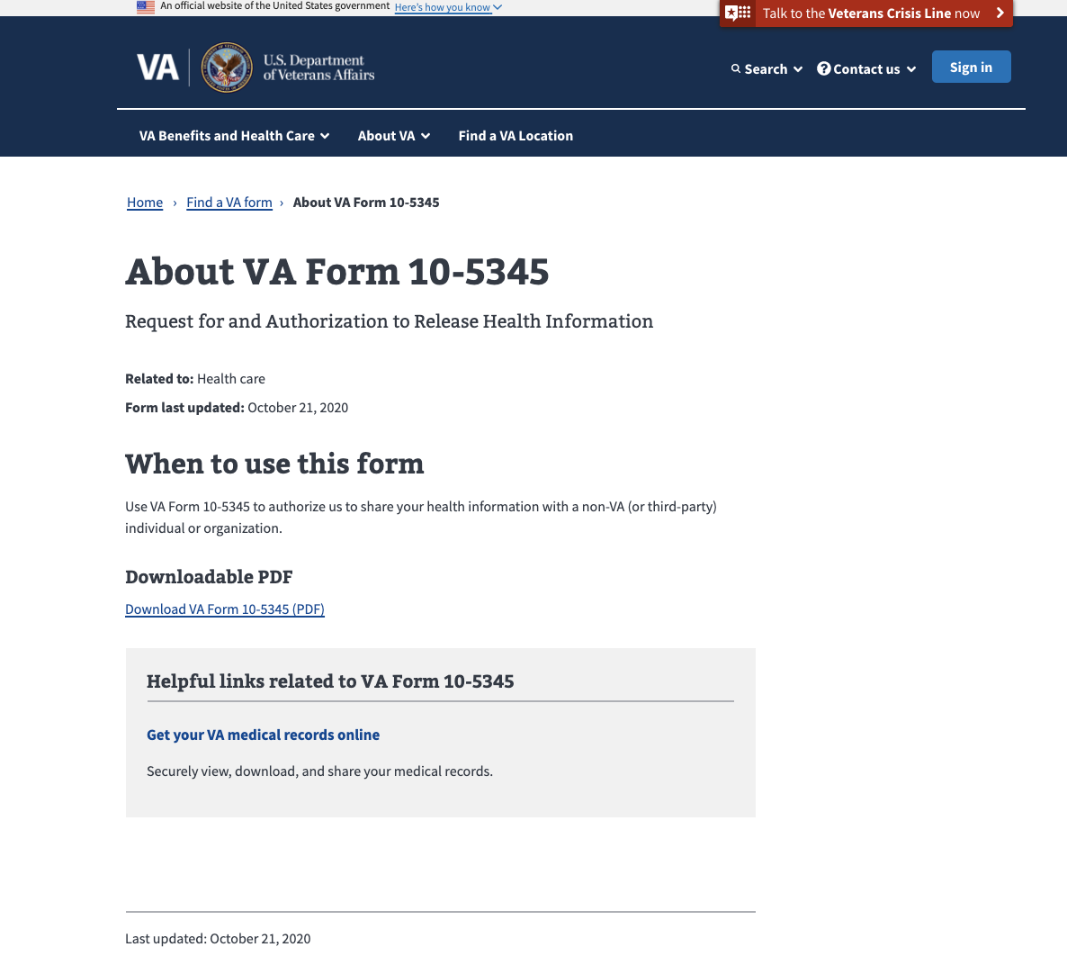
Metrics - Form Detail Pages (Dec 1 – Jan 1)
MODERNIZED Find a vA Form
4% decrease in views of Form Detail pages, likely attributed to winter holiday period
Likewise, 9 of the top 10 Form Detail pages saw decreases ranging from 3% to 25%
70% of the form detail pages saw clicks to Online Tools increase from 3% to 37%, depending on form
Half of the form detail pages saw clicks to Helpful Links increase from 2% to 14%, depending on the form

Slide 4
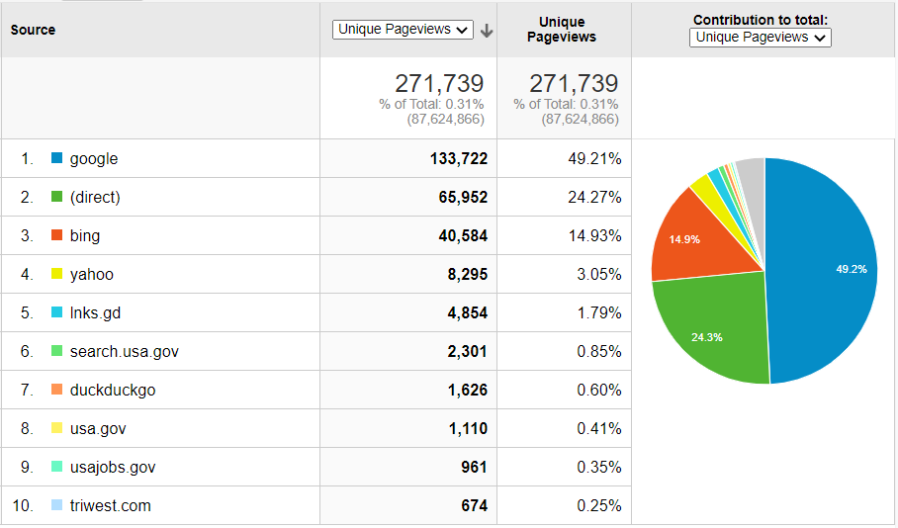
Search Engines – Find a VA Form Search Page (Dec 1 – Jan 1)
MODERNIZED Find a vA Form
Notes:
About half of the visits to the Search Page come from Google, no surprise. About 25% is Direct -- people who went straight to VA.gov, or the referrer is unknown
% of total at top is total traffic across all VA.gov.

Slide 5
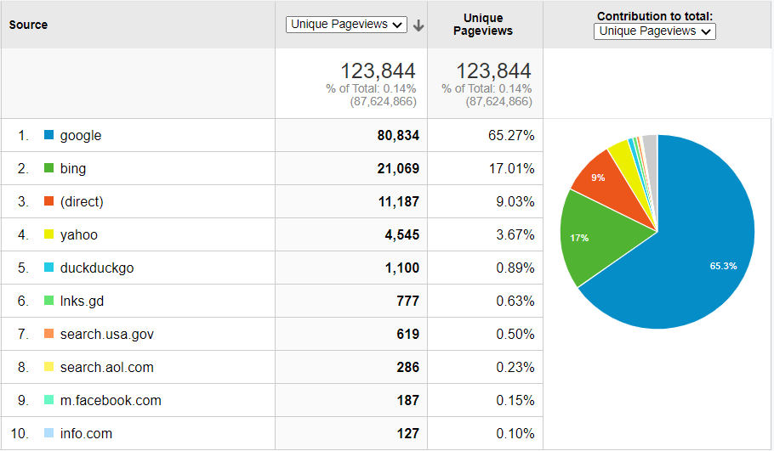
Search Engines – Form Detail Pages (Dec 1 – Jan 1)
MODERNIZED Find a vA Form
Notes:
65% of the visits to the Form Details pages from Google, no surprise. Only 9% is Direct -- people who went straight to VA.gov then found it via sitewide search. We anticipate that direct number will increase once the link is made between the search and details pages. VA.gov > Form > Detail vs. Google > Detail
% of total at top is total traffic across all VA.gov.

Slide 6
Iterative Improvements – Delivering Veteran Value Faster
MODERNIZED Find a vA Form
Done
Underway
Next
Added link to new Careers and Employment online tool on Form 28-8832 detail page
Embedded new analytics tags to enable reporting of new features launching this month
API update to support connecting search results to detail pages
Connecting search results to detail pages and online applications
Displaying most recent of “modified” vs. “published” date
Tailoring search results to better handle deleted forms
Adding ability to sort forms by last modified date
Improved search
Enhancements to produce relevant results for searches that omit dashes, spaces, letters in form names
Enhancements to rank form name and title matches higher than other types of matches in search results

Slide 7
On the Horizon
MODERNIZED Find a vA Form
Q1/Q2 2021
Internal notifications for deleted forms
Discovery for VA forms management Proof of Concept (POC)
Ongoing
Link to new digital applications as they come online, transitioning veterans from paper submission to self-service

