Slide 1

Update Modernized Find a VA Form 1.0
March 2021

Slide 2
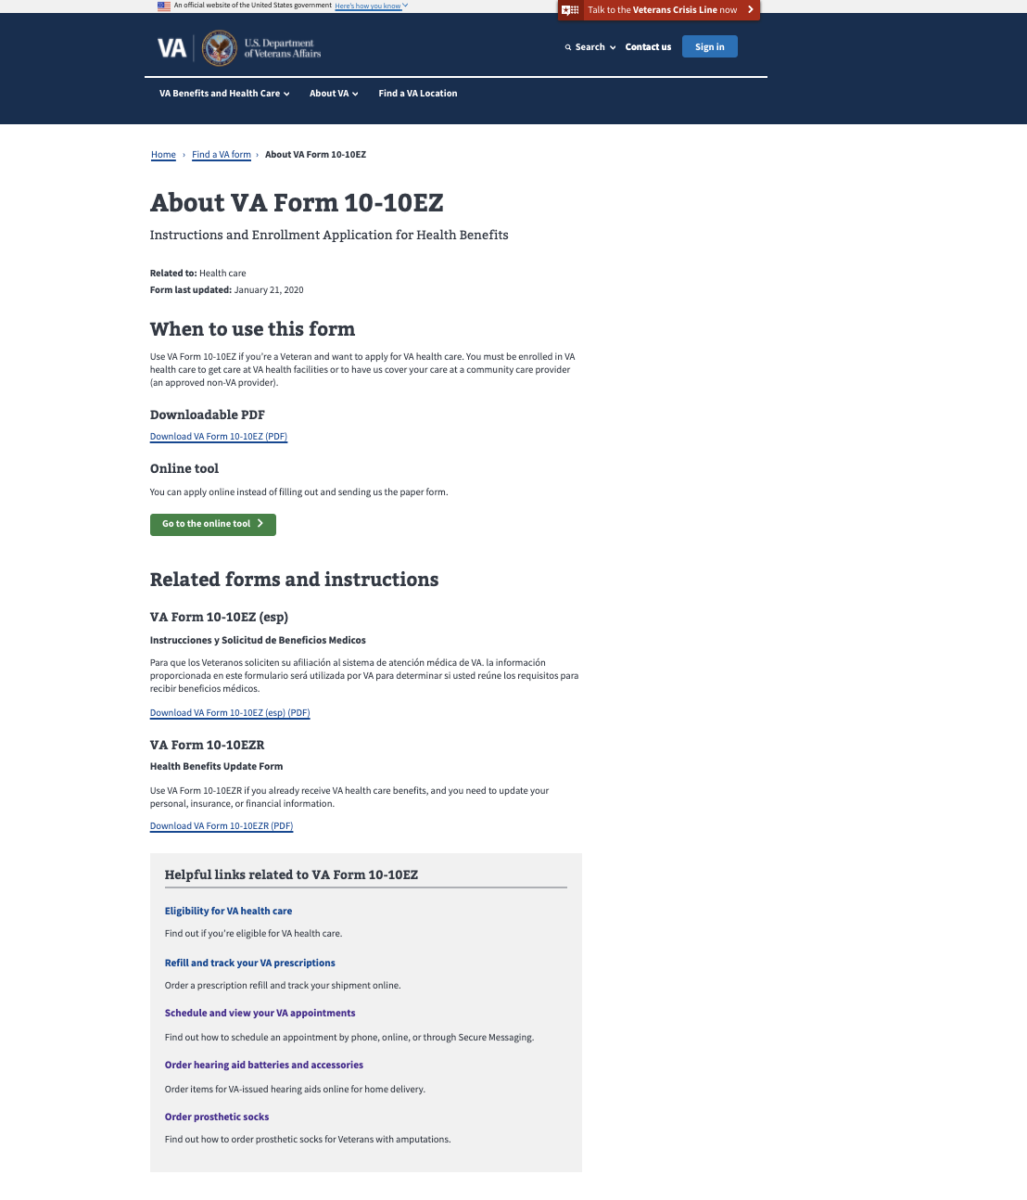
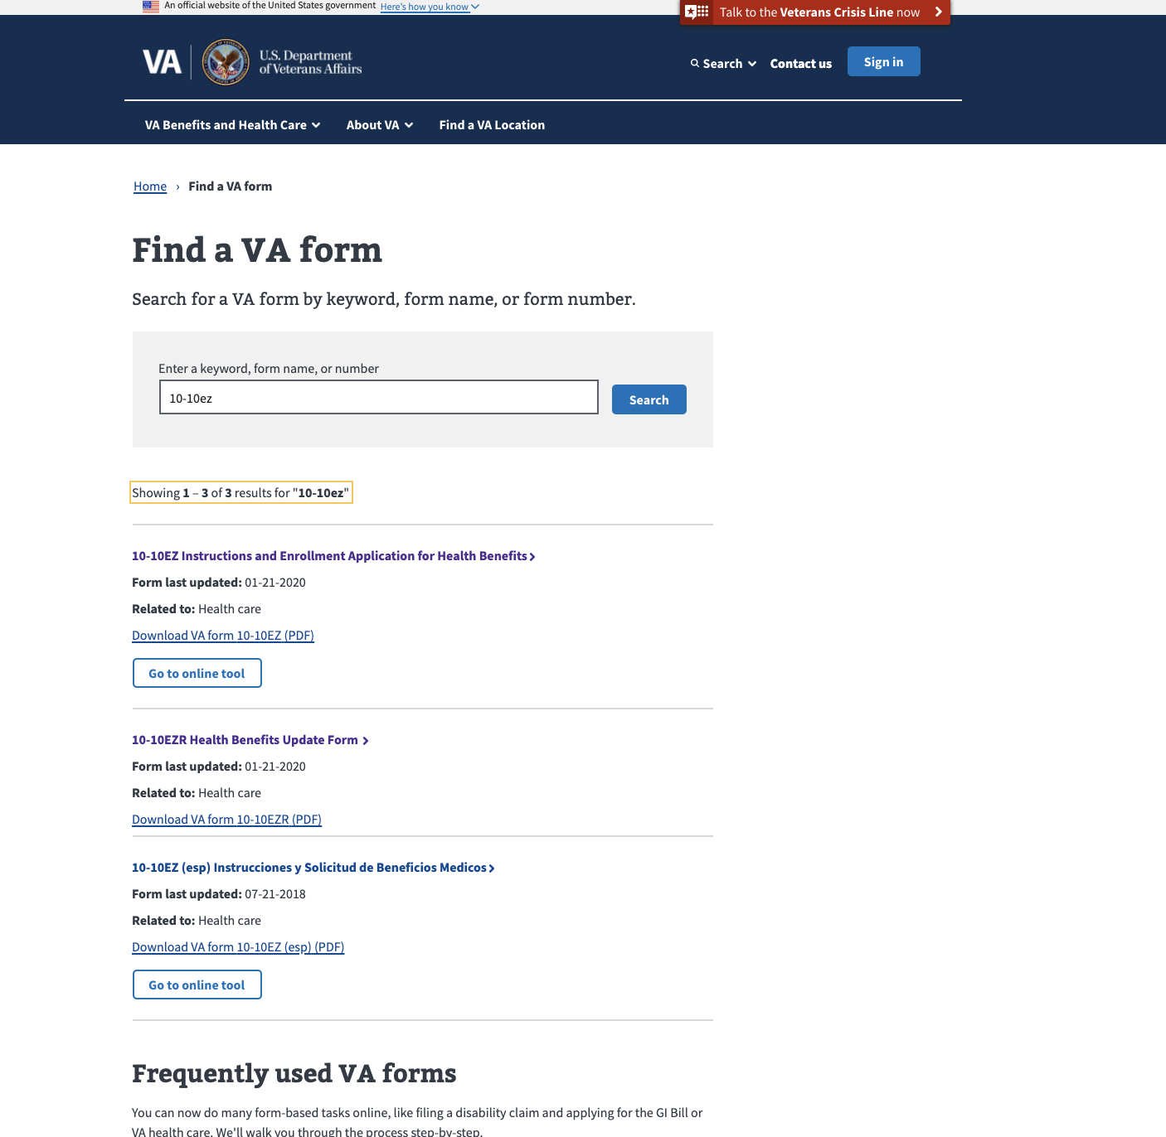
Latest Releases: Connecting Search to Details Page
Modernized Find a VA Form
Notes:
Live week of January 18th.

Slide 3
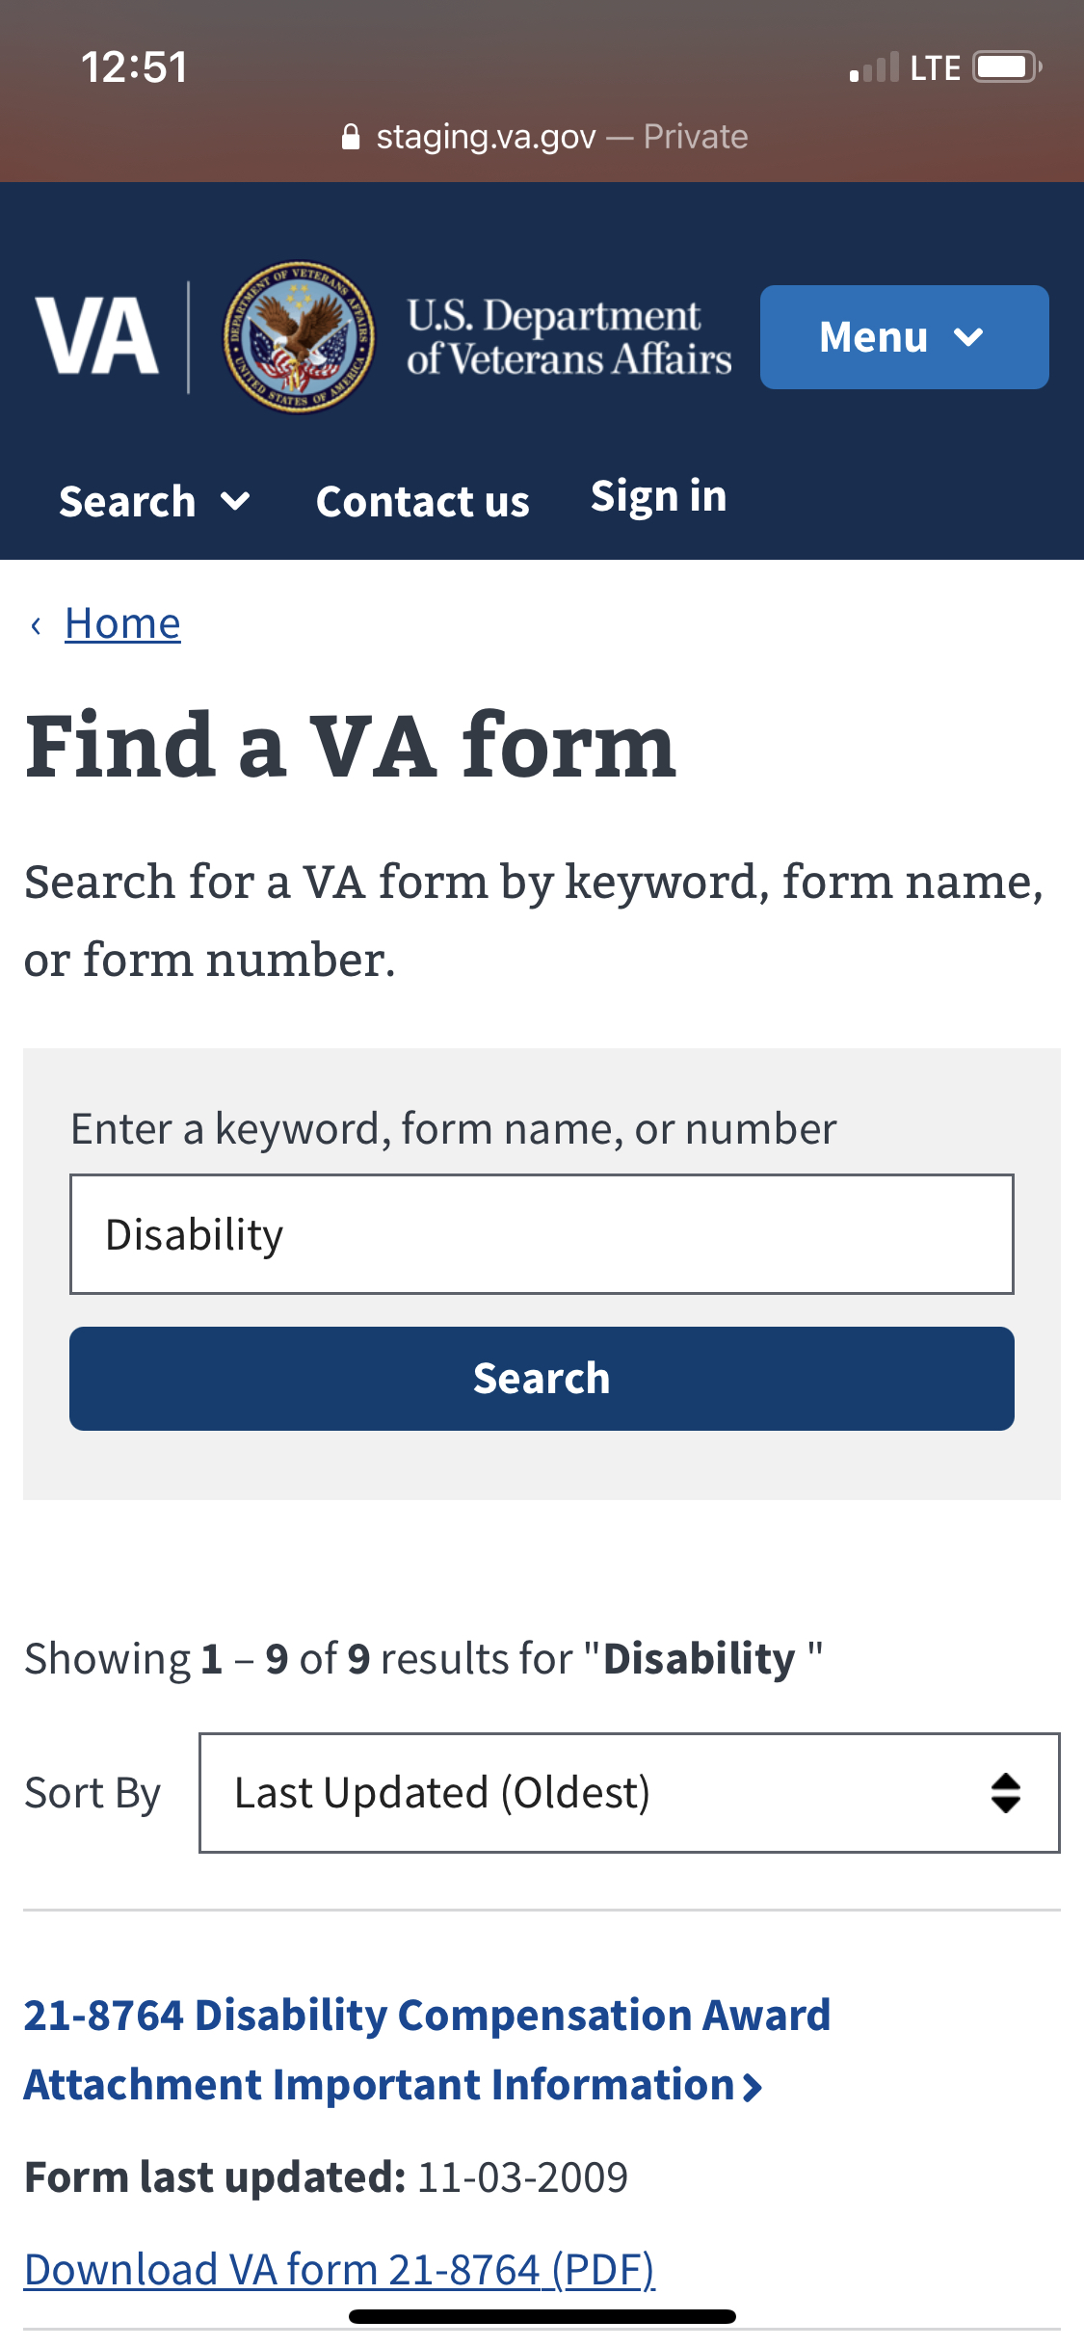
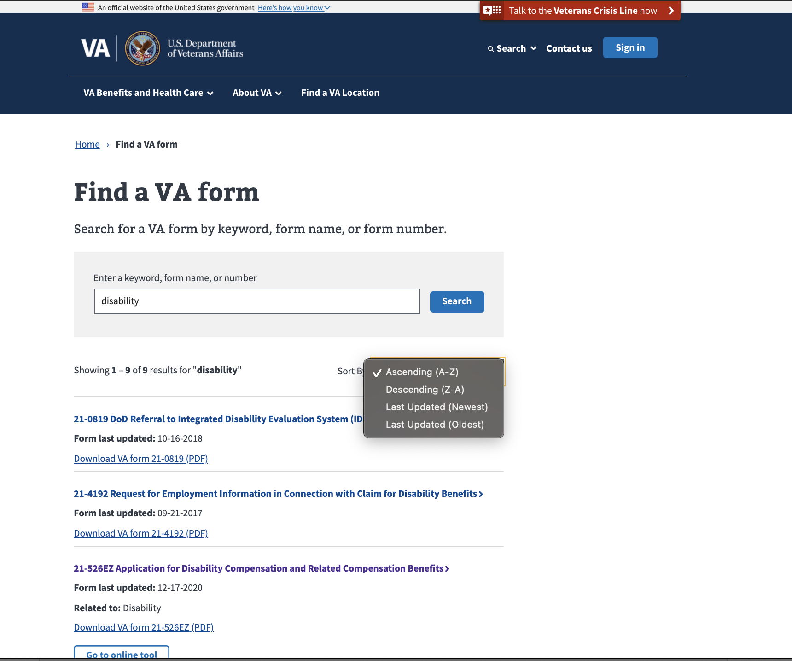
Latest Releases: Search Sorting Feature
Modernized Find a VA Form

Slide 4
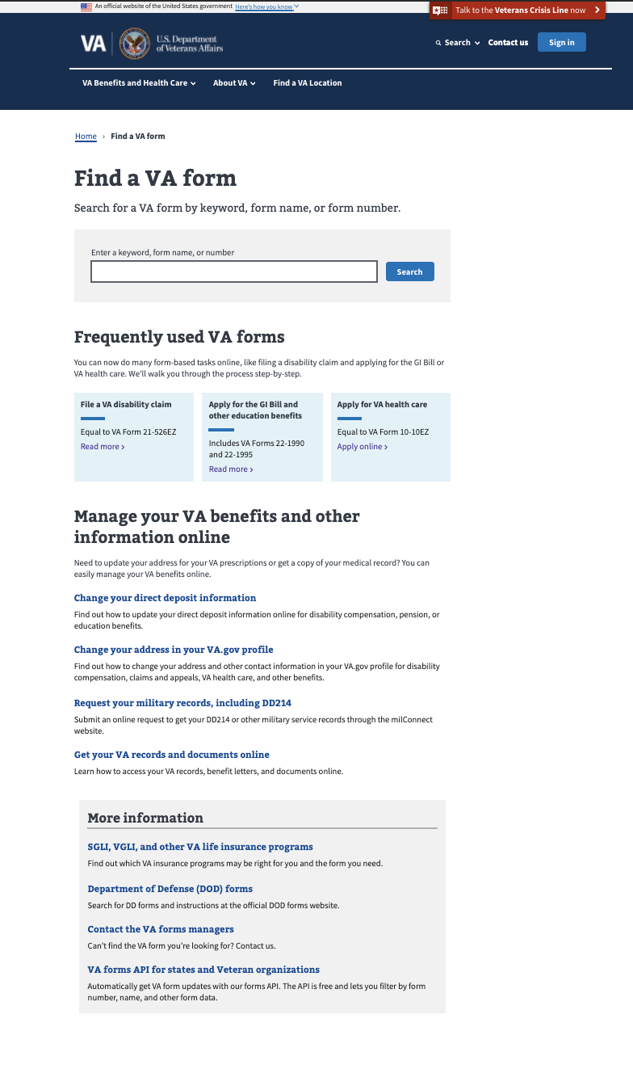
Metrics - Landing Page
Modernized Find a VA Form
Notes: Metrics adjusted to show unique pageviews, events; exclude detail page views formerly shown as landing page visits
Unique Page Views: 3% decrease since launch -- 160,543 in July to 156,207 in February. Monthly average unique page views: 155,023, an average decrease of 0.4%.
Bounce rate: 18%
Unique Searches: 8% decrease from January to February.
Monthly average unique form searches: 85,289
Search refinement rate: 51%
Top Forms Searches in February:
10-2850c
10-2850a
21-526ez
21-4138
20-0995
Frequently used VA forms clicks: 10,895 in February
21-22
10-10ez
10-2850
10-0885
dd214

Slide 5
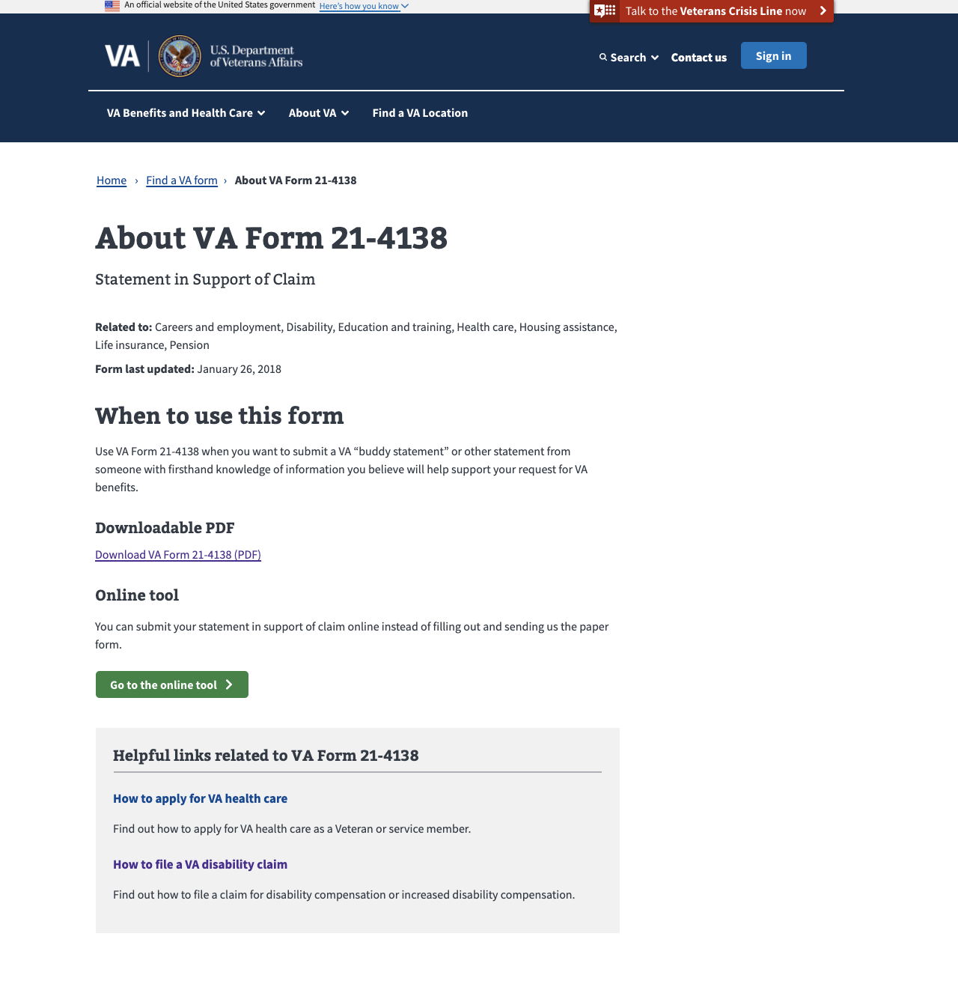
Metrics – Detail Pages February 2021
MODERNIZED Find a vA Form
Note: Metrics adjusted to show unique views and events vs. total views and events
Total Unique Page Views: Rose 14% to 172,000 from January to February.
Top 5 PDF Downloads from Detail Pages:
21-4138 (9,702)
10-5345 (6,548)
20-0995 (6,383)
10-10172 (5,026)
21-526EZ (4,808)

Slide 6
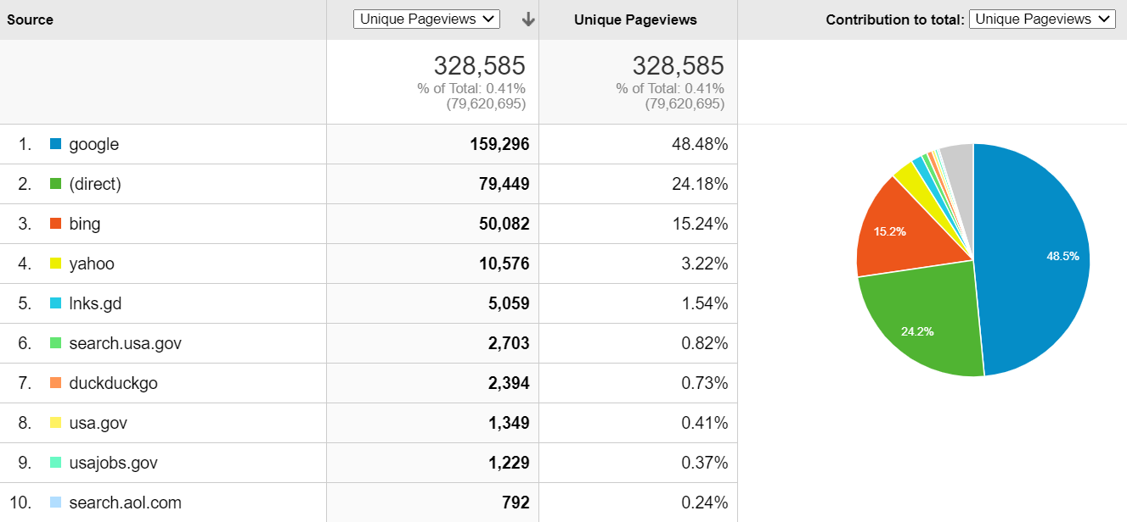
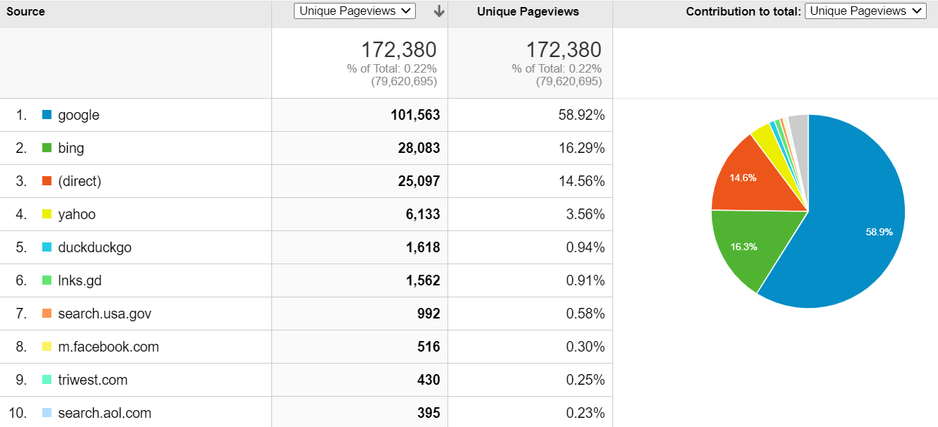
Metrics: Key Actions & Drivers February 2021
Modernized Find a VA Form
Total VA Form PDF Downloads: 190,389 (3% decrease from Jan)
Landing Page: 62,065 (27.61% decrease)
Details Pages: 119,318 (16.33% increase)
Total Online Tool Clicks: 9,720
Landing Page: 3,457 (182% increase)
Details Pages: 12,150 (41.67% increase)
Top Sources of Traffic
Landing Page
Details Pages

Slide 7
Product Team Focus
MODERNIZED Find a vA Form
Q1/Q2 2021
Improving Search experience
Discovery for VA forms management Proof of Concept (POC)
Ongoing
Link to new digital applications as they come online to encourage veterans to self-serve and speed time to outcomes

