Slide 1

Veterans Experiences at VA Benefit Offices
Research Findings

Slide 2
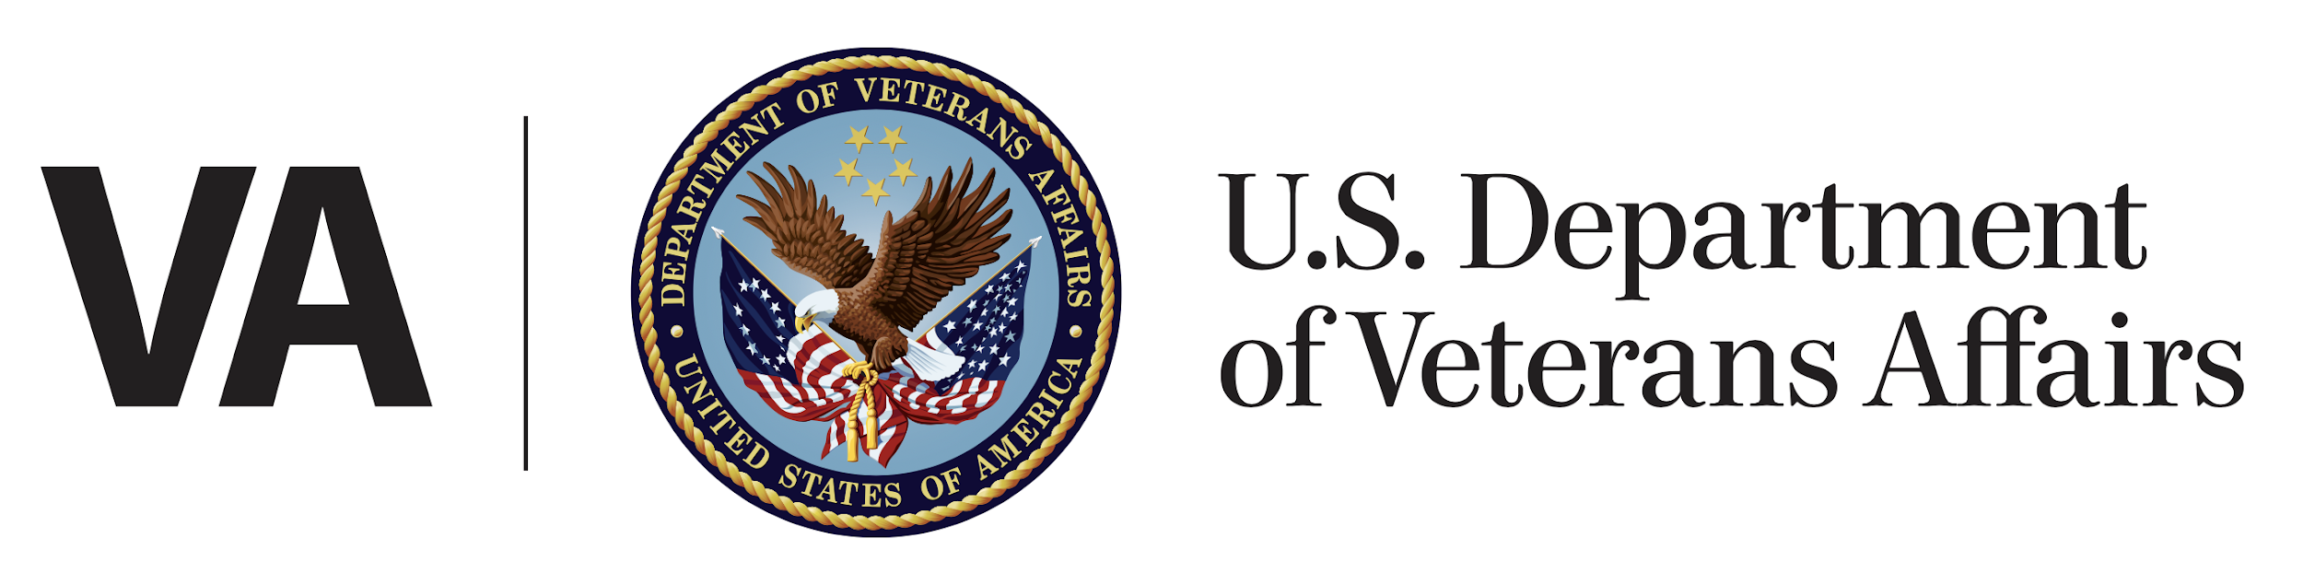
How this research maps to the Veteran journey
Getting Up
Starting up
Reinventing Myself
Putting Down Roots
Retiring
Aging
Dying
Reinventing myself
Joining
Serving
Getting out
Starting up
Taking care of myself
Retiring
Aging
Dying
Putting down roots
For a fully detailed Veteran journey, go to https://github.com/department-of-veterans-affairs/va.gov-team/blob/master/platform/design/va-product-journey-maps/Veteran%20Journey%20Map.pdf
Serving and separation
Living civilian life
Retiring and aging

Slide 3
OCTO-DE goals that this research supports
Supported
Not supported
Veterans and their families can apply for all benefits online
Veterans and their families can find a single, authoritative source of information
Veterans and their families trust the security, accuracy, and relevancy of VA.gov
Veterans can manage their health services online
VFS teams can build and deploy high-quality products for Veterans on the Platform
Logged-in users have a personalized experience, with relevant and time-saving features
Logged-in users can update their personal information easily and instantly
Logged-in users can easily track applications, claims, or appeals online
Completion rate of online transactions
Percent of applications submitted online (vs. paper)
Veteran satisfaction with VA.gov
Benefit use and enrollment, across all business lines
Benefit value (in $) delivered from online applications or transactions
Number of VA.gov users as a function of total Veteran population
Usage of digital, self-service tools
Measures to increase
Time to successful complete and submit online transactions
Time to process online applications (vs. paper)
Call center volume, wait time, and time to resolution
Time from online benefit discovery to benefit delivery
Measures to decrease

Slide 4
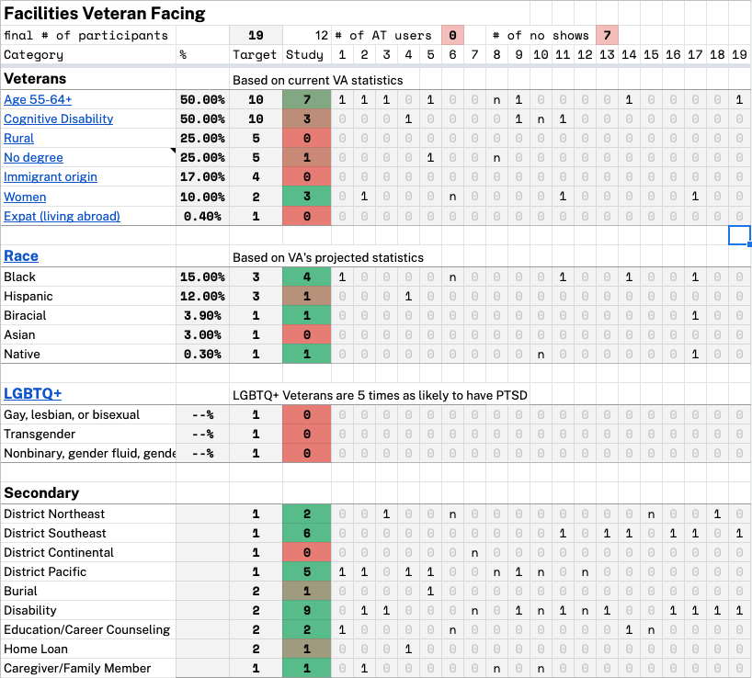
Participant Demographics
Participant Tracker
Findings may not include the perspectives of the following underserved Veteran groups:
Continental District
LGBTQ+
Asian
Below 45
Rural
Veterans visiting offices other than Regional
We recommend studies with these underserved groups in the future.
Notes:
Let’s have a quick overview of our demographics.
Continental District
LGBTQ+
Asian
Below 45
Rural
Veterans visiting offices other than Regional
I think we got a lot of useful information out of this research but there is a lot of work we need to do on demographic resourcing before we can really say these results are rigorous from any kind of quantitative perspective.
Our demographics were simply not very representative of Veterans as a total population group, and I have some concerns about our overrepresentation of:
older Veterans (despite being a proportionally large segment of Veterans to begin with)
Veterans with higher education
Live in cities
Only spoke with one Veteran under 40. Some of this is probably because we had disproportionate number of recruited Veterans under 40 no show.
Several our intended areas of study are hard to comment on because we lack any information.
Main thing we have trouble commenting on is how Veteran’s experience service information because almost all Veterans went to Regional Offices and correctly expected them to be full service.

Slide 5
Key findings
Veterans would like to use the website to complete tasks when the steps are clear
Veterans prefer to speak to a person on-site if they can’t find clear information online
Veterans expect Regional Benefit Offices to be “one-stop shops” for services
Veterans aren’t sure of what tasks they can complete at the various VA offices

Slide 6
Finding #1: Veterans would like to use the website to complete tasks when the steps are clear
Most Veterans (10 / 12) prefer to complete their tasks online if the information and instructions are clear
Tasks include: raising their disability rating, securing a home loan, seeking education funding
Veterans cite convenience as necessary for completing their tasks
No one rated phone as their preferred contact method:
7 / 12 rated phone as their last preference for contact
Most Veterans used the website first to get information about their benefits and tasks to be completed
Half of the sample expressed that the information they need is not easily found on the website

Slide 7
Finding #1: Veterans would like to use the website to complete tasks when the steps are clear
“If they offer it online, I would do it online. I do everything online. I have done request for records online, and that is way easier because before you had to go to the VA.” -p4
“I guess I wish that information was easier found out there [the website]. It may be, but I haven’t found it.” -p3
“Depending on what the task was I would rather do it online if I trusted it would get done properly” -p17

Slide 8
Finding #2: Veterans prefer to speak to a person on site if they cannot find clear information online first
Veterans are more likely to visit the benefits office when they need additional information to complete their tasks
Tasks include: job placement services, education benefits, forms assistance, and determining access to mental healthcare benefits
Half of the Veterans interviewed attempted to find answers to their questions online first
Even if the Veteran went in-office, they expressed that they did some initial research on the website to start the process
When Veterans couldn’t complete every step in the process themselves, they had confidence that the in-office staff could help them figure out next step(s)
Veterans expressed a high level of trust with the staff at the Benefits Office

Slide 9
Finding #2: Veterans prefer to speak to a person on site if they cannot find clear information online first
“I did go to the benefits website and it gave me a little information on what programs are available, but I do like sitting down with someone to get the information.” -p14
“One-stop shopping is why I picked this one [regional benefits office]. I knew I could do everything in this office. I did some researching, and you could click on a toggle and this one popped up with everything I needed to handle I could do it at this site.” -p2

Slide 10
Finding #3: Veterans expect Regional Benefit Offices to be “one-stop shops” for services
Veterans used the website or Google prior to visiting a location to get a baseline understanding of offerings
Veterans have a high level of trust in staff at the Regional Benefits Office and most expressed satisfaction with their experience in-person
Veterans understood what they could expect at a Regional Benefits Office, but were less familiar with other types of locations
Note: 83% of Veterans sampled had never visited another office
9 / 12 Veterans visited a Regional Benefits Office and had no problems getting information on the services they needed while there

Slide 11
Finding #3: Veterans expect Regional Benefit Offices to be “one-stop shops” for services
“I think what gives them a 5-star rating is that they are a one stop shop. They can help you with everything that you may need assistance with” -p1
“There is one [satellite benefits office] that is closer to my house, but I prefer to go to the one I went to initially because I have always had success there.”-p1
“The thing about going to the regional office is that is where all the information is available.” -p9

Slide 12
Finding #4: Veterans aren’t sure of what tasks they can complete at the various VA offices
The differences between offices and what Veterans can accomplish at each isn’t obvious
When in doubt, Veterans default to the Regional or Satellite Benefit Offices
Veterans were most confident about what they could accomplish at Regional Benefit Offices
“I would think that the information is pushed from Regional to Satellite and that they would recommend other offices if they thought it would benefit you more” -p1

Slide 13
Additional Insights
Many Veterans cited frustration with phone assistance and ranked it as their third preference out of receiving assistance via web, in-person, or over the phone
Phone trees and directories posed a level of frustration for Veterans, therefore they would rather show up in-person to ask questions about their specific needs
Phone assistance often left the Veterans without the answers they need to complete their task

Slide 14
Additional Insights
“I did check the website, and I did try calling and I was on hold forever. I think after 30 minutes of being on hold I gave up.” -p.13
“I haven’t always had good experiences with talking to people on the phone with giving out incorrect information. I just don’t trust that over reading or talking face to face.”-p.14
“When I called to get clarification, I got no answer. You still find yourself trying to get there in person so you can get clarification.”- p.17

Slide 15
Additional Insights
Benefit tasks Veterans sought to complete:
Increasing disability rating
This was the most common in our sample with 9 / 12 participants
Seeking VA license plate
Seeking guidance with education needs
Seeking help getting name change in database
Securing a home loan
Seeking education funding
Job placement services
Forms assistance
Determining access to mental healthcare benefits

Slide 16
Recommendations
Create VBA Regional Office pages to follow existing facilities patterns
Most Veterans got preliminary information from VA website or Google
Veterans were comfortable looking up information on facility pages
Implement clearer content when the steps to complete a task are complex or multi-step
Veterans consistently cited a desire to speak someone if they felt their situation was complex
Clearer content about what the requirements are for each benefit could save time and frustration for Veterans
Share insights with Content Team and Benefits Team
Follow up with research into the types of services available at each facility
Make further distinctions about what services are available at what facility type

Slide 17
Further Research
Deep dive into what Veterans are visiting facilities for
What do Veterans need to accomplish most often?
What questions are they answering?
Do their websites have the appropriate information for frequently asked questions?
What is the Veteran experience at each facility type?
Additional research on how and when Veterans use their peer network for support
Forms usability and accessibility discovery
Content audit on accuracy and completeness of benefits processes listed on VA website

