Slide 1
Health Apartment Information Architecture: Overall findings
Tree test findings

Slide 2
Research Goals
As we work toward the integration of My HealtheVet into the modernized VA.gov experience, we want to: 1. Ensure Veterans, family members, and caregivers can easily find the content and tools they need wherever they are in their VA health care journey.
2. Identify where the MHV experience most naturally fits into the modernized VA.gov.
3. Maintain - or improve upon - the high performance of the existing VA.gov health care hub.
We want to evaluate how variations of the health care hub information architecture (IA) perform in key tasks for:
Veterans who are exploring and applying for benefits for themselves
Family members & caregivers who are exploring and applying for benefits themselves or for the Veteran they care for
Veterans who are managing health care benefits for themselves
Family members & caregivers who are managing their own health care benefits or are managing the health care benefits of the Veteran they care for

Slide 3

How this research maps to the Veteran journey
Engaging VA to access benefits and services
Attending to health needs
Recognizing and addressing mental health needs
Managing primary care and chronic health issues
Maintaining my emotional health
Taking care of my health
Managing my declining health
Reinventing myself
Joining
Serving
Getting out
Starting up
Taking care of myself
Retiring
Aging
Dying
Putting down roots
For a fully detailed Veteran journey, go to https://github.com/department-of-veterans-affairs/va.gov-team/blob/master/platform/design/va-product-journey-maps/Veteran%20Journey%20Map.pdf
Serving and separation
Living civilian life
Retiring and aging

Slide 4
OCTO-DE goals that this research supports
Supported
Not supported
Veterans and their families can apply for all benefits online
Veterans and their families can find a single, authoritative source of information
Veterans and their families trust the security, accuracy, and relevancy of VA.gov
Veterans can manage their health services online
VFS teams can build and deploy high-quality products for Veterans on the Platform
Logged-in users have a personalized experience, with relevant and time-saving features
Logged-in users can update their personal information easily and instantly
Logged-in users can easily track applications, claims, or appeals online
Completion rate of online transactions
Percent of applications submitted online (vs. paper)
Veteran satisfaction with VA.gov
Benefit use and enrollment, across all business lines
Benefit value (in $) delivered from online applications or transactions
Number of VA.gov users as a function of total Veteran population
Usage of digital, self-service tools
Measures to increase
Time to successful complete and submit online transactions
Time to process online applications (vs. paper)
Call center volume, wait time, and time to resolution
Time from online benefit discovery to benefit delivery
Measures to decrease

Slide 5
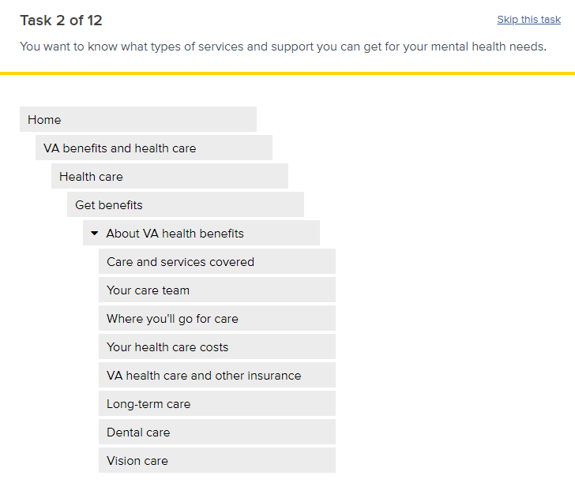
Methodology
We conducted 3 rounds of testing utilizing Optimal Workshop’s Treejack tool
Unmoderated tree test with Veterans
Moderated tree test with Veterans over Zoom
Unmoderated tree test with Veteran family members and caregivers
Participants were shown 1 of the 3 trees and were asked to complete 12 tasks by navigating the menu structure and indicating where they would be able to find the answer.
Half (6) of the tasks in each test were related to related to getting health care benefits, and the other half were related to managing health care or health benefits
For the family member/caregiver test, some of the tasks were specific to the family member or caregiver’s benefits, while others were specific to helping the Veteran in their life with their benefits
Tasks were randomized to avoid bias from learning the tree as the test progressed.

Slide 6
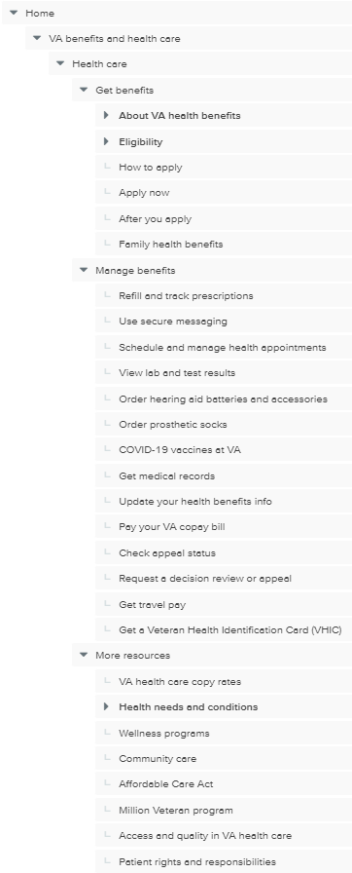
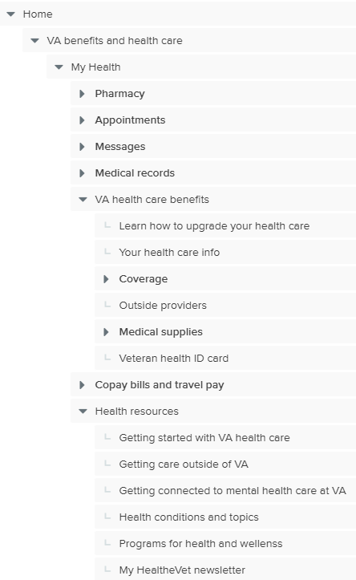
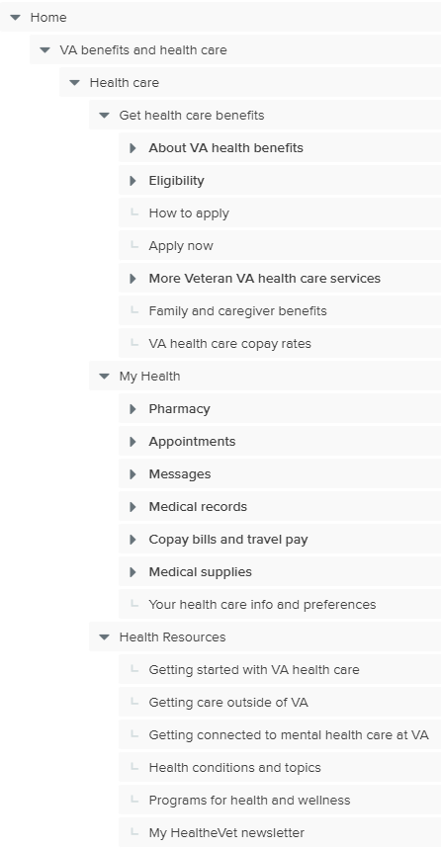
Hypotheses tested
Baseline
Hypothesis 0 (H0)
Hypothesis 1 (H1)
There were 3 versions of the IA tested:
Both the Veteran unmoderated and Caregiver unmoderated tests included all 3 versions
The Veteran moderated test only included H0 and H1
All 3 trees included the full IA of the VA benefits and health care menu (all benefit hubs, records, and the audience hubs), the About VA menu, and Find a VA location

Slide 7
Hypotheses tested - Baseline
Baseline Veterans, family members, and caregivers find it easier to complete health care related tasks when there is one area on VA.gov for all health care content and tools, - separated by type of content - regardless of enrollment or authentication status
This tree represents the existing IA of the health care hub on VA.gov, where content is separated into 3 spokes – get benefits, manage benefits, and more resources
Including this in the test allowed us to gain insights on how the current IA is performing, and set a baseline to determine if either of the hypotheses tested performed better or worse than baseline.
The health care hub includes all health care related content and features
Health care hub
Get benefits
Manage benefits
More resources

Slide 8
Hypotheses tested – H0
Hypothesis 0 Veterans, family members, and caregivers find it easier to complete health care related tasks when there is one area on VA.gov for all health care content and tools regardless of enrollment or authentication status
In this concept, the health care hub (aka “health apartment”) would include all content and tools related to health care, not segmented by enrollment status (i.e. “get” versus “manage” spokes), and would be personalized for authenticated users (i.e. authenticate in place strategy)
In the proposed design, tools and content used to manage and track health care are prioritized in the structure, while content related to getting benefits (for both Veterans and family members) is placed under a single menu option in a lower position.
The health apartment includes all health care related content and features
My health (Health apartment)
Manage benefit
Manage benefit
Manage benefit
Manage benefit
Manage benefit
Get benefits
Health resources

Slide 9
Hypotheses tested – H1
Hypothesis 1 Veterans, family members, and caregivers find it easier to complete health care related tasks when the options specific to their enrollment status are in two separate sections or experiences.
In this concept, items related to exploring and applying for health care would be in a separate section of VA.gov from the items related to managing health care and benefits (i.e. the “health apartment”)
The “health apartment” may live inside or outside the health care hub. The tree tested represents the drill down regardless of where the two areas specifically live - i.e. once the user clicks on “My health” in the health care hub they may continue to navigate in the hub, or they may be taken somewhere else to continue navigating – either way it’s the same structure.
In this proposed design, content would continue to be segmented into a spokes structure, separating “get” tasks from “manage” tasks. Content and tools related to getting benefits are prioritized in the structure, however, with the spokes (get, manage, resources); the manage tasks still have prominent placement.
The health apartment replaces the manage spoke of the health care hub
Health care hub
Resources & support
Get benefits
My health (Health apt)
Health resources
The health apartment lives separate from the health care hub
Health care hub
Health apartment
Resources & support
Get benefits
My health
Health resources

Slide 10
Participants
Veteran unmoderated
Baseline: 46 participants
21 not enrolled, 23 enrolled
Hypothesis 0: 51 participants
24 not enrolled, 27 enrolled
Hypothesis 1: 51 participants
27 not enrolled, 24 enrolled
Veteran moderated
Hypothesis 0: 11 participants
5 not enrolled, 6 enrolled
Hypothesis 1: 10 participants
4 not enrolled, 6 enrolled
Family/Caregiver unmoderated
Baseline: 30 participants
Hypothesis 0: 41 participants
Hypothesis 1: 42 participants
Findings may not include a range of perspectives from the following underserved Veteran groups: have a cognitive disability, live in a rural area, have other than honorable discharge, are of immigrant origin, identify as Latin or Asian, use assistance technology

Slide 11
Menu items & tasks evaluated
Tasks were chosen to represent a mix of top health content & tools
Veteran participants were asked to completed the tasks as they related to themselves. For the family member participants, some tasks were specific to their own health care benefits, and some tasks asked how they would complete tasks for the Veteran in their life.
“Get benefits” tasks
Eligibility
Apply for health care (Veterans only)
Mental health
Dental care
Copay rates
Community care
“Manage benefits” tasks
Priority groups
Medical records
Copay bills
Prescriptions
Secure messaging
Travel pay

Slide 12
Common metrics in tree tests
Success rate - The percent of participants that selected the correct answer, regardless of how they got there.
Directness - The percent of participants that went directly to an answer without backtracking, regardless if the answer was right or wrong
These 2 metrics are most often looked at together when analyzing a tree test
A high success rate with low directness could indicate that participants had to work hard and dig around in the structure to find the answer
A low success rate and high directness could mean participants misunderstood an incorrect option or section of your tree as the correct answer (they confidently went to the wrong answer)
Direct success - The percent of participants that went directly to the correct answer.
Path – How participants navigated the trees, including their first click, as well as areas of the tree explored to find the answer
Always keep in mind that all labels and parts of a structure can impact any task. For example, a section of the tree may be perfectly labeled and structured, but if another part has a misleading label, it can draw visitors away.
Notes:
There are other metrics used in tree testing (i.e. time taken per task, skip rate, etc), however no significant patterns in these were found for this test.

Slide 13
Findings

Slide 14
Key findings across all tests
Veterans assumed a section labeled “My Health” represented personal information intended for those already enrolled in health care
The “My health” area of H0 performed poorly for Veteran eligibility and apply content, and was largely bypassed for family eligibility content
The “My health” section performed well for manage tasks in H0, but didn’t perform quite as well when nested 1 level deeper in H1
Critical aspects of health care -- such as mental health care, dental care, and community care – improved, but still need to be easier to find for all audiences
Performance of copay rates, copay bills, and travel pay tasks were mixed, and so were participant opinions on placement
The family member hub was a common destination in the caregiver study for any task related to a family member’s or caregiver’s benefits
While numbers were small, the service member hub was a consideration for some Veterans, particularly for tasks related to getting benefits

Slide 15
Key finding 1: Veterans assumed a section labeled “My Health” represented personal information intended for those already enrolled in health care
For many of the participants, “My health” meant it was personal
14/21 participants directly commented on how they felt “my health” indicated that the information was personal - ½ of those comments were made by participants not enrolled in VA health care
Note: We did not do a moderated study with family members and caregivers, so it is not clear how that audience interpreted “My health” as a label
“My Health” was not expected to include content and tasks related to getting health care benefits, and some participants looked elsewhere for that information
10 participants (4 enrolled, 6 not enrolled) indicated they wouldn’t expect to find general info or eligibility content in that section because they interpreted it as something that wouldn’t be there if you weren’t enrolled
H0 also showed an increase in participants browsing and selecting an answer in the Service member benefits hub for the eligibility and apply tasks
In the moderated study, 4/10 Veterans looked in the Service member benefits hub for eligibility and apply information
In the unmoderated tests, data shows an average of almost 3 times the percent of participants looking for and selecting answers in the Service member benefits hub compared to baseline and H1
“ ’My’ helps me understand its for me” – H0 participant
” when it says ‘my health’, its talking about me, the things that are useful to me…or the benefits I have been using, my benefits” – H1 participant
“everything related to my health care...visits, my pharmacy, my copays...that way I should be signed in and that info is only there for me” – H1 participant
Paths and selections | Health care/My health | Selected | Service member hub | Selected
Task: Veteran eligibility | Browsed | Selected | Browsed | Selected
Veteran Baseline – unmod (46) | 87% | 87% | 7% | 4%
Veteran H0 - unmod (51) | 76% | 67% | 53% | 24%
Veteran H1 - unmod (51) | 86% | 84% | 20% | 10%
Task: Veteran apply | Browsed | Selected | Browsed | Selected
Veteran Baseline – unmod (46) | 91% | 91% | 13% | 2%
Veteran H0 - unmod (51) | 75% | 67% | 31% | 12%
Veteran H1 - unmod (51) | 94% | 92% | 6% | 2%
Notes:
References:
(M2) Moderated key finding 2: While “My Health” provided an intuitive go-to location for “Manage” tasks, it was often not considered for “Get” content and tasks
(V2) Veteran unmoderated key finding 2: For “get benefits” tasks, H1 was flat, while H0 showed a significant detriment in comparison to baseline
(V3) Veteran unmoderated key finding 3: For “get benefits” tasks, , H0 failed 3 key tasks (eligibility, apply, and copay rates)
(C2) Caregiver unmoderated key finding 2: Health care eligibility information for Veterans was challenging to find, especially in H0
Data sources
Service member hub browsing and selection data
Average % of participants in the Veteran unmoderated study that navigated to or selected an option in the service member hub in tasks 1 and 2
Browse data found by taking # of participant paths that included the service member hub divided by paths possible (i.e. H0 had 51 participants x 2 tasks = 102 paths possible)
Selection data found by taking # of answers selected in the service member hub divided by selections possible
There may be some desire to have general benefit information within a personalized “My health” section
a couple of Veterans commented that they would expect to see what they are eligible for there – this should be further researched, it is not clear if it should only be what the visitor is eligible for or if it should be any available benefit
H0 performed similarly to baseline on dental care and significantly better than baseline on mental health and community care content – this may support the idea that Veterans expect to have access information under “My health” that relates to what coverage they have

Slide 16
Key finding 2: The “My health” area of H0 performed poorly for Veteran eligibility and apply content, and was largely bypassed for family eligibility content
Participants struggled to find Veteran eligibility and apply content under “My health” in H0
H0 had significantly lower task success and directness for the Veteran eligibility and apply tasks
Of those that looked in My health, only a fraction navigated down to the coverage section where the needed content was located – this location was 1-2 clicks deeper in H0 than in the other trees
In H0, more participants looked to the service member hub than in the other trees
Task Success/Directness | Veteran Eligibility | Veteran Apply | Family Eligibility
Baseline - All (76) | 74% / 75% | 78% / 80% | 67% / 83%
H0 - All (103) | 29% / 46% | 32% / 43% | 83% / 93%
H1 - All (101) | 78% / 63% | 68% / 61% | 65% / 68%
= 10% or more improvement over baseline / = 10% or more decline over baseline,
“ I'm used to going to My health, but if I'm looking for if I'm eligible it wouldn't be there just yet...The way I am looking at my health is if I am already enrolled.” – H0 participant
Percent of participants that visited each level of H0 for “Get benefits” tasks
My health - 84%
VA health care benefits - 58%
“If I don’t have healthcare yet, then it wouldn’t be under my health because I am not in their system. It should be under benefits so I could apply for healthcare. My health is not the first one I would select because I am not enrolled” – H0 participant
Coverage - 31%
Very few family member and caregiver participants explored “My health” in H0, and instead found the answer in the family member benefits hub
This change in navigational pattern resulted in a high task success rate
Note: Because we did not do a moderated study with family members and caregivers, it is not clear how that audience interpreted “My health” as a label
Paths and selections | Health care/My health | Selected | Family member hub | Selected
Task: Family eligibility | Browsed | Selected | Browsed | Selected
Caregiver Baseline (30) | 40% | 23% | 53% | 57%
Caregiver H0 (41) | 15% | 5% | 85% | 86%
Caregiver H1 (40) | 38% | 13% | 63% | 60%
Notes:
References:
(M1) Moderated key finding 1: Mission-critical “Get” content would benefit from multiple paths, elevation in the IA, and more direct navigation
(M2) Moderated key finding 2: While “My Health” provided an intuitive go-to location for “Manage” tasks, it was often not considered for “Get” content and tasks
(V2) Veteran unmoderated key finding 2: For “get benefits” tasks, H1 was flat, while H0 showed a significant detriment in comparison to baseline
(V3) Veteran unmoderated key finding 3: For “get benefits” tasks, , H0 failed 3 key tasks (eligibility, apply, and copay rates)
(C2) Caregiver unmoderated key finding 2: Health care eligibility information for Veterans was challenging to find, especially in H0
(C3) Caregiver unmoderated key finding 3: Family & caregiver participants struggled to find information related to getting health care benefits for themselves
Data sources
Success/directness by task
Individual task success and directness from Optimal Workshop data
Hypothesis level task success and directness calculated by averaging the data across each test
Family member hub browsing and selection data
Average % of participants in the Family/caregiver unmoderated study that navigated to or selected an option in the family member hub in task 6 (family/caregiver eligibility)
Browse data found by taking # of participant paths that included the family member hub divided by paths possible (i.e. H0 had 41 participants x 1 tasks = 41 paths possible)
Selection data found by taking # of answers selected in the family member hub divided by selections possible

Slide 17
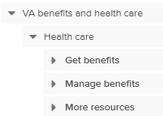
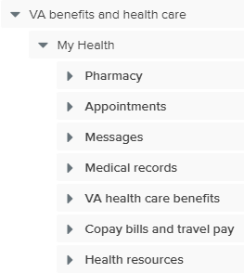
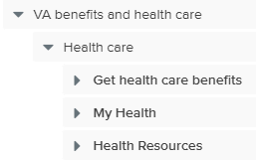
Key finding 3: The “My health” section performed well for manage tasks in H0, but didn’t perform quite as well when nested 1 level deeper in H1
The “My health” section in H0 was a simplified structure that brought key manage tasks to a higher level of the IA than baseline and H1
All core “manage” tasks were at the top level of “My health”, which brought visibility to these features. Baseline and H1 utilized spokes where “Get benefits” and “Resources” were at the same level as “My health”, requiring users to choose a path and click one level deeper for the same tasks.
In addition, the options immediately under “My health” were greatly simplified with only 7 options, compared to the “Manage benefits” section of baseline which had 14 options.
“My health” was missing some “manage” options that were included in baseline, and other “manage” options were nested in a broad menu option – these missing and nested options were not evaluated in this test.
“My health” when placed at an equal level to “Get benefits” created some navigational changes
In the Veteran unmoderated test for H1, significantly more Veterans visited the “Get benefits” spoke for manage tasks
While prescription and messaging tasks performed well both hypotheses, medical records, copay bills, and travel pay tasks had less success than H0, and significantly less success than baseline
In H1, “my health” is at the same level as “get benefits” – does this structure change how visitors interpret “My health” as it’s related to benefit tasks vs medical tasks?
Baseline
H0
H1
% navigated to “get benefits” menu | Get benefits tasks | Manage benefits tasks
Baseline Veteran – unmoderated (46) | 54% | 7%
H0 Veteran – unmoderated (51)* | 58% | 5%
H1 Veteran – unmoderated (51) | 72% | 21%
Success/ Directness | Prescription | Secure Message | Medical records | Pay copay bill | Travel pay
Baseline (76) | 86% / 65% | 59% / 53% | 87% / 67% | 72% / 73% | 55% / 39%
H0 (103) | 95% / 95% | 84% / 88% | 91% / 88% | 78% / 75% | 73% / 71%
H1 (101) | 83% / 68% | 79% / 75% | 70% / 80% | 60% / 66% | 46% / 36%
Notes:
*The equivalent “get benefits” section in H0 is the “VA health are benefits” menu option directly under “My health”
References:
(V5) Veteran unmoderated key finding 5: For “manage benefits” tasks, H0 showed significant improvement in direct success compared to baseline
(V6) Veteran unmoderated key finding 6: For “manage benefits” tasks, H1 showed a significant decrease in 3 tasks – medical records, travel pay, pay copay bill
(C6) Caregiver unmoderated key finding 6: For tasks related to managing health care, “My health” in H0 performed extremely well, while the same section in H1 performed significantly worse than baseline
(V7) Veteran unmoderated key finding 7: For “manage benefits” tasks, H1 showed a shift of where participants were exploring and selecting answers
Data sources:
Success/directness by task
Individual task success and directness from Optimal Workshop data
Hypothesis level task success and directness calculated by averaging the data across each test
“Get benefits” spoke browsing data
Average % of participants in the Veteran unmoderated study that navigated the “Get health care benefits” menu in H1 or the “Get benefits” menu in baseline in all the manage tasks (priority groups, prescription, messaging, medical records, copay bills, travel pay)
Browse data found by taking # of participant paths that included the “get benefits” section divided by paths possible
Data manually calculated from downloaded Optimal paths for each hypothesis
Notes:
- The priority groups task (task 6) was not included in the success/directness table due to it being a poor performing task across all tests, and did not provide any insights into the findings

Slide 18
Key finding 4: Critical aspects of health care - such as mental health care, dental care, and community care – improved, but still need to be easier to find for all audiences
Both H0 and H1 improved results for these services, but Veteran comments confirmed that they could be further improved
Mental health and dental care were 1 click deeper in H0 and H1, and community care was 1 level higher in H0
At least 11 Veterans commented that they wanted to see things like dental care and mental health up higher in the menu, and general sentiment was that it was too many steps to get to them
3 Veterans commented that they had seen the dental option in a previous task, but couldn’t remember how to get back to it
Clicks to content | Baseline | H0 | H1
Mental health | 5 - More resources | 6 - VA health care benefits | 6 – Get health care benefits
Dental care | 5 - Get benefits | 6 - VA health care benefits | 6 – Get health care benefits
Community care | 5 - Get benefits | 4 - VA health care benefits | 5 - Get health care benefits
“ When it says healthcare benefits, it should have dental and mental health there instead of having to dig for it” - H1 participant
Task Success/Directness | Dental | Mental health | Community care
Baseline - All (76) | 55% / 53% | 37% / 49% | 39% / 51%
H0 - All (103) | 65% / 55% | 52% / 63% | 79% / 73%
H1 - All (101) | 67% / 67% | 65% / 52% | 60% / 47%
“ would like to see dental and mental up higher, want to hit my health and see it right there” - H0 participant
Veterans strongly felt mental health services need to be front and center
At least 8 Veterans indicated they wanted mental health to be higher in the structure
Several participants made selections in the “resources” section, which was 2 clicks higher in the IA than in the core benefit content
= 10% or more improvement over baseline / = 10% or more decline over baseline,
% of selections in resources | Dental | Mental health | Community care
Baseline Veteran – unmoderated (46) | 9% | 24% | 54%
H0 Veteran – unmoderated (51) | 8% | 33% | 22%
H1 Veteran – unmoderated (51) | 6% | 45% | 49%
“ that is a big issue for a lot of Veterans because we don’t know where to start. I think it is a decent place but with mental health you could put it on a banner because some people go to the page, but they don’t dig. Put it everywhere. Just scream it from the roof tops. To me when it comes to mental health there is no such thing as too much.”
Notes:
References:
(M4) Moderated key finding 4: Mental Health should be easier to find with fewer steps to in navigation
(V4) Veteran unmoderated key finding 4: Both H0 and H1 showed significant improvements in the mental health and community care tasks
(C4) Caregiver unmoderated key finding 4: Mental health care information was challenging to find
(C7) Caregiver unmoderated key finding 7: H0 improved the findability of community care content
Data sources
Success/directness by task
Individual task success and directness from Optimal Workshop data
Hypothesis level task success and directness calculated by averaging the data across each test
Resources section selected options
Average % of participants in the Veteran unmoderated study that made a selection in the resources section of that tree for each of the indicated tasks (dental, mental health, community care)
Selection data found by taking # of answers selected in the resources section divided by selections possible (i.e. In H0 4 participants selected an option in resources for dental care, divided by 51 possible participant answers)

Slide 19
Key finding 5: Performance of copay rates, copay bills, and travel pay tasks were mixed, and so were participant opinions on placement
Participants generally had mixed feelings about where and how features related to copays, bills, and travel reimbursement should be organized
6 participants expressed that copay bills and travel pay should be separate options, and 4 participants suggested that anything that had to do with money should be separate from the health care section
Requesting travel pay was more easily accomplished in H0
Once in “My health” in H0, travel pay was in the top level
In H1, participants explored” Get health care benefits” more than “My health” –in this structure, do visitors interpret the “my health” label as health related only, and not where they would find benefit related tasks?
In baseline, participants equally explored the get, manage, and resources areas
“ not everybody is going to pay a copay and not everybody is eligible to be reimbursed for travel” - H0 participant
“I am kind of on the fence about combining them because one of them is where I am paying the VA and one is where I am getting paid. So, the money is going in opposite directions.” – H1 participant
Task Success/Directness | Copay rates | Pay copay bill | Travel pay
Baseline - All (76) | 52% / 64% | 72% / 73% | 55% / 39%
H0 - All (103) | 27% / 49% | 78% / 75% | 73% / 71%
H1 - All (101) | 62% / 76% | 60% / 66% | 46% / 36%
Participants were generally not sure where information for copay rates should be
Copay rates had the best success when located under the “Get benefits” section of H1
Some Veterans suggested it be higher up in the health care menu, some assumed it would be with the specific type of care, some wanted it under “Coverage”, some wanted it combined with copay bills and travel pay
= 10% or more improvement over baseline / = 10% or more decline over baseline,
Clicks to content | Baseline | H0 | H1
Copay rates | 4 – More resources | 4 – My health | 4 – Get benefits
Pay copay bill | 4 - Manage benefits | 4 – My health | 5 – My health
Travel pay | 4 - Manage benefits | 4 – My health | 5 – My health
“it's really not health care...I think anything that deals with money should be separate from benefits and health care” – H1 participant
Notes:
References:
(M5) Moderated Veteran key finding 5: Copay, Travel pay, and other financial content and tools could benefit from better organization, labeling, and definition
(V6) Veteran unmoderated key finding 6: For “manage benefits” tasks, H1 showed a significant decrease in 3 tasks – medical records, travel pay, pay copay bill
Data sources
Success/directness by task
Individual task success and directness from Optimal Workshop data
Hypothesis level task success and directness calculated by averaging the data across each test
Notes:
Placement of each option
Copay rates – Baseline > resources, H0 > copay bills and travel pay, H1 > get benefits – all were 4 clicks deep
Pay copay bill – Baseline > manage benefits, H0 > copay bills and travel pay, H1 > copay bills and travel pay – Bl and H0 were 4 clicks deep, H1 was 5, you have to get into “My health” to see it Travel pay – Baseline >manage benefits, H0 > copay bills and travel pay, H1 > copay bills and travel pay - Bl and H0 were 4 clicks deep, H1 was 5, you have to get into “My health” to see it
Copay rates
H1 – once in “health care”, more people went to “Get health care benefits” than My health or resources, compared to Baseline where more when to resources, and in H0 they were split between copay option and VA health care benefits – may indicate that it’s needed in multiple places based on enrollment status
Health care benefits - 3, Coverage 2, Services – 3, Copay bills and travel pay – 2

Slide 20
Key finding 6: The family member hub was a common destination in the caregiver study for any task related to a family member’s or caregiver’s benefits
About 1/3 of the participants explored and selected an answer in the family member hub for tasks related to getting or managing family member benefits
This trend can be observed in all 3 trees tested
Slightly more participants browsed the family member hub for tasks related to getting benefits than tasks related to managing benefits
In H0, where the “My health” label was used at the top of the health care hub, this percentage significantly increased for tasks related to getting benefits
% of participants active in the family member hub | Baseline |  | H0 |  | H1
 | Browsed | Selected | Browsed | Selected | Browsed | Selected
All tasks for Veteran | 3% | 2% | 5% | 4% | 3% | 3%
All tasks for family/caregivers | 31% | 26% | 49% | 38% | 37% | 31%
All get benefits tasks | 17% | 16% | 31% | 29% | 22% | 21%
Get Veteran benefits | 3% | 3% | 8% | 5% | 3% | 3%
Get Family benefits | 31% | 29% | 54% | 53% | 40% | 38%
All manage benefits tasks | 17% | 12% | 18% | 12% | 16% | 13%
Manage Veteran benefits | 3% | 1% | 3% | 2% | 4% | 2%
Manage Family benefits | 30% | 23% | 32% | 22% | 28% | 23%

Slide 21
Key finding 7: While numbers were small, the service member hub was a consideration for some Veterans, particularly for tasks related to getting benefits
Participants visited and selected answers in the service member hub slightly more in H0 than in the other trees
3 tasks had over 25% of participants browse the service member hub for an answer in H0
Traffic to the service member hub for the travel pay task was higher in baseline and H1
Almost a 1/3 of participants in baseline and H1 visited the service member hub for the travel pay task
This was the only “manage” task that had a significant number of participants browse the service member hub
% of Veterans active in the service member hub | Baseline |  | H0 |  | H1
 | Browsed | Selected | Browsed | Selected | Browsed | Selected
Veteran eligibility | 13% | 4% | 53% | 27% | 20% | 10%
Apply | 13% | - | 31% | 14% | 6% | -
Dental care | 15% | - | 18% | 10% | 15% | 6%
Mental health | 20% | - | 14% | 8% | 16% | 6%
Community care | 11% | - | 6% | - | - | -
Copay rates | - | - | 25% | 16% | - | -
Travel pay | 37% | 4% | 20% | 8% | 33% | 12%
[Moderator: What did you expect to find in the service member hub?] "all the benefits you can receive as a Veteran" from being a past service member” – H0 participant
“my health should be what I have, and service member benefit is what I'm entitled to” – H1 participant
“I'm a service member myself, so I'm going to click on that” – H0 participant
Notes:
*Percent based on Veteran unmoderated study only
A “-” indicates the amount was less than 4%

Slide 22
Top recommendations
Refine H1 and re-test with an unmoderated tree test followed by refinements as needed and a moderated prototype test
Keep the label for the top level of the health care hub generic to ensure that it does not deter or exclude visitors that have not yet enrolled in any VA health care programs
Continue to test “My health” as a replacement label for the manage benefits spoke/section of the health care hub
Keep content related to eligibility and applying for VA health care in a prominent position
Evaluate moving key types of care – such as mental health and dental care – up to the same level as core health care information
Ensure that content that is equally relevant to those enrolled and those not enrolled in VA health care – such as types of care available or costs of care – is thoroughly cross-linked within the get benefits and my health/manage benefits sections
Add links to family member and caregiver eligibility content on Veteran eligibility pages
Review the service member and family member benefits hubs to ensure that all benefits available to those audiences are clearly referenced and linked

Slide 23
Appendix

Slide 24
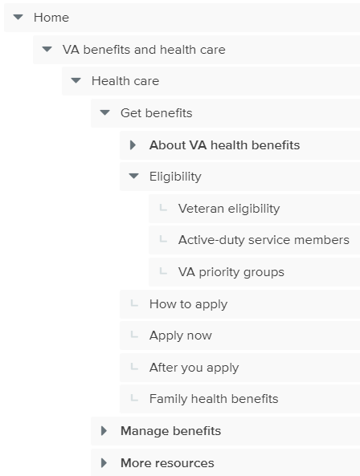
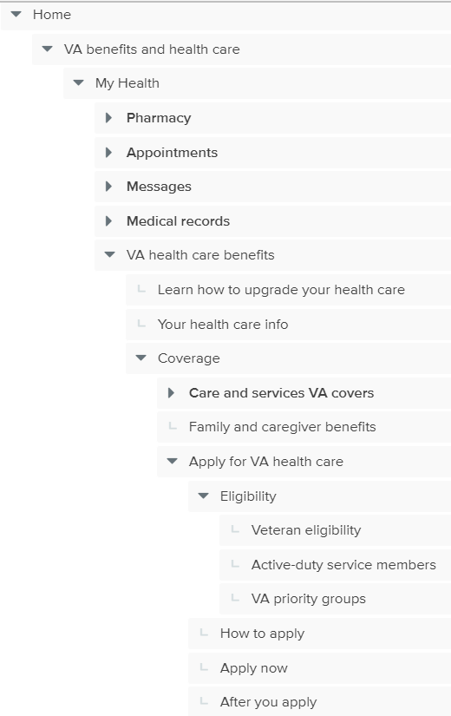
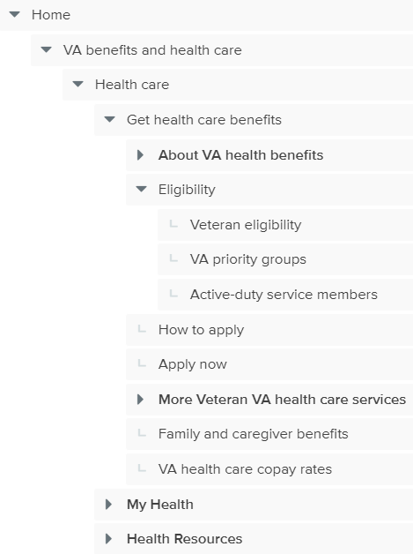
Eligibility
As a Veteran, you want to know if you qualify for VA health care
As a family member or caregiver of a Veteran, you want to know if the Veteran qualifies for VA health care.
You're the spouse or caregiver of a Veteran and you want to know if you can get health care through VA

Slide 25
Apply
As a Veteran, you want to know if you qualify for VA health care
As a family member or caregiver of a Veteran, you want to know if the Veteran qualifies for VA health care.
You're the spouse or caregiver of a Veteran and you want to know if you can get health care through VA

Slide 26
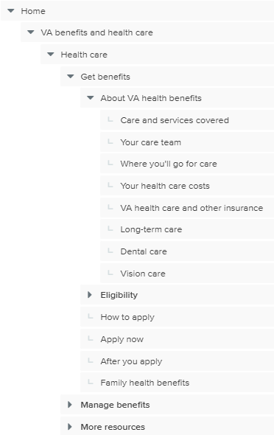
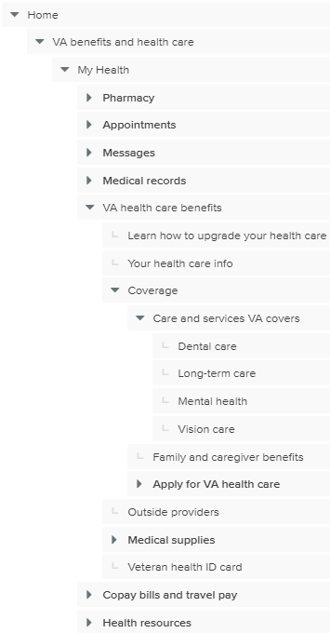
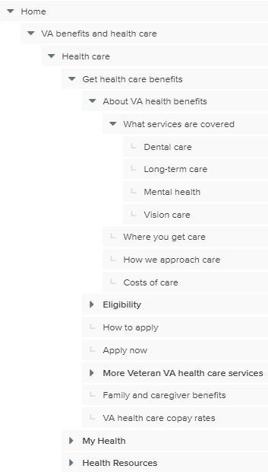
Mental health
As a Veteran, you want to know if you qualify for VA health care
As a family member or caregiver of a Veteran, you want to know if the Veteran qualifies for VA health care.
You're the spouse or caregiver of a Veteran and you want to know if you can get health care through VA

Slide 27
Dental care
As a Veteran, you want to know if you qualify for VA health care
As a family member or caregiver of a Veteran, you want to know if the Veteran qualifies for VA health care.
You're the spouse or caregiver of a Veteran and you want to know if you can get health care through VA

Slide 28
Community care
You want to know if VA will pay for you to get health care outside of VA.
As a family member or caregiver of a Veteran, you want to know if VA will pay for the Veteran to get health care outside of VA.

Slide 29
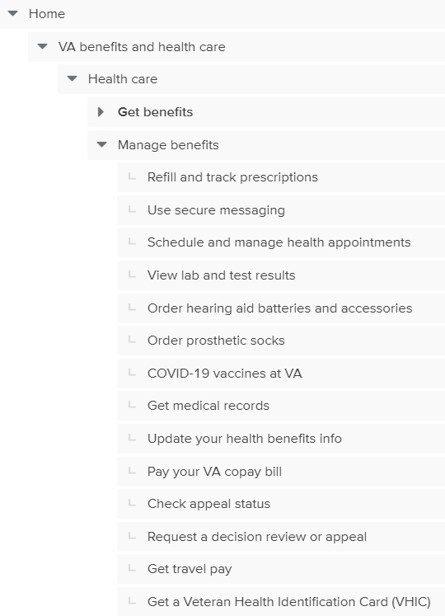
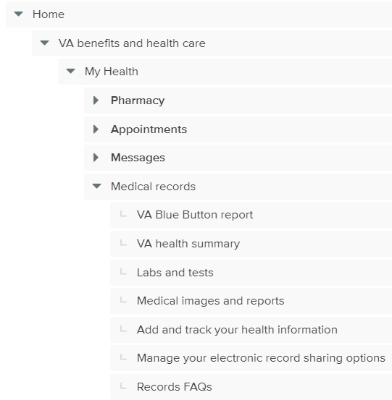
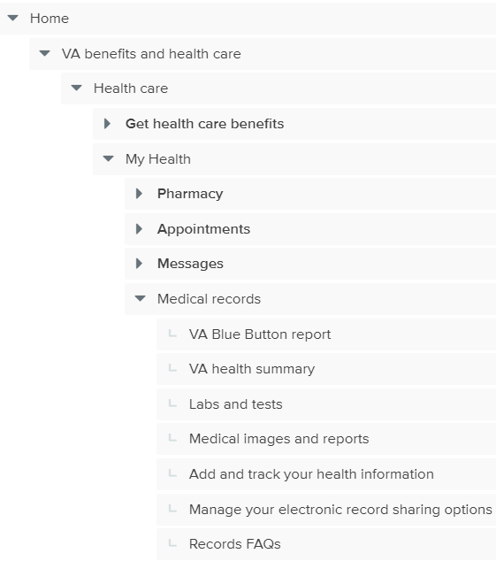

Medical Records
As a Veteran with VA health care, you want to send your VA health records to a non-VA provider.
As a family member or caregiver of a Veteran, you want to send their VA health records to a non-VA provider
Notes:
H1 performed similarly to baseline in task success, and a slightly lower directness for the caregiver group.
H0 consistently performed worse than baseline with both the Veteran and caregiver audience.

Slide 30
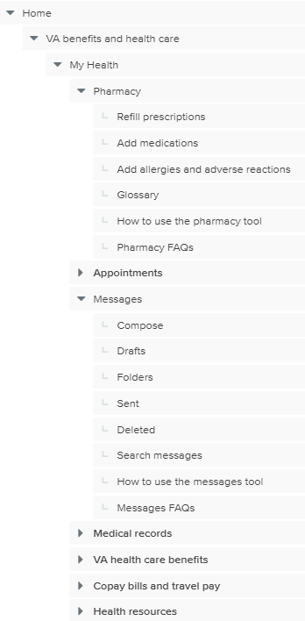
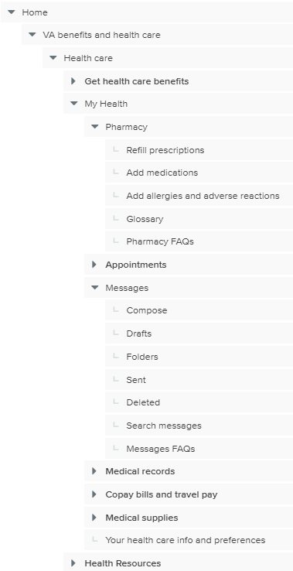
Prescriptions
You need to request a refill for a prescription you get from VA by mail.
The Veteran in your family needs to request a refill for a prescription they get from VA by mail.
Notes:
H1 performed similarly to baseline in task success, and a slightly lower directness for the caregiver group.
H0 consistently performed worse than baseline with both the Veteran and caregiver audience.

Slide 31
Messaging
You have a question for your doctor and want to communicate with them online.
As a Veteran's family member or caregiver, you have a question for the Veteran's doctor and want to communicate with them online
Notes:
H1 performed similarly to baseline in task success, and a slightly lower directness for the caregiver group.
H0 consistently performed worse than baseline with both the Veteran and caregiver audience.

Slide 32
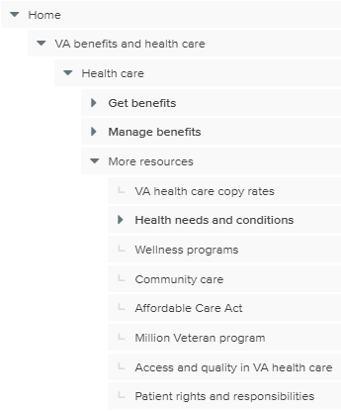
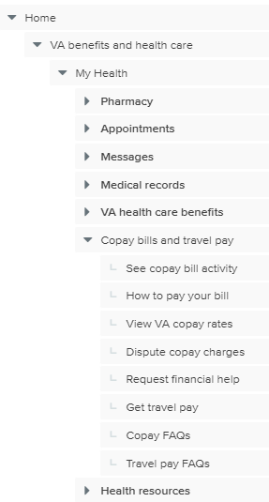
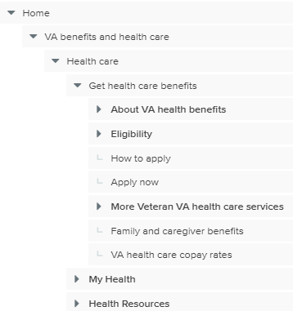
Copay rates
You want to find out the costs for VA health care services.
As a family member or caregiver of a Veteran, you want to find out the Veteran's cost for health care services.

Slide 33
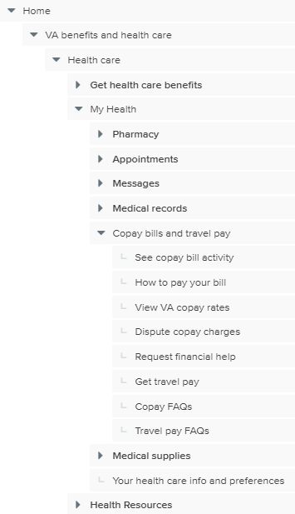
Pay copay bill
You want to check how much you owe for your last medical visit and pay your bill.
As a family member or caregiver of a Veteran, you want to check how much the Veteran owes for their last medical visit and pay the bill.

Slide 34
Travel pay
You drove to your VA primary care appointment and want to get paid back for the cost of gas.
You drove the Veteran in your family to a VA primary care appointment at VA and want to get paid back for the cost of gas.

Slide 35
Clicks to content tested
 | Baseline | H0 | H1
Total levels in structure | 5 | 7 | 6
Veteran eligibility | 5 (get benefits) | 7 (VA health care benefits) | 5 (get benefits)
Family member eligibility | 4 (get benefits) | 5 (VA health care benefits) | 4 (get benefits)
Apply | 4 (get benefits) | 6 (VA health care benefits) | 4 (get benefits)
Mental health | 5 (more resources) | 6 (VA health care benefits) | 6 (get benefits)
Dental care | 5 (get benefits) | 6 (VA health care benefits) | 6 (get benefits)
Community care | 5 (get benefits) | 4 (VA health care benefits) | 5 (get benefits)
Copay rates | 4 (more resources) | 4 (copay bills and travel pay) | 4 (get benefits)
Priority groups | 5 (get benefits) | 7 (coverage) | 5 (get benefits)
Medical records | 4 (manage benefits) | 4 (medical records) | 5 (my health)
Prescriptions | 4 (manage benefits) | 4 (prescriptions) | 5 (my health)
Secure messaging | 4 (manage benefits) | 4 (messages) | 5 (my health)
Pay copay bill | 4 (manage benefits) | 4 (copay bills and travel pay) | 5 (my health)
Travel pay | 4 (manage benefits) | 4 (copay bills and travel pay) | 5 (my health)

Slide 36
Veteran task success rates (unmoderated test)
Task | Baseline (30) | Hypothesis 0 (41) | Hypothesis 1 (40)
Overall | 67% | 62% | 67%
Eligibility | 87% | 24% | 80%
Apply | 78% | 27% | 76%
Dental | 67% | 67% | 76%
Mental health | 43% | 57% | 71%
Copay rates | 70% | 33% | 67%
Community Care | 48% | 84% | 63%
Priority groups | 15% | 24% | 35%
Medical records | 87% | 88% | 69%
Pay copay | 87% | 94% | 69%
Prescriptions | 89% | 90% | 82%
Messaging | 65% | 80% | 76%
Travel pay | 67% | 80% | 39%
= 10% or more improvement over baseline / = 10% or more decline over baseline / * = top score/correct option / [x] = incorrect option

Slide 37
Family member/Caregiver task success rates (unmoderated test)
Task | Baseline (30) | Hypothesis 0 (41) | Hypothesis 1 (40)
Overall | 51% | 54%* | 51%
Eligibility | 60%* | 17% | 53%
Dental | 43% | 46%* | 35%
Mental health | 30% | 34% | 55%*
Copay rates | 33% | 29% | 68%*
Eligibility | 67% | 83%* | 65%
Community Care | 30% | 61%* | 48%
Priority groups | 23% | 17% | 35%*
Medical records | 87% | 93%* | 70%
Pay copay | 57%* | 41% | 30%
Prescriptions | 83% | 95%* | 68%
Messaging | 57% | 80%* | 60%
Travel pay | 43% | 49%* | 28%
= 10% or more improvement over baseline / = 10% or more decline over baseline / * = top score/correct option / [x] = incorrect option

Slide 38
Key findings from each test
Veteran unmoderated
Neither hypotheses showed a significant change compared to baseline when looking across the full structure for all tasks
For “get benefits” tasks, H1 was flat, while H0 showed a significant detriment
For “get benefits” tasks, H0 failed 3 key tasks
For “get benefits” tasks, Both H0 and H1 showed significant improvements in the mental health and community care tasks
For “manage benefits” tasks, H0 showed significant improvement in direct success, while H1 was flat
For “manage benefits” tasks, H1 showed a significant decrease in 3 tasks
For “manage benefits” tasks, H1 showed a shift of where participants were exploring and selecting answers
Veteran moderated
Mission-critical content would benefit from multiple paths, elevation in the IA, and more direct navigation access/availability
While “My Health” provided an intuitive go-to location for “Manage” tasks, it was often not considered for “Get” content and tasks
Labeling and taxonomy bear improvement; Clear, concise language and familiar keywords
Mental Health should be easier to find with fewer steps to in navigation
Copay, Travel pay, and other financial content and tools could benefit from better organization, labeling, and definition
Family members and Caregivers unmoderated
H1 did better on tasks related to getting benefits, and H0 did better on tasks related to managing benefits
Eligibility information for Veterans was challenging to find, especially in H0
Participants struggled to find information related to getting health care benefits for themselves
Mental health care information was challenging to find
Participants visited and selected answers in the service member and family member benefits hubs more often in H0 than baseline and H1
For tasks related to managing health care, “My health” in H0 performed extremely well, while the same section in H1 performed significantly worse than baseline
H0 improved the findability of community care content

