Slide 1

Product Overview Find a Form 1.0
October 2020

Slide 2
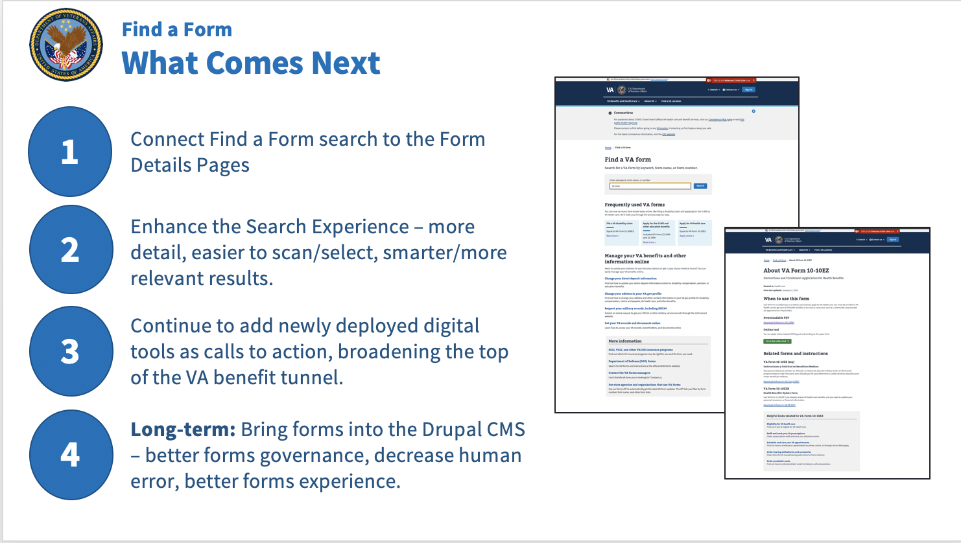
Find a Form What Comes Next
Next: Pilot with Brian McCarthy to migrate customer-facing VHA forms into the CMS.

