Slide 1
Voicebot
Product Outline

Slide 2
Table of Contents
Slide 2 - Overview
Slide 3 - Benefits
Slide 4 - MVP Scope
Slide 5 - Assumptions
Slide 6 - Timeline
Slide 7 - Blockers
Slide 8 - Platforms
Slide 9 - Risks

Slide 3
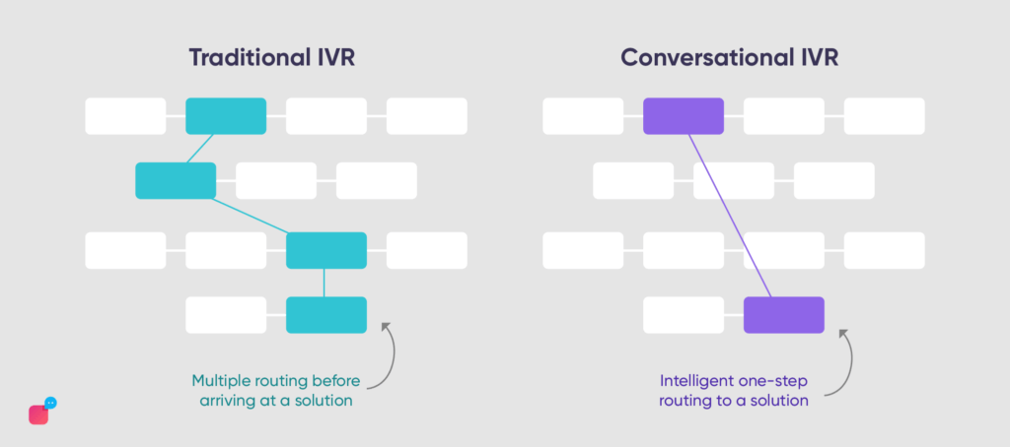
Overview
Develop and test a natural language understanding (NLU) telephony platform in the existing IVR tree navigation system to address NCC VBA’s highest call volume request (compensation claims status and PACT Act) to a fixed number of Veteran callers in order to:
Provide a better Veteran experience by reducing the burden of navigating tree-based IVRs.
Increase the amount of time agents have available for complex requests by reducing the routine call volume historically passed to the call center.
Source: Verloop.io

Slide 4
Benefits
VBA Benefits
Veteran Benefits
Reduce call volume for agents by addressing highest call volume requests
Reduce general information calls allowing agents to focus on complex cases
Reduce agent call time
use Voicebot gathered caller intent and details for real time agent use
automate phone authentication to decrease manual authentication processing time
In depth analytics collection to measure Veteran needs and experience satisfaction
No wait time to have claim status and PACT Act questions answered
Reduce wait time for agent required calls
Better customer experience by transferring collected information to agent
By leveraging AI multilingual skills, we can increase service to Veterans that speak different languages
Allow callers to receive information via text or email in real time

Slide 5
MVP Scope
The Voicebot will prompt the NCC VBA Veteran caller to state their concern or question, identify the caller’s intent using artificial intelligence, and respond accordingly using data retrieved from API(s), custom content, or routing the caller to the correct live agent.
The requests the Voicebot will support are: ​
​ General Claim Status – answer questions related to compensation claims
Personalized Claim Status – answer inquiries about the status of a Veteran’s open compensation claims
PACT Act – answer basic PACT Act questions
Notes:
p

Slide 6
Assumptions
Technology
Built with VA licensed Google Dialogflow or Amazon Lex
Integration
Voicebot lives inside Cisco telephony framework
Use existing authentication API/process
Service integration Cisco Telephony/WebEx Connect offerings
VANotify - sending links and information via email and text
Data
Calls existing Claims and Veteran APIs
Uses created service webhook to handle queries and pass date to Voicebot
Data will be stored in VA approved containers
Dynamic and Custom content for intent fulfillment
Collaboration
Content will be approved via VBA
NCC call line for small regional roll out
Continual HCD research / testing throughout development and launch
Notes:
Uses created webhook

Slide 7
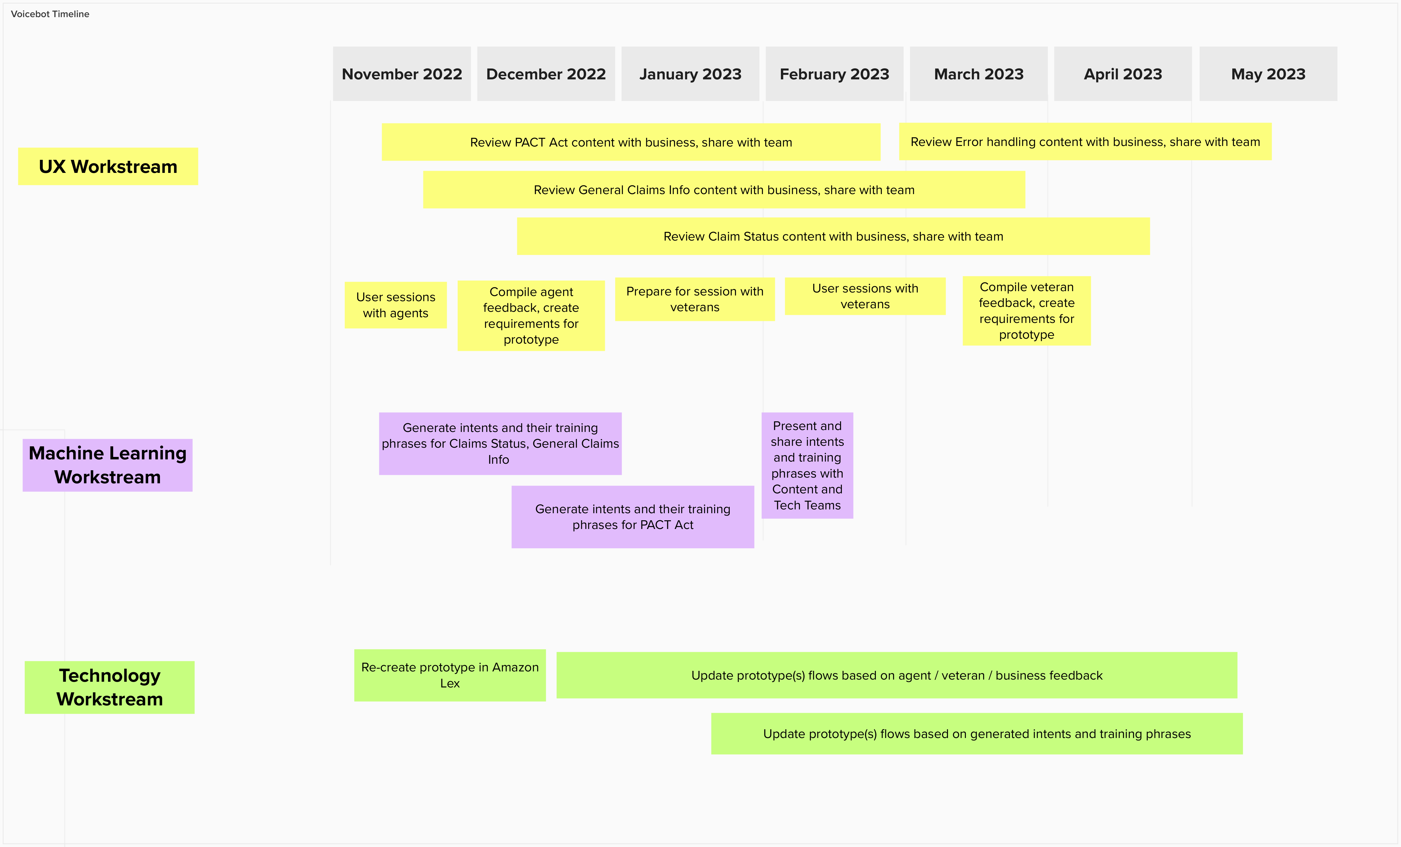
Timeline
*Timeline is dependent on platform selection, procuring licenses, and setting up environments / sandboxes

Slide 8
Blockers
The following risks blockers would need to be resolved before Voicebot is able to go to Production:
Platform selection / License procurement– No decision has been officially made for which platform the Voicebot will be developed in.
A Google DialogFlow prototype was developed demoed on 11/4/22.
An Amazon Lex prototype was developed and demoed on 12/8/22.
Development sandbox – A VA sandbox for Voicebot development needs to be established so the team can begin to integrate with VA services.
NCC IVR branch – A branch for development needs to be created and integrated with the sandbox so the Voicebot can test API integration
ATO – Google Cloud is not ATO-approved by the VA. An ATO would need to be approved for DialogFlow, if it is selected

Slide 9

Platforms Under Analysis/Consideration
Google DialogFlow
Amazon Lex
Solid documentation that was correct and easy to follow.
UI is easy to use to create and follow flows in.
Can pass any value/type back in response, making it easier to pass back responses from API calls.
Can use any web service provider for service integration.
Has a lot more tools and capabilities out of the box – create test cases, environment setup, etc.
Easy to trace issues
Analytics available to track user interaction.
Documentation is missing details, in some cases doesn't exist for functionality.
UI is difficult to follow flows in
Variables are only strings making them difficult to perform logic on.
UI, on multiple occasions, showed wrong information.
Could only use Amazon Lambda for service integration
Any change, minor or major, requires complete rebuild/retrain
No functional testing or environments built-in
Debugging is non-existent
Would need to use IVR to create actual flows.

Slide 10
Risks
The following risks have been identified:
A VA development sandbox has not yet been set-up for developing the Voicebot. The sandbox is dependent on a platform selection being made, which has also not yet occurred. The lack of a sandbox prevents the project from making progress in developing a Voicebot that would go to Production.
a. Booz Allen has attempted to mitigate the risk by setting up their own sandboxes; an AWS sandbox for Amazon Lex and a Google Cloud sandbox for DialogFlow were set-up and used to develop two prototypes. This has allowed Booz Allen to begin early development. However, because the sandboxes are not within the VA, there has been no integration to VA API's which would allow for authentication of the caller and for retrieving claim status information.

