Slide 1
Voicebot
Booz Allen Status Meeting
July 27, 2023

Slide 2
Agenda
UX Workstream
Technology Workstream
Integration Workstream
Ad Hoc updates
ML
Workstream updates
Catch-up items
Open Forum

Slide 3
UX Workstream
Item | Description | Status | Next Steps | Owner
Content creation for Voicebot responses: claims and PACT Act | Develop content, procedures, and get approvals; documenting how Voicebot will support claims and PACT Act questions | Finalize conversational flow for Test Session D in collaboration with UX and Danielle, using VA.gov's PACT Act wizard documentation as a starting point. Begin ideation of a voice style guide with UX. | Test conversational flow for Test Session D. Develop voice style guide document. | Grace/ Sunayna
Content for introduction, errors, parameter prompts, etc. | Develop content for managing user expectations throughout conversation | Improve general error messages and create specific messaging placements in the PACT Act flow. | Test help menu intent & content. | Grace/ Sunayna
UX Design & Strategy | Efforts to elicit design inputs from end user research and testing | Collaboration on flow and schema for Session D user intent Iterations of rough draft for User Test Session D Continued design for the User Interface on Intent Designer | Continue with Test Session D creation/refinement sessions Finish Test Session D Rough Draft Continue User Interface design for Intent Designer tool | Julie/Ty

Slide 4
Technology and Integration Workstreams
Item | Description | Status | Next Steps | Owner
Google DialogFlow | Implementing Voicebot solution in DialogFlow | Investigating having more, page-specific, error messaging to provide a better experience for caller and offer more detailed guidance on moving forward Met with Google on July 14 Intent Designer additions – sorting by name and date, system key generation for ML to hit external API to access DB, and filtering of enabled/disabled Training phrases. Working with UX on ID wireframing and implementing dashboard with identified metrics. | Add eligibility track to DF (route group) Update pact illness entities in DF to help better matching of intents. ID features – each piece of content will get its own page with history to track changes, minor Front end copy changes and ML asks including updating avg # TPs to only include enabled, and dup analysis to only compare enabled. Still working on setting up regular cadence with Google | Josh / Nicole
Cloud Webhook Service | Cloud Function being used for webhooks in DialogFlow | Status call occurred on July 6 at 2:30pm | ECSO cloud approved, in process of being acquired ECSO to: Send updated Cost Estimate Have ECSO leadership sign Financial MOU Schedule Pre-Provisioning and Provisioning Planning calls | VA
VA Sandbox | Sandbox for Voicebot development | VA has created sandbox | Booz Allen exploring sandbox | Josh
ATO acquisition | DTC preparing for ATO | Project identified as moderate risk | ATO timeline TBD | VA

Slide 5
Ad Hoc
Item | Description | Status | Next Steps | Owner
Deliverables from June In-Person | Ways of Working and Team Charter | Team began work on Ways of Working and Team Charter | Documents completed – call scheduled for today, 7/27 @ 3:30pm to review | Robyn
VBA In-Person | Meeting with VBA to review scope and questions | Team reviewed use cases and generated list of questions Space tentatively reserved at Booz Allen: DC office: Mon 8/21 – Wed 8/23 McLean office: Wed 8/23 – Fri 8/25 | Awaiting Regina's availability for September | Kate/Gian
UC virtual meeting | Meeting with UC to walkthrough integration & authentication questions | Weekly calls occurring while we await UC workshop | Virtual workshop tentatively rescheduled for 8/16 and 8/17 – UC is hopeful that environments will be ready to use at this time | Gian
VCL meeting with Dr. Foreman | Meeting with VCL to discuss Voicebot opportunities | Voicebot ready to engage with Dr. Foreman to discuss crisis-management – both chatbot and voice | Call scheduled for 8/17 | VA
USPS Contact | Meeting with USPS to ask implementation questions | Team prepared questions for USPS on 6/29 | Kate to schedule call with USPS POC | VA

Slide 6
ML Workstream
Item | Description | Status | Next Steps | Owner
PACT Act and Disability Claims use cases | Voicebot will use training phrases extracted from Chatbot transcripts, reddit and survey (for PACT), and AVA data to develop intents for classification of PACT Act and disability claim related user inquiries. | Working on restructuring the Pact Act Track in Google Dialog flow based on user and team testing plan. Analyzing chatbot transcripts all together (Nov ‘22 – Apr ’23). BigQuery connection established Made API connection from intent designer to perform further analysis of training phrases. | Beginning exploration phase of VCL routing abilities, including gathering training phrases from various sources. Working on related intents to be placed in the flows so the caller can ask non prompted intents. Creating entities within Google DialogFlow to support synonyms and decrease the number of redundant training phrase. Beginning exploration of PowerBI tool for data management. Beginning exploration of generative AI capabilities withing Google DialogFlow Gathering metadata from Google DialogFlow with BigQuery connection | Booz Allen
Notes:
As user inquiries evolve, supplement training phrases: newer data, test subjects, etc
eGain data to be made available
Exploring availability of AVA data in CxDW
Step 1. train a small number of intents in dialogflow with quality training phrases. If we can achieve high classification accuracy on those intents, namely low false positives and low false negatives, that would be a and if we and let bot perform well at classifying those, with everything else
End-user input (speech) > intent classification (success determined by quality of training phrases) > bot response with relevant and approved content > end-user input >> classification of bot response
(claim status and PACT Act alone can easily grow into 10-20+ distinct intents if we pursue self-help options deeply or they could just be two intents and there are now flows, just classification and routing immediately back to cisco).
UX – content, procedures, approvals, best practices, user testing, flow design and re-design
ML – two-fold application: 1) process large datasets to generate run language models on data VA has collected that captures users’ interactions with the contact center to extract examples of end-user inquires from existing data that most closely resembles what voicebot will encouter, ensure variety utteranceslanguage models

Slide 7
Machine Learning catch-up
Agenda
Meeting with Google – summary from ML perspective
Supporting Test Session D
ML Inner Workings
Anything else

Slide 8

Google Meeting Summary
Google Meeting Summary
Google provided guidance on:
Connecting to BigQuery
Training phrase optimization
Entity creation for use in multiple intents
Newest Google DialogFlow Implementations: Generative AI and Large Language Models (LLMs) Option
Organizations can now point to their own data, including websites, FAQ lists, or any other document on the web or stored in Google Cloud
This allows DialogFlow to use the VA’s support knowledge to independently generate precise and immediate responses to veteran questions and serve as a conversational search engine
Eliminates the need for multiple, specific intents
Next Steps:
Set up a regular meeting cadence with Google’s DialogFlow team for both developer and ML team
Ask about implementing generative AI agent
How will generative AI agent affect our current flow
Notes:
https://cloud.google.com/blog/products/ai-machine-learning/generative-ai-powered-chatbots-and-virtual-agents

Slide 9

Supporting Test Session D
ML Supporting Test Session D
Flow Redesign
Targeted & shorter training phrases to support new answer choices in content
Identifying related intents; this allows the caller to ask questions outside of prompted topics
Creating entities for PACT Act, locations, and diseases
Analyzing older training phrases from chatbot transcripts and past test sessions to understand the flow of how the caller usually asks questions
Data Metrics to Collect
How veterans ask content to be repeated
When do veterans ask to be transferred to an agent; where can we improve content vs. where does the veteran absolutely need to talk to an agent
Post test session D: analyze match confidence levels between test subject’s utterance and their intended intent
Initial Utterance
“How to register for Burn Pit Registry?” content
Utterances
Matched Intent
Burn pit health effects
Burn Pit Health Effects Intent
To register for the Burn Pit Registry, use one of the sign in options on the Access VA page and complete the questionnaire...
What other questions can I help you with?
Can you check on my open disability claim?
I served in Iraq and I want to register for burn pits.
Claim Status Intent
Determine my eligibility for PACT.
Healthcare Eligibility Tool
Can I speak with an agent?
Agent Transfer
Notes:
Identifying supporting intents to ensure flow is dynamic
Repeat
Flow redesign
to include more guided approach of conversation for the caller
Targeted training phrases
Supply Training phrases to support answer choices
Smaller training phrases
Identifying related intents and testing
allowing caller to ask questions outside of prompted topics
guide the caller towards applying for PACT Act
proactive next steps
Proposing ideas for improvement – for e.g.; entities
PACT Act
Location and disease related to PACT Act
Historical references for establishing the flow
analyzing older taring phrases to understand how caller usually ask a question on a certain topic and recommend flow design.
Post test session support with data analysis and automation
Will provide post session support to clean and organize test data
Recommendation to collect a few data metrics from test session D to improve performance
utterances for repeat functionality
Pattern in agent transfer instances
Analyze match confidence level between test subject’s utterance and intents
Cross workstream collaboration

Slide 10

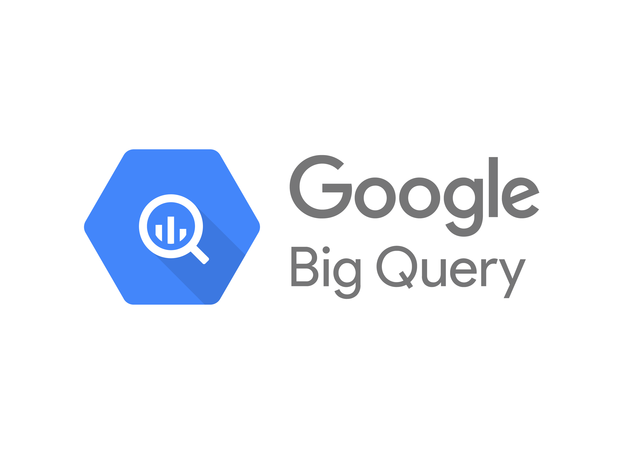


Inner Workings
ML Inner Workings
Chatbot Transcripts
Setting up a pipeline to perform clustering analysis on chatbot transcripts from November ‘22 through April ’23
Will eliminate duplicates and identify any new patterns in Veteran requests
Intent Designer Updates
Intent Designer has become a training phrase and content management tool
Already implemented: API connection to allow download of every single training phrase along with corresponding intent
In progress: sorting by different parameters, advanced duplicate analysis, change log, flow location, link to corresponding content, ”what if” page
Power BI
Created workspace and imported chatbot transcript data
Will serve as a pre-processing tool and analytics platform for every single training phrase
Dual purpose:
1. Connect to BigQuery to analyze call data
2. Data cleaning/analysis of all training phrases
project_id
agent_id
Turn_position
Request_time
userUtterance
intent
agentUtterance
confidence
sentimentMagnitude
sentimentScore
Notes:
Clustering analysis of chatbot transcripts
Data from November to April (may add May and June)
Setting up a pipeline to analyze all at once for better result
Intent designer update for ML (sorting, cosine analysis, download capability, API connection, link to content and change log)
Help to manage training phrases
Flow /page-based training phrases analysis
Intent similarity analysis to determine how different the training phrases need to be.
Exploring Power Bi to perform data cleaning and analysis.
Data cleaning/analysis
Dashboard of overall view of training phrases
Not hooked up to DF data yet
Support content, UX and Dev
A bridge between technical and nontechnical members of the team.
WHY INTENT DESIGNER IS IMPORTANT

Slide 11
Open Forum
Questions / Open Discussion

Slide 12
Appendix

Slide 13
Project Overview
Detailed scope for Omnichannel project will be voice.
Discovery through building and learning—build it, learn from it, iterate it.
With an overall strategy of transitioning MyVA411, transition VBA to using a Natural Language Understanding (NLU) platform.
Determine the problem categories and point of transition.
Through learning and understanding how self-service and triage can be supported through voice channels, assess another product which may replace AudioCARE.
Stipulations:
Projects must have a customer experience and Omnichannel mindset toward best customer experience for Veterans.
Small iterative releases, solutions to run in parallel with existing solutions to Veterans are not negatively affected by our transitions.
All products must have Veteran input.

