Slide 1
Omnichannel Voice Team
Booz Allen Status Meeting

Slide 2
Agenda
Priority/Ad Hoc Items
Open Forum

Slide 3
Priority/Ad Hoc Items
Item | Description | Status | Next Steps | Owner
Background Documentation | Documentation providing insight into processes/ systems/ research of use to Voice Team | More IVR Flows and NCC Call Data provided on 7/7 Met with John Rocco on 7/11 to discuss IVR Solutions Results provided on 7/7 Reviewed and responded with minimum level of FedRAMP certification required Claims Austin Offsite notes provided on 7/7 | Meet with John Rocco on 7/18 to continue discussing reporting and sourcing call center data | Gian
Staff Onboarding | Onboarding staff according to project needs | All staff on onboarding process New team members; Millie Mamedova and Sunayna Goel | Continuing to staff to needs accordingly | Sara
VA IVR dependencies | Investigate other components required for Google DialogFlow | Team is researching DialogFlow | Identify and investigate if components are FedRAMP certified | Millie / Ray
Voiceflow | Explore and experiment with Voiceflow as an IVR | Team has created a sample IVR through Voiceflow Voiceflow was identified as not being FedRAMP certified | Continue exploring Voiceflow Establish if Voiceflow would be used as the IVR system or for just discovery | Booz Allen
Early Google DialogFlow testing | Obtaining access to Dialogflow | In-process – contingent on FedRAMP level determination | Investigate on VA side once GFE’s are obtained | Ray

Slide 4
Open Forum
Next Steps
Action Items

Slide 5
Appendix

Slide 6
Completed Items
Item | Description | Status | Owner
Status Meeting Cadence | Establishing the day and time Voice team will meet for weekly status calls | Weekly status meetings scheduled for 2:30pm on Thursdays | Gian

Slide 7
Project Overview
Detailed scope for Omnichannel project will be voice.
Discovery through building and learning—build it, learn from it, iterate it.
With an overall strategy of transitioning MYVA411, transition VBA to using a Natural Language Understanding (NLU) platform.
Determine the problem categories and point of transition.
Through learning and understanding how self-service and triage can be supported through voice channels, assess another product which may replace AudioCARE.
Stipulations:
Projects must have a customer experience and Omnichannel mindset toward best customer experience for Veterans.
Small iterative releases, solutions to run in parallel with existing solutions to Veterans are not negatively affected by our transitions.
All products must have Veteran input.

Slide 8
Project Timeline
 | Apr 2022 | May | Jun | Jul | Aug | Sep | Oct | Nov | Dec | Jan 2023 | Feb | Mar | Apr
 |  |  |  | `
*Note: These dates are notional and subject to change pending additional scoping and decisions from project managers and stakeholders.

Slide 9
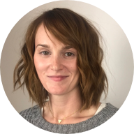
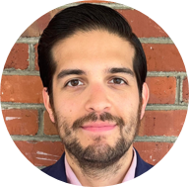

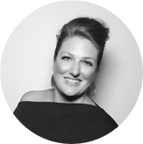
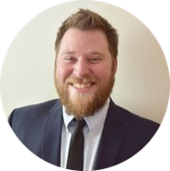



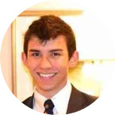
Project Team
Sara Snead
Program Manager
Gian Bustillo
Project Manager
Kateleigh Clark
Project Advisor
Julie Naga
UX Lead
Ray Walther
Cognitive Solutions & Technology Lead
Filip Fafara
Technical Advisor
Grace Goodenough
Project Scheduler
Sunayna Goel
Business Analyst
Patrick Onesty
Technical Writer

