Slide 1
Omnichannel Voice Team
Booz Allen Status Meeting

Slide 2
Agenda
Priority/Ad Hoc Items
Open Forum

Slide 3
Priority/Ad Hoc Items
Item | Description | Status | Next Steps | Owner
Background Documentation | Documentation providing insight into processes/ systems/ research of use to Voice Team | Met with John Rocco on 7/18 to discuss call center data and reports MyVA411 Scope Documents and IVR Experience Report provided by Kate on 7/18 MURAL pre-discovery board laying out all gathered research | Meet with NCC (Mary and Regina) for introductions and call center data / transcripts Continue to review provided documentation Voice MURAL created | Gian
Voiceflow | Explore and experiment with Voiceflow as an IVR | Team has created a sample IVR through Voiceflow | Continue exploring Voiceflow and its offerings | Booz Allen
Staff Onboarding | Onboarding staff according to project needs | Staff in onboarding process New team members; Sunayna Goel and Ty Allen | Continue to staff to needs accordingly Team to get PIV’s and GFE’s in the coming weeks | Sara
NLU Platform | Deciding between Amazon Lex and Google DialogFlow as NLU Platform | Comparison research has already been completed VA waiting for response from Google for questions regarding FedRAMP level and needed developer skills | VA to decide on a platform by end of July | VA
User Research | User Research to inform NLU | Confirming use cases | Proceed with Audiocare / Pharmacy use case research gathering | Julie

Slide 4
Open Forum
Next Steps
Action Items

Slide 5
Appendix

Slide 6
Project Overview
Detailed scope for Omnichannel project will be voice.
Discovery through building and learning—build it, learn from it, iterate it.
With an overall strategy of transitioning MyVA411, transition VBA to using a Natural Language Understanding (NLU) platform.
Determine the problem categories and point of transition.
Through learning and understanding how self-service and triage can be supported through voice channels, assess another product which may replace AudioCARE.
Stipulations:
Projects must have a customer experience and Omnichannel mindset toward best customer experience for Veterans.
Small iterative releases, solutions to run in parallel with existing solutions to Veterans are not negatively affected by our transitions.
All products must have Veteran input.

Slide 7
Project Timeline
 | Apr 2022 | May | Jun | Jul | Aug | Sep | Oct | Nov | Dec | Jan 2023 | Feb | Mar | Apr
 |  |  |  | `
*Note: These dates are notional and subject to change pending additional scoping and decisions from project managers and stakeholders.

Slide 8
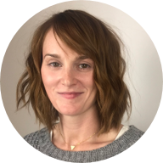
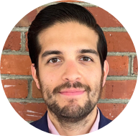


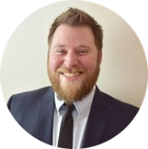


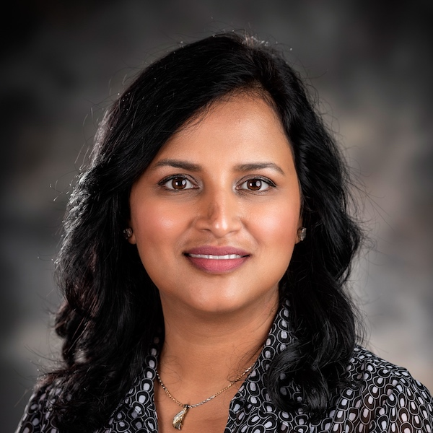
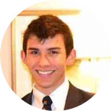
Project Team
Sara Snead
Program Manager
Gian Bustillo
Project Manager
Kateleigh Clark
Project Advisor
Julie Naga
UX Lead
Ray Walther
Cognitive Solutions & Technology Lead
Filip Fafara
Technical Advisor
Grace Goodenough
Project Scheduler
Sunayna Goel
Business Analyst
Patrick Onesty
Technical Writer

