Slide 1
Omnichannel Voice Team
Booz Allen Status Meeting

Slide 2
Agenda
Priority/Ad Hoc Items
Open Forum

Slide 3
Priority/Ad Hoc Items
Item | Description | Status | Next Steps | Owner
MyVA411 Call Data | Identifying most common reasons Veterans call into the MyVA411 | Met with John Rocco on 7/18 to discuss call center data and reports Chante working on acquiring MyVA411 general call data | Meet with Vlad and John to discuss reports Identify potential discovery items using Chante's data | Gian
Claims Research | Researching how to improve Veteran experience when calling for claims | Introductions with NCC needed to begin claims discovery Pre-discovery research exploring claims, claims process, pain points, etc. | Kick-off meeting with NCC to be scheduled Continue desk research using existing VA work and open-source information to glean from | VA / Booz Allen
NLU Platform | Deciding between Amazon Lex and Google DialogFlow as NLU Platform | Comparison research has already been completed VA waiting for response from Google for questions regarding FedRAMP level | VA to decide on a platform in early August | VA
Voiceflow | Explore and experiment with Voiceflow as an IVR | Team has created a sample IVR through Voiceflow | Continue exploring Voiceflow and its offerings | Booz Allen
Staff Onboarding | Onboarding staff according to project needs | Staff in onboarding process | Continue to staff to needs accordingly Team to get PIV’s and GFE’s in the coming weeks | Sara

Slide 4
Open Forum
Next Steps
Action Items

Slide 5
Appendix

Slide 6
Project Overview
Detailed scope for Omnichannel project will be voice.
Discovery through building and learning—build it, learn from it, iterate it.
With an overall strategy of transitioning MyVA411, transition VBA to using a Natural Language Understanding (NLU) platform.
Determine the problem categories and point of transition.
Through learning and understanding how self-service and triage can be supported through voice channels, assess another product which may replace AudioCARE.
Stipulations:
Projects must have a customer experience and Omnichannel mindset toward best customer experience for Veterans.
Small iterative releases, solutions to run in parallel with existing solutions to Veterans are not negatively affected by our transitions.
All products must have Veteran input.

Slide 7
Project Timeline
 | Apr 2022 | May | Jun | Jul | Aug | Sep | Oct | Nov | Dec | Jan 2023 | Feb | Mar | Apr
 |  |  |  | `
*Note: These dates are notional and subject to change pending additional scoping and decisions from project managers and stakeholders.

Slide 8

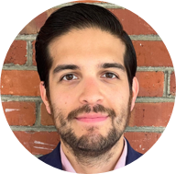


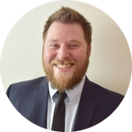


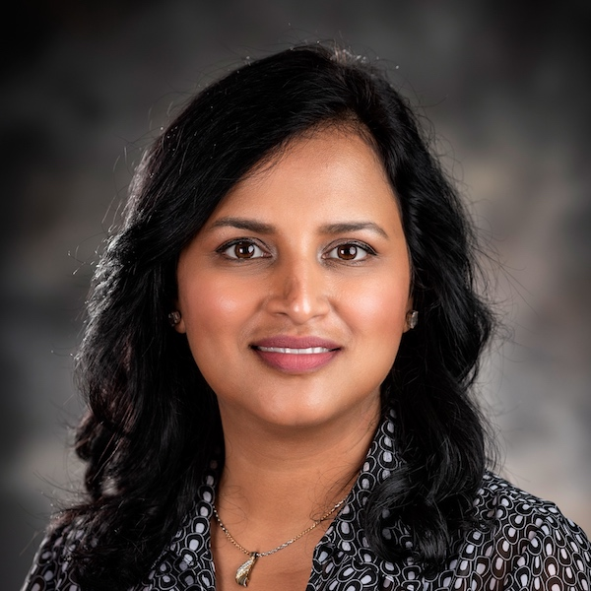

Project Team
Sara Snead
Program Manager
Gian Bustillo
Project Manager
Kateleigh Clark
Project Advisor
Julie Naga
UX Lead
Ray Walther
Cognitive Solutions & Technology Lead
Filip Fafara
Technical Advisor
Grace Goodenough
Project Scheduler
Sunayna Goel
Business Analyst
Patrick Onesty
Technical Writer

