Slide 1
Omnichannel Voice Team
Booz Allen Status Meeting
August 4, 2022

Slide 2

Agenda
Priority/Ad Hoc Items
Initial Roadmap, Team Name
Open Forum
VA Onboarding Status
 | eQIP | Remote Access | PIV | GFE | Data Access
Gian |  |  | - | - | -
Grace |  | - | - | - | -
Julie |  |  | scheduling | - | -
Millie |  |  |  | - | in progress
Ray |  |  |  | scheduling PU | -
Sunayna | submitted | - | - | - | -
Ty | in progress | - | - | - | -

Slide 3
Priority/Ad Hoc Items
Item | Description | Status | Next Steps | Owner
MyVA411 Call Data | Identifying most common reasons Veterans call into the MyVA411 | Met with John Rocco on 7/18 to discuss call center data and reports Chante provided call center data | Review call center data provided by Chante to identify potential discovery items (data on VA side – awaiting access) Desk research Veteran experience within existing HCD phone/chatbot project work | Gian
Claims Research | Researching how to improve Veteran experience when calling for claims | Introductions with NCC needed to begin claims discovery Pre-discovery research exploring claims, claims process, pain points, existing resources, etc. | Kick-off meeting with NCC has been scheduled for XXXX Continue desk research using existing VA work and open-source information to glean from | VA / Booz Allen
NLU Platform | Deciding between Amazon Lex and Google DialogFlow as NLU Platform | Comparison research has already been completed | VA to decide on a platform in early August | VA
Voiceflow | Explore and experiment with Voiceflow as an IVR | Team demoed their sample IVR and demonstrated basic Voiceflow prototype capabilities to Luciana on 8/1 | Continue exploring Voiceflow and its offerings Explore Alexa Skills as possible user research prototype | Booz Allen
Staff Onboarding | Onboarding staff according to project needs | Staff in onboarding process | Continue to staff to needs accordingly Team to get PIV’s and GFE’s in the coming weeks | Sara

Slide 4
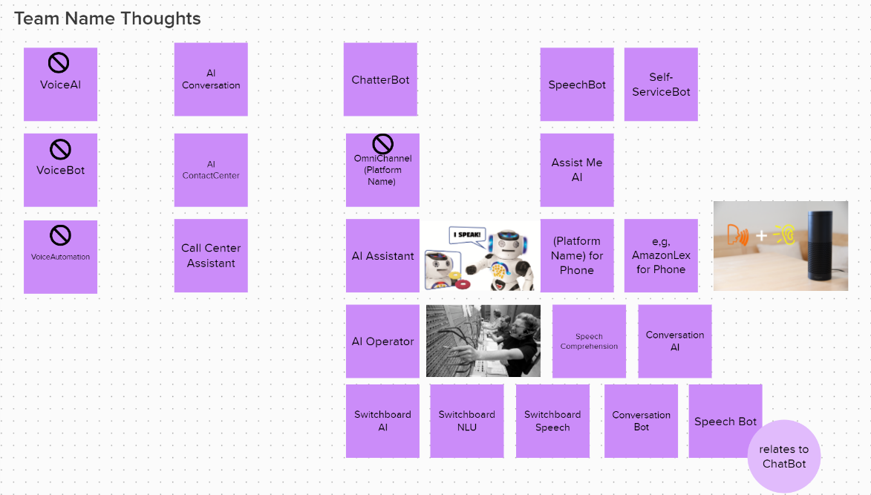
What are we calling this team?

Slide 5
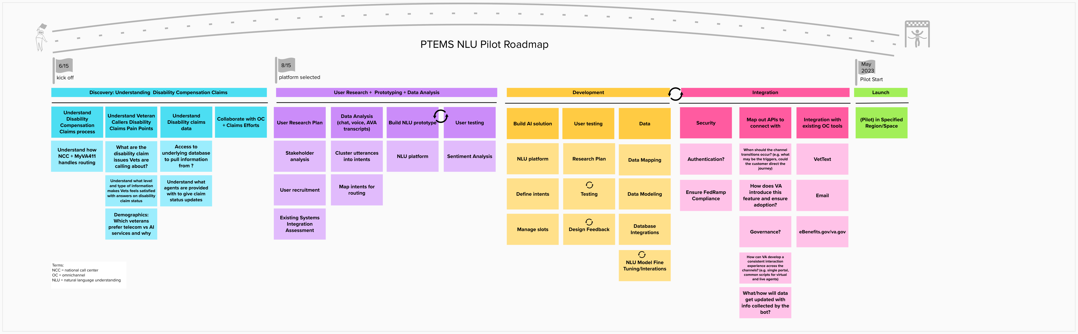
Initial Roadmap (draft)

Slide 6
Open Forum
Next Steps
Action Items

Slide 7
Appendix

Slide 8
Project Overview
Detailed scope for Omnichannel project will be voice.
Discovery through building and learning—build it, learn from it, iterate it.
With an overall strategy of transitioning MyVA411, transition VBA to using a Natural Language Understanding (NLU) platform.
Determine the problem categories and point of transition.
Through learning and understanding how self-service and triage can be supported through voice channels, assess another product which may replace AudioCARE.
Stipulations:
Projects must have a customer experience and Omnichannel mindset toward best customer experience for Veterans.
Small iterative releases, solutions to run in parallel with existing solutions to Veterans are not negatively affected by our transitions.
All products must have Veteran input.

Slide 9
Project Timeline
 | Apr 2022 | May | Jun | Jul | Aug | Sep | Oct | Nov | Dec | Jan 2023 | Feb | Mar | Apr
 |  |  |  | `
*Note: These dates are notional and subject to change pending additional scoping and decisions from project managers and stakeholders.

Slide 10

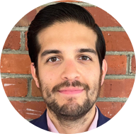


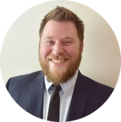


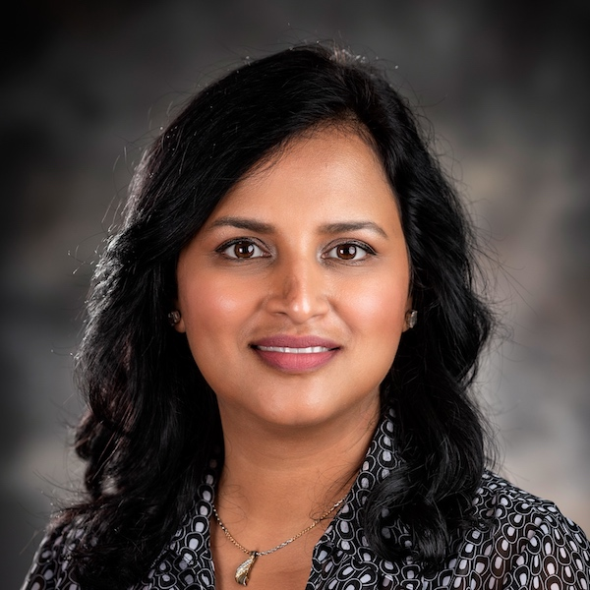

Project Team
Sara Snead
Program Manager
Gian Bustillo
Project Manager
Kateleigh Clark
Project Advisor
Julie Naga
UX Lead
Ray Walther
Cognitive Solutions & Technology Lead
Filip Fafara
Technical Advisor
Grace Goodenough
Project Scheduler
Sunayna Goel
Business Analyst
Patrick Onesty
Technical Writer

