Slide 1
Omnichannel VoiceBot Team
Booz Allen Status Meeting
August 11, 2022

Slide 2
Agenda
Priority/Ad Hoc Items
Open Forum

Slide 3
Priority/Ad Hoc Items
Item | Description | Status | Next Steps | Owner
Claims Research | Researching how to improve Veteran experience when calling for claims | Claims Information Requested by Veteran Requested NCC Claims call metrics Pre-discovery research Available Claims Information from VA Karan provided Claims API documentation and Claims status tool What is available to veteran vs what is available to agent | Claims Information Requested by Veteran Kate running reports on NCC Claims call metrics Kate working to provide Booz Allen DataBricks and CxDW access Kick-off meeting with NCC on 8/17 Booz Allen to continue desk research using existing VA work and open-source information to glean from Available Claims Information from VA Booz Allen to review information provided by Karan Schedule call with Karan | VA / Booz Allen
Non-Claims Research | Identifying most common reasons Veterans call into the | Team identified most common call types from MyVA411 call center reports provided by Chante Created Word Cloud for Case Type = "Other" | Kate running reports on NCC call metrics Kate working to provide Booz Allen DataBricks and CxDW access Desk research Veteran experience within existing HCD phone/chatbot project work | Gian
NLU Platform | Decision for Voicebot Platform | Comparison research completed Microsoft Conversational AI demo with Booz Allen on 8/9 | VA to decide on a platform in August | VA
Prototyping/ User Test Tool | Explore Voiceflow vs Alexa skills | Team completed SWOT analysis comparing Alexa Skills with Voiceflow | Team concluded Voiceflow was best prototyping tool | Booz Allen

Slide 4

Priority/Ad Hoc Items
Item​ | Description​ | Status​ | Next Steps​ | Owner​
Staff Onboarding | Onboarding staff according to project needs | Staff in onboarding process Nicole Bush (developer) beginning 8/15 Team is signed up with Slack | Continue to staff to needs accordingly Team to get PIV’s and GFE’s in the coming weeks | Sara
 | eQIP | Remote Access | PIV | GFE | Teams Access
Gian |  |  | Scheduled | -
Grace |  | - | - | - | -
Julie |  |  |  | - | -
Millie |  |  |  | -
Ray
Sunayna |  |  | - | -
Ty |  | - | - | - | -

Slide 5
Open Forum
Action Items

Slide 6

Prototyping Tool SWOT Analysis
strengths, weaknesses, opportunities, & threats (SWOT) analysis process
SWOT Analysis Process
Notes:
Slide has visual representations of the SWOT analysis we have done on the prototyping tools.
SWOT process stands for Strenghts. / Weaknesses / opportunities and Threats
This technique is used to do comparison of products or strategic approaches.
Compares internal/external factors, as well as, current and future potential of items
Thought this was perfect fit while we are evaluating and experimenting with these tools two tools
The little black box just illustrates the process we used applying to each SWOT Aarea where we generated all that we have learned so far and then clustering related notes and gaving each a representative label.
We devised the following questions for the analysis areas to help us compare the two most viable:
Strengths: What does this tool do well? What unique aspects does it have?
Weaknesses: What could this tool do better? What does this tool leave to be desired
Opportunities: How well does it fit our task? How would this tool make prototyping better / easier?
Threats: What aspect present a problem or issue for our task? What might get in the way of our success?

Slide 7
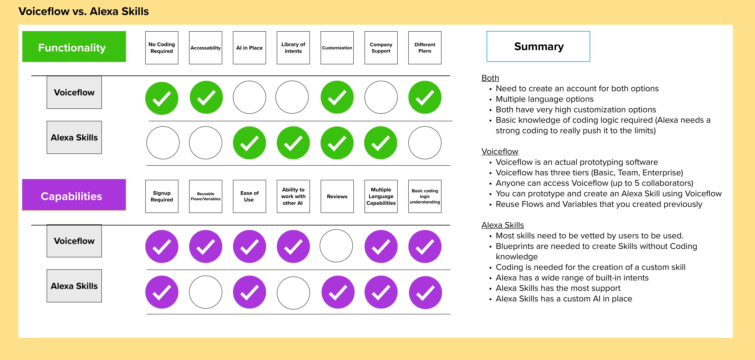



Prototyping Tool SWOT Analysis continued
Strengths, weaknesses, opportunities, & threats (SWOT)
Notes:
This comparison chart is the final comparison of the labels resulting from the analysis. We found that two representative labels found in SWOT analysis applied to all four analysis areas:
Functionality, Capability. This chart compares the two. Functionality in the Green and Capability in the Purple. The check indicates the strength of each factor.
Voiceflow = 10 checks
Alexa = 9 checks
May seems equal – when you take into the most important and least important areas for our team to use the tool – (which indicated by the thumbs up and thumbs down) Voiceflow comes out on top.
The details are here – but I will give you my top three of this determination - Actual prototyping and anyone can access it and reusable flows/ variables.

Slide 8
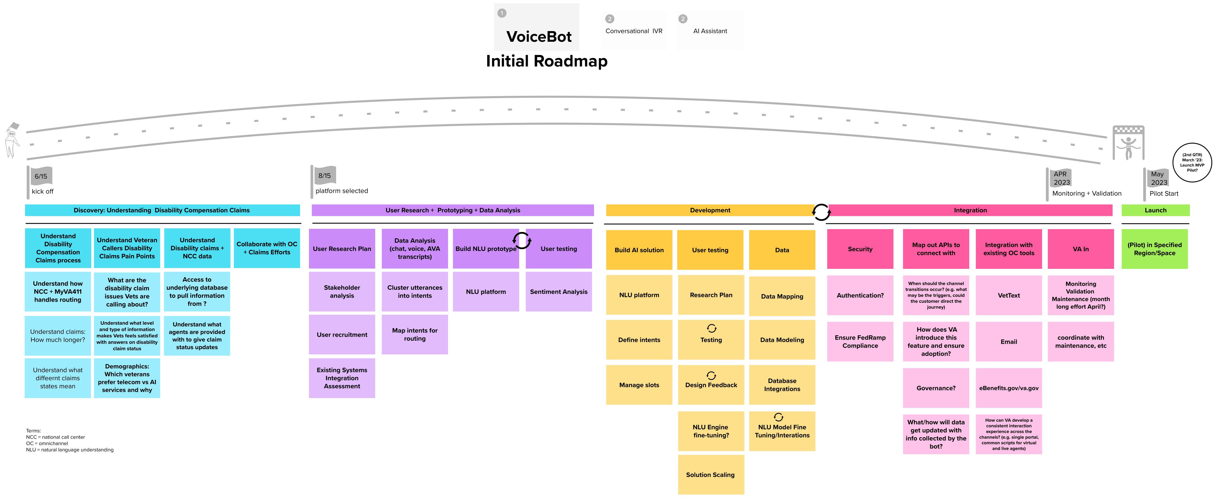
Roadmap

Slide 9
Appendix

Slide 10
Benefit Claims API
Attributes | Description
evss_id* | integerUpstream service identifier
date_filed* | string($date) example: 2018-06-04Date in YYYY-MM-DD the claim was first filed
min_est_date | stringnull($date) example: 2019-06-04Minimum Estimated Claim Completion Date
max_est_date* | stringnull($date) example: 2019-09-04Maximum Estimated Claim Completion Date
open* | boolean example: true. Has the claim been resolved
waiver_submitted* | Boolean example: false. Requested Decision or Waiver 5103 Submitted
documents_needed* | Boolean example: false. Does the claim require additional documents to be submitted
development_letter_sent* | boolean example: false. Indicates if a Development Letter has been sent to the Claimant regarding a benefit claim
decision_letter_sent | boolean example: false. Indicates if a Decision Letter has been sent to the Claimant regarding a benefit claim
status* | String example: Claim received. Current status of the claim
requested_decision* | Boolean example: false. The claim filer has requested a claim decision be made
claim_type* | String example: Compensation.
VA API Platform | Benefits Claims API Documentation

Slide 11
Project Overview
Detailed scope for Omnichannel project will be voice.
Discovery through building and learning—build it, learn from it, iterate it.
With an overall strategy of transitioning MyVA411, transition VBA to using a Natural Language Understanding (NLU) platform.
Determine the problem categories and point of transition.
Through learning and understanding how self-service and triage can be supported through voice channels, assess another product which may replace AudioCARE.
Stipulations:
Projects must have a customer experience and Omnichannel mindset toward best customer experience for Veterans.
Small iterative releases, solutions to run in parallel with existing solutions to Veterans are not negatively affected by our transitions.
All products must have Veteran input.

Slide 12
Project Timeline
 | Apr 2022 | May | Jun | Jul | Aug | Sep | Oct | Nov | Dec | Jan 2023 | Feb | Mar | Apr
 |  |  |  | `
*Note: These dates are notional and subject to change pending additional scoping and decisions from project managers and stakeholders.

Slide 13
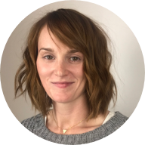
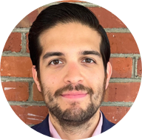

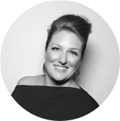
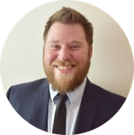

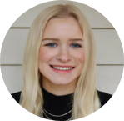
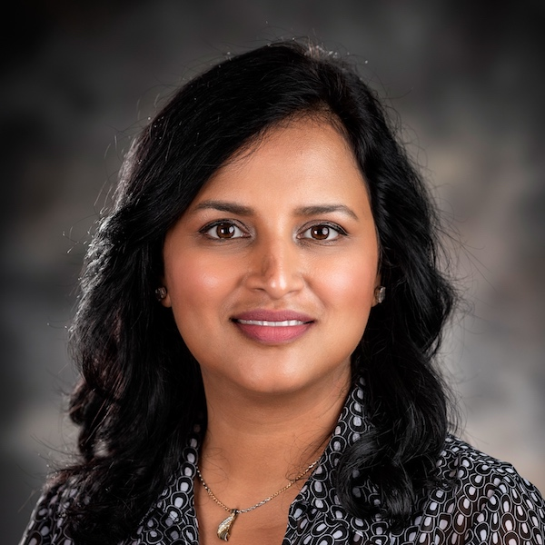

Project Team
Sara Snead
Program Manager
Gian Bustillo
Project Manager
Kateleigh Clark
Project Advisor
Julie Naga
UX Lead
Ray Walther
Cognitive Solutions & Technology Lead
Filip Fafara
Technical Advisor
Grace Goodenough
Project Scheduler
Sunayna Goel
Business Analyst
Patrick Onesty
Technical Writer

