Slide 1
Omnichannel VoiceBot Team
Booz Allen Status Meeting
August 18, 2022

Slide 2
Agenda
Priority/Ad Hoc Items
Open Forum

Slide 3
Priority/Ad Hoc Items
Item | Description | Status | Next Steps | Owner
Claims | Improving Veteran experience when calling for claims | Research self-service / triage opportunities NCC Kick-off meeting occurred on 8/17 Kate has requested¹ NCC call metrics Team has reviewed uploaded metrics so far Kate working to provide Booz Allen DataBricks access Pre-discovery research Defining claims requirements Booz Allen has created sample workflow using Luciana’s Claims Notes and existing API fields | Research self-service / triage opportunities Kate to send data requests to Regina (NCC) Team to begin engaging with NCC Booz Allen will perform analysis on call metrics Identify SME’s for data uploaded to CxDW Booz Allen to continue desk research using existing VA work and open-source information to glean from Discuss next steps for PACT Act support Defining claims requirements Review workflow with Luciana for feedback and create additional workflows | VA / Booz Allen
Non-Claims Research | Identifying most common reasons Veterans call into the | NCC Kick-off meeting occurred on 8/17 Kate has requested¹ NCC call metrics Kate working to provide Booz Allen DataBricks and CxDW access Search Terms metrics uploaded | Kate to send data requests to Regina (NCC) Team to begin engaging with NCC Booz Allen will perform analysis on call metrics once available Booz Allen reviewing Search Terms metrics | VA / Booz Allen
¹ Latest status of data requests here

Slide 4
Priority/Ad Hoc Items
Item | Description | Status | Next Steps | Owner
Claims Benefit Lighthouse API | Familiarizing ourselves with Claims Benefit API | Email sent to VA API team to understand: Process for updating API Eligible fields for API | VA API team and Booz Allen to continue discussions Team to determine how to authenticate veteran | Gian
Veteran Crisis Line Research | Learning about VCL | Identify how to support veterans in crisis through Voicebot | Schedule call with Dr. April Foreman | Gian
NLU Platform | Deciding a Voicebot Platform | Comparison research completed Microsoft Conversational AI demo with Booz Allen on 8/9 | VA to decide on a platform in August Assist in setting up VA environment for platform? | VA
Prototyping/ User Test Tool | Explore Voiceflow vs Alexa skills | Team concluded Voiceflow was best prototyping tool using SWOT analysis | Create VA environment to support Voiceflow | Booz Allen

Slide 5

Priority/Ad Hoc Items
Item​ | Description​ | Status​ | Next Steps​ | Owner​
Staff Onboarding | Onboarding staff according to project needs | Staff in onboarding process Nicole Bush (developer) joined Voicebot on 8/17 | Continue to staff to needs accordingly Team to get PIV’s and GFE’s in the coming weeks | Sara
 | eQIP | Remote Access | PIV | GFE | Teams Access | Slack Access
Gian |  |  |  | -
Grace |  |  | Scheduled | Scheduled
Julie
Millie |  |  |  | -
Ray
Sunayna |  |  | - | -
Ty |  |  | - | -
Nicole | - | - | - | - | - | -

Slide 6
Open Forum
Action Items

Slide 7
Appendix

Slide 8
Benefit Claims API
Attributes | Description
evss_id* | integerUpstream service identifier
date_filed* | string($date) example: 2018-06-04Date in YYYY-MM-DD the claim was first filed
min_est_date | stringnull($date) example: 2019-06-04Minimum Estimated Claim Completion Date
max_est_date* | stringnull($date) example: 2019-09-04Maximum Estimated Claim Completion Date
open* | boolean example: true. Has the claim been resolved
waiver_submitted* | Boolean example: false. Requested Decision or Waiver 5103 Submitted
documents_needed* | Boolean example: false. Does the claim require additional documents to be submitted
development_letter_sent* | boolean example: false. Indicates if a Development Letter has been sent to the Claimant regarding a benefit claim
decision_letter_sent | boolean example: false. Indicates if a Decision Letter has been sent to the Claimant regarding a benefit claim
status* | String example: Claim received. Current status of the claim
requested_decision* | Boolean example: false. The claim filer has requested a claim decision be made
claim_type* | String example: Compensation.
VA API Platform | Benefits Claims API Documentation

Slide 9
Project Overview
Detailed scope for Omnichannel project will be voice.
Discovery through building and learning—build it, learn from it, iterate it.
With an overall strategy of transitioning MyVA411, transition VBA to using a Natural Language Understanding (NLU) platform.
Determine the problem categories and point of transition.
Through learning and understanding how self-service and triage can be supported through voice channels, assess another product which may replace AudioCARE.
Stipulations:
Projects must have a customer experience and Omnichannel mindset toward best customer experience for Veterans.
Small iterative releases, solutions to run in parallel with existing solutions to Veterans are not negatively affected by our transitions.
All products must have Veteran input.

Slide 10
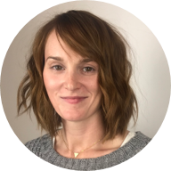
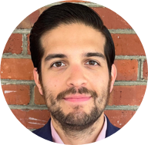

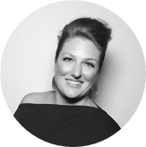
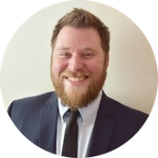


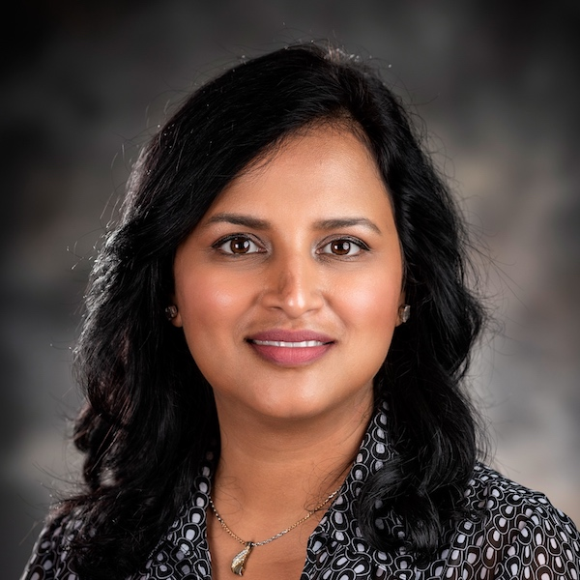
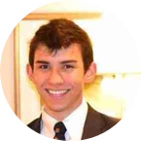
Project Team
Sara Snead
Program Manager
Gian Bustillo
Project Manager
Kateleigh Clark
Project Advisor
Julie Naga
UX Lead
Ray Walther
Cognitive Solutions & Technology Lead
Filip Fafara
Technical Advisor
Grace Goodenough
Project Scheduler
Sunayna Goel
Business Analyst
Patrick Onesty
Technical Writer

