Slide 1
Omnichannel VoiceBot Team
Booz Allen Status Meeting
August 25, 2022

Slide 2
Agenda
Priority/Ad Hoc Items
Open Forum

Slide 3
Priority/Ad Hoc Items
Item | Description | Status | Next Steps | Owner
Claims | Improving Veteran experience when calling for claims | Research self-service / triage opportunities CRM – Call data not yet uploaded to CxDW Pre-discovery research Defining claims requirements Booz Allen creating workflows using existing claims research Booz Allen to learn about PACT Act content Booz Allen to learn how to integrate a Voicebot into Cisco Telephony | Research self-service / triage opportunities Booz to review CRM data once uploaded, begin identifying intents Booz Allen to continue desk research using existing VA work and open-source information to glean from Booz Allen to share findings with VA in coming weeks Team to begin engaging with NCC in coming weeks Ahmed to provide VHA Community Care POC (claim status self-service) Defining claims requirements VA to provide feedback on claims workflow Luciana to schedule call with Content Team regarding PACT Act Identify point of contact for Cisco Telephony | VA / Booz Allen
Non-Claims Research | Identifying most common reasons Veterans call into the | IVR - Data uploaded into CxDW Booz Allen met with Amber, questions remain AVA Request test – Not yet uploaded Kate working to provide Booz Allen DataBricks and CxDW access All VA.gov Search Terms – Analysis done | Booz Allen to meet with business for outstanding questions Booz Allen to review AVA data once uploaded | VA / Booz Allen

Slide 4
Priority/Ad Hoc Items
Item | Description | Status | Next Steps | Owner
Claims Benefit Lighthouse API | Familiarizing ourselves with Claims Benefit API | Email sent to VA API team to understand: Process for updating API Eligible fields for API Gian sent follow-up email | VA API team and Booz Allen to continue discussions | Gian
Authenticating Veteran | Learning how Voicebot will authenticate Veteran | Booz Allen to learn how Voicebot will authenticate Veteran for claims and non-claims personalized information | VA to schedule call with Brian from Identity Team | Booz Allen /VA
Veteran Crisis Line Research | Learning about VCL | Identify how to support veterans in crisis through Voicebot Team reviewing Crisis Mural in preparing with meeting for Dr. Foreman | VA to schedule call with Dr. April Foreman | VA
NLU Platform | Deciding a Voicebot Platform | Comparison research completed Microsoft Conversational AI demo with Booz Allen on 8/9 | VA to decide on a platform in August | VA
Prototyping/ User Test Tool | Explore Voiceflow vs Alexa skills | Team concluded Voiceflow was best prototyping tool using SWOT analysis | Create VA environment to support Voiceflow | Booz Allen

Slide 5

Priority/Ad Hoc Items
Item​ | Description​ | Status​ | Next Steps​ | Owner​
Staff Onboarding | Onboarding staff according to project needs | Staff in onboarding process Nicole Bush (developer) joined Voicebot on 8/17 | Continue to staff to needs accordingly Remaining team members to get PIV’s and GFE’s in coming weeks | Sara
 | eQIP | Remote Access | PIV | GFE | Teams Access | Slack Access
Gian |  |  |  | -
Grace
Julie
Millie |  |  |  | -
Ray
Sunayna |  |  | Scheduled | Scheduled
Ty |  |  | Scheduled | -
Nicole | - | - | - | - | - | -

Slide 6
Open Forum
Action Items

Slide 7
Appendix

Slide 8
Benefit Claims API
Attributes | Description
evss_id* | integerUpstream service identifier
date_filed* | string($date) example: 2018-06-04Date in YYYY-MM-DD the claim was first filed
min_est_date | stringnull($date) example: 2019-06-04Minimum Estimated Claim Completion Date
max_est_date* | stringnull($date) example: 2019-09-04Maximum Estimated Claim Completion Date
open* | boolean example: true. Has the claim been resolved
waiver_submitted* | Boolean example: false. Requested Decision or Waiver 5103 Submitted
documents_needed* | Boolean example: false. Does the claim require additional documents to be submitted
development_letter_sent* | boolean example: false. Indicates if a Development Letter has been sent to the Claimant regarding a benefit claim
decision_letter_sent | boolean example: false. Indicates if a Decision Letter has been sent to the Claimant regarding a benefit claim
status* | String example: Claim received. Current status of the claim
requested_decision* | Boolean example: false. The claim filer has requested a claim decision be made
claim_type* | String example: Compensation.
VA API Platform | Benefits Claims API Documentation

Slide 9
Project Overview
Detailed scope for Omnichannel project will be voice.
Discovery through building and learning—build it, learn from it, iterate it.
With an overall strategy of transitioning MyVA411, transition VBA to using a Natural Language Understanding (NLU) platform.
Determine the problem categories and point of transition.
Through learning and understanding how self-service and triage can be supported through voice channels, assess another product which may replace AudioCARE.
Stipulations:
Projects must have a customer experience and Omnichannel mindset toward best customer experience for Veterans.
Small iterative releases, solutions to run in parallel with existing solutions to Veterans are not negatively affected by our transitions.
All products must have Veteran input.

Slide 10

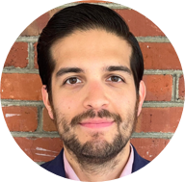


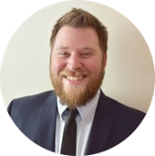


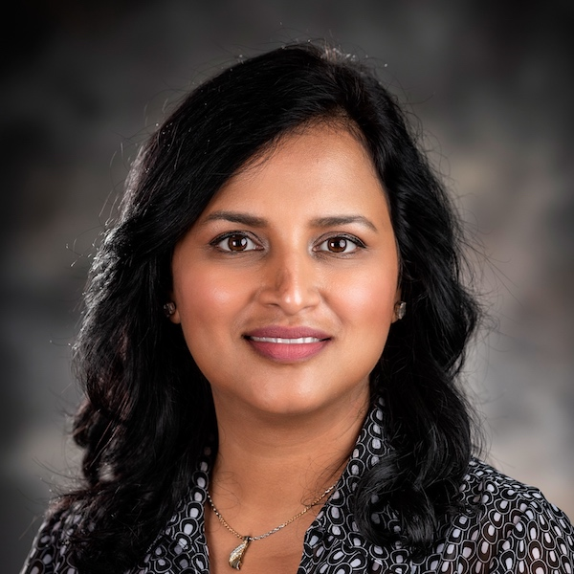

Project Team
Sara Snead
Program Manager
Gian Bustillo
Project Manager
Kateleigh Clark
Project Advisor
Julie Naga
UX Lead
Ray Walther
Cognitive Solutions & Technology Lead
Filip Fafara
Technical Advisor
Grace Goodenough
Project Scheduler
Sunayna Goel
Business Analyst
Patrick Onesty
Technical Writer

