Slide 1
Omnichannel VoiceBot Team
Booz Allen Status Meeting
September 1, 2022

Slide 2
Agenda
UX Workstream
Technology Workstream
Integration Workstream
Ad Hoc Items
Open Forum

Slide 3
UX Workstream
Item | Description | Status | Next Steps | Owner
Claims - Intent Research | Researching veteran’s intents for claims questions | CRM call data to be uploaded to CxDW AVA Request Text data to be uploaded to CxDW eGain data to be made available | Booz Allen to review CRM data once uploaded, begin identifying intents for Claims call types Booz Allen to share findings with VA in coming weeks Team to begin engaging with NCC in coming weeks | VA / Booz Allen
Claims – Workflows | Documenting how Voicebot will support claims questions | Booz Allen creating workflows using existing claims research Feedback provided by VA Booz Allen to learn how to integrate a Voicebot into Cisco Telephony VA provided Status of a Claim training | Booz Allen to update workflows based on feedback and three provided uses cases - 1) why is the decision taking so long? 2) what does that status mean? 3), how do I send more documentation? Update workflows based on Training video Unified Service Desk – what API? Identify point of contact for Cisco Telephony | Booz Allen
Veteran Crisis Line Research | Learning how Voicebot will support VCL | Identify how to support veterans in crisis through Voicebot Team reviewing Crisis Mural in preparing with meeting for Dr. Foreman | Booz Allen documenting questions for Dr. Foreman VA to schedule call with Dr. April Foreman | VA
PACT Act | Learning what about PACT Act | Booz Allen to learn about PACT Act content | Luciana to schedule call with Content Team regarding PACT Act | VA / Booz Allen

Slide 4
Technology Workstream
Item | Description | Status | Next Steps | Owner
NLU Platform | Deciding a Voicebot Platform | Comparison research completed Microsoft Conversational AI demo with Booz Allen on 8/9 | VA to decide on a platform in August VA to obtain DialogFlow trial licenses | VA
DialogFlow Trial Licenses | Preparing for DialogFlow | Booz Allen would like to prepare for DialogFlow development by speaking with Google, ask questions Booz Allen reviewing DialogFlow – IVR Testing document | Meet and Greet with Google to be scheduled by VA Google to schedule training sessions on DialogFlow Booz Allen to investigate in-house trial license services | Booz Allen / VA

Slide 5
Integration Workstream
Item | Description | Status | Next Steps | Owner
Claims Benefit Lighthouse API | Familiarizing ourselves with Claims Benefit API | Voicebot will not depend on updated Claims API | Booz Allen to discover what changes will be made to Claims API, and by when | Gian
Authenticating Veteran | Learning how Voicebot will authenticate Veteran | Booz Allen to learn how Voicebot will authenticate Veteran for claims and non-claims personalized information | VA to schedule call with Brian from Identity Team | Booz Allen / VA
Integrating into Cisco IVR Telephony | Identifying how calls with transfer from IVR to Voicebot to IVR | Nicole learning about Cisco IVR Telephony | VA to schedule call with Brian from Identity Team Identify point of transition from IVR to Voicebot | Booz Allen / VA

Slide 6

Ad Hoc Items
Item​ | Description​ | Status​ | Next Steps​ | Owner​
Project Timeline | Listing Voicebot tasks over PoP | Booz Allen updating timeline | Booz Allen to share project timeline by next week | Gian
Staff Onboarding | Onboarding staff according to project needs | Staff in onboarding process | Continue to staff to needs accordingly Team members to get PIV’s and GFE’s in coming weeks | Sara
 | eQIP | Remote Access | PIV | GFE | Teams Access | Slack Access
Gian
Grace
Julie
Millie |  |  |  | -
Ray
Sunayna
Ty
Nicole | - | - | - | - | - | -

Slide 7
Open Forum
Open discussion

Slide 8
Appendix

Slide 9
Benefit Claims API
Attributes | Description
evss_id* | integerUpstream service identifier
date_filed* | string($date) example: 2018-06-04Date in YYYY-MM-DD the claim was first filed
min_est_date | stringnull($date) example: 2019-06-04Minimum Estimated Claim Completion Date
max_est_date* | stringnull($date) example: 2019-09-04Maximum Estimated Claim Completion Date
open* | boolean example: true. Has the claim been resolved
waiver_submitted* | Boolean example: false. Requested Decision or Waiver 5103 Submitted
documents_needed* | Boolean example: false. Does the claim require additional documents to be submitted
development_letter_sent* | boolean example: false. Indicates if a Development Letter has been sent to the Claimant regarding a benefit claim
decision_letter_sent | boolean example: false. Indicates if a Decision Letter has been sent to the Claimant regarding a benefit claim
status* | String example: Claim received. Current status of the claim
requested_decision* | Boolean example: false. The claim filer has requested a claim decision be made
claim_type* | String example: Compensation.
VA API Platform | Benefits Claims API Documentation

Slide 10
Project Overview
Detailed scope for Omnichannel project will be voice.
Discovery through building and learning—build it, learn from it, iterate it.
With an overall strategy of transitioning MyVA411, transition VBA to using a Natural Language Understanding (NLU) platform.
Determine the problem categories and point of transition.
Through learning and understanding how self-service and triage can be supported through voice channels, assess another product which may replace AudioCARE.
Stipulations:
Projects must have a customer experience and Omnichannel mindset toward best customer experience for Veterans.
Small iterative releases, solutions to run in parallel with existing solutions to Veterans are not negatively affected by our transitions.
All products must have Veteran input.

Slide 11
User Concern + VoiceBot Flows
What does it mean when..?
What can I do about it..?
Where do I find it?
What's happening ?
How’ much longer..?
How do I start?

Slide 12
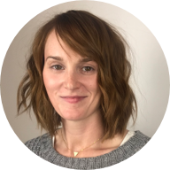
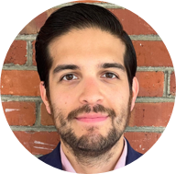

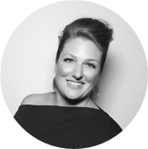
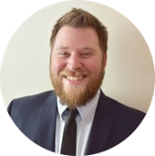

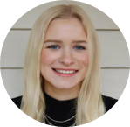
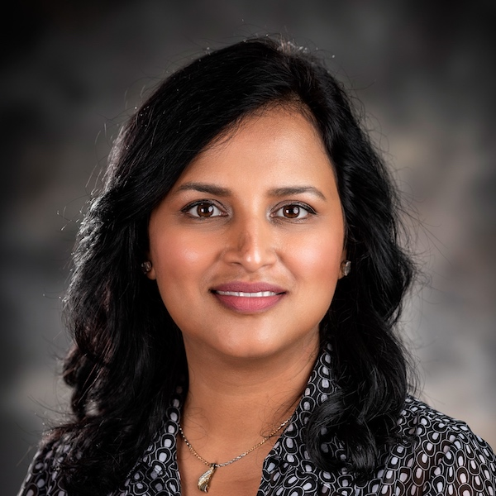
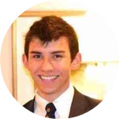
Project Team
Sara Snead
Program Manager
Gian Bustillo
Project Manager
Kateleigh Clark
Project Advisor
Julie Naga
UX Lead
Ray Walther
Cognitive Solutions & Technology Lead
Filip Fafara
Technical Advisor
Grace Goodenough
Project Scheduler
Sunayna Goel
Business Analyst
Patrick Onesty
Technical Writer

