Slide 1
Omnichannel VoiceBot Team
Booz Allen Status Meeting
September 15, 2022

Slide 2
Agenda
UX Workstream
Technology Workstream
Integration Workstream
Ad Hoc Items
Open Forum

Slide 3
UX Workstream
Item | Description | Status | Next Steps | Owner
Claims - Intent Research | Researching veteran’s intents for claims questions | Booz Allen has performed analysis on agent notes from MyVA411 AVA Request Text data provided to Booz Allen UDO conditioned call data to be made available on 10/4 eGain data to be made available | Booz Allen to share with the VA other identified claims utterances – possible additions to MVP? Booz Allen performing analysis on AVA data Booz Allen to review UDO data when available Team to begin engaging with NCC in coming weeks | VA / Booz Allen
Claims – Workflows | Documenting how Voicebot will support claims questions | Booz Allen updating workflows based on feedback provided by VA Booz Allen uploaded flows to Teams | VA to review and provide feedback Booz Allen to reach out to Content Team for follow-up call Booz Allen to set-up call? | Booz Allen
Veteran Crisis Line Research | Learning how Voicebot will support VCL | Team reviewing Crisis Mural in preparing with meeting for Dr. Foreman VA provided list of crisis utterances to Booz Allen | Booz Allen documenting questions for Dr. Foreman VA to schedule call with Dr. April Foreman Discuss VCL scope in Voicebot based on Brian Mahlum's recent comments | VA
PACT Act | Learning what about PACT Act | Booz Allen to learn about PACT Act content Booz Allen created PACT Act workflow based on existing PACT text from MyVA411 and NCC | Discussion around text to begin with Content team | VA / Booz Allen

Slide 4
Technology Workstream
Item | Description | Status | Next Steps | Owner
Voicebot Platform | Deciding a Voicebot Platform | Booz Allen working to create sandbox on Booz Allen side to begin DialogFlow learning Booz Allen investigating Amazon Lex | Training session with Google to occur in October Booz Allen to hold call with Amazon Lex architect the week of 9/19 | Booz Allen
ATO Process | Beginning the ATO Process for going live with Voicebot | ATO process beginning for a Feb 1 launch date | VA to begin ATO process | VA

Slide 5
Integration Workstream
Item | Description | Status | Next Steps | Owner
Authenticating Veteran | Learning how Voicebot will authenticate Veteran | Booz Allen to learn how Voicebot will authenticate Veteran for claims and non-claims personalized information Call held with Identity Team on 9/14 | Follow-up call needed with Identity Team | Booz Allen / VA
Integrating into Cisco IVR Telephony | Identifying how calls with transfer from IVR to Voicebot to IVR | Nicole learning about Cisco IVR Telephony Call held with Identity Team on 9/14 | Follow-up call needed with Identity Team | Booz Allen / VA
Unified Service Desk and UDO | Learn about Unified Service Desk and UDO | Booz Allen had call scheduled with Chad | Chad to send BGS documentation and POC for BGS Chad to provide UDO demo to team | Booz Allen
Scraping information from VA.gov | Learning from Chatbot how to scrap VA.gov info | Booz Allen reached out to Chatbot to learn how Chatbot scrapes information from VA.gov | Booz Allen reviewing shared information from ThoughtWorks | Nicole
Claims Benefit Lighthouse API | Familiarizing ourselves with Claims Benefit API | Booz Allen met with Lighthouse API team TBD Version 2.0 attributes and timeline | Booz Allen to rely solely on version 1.0 for planning purposes | Gian

Slide 6

Ad Hoc Items
Item​ | Description​ | Status​ | Next Steps​ | Owner​
Github and Zenhub | Learning about Github and Zenhub | Booz Allen created github accounts Voicebot repo created | VA to designate Booz Allen github accounts as VA Org accounts | Gian
Project Timeline and MVP | Listing Voicebot tasks over PoP | Booz Allen shared Timeline and MVP with VA, received feedback | Booz Allen made Timeline available through MURAL | Gian
 | eQIP | Remote Access | PIV | GFE | Teams Access | Slack Access
Gian
Grace
Julie
Millie |  |  |  | -
Ray
Sunayna
Ty
Nicole |  |  | - | - | - | -
Josh | - | - | - | - | - | -

Slide 7
Open Forum
Open discussion

Slide 8
Appendix

Slide 9
Benefit Claims API (current version, 1.0)
Attributes | Description
evss_id* | integerUpstream service identifier
date_filed* | string($date) example: 2018-06-04Date in YYYY-MM-DD the claim was first filed
min_est_date | stringnull($date) example: 2019-06-04Minimum Estimated Claim Completion Date
max_est_date* | stringnull($date) example: 2019-09-04Maximum Estimated Claim Completion Date
open* | boolean example: true. Has the claim been resolved
waiver_submitted* | Boolean example: false. Requested Decision or Waiver 5103 Submitted
documents_needed* | Boolean example: false. Does the claim require additional documents to be submitted
development_letter_sent* | boolean example: false. Indicates if a Development Letter has been sent to the Claimant regarding a benefit claim
decision_letter_sent | boolean example: false. Indicates if a Decision Letter has been sent to the Claimant regarding a benefit claim
status* | String example: Claim received. Current status of the claim
requested_decision* | Boolean example: false. The claim filer has requested a claim decision be made
claim_type* | String example: Compensation.
VA API Platform | Benefits Claims API Documentation

Slide 10
Benefit Claims API (proposed new version, 2.0)
Attributes | Description
claimId | string
 | nullable: true example: 600131328 Claim ID in VBMS
claimType | string example: Compensation Name of claim type
claimDate | stringnull($date) example: 2018-06-04 Date in YYYY-MM-DD the claim was first filed
closeDate | stringnull($date) example: 2019-09-04 Date claim was closed
developmentLetterSent | boolean example: false If true, a development letter has been sent to the claimant regarding a benefit claim
decisionLetterSent | boolean example: false If true, a decision letter has been sent to the claimant regarding a benefit claim
documentsNeeded | boolean example: false If true, the claim requires additional documents to be submitted
endProductCode | string End product code of claim
lighthouseId | string nullable: true example: 600131328 Claim ID in Lighthouse
status | string Status of claim Enum: [ PENDING, CLAIM_RECEIVED, INITIAL_REVIEW, EVIDENCE_GATHERING_REVIEW_DECISION, PREPARATION_FOR_NOTIFICATION, COMPLETE, ERRORED ]
5103WaiverSubmitted | boolean nullable: true example: false If true, indicates a decision has been requested and/or a Waiver 5103 has been submitted
https://dev-developer.va.gov/explore/benefits/docs/claims?version=current

Slide 11
Project Overview
Detailed scope for Omnichannel project will be voice.
Discovery through building and learning—build it, learn from it, iterate it.
With an overall strategy of transitioning MyVA411, transition VBA to using a Natural Language Understanding (NLU) platform.
Determine the problem categories and point of transition.
Through learning and understanding how self-service and triage can be supported through voice channels, assess another product which may replace AudioCARE.
Stipulations:
Projects must have a customer experience and Omnichannel mindset toward best customer experience for Veterans.
Small iterative releases, solutions to run in parallel with existing solutions to Veterans are not negatively affected by our transitions.
All products must have Veteran input.

Slide 12
User Concern + VoiceBot Flows
What does it mean when..?
What can I do about it..?
Where do I find it?
What's happening ?
How’ much longer..?
How do I start?

Slide 13

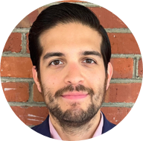





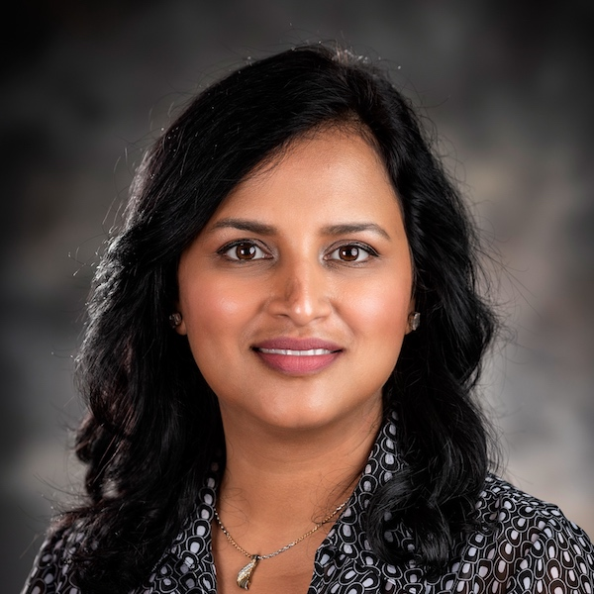

Project Team
Sara Snead
Program Manager
Gian Bustillo
Project Manager
Kateleigh Clark
Project Advisor
Julie Naga
UX Lead
Ray Walther
Cognitive Solutions & Technology Lead
Filip Fafara
Technical Advisor
Grace Goodenough
Project Scheduler
Sunayna Goel
Business Analyst
Patrick Onesty
Technical Writer

