Slide 1
Omnichannel Voicebot Team
Booz Allen Status Meeting
September 22, 2022

Slide 2
Agenda
UX Workstream
Technology Workstream
Integration Workstream
Ad Hoc Items
Open Forum

Slide 3
UX Workstream
Item | Description | Status | Next Steps | Owner
Claims - Intent Research | Researching veteran’s intents for claims questions | Intent determination project working to provide additional intents Claim Status Tool is using EVSS service to provide claim data UDO conditioned call data to be made available on 10/4 eGain data to be made available | Team to review provided intents to identify other intents to be supposed by Voicebot Booz Allen to review EVSS service for possible integration with Voicebot Booz Allen to review UDO data when available Team to hold a call with NCC on 9/22 | VA / Booz Allen
Claims – Workflows | Documenting how Voicebot will support claims questions | Booz Allen updating workflows based on feedback provided by VA Booz Allen uploaded flows to Teams Booz Allen reached out to Danielle and Beth for follow-up call | VA to review and provide feedback Booz Allen to meet with Danielle and Beth | Sunayna/ Julie/Grace
PACT Act | Learning what about PACT Act | Booz Allen is preparing the PACT workflow for call with Content team | Booz Allen to share flow with Danielle and Beth for feedback | Grace
Veteran testing | Preparation for initial testing | Prototyping flows in Adobe XD Initial test plan + script in progress | - Refine specific testing goals; align prototype/plan/script | Julie / Ty
Veteran Crisis Line Research | Learning how Voicebot will support VCL | At Brian Mahlum's direction, no immediate plans for Voicebot support VCL | N/A | N/A

Slide 4
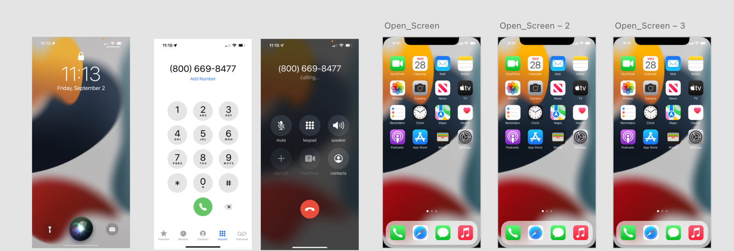
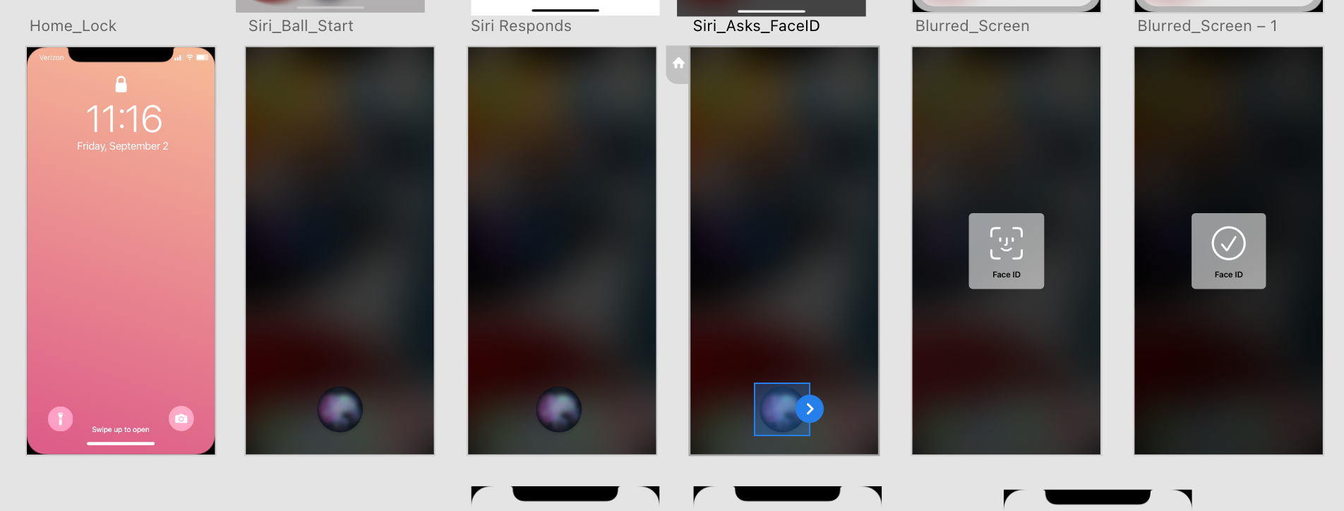
UX Workstream
User test prototype preparation: Mobile device screen (Apple) with voice commands/responses in Adobe XD
Adobe XD show & tell
Mobile voice asst
Call Sequence
Potential starting
sequence

Slide 5
Technology Workstream
Item | Description | Status | Next Steps | Owner
Voicebot Platform | Exploring Possible Voicebot Platforms | Booz Allen working to create sandbox on Booz Allen side to begin DialogFlow learning Booz Allen held call with Amazon on 9/15 | Training session with Google to occur in October Booz Allen to hold follow-up call with Amazon to continue learning – set up demo | Nicole
ATO Process | Learning about ATO process | VA researching ATO requirements | ATO may be on hold due to lack of licenses / platform decision | VA

Slide 6
Integration Workstream
Item | Description | Status | Next Steps | Owner
Authenticating Veteran | Learning how Voicebot will authenticate Veteran | Booz Allen to learn how Voicebot will authenticate Veteran for claims and non-claims personalized information Call held with Brian's Team on 9/14 | Follow-up call scheduled with Klay and Christian on 9/26 | Millie
Integrating into Cisco IVR Telephony | Identifying how calls with transfer from IVR to Voicebot to IVR | Nicole learning about Cisco IVR Telephony Call held with Brian's Team on 9/14 | Follow-up call scheduled with Klay and Christian on 9/26 | Millie
Unified Service Desk and UDO | Learn about Unified Service Desk and UDO | Booz Allen met with Chad | Chad to send BGS documentation and POC for BGS Chad to provide UDO demo to team | Gian
Pulling content from VA.gov | How does ChatBot pull info from VA.gov | Booz Allen has received access to Drupal CMS tool | Booz Allen reviewing shared information from ThoughtWorks Reviewing Drupal CMS GraphQL explorer | Nicole
Claims Benefit Lighthouse API | Familiarizing ourselves with Claims Benefit API | Booz Allen met with Lighthouse API team TBD Version 2.0 attributes and timeline | Booz Allen to rely solely on version 1.0 for planning purposes Booz Allen investigating using other source for claims status data | Booz Allen

Slide 7

Ad Hoc Items
Item​ | Description​ | Status​ | Next Steps​ | Owner​
Github and Zenhub | Learning about Github and Zenhub | Booz Allen created github accounts Voicebot repo created | VA to designate Booz Allen github accounts as VA Org accounts Booz Allen to migrate to Zenhub | Gian
Project Timeline and MVP | Listing Voicebot tasks over PoP | Booz Allen shared Timeline and MVP with VA, received feedback | Booz Allen made Timeline available through MURAL | Gian
Team of Teams meeting | Weekly meeting | Gian attended Team of Teams meeting on 9/20 | Gian to begin participating 9/27 | Gian
 | eQIP | Remote Access | PIV | GFE | Teams Access | Slack Access
Gian
Grace
Julie
Millie |  |  |  | -
Ray
Sunayna
Ty
Nicole
Josh | - | - | - | - | - | -

Slide 8
Open Forum
Open discussion

Slide 9
Appendix

Slide 10
Benefit Claims API (current version, 1.0)
Attributes | Description
evss_id* | integerUpstream service identifier
date_filed* | string($date) example: 2018-06-04Date in YYYY-MM-DD the claim was first filed
min_est_date | stringnull($date) example: 2019-06-04Minimum Estimated Claim Completion Date
max_est_date* | stringnull($date) example: 2019-09-04Maximum Estimated Claim Completion Date
open* | boolean example: true. Has the claim been resolved
waiver_submitted* | Boolean example: false. Requested Decision or Waiver 5103 Submitted
documents_needed* | Boolean example: false. Does the claim require additional documents to be submitted
development_letter_sent* | boolean example: false. Indicates if a Development Letter has been sent to the Claimant regarding a benefit claim
decision_letter_sent | boolean example: false. Indicates if a Decision Letter has been sent to the Claimant regarding a benefit claim
status* | String example: Claim received. Current status of the claim
requested_decision* | Boolean example: false. The claim filer has requested a claim decision be made
claim_type* | String example: Compensation.
VA API Platform | Benefits Claims API Documentation

Slide 11
Benefit Claims API (proposed new version, 2.0)
Attributes | Description
claimId | string
 | nullable: true example: 600131328 Claim ID in VBMS
claimType | string example: Compensation Name of claim type
claimDate | stringnull($date) example: 2018-06-04 Date in YYYY-MM-DD the claim was first filed
closeDate | stringnull($date) example: 2019-09-04 Date claim was closed
developmentLetterSent | boolean example: false If true, a development letter has been sent to the claimant regarding a benefit claim
decisionLetterSent | boolean example: false If true, a decision letter has been sent to the claimant regarding a benefit claim
documentsNeeded | boolean example: false If true, the claim requires additional documents to be submitted
endProductCode | string End product code of claim
lighthouseId | string nullable: true example: 600131328 Claim ID in Lighthouse
status | string Status of claim Enum: [ PENDING, CLAIM_RECEIVED, INITIAL_REVIEW, EVIDENCE_GATHERING_REVIEW_DECISION, PREPARATION_FOR_NOTIFICATION, COMPLETE, ERRORED ]
5103WaiverSubmitted | boolean nullable: true example: false If true, indicates a decision has been requested and/or a Waiver 5103 has been submitted
https://dev-developer.va.gov/explore/benefits/docs/claims?version=current

Slide 12
Project Overview
Detailed scope for Omnichannel project will be voice.
Discovery through building and learning—build it, learn from it, iterate it.
With an overall strategy of transitioning MyVA411, transition VBA to using a Natural Language Understanding (NLU) platform.
Determine the problem categories and point of transition.
Through learning and understanding how self-service and triage can be supported through voice channels, assess another product which may replace AudioCARE.
Stipulations:
Projects must have a customer experience and Omnichannel mindset toward best customer experience for Veterans.
Small iterative releases, solutions to run in parallel with existing solutions to Veterans are not negatively affected by our transitions.
All products must have Veteran input.

Slide 13
User Concern + VoiceBot Flows
What does it mean when..?
What can I do about it..?
Where do I find it?
What's happening ?
How’ much longer..?
How do I start?

Slide 14
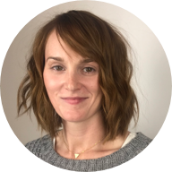
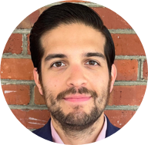
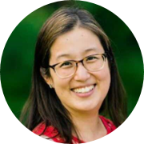
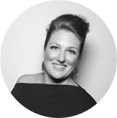
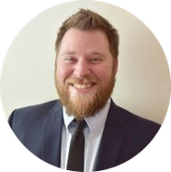

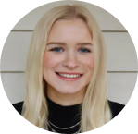
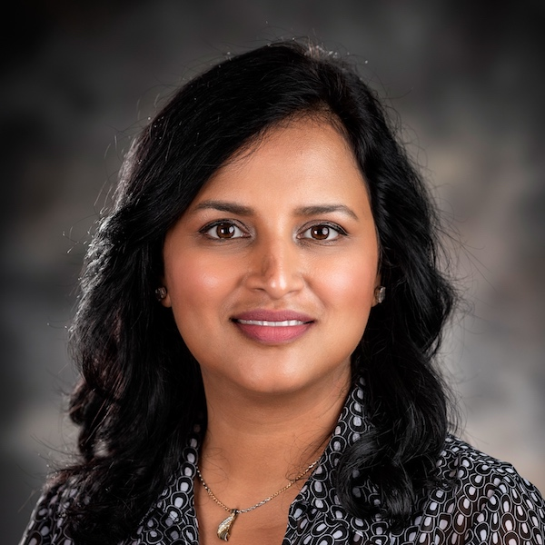
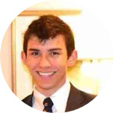
Project Team
Sara Snead
Program Manager
Gian Bustillo
Project Manager
Kateleigh Clark
Project Advisor
Julie Naga
UX Lead
Ray Walther
Cognitive Solutions & Technology Lead
Filip Fafara
Technical Advisor
Grace Goodenough
Project Scheduler
Sunayna Goel
Business Analyst
Patrick Onesty
Technical Writer

