Slide 1
Omnichannel Voicebot Team
Booz Allen Status Meeting
September 29, 2022

Slide 2
Agenda
UX Workstream
Technology Workstream
Integration Workstream
Ad Hoc Items
Open Forum

Slide 3
UX Workstream
Item | Description | Status | Next Steps | Owner
Claims - Intent Research | Researching veteran’s intents for claims questions | Intent determination project working to provide additional intents UDO raw in ADLS; UDO conditioned call data to be made available on 10/4 Chatbot transcripts available in ADLS eGain data to be made available Exploring availability of AVA data in CxDW | Team to evaluate intents identified by IDPR project as candidates for Voicebot support Align on intent determination scope beyond MyVA411 and AVA data analysis completed thus far | Millie/Kate, Luciana
Claims – Workflows | Documenting how Voicebot will support claims questions | Booz Allen uploaded flows to Teams VA provided additional feedback on workflows Booz Allen held call with Danielle to discuss moving forward with reviewing flows Booz Allen reviewed VA's workflow feedback | Booz Allen making changes where necessary Booz Allen making a grid to identify Voicebot's capabilities Booz Allen to schedule additional call with Danielle | Sunayna/ Julie/Grace
PACT Act | Learning about PACT Act | Booz Allen held call with Danielle to discuss content strategy and PACT Act | Booz Allen and Danielle to discuss PACT Act at next call | Grace
Veteran testing | Preparation for initial testing | Booz Allen is working on prototyping flows in Adobe XD Booz Allen working on creating test plan | Booz Allen and VA to meet to go over usability testing and scheduling | Julie / Ty

Slide 4
Technology Workstream
Item | Description | Status | Next Steps | Owner
Voicebot Platform | Exploring Possible Voicebot Platforms | Booz Allen working to create sandboxes on Booz Allen side to begin DialogFlow and Lex learning | Voicebot submitted sandbox request tickets on 9/27, which are in the process of being approved | Nicole
ATO Process | Learning about ATO process | Booz Allen researching ATO requirements | Booz Allen and VA to meet Tuesday 10/4 to discuss ATO | Gian

Slide 5
Integration Workstream
Item | Description | Status | Next Steps | Owner
EVSS and BGS Services | Investigating EVSS and BGS services | Claim Status Tool is using EVSS service to provide claim data | Booz Allen to review EVSS service for possible integration with Voicebot | Josh
Authenticating Veteran | Learning how Voicebot will authenticate Veteran | Booz Allen to learn how Voicebot will authenticate Veteran for claims and non-claims personalized information | Follow-up call re-scheduled with Klay and Christian for 10/3 | Millie
Integrating into Cisco IVR Telephony | Identifying how calls with transfer from IVR to Voicebot to IVR | Booz Allen learning about Cisco IVR Telephony | Follow-up call re-scheduled with Klay and Christian for 10/3 | Millie
Unified Service Desk and UDO | Learn about Unified Service Desk and UDO | Booz Allen met with Chad | Chad to send BGS documentation and POC for BGS Chad to provide UDO demo to team | Gian
Pulling content from VA.gov | How does ChatBot pull info from VA.gov | Booz Allen has received access to Drupal CMS tool | Booz Allen reviewing shared information from ThoughtWorks Reviewing Drupal CMS GraphQL explorer | Nicole
Claims Benefit Lighthouse API | Familiarizing ourselves with Claims Benefit API | Booz Allen met with Lighthouse API team TBD Version 2.0 attributes and timeline | Booz Allen to rely solely on version 1.0 for planning purposes Booz Allen investigating using other source for claims status data | Booz Allen

Slide 6

Ad Hoc Items
Item​ | Description​ | Status​ | Next Steps​ | Owner​
Github and Zenhub | Learning about Github and Zenhub | Booz Allen created Github accounts Voicebot repo created Booz Allen began using Zenhub for Kanban | Booz Allen to migrate documents to Github Booz Allen to continue using and learning Zenhub | Gian
Google Training | DialogFlow Training session | Booz Allen and Google are communicating regarding October 26 training session at Booz HQ | Booz Allen working on travel arrangements for Voicebot team | Gian
 | eQIP | Remote Access | PIV | GFE | Teams Access | Slack Access | Zenhub Access
Gian
Grace
Julie
Millie |  |  |  | -
Ray
Sunayna
Ty
Nicole
Josh | - | - | - | - | - | -

Slide 7
Open Forum
Open discussion

Slide 8
Appendix

Slide 9
Benefit Claims API (current version, 1.0)
Attributes | Description
evss_id* | integerUpstream service identifier
date_filed* | string($date) example: 2018-06-04Date in YYYY-MM-DD the claim was first filed
min_est_date | stringnull($date) example: 2019-06-04Minimum Estimated Claim Completion Date
max_est_date* | stringnull($date) example: 2019-09-04Maximum Estimated Claim Completion Date
open* | boolean example: true. Has the claim been resolved
waiver_submitted* | Boolean example: false. Requested Decision or Waiver 5103 Submitted
documents_needed* | Boolean example: false. Does the claim require additional documents to be submitted
development_letter_sent* | boolean example: false. Indicates if a Development Letter has been sent to the Claimant regarding a benefit claim
decision_letter_sent | boolean example: false. Indicates if a Decision Letter has been sent to the Claimant regarding a benefit claim
status* | String example: Claim received. Current status of the claim
requested_decision* | Boolean example: false. The claim filer has requested a claim decision be made
claim_type* | String example: Compensation.
VA API Platform | Benefits Claims API Documentation

Slide 10
Benefit Claims API (proposed new version, 2.0)
Attributes | Description
claimId | string
 | nullable: true example: 600131328 Claim ID in VBMS
claimType | string example: Compensation Name of claim type
claimDate | stringnull($date) example: 2018-06-04 Date in YYYY-MM-DD the claim was first filed
closeDate | stringnull($date) example: 2019-09-04 Date claim was closed
developmentLetterSent | boolean example: false If true, a development letter has been sent to the claimant regarding a benefit claim
decisionLetterSent | boolean example: false If true, a decision letter has been sent to the claimant regarding a benefit claim
documentsNeeded | boolean example: false If true, the claim requires additional documents to be submitted
endProductCode | string End product code of claim
lighthouseId | string nullable: true example: 600131328 Claim ID in Lighthouse
status | string Status of claim Enum: [ PENDING, CLAIM_RECEIVED, INITIAL_REVIEW, EVIDENCE_GATHERING_REVIEW_DECISION, PREPARATION_FOR_NOTIFICATION, COMPLETE, ERRORED ]
5103WaiverSubmitted | boolean nullable: true example: false If true, indicates a decision has been requested and/or a Waiver 5103 has been submitted
https://dev-developer.va.gov/explore/benefits/docs/claims?version=current

Slide 11
Project Overview
Detailed scope for Omnichannel project will be voice.
Discovery through building and learning—build it, learn from it, iterate it.
With an overall strategy of transitioning MyVA411, transition VBA to using a Natural Language Understanding (NLU) platform.
Determine the problem categories and point of transition.
Through learning and understanding how self-service and triage can be supported through voice channels, assess another product which may replace AudioCARE.
Stipulations:
Projects must have a customer experience and Omnichannel mindset toward best customer experience for Veterans.
Small iterative releases, solutions to run in parallel with existing solutions to Veterans are not negatively affected by our transitions.
All products must have Veteran input.

Slide 12
User Concern + VoiceBot Flows
What does it mean when..?
What can I do about it..?
Where do I find it?
What's happening ?
How’ much longer..?
How do I start?

Slide 13
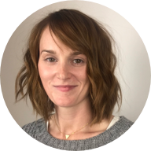
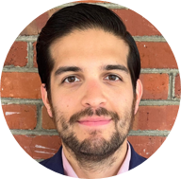

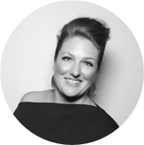
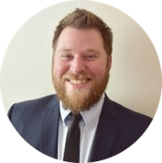


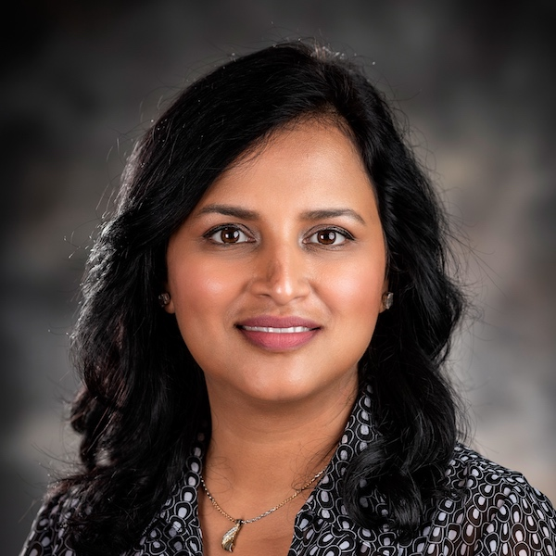
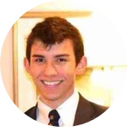
Project Team
Sara Snead
Program Manager
Gian Bustillo
Project Manager
Kateleigh Clark
Project Advisor
Julie Naga
UX Lead
Ray Walther
Cognitive Solutions & Technology Lead
Filip Fafara
Technical Advisor
Grace Goodenough
Project Scheduler
Sunayna Goel
Business Analyst
Patrick Onesty
Technical Writer

