Slide 1
MPCS Practicum
Naga Nithin Manne, University of Chicago
Project Advisors:
Tanu Malik, DePaul University
Amitabh Chaudhary, University of Chicago

Slide 2
Problem Statement
Goal: Implement an execution cache in Jupyter Notebook
Application Usecase: Improve sharing of Notebook-based machine learning workflows
Sub-goals:
Create an execution cache that stores
the state of a running process,
input and (intermediate) output data
Share the Notebook as a self-contained package
Notebooks are deployable irrespective of environment
Detect reuse in subsequent executions
Reuse cached state such that subsequent executions are faster.

Slide 3
Execution Caching
Most machine learning algorithms are perfect to cache due to high computation time and low size of the trained model
Storing pre-computed information for later re-use
Inherent trade-off between computation time vs. storage space

Slide 4
Jupyter Notebook
Frequently used in data science domain to share code and results
A web-based interactive computational environment
Essentially a front-end for Jupyter kernels which are responsible for actual execution
Execution split into user-defined cells, which are executed in a specific order by the user
Select Cell to Execute
Jupyter Notebook Server
Browser Front-End
Kernel
User
HTTP
ØMQ

Slide 5
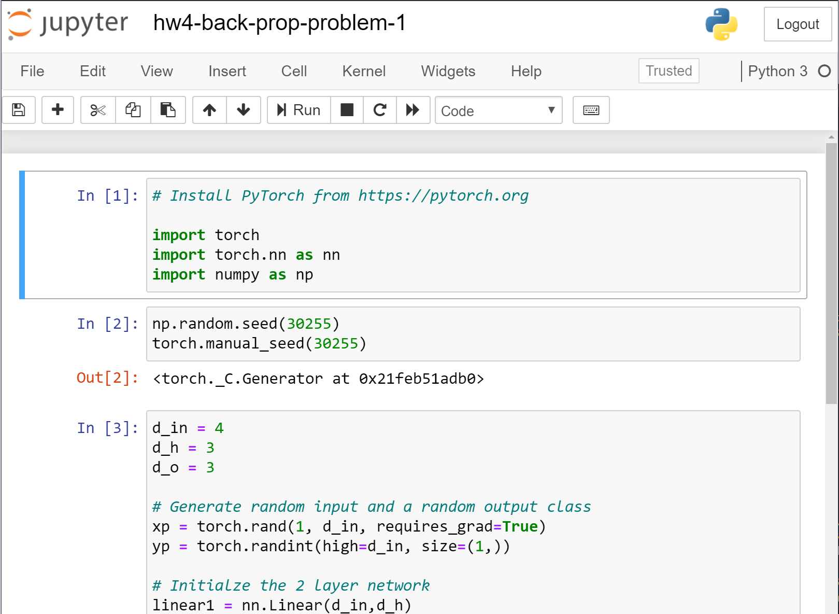
Kernel
Cells

Slide 6
Sharing a Jupyter Notebook is not sufficient
Executing this shared notebook is not always trivial
Requires the correct version of Python, the libraries used, and also any underlying C-bindings that these packages need to execute
Example: Spatial computation libraries import gdal import ogr import osr import pysal
Also requires any input dataset that’s used
Jupyter Notebooks must encapsulate data and dependencies

Slide 7
Container environment to share Jupyter Notebooks
Sciunit
A framework for automatic containerization of the application (source code, binaries, system libraries, environment) and all its input and output files
Uses tracing utilities to record and create a dependency graph at run-time and store them
Sciunit exactly repeats any execution given same inputs regardless of any differences with target machine environment.

Slide 8
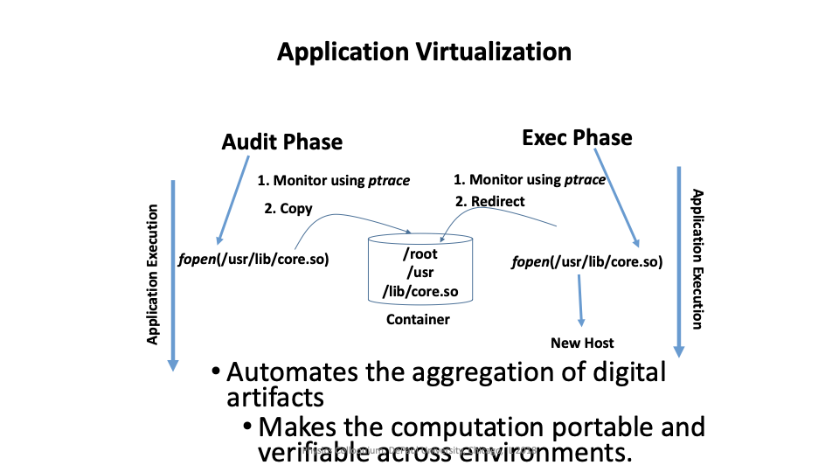
Sciunit Containerization

Slide 9
Execution checkpoints
[1]
import sys
[1]
import sys
[2]
a = 1
e1
e2
Executable
python
python
Dependencies
sys.py
sys.py
Memory Map,
Pages, Shared
Memory
sys
sys
a

Slide 10
Checkpoint/Restore In Userspace (CRIU)
Freeze an individual application and checkpoint its state to disk.
Captures all open file descriptors and any open network connections
CRIU supports RPC(Remote Procedure Calls) which uses Google Protocol Buffers to encode its calls.
Process
CRIU-RPC Service
protobuf

Slide 11
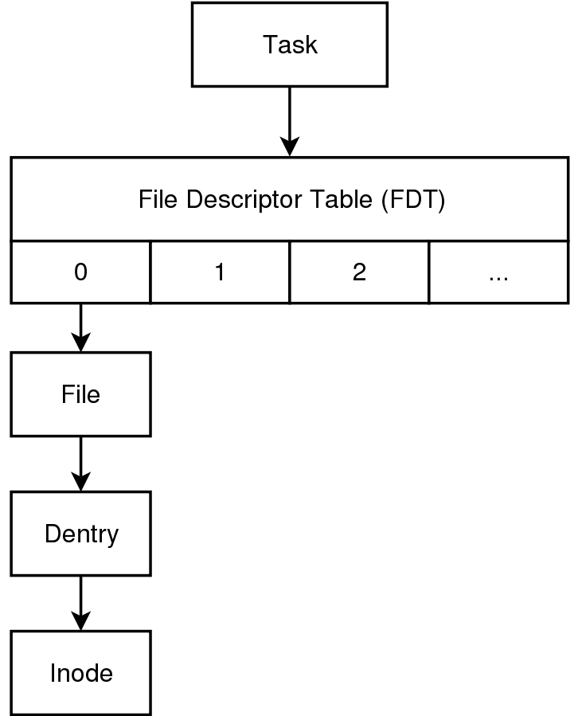
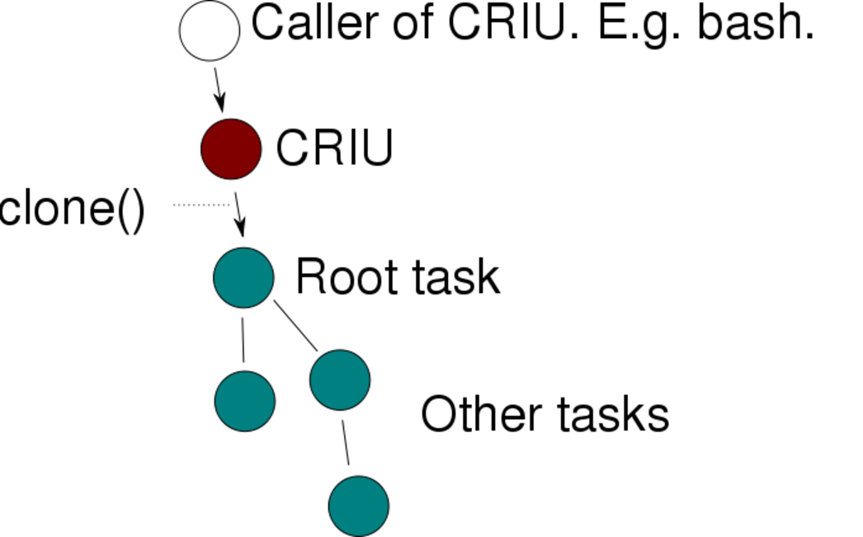
CRIU
Restoring Processes
Dumping Files Descriptors

Slide 12
Challenges of integrating CRIU with Jupyter
Restoring non existent TCP connections causes them to enter FIN_WAIT_1 state and wait indefinitely
Solution: Use the kernel to find any open TCP connections from this process and close them
Effects: Jupyter web application sees the broken pipe and automatically reconnects when interacting
Checkpoint/Restore requires superuser privileges which may not be an option under certain circumstances

Slide 13
Design of Execution Cache
User Processes
Superuser Daemons
Jupyter Notebook
Checkpoint
Restore
CRIU-RPC Service
protobuf RPC
Sciunit Kernel
Socket
Listener
Jupyter Process

Slide 14
Design
Use the existing IPython implementation to create the new kernel, that gets control whenever a cell gets executed
Use Sciunit to capture the dependencies and CRIU to make a checkpoint of the Jupyter process
Restore process from checkpoint when all dependencies match
This is done by having a listener which dumps/restores the Jupyter process and communicates through sockets.

Slide 15
Timeline
Create a new Jupyter kernel that monitors the execution flow of the cells
Creates an execution checkpoint and store dependency graph upon execution of each cell using the Sciunit framework and CRIU
Load from cache instead of re-executing when dependencies match
Benchmarking on standard data science algorithms

Slide 16
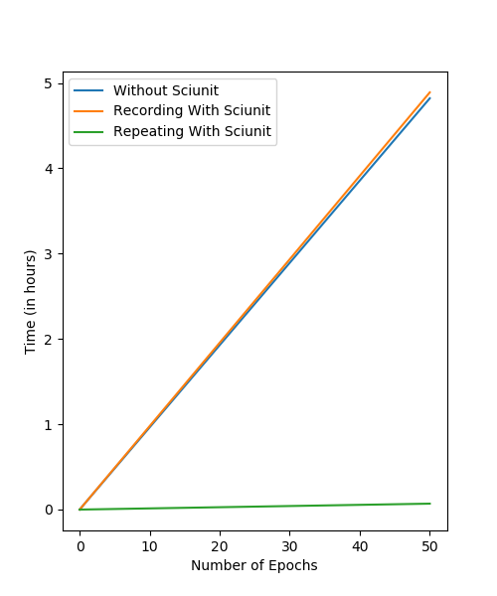
Performance
Convolutional Neural Network
6 Convolutional Layers
3 Max Pooling Layers
3 Fully Connected Layers
CIFAR-100 Dataset
Images database with 100 classes of objects
Cache Size
Dataset: 1.37 GB
Overall: 1.38 GB

Slide 17
Future Goals
Use deduplication to store process checkpoints more efficiently
Support caching multiple kernels at the same time independently
Store memory maps more efficiently since they are usually quite sparse

Slide 18
Questions?

