Slide 1
MPCS Practicum
Naga Nithin Manne, University of Chicago
Project Advisors:
Tanu Malik, DePaul University
Amitabh Chaudhary, University of Chicago

Slide 2
Problem Statement
Goal: Implement an execution cache for Jupyter Notebooks to improve sharing of machine learning workflows
Create an execution cache that stores
the state of a running process,
input and (intermediate) output data
such that subsequent executions, irrespective of environment, are faster.

Slide 3
Execution Caching
Most machine learning algorithms are perfect to cache due to high computation time and low size of the trained model
Storing pre-computed information for later re-use
Inherent trade-off between computation time vs. storage space

Slide 4
Jupyter Notebook
Frequently Used in Data Sceince to share code and results
A web-based interactive computational environment
Essentially a front-end for Jupyter kernels which are responsible for actual execution
Execution split into cells, which are executed in a specific order by the user
Select Cell to Execute
Jupyter Notebook Server
Browser Front-End
Kernel
User
HTTP
ØMQ

Slide 5
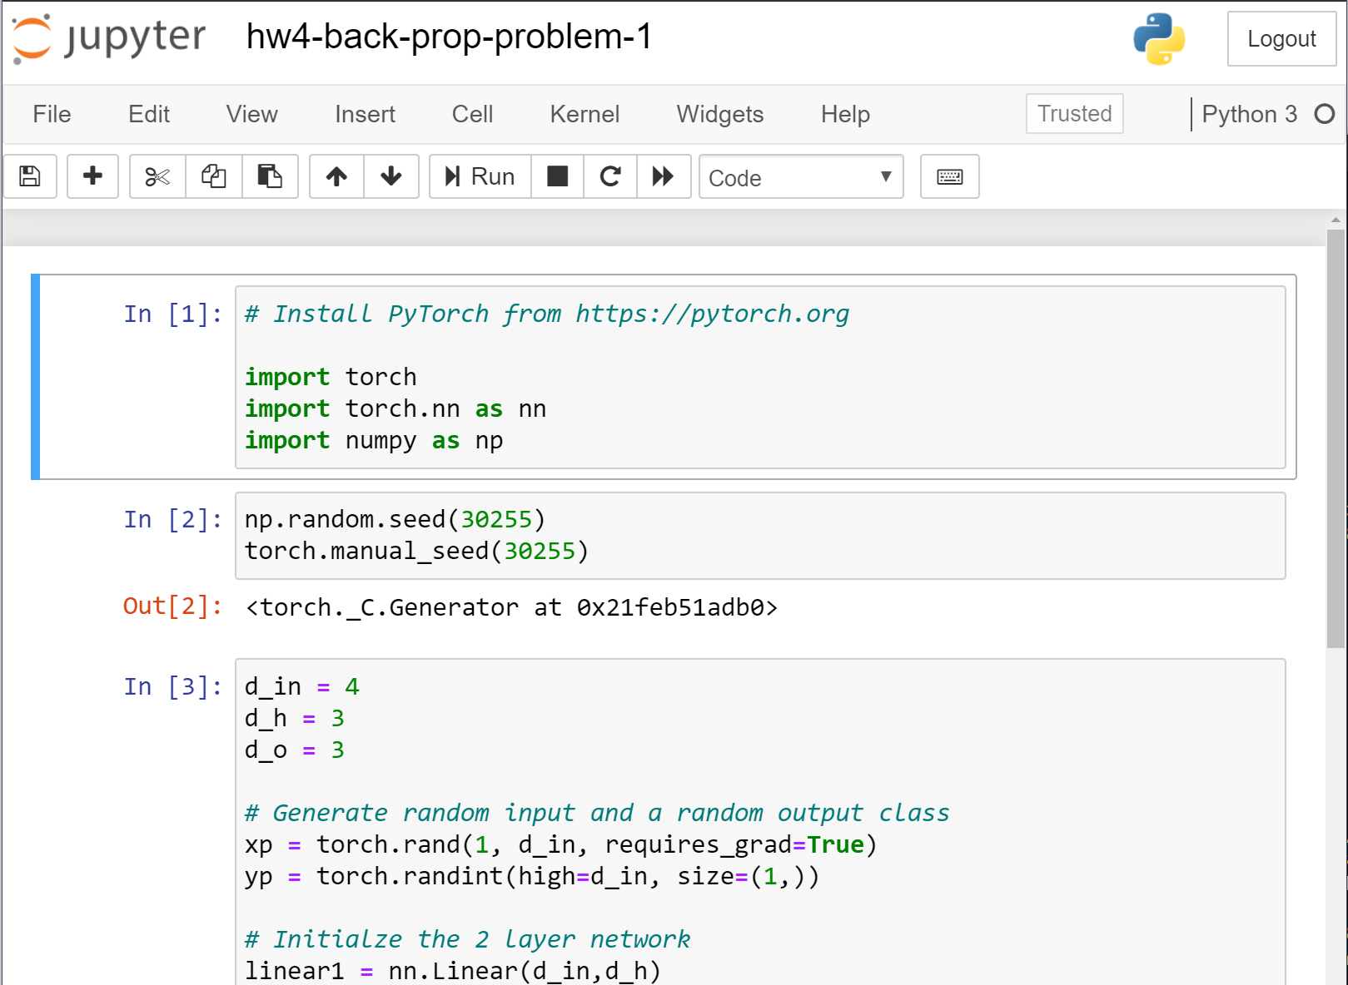
Kernel
Cells

Slide 6
Sharing a Jupyter Notebook is not sufficient
Executing this shared notebook is not always trivial
Requires the correct version of Python, the libraries used, and also any underlying C-bindings that these packages need to execute
Example: Spatial computation libraries import gdal import ogr import osr import pysal
Also requires any input dataset that’s used

Slide 7
Container environment to share Jupyter Notebooks
Sciunit
A framework for automatic containerization of the application (source code, binaries, system libraries, environment) and all its input and output files
Uses tracing utilities to record and create a dependency graph at run-time and store them
Sciunit exactly repeats any execution given same inputs regardless of any differences with target machine environment.

Slide 8
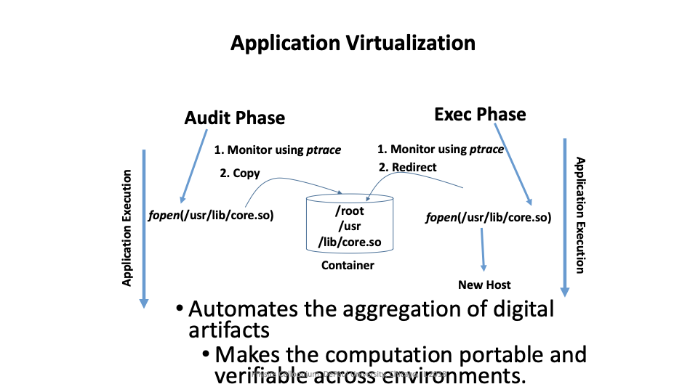
Sciunit Containerization

Slide 9
Project Goals
Create a new Jupyter kernel that monitors the execution flow of the cells
Creates an execution checkpoint and store dependency graph upon execution of each cell using the Sciunit framework
Load from cache instead of re-executing when the dependencies match
Benchmarking on standard data science algorithms

Slide 10
Execution checkpoints
[1]
import sys
[1]
import sys
[2]
import os
e1
e2
python
python
<code>
<code>
sys
sys
os

Slide 11
Current Status
Use the existing IPython implementation to create the new kernel, that gets control whenever a cell gets executed
Hash the code block, and save the execution state upon executing a cell
Load objects from cache instead of re-executing if code hash matches and go back to normal execution if there’s a mismatch

Slide 12
Performance
On a simple Neural Network(2 hidden layers) trained on the MNIST dataset of handwritten characters
Training Time: 10 minutes
Loading from Cache: <100 ms

Slide 13
Questions?

Slide 14
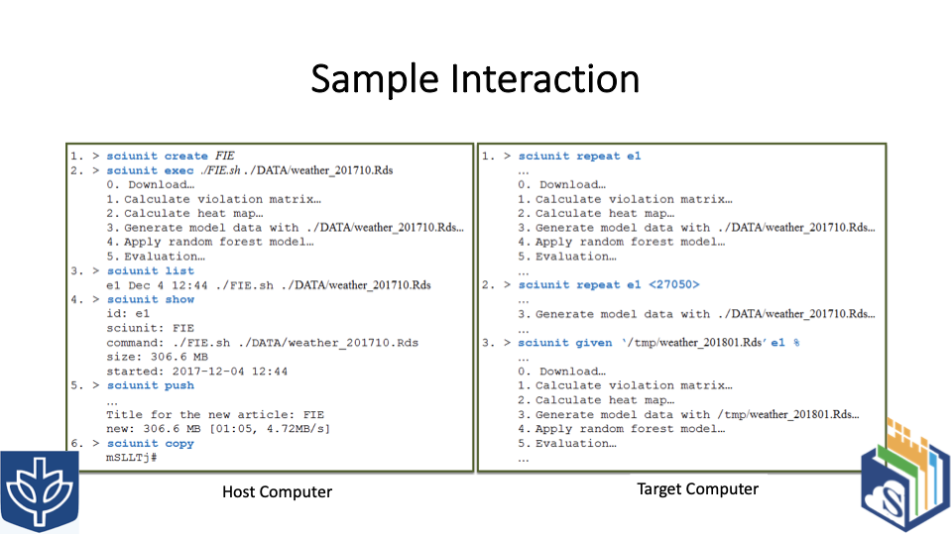
Sciunit Usage

