Slide 1
Prática 1

Slide 2

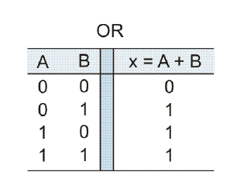
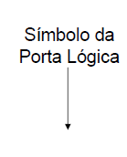
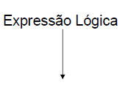

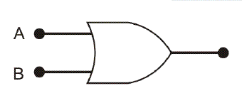


Slide 3
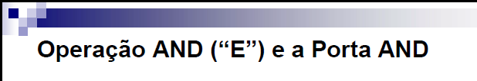
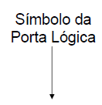
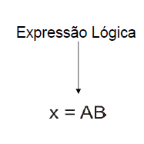
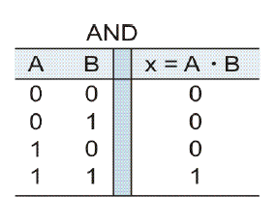
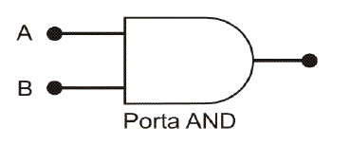

Slide 4
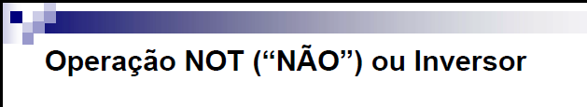
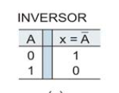
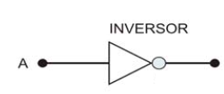
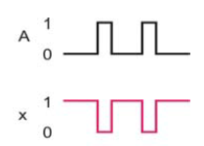




Slide 5
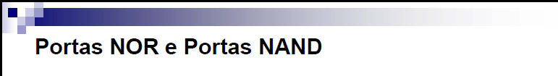
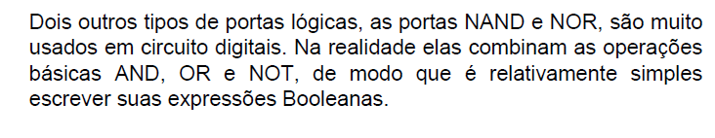


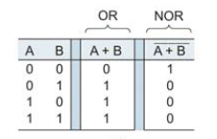



Slide 6


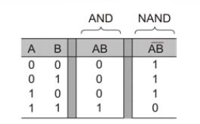



Slide 7

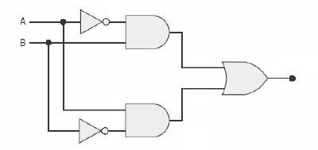
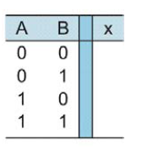



Slide 8

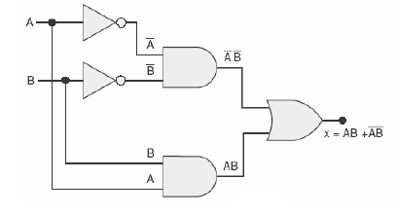
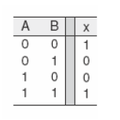


Slide 9
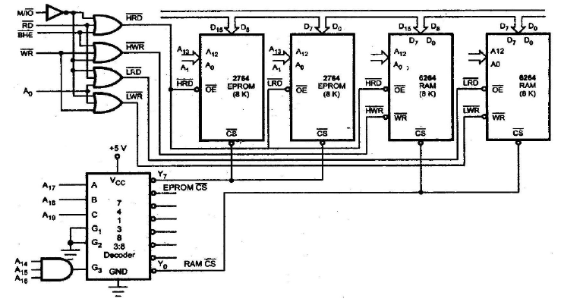

Slide 10
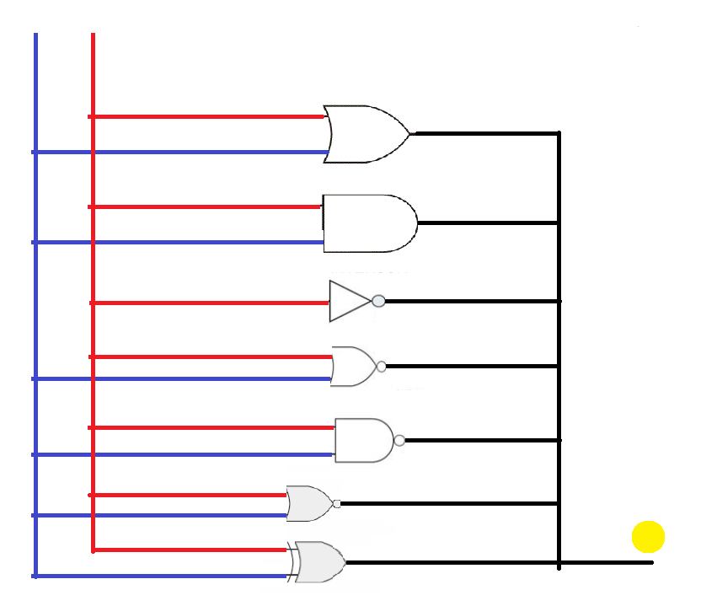
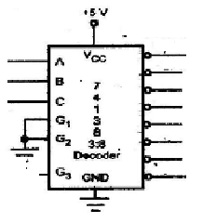
Entradas
P0 P2
CS - OU
P3
P4
P5
CS-OU
CS- E
CS –NÃO
CS-NOU
CS-NE
CS-XOU
CS-XNOU
Saída (P1-LED)

Slide 11
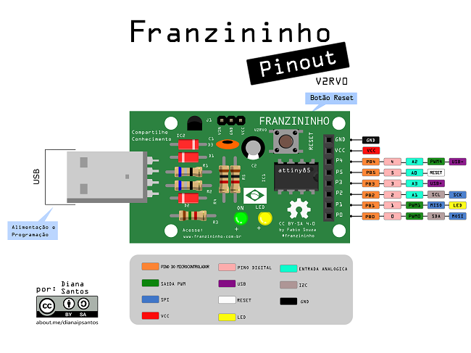

Slide 12
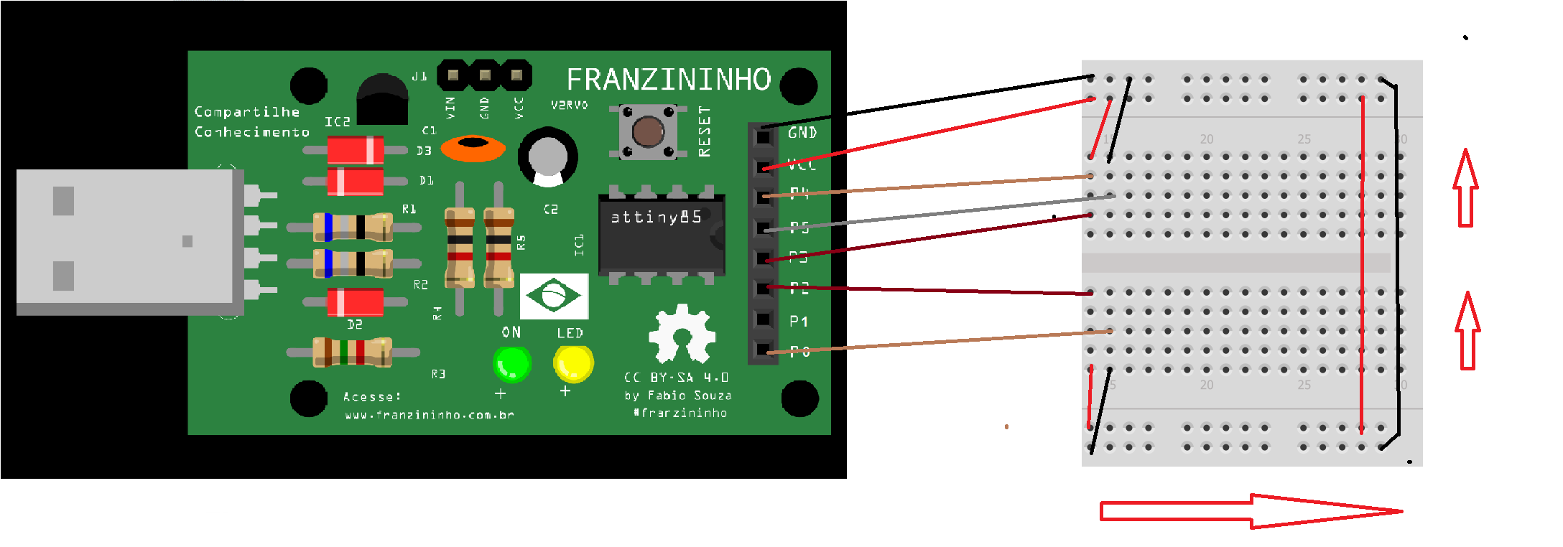
P5 P4 P3 P2 P0 P1
Porta OU
0 0 0 0 0 0
0 0 0 0 1 1
0 0 0 1 0 1
0 0 0 1 1 1
P5 P4 P3 P2 P0 P1
0 0 1 0 0 0
0 0 1 0 1 0
0 0 1 1 0 0
0 0 1 1 1 1
1 0 1 0 0 1
1 0 1 0 1 0
1 0 1 1 0 0
1 0 1 1 1 1
Porta E
Porta XOU
Porta Não
0 1 0 0 0 1
0 1 0 0 1 0
Porta XNOU
1 1 0 0 0 0
1 1 0 0 1 1
1 1 0 1 0 1
1 1 0 1 1 0
Porta NOU
0 1 1 0 0 1
0 1 1 0 1 0
0 1 1 1 0 0
0 1 1 1 1 0
Porta NE
1 0 0 0 0 1
1 0 0 0 1 1
1 0 0 1 0 1
1 0 0 1 1 0

