Slide 1



EX-FEVER: A Dataset for Multi-hop Explainable Fact Verification
Huanhuan Ma, Weizhi Xu, Yifan Wei, Liuji Chen, Liang Wang,
Qiang Liu, Shu Wu, Liang Wang
Notes:
`Hello everyone! I'm a master's student from the Institute of Automation, Chinese Academy of Sciences
Today, I'm excited to share our ACL paper with you titled "EX-FEVER a dataset for multi-hop explainable fact verification "

Slide 2
Fact Verification
In the era of mobile internet, the proliferation of misleading or fake information has raised great concern in human society.
Fact verification, also known as fact-checking, is the task of determining the veracity of claims by finding supporting evidence.
It plays a crucial role in combating misinformation and maintaining the integrity of public discourse.
Current research on automatic fact verification, using deep learning methods, focuses only on accuracy improvement while neglecting explainability, a crucial ability of an automatic fact verification system.
Notes:
In the era of mobile internet, the proliferation of misleading or fake information has raised great concern in human society.
Fact verification, also known as fact-checking, is the task of determining the veracity of claims by finding supporting evidence.
It plays a crucial role in combating misinformation and maintaining the integrity of public discourse.
Current research on automatic fact verification using deep learning methods only focuses on improving accuracy, while neglecting explainability, which hinder the trustworthiness and acceptance of these systems

Slide 3
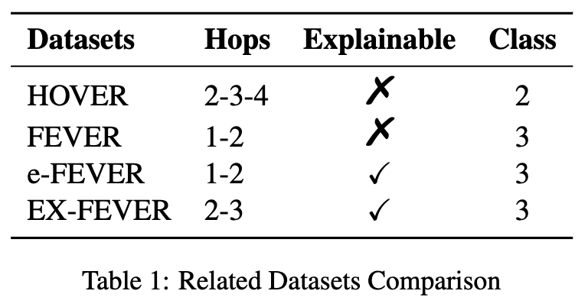
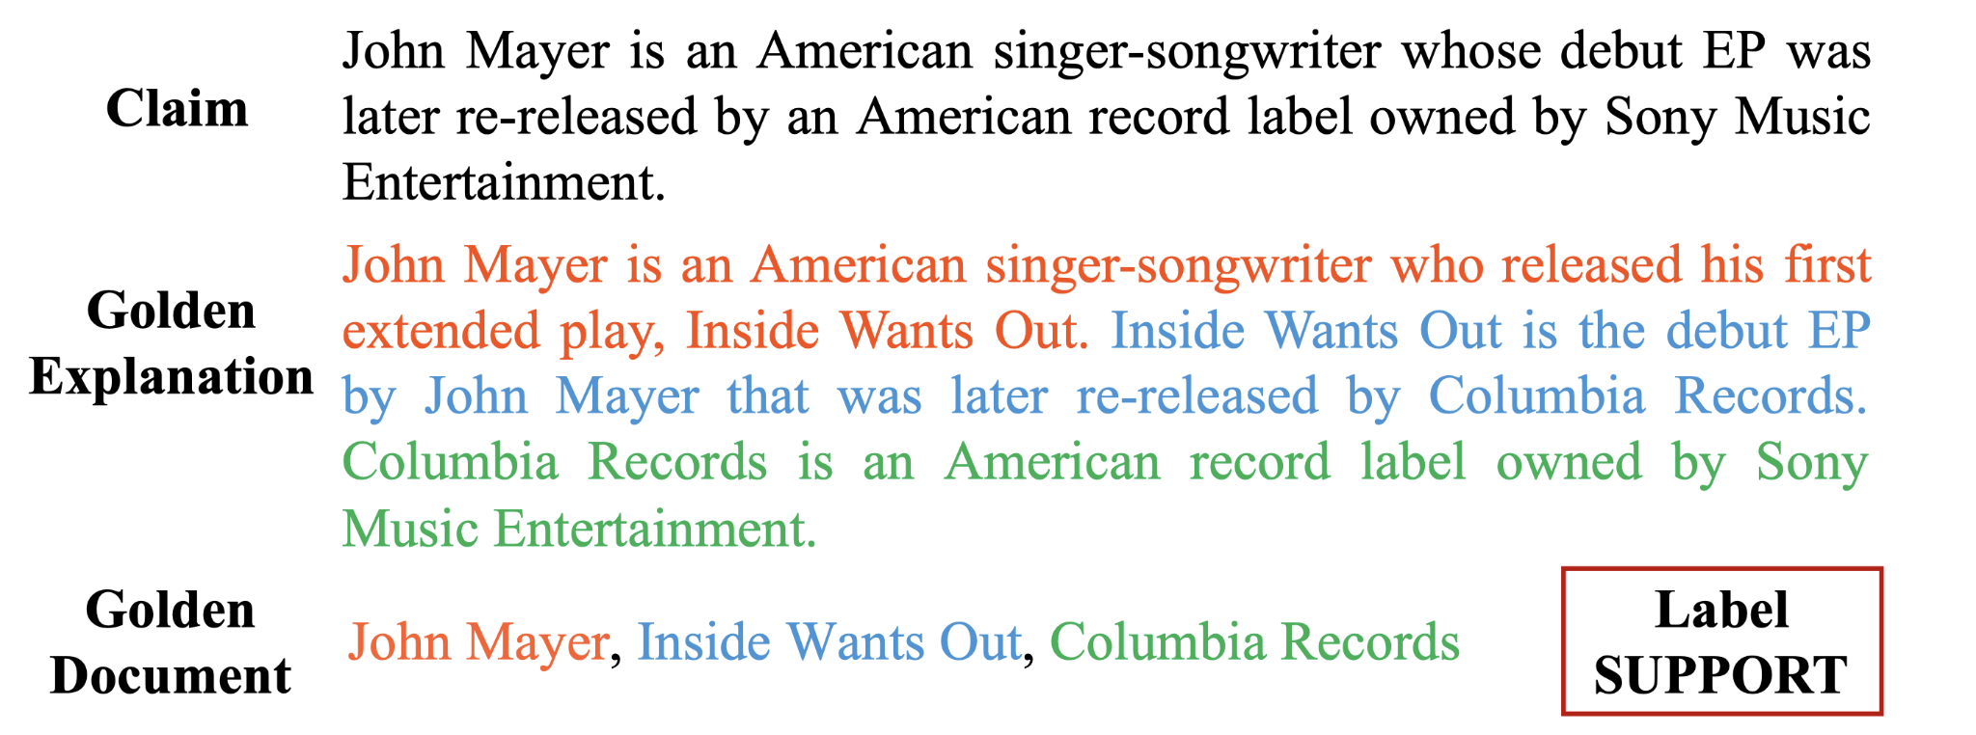
EX-FEVER Dataset Overview
Key features: 60,000+ complex multi-hop claims
Dataset composition:
Verification labels (SUPPORTS, REFUTES, NOT ENOUGH INFO)
Explanatory annotations
Notes:
To address this limitation, we propose the dataset for multi-hop explainable fact verification. Our dataset involves 60,000 claims requiring 2-hop or 3-hop reasoning, each accompanied by golden documents and explanations. These explanations describe the minimally sufficient information needed to verify a claim, with necessary rewriting to exclude unrelated information.

Slide 4
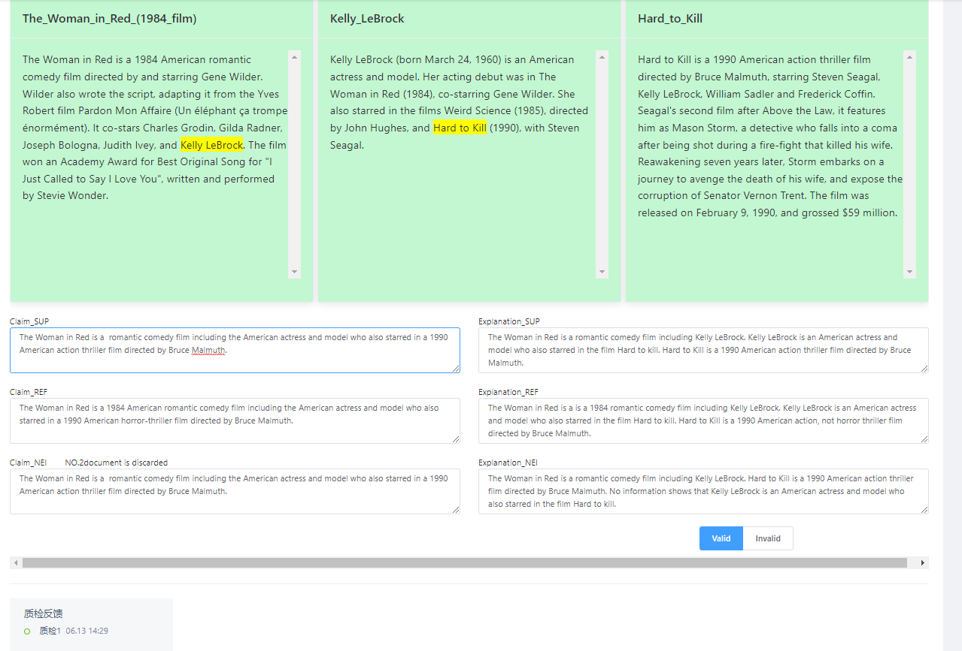
Dataset construction
We use Top 50,000 popular Wikipedia pages and Create multi-hop reasoning paths using hyperlinks.
We hired annotators, trained them with detailed guidelines
We reviewed and refined their work through quality inspections. In total, we collected 60,000 annotated claims, each with a verdict and explanation
Notes:
We hired annotators from Appen, trained them with detailed guidelines, and selected articles from the top 50,000 popular Wikipedia pages. Using hyperlinks, we created multi-hop reasoning paths. We reviewed and refined their work through quality inspections. In total, we collected 60,000 annotated claims, each with a verdict and explanation.

Slide 5
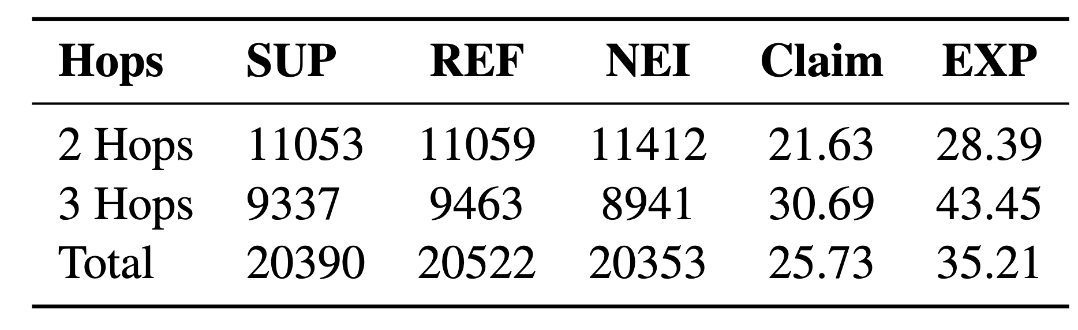
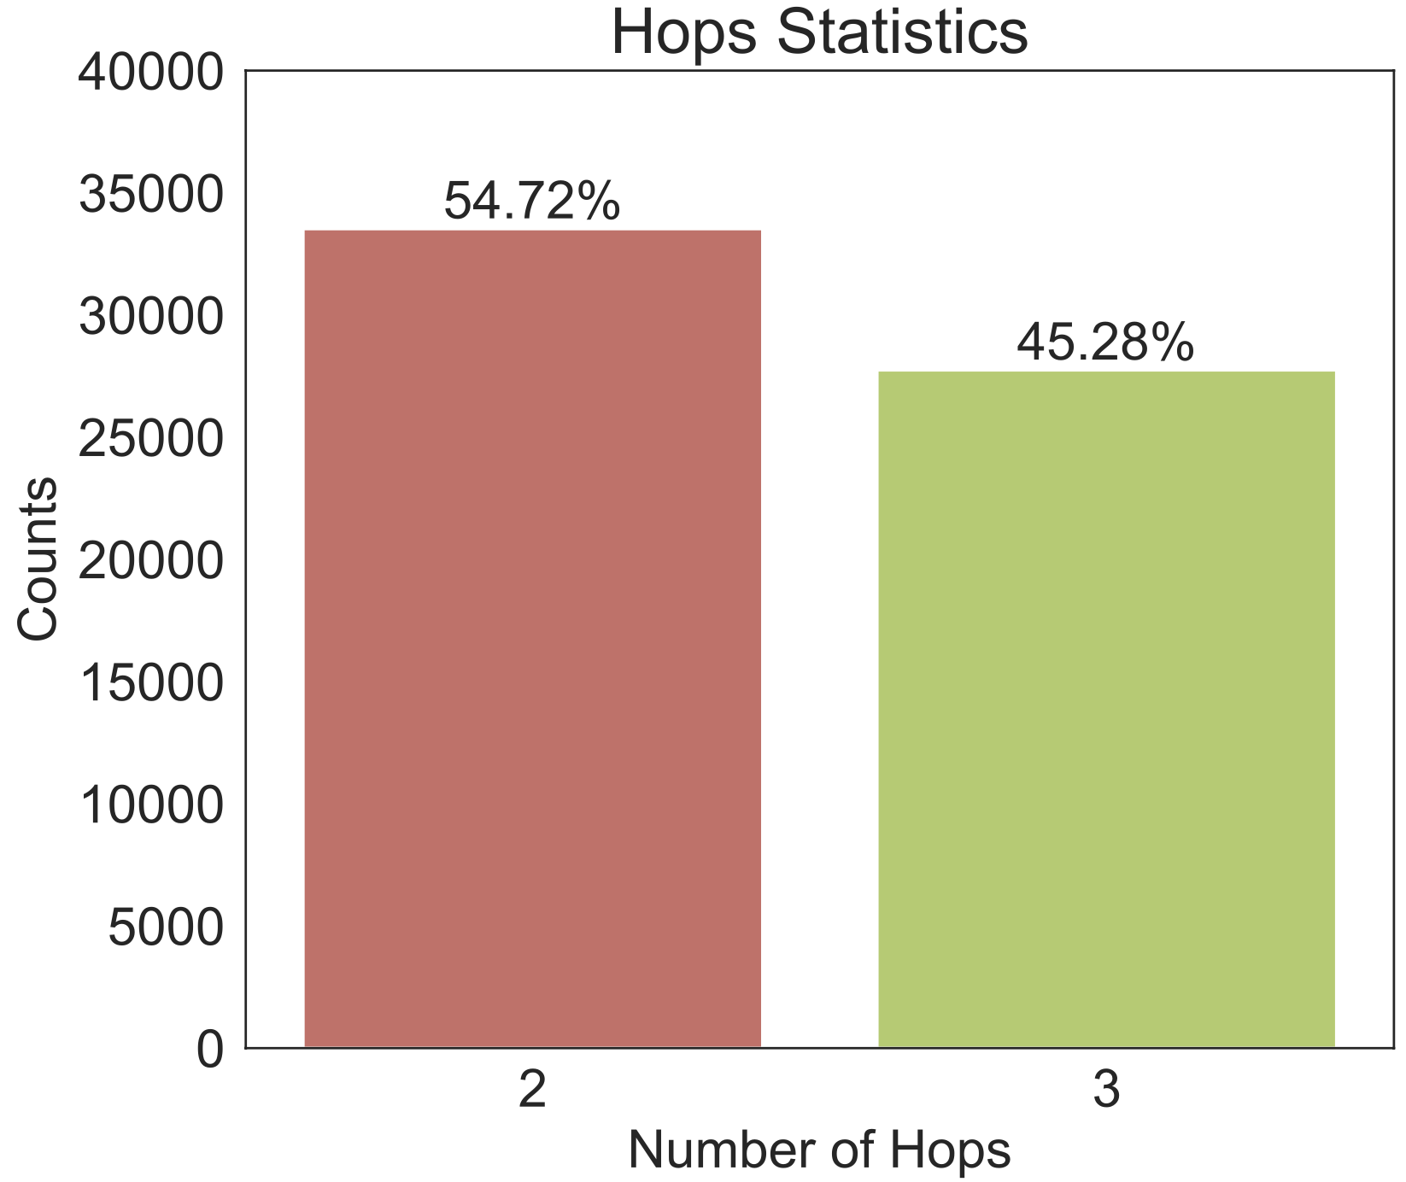
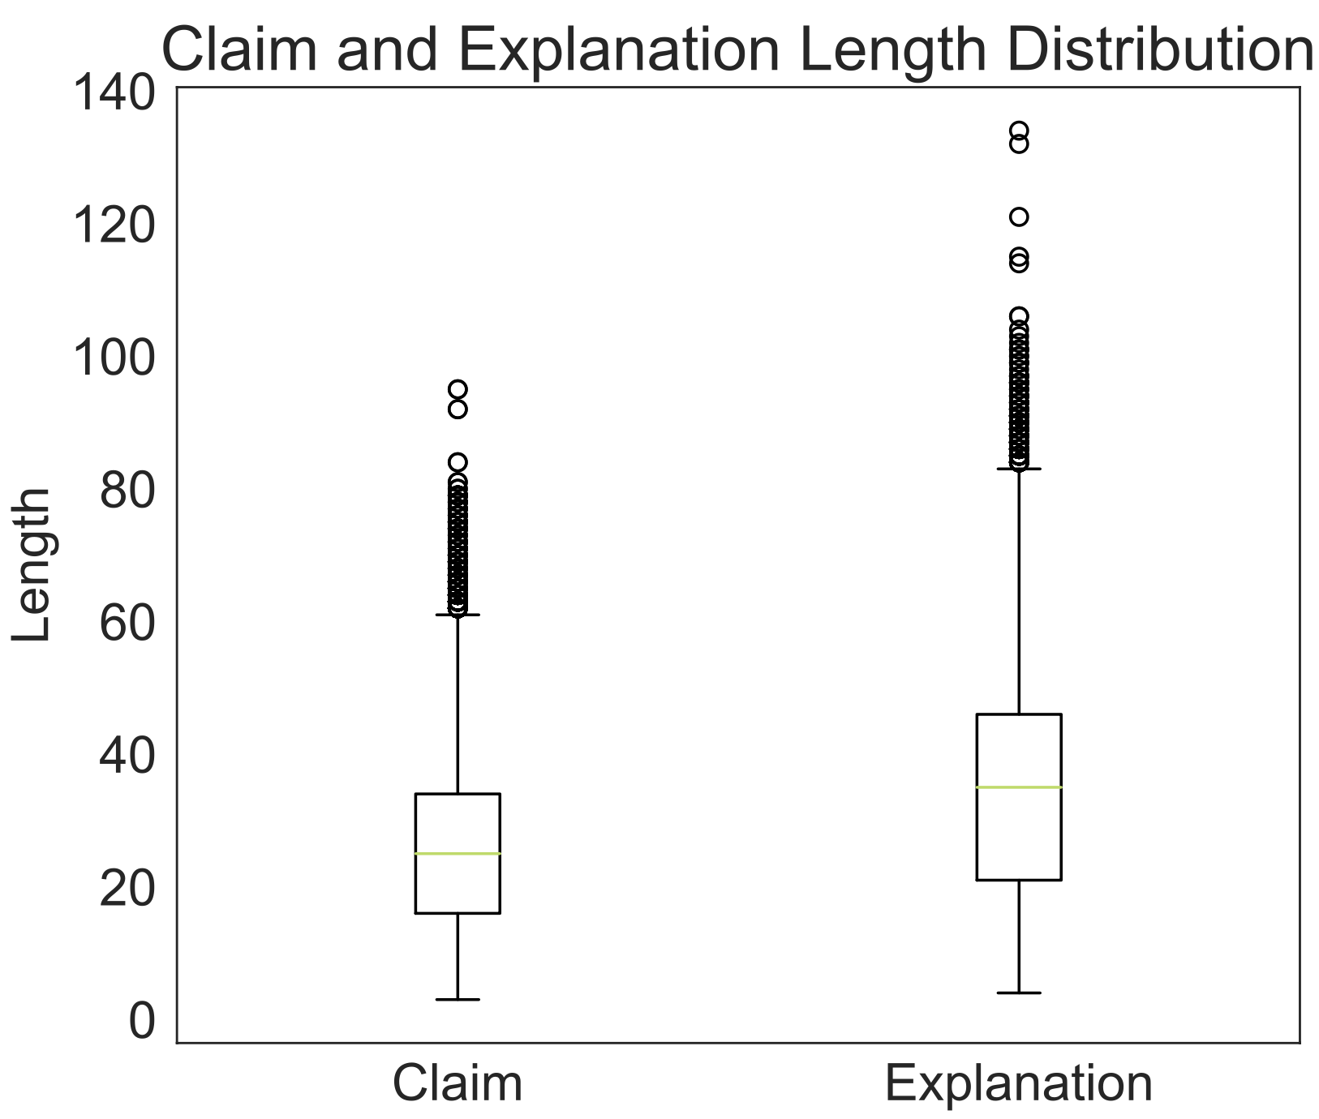
Dataset Characteristics
Table1: Data Statistics with different number of hops and different label classes. The average claim length and explanation length in word level are reported.
Notes:
Here are the dataset characteristics: We ensure that each category is uniformly distributed. This chart shows the distribution of claim and explanation lengths in our dataset.

Slide 6
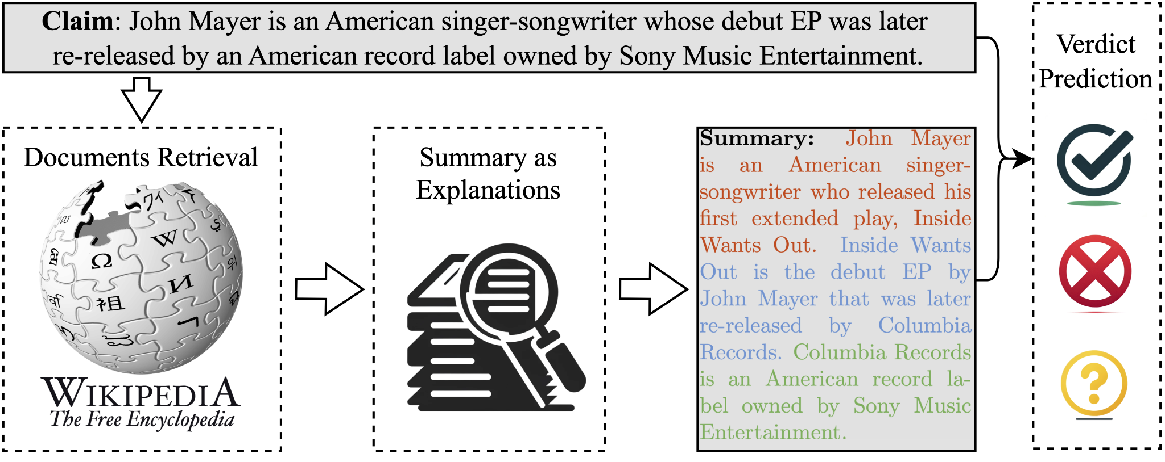
Benchmark System Architecture
The baseline system comprises three stages: document retrieval, summary generation as explanations, and verdict prediction. The system produces two main outputs: a veracity label and a summary that serves as an explanation for the prediction.
Notes:
With the dataset we construct the baseline system.
The baseline system comprises three stages: document retrieval, summary generation as explanations, and verdict prediction. The system produces two main outputs: a veracity label and a summary that serves as an explanation for the prediction.

Slide 7
Experimental Setup
Model selection
Evaluation Metrics
Document Retrieval
Rule-based: TF-IDF
Neural-based:
BERT-based model
MDR model
Explanatory Stage
BART Fine-tuned on dataset's training split
Verdict Prediction
BERT
GEAR - graph-based text reasoning model
Document Retrieval
Exact match score (EM)
Recall@k
Explanation Generation
ROUGE score
Verification
Accuracy
F1 score
Notes:
This is the implementation details of our baseline system: We fine-tuned state-of-the-art, representative models on our dataset and evaluated them using standard metrics.

Slide 8
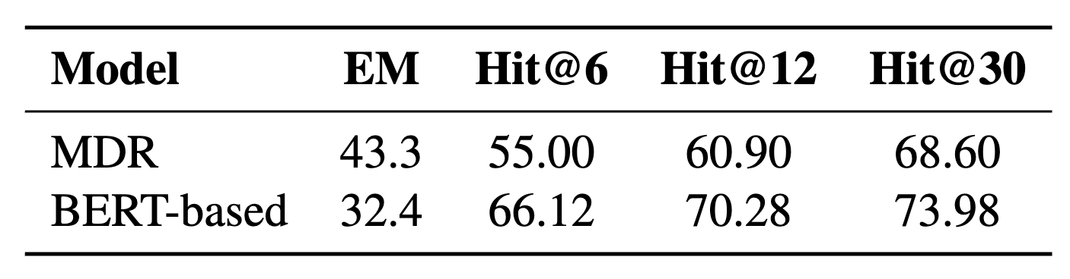
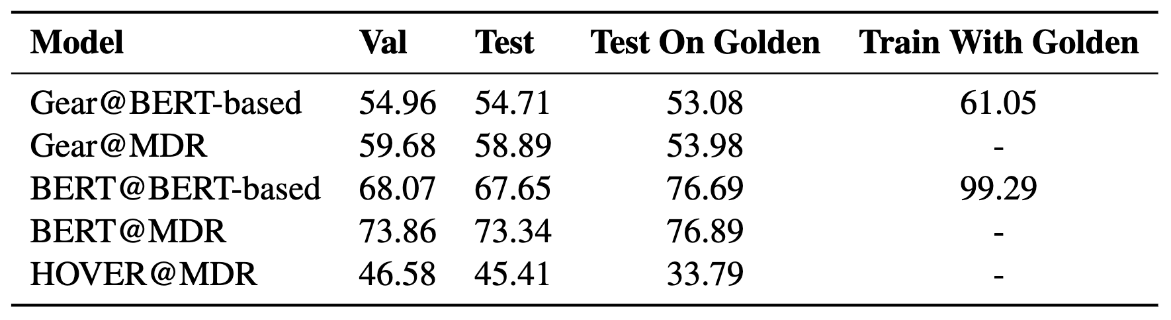
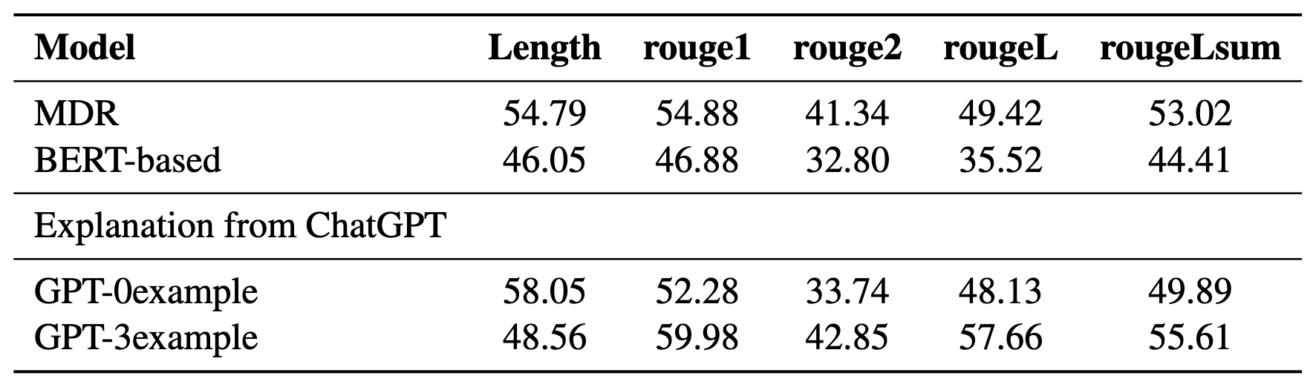
Results & Analysis
Table2: Retrieve Model Performance Comparison
Table4: Verify Model Comparison. The accuracy (%) of each model is reported
Table3: Generated Summary Metrics Comparison
Overall Conclusions
Retrieval model quality significantly impacts system performance
EM score is crucial due to text generation model constraints
Current graph-based methods may lack true reasoning capabilities
High-quality explanations are vital for accurate verdict prediction
Notes:
From the experimental results, we can see that
• The quality of the retrieval model significantly impacts overall system performance.
• The EM score is crucial due to the constraints of the text generation model.
• Current graph-based methods may lack true reasoning capabilities.
• High-quality explanations are essential for accurate verdict prediction.

Slide 9
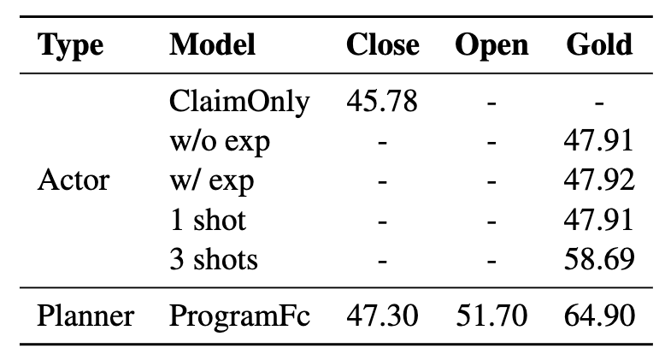
Large Language Model Exploration
LLMs as actors: direct fact-checking
LLMs as planners: decomposing complex claims
Table4: Use LLM as an actor or a planner. The accuracy (\%) of each model is reported.
Findings:
Despite extensive training data, LLMs require additional knowledge to perform well on this task. Incorporating few-shot examples proves effective.
Large models excel in generating guides to assist other models in making judgments, rather than making predictions directly.
Notes:
Furthermore, we conducted preliminary investigations into using LLMs for explainable fact-checking tasks.
We explored two approaches for employing LLMs:
1. LLMs as Actors: Direct fact-checking.
2. LLMs as Planners: Decomposing complex claims.
Our experimental results reveal that:
• Despite extensive training data, LLMs require additional knowledge to perform effectively on this task. Incorporating few-shot examples has proven to be an effective strategy.
• Large models excel in generating guides to assist other models in making judgments, rather than making predictions directly.

Slide 10
Conclusion
Dataset Introduction: We present a publicly accessible fact-checking dataset, EX-FEVER, with over 60,000 multi-hop claims and detailed annotations for understanding veracity assessments.
System Design: Our comprehensive system includes retrieval, summarization for explanation, and verification stages, highlighting the dataset's significance.
LLM Investigations: Preliminary studies with the GPT-3.5-turbo model show that using LLMs as planners yields better performance than as actors, particularly in generating explanations.
Improvement Potential: Despite the capabilities of LLMs, there is substantial room for enhancement in the fact-checking process.
Benchmarking Value: EX-FEVER serves as a crucial benchmark for advancing explainable multi-hop fact-checking, aiding in reliability and informed decision-making across various fields.
Notes:
To conclude, we present EX-FEVER, a new fact-checking dataset with over 60,000 multi-hop claims and detailed veracity annotations. Our system includes retrieval, summarization, and verification stages, demonstrating the dataset’s importance.
Initial studies with GPT-3.5-turbo show that LLMs perform better as planners for generating explanations rather than as actors in direct fact-checking.
Despite the progress, there’s still room for improvement in fact-checking. EX-FEVER is a key benchmark for advancing explainable multi-hop fact-checking and enhancing decision-making.

Slide 11
Thanks

