Slide 1

New dataset
Joint UKF, DRAM, PSO

Slide 2
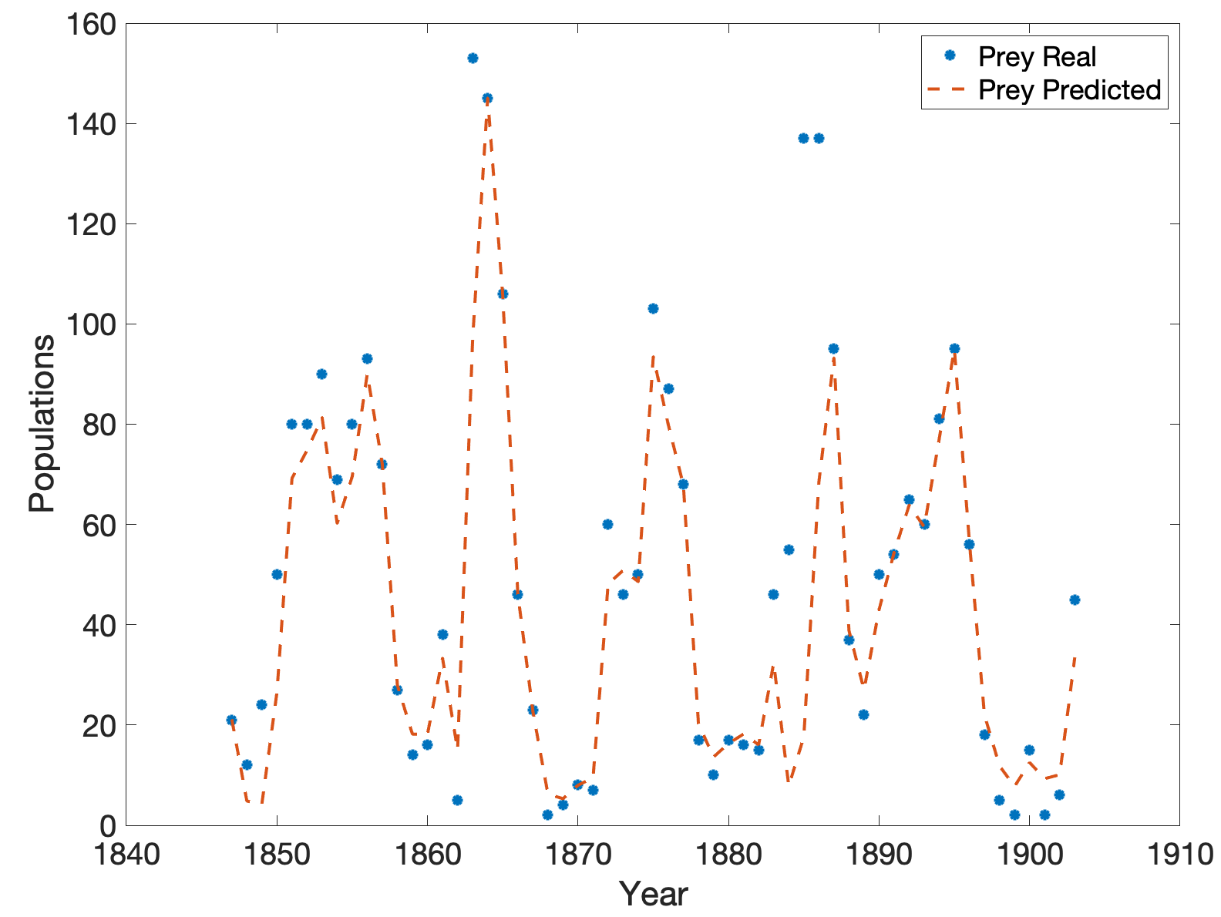
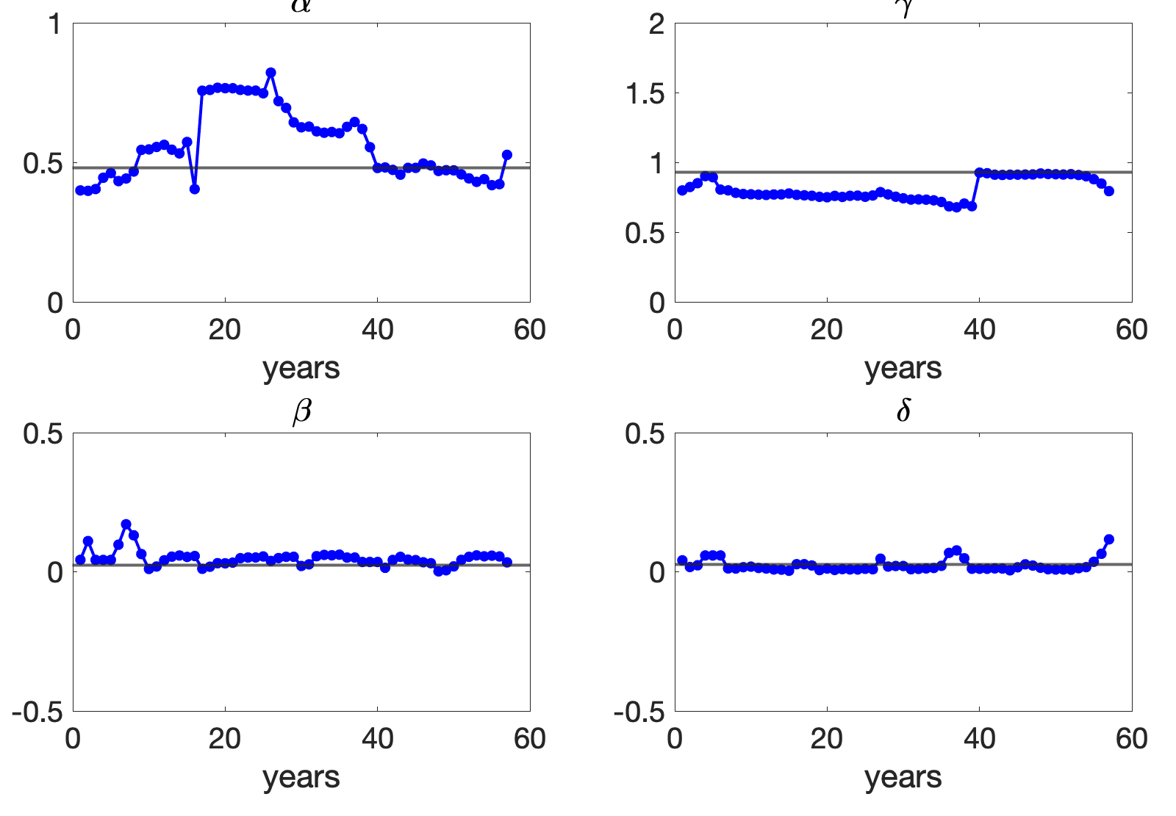
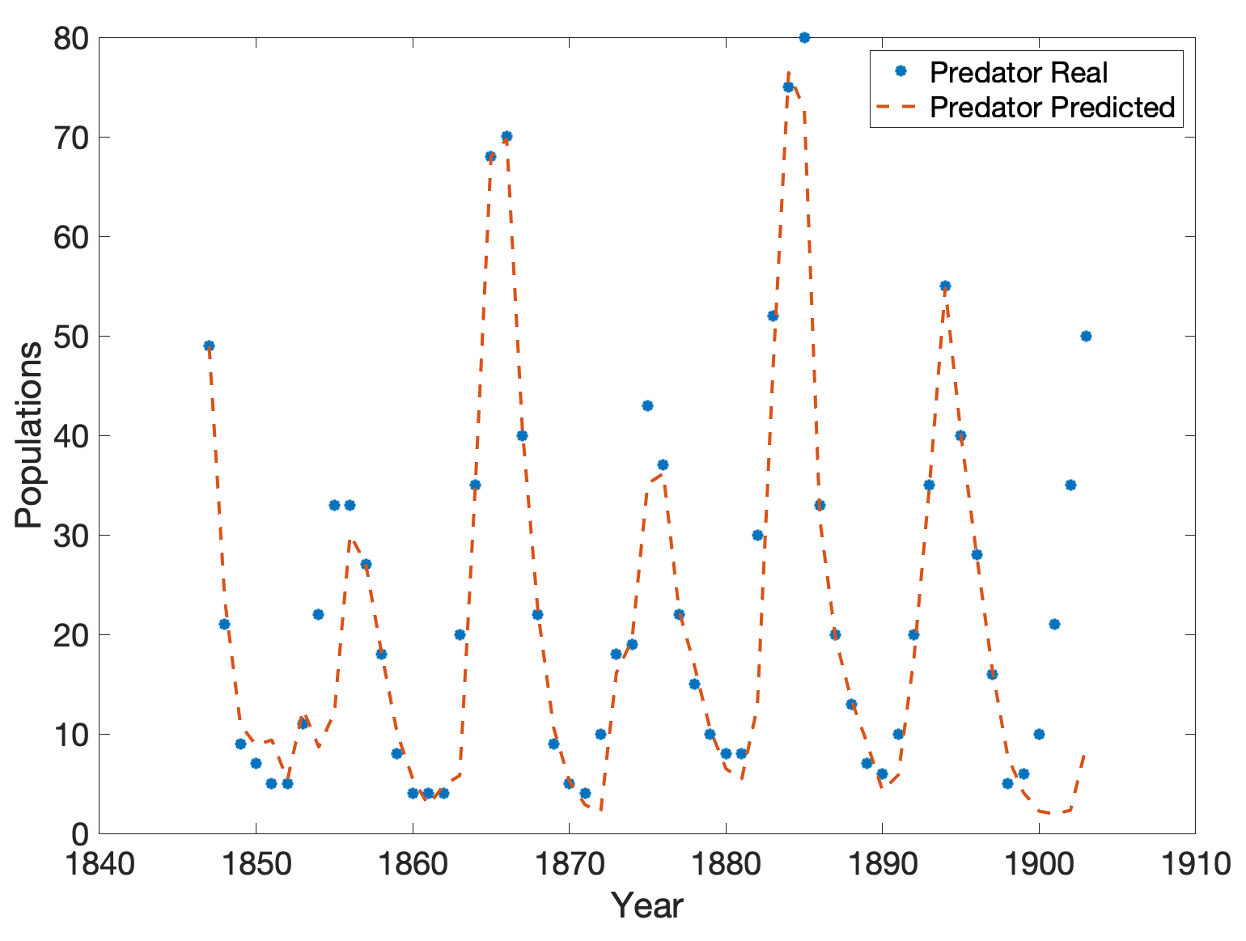

Slide 3
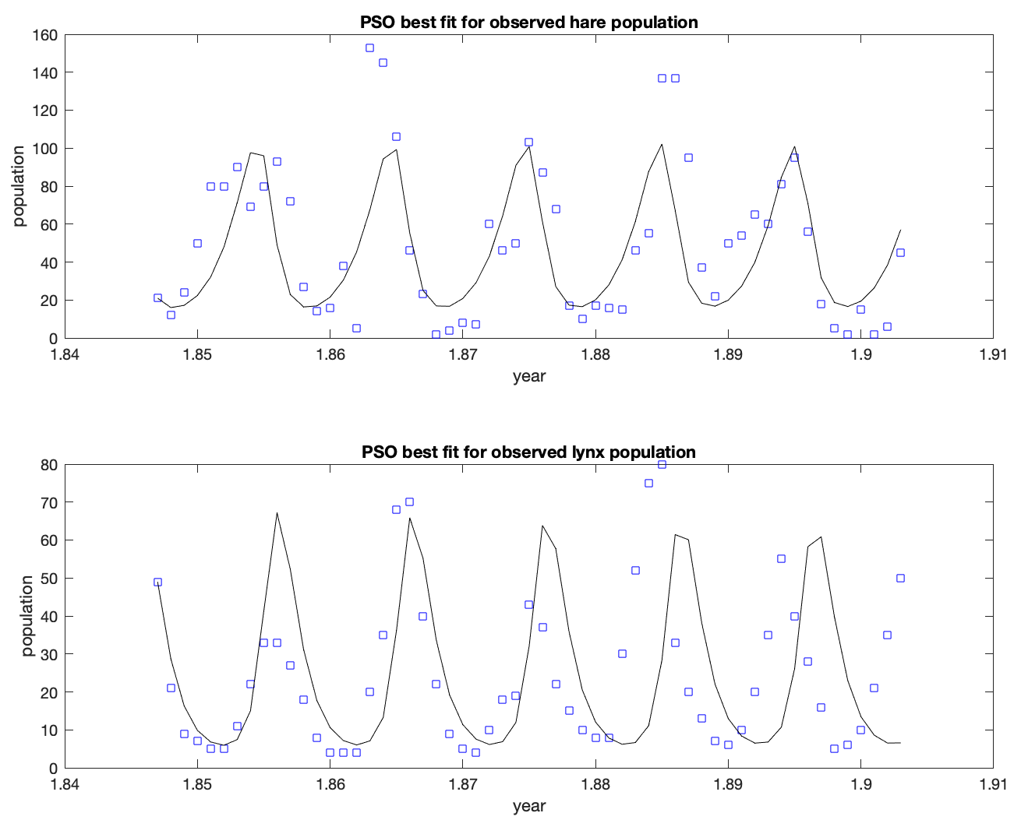

Slide 4
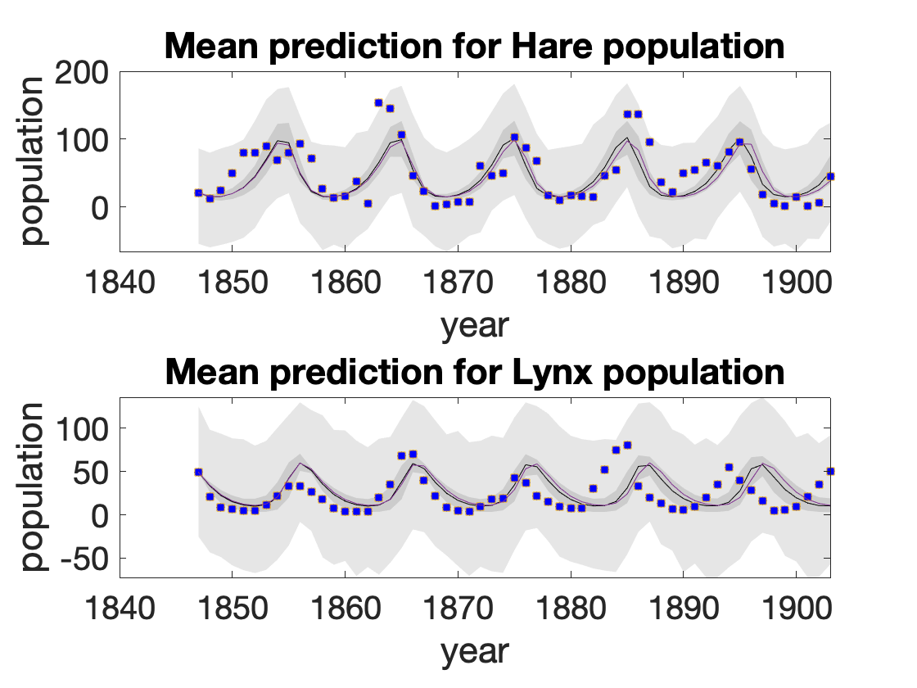
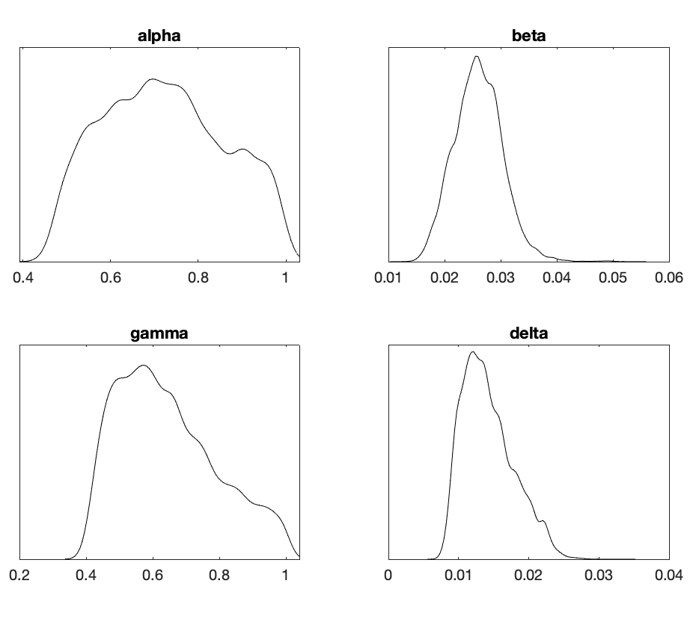
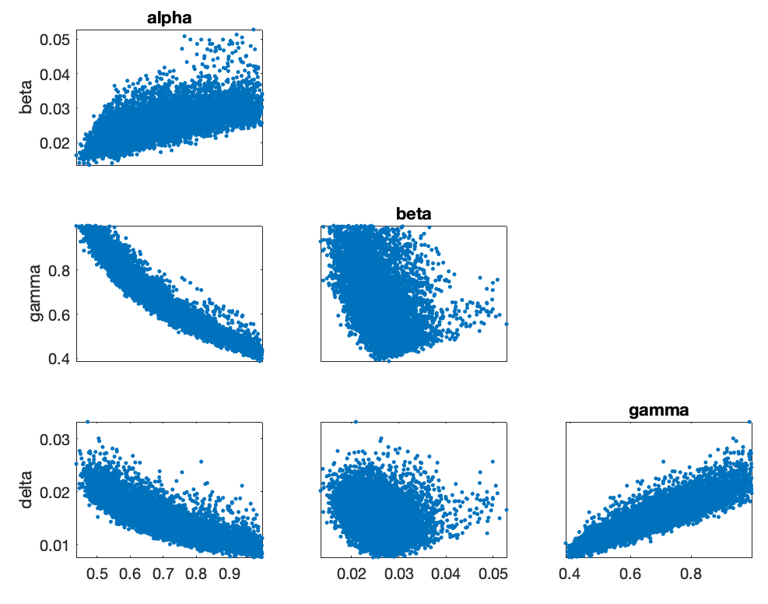
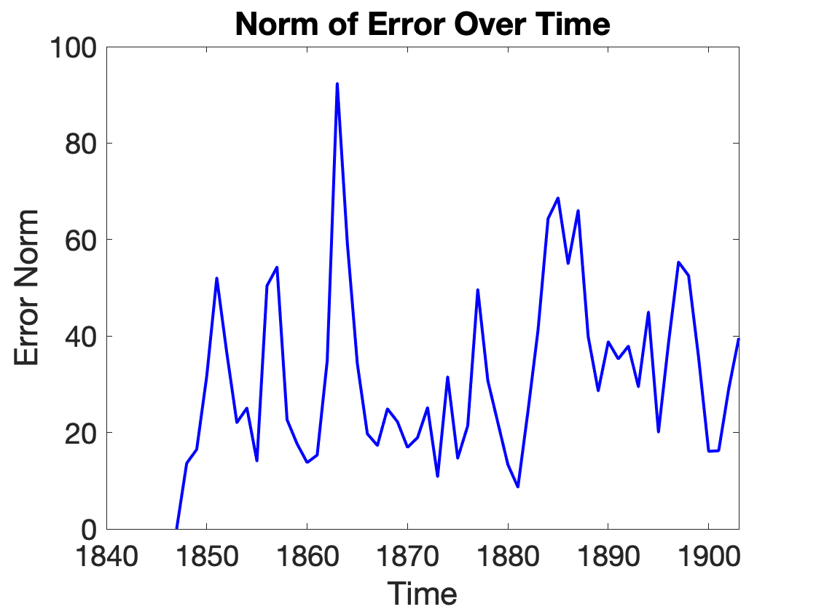

Slide 5
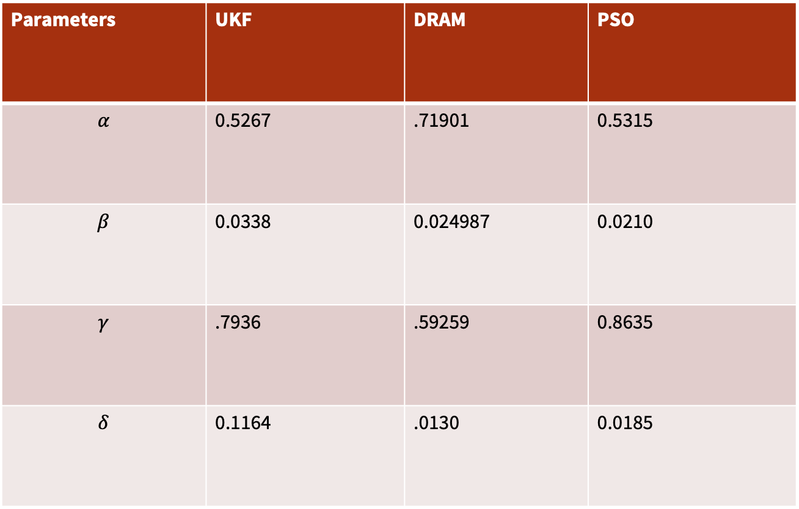
Parameters | UKF | DRAM | PSO
$$α$$ | 0.5267 | .71901 | 0.5315
$$β$$ | 0.0338 | 0.024987 | 0.0210
$$γ$$ | .7936 | .59259 | 0.8635
$$δ$$ | 0.1164 | .0130 | 0.0185
Should take average

Slide 6
