Slide 1

Joint UKF notes Compare UKF with MCMC
An Do
June 16th, 2021

Slide 2

Prey-Predator model- Joint UKF

Slide 3

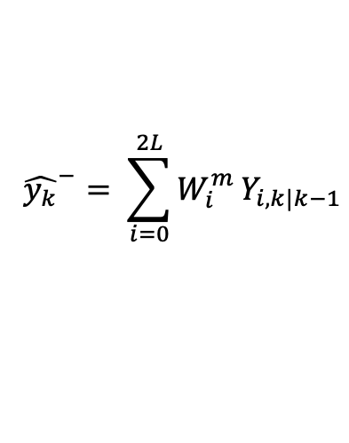



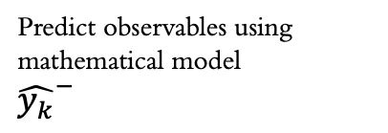
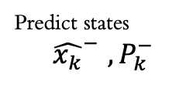
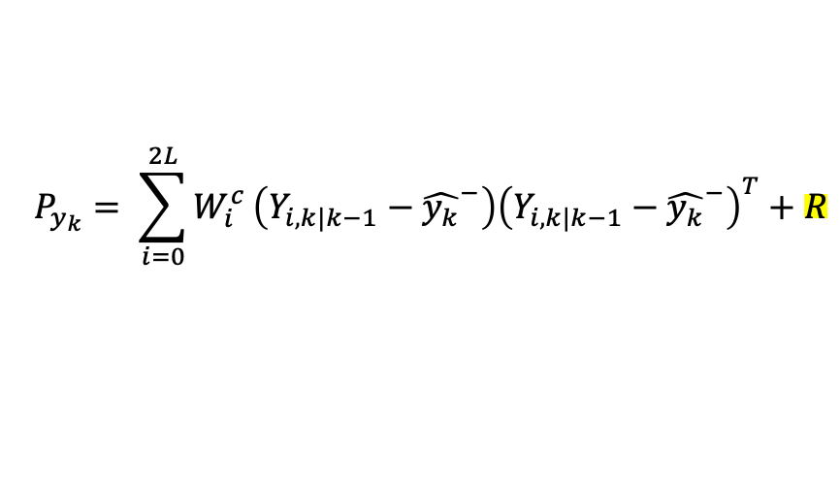
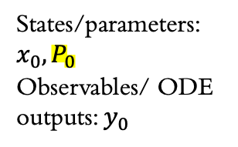

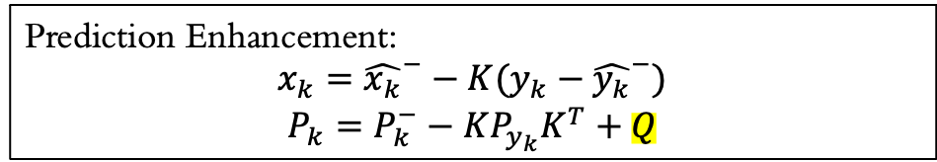

Unscented Kalman Filter
Predict observables using mathematical model
${\hat{y_{k}}}^{−}$
Predict states
$${\hat{x_{k}}}^{−} , P_{k}^{−}$$
$$x_{k−1}, P_{k−1}$$
Sample sigma vectors
Initial
Previous state
Prior estimates
States/parameters: $x_{0}, P_{0}$
Observables/ ODE outputs: $y_{0}$
Prediction Enhancement:
$$x_{k}={\hat{x_{k}}}^{−}−K(y_{k}−{\hat{y_{k}}}^{−})$$
$$P_{k}=P_{k}^{−}−KP_{y_{k}}K^{T}+Q$$
$$Y_{i,k|k−1}=H\left(χ_{i,k|k−1}\right)$$
$${\hat{y_{k}}}^{−}= \sum_{i=0}^{2L}{W_{i}^{m}}Y_{i,k|k−1}$$
$$P_{y_{k}}= \sum_{i=0}^{2L}{W_{i}^{c}}\left(Y_{i,k|k−1}−{\hat{y_{k}}}^{−}\right){\left(Y_{i,k|k−1}−{\hat{y_{k}}}^{−}\right)}^{T}+R$$
New input data $y_{k}$
$$P_{{x_{k},y}_{k}}= \sum_{i=0}^{2L}{W_{i}^{c}}\left(χ_{i,k|k−1}−{\hat{x_{k}}}^{−}\right){\left(Y_{i,k|k−1}−{\hat{y_{k}}}^{−}\right)}^{T}$$
$P_{y_{k}}:$ $error covariance matrix$
$P_{{x_{k}, y}_{k}}$: covariance matrix between states and variables
$K=P_{x_{k}},y_{k}P_{y_{k}}^{−1}$: Kalman gain

Slide 4
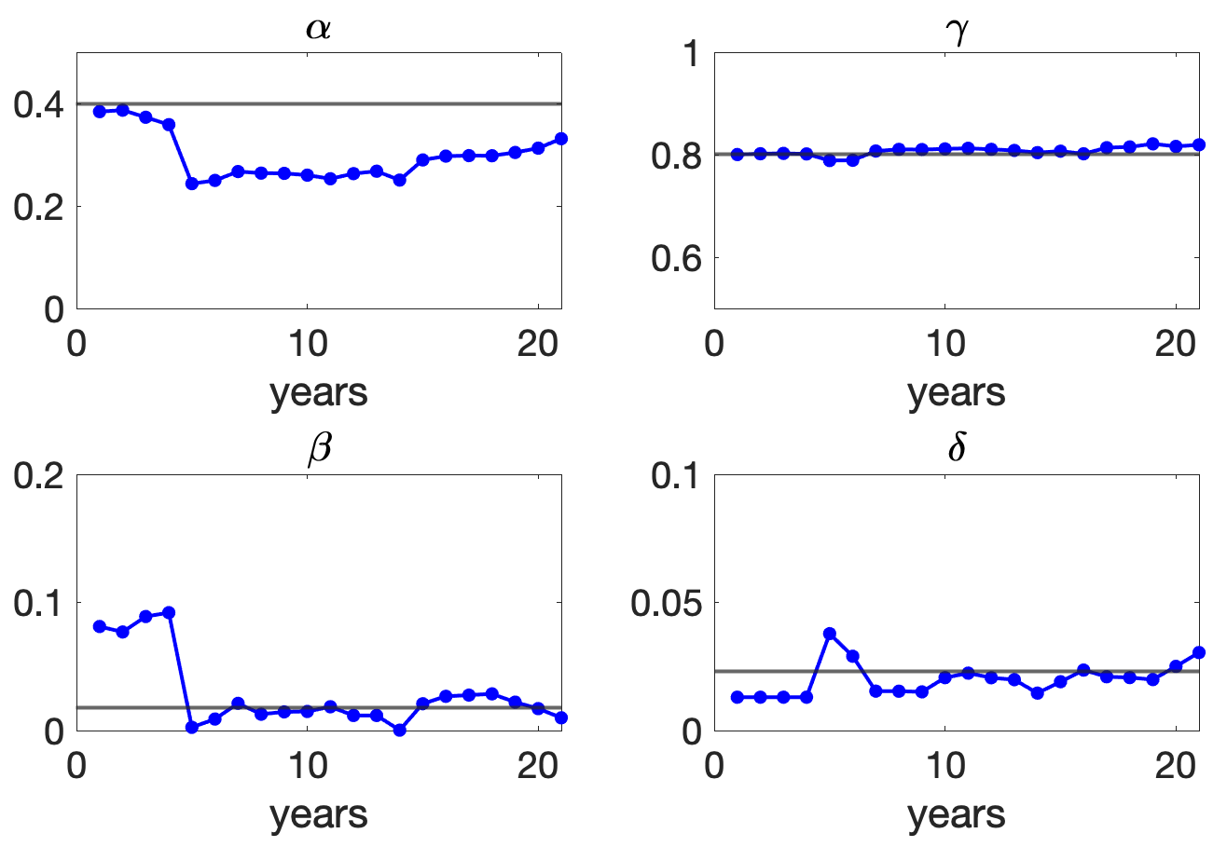
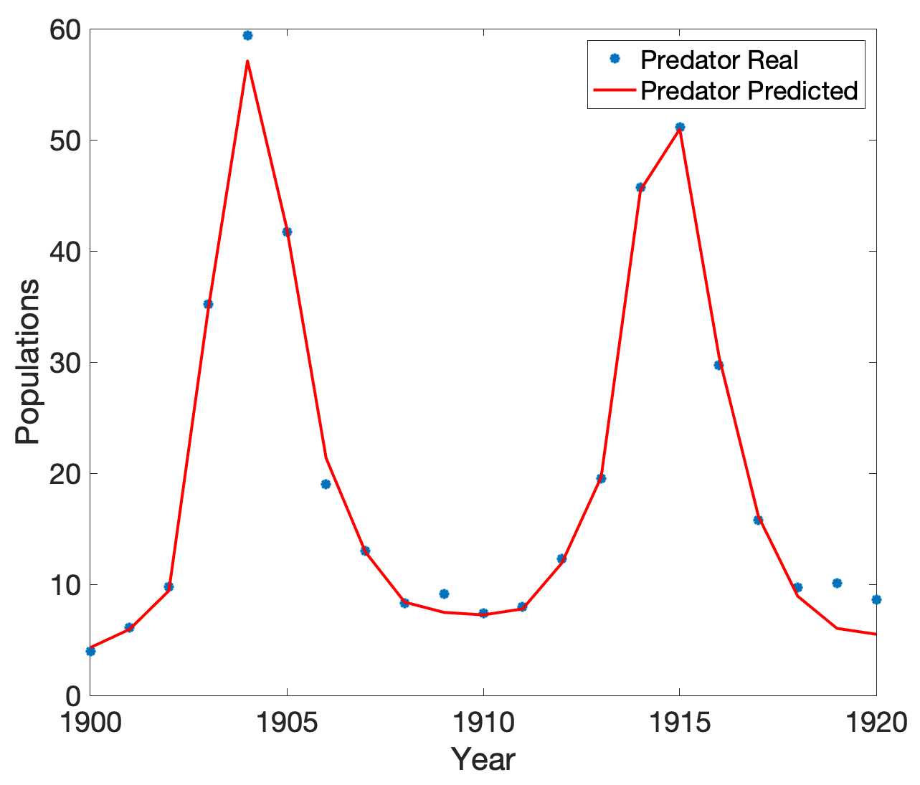
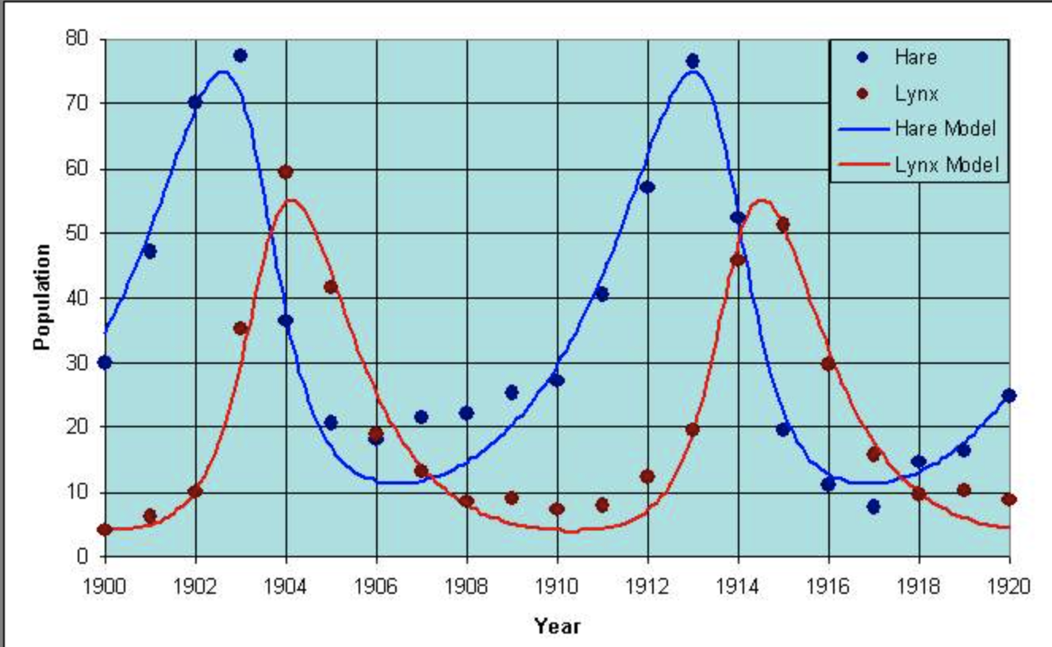
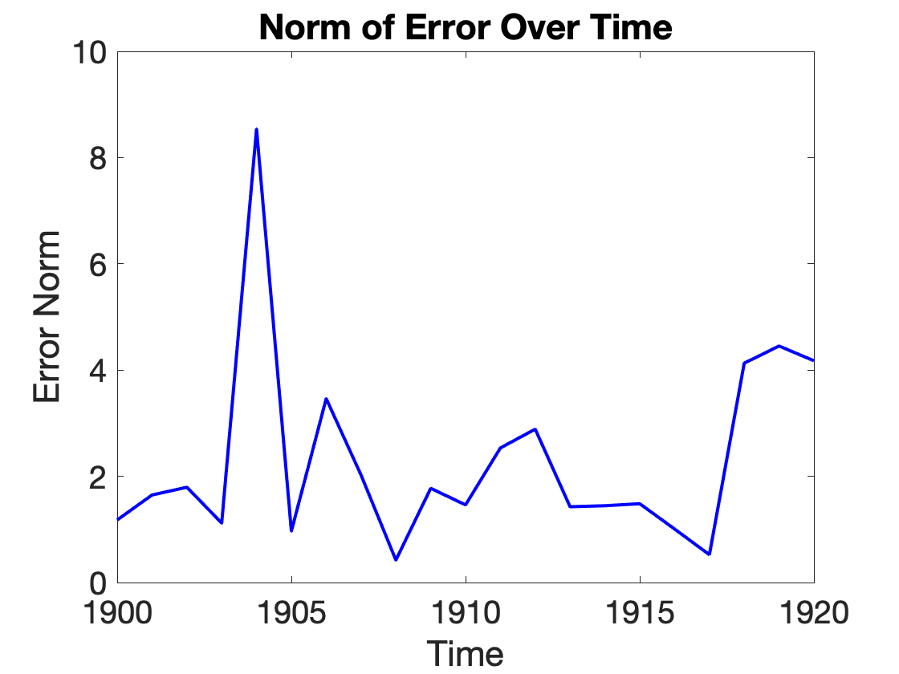
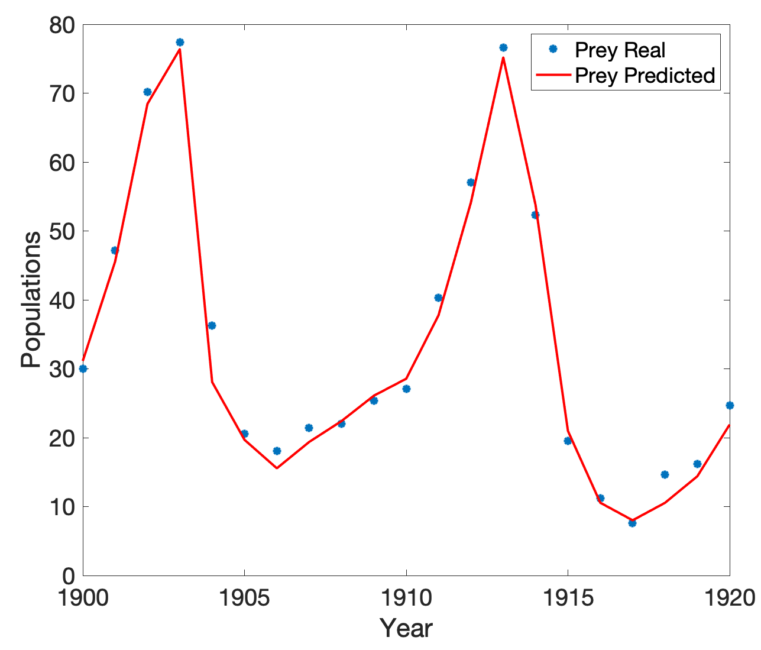
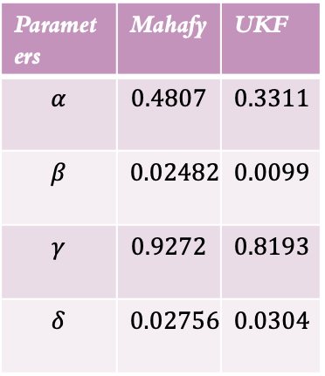
Parameters | Mahafy | UKF
$$α$$ | $$0.4807$$ | $$0.3311$$
$$β$$ | $$0.02482$$ | $$0.0099$$
$$γ$$ | $$0.9272$$ | $$0.8193$$
$$δ$$ | $$0.02756$$ | $$0.0304$$

Slide 5
Prey-Predator model- DRAM

Slide 6
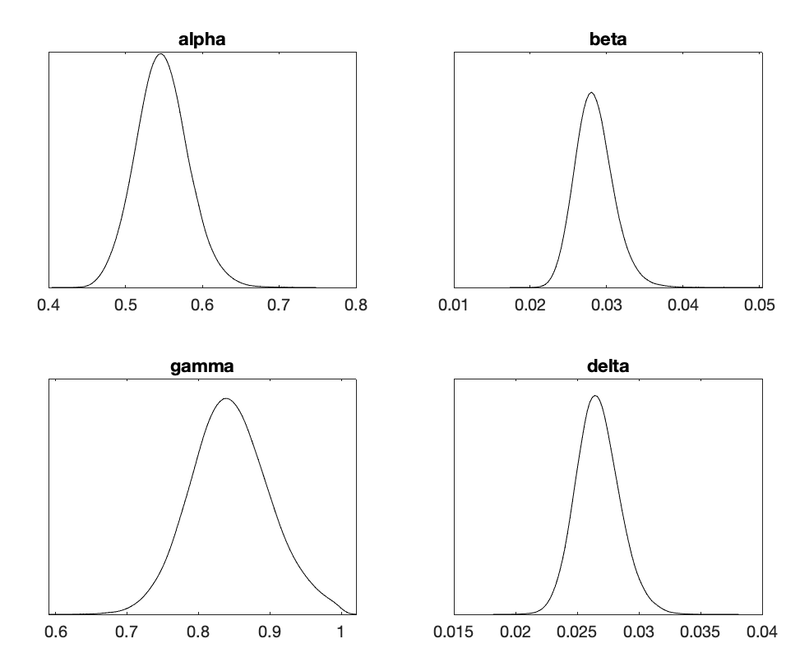
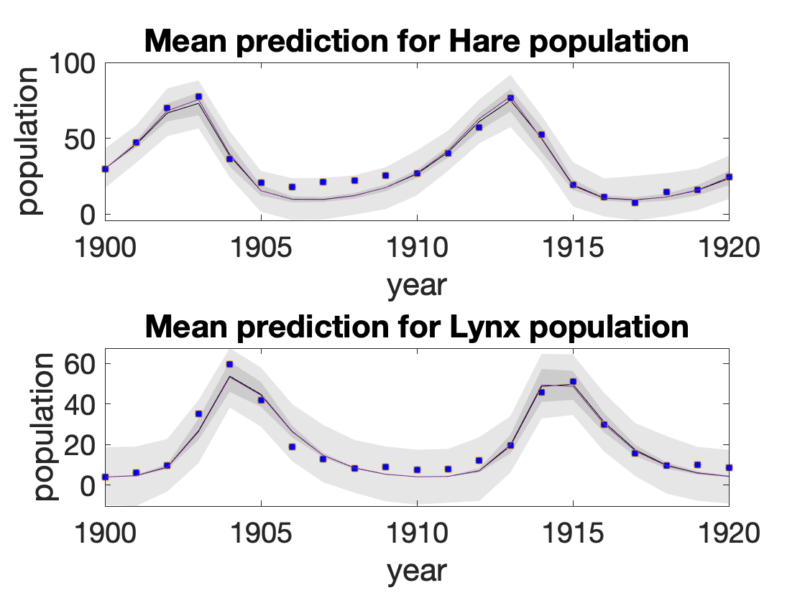
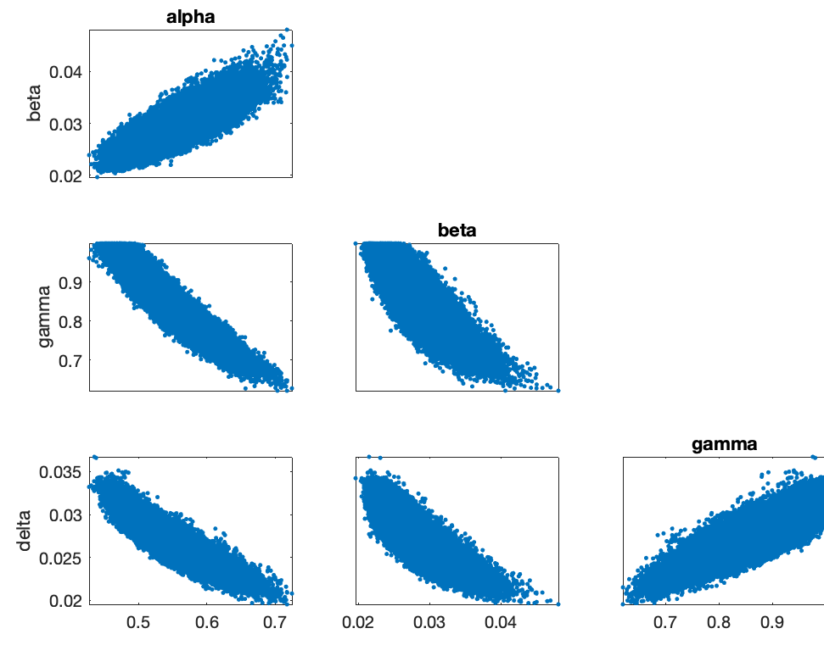
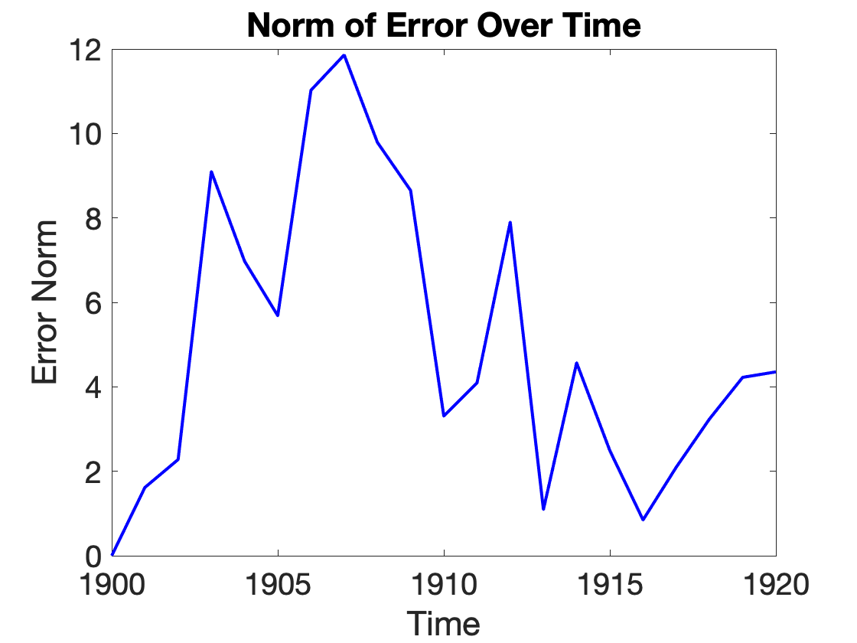
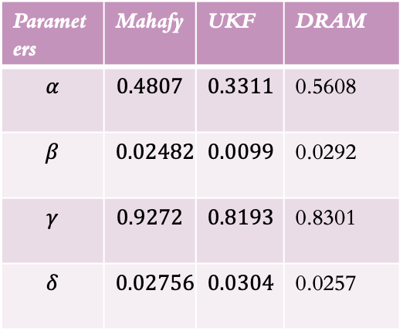
Parameters | Mahafy | UKF | DRAM
$$α$$ | $$0.4807$$ | $$0.3311$$ | 0.5608
$$β$$ | $$0.02482$$ | $$0.0099$$ | 0.0292
$$γ$$ | $$0.9272$$ | $$0.8193$$ | 0.8301
$$δ$$ | $$0.02756$$ | $$0.0304$$ | 0.0257

Slide 7
Prey-Predator model- All methods

Slide 8
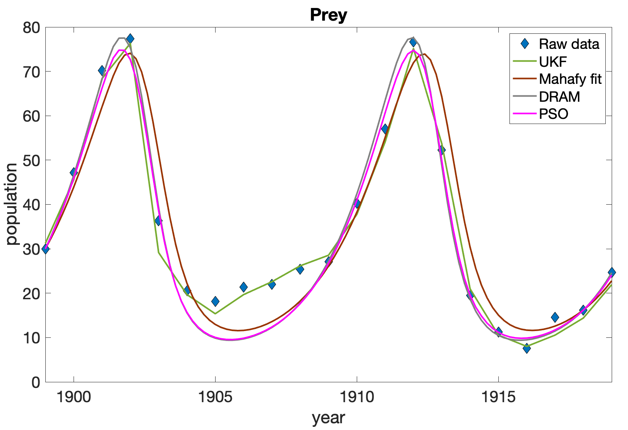
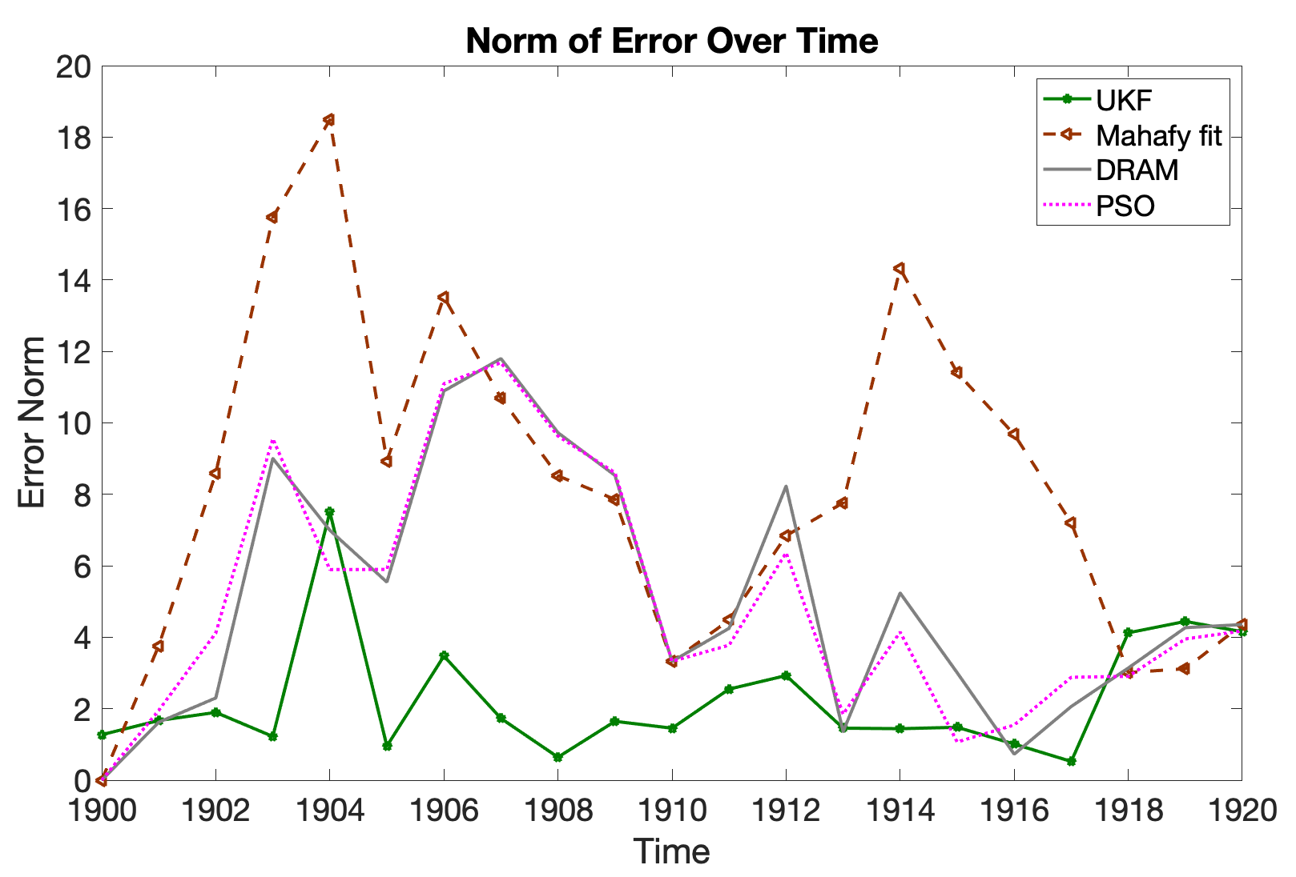
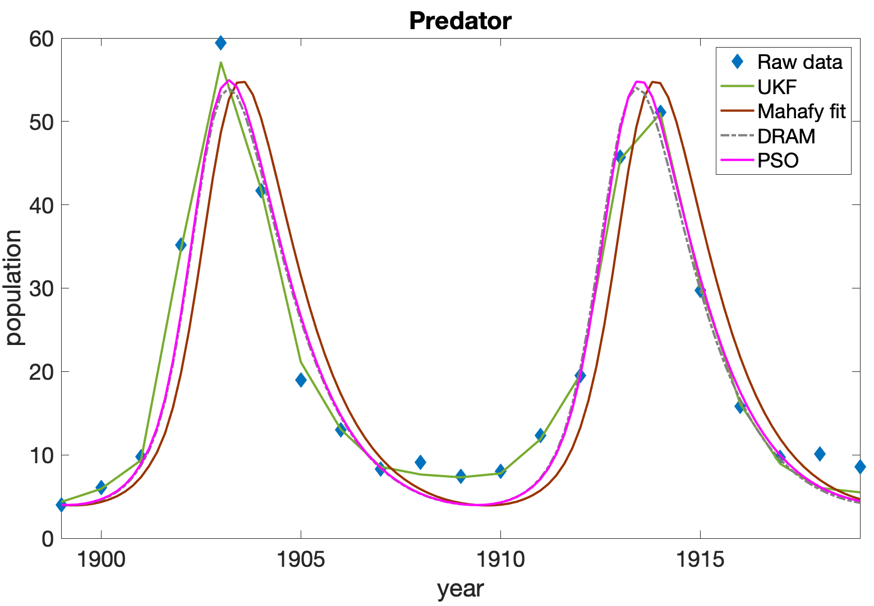
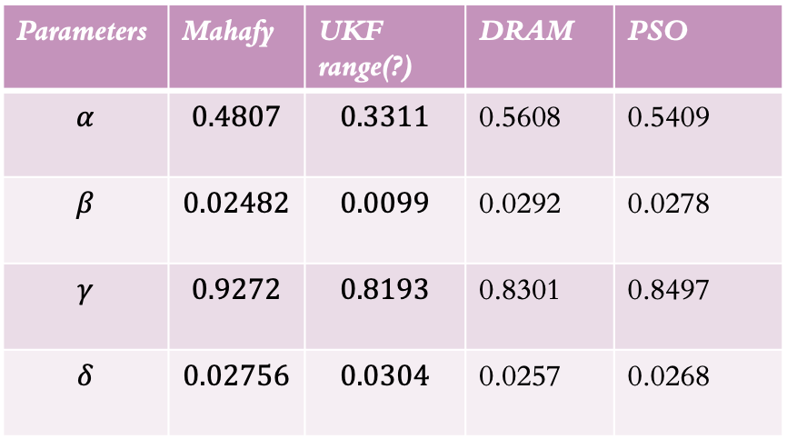
Parameters | Mahafy | UKF range(?) | DRAM | PSO
$$α$$ | $$0.4807$$ | $$0.3311$$ | 0.5608 | 0.5409
$$β$$ | $$0.02482$$ | $$0.0099$$ | 0.0292 | 0.0278
$$γ$$ | $$0.9272$$ | $$0.8193$$ | 0.8301 | 0.8497
$$δ$$ | $$0.02756$$ | $$0.0304$$ | 0.0257 | 0.0268

Slide 9
What has been changed ?
State covariance matrix 0.01 * identity matrix
Measurement error covariance matrix: diagonal matrix whose entries are the initial data
Without fminsearh routine there is no noise in the solution

