Slide 1

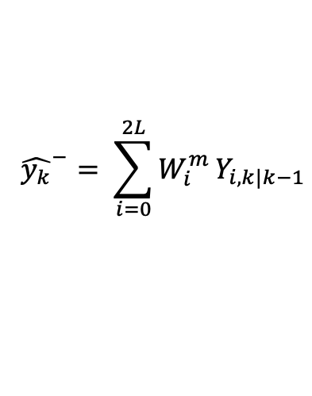



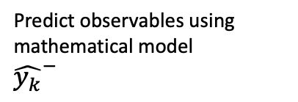
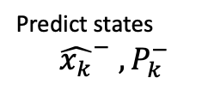
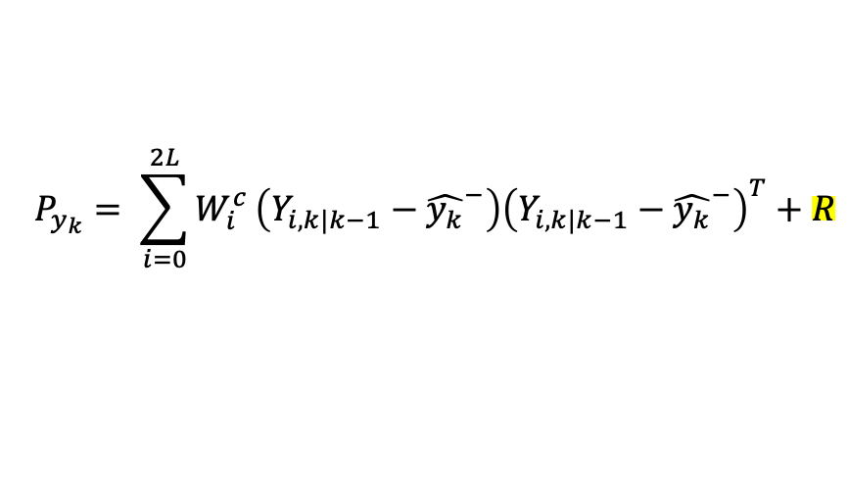
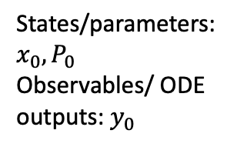

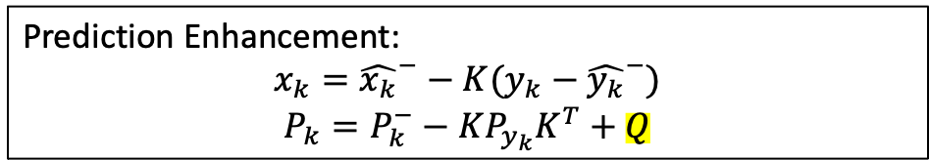

Unscented Kalman Filter
Predict observables using mathematical model
${\hat{y_{k}}}^{−}$
Predict states
$${\hat{x_{k}}}^{−} , P_{k}^{−}$$
$$x_{k−1}, P_{k−1}$$
Initial
Previous state
Sample sigma vectors
Prior estimates
States/parameters: $x_{0}, P_{0}$
Observables/ ODE outputs: $y_{0}$
Prediction Enhancement:
$$x_{k}={\hat{x_{k}}}^{−}−K(y_{k}−{\hat{y_{k}}}^{−})$$
$$P_{k}=P_{k}^{−}−KP_{y_{k}}K^{T}+Q$$
$$Y_{i,k|k−1}=H\left(χ_{i,k|k−1}\right)$$
$${\hat{y_{k}}}^{−}= \sum_{i=0}^{2L}{W_{i}^{m}}Y_{i,k|k−1}$$
$$P_{y_{k}}= \sum_{i=0}^{2L}{W_{i}^{c}}\left(Y_{i,k|k−1}−{\hat{y_{k}}}^{−}\right){\left(Y_{i,k|k−1}−{\hat{y_{k}}}^{−}\right)}^{T}+R$$
New input data $y_{k}$
$$P_{{x_{k},y}_{k}}= \sum_{i=0}^{2L}{W_{i}^{c}}\left(χ_{i,k|k−1}−{\hat{x_{k}}}^{−}\right){\left(Y_{i,k|k−1}−{\hat{y_{k}}}^{−}\right)}^{T}$$
$P_{y_{k}}:$ $error covariance matrix$
$P_{{x_{k}, y}_{k}}$: covariance matrix between states and variables
$K=P_{x_{k}},y_{k}P_{y_{k}}^{−1}$: Kalman gain

Slide 2
Dual UKF | Joint UKF
States and parameters are estimated in parallel. | the parameters and state variables are appended to the state vector to make one large state vector.

Slide 3

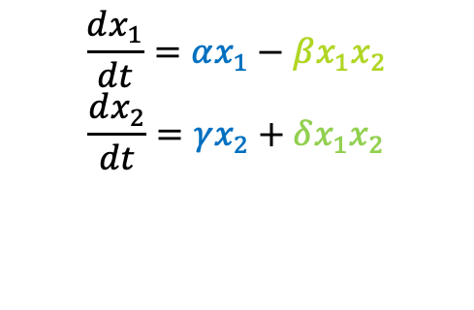

Uncented Kalman filter (UKF)
Example: Predator-Prey (Lotka-Voltera) model
Growth term
Interaction term
Prey population
$$\frac{dx_{1}}{dt}=αx_{1}−βx_{1}x_{2}$$
$$\frac{dx_{2}}{dt}=γx_{2}+δx_{1}x_{2}$$
Estimate parameter values
Mahafy’s dataset
Dual and joint UKF
Mahafy’s estimated parameters:
Predator population
Growth term
Interaction term
$$α=0.4, β=0.018, γ=0.8, δ=0.023$$
Alpha = a_1
Beta = a_2
Gamma = -b_1
delta = B_2

Slide 4
Dual UKF 1 iteration
Current initial guess in the code is not closed to Mahafy’s estimated values:

Slide 5
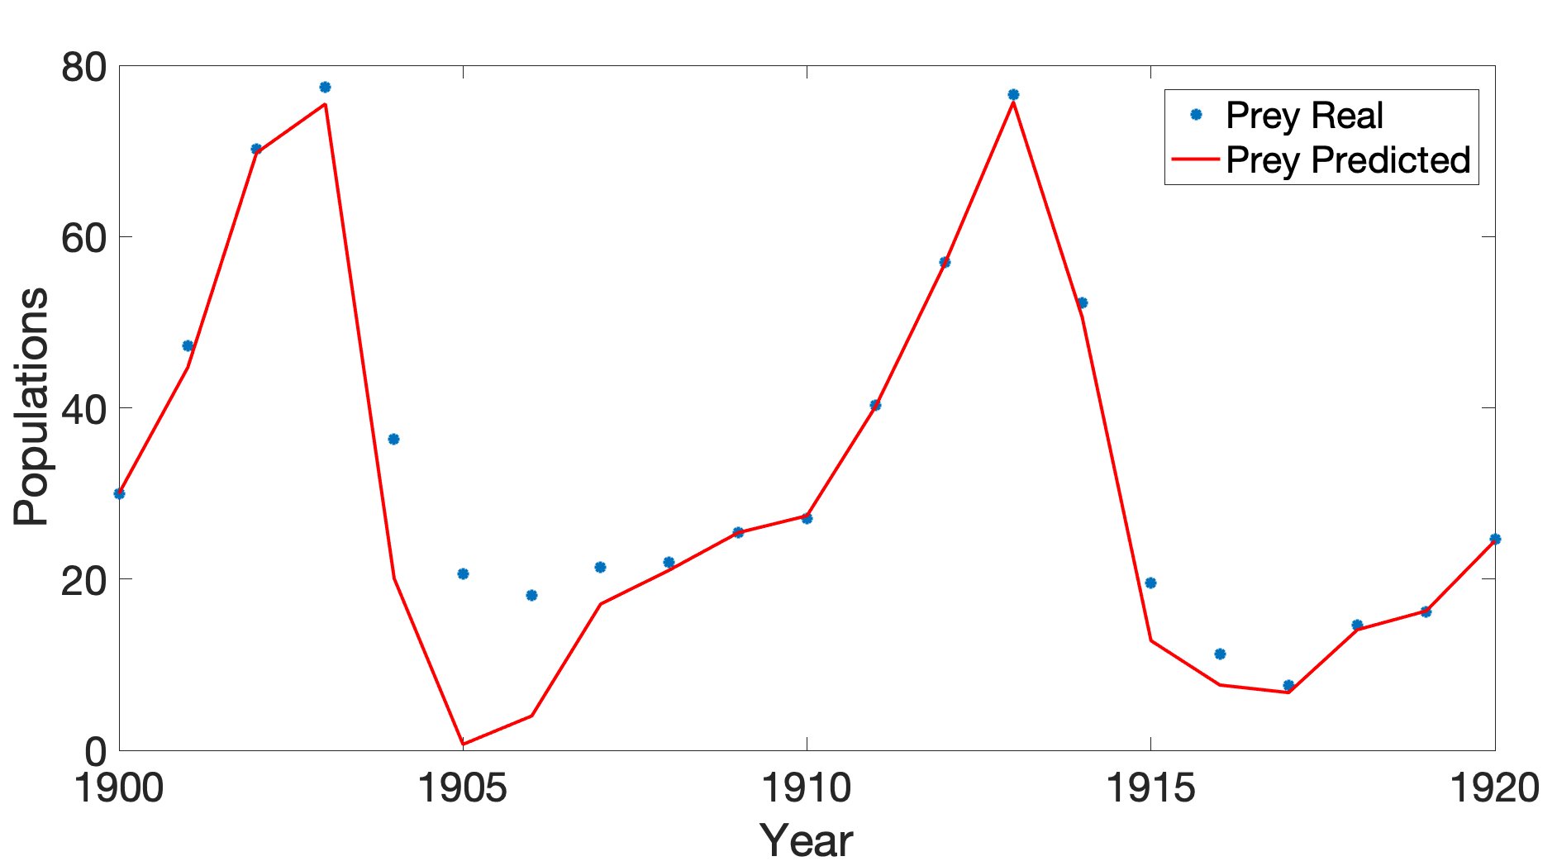
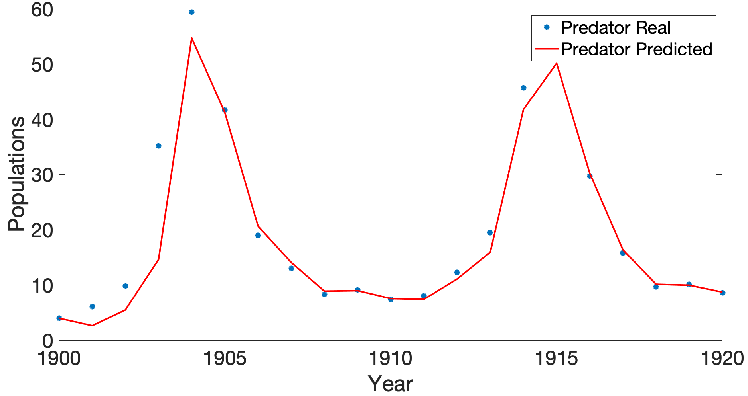
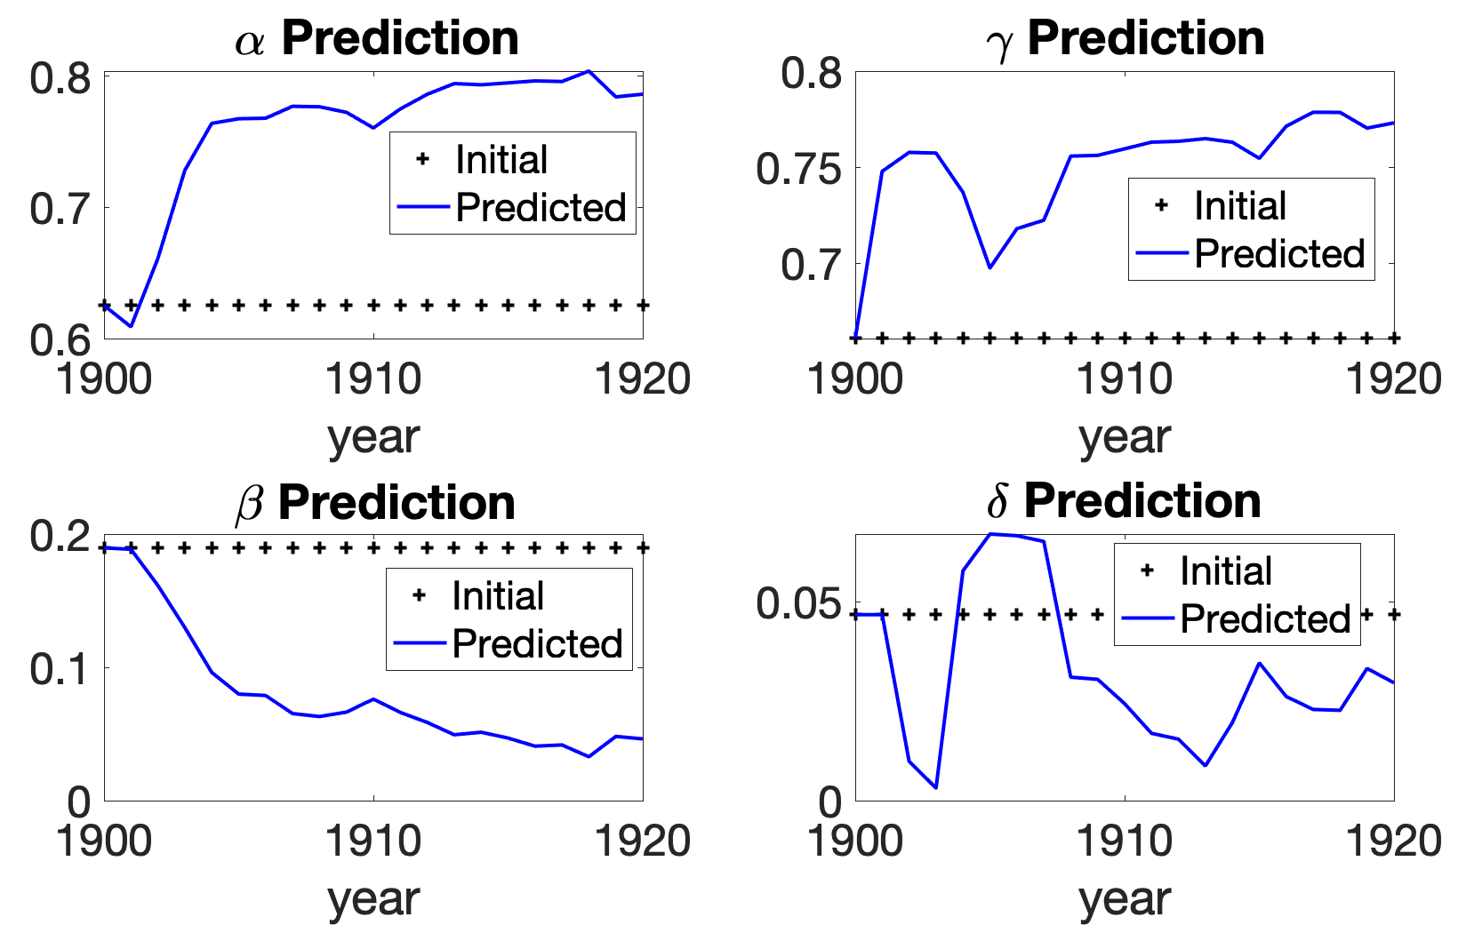
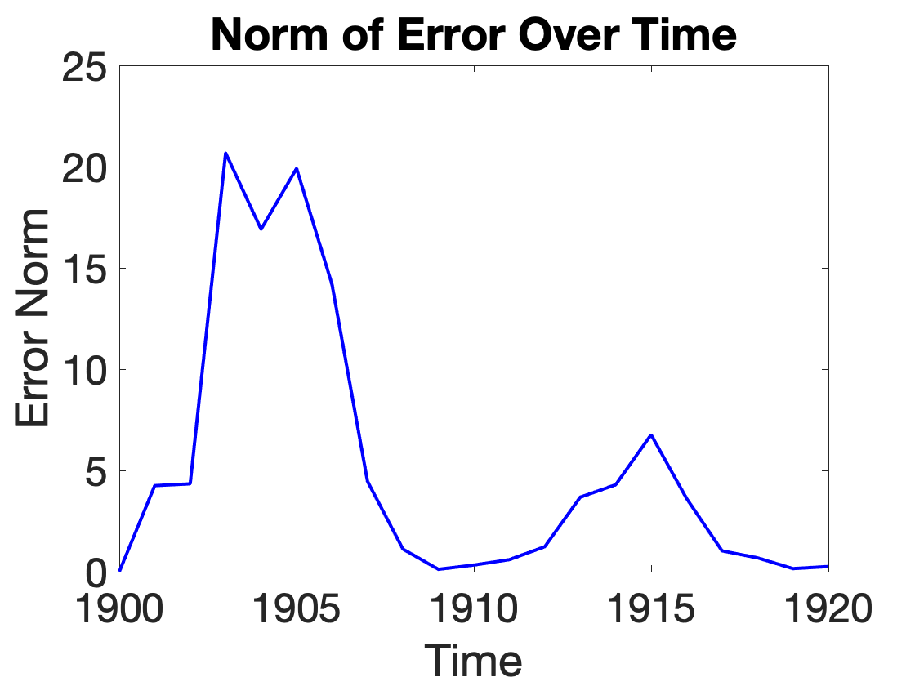
Fitting prey and predator using Mahafy’s data using Kalman filter. Parameter values are updated over each time step. This means their values are time dependent.
(A)
(B)
(C)
(D)
Combine error of both prey and predator

Slide 6
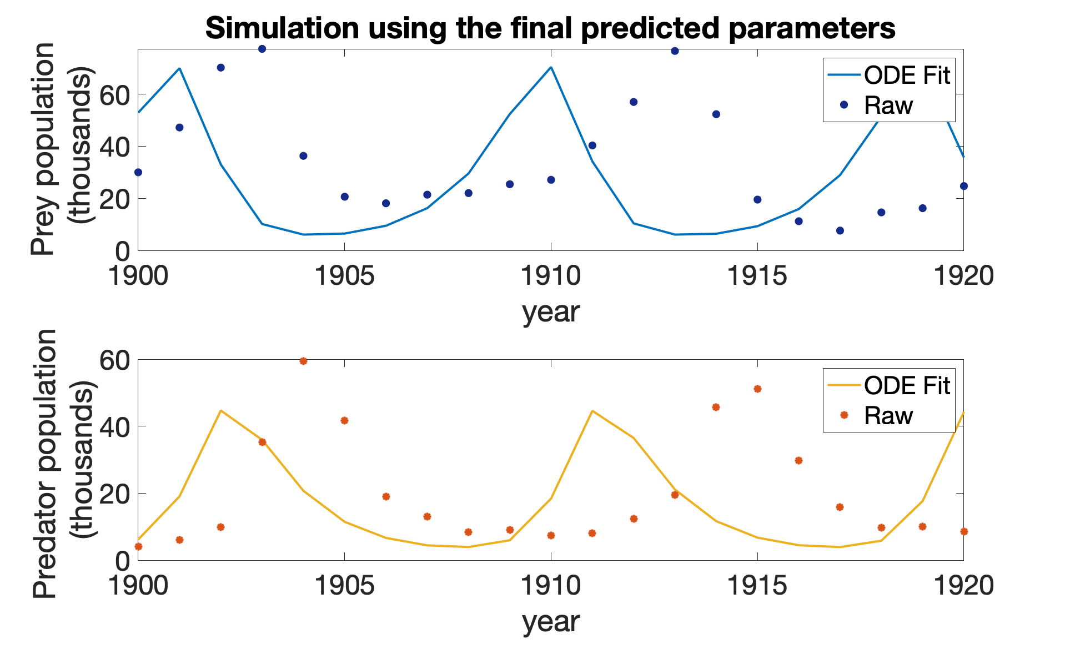
Using the final predicted parameters values to solve the ODE model then plot against data. Simulated data have a shift to the left but overall the trend looks better than the Shtylla’s dataset.

Slide 7
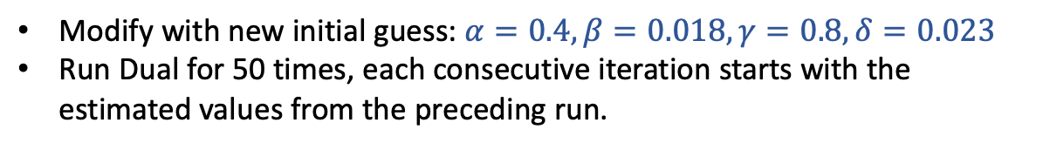
Dual UKF multiple runs
Modify with new initial guess: $α=0.4, β=0.018, γ=0.8, δ=0.023$
Run Dual for 50 times, each consecutive iteration starts with the estimated values from the preceding run.

Slide 8
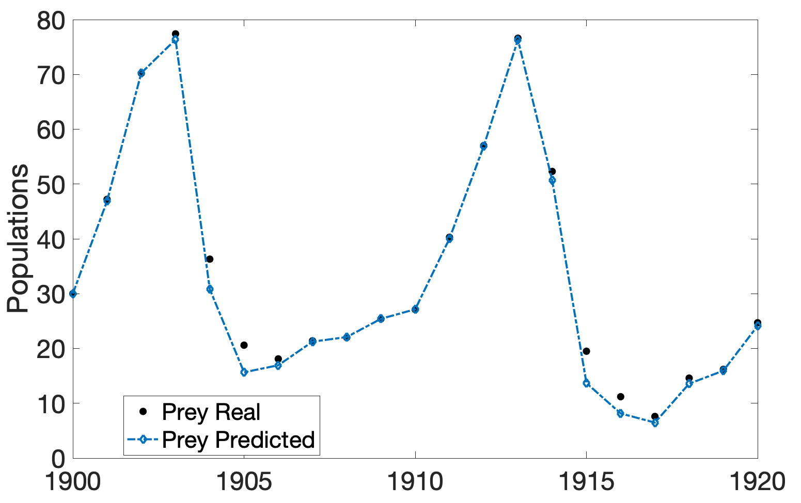
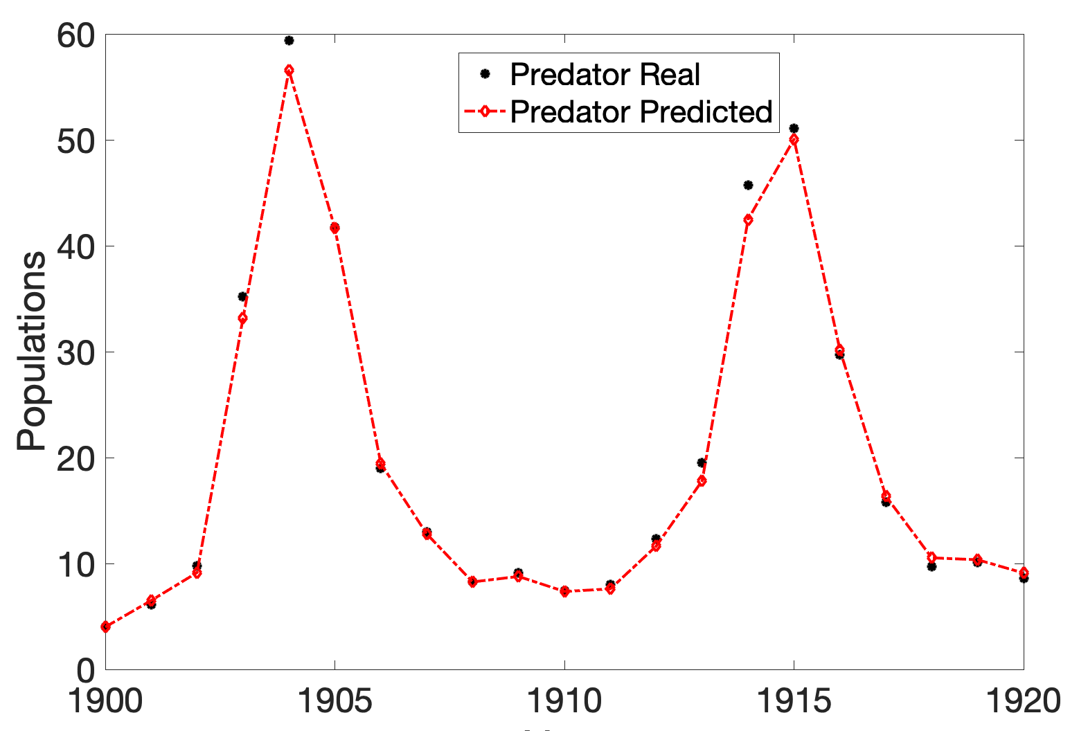
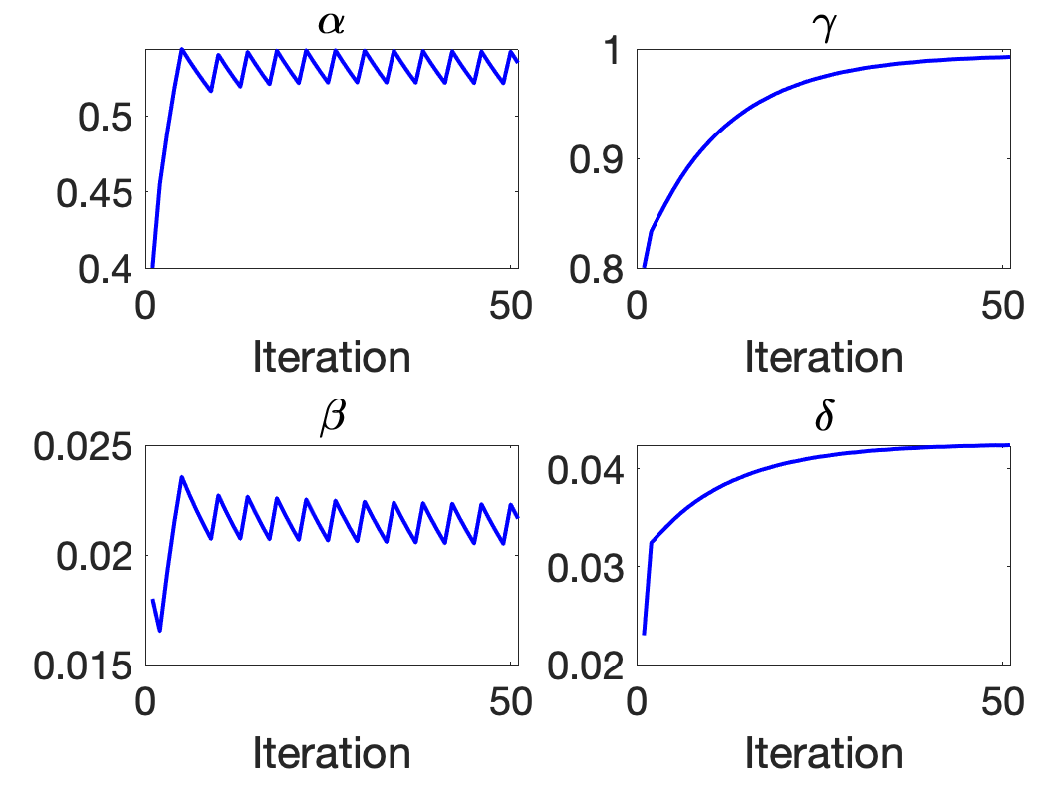
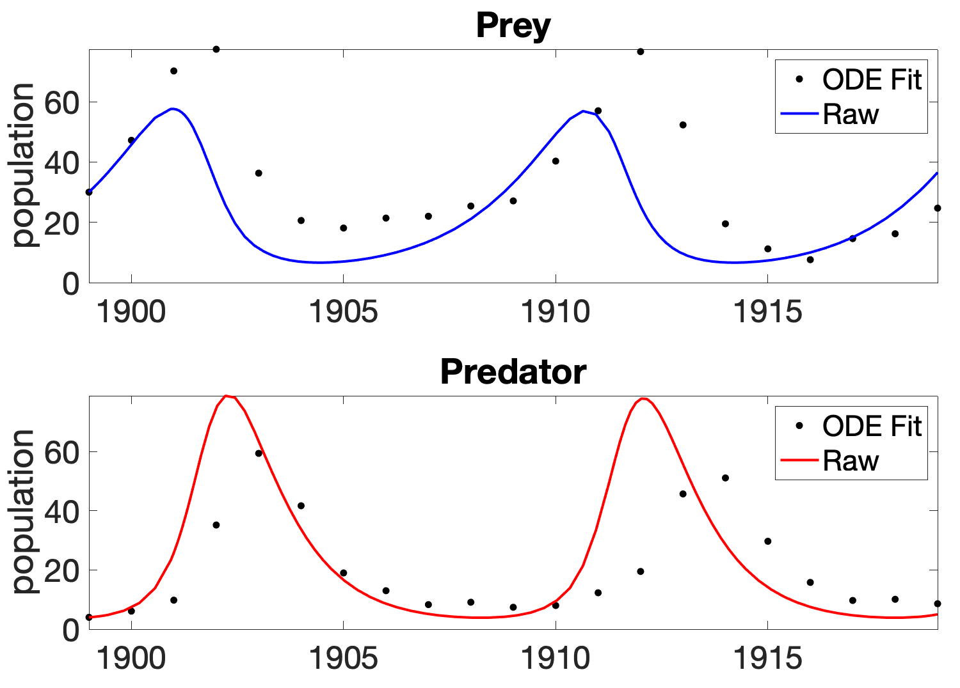
(A)
(B)
(C)
(D)

Slide 9
Joint UKF 1 iteration
Original code from REU students
Initial parameters are not close to Mahafy’s estimated parameters

Slide 10
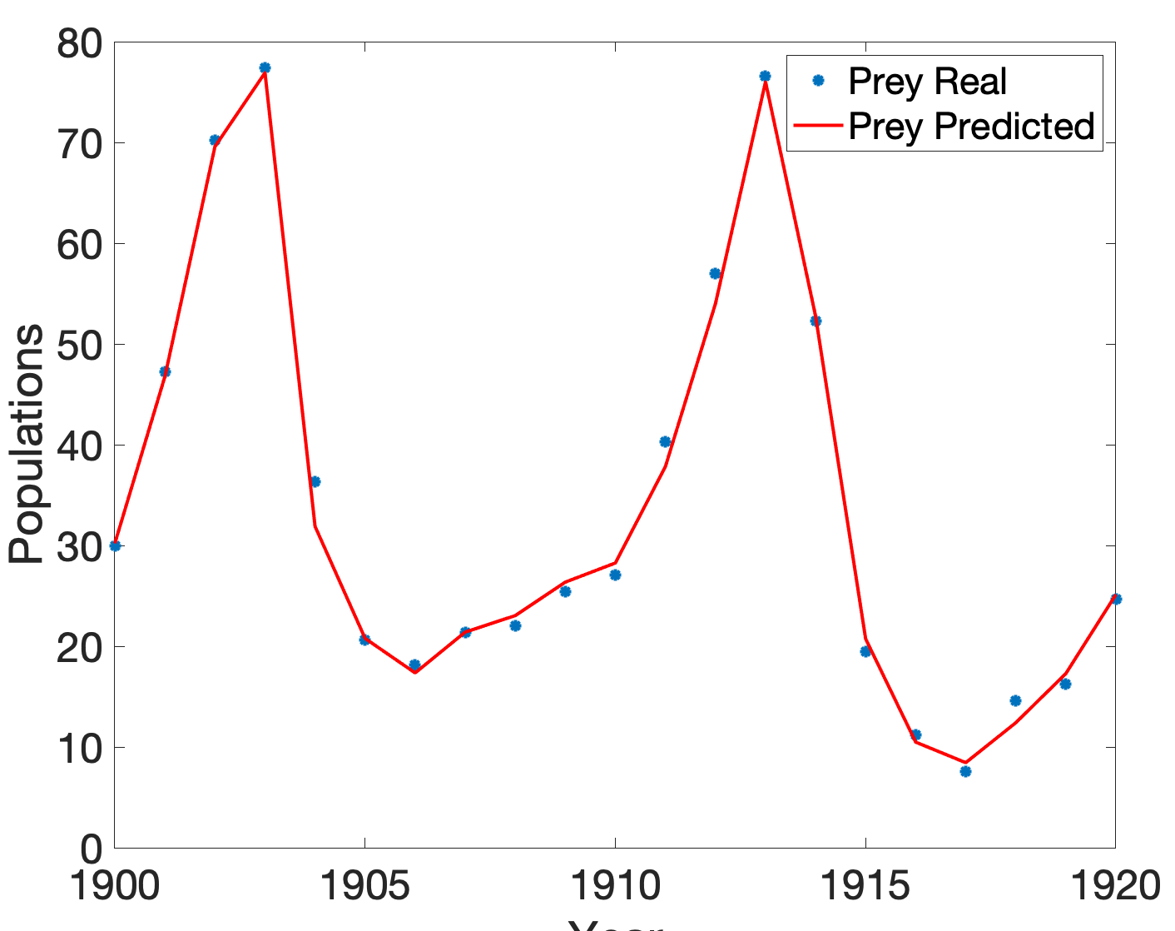
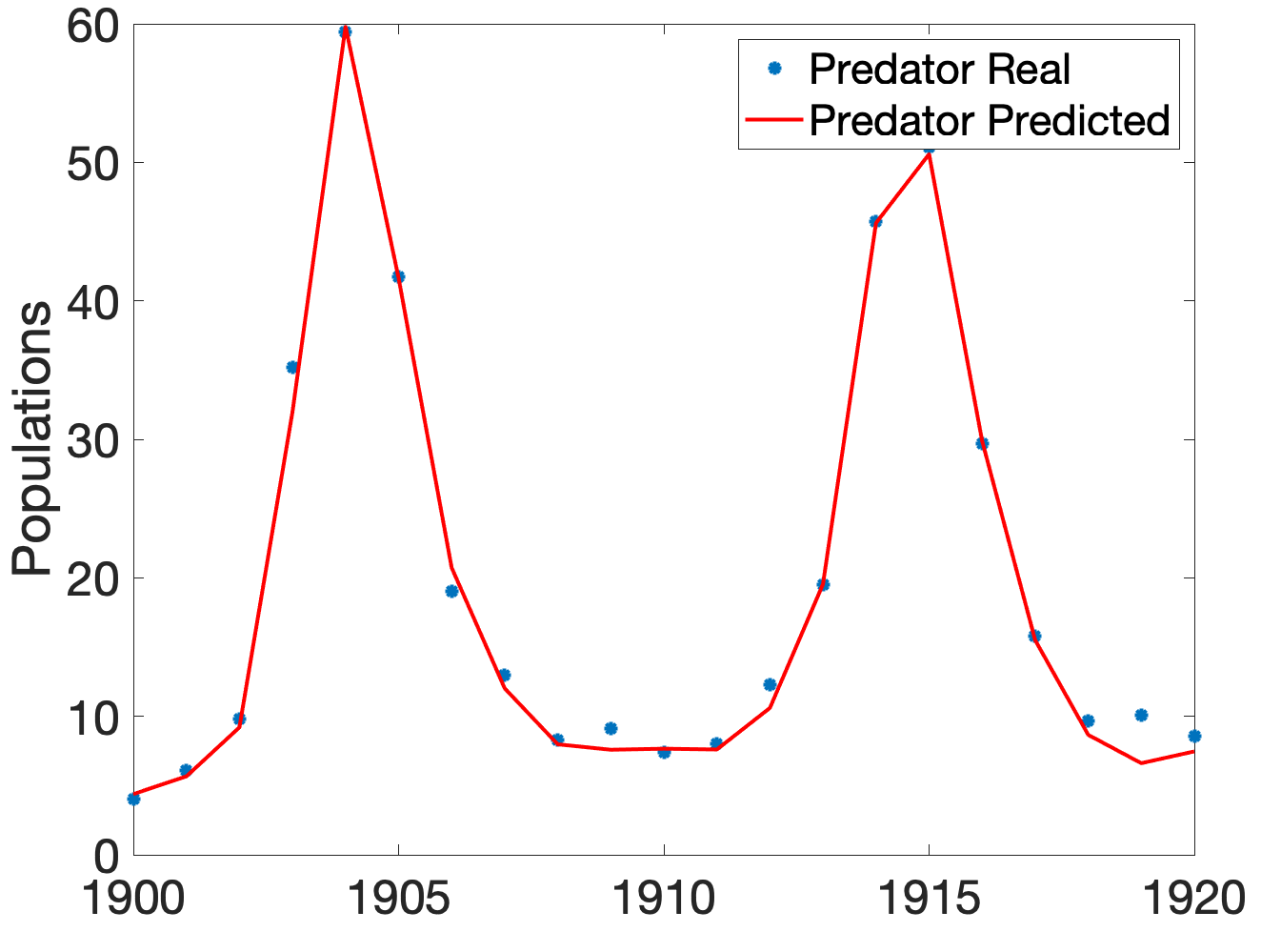
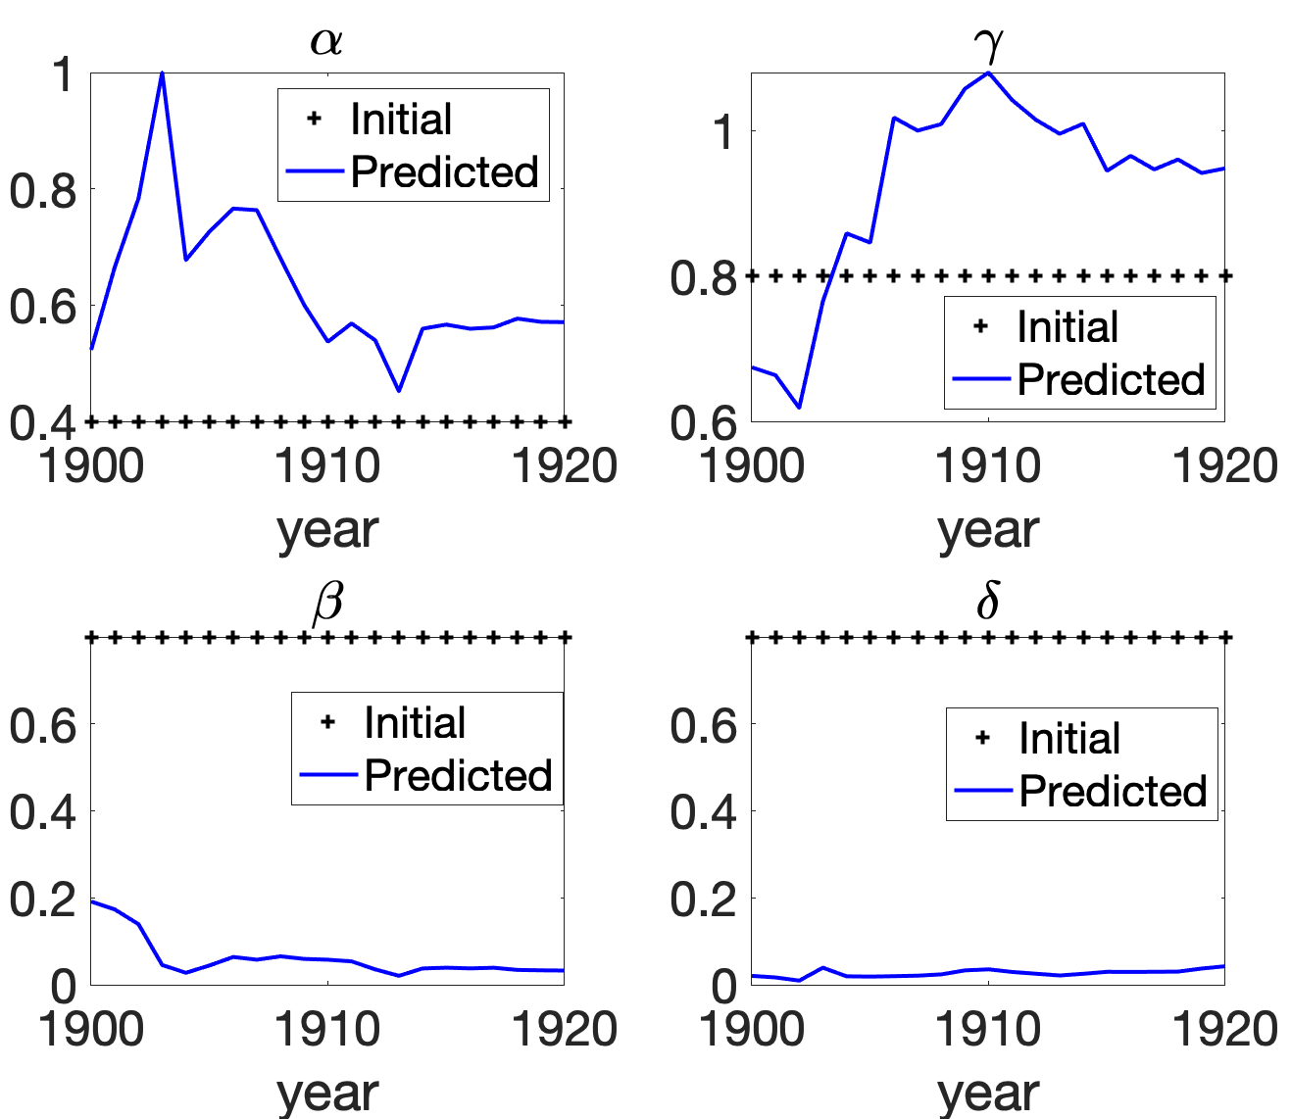
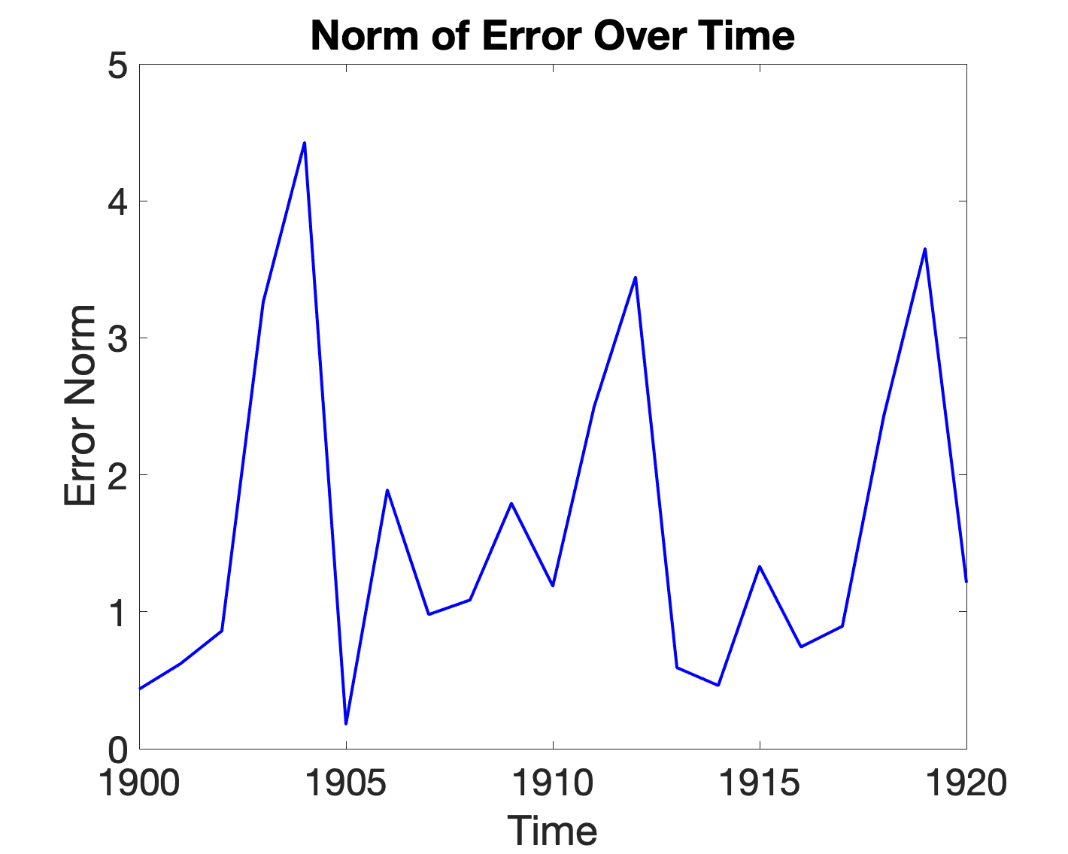

(A)
(B)
(C)
$$α=0.4, β=0.018, γ=0.8, δ=0.023$$
(D)

Slide 11
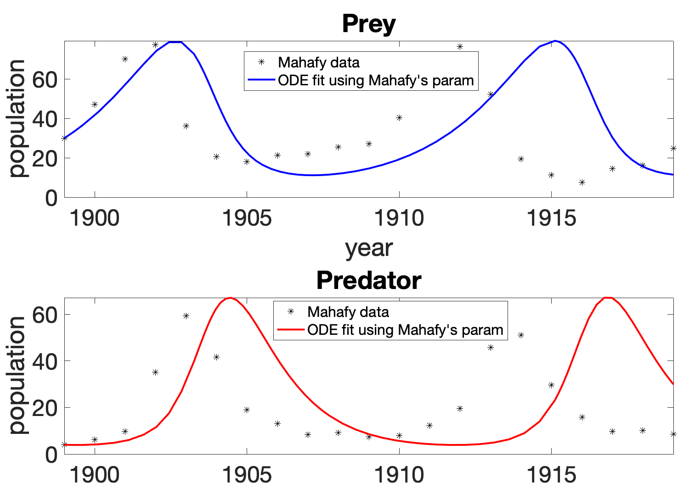
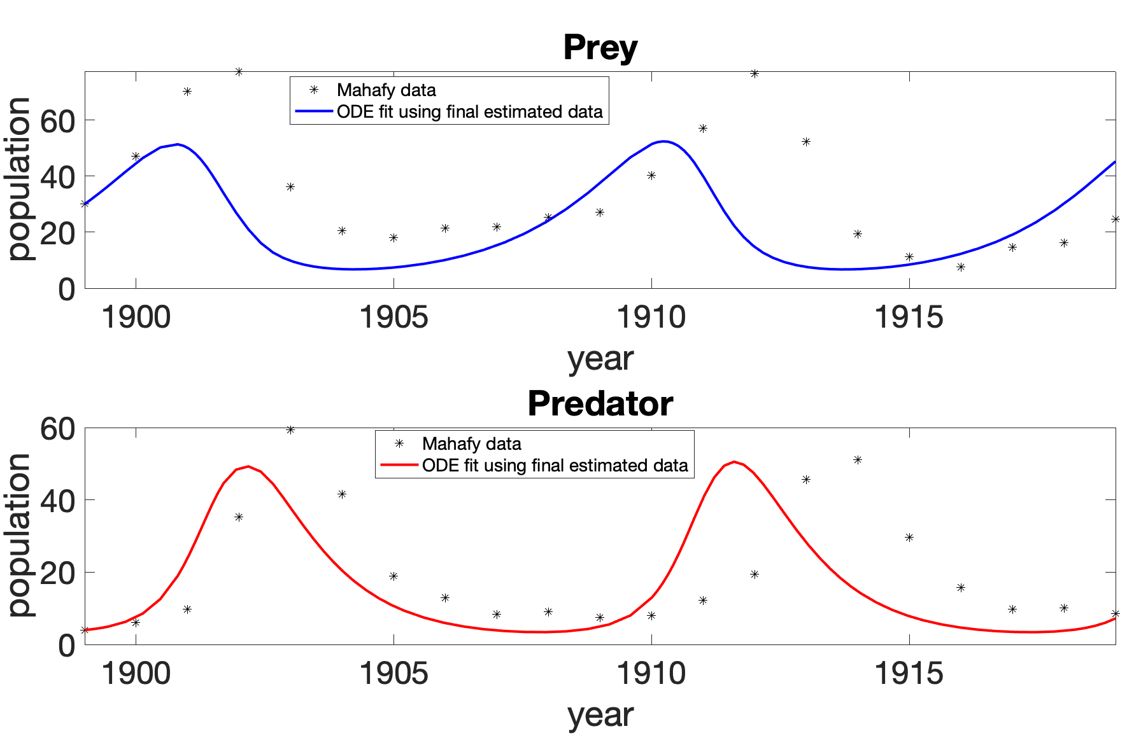
ODE fitting using Mahafy’s estimated parameters
ODE fitting using Joint UKF estimated parameters

Slide 12
Joint UKF 1 iterations
Using Mahafy’s estimated parameters as initial guess

Slide 13
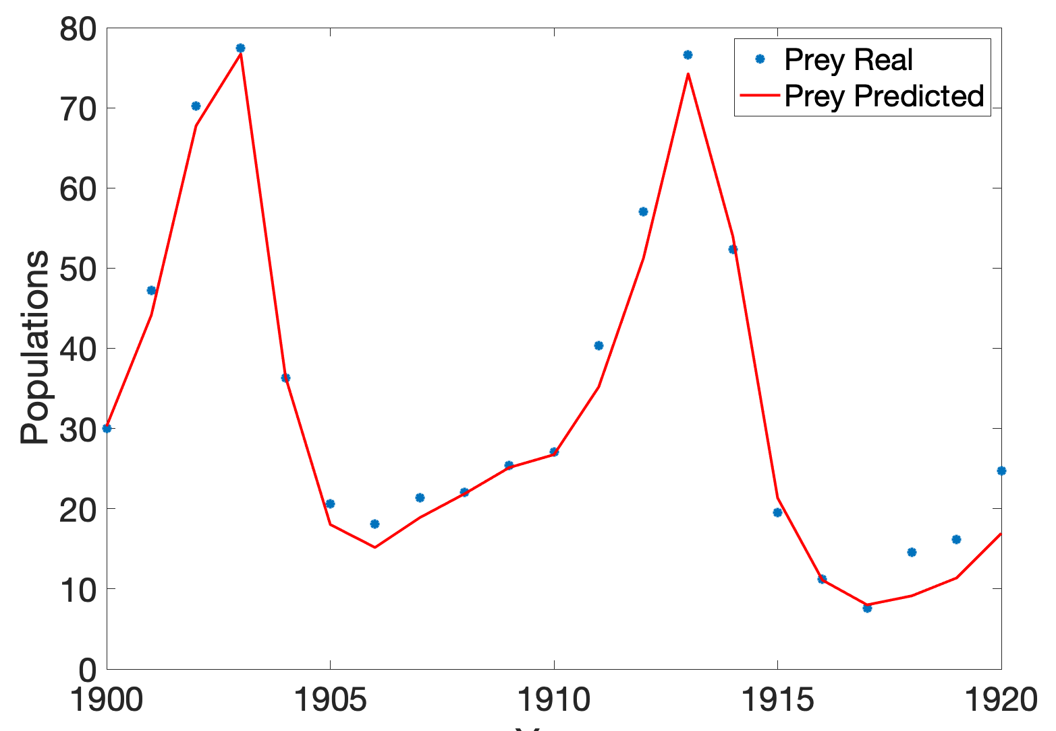
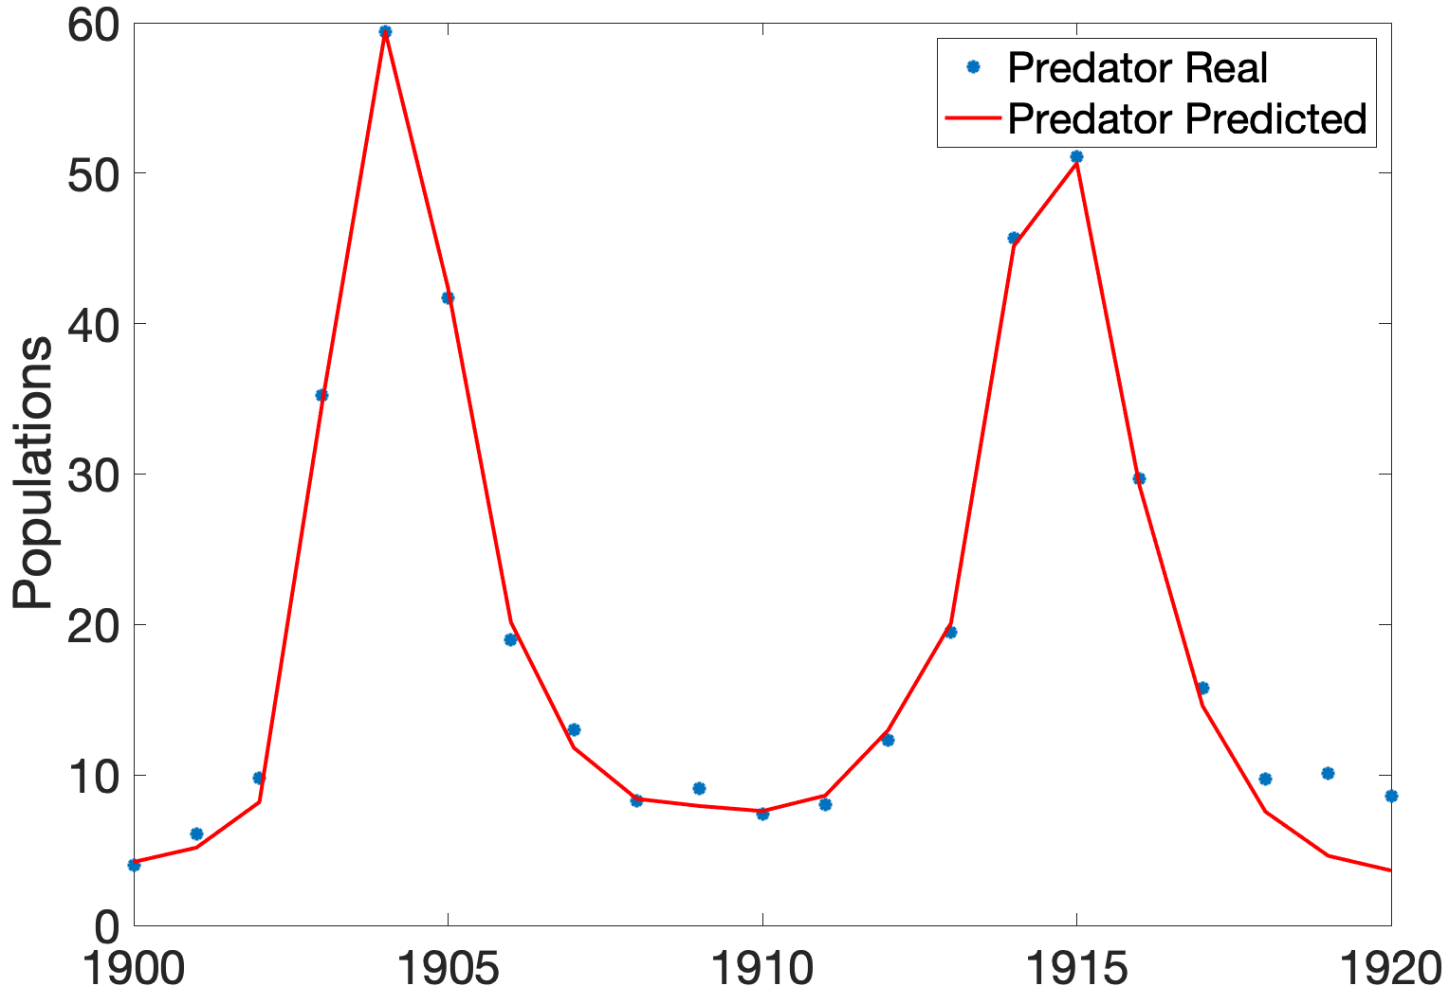
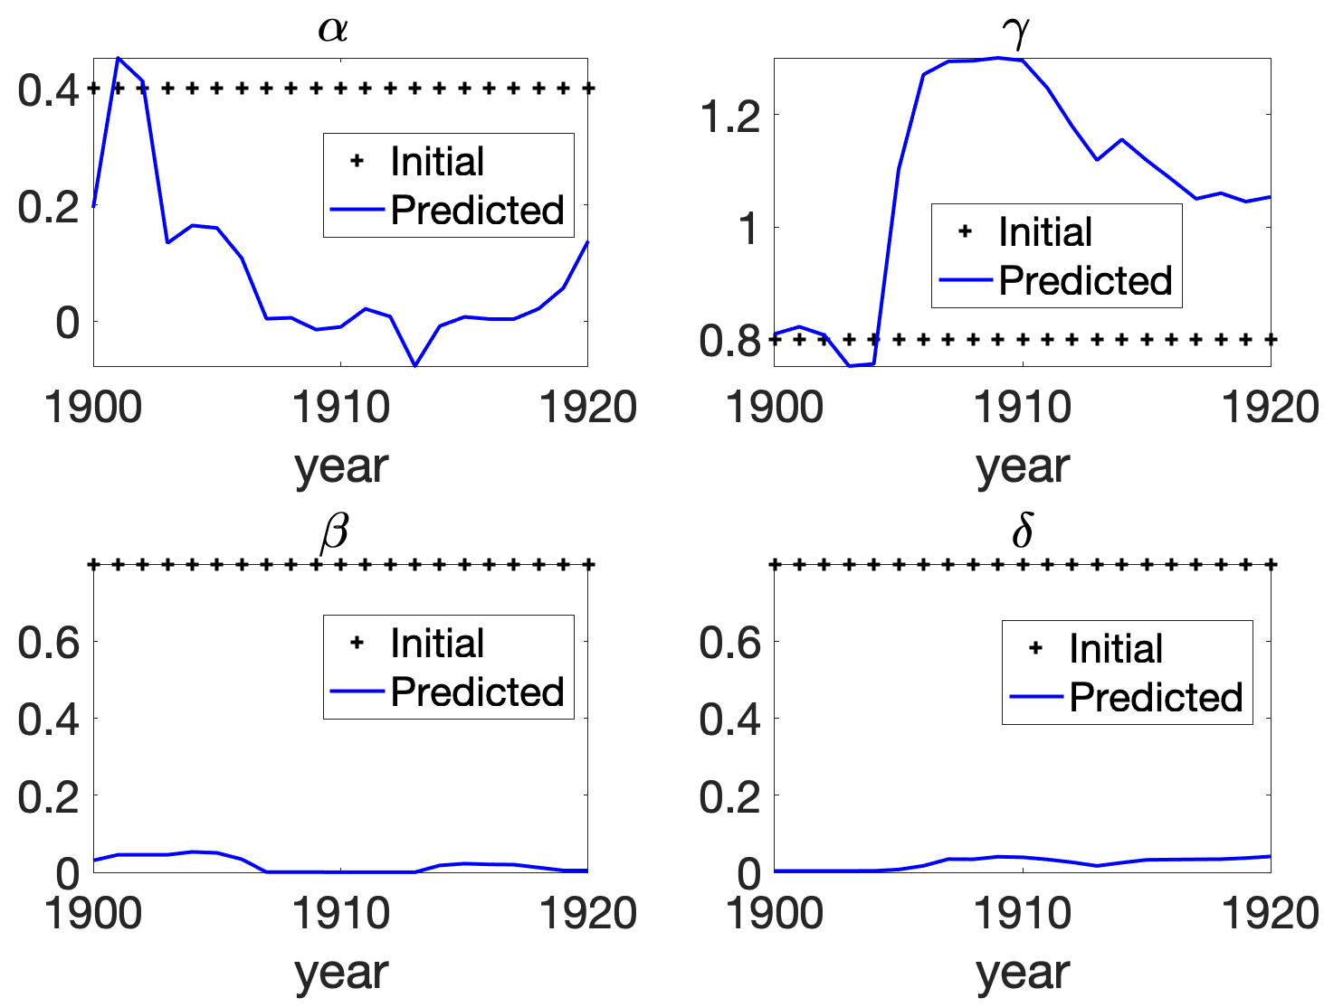
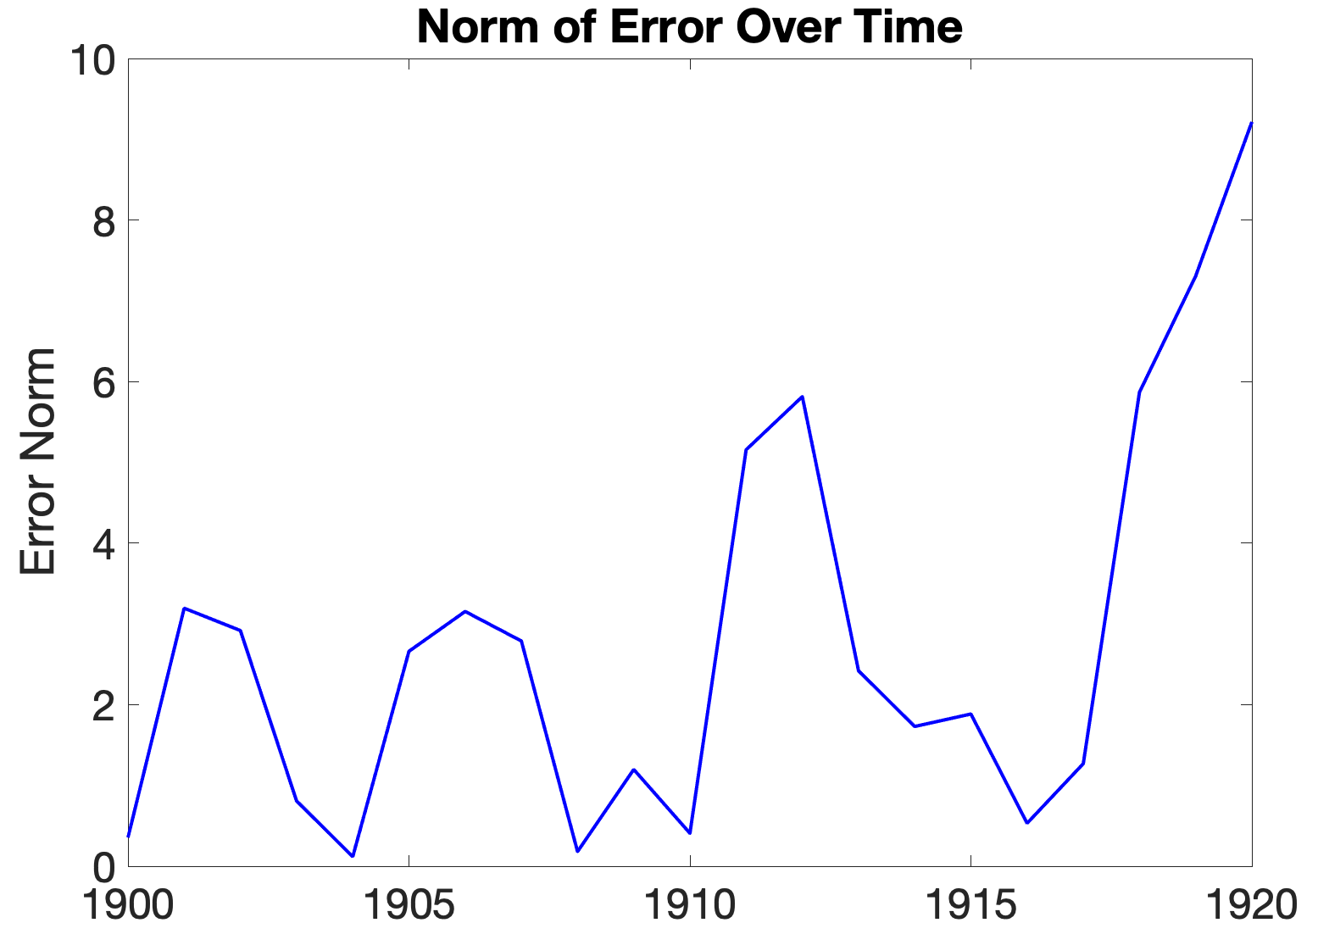

(A)
(B)
(C)
$$α=0.4, β=0.018, γ=0.8, δ=0.023$$
(D)

Slide 14
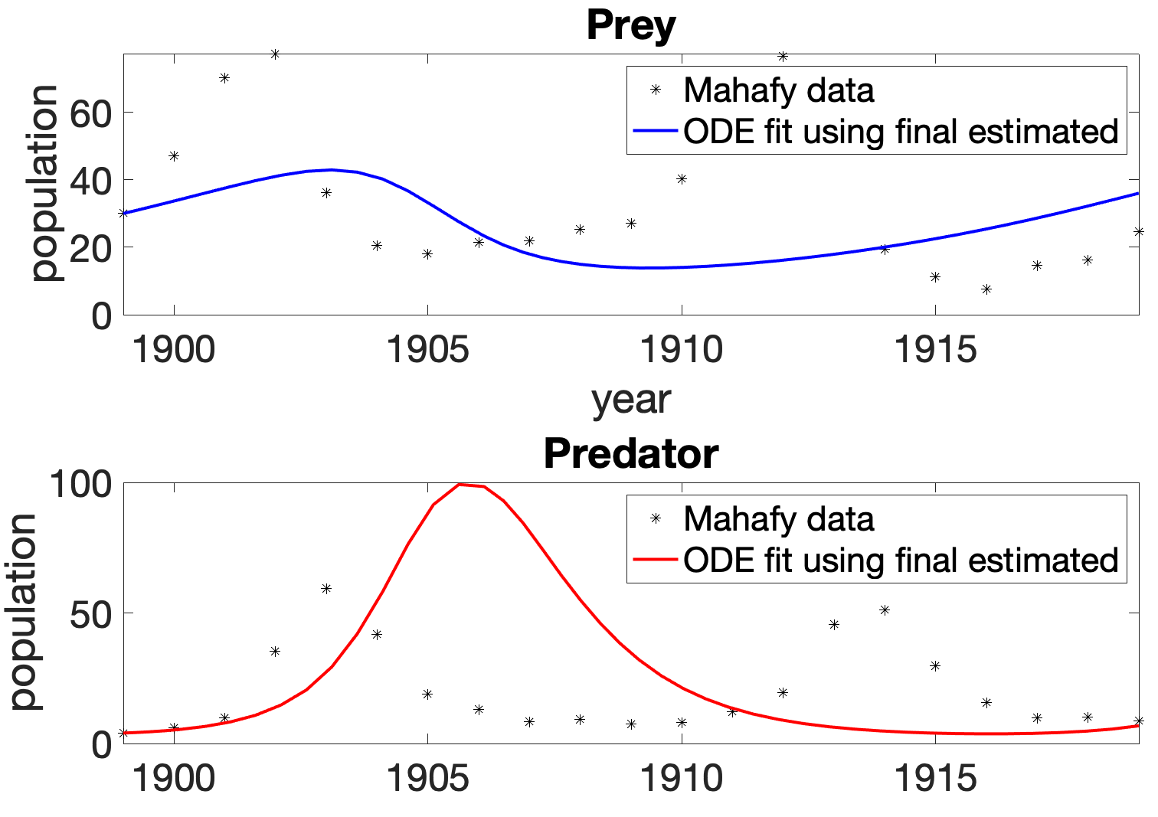
ODE fitting using Mahafy’s estimated parameters
ODE fitting using Joint UKF estimated parameters

Slide 15
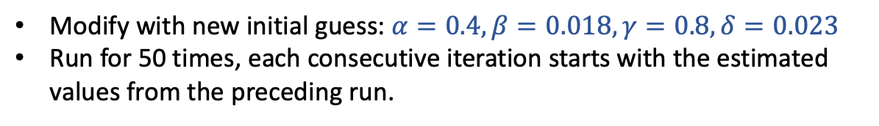
Joint UKF multiple runs
Modify with new initial guess: $α=0.4, β=0.018, γ=0.8, δ=0.023$
Run for 50 times, each consecutive iteration starts with the estimated values from the preceding run.

Slide 16
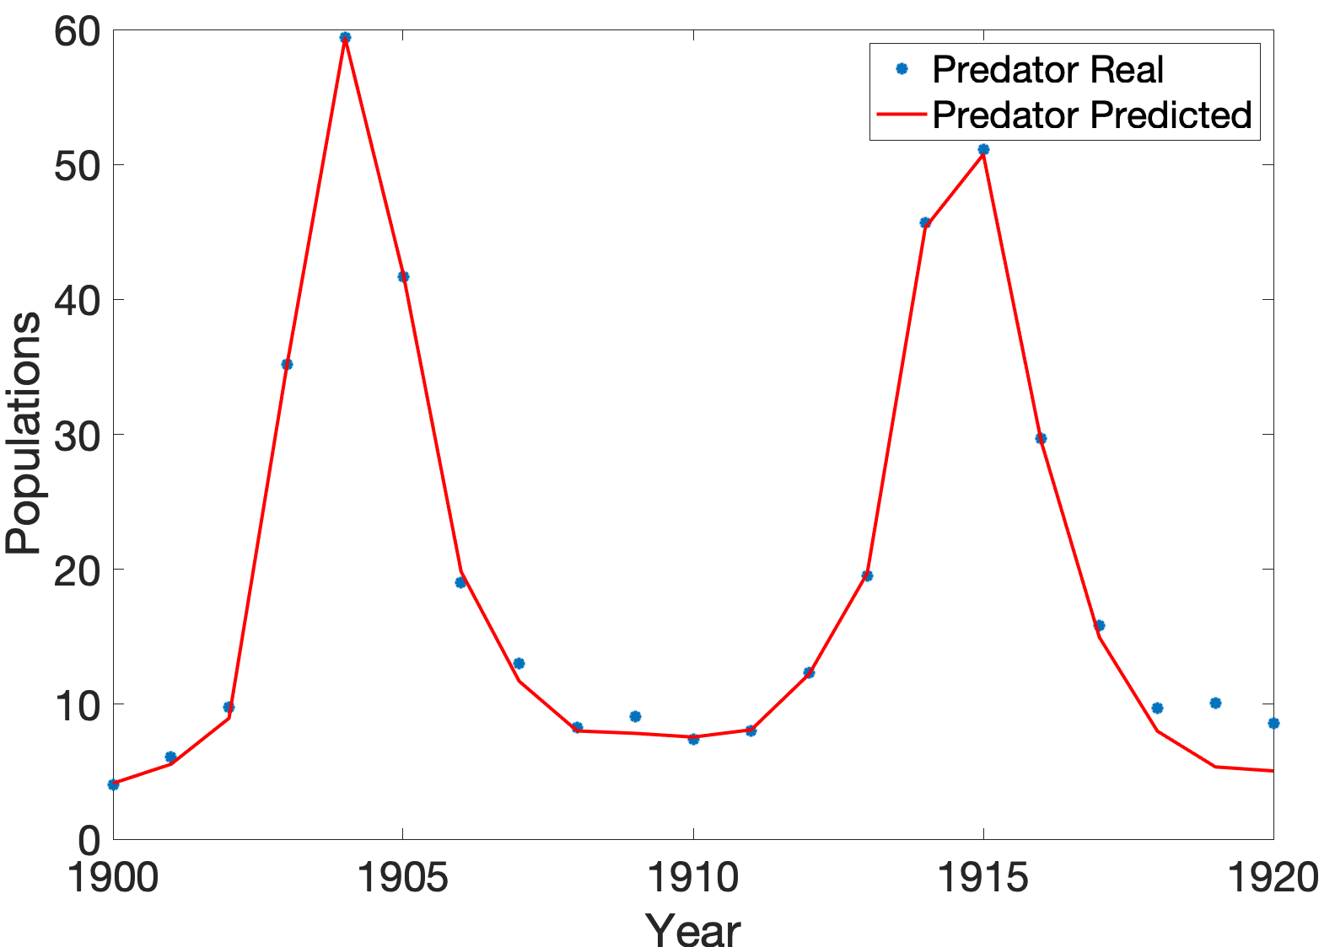
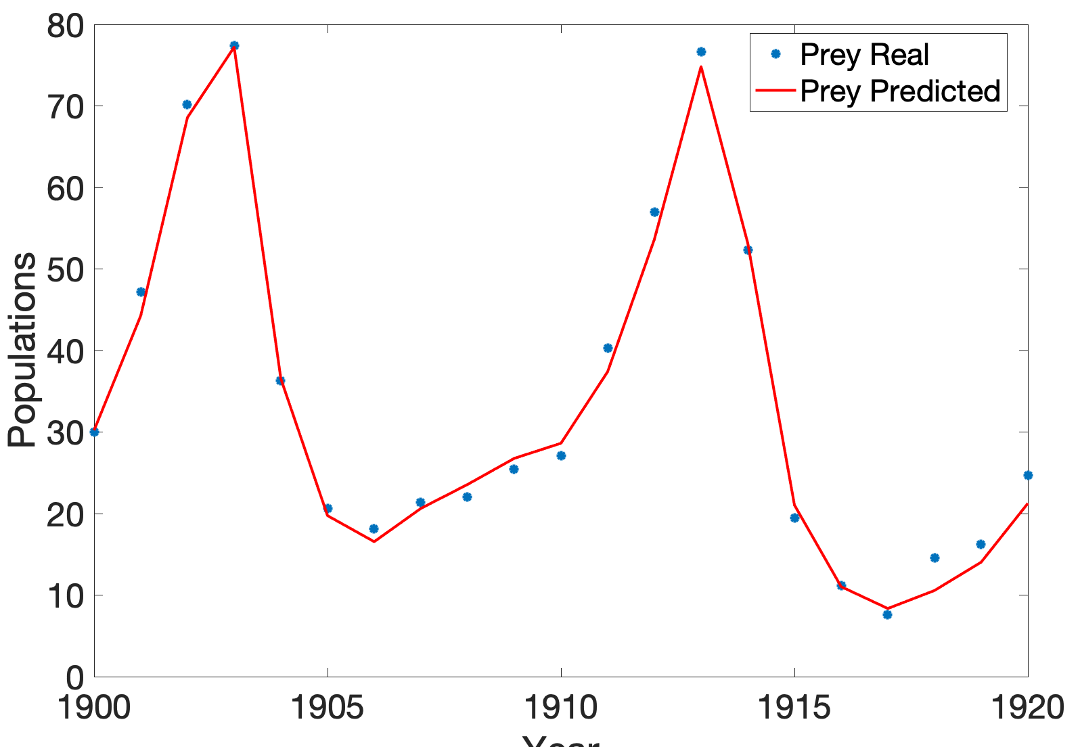
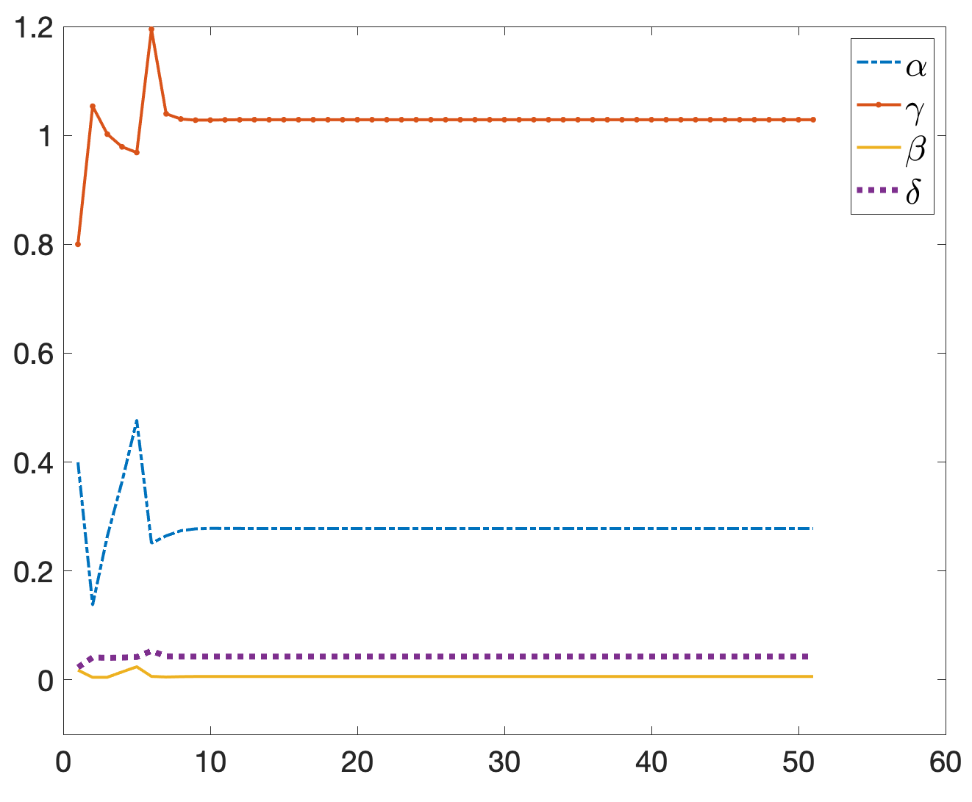
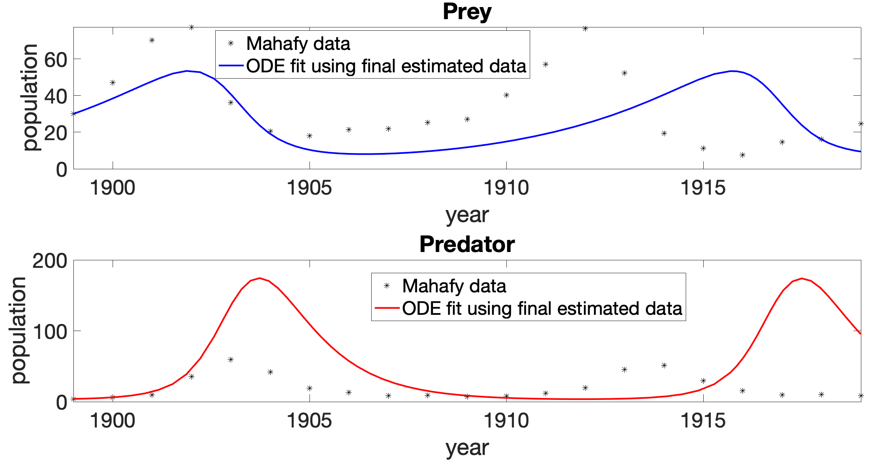
(A)
(B)
(C)
(D)

Slide 18
Terminology | Description
Latent variables | State variables or model parameters, whose data cannot be accessed through any experimental studies. In our case, latent variables are model parameters.
Observables | State variables whose data can be measured, observed over time
Process noise (Q) | describes outside forces and situations which, as a result of their actions, affect states in the model. Assigning too high of variance values to the parameter noise can have severe consequences on the performance of the filter due to an inability for the ODE solver to find adequate solutions. One must be sure to tune these especially closely. Secondly, diagonal matrices seem to work best, with 0’s in the off-diagonal spots.
Measurement (R) noise | Determines how much one should weight the observable values being inputted into the model. Independent from any algorithm Set to the same matrix for both joint and dual UKF
Prior estimate | Predicted state using our knowledge of the system
Posterior estimate | Updated prior estimates with available data
Unscented Transformtation (UT) | is used to understand the distribution of a random variable after a nonlinear transformation has been applied to it. It creates a set of sigma vectors around some initial guess of state variables then transform it through a nonlinear function. Details in next page.
Give an example for each terminology in the context of diabetes in Albers 2007 and prey predator model
At the end of each sentence, give E.g.

Slide 19
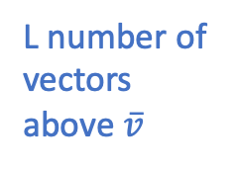
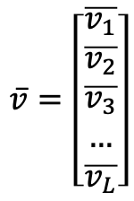
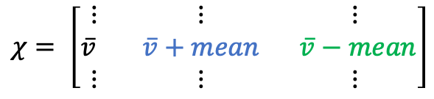
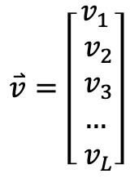
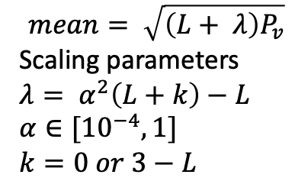
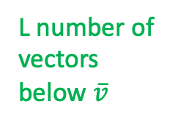
Sigma vector matrix
Random variable $v$ (size $L×1$, where $L$ is the number of state in the system), whose distribution mean is $\overline{v}$ and the covariance $P_{v}$:
$$\overline{v}=\left[\begin{matrix}\overline{v_{1}} \\ \overline{v_{2}} \\ \overline{v_{3}} \\ … \\ \overline{v_{L}}\end{matrix}\right]$$
$$\overset{⃑}{v}=\left[\begin{matrix}v_{1} \\ v_{2} \\ v_{3} \\ … \\ v_{L}\end{matrix}\right]$$
Sigma vector matrix $χ$, whose size is $L×(2L+1)$:
$$χ= \left[\begin{matrix}⋮ & ⋮ & ⋮ \\ \overline{v} & \overline{v}+mean & \overline{v}−mean \\ ⋮ & ⋮ & ⋮\end{matrix}\right]$$
$$mean= \sqrt{\left(L+ λ\right)P_{v}}$$
Scaling parameters
$λ= α^{2}\left(L+k\right)−L$
$α∈[{10}^{−4},1]$
$k=0 or 3−L$
L number of vectors above $\overline{v}$
L number of vectors below $\overline{v}$

Slide 20
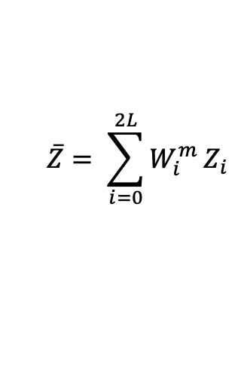
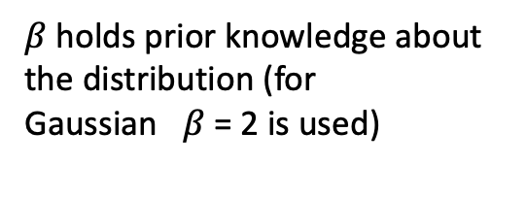
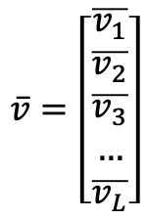
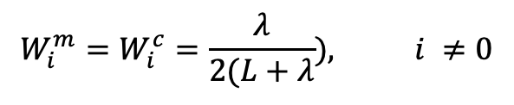
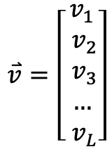

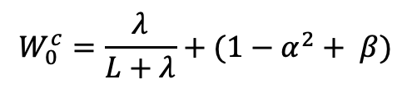
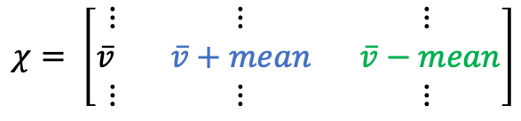
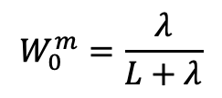
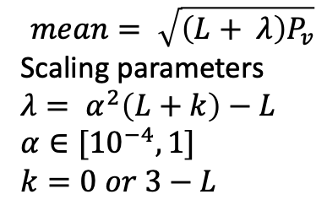
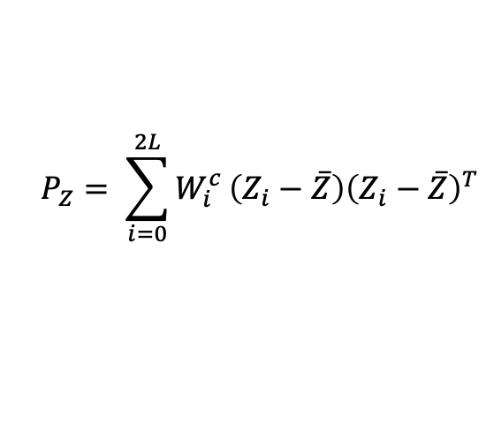
Transformed sigma vector matrix
$$mean= \sqrt{\left(L+ λ\right)P_{v}}$$
Scaling parameters
$λ= α^{2}\left(L+k\right)−L$
$α∈[{10}^{−4},1]$
$k=0 or 3−L$
Once assembling a sigma vector matrix
$$\overset{⃑}{v}=\left[\begin{matrix}v_{1} \\ v_{2} \\ v_{3} \\ … \\ v_{L}\end{matrix}\right]$$
$$\overline{v}=\left[\begin{matrix}\overline{v_{1}} \\ \overline{v_{2}} \\ \overline{v_{3}} \\ … \\ \overline{v_{L}}\end{matrix}\right]$$
$$χ= \left[\begin{matrix}⋮ & ⋮ & ⋮ \\ \overline{v} & \overline{v}+mean & \overline{v}−mean \\ ⋮ & ⋮ & ⋮\end{matrix}\right]$$
Transform them through a nonlinear function to obtain:
$$Z=f(χ)$$
Goal: to identify the mean and covariance matrix of $Z$
$$W_{0}^{m}=\frac{λ}{L+λ}$$
$$\overline{Z}= \sum_{i=0}^{2L}{W_{i}^{m}}Z_{i}$$
$$W_{0}^{c}=\frac{λ}{L+λ}+(1−α^{2}+ β)$$
$β$holds prior knowledge about the distribution (for Gaussian $β$= 2 is used)
$$P_{Z}= \sum_{i=0}^{2L}{W_{i}^{c}}\left(Z_{i}−\overline{Z}\right){\left(Z_{i}−\overline{Z}\right)}^{T}$$
$$W_{i}^{m}=W_{i}^{c}=\frac{λ}{2(L+λ}), i ≠0$$

