Slide 1
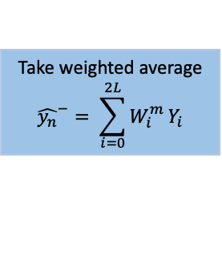
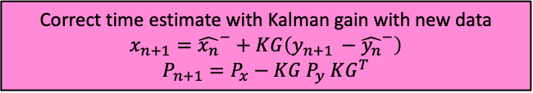

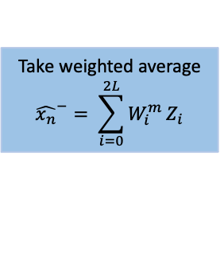




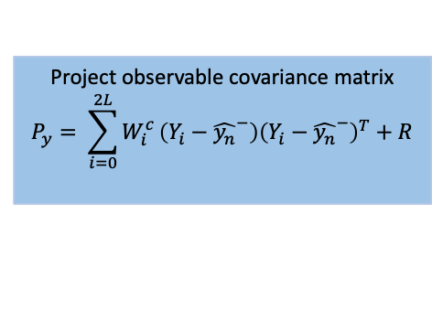
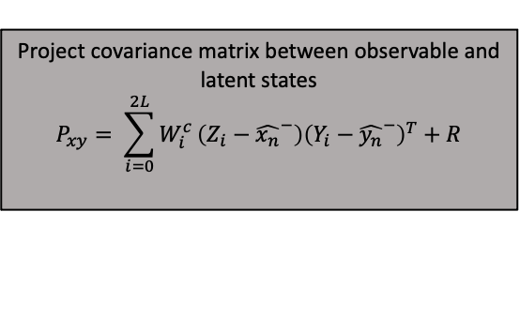

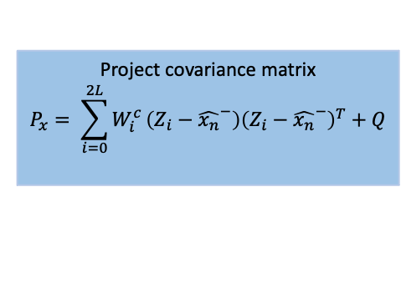
Sample sigma vectors $χ$
Dynamical system $F$
Current
Time update via dynamical model
$$Z_{i}=F\left(χ_{i}\right)$$
Extract observable state variables
$$Y_{i}=H\left(Z_{i}\right)$$
$x_{n}:$ state variables and parameters at time n
$P_{n}:covariance matrix at time n$
Take weighted average
$${\hat{x_{n}}}^{−}= \sum_{i=0}^{2L}{W_{i}^{m}}Z_{i}$$
Take weighted average
$${\hat{y_{n}}}^{−}= \sum_{i=0}^{2L}{W_{i}^{m}}Y_{i}$$
Project observable covariance matrix
$$P_{y}= \sum_{i=0}^{2L}{W_{i}^{c}}\left(Y_{i}−{\hat{y_{n}}}^{−}\right){\left(Y_{i}−{\hat{y_{n}}}^{−}\right)}^{T}+R$$
Project covariance matrix
$$P_{x}= \sum_{i=0}^{2L}{W_{i}^{c}}\left(Z_{i}−{\hat{x_{n}}}^{−}\right){\left(Z_{i}−{\hat{x_{n}}}^{−}\right)}^{T}+Q$$
Project covariance matrix between observable and latent states
$$P_{xy}= \sum_{i=0}^{2L}{W_{i}^{c}}\left(Z_{i}−{\hat{x_{n}}}^{−}\right){\left(Y_{i}−{\hat{y_{n}}}^{−}\right)}^{T}+R$$
Calculate Kalman gain
$$KG=P_{xy}P_{y}^{−1}$$
Next time point data
$$y_{n+1}$$
Correct time estimate with Kalman gain with new data
$$x_{n+1}={\hat{x_{n}}}^{−}+KG\left(y_{n+1 }−{\hat{y_{n}}}^{−}\right)$$
$$P_{n+1}=P_{x}−KG P_{y} KG^{T}$$

