Slide 1

Joint UKF notes
An Do
June 7th, 2021

Slide 2

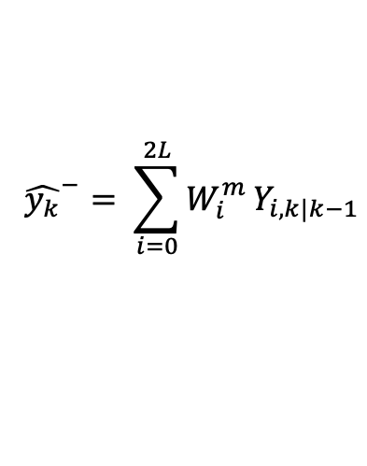



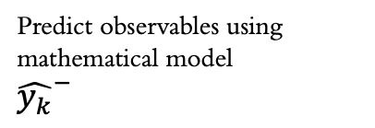
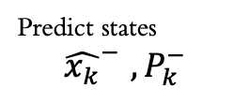
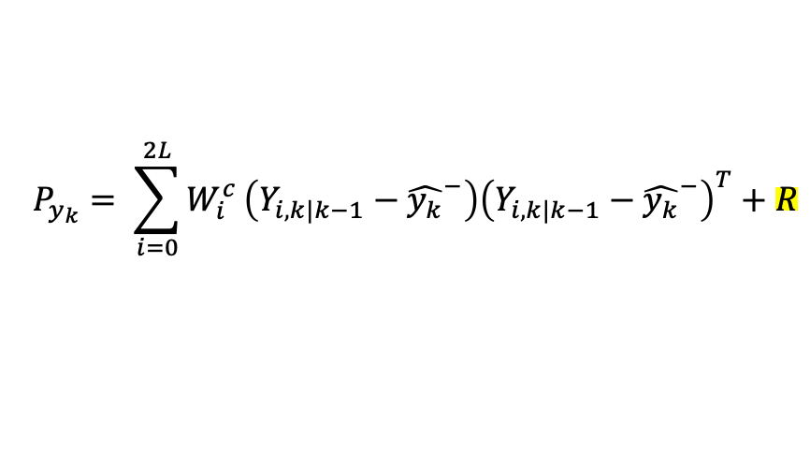
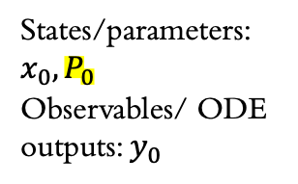

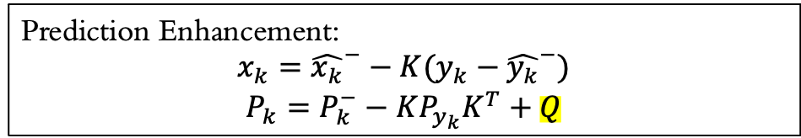

Unscented Kalman Filter
Predict observables using mathematical model
${\hat{y_{k}}}^{−}$
Predict states
$${\hat{x_{k}}}^{−} , P_{k}^{−}$$
$$x_{k−1}, P_{k−1}$$
Sample sigma vectors
Initial
Previous state
Prior estimates
States/parameters: $x_{0}, P_{0}$
Observables/ ODE outputs: $y_{0}$
Prediction Enhancement:
$$x_{k}={\hat{x_{k}}}^{−}−K(y_{k}−{\hat{y_{k}}}^{−})$$
$$P_{k}=P_{k}^{−}−KP_{y_{k}}K^{T}+Q$$
$$Y_{i,k|k−1}=H\left(χ_{i,k|k−1}\right)$$
$${\hat{y_{k}}}^{−}= \sum_{i=0}^{2L}{W_{i}^{m}}Y_{i,k|k−1}$$
$$P_{y_{k}}= \sum_{i=0}^{2L}{W_{i}^{c}}\left(Y_{i,k|k−1}−{\hat{y_{k}}}^{−}\right){\left(Y_{i,k|k−1}−{\hat{y_{k}}}^{−}\right)}^{T}+R$$
New input data $y_{k}$
$$P_{{x_{k},y}_{k}}= \sum_{i=0}^{2L}{W_{i}^{c}}\left(χ_{i,k|k−1}−{\hat{x_{k}}}^{−}\right){\left(Y_{i,k|k−1}−{\hat{y_{k}}}^{−}\right)}^{T}$$
$P_{y_{k}}:$ $error covariance matrix$
$P_{{x_{k}, y}_{k}}$: covariance matrix between states and variables
$K=P_{x_{k}},y_{k}P_{y_{k}}^{−1}$: Kalman gain

Slide 3

Chow’s implementation

Slide 4
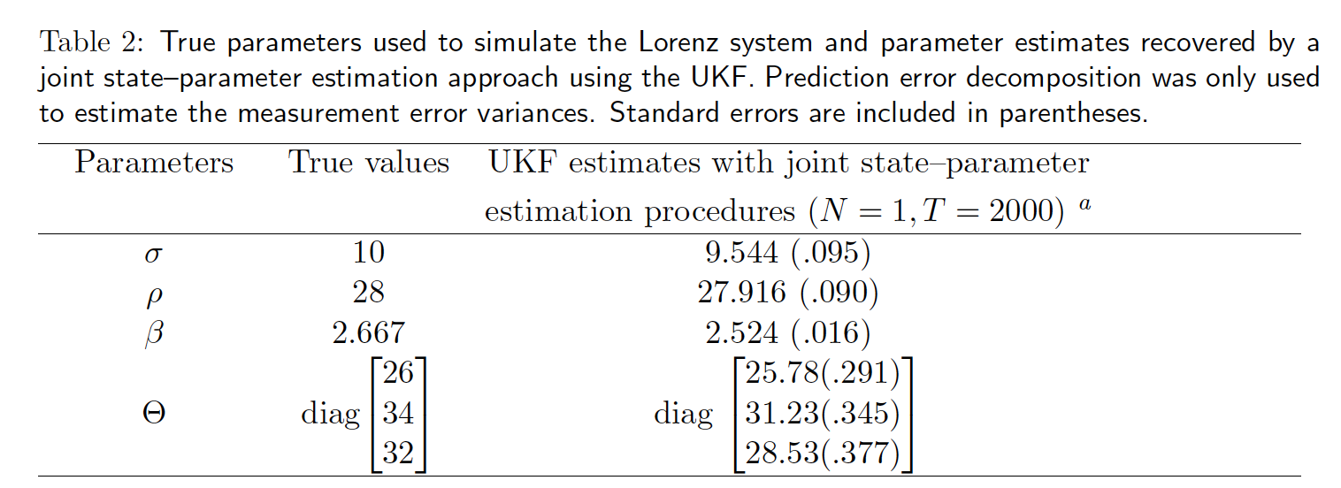
Generate pseudo data
Simulating ODE model with true parameters
Add noise to the model output
Initiate parameters guesses and initial observable data
Covariance matrix P0
Process covariance matrix Q
Measurement error covariance matrix R
Optimal initial parameters from fmin routine
Did not show in the code
Minimize negative log likelihood with respect to the initial parameters and observable data (why?)
Run UKF → negative log likelihood
Updated measurement error covariance matrix with the optimal initial parameters found from fminsearch (why?)
Goal: using UKF & MLE to estimate the true parameters
Run UKF with updated measurement error and initial parameters

Slide 5
Modified Joint UKF adapting chow’s

Slide 6

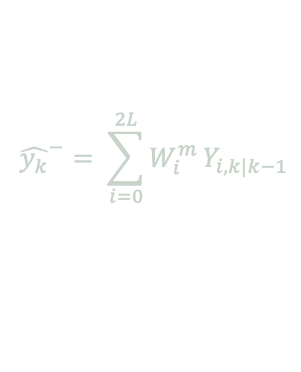


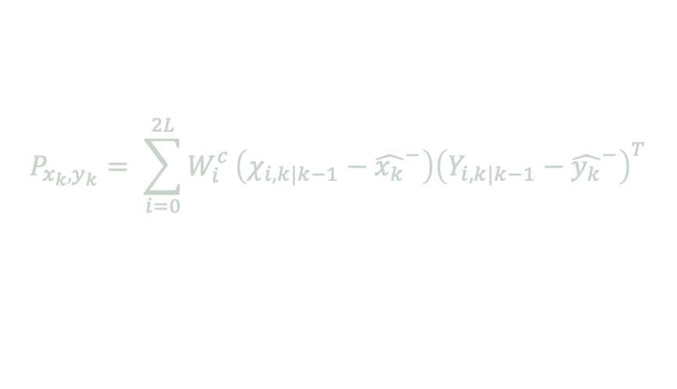
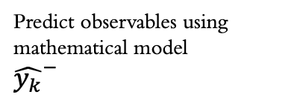
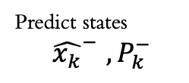
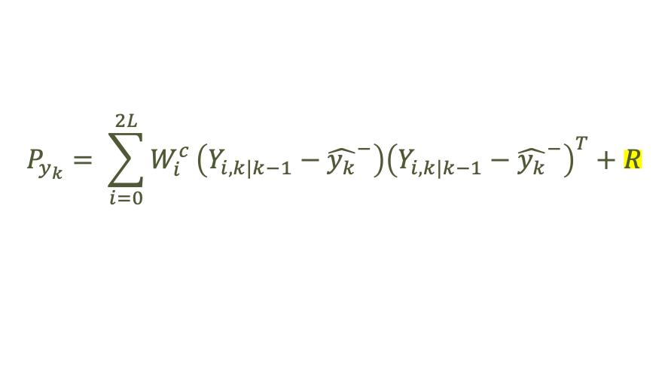
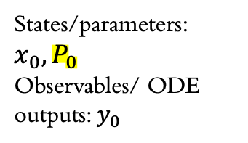



Predict observables using mathematical model
${\hat{y_{k}}}^{−}$
Predict states
$${\hat{x_{k}}}^{−} , P_{k}^{−}$$
$$x_{k−1}, P_{k−1}$$
Initial
Previous state
Sample sigma vectors
Prior estimates
Modified. See code
States/parameters: $x_{0}, P_{0}$
Observables/ ODE outputs: $y_{0}$
Prediction Enhancement:
$$x_{k}={\hat{x_{k}}}^{−}−K(y_{k}−{\hat{y_{k}}}^{−})$$
$$P_{k}=P_{k}^{−}−KP_{y_{k}}K^{T}+Q$$
Same in the original code
Modified.
Diagnonal matrix
Entries are the optimal initial observable data from fminsearch routine
Chow’s implementation put the optimal parameter values here but the dimension won’t match
$$Y_{i,k|k−1}=H\left(χ_{i,k|k−1}\right)$$
$${\hat{y_{k}}}^{−}= \sum_{i=0}^{2L}{W_{i}^{m}}Y_{i,k|k−1}$$
New input data $y_{k}$
$$P_{y_{k}}= \sum_{i=0}^{2L}{W_{i}^{c}}\left(Y_{i,k|k−1}−{\hat{y_{k}}}^{−}\right){\left(Y_{i,k|k−1}−{\hat{y_{k}}}^{−}\right)}^{T}+R$$
$$P_{{x_{k},y}_{k}}= \sum_{i=0}^{2L}{W_{i}^{c}}\left(χ_{i,k|k−1}−{\hat{x_{k}}}^{−}\right){\left(Y_{i,k|k−1}−{\hat{y_{k}}}^{−}\right)}^{T}$$
$P_{y_{k}}:$ $error covariance matrix$
$P_{{x_{k}, y}_{k}}$: covariance matrix between states and variables
$K=P_{x_{k}},y_{k}P_{y_{k}}^{−1}$: Kalman gain

Slide 7
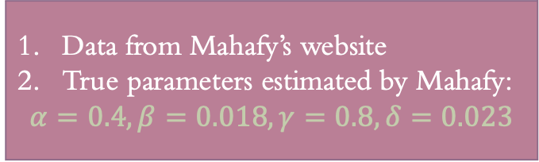
Data from Mahafy’s website
True parameters estimated by Mahafy:
$$α=0.4, β=0.018, γ=0.8, δ=0.023$$
Initiate parameters guesses and initial observable data
Covariance matrix P0
Process covariance matrix Q
Measurement error covariance matrix R
Minimize negative log likelihood with respect to the initial parameters and observable data
Run UKF → negative log likelihood
Updated measurement error covariance matrix with the optimal initial observable data found from fminsearch (why?)
Goal: using UKF & MLE to estimate the true parameters
Run UKF with updated measurement error and initial parameters

Slide 8
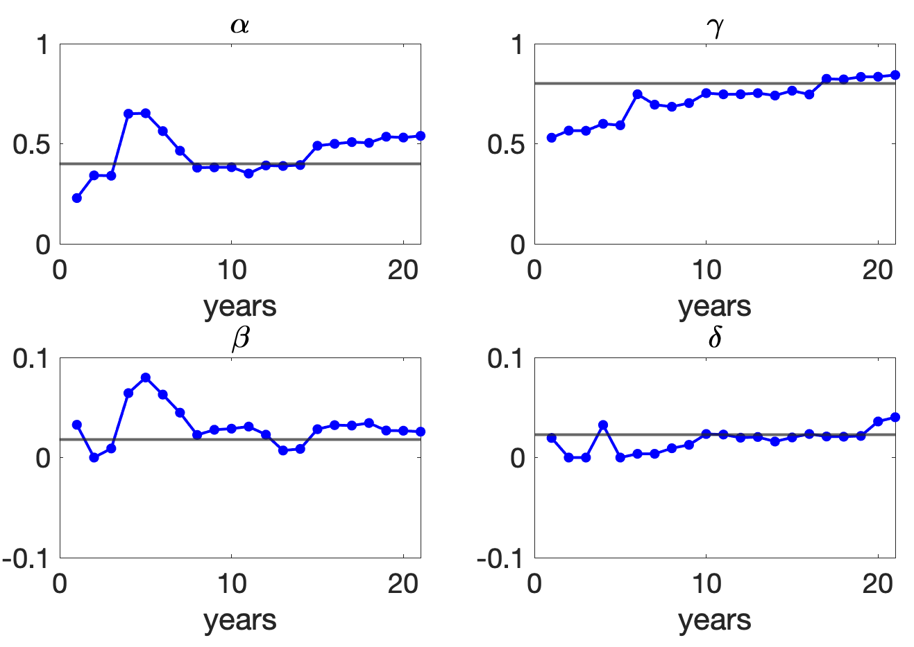
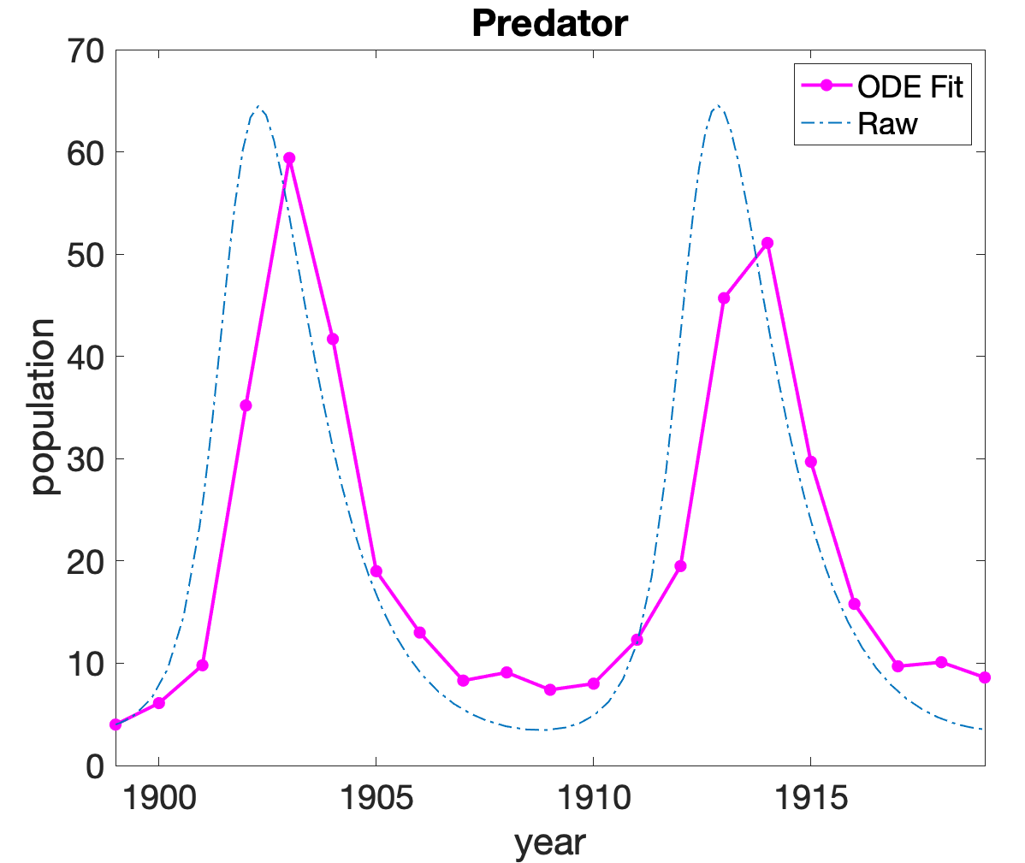
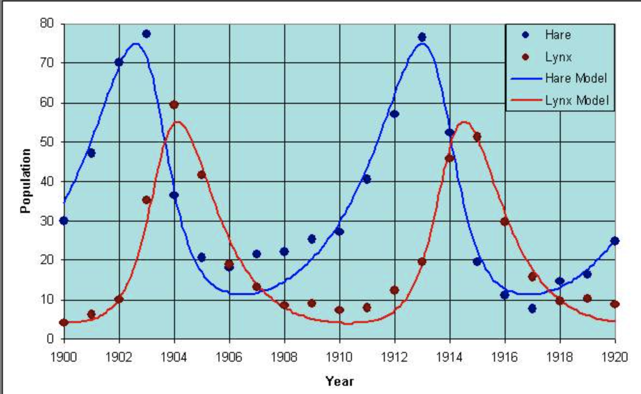
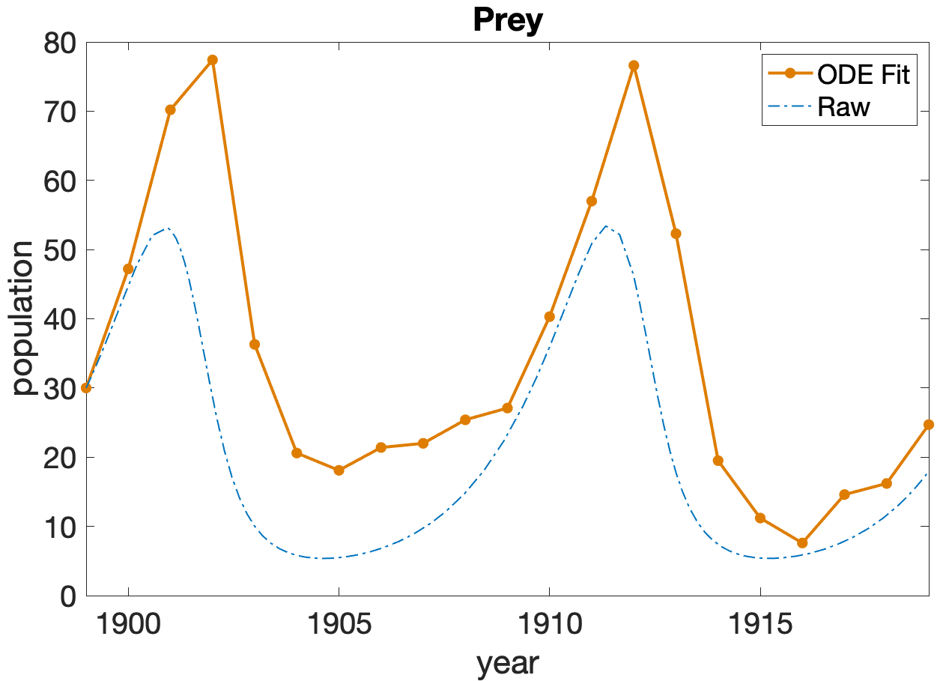
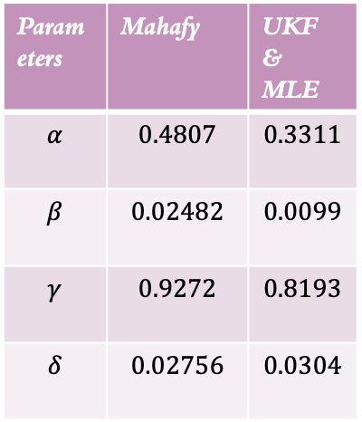
Parameters | Mahafy | UKF & MLE
$$α$$ | $$0.4807$$ | $$0.3311$$
$$β$$ | $$0.02482$$ | $$0.0099$$
$$γ$$ | $$0.9272$$ | $$0.8193$$
$$δ$$ | $$0.02756$$ | $$0.0304$$

