Slide 1
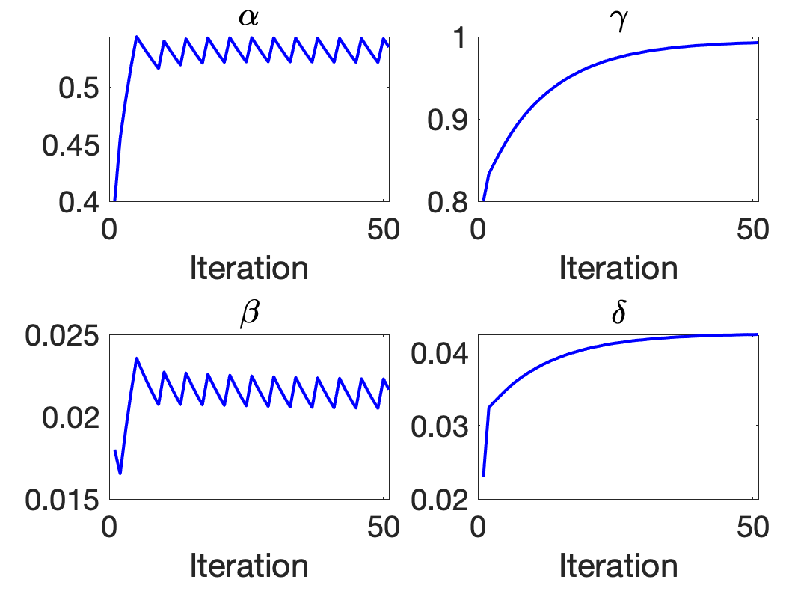
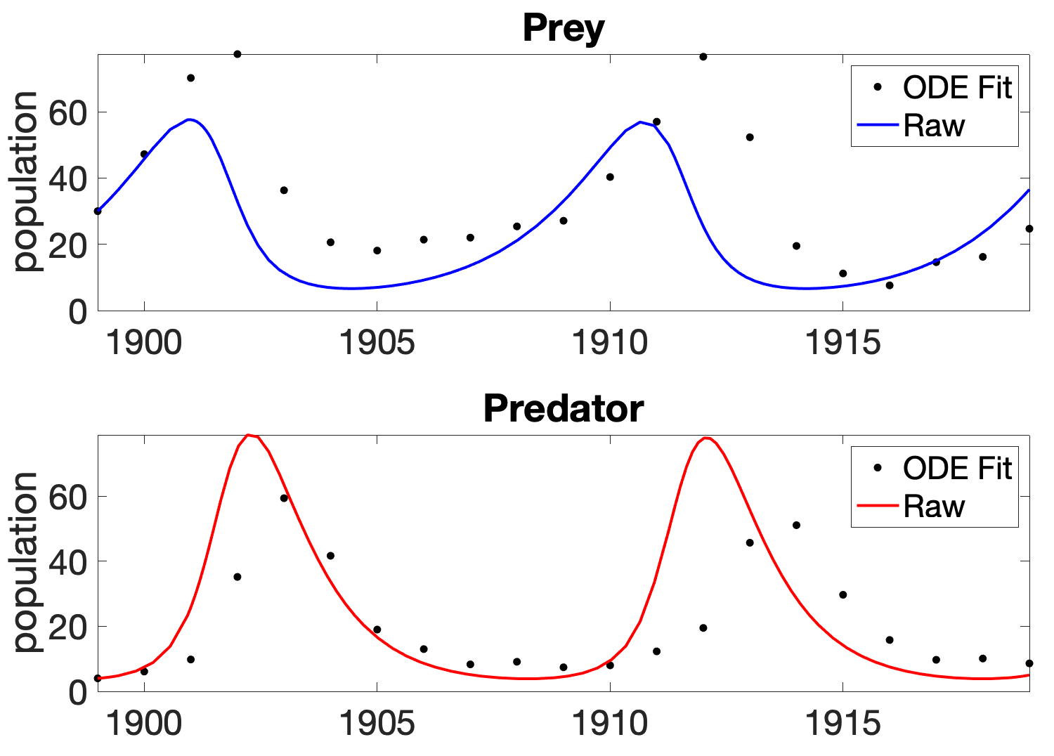
Dual UKF Prey-Predator model
Last time:
Dataset: Mahafy from 1900-1920
Initial guess: estimated parameters from Mahafy’s
Multiple run (n=50), using the final estimated parameters as the initial guess for the proceeding iteration
The final estimated parameters do not yield as satisfactory dynamics to the data
Suggestion: Run 1 iteration, calculate the mean of the estimated parameters across all the time point. Use the average parameters as input in the ODE system

Slide 2
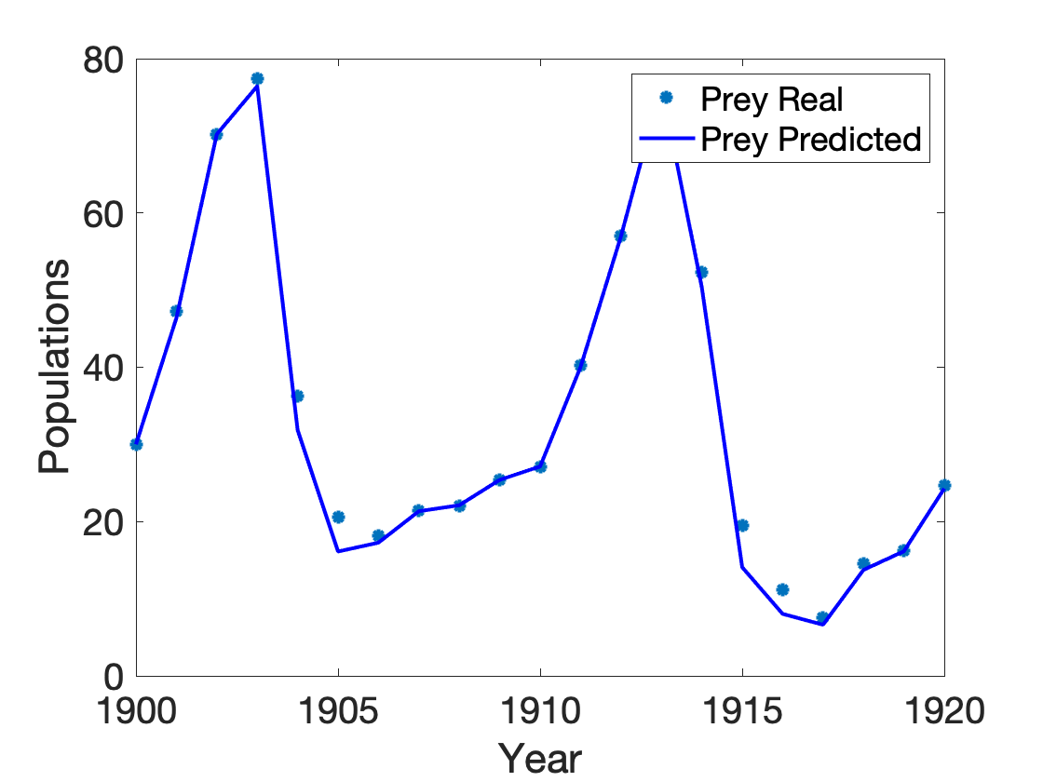
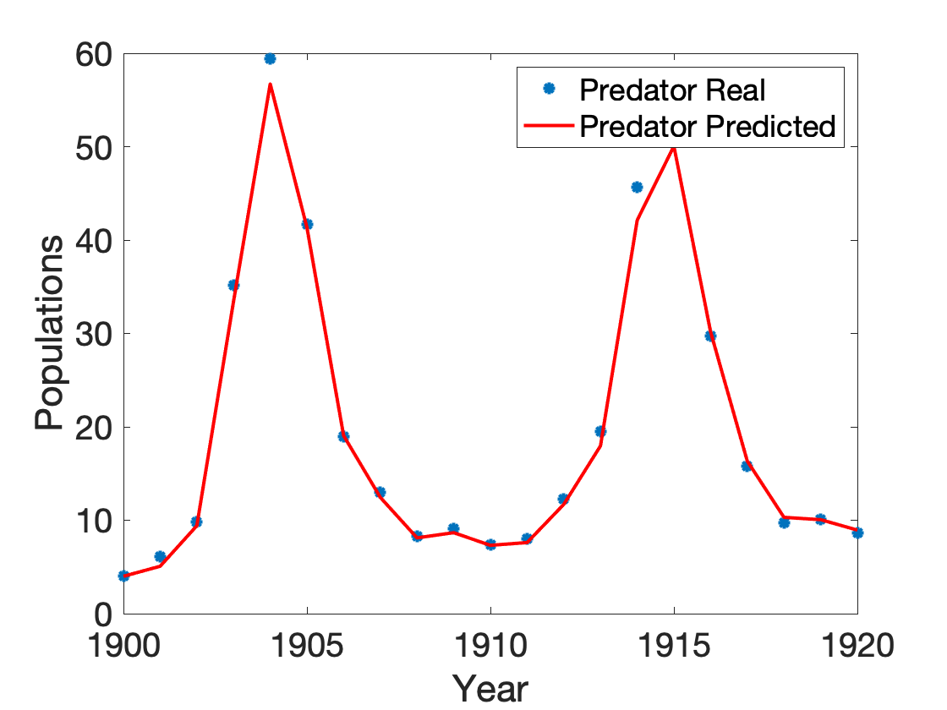
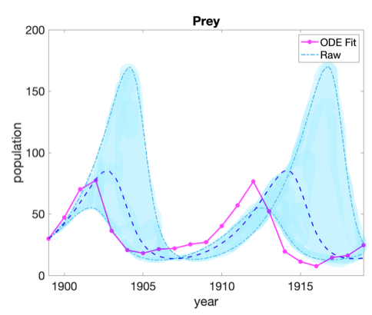
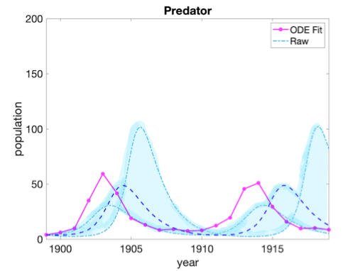
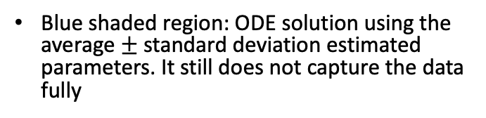
Dual UKF Prey-Predator model
Modify:
Run 1 iteration, calculate the mean of the estimated parameters across all the time point.
Plot the mean and 1 standard deviation up and down
(A)
(B)
Still yield very good prediction power
(C)
(D)
Blue shaded region: ODE solution using the average $±$ standard deviation estimated parameters. It still does not capture the data fully

Slide 3
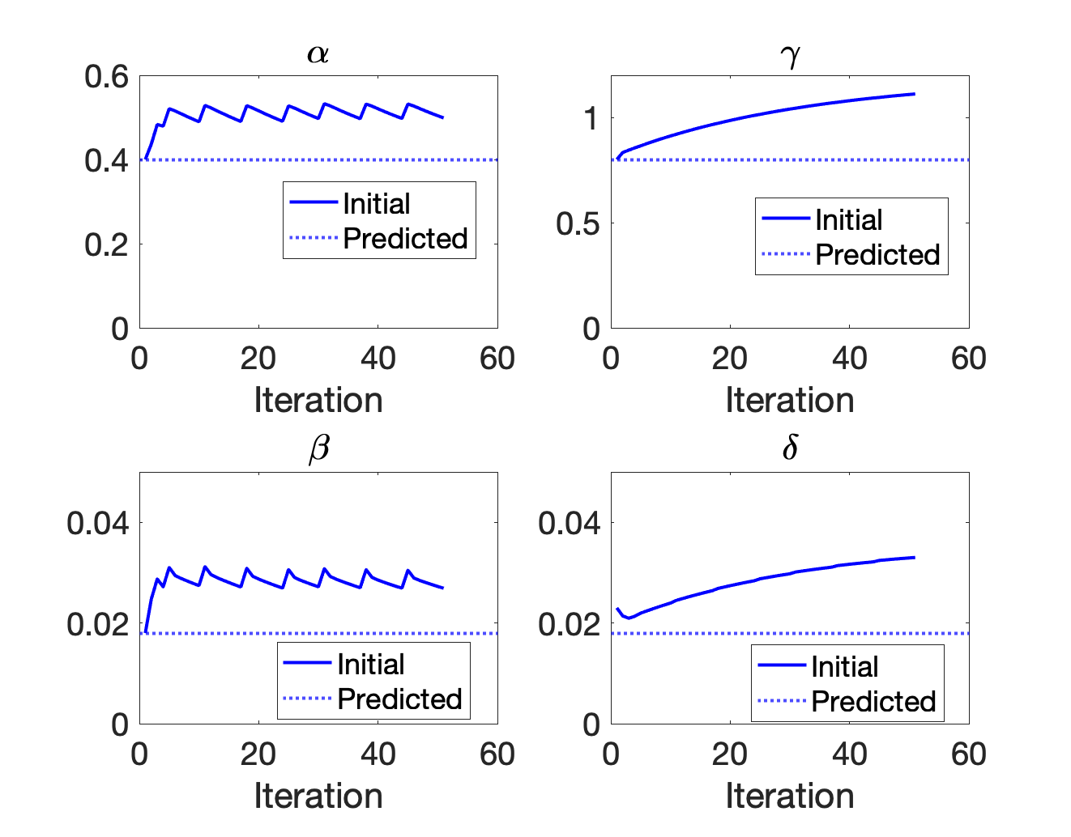
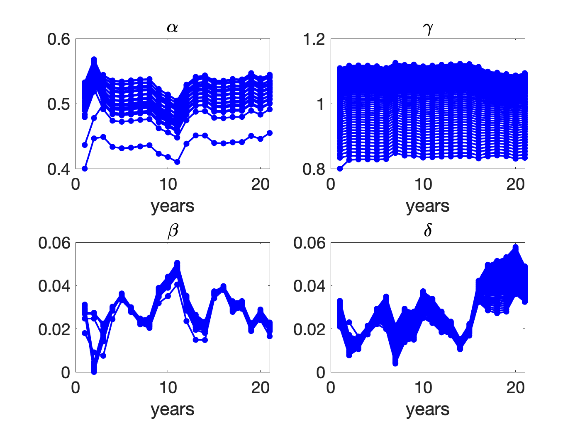
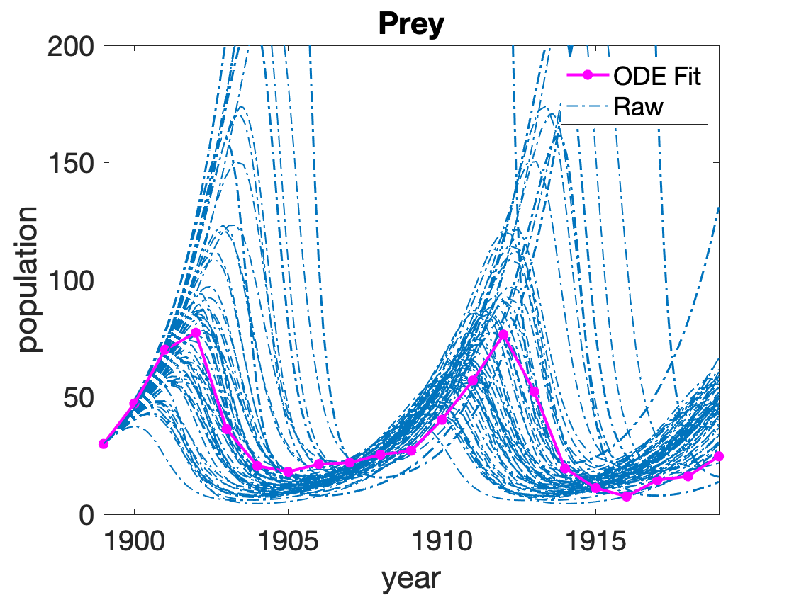
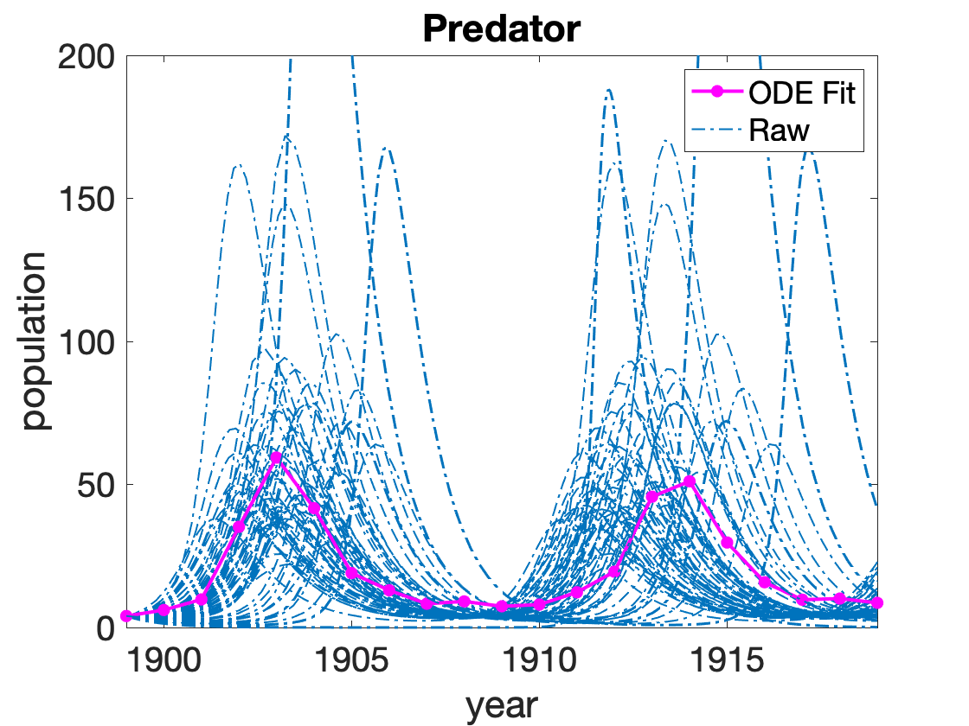
Dual UKF Prey-Predator model
Modify:
Run 501 iterations, use the mean of the estimated parameters of the previous step to be the input for the preceding step
(A)
(B)
Estimated parameters dynamics are similar, but shifting upward
(C)
(D)
(D)
Plot a distribution of DE solution by drawing parameters from a normal distribution

Slide 4
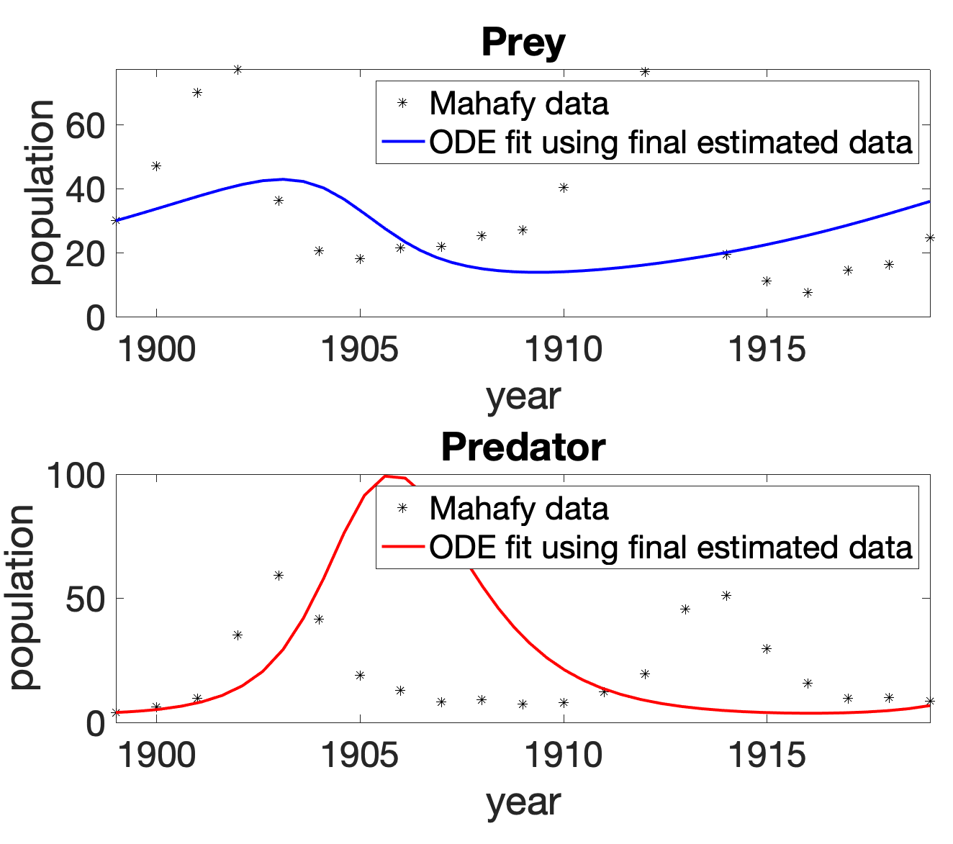
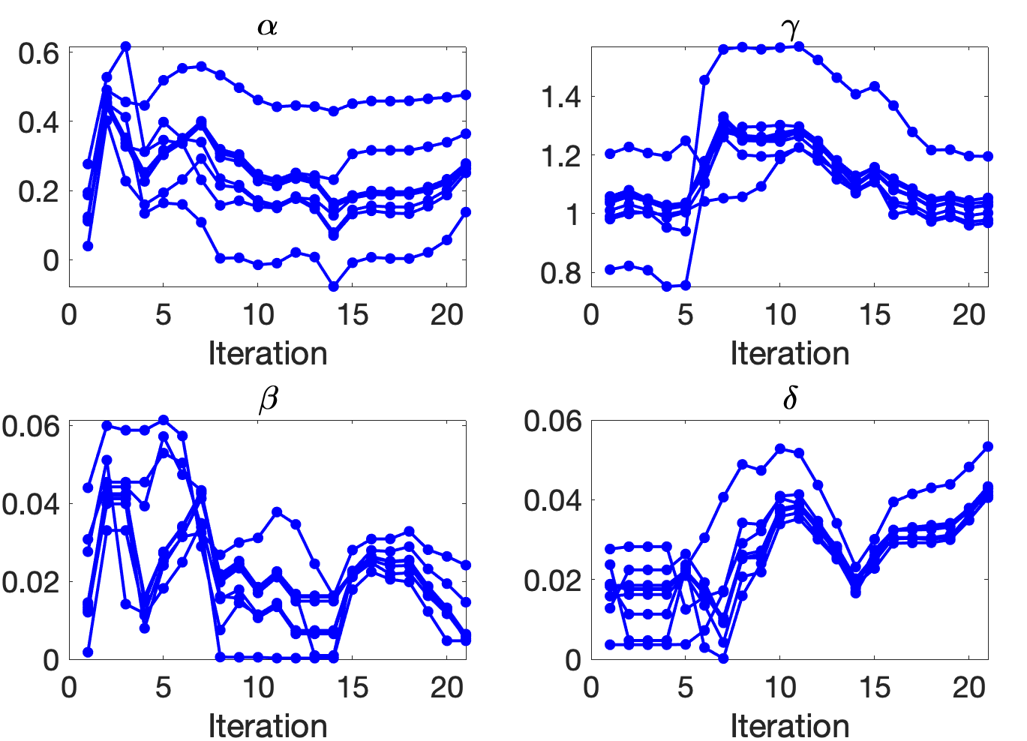
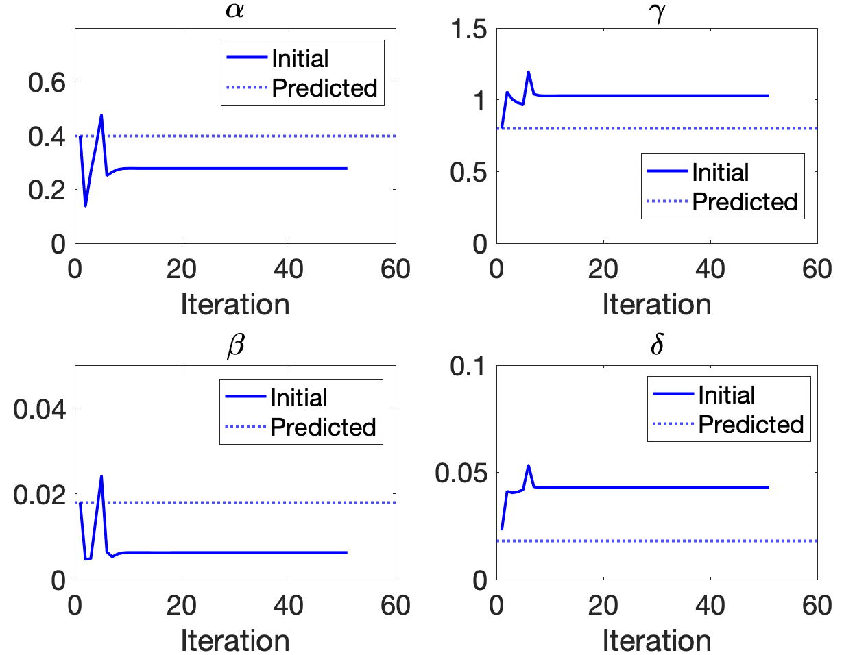
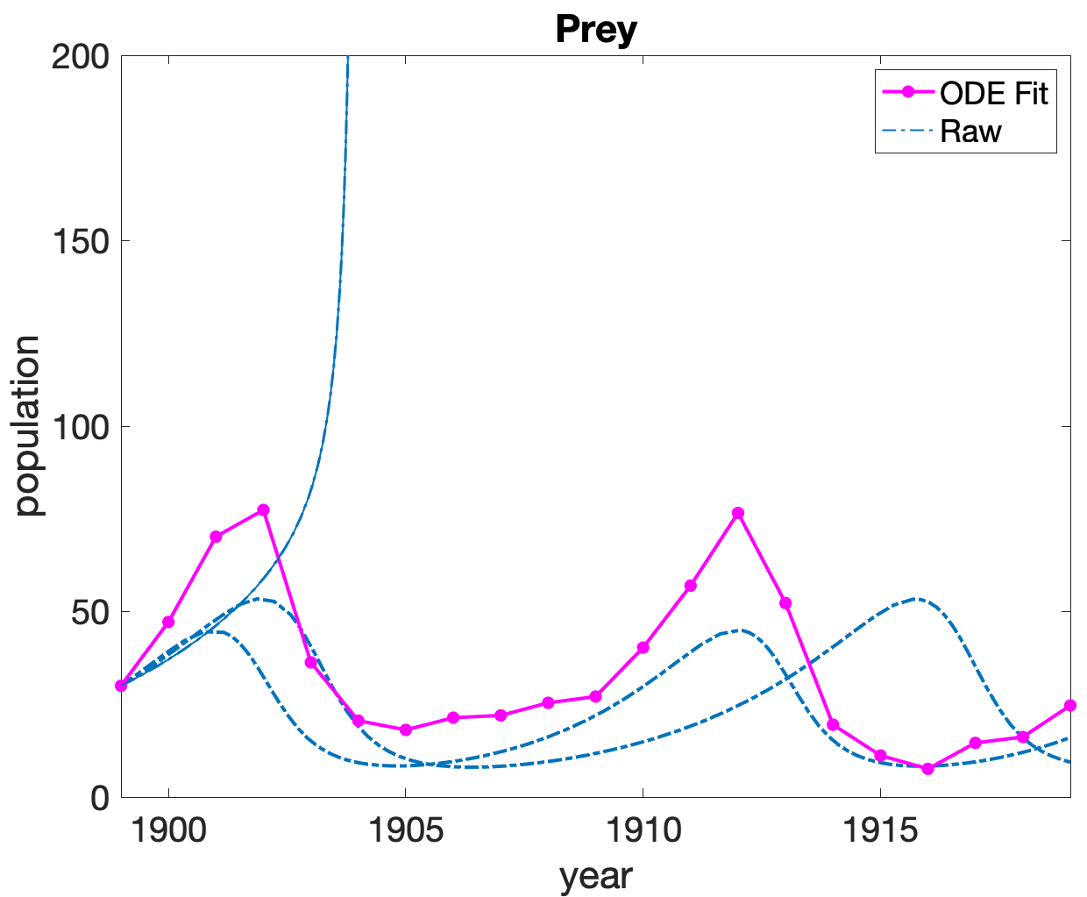
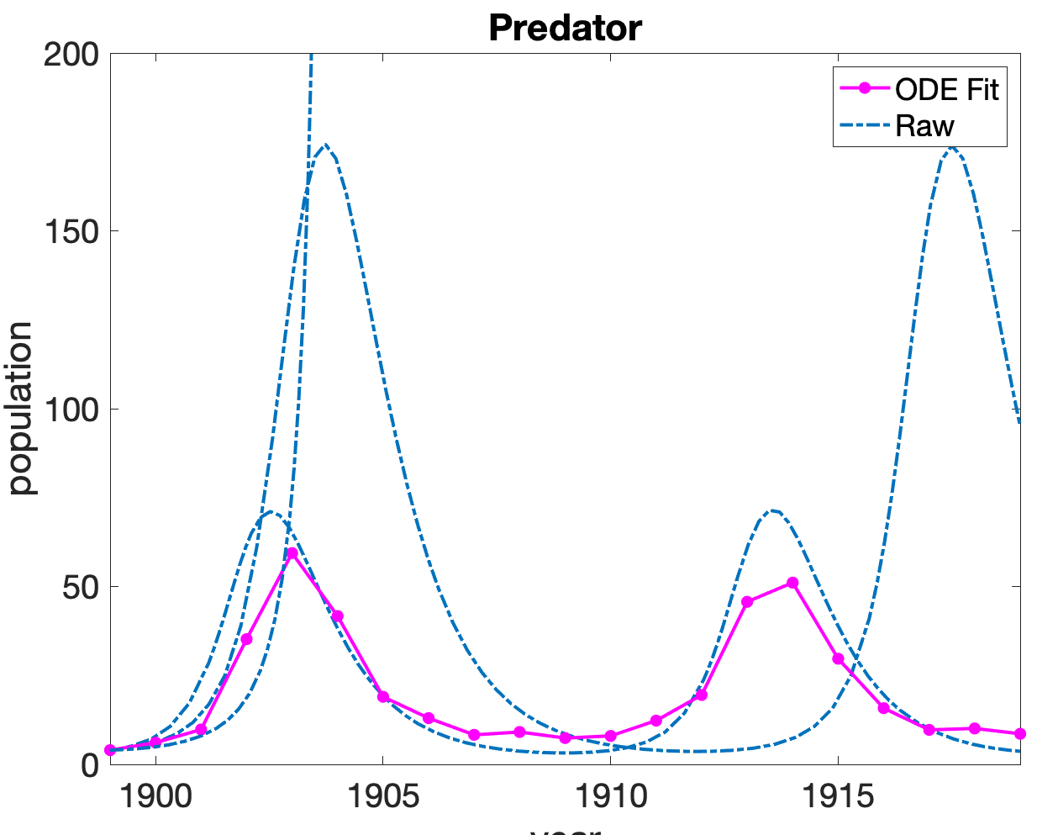
Joint UKF Prey-Predator model
(B)
(A)
1 iteration still does not yield good approximation of the dataset
Parameter estimation converges
Running 50 iterations, simulate the model with the average estimated parameter, 1 standard deviation up and down
Simulating with below 1 standard deviation, system blows up
(C)
(D)

