Slide 1

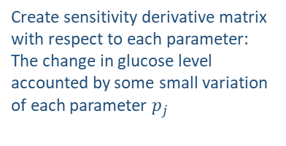

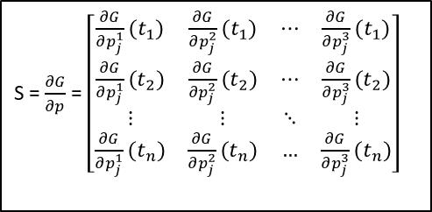
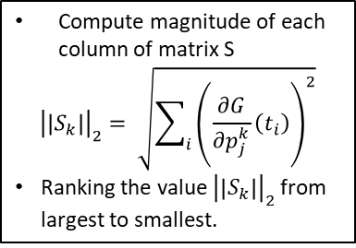
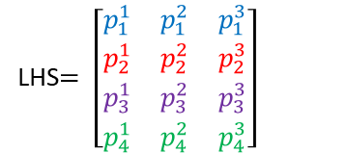
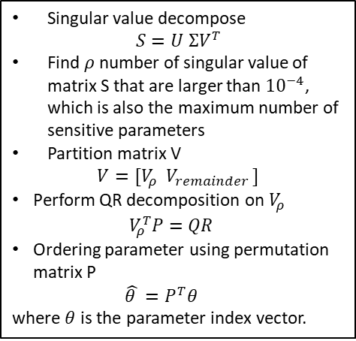

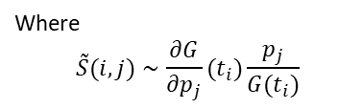
$$\begin{matrix}\begin{aligned}p_{1} \\ values\end{aligned} & \begin{aligned}p_{2} \\ values\end{aligned} & \begin{aligned}p_{3} \\ values\end{aligned}\end{matrix}$$
LHS$= \left[\begin{aligned}\begin{matrix}p_{1}^{1} & p_{1}^{2} & p_{1}^{3}\end{matrix} \\ \begin{matrix}p_{2}^{1} & p_{2}^{2} & p_{2}^{3}\end{matrix} \\ \begin{matrix}p_{3}^{1} & p_{3}^{2} & p_{3}^{3}\end{matrix} \\ \begin{matrix}p_{4}^{1} & p_{4}^{2} & p_{4}^{3}\end{matrix}\end{aligned}\right]$
For each row of LHS matrix
$$\left[\begin{matrix}p_{j}^{1} & p_{j}^{2} & p_{j}^{3}\end{matrix}\right]$$
Create sensitivity derivative matrix with respect to each parameter: The change in glucose level accounted by some small variation of each parameter $p_{j}$
S = $\frac{∂G}{∂p}$ = $\left[\begin{matrix}\frac{∂G}{∂p_{j}^{1}}(t_{1}) & \frac{∂G}{∂p_{j}^{2}}(t_{1}) & ⋯ & \frac{∂G}{∂p_{j}^{3}}(t_{1}) \\ \frac{∂G}{∂p_{j}^{1}}(t_{2}) & \frac{∂G}{∂p_{j}^{2}}(t_{2}) & ⋯ & \frac{∂G}{∂p_{j}^{3}}(t_{2}) \\ ⋮ & ⋮ & ⋱ & ⋮ \\ \frac{∂G}{∂p_{j}^{1}}(t_{n}) & \frac{∂G}{∂p_{j}^{2}}(t_{n}) & … & \frac{∂G}{∂p_{j}^{3}}(t_{n})\end{matrix}\right]$
Compute relative sensitivity matrix
$$\tilde{S}=S∗ \frac{p}{G}$$
Where
$$\tilde{S}(i,j)∼\frac{∂G}{∂p_{j}}(t_{i})\frac{p_{j}}{G(t_{i})}$$
$$\frac{∂G}{∂p_{j}}(t_{i})∼\frac{G\left(t_{i};, p_{j}+ε\right)−G(t_{i};p_{j})}{ε}$$
SVD ranking
Norm2 ranking
SVD ranking
Norm 2 ranking
Perform SVD ranking and norm2 ranking as for sensitivity matrix
Singular value decompose
$$S=U ΣV^{T}$$
Find $ρ$ number of singular value of matrix S that are larger than ${10}^{−4}$, which is also the maximum number of sensitive parameters
Partition matrix V
$$V=[V_{ρ} V_{remainder }]$$
Perform QR decomposition on $V_{ρ}$
$V_{ρ}^{T}P=QR$
Ordering parameter using permutation matrix P
$\hat{θ }=P^{T}θ$
where $θ$ is the parameter index vector.
Compute magnitude of each column of matrix S
$${\left|\left|S_{k}\right|\right|}_{2}= \sqrt{\sum_{i}{{\left(\frac{∂G}{∂p_{j}^{k}}\left(t_{i}\right)\right)}^{2}}}$$
Ranking the value ${\left|\left|S_{k}\right|\right|}_{2}$ from largest to smallest.

