Slide 1


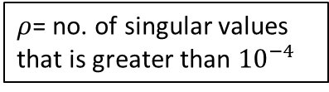
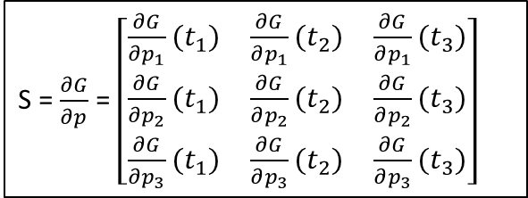





Model_LHS
Generate LHS matrix
Create sensitivity derivative matrix with respect to each parameter
$${\left|\left|\tilde{S}\right|\right|}_{2}$$
Relative sensitivity Norm
S = $\frac{∂G}{∂p}$ = $\left[\begin{matrix}\frac{∂G}{∂p_{1}}(t_{1}) & \frac{∂G}{∂p_{1}}(t_{2}) & \frac{∂G}{∂p_{1}}(t_{3}) \\ \frac{∂G}{∂p_{2}}(t_{1}) & \frac{∂G}{∂p_{2}}(t_{2}) & \frac{∂G}{∂p_{2}}(t_{3}) \\ \frac{∂G}{∂p_{3}}(t_{1}) & \frac{∂G}{∂p_{3}}(t_{2}) & \frac{∂G}{∂p_{3}}(t_{3})\end{matrix}\right]$
$$\tilde{S}=S∗ \frac{p}{G}$$
Relative sensitivity matrix
SVD Decomp
$$\tilde{S}=U ΣV^{T}$$
$ρ$= no. of singular values that is greater than ${10}^{−4}$
Partitioning matrix V
$$V=[V_{ρ} V_{rem}]$$
QR decomp
$$\hat{θ}=P^{T}θ$$
$$V_{ρ}^{T}P=QR$$
Reordering parameter vector $\vec{θ}$

