Slide 1
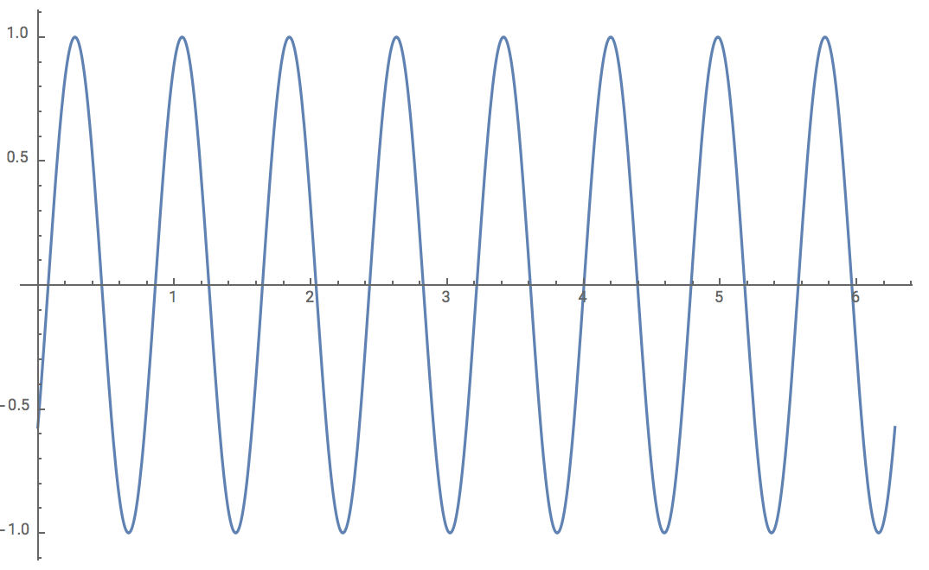
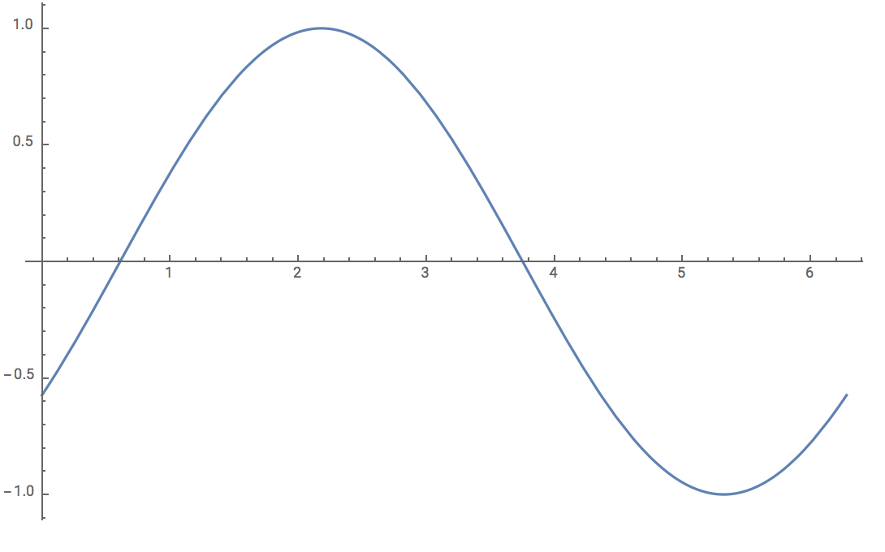
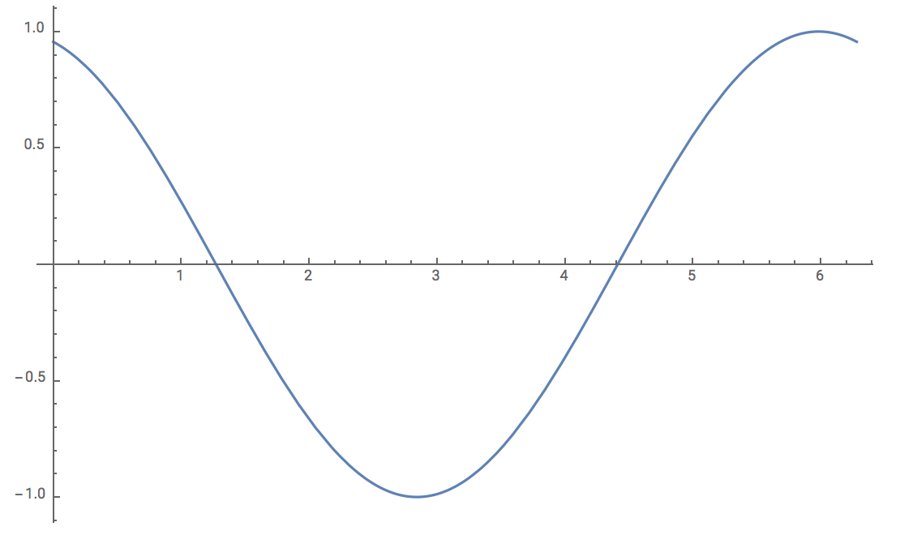




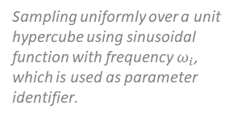




For i = parameter
Sampling uniformly over a unit hypercube using sinusoidal function with frequency $ω_{i}$, which is used as parameter identifier.
Applying inverse cumulative inverse function with respect to each parameter to generating sampling values
$$p_{1}$$
$$\begin{matrix}\begin{aligned}p_{1} \\ values\end{aligned} & \begin{aligned}p_{2} \\ values\end{aligned} & \begin{aligned}p_{3} \\ values\end{aligned}\end{matrix}$$
$$X= \left[\begin{aligned}\begin{matrix}p_{1}^{1} & p_{1}^{2} & p_{1}^{3}\end{matrix} \\ \begin{matrix}p_{2}^{1} & p_{2}^{2} & p_{2}^{3}\end{matrix} \\ \begin{matrix}p_{3}^{1} & p_{3}^{2} & p_{3}^{3}\end{matrix} \\ \begin{matrix}p_{4}^{1} & p_{4}^{2} & p_{4}^{3}\end{matrix}\end{aligned}\right]$$
NS combination of parameters
$$p_{2}$$
Now repeat process for each of our K parameters:
NR times, we will generate NS parameter combinations,
and store the 2 sensitivity indices for the parameter we are focusing on
(resulting in a sensitivity structure for parameter i).
$$p_{3}$$
Simulate the dynamic model with each row of NS parameter combination
Store each sensitivity index after each run and take average
Sensitivity Index
$$\left[\begin{matrix}\begin{aligned}Avg S_{i} \\ Avg S_{Ti} \\ \begin{matrix}S_{i1} & S_{i2}\begin{matrix} … & S_{iNR}\end{matrix}\end{matrix}\end{aligned} \\ \begin{matrix}S_{Ti1} & S_{Ti2}\begin{matrix} … & S_{TiNR}\end{matrix}\end{matrix}\end{matrix}\right]$$
Statistical Inference
Compare with dummy parameter using Student t-test
Sensitivity Index
$$\left[\begin{matrix}\begin{aligned}Avg S_{i} \\ Avg S_{Ti} \\ \begin{matrix}S_{i1} & S_{i2}\begin{matrix} … & S_{iNR}\end{matrix}\end{matrix}\end{aligned} \\ \begin{matrix}S_{Ti1} & S_{Ti2}\begin{matrix} … & S_{TiNR}\end{matrix}\end{matrix}\end{matrix}\right]$$
Compute Sensitivity Index:
$$\left[\begin{matrix}S_{i} \\ S_{Ti}\end{matrix}\right]$$
K=#of pars
Repeat for NR number of times

