Slide 1
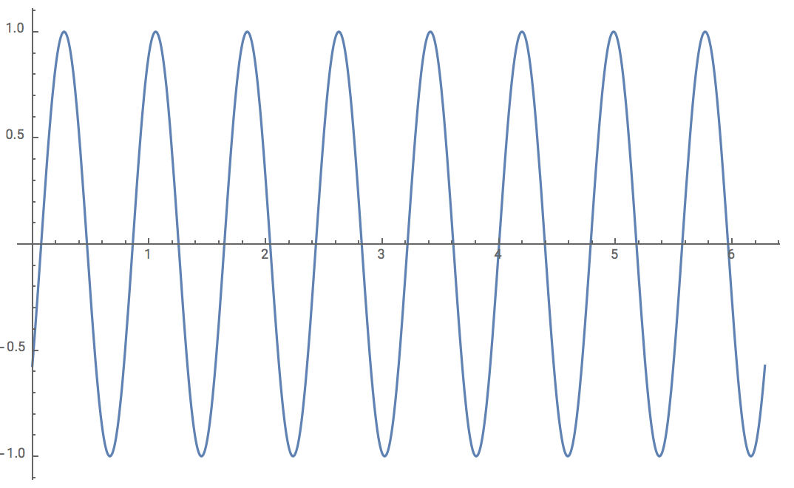
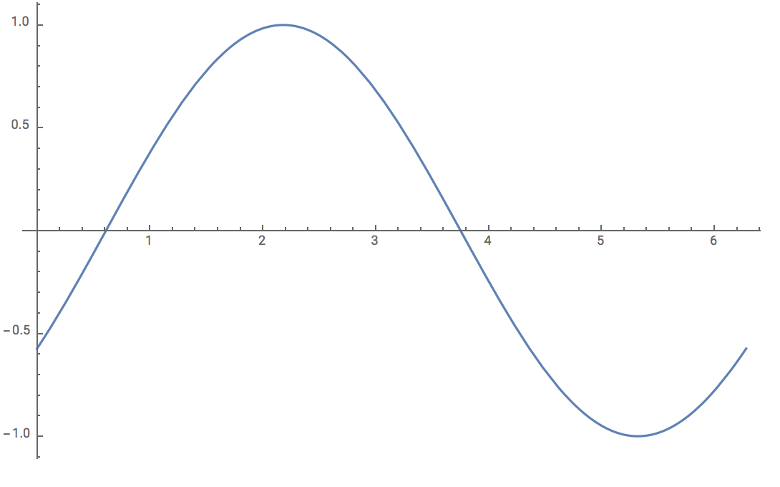
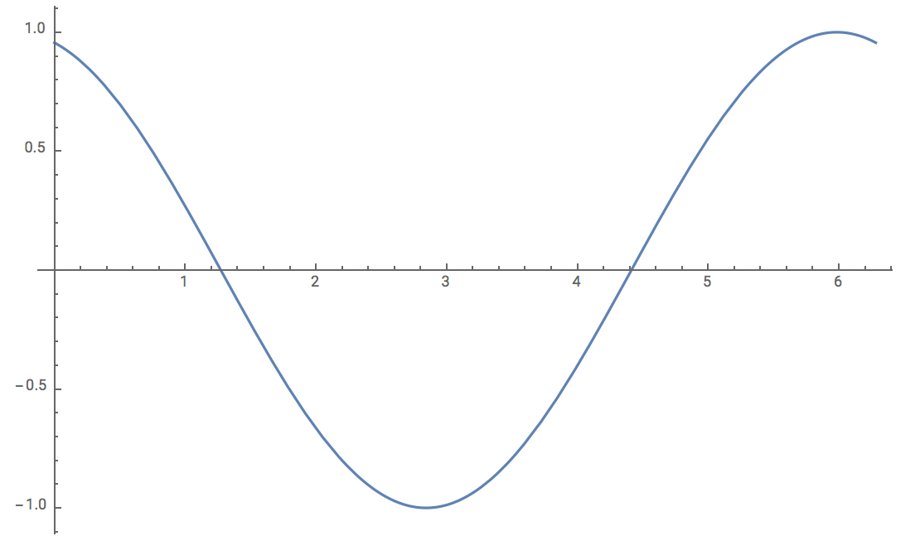


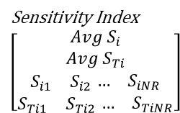
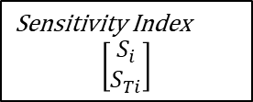

For i = parameter
Repeat for K number of parameters
Parameter $p_{i}$ is a assigned with higher frequency
Repeat for NR number of times
All parameter 1 values
Now repeat process for each of our K parameters:
NR times, we will generate NS parameter combinations,
and store the 2 sensitivity indices for the parameter we are focusing on
(resulting in a sensitivity structure for parameter i).
$$X_{i}= \left[\begin{matrix}a_{1} & b_{1} & c_{1} \\ a_{2} & b_{2} & c_{2} \\ a_{3} & b_{3} & c_{3}\end{matrix}\right]$$
First combo for parameter 1
Second combo for parameter 1
Matrix X_i has dimension NS (sample points, rows) by K (parameters, cols)
Model
Ex: System of ODEs – model simulated NS times (using each of the NS param combos)
Statistical Inference
Compare with dummy parameter using Student t-test
Sensitivity Index
$$\left[\begin{matrix}\begin{aligned}Avg S_{i} \\ Avg S_{Ti} \\ \begin{matrix}S_{i1} & S_{i2}\begin{matrix} … & S_{iNR}\end{matrix}\end{matrix}\end{aligned} \\ \begin{matrix}S_{Ti1} & S_{Ti2}\begin{matrix} … & S_{TiNR}\end{matrix}\end{matrix}\end{matrix}\right]$$
Sensitivity Index
$$\left[\begin{matrix}\begin{aligned}Avg S_{i} \\ Avg S_{Ti} \\ \begin{matrix}S_{i1} & S_{i2}\begin{matrix} … & S_{iNR}\end{matrix}\end{matrix}\end{aligned} \\ \begin{matrix}S_{Ti1} & S_{Ti2}\begin{matrix} … & S_{TiNR}\end{matrix}\end{matrix}\end{matrix}\right]$$
Sensitivity Index
$$\left[\begin{matrix}S_{i} \\ S_{Ti}\end{matrix}\right]$$
Take average
Consolidate
K=#of pars
Loop NR times to generate NR different sensitivity indices for parameter i.
Store each S index for each of the NR runs (for param i) and take the average over all NR sensitivity values.

