Slide 1
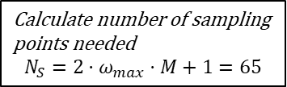
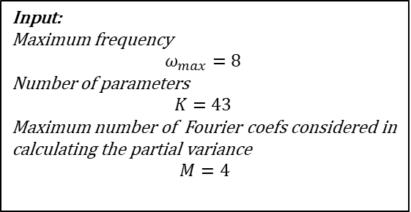
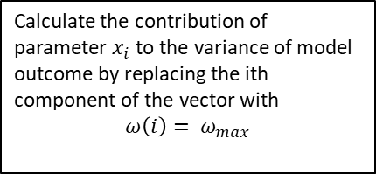
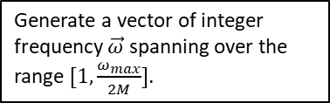
Input:
Maximum frequency
$$ω_{max}=8$$
Number of parameters
$$K=43$$
Maximum number of Fourier coefs considered in calculating the partial variance
$$M=4$$
Calculate number of sampling points needed
$$N_{S}={2⋅ω}_{max}⋅M+1=65$$
Calculate the contribution of parameter $x_{i}$ to the variance of model outcome by replacing the ith component of the vector with
$$ω\left(i\right)= ω_{max}$$
Generate a vector of integer frequency $\vec{ω}$ spanning over the range $[1,\frac{ω_{max}}{2M}]$.

